Slide 1
A Subdivision-Based Representation for Vector Image Editing
(Nov. 2012 issue spotlight paper)
Zicheng Liao, Hugues Hoppe*, David Forsyth, Yizhou Yu
University of Illinois at Urbana-Champaign
Microsoft Research*
Notes:
Thanks for the introduction.
The work I present today is called "A subdivision-based representation for vector image editing". It's a joint work by U of I at Urbana-Champaign, and Microsoft Research. It was first published on TVCG and selected to be presented at I3D.

Slide 2
Vector image
Pixel image
Notes:
First, Let me show a simple example in case any one is unfamiliar with vector graphics. On the upper left of the page it's a logo of U of I. Here is the magnified view of the logo in pixel image presentation. And this is the result if it is a vector image. It's clear that the vector image preserves the edge in higher resolution.
The basic idea of a vector image is to represent an image with some geometric primitives that mathematically define the color and edges of an image. One advantage of such a vector representation is super-resolution as what I just show. And of course there are other advantages like better edibility. A main question is: given a pixel image, how to convert it into a vector image with good properties. This is essentially what we do in this work.

Slide 3
Related work
Parametric curve [Selinger 2003, Kopf 2011]
Continuous edges
Piecewise constant color
Triangle mesh [Lecot 2006]
Piecewise linear color
Densely sample along edges
Parametric surfaces
Gradient mesh [Sun 2007] or TPS [Xia 2009, Finch 2011]
Higher order continuity for both color and edge
PDE: Diffusion curve [Orzan 2008]
Colored edges and then diffuse (Poisson equation)
Minimize first order derivative → large fitting error
Notes:
First let me show a few related works of image vectorization:
The first type of vector image is to use parametric curve to represent an image. This type of vector representation mainly aims at logo, cartoon figures or the pixel art. The resultant vector image will have piecewise constant color and higher order continuous edges.
To model color variance of an image, one method is to use a triangular mesh. Because a mesh is piecewise linear surface, this will produce a vector image with piecewise linear color patches. One thing to notice is that although piecewise linear color surface is of higher order continuity than piecewise constant color surface, the visual effect is usually less as good. Because the discontinuity across the face boundaries usually appears as artifacts, while piecewise constant color with continuous edges does not, in fact the latter is a very popular choice of image stylization. This makes triangulation not quite a good choice of image vectorization.
To effectively represent color variation of a natural image, one could use a higher order parametric surface, examples are the gradient mesh work by Sun 2007, and the TPS representation of color by Xia 2009 and Finch 2011. These method will have high order continuity for both color and edges.
Another famous vector image representation is the diffusion curve method. It represents a vector image by a set of colored edges; the rest part of the image is defined by diffusing the edge colors to the whole image domain, solved by a Poisson equation. While this method has become very popular, one problem that's worth mentioning is that a diffused surface could have large fitting error if the constraints are not dense enough. This is because diffusion, or the Poisson equation, only minimize the first-order derivative cost, which in another terminology, is called the membrane interpolation. A better way is to minimize the second order derivative cost, which is exactly what the thin-plate spline does. This was the main motivation of the TPS work by Xia 2009. And the Finch 2011 paper, I guess, took the same line of thought.

Slide 4
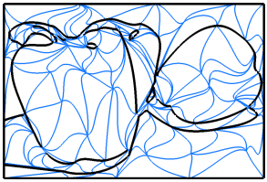
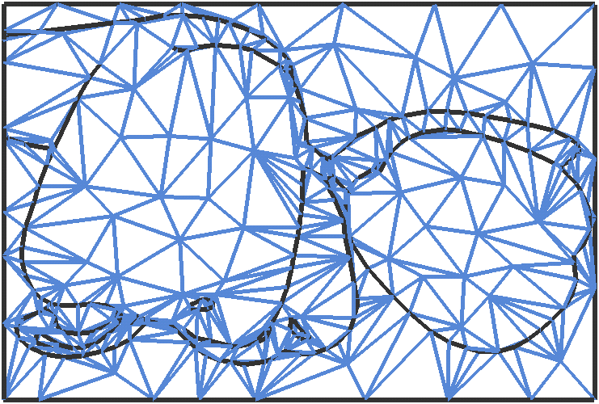
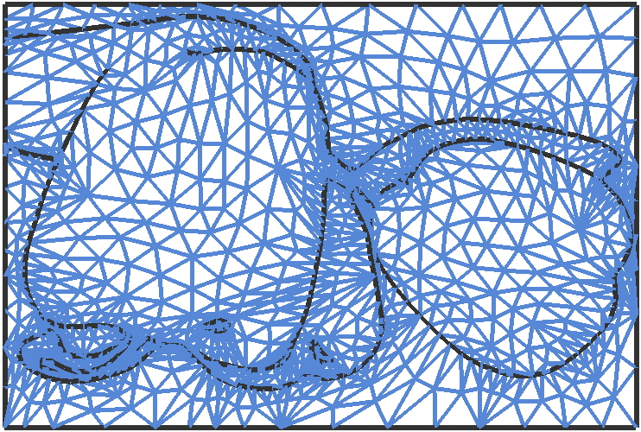
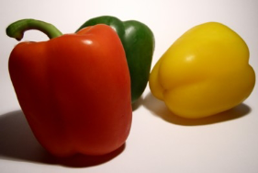
Motivation
Boundary continuity
Subdivision surface
[Xia-Liao-Yu SIGGRAPHAsia 09]
Our subdivision approach
At least C1 continuous;
C2 along edges
C0 continuity across boundary
Notes:
Let me briefly mention the motivation of this work before we go to the details.
The main motivation of this work is to avoid the boundary discontinuity problem that occurs in the Xia2009 work. The idea of Xia 2009 work was to decompose an image domain into a set of nonoverlapping bezier patches, for each patch fits the color with a TPS. However, the continuity across the patch boundaries is only C0, which is a big problem as you imagine a surface that is connected but the first order derivative is not continuous. Our solution to this problem is to use subdivision surfaces, as is shown on the right. The control mesh is a triangular mesh, and this is what it looks like after one-level of subdivision. By keeping the subdivision a few iterations, it will eventually approach to a surface at least C1 continuous, and the edges are C2 continuous.

Slide 5
Motivation (2)
Level-of-detail control
Mesh pyramid
Structure-aware image abstraction
Signal processing on vector image

Slide 6
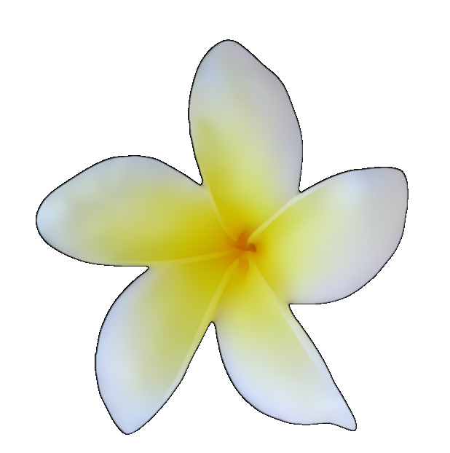
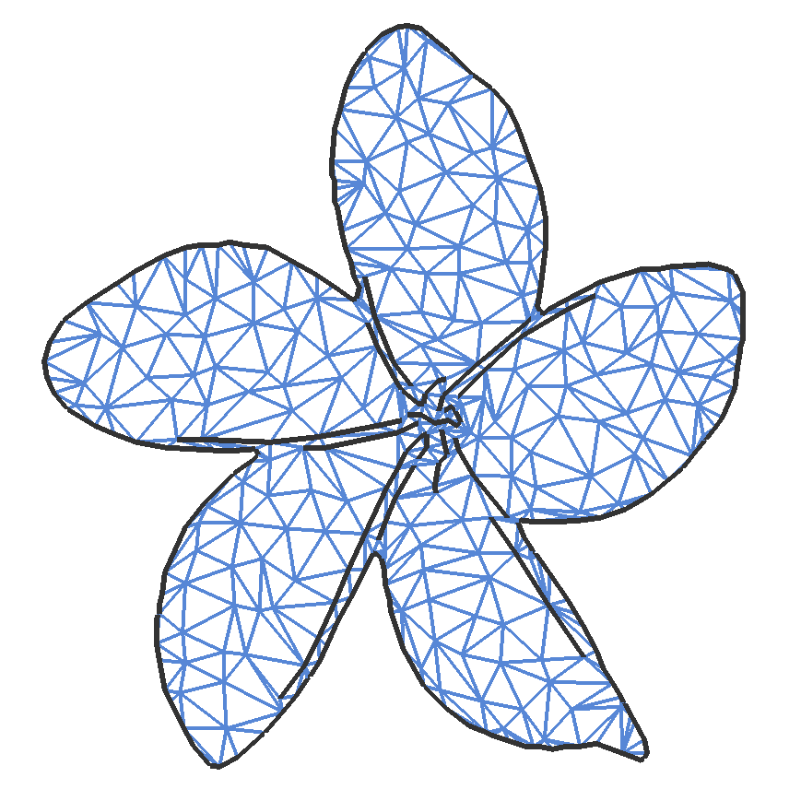
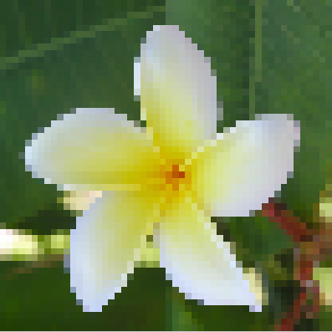
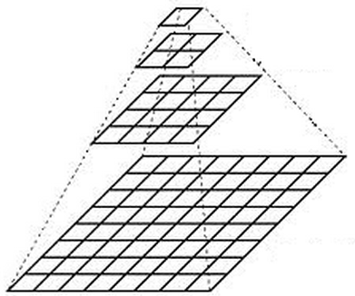
Roadmap
Part I: Subdivision-based image vectorization
Part II: Multi-resolution representation
➔
➔

Slide 7
Subdivision-based image vectorization
Basic idea
Triangular control mesh
Subdivision of control mesh to fit color
Subdivision curves for image feature (edges)
Pipeline
input
Feature detection
Control mesh
Optimization
Subdivision
Rasterization
Notes:
This is an overview of the subdivision-based image vectorization solution.
The basic idea is to partition an image domain into a set of triangular patches, which form the triangular control mesh. Then we apply subdivision to the control mesh to fit the image color. The image features are fit by the corresponding subdivision curves.
The pipeline is like this: given an input image, we first do feature detection by the standard canny detector. And then construct a control mesh with respect to the image feature and color. And then we need to optimize the control mesh position such that the subdivision surface approximate the image color well. The optimized control mesh is the final vector image representation. To rasterize the vector image, we simply do subdivision to the control mesh and evaluate the color at each pixel location.

Slide 8
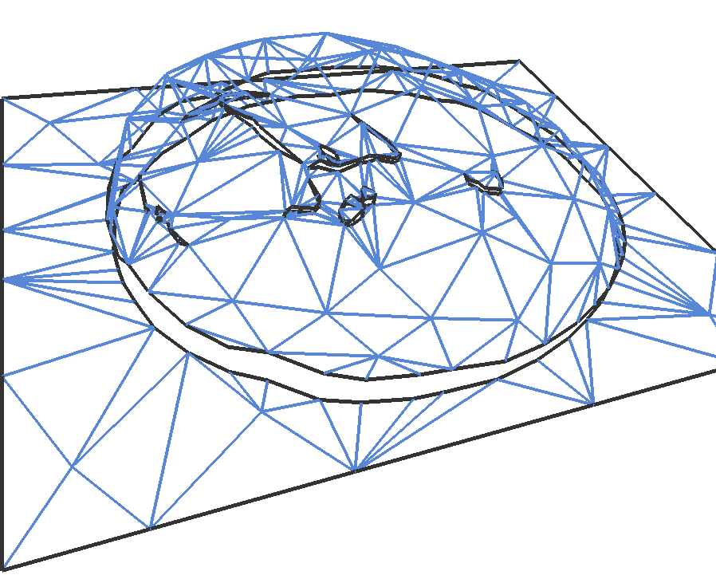
Control mesh
Triangulate pixel grid → Mesh simplification
Cut mesh open along image features
For a vertex on a feature:
A pair of vertices with same (x,y)
Careful simplification to maintain
mirroring structure and fitting error
Based on [Xia 2009]
Notes:
The control mesh is constructed by triangulating the original image grid and do mesh simplification. The image simplification will adaptively allocate vertices based on color variance.
Special attention must be paid to the image features, where we want to preserve the sharp contrast. It is necessary to cut the mesh open along feature to preserve the sharpness at high resolution. As a result, a vertex on an image feature is split into a pair of vertices which have the same xy location but different color. The simplification procedure must be careful to these special pair of vertices to maintain the mirroring structure. And also, simplification is more conservative to the feature vertices to make sure the fitting error to the original image feature is small.
This part of work is largely based on the work of [Xia 2009], and it's crucial to the quality of final result.

Slide 9
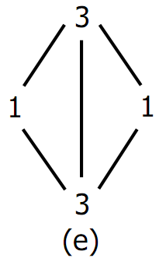
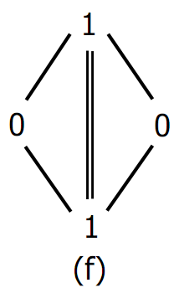
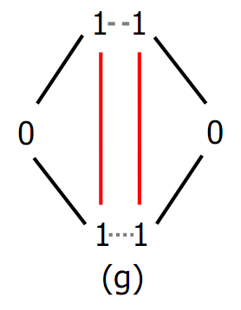
Subdivision scheme
Discontinuity-preserving Piecewise-smooth surface
Loop’s subdivision [Loop 1987]
Piecewise smooth Loop subdivision [Hoppe 1994]
Vertex mask
Edge mask
[Loop87]
[Hoppe94]
Our masks
Notes:
Here it comes the subdivision scheme we use. We call it discontinuity preserving piecewise smooth subdivision surface, which is an extension of the piecewise smooth subdivision surface work by [Hoppe 1994], which in turn, was an extension of the Loop's subdivision scheme by Charles Loop in 1987.
I'll skip the details of how these subdivision masks work, but to briefly describe the evolution of this line of work. First, the Loop's subdivision surface was introduced as an generalization of the Cat-mull subdivision to triangular meshes. Loop's subdivision surface is an everywhere smooth surface, it has only two masks. And This is the mask set of the Hoppe's subdivision scheme; three masks are introduced to make a piecewise smooth subdivision surface, which allows first-order discontinuity at desired locations. This is our mask set, which has two more masks. The two masks are introduced to preserve the discontinuity across the image features. The red edges correspond to the pair of edges along an image feature. What it says is that the subdivision of one side of the feature takes one color value, and the other side takes a different color value, which is exactly we want to.

Slide 10
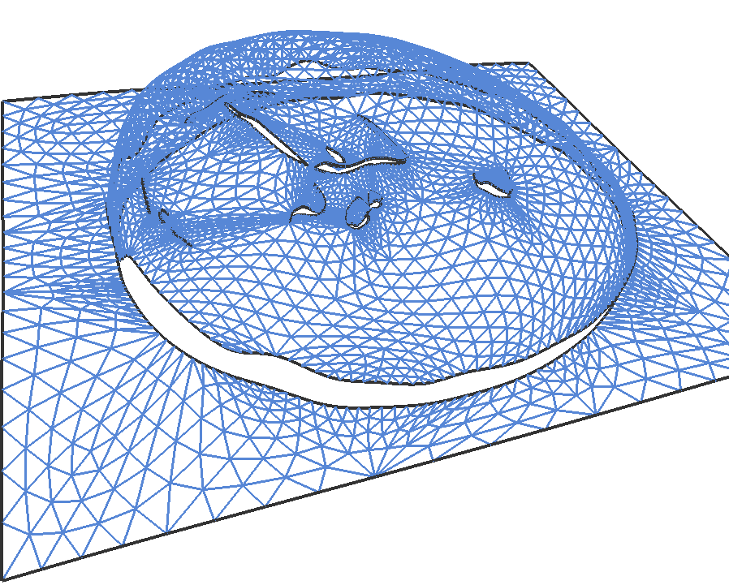
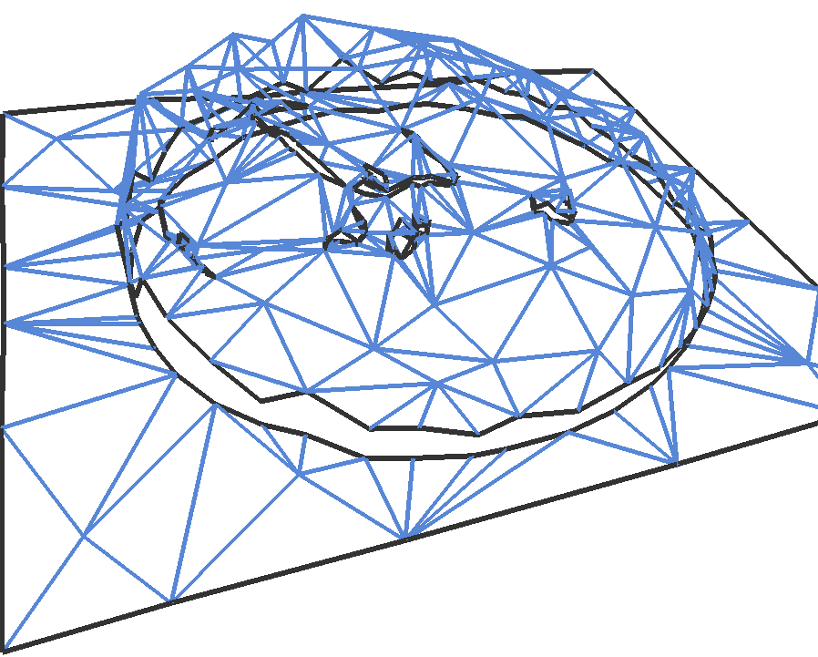
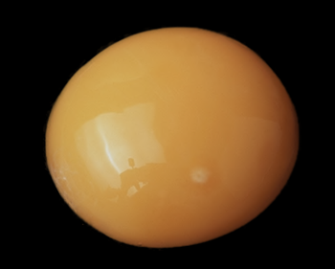
Mesh Position Optimization
For each vertex on subdivided surface
, a is sparse
(The entries of a are determined by subdivision)
Minimize:
Least square fitting!
Subdivision
Optimization
x
x*
s
y
Notes:
The last step is to optimize the control mesh such that the subdivision surface approximates the image color well. We've already had the control mesh, and the subdivision solution. The optimization is to minimize the squared difference of vertices on the subdivision surface to the corresponding pixel value of the input image.
Each subdivision vertex is expressed as a linear interpolation of a few local control vertices, so a_i is a sparse vector, and the Big A is a sparse rectangular matrix with more constraints than variables. And it's simply a least square fitting problem which can be solved by any linear solver.

Slide 11
Result
Input
Reconstruction

Slide 12
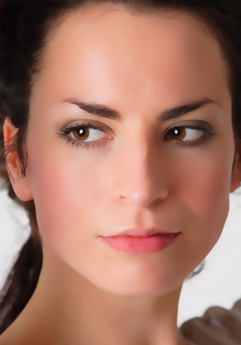
Another result
Input
Reconstruction

Slide 13
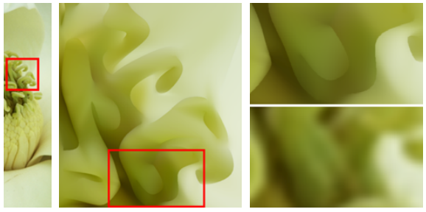
Super-resolution
Bicubic interpolation
Input
Magnification (8x)
Comparison
Notes:
Another big advantage of a vector representation is super-resolution. Because it converts the discrete image signal into a continuous space. So the color can be evaluated as any resolution. (The discontinuity of the underlying mesh across feature is also important for super-resolution, because it maintains the sharp color change.)
In this example, the middle image shows a 8 times magnification of the original image. Notice that the details and edges of the local patch is well preserved. On the right, it shows the comparison with the bicubic interpolation on a pixel image. The bicubic interpolation produces an overly blurred result.

Slide 14
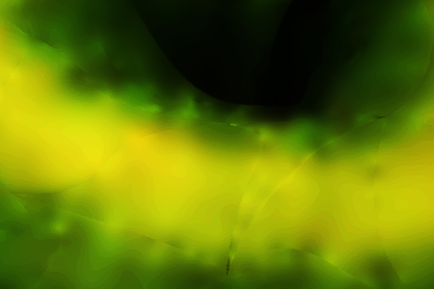
Boundary continuity
At least C1 except cross feature, C2 along features
[Xia 2009] C0 across patch boundary
Xia09
Ours
[Xia 2009]
Input
Ours
(Image sharpened for a better view of artifacts)
Notes:
Lastly, let me briefly mention another important advantage of the subdivision-based representation. It’s the continuity property. In geometric modeling, This is an extremely important concept.
The quick conclusion is that our subdivision-based surface has the property that the curved feature is C2 continuous, and the surface is at least C1 continous except across the feature, which we deliberatively maintain its discontinuity for sharp feature. Actually this continuity property was the major motivation of this project. In a previous vectorization project which I co-authored, it only has C0 continuity across patches.
The figure shows a comparison of this effect. The input is a local patch of an apple image. In the middle it shows the vectorization result. You can see the patch-boundary artifacts in the previous work result.

Slide 15
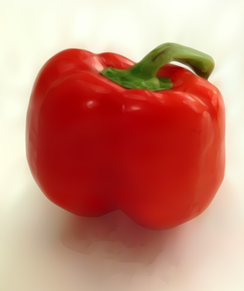
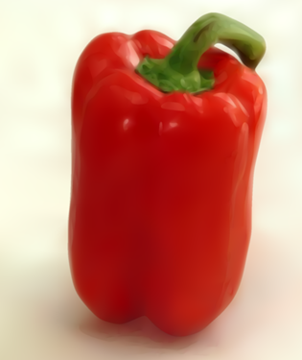
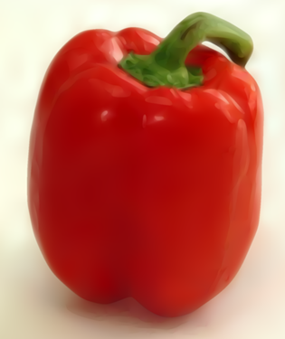
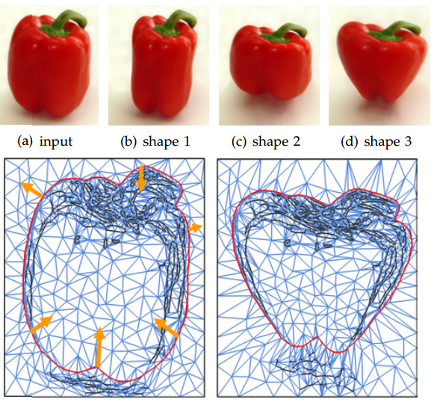
Editability
Shape editing
Fast feature selection
ARAP deformation [Igarashi 2005]
Control mesh (input)
Control mesh (shape3)
Notes:
Because we have an explicit representation of feature, We can select a whole feature by a single mouse click and drag it around.
The deformation algorithm we use here is called As-Rigid-As-Possible, which is a global deformation operation that adjusts the position of all the vertices in the mesh such that the overall mesh geometry is best-preserved. The mesh geometry is encoded by triangle angle in their local coordinate frame.

Slide 16
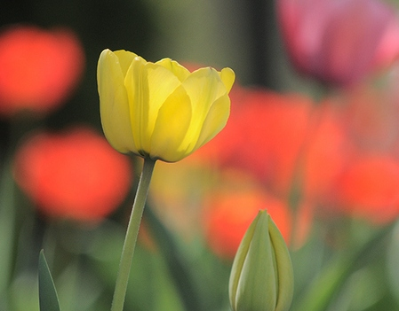
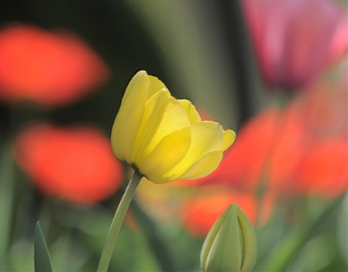
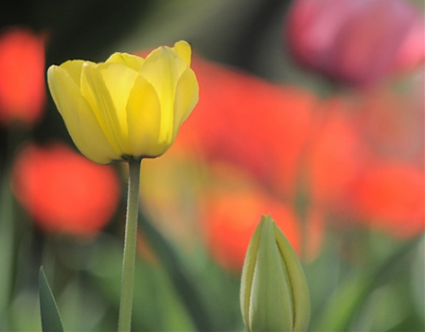
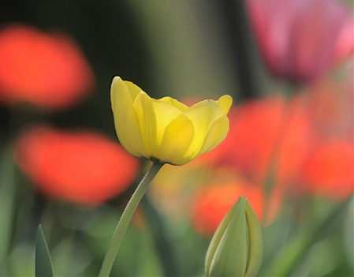
Shape editing (more)

Slide 17
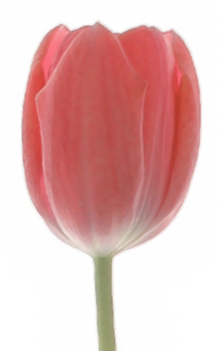
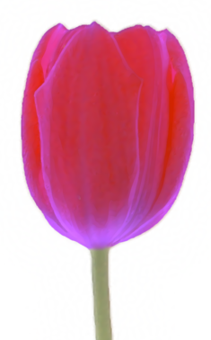
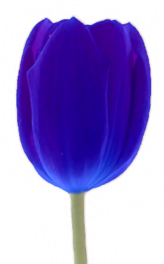
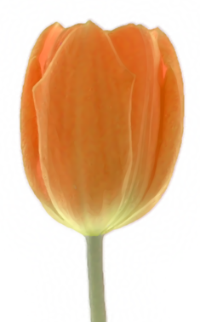
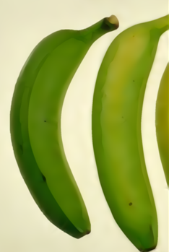
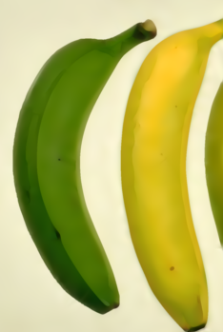
Editability
Color editing
Blend
Transform
Notes:
There are two color editing modes.
In “blend” mode, the color is computed as a linear blend of original color and target color.
In Transform mode, the color is computed as a transformation of the original color with a 3x3 diagonal matrix.
The blend mode is a translation operator, the transform model is a scaling operation. Notice that both color editing operation will preserve the color details in the input.

Slide 18
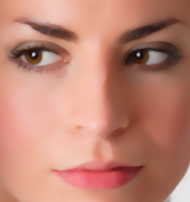
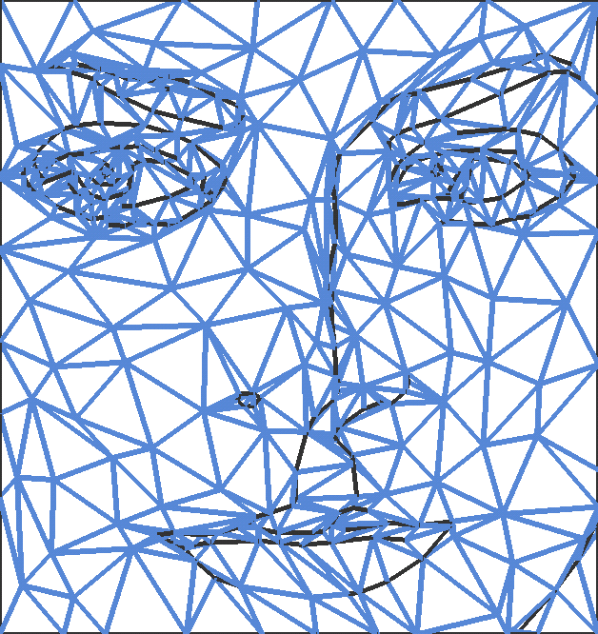
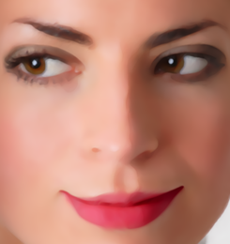
Face editing
Edit result
(Edited parts: lips, eyes, and eye brow)
Input
Notes:
The definition is still too abstract. Let me show a few examples.
One example is face editing. Given a face image, if we managed to create an underlying structured representation like this, then we can easily deform, and do make up to the face by manipulating this sparse control mesh, and get a new face image like this. Apparently, without the structure, it’s extremely difficult to achieve such an editing effect on a pixel image.

Slide 19
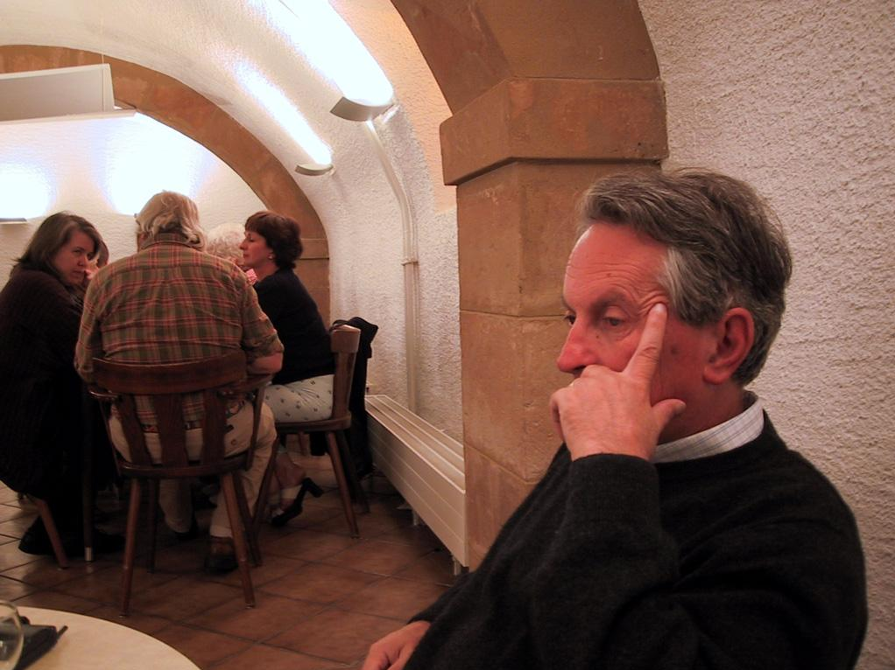
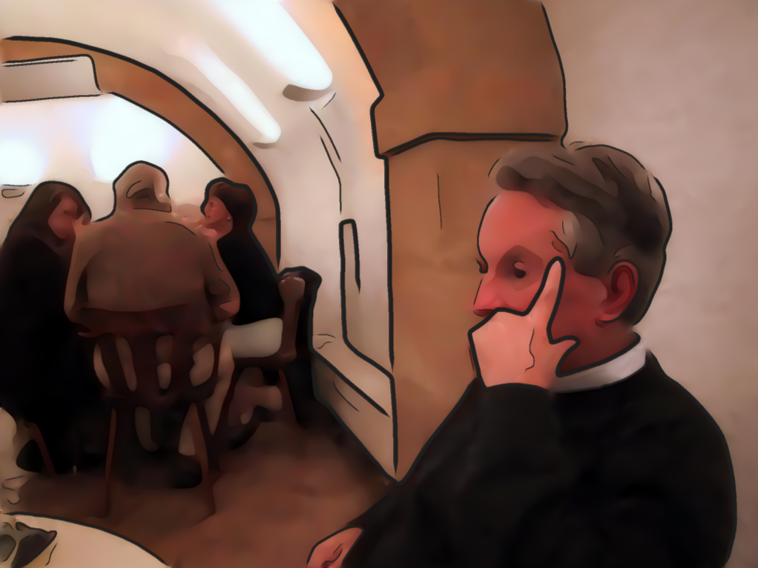
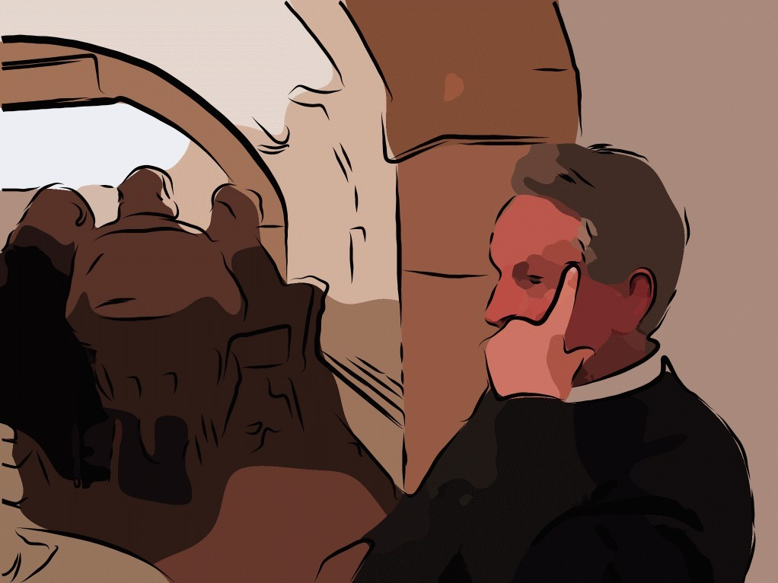
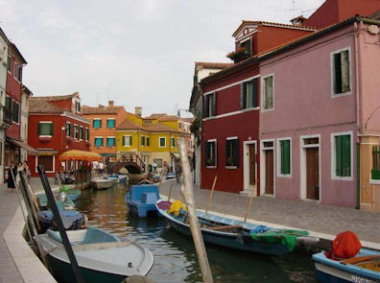
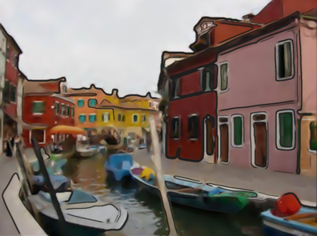
Image stylization
Stylized
Input
Stylized
[Liao 2012]
Stylized
[DeCarlo 02]
Input

Slide 20
Combined effects

Slide 21
Multiresolution representation
Level-of-detail control
Signal processing
submission]
➔
Notes:
Progressive representation is to represent object content in multi-resolution such that it can change gradually. In the image vectorization project, we built such a progressive representation for the vector image. The motivation is: level-of-detail control, multi-resolution editing, compression and progressive transmission and display.
Here I am using the canonical Laplacian pyramid figure as a symbol of some progressive representation of the vector image, it doesn't mean we used the same image pyramid in the work.

Slide 22
Progressive representation
Background
Image pyramid [Burt-Adelson 1983]
Gaussian pyramid, and Laplacian pyramid
Huge impact on signal processing in images
Progressive mesh [Hoppe 1996]
Base mesh + edge collapses
A reversible series coarse-to-fine meshes
Signal processing for meshes [Guskov 1999]
Extends image signal processing tools to meshes
Base mesh + detail vectors
Notes:
The very first progressive representation of images is the image pyramid work by Burt-Adelson, which…
And then the progressive mesh by Hoppe 1996 can be regarded as an extension of the Gaussian pyramid to a mesh. It represents a dense mesh by a base mesh plus a series of edge collapses from progressive mesh simplification. This compact structure can produce a reversible series of coarse-to-fine meshes.
Later on, the work of signal processing for meshes by Peter schroder, extends the image signal processing tools, such as downsample, upsample, filtering to meshes. It's basically an implementation of the Laplacian pyramid algorithm on a mesh with a non-uniform relaxation. The representation is a base mesh plus a series of detail vectors. We'll see a direct comparison of this structure to an image Laplacian pyramid structure soon.
What we do in this part is firstly build a multi-resolution control mesh based on progressive mesh structure, and then we employee the idea from Peter Schroder to build a Laplacian pyramid on the vector image representation for signal processing.

Slide 23
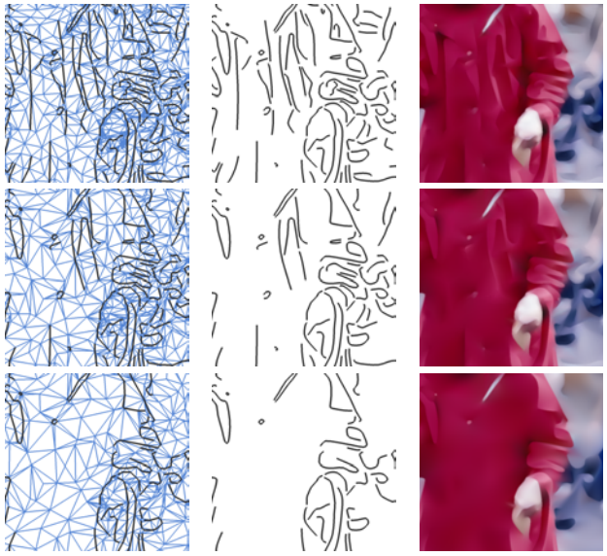
Multi-resolution vector image
Representation
Progressive mesh structure
Feature-oriented
Algorithm
Saliency-based feature merging
Progressive mesh simplification
Level 0
Level 1
Level 2
Notes:
The motivation of making a multi-resolution representation is to support displaying an image at different level of details. Progressive mesh simplification of the control mesh could roughly do it. But for an image, A lot more information is carried in the image features. So it's important that image features could also be downsampled/upsampled as we decrease or increase the LOD. So our multi-resolution representation is based on the progressive mesh structure, and is also feature oriented.
What we need to do is to assign a saliency value to each image feature and sort them. As we go from one level to the next coarser level, we first merge a fraction of low saliency features, and the do progressive mesh simplification. The figure on the right illustrates the effect of feature merging and edge collapse.

Slide 24
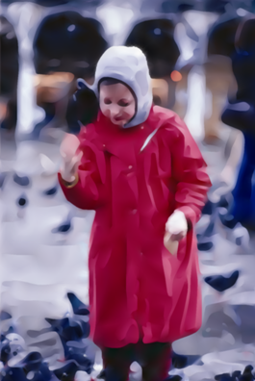
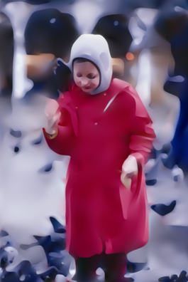
Multi-level image abstraction
Notes:
This example, we saw it before, shows the result of changing the level of image abstraction based on the multi-resolution representation.

Slide 25
Signal processing on Vector image
Image based signal processing
Downsample, upsample, filter
Vector image pyramid
Coarsest-level mesh
A sequence of detail vectors
Algorithm
Pre-smoothing
Down-sample
Relaxation
Detail computation
Detail enhancement/smoothing
Laplacian pyramid
- Coarsest-level Gaussian image
- Laplacian images
Notes:
This page shows how did we implement signal processing directly on our vector image. Image-based signal processing, such as downsample, upsample and filtering are very frequently used on images. On pixel image representation, the Laplacian pyramid algorithm can do it in a very elegant way. But it's not intuitive how to do it directly on vector images.
What we did was inspired by the Peter Schroder's work. We call it a vector image pyramid, which has a perfect analogy to the Laplacian pyramid structure of a pixel image. The representation consists of a base mesh, which correspond to, and a sequence of detail vectors, which correspond to ….
The algorithm also bears the same spirit of Laplacian pyramid algorithm. The main difference is that we need a more careful relaxation scheme that respects to the mesh geometry.

Slide 26
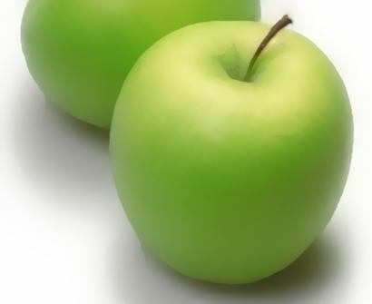
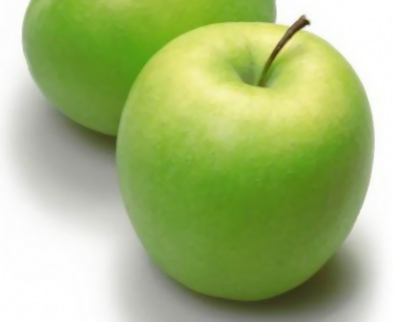
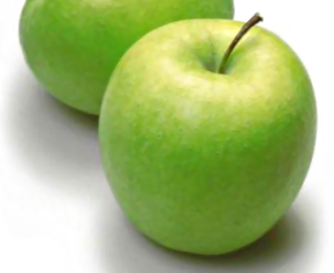
Result (detail enhancement/smoothing)
Smoothing
Input
Input
Enhancement
Operated on mesh instead of pixels!

Slide 27
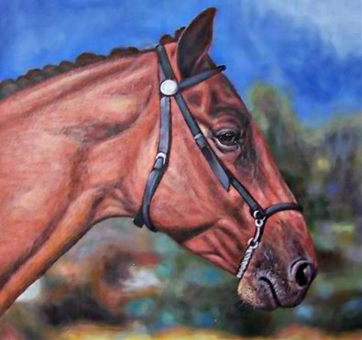
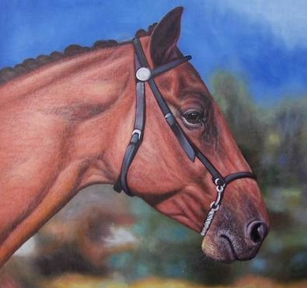
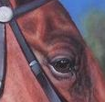
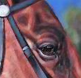
Results (detail enhancement)
Enhancement
Input

Slide 28
Conclusion
A image vectorization method based on Subdivision surfaces
A multi-resolution representation that supports image abstraction and signal processing
Editing tools: shape/color editing, image stylization

Slide 29
Thanks

