Slide 1
Amortized Supersampling
Lei Yang ^{H}, Diego Nehab ^{M}, Pedro V. Sander ^{H},
Pitchaya Sitthi-amorn ^{V}, Jason Lawrence ^{V},
Hugues Hoppe ^{M}
Dec. 18, 2009, Pacifico Yokohama, Japan
Notes:
Hello everyone. Today I will present our paper on Amortized Supersampling.
This is a joint work with several other researchers from HKUST, Microsoft Research and University of Virginia.

Slide 2
Outline
Problem
Amortized supersampling – basic approach
Challenge - the resampling blur
Our algorithm
Results and conclusion
Notes:
This is the outline of the talk. I will first describe the problem that we address in the paper, explain the basic ideas and challenges, describe our algorithm, and finally present some results.

Slide 3
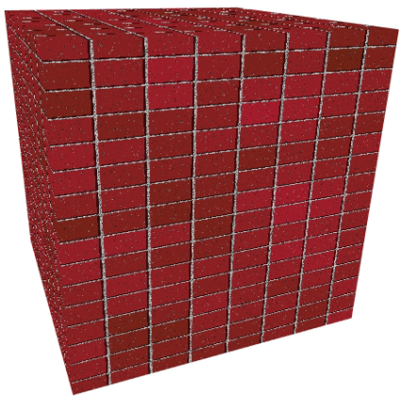
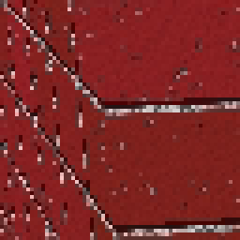
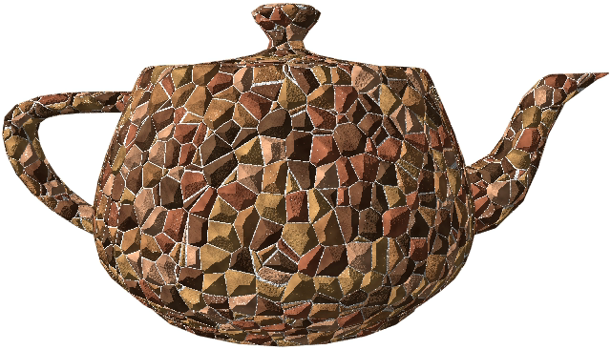
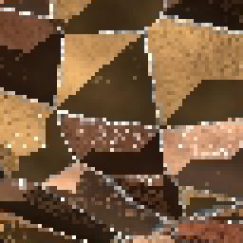
Problem
Shading signals not band-limited
  Procedural materials
  Complex shading functions
Band-limited version
(analytically antialiased)
  Ad-hoc
  Difficult to obtain
Notes:
Our amortized supersampling method aims at antialiasing high-frequency shading signals, such as procedurally generated materials and complex shading functions.
These signals are usually not band-limited by nature, so they could show strong aliasing when sampled regularly.
On the right we show two such examples. To remove the aliasing artifacts, one common solution is to convert the shaders to their band-limited versions by hand.
However, such a conversion process is usually tedious and ad-hoc, or even too difficult to apply in some cases.

Slide 4
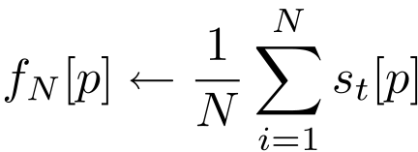
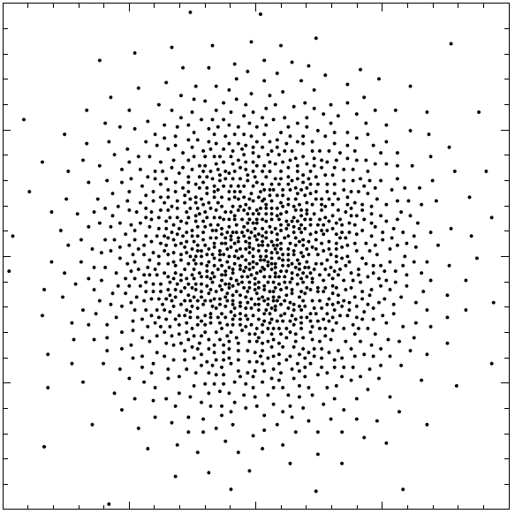
Problem
Supersampling
  General antialiasing solution
  Compute a Monte-Carlo integral
  Can be prohibitively expensive
Notes:
The most general approach for antialiasing is to increase the spatial sampling rate using supersampling. To do so we simply evaluate the shading function at N predetermined sample points s_t around the pixel center p, and average the results to obtain the pixel value. Unfortunately supersampling can be prohibitively expensive. Evaluating shaders tens of hundreds of times for every pixel is generally not acceptable for real-time applications.

Slide 5
Accelerating Supersampling
Shading functions usually vary slowly over time
Reuse samples from previous frames
  Reprojection
  Generate only one sample every frame
……
Frame 1
Frame 2
Frame 3
Frame t
Notes:
We notice that in many applications, shading functions typically change slowly over time. In such occasions, we could potentially reuse samples that are computed in previous frames to reduce shading costs. In fact, if we compute only one sample for every pixel in every frame, and reproject all previously computed samples that lie close to the same surface point to the current pixel, then once enough frames are rendered, we will have sufficient samples to produce an alias-free image.

Slide 6
Amortized Supersampling
Cannot afford to store all the samples from history
Keep only a running accumulated result
  Update it every frame using exponential smoothing
=
Frame 1 ~ t-1
Frame t-1
Frame t
Notes:
Unfortunately, it is inefficient to use every single sample from history because of the storage overhead and the reprojection cost.
We can efficiently approximate this by keeping only one single running accumulated result for each pixel. All the previous samples are averaged and represented by this single value. Here we use f_t[p] to represent this running result of point p at frame t. When the new sample s_t[p] is obtained, it is blended with the previous frame’s result using a recursive exponential smoothing filter. The smoothing weight \alpha controls the relative contributions of the previous and current samples.
This idea is similar to using an accumulation buffer, but notice that in our case there can be arbitrary scene motions between frames. In the formula the reprojection operator \pi maps point p to its corresponding position in the previous frame. For most type of motions there is no exact 1:1 mapping of the pixels between adjacent frames, so some sort of resampling is required.

Slide 7
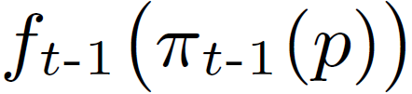
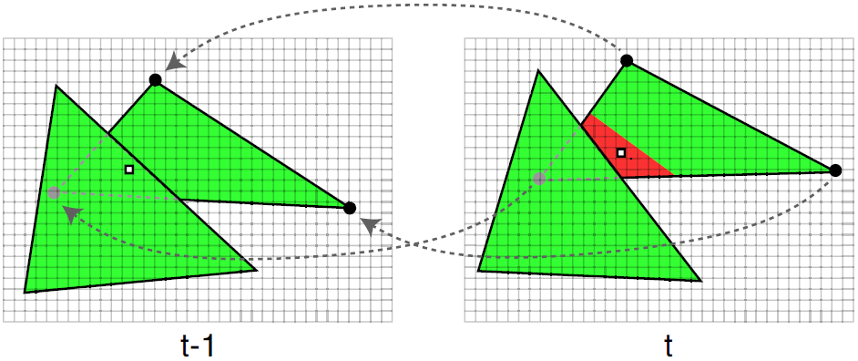
Reverse Reprojection ^{[Nehab07, Scherzer07]}
Compute previous location π_{t-1}(p) of point p
A bilinear texture fetch for the previous value
  Check depth for occlusion changes
p
π_{t-1}(p)
Notes:
The reprojection operator \pi can be efficiently computed on the GPU. After the previous location of point p is determined, the previously accumulated value for that point can be loaded using a bilinear texture fetch in the history buffer. The bilinear fetch is the simplest approach for resampling, which accounts for the irregular pixel mapping between adjacent frames. Care must be taken to ensure that occlusion is handled properly. This strategy, referred to as reverse reprojection, was proposed in two previous papers, in which it has been combined with the recursive smoothing filter to antialias shadow boundaries. Refer to these papers for additional detail.

Slide 8
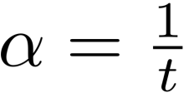



Effect of the smoothing factor α
Larger α: less history, more aliasing/noise
Smaller α: less fresh value, more smoothing
Equal weight of samples:
(1 – α) ·
+
(α) ·
→
Frame t-1
Frame t
Notes:
Let’s go back and have a careful look at the recursive smoothing filter. As I said, the smoothing factor \alpha controls the relative contributions of the previous frame’s value and the current sample s_t. Larger \alpha discards stale data more quickly and gives more weight to the new sample, but will unfortunately lead to more aliasing or noise. Smaller \alpha, on the other hand, respects history data more and allows better smoothing over time, but makes it less responsive to the signal changes. In fact, if the shading signal is static and we want to assign equal weight to all the previous samples as done in supersampling, we can let \alpha follow a harmonic progression, 1/t, from the first frame to the current. In that case, the result will gradually converge to a perfectly supersampled value.

Slide 9
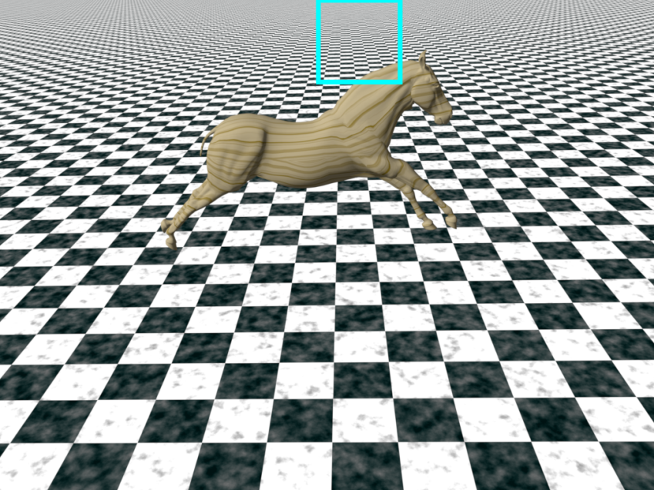
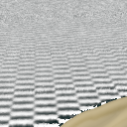
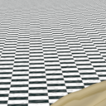
An artifact of recursive reprojection
Severe blur due to repeated bilinear interpolation
Recursive
reprojection
Ground truth
Notes:
Until now I have described the basic idea of supersampling through reprojection. Its implementation is very efficient, and it can be easily combined with existing shaders as a single rendering pass. However, a major problem of keeping only a single history value per pixel is that the error of repeated bilinear interpolation accumulates and leads to severe spatial blur of the reconstructed estimate. This is shown in the close up image of this horse and checker board scene. In order to limit this undesirable artifact, let’s first model it mathematically.

Slide 10
Factors of the blur
Fractional pixel velocity v = (v_{x}, v_{y})
Exponential smoothing factor α
v =(0.5, 0.5)
……
Frame t-3
Frame t-2
Frame t-1
Frame t
(1- α)³
(1- α)²
(1- α)
……
Frame t-3
Frame t-2
Frame t-1
Frame t
Notes:
There are two major factors that affect the amount of blur in the preliminary amortized supersampling process that I’ve just described. The first one is fractional pixel velocity, which stands for the fractional part of the displacement between the current pixel and its reprojected position. If it is non-zero, let’s say (0.5, 0.5), the current pixel will map to the middle of four pixels in the previous frame, and a bilinear sampling will blend them equally. Note that this happens all the way recursively, and the magnitude of the velocity controls how the four neighboring pixels are bilinearly blended. A value that is close to 0 or 1 will concentrate the weights on one of the corners, which will reduce the amount of blur introduced. So the total amount of blur correlates with this velocity.
Another influence over the blur is the exponential smoothing factor \alpha. Since the data obtained recursively from previous frames receive an exponentially decreasing weight, the powers of (1-\alpha), the value \alpha thus controls the rate in which old blurred results are thrown away. The larger \alpha, the less weights to the old values, and therefore the less amount of blur.

Slide 11
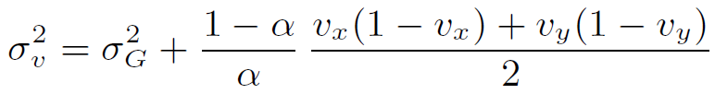
The amount of blur
The expected blur variance is (derivation in the appendix)
Approaches for reducing the blur:
  Increase resolution of the history buffer
  Avoid bilinear resampling whenever possible
  Limit α when needed
Notes:
Now let’s look at a more formal relationship between the blur and the two factors. We characterize the amount of blur at each pixel by the weighted spatial variance \sigma_v of the previously accumulated sample offset. In our derived formula, \sigma_G is a constant that denotes the variance of the random jittering kernel. The other terms, which are related to \alpha and the fractional velocity, suggests several approaches for reducing the amount of blur.
We first notice that the fractional velocity can be cut down by increasing the resolution of the history buffer. For example, by maintaining the history estimate at twice the screen resolution will reduce the expectation of both v and (1-v) by half. Next, we can also directly avoid bilinear sampling the buffer whenever possible to avoid blurring samples with their neighbors. Finally, the last resort is to prevent \alpha from being set too low to ensure a minimum amount of recomputed shading. Next I will explain our revised algorithm based on these three strategies.

Slide 12
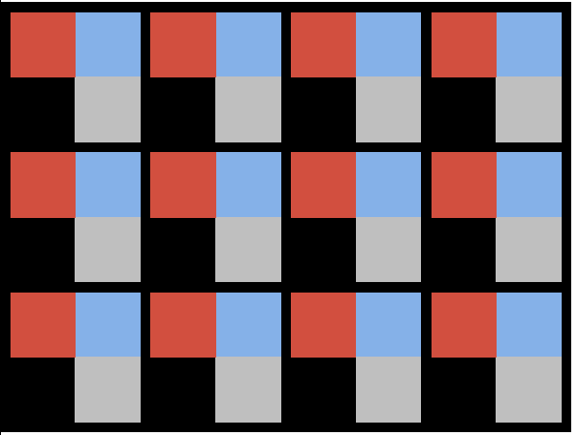
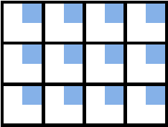
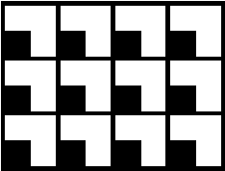

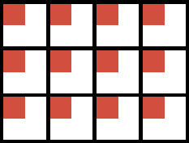
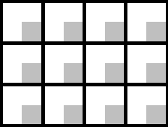
(1) Increase resolution
Option 1:
Keep a history buffer at high resolution (2x2)
  Have to update it every frame ☹
Option 2:
Keep 4 subpixel buffers at normal resolution
  Only update one of them each frame ☺
High-resolution buffer
Subpixel buffers
Notes:
For increasing the resolution, we can directly maintain a history buffer at a higher resolution, let’s say, 2x2. Each pixel in the final frame will then map to 4 subpixels in the history buffer. However, this scheme requires us to update every subpixel in every frame, which is an undesirably demanding task. So instead, we switch to option 2 and break this high resolution buffer into 4 subpixel buffers of the normal screen resolution. Each subpixel buffer manages 1 quadrant of the subpixels in the high resolution buffer in an interleaved way. Using this scheme, the 4 subpixels of a pixel become independent and we will only update one of them each frame, in a round-robin or random fashion.

Slide 13
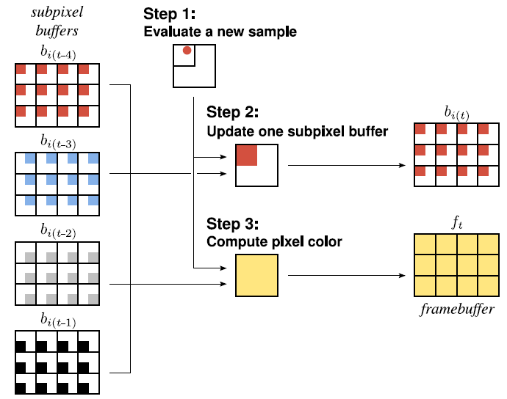
Subpixel buffers
Notes:
Here is an illustration of our subpixel buffer algorithm. Let’s say that in a particular frame we want to update the red quadrant of all the pixels. For every pixel, we first evaluate a new sample for the red quadrant. Then the history value of that quadrant is reconstructed from the four subpixel buffers, and combined with the new sample using exponential smoothing to update the quadrant pixel value. The final pixel color can also be obtained in a similar way, but considering the entire pixel area.
Note that in a static scene, fetching the history value is not an issue since none of the subpixels move. But in the existence of arbitrary scene motion, a subpixel or a pixel may be reprojected to an arbitrary position in any of the subpixel buffers. So we need a reconstruction strategy that accounts for that.

Slide 14
(2) Avoid bilinear sampling
Reconstructing from subpixel buffers
  Forward reproject the samples from 4 subpixel buffers to the current subpixel quadrant
  Weight them using a tent function
  GPU approximation/acceleration
Notes:
For the reconstruction, as we are trying hard to avoid reintroducing unwanted blur, bilinear sampling the subpixel buffers is not a good choice. Our solution here deviates a little bit from the traditional reprojection process. To achieve a more accurate reconstruction, instead of reverse-reprojecting the current position to the previous buffers and resampling, we forward-reproject all the related samples from 4 subpixel buffers to the current subpixel quadrant. These samples, now in the current frame, are weighted using a tent function. The tent function is placed to encompass the subpixel or the pixel region, depending on which one is being reconstructed.
We also have a GPU optimization that avoids all the hassle of forward reprojection. The details are in the paper.

Slide 15
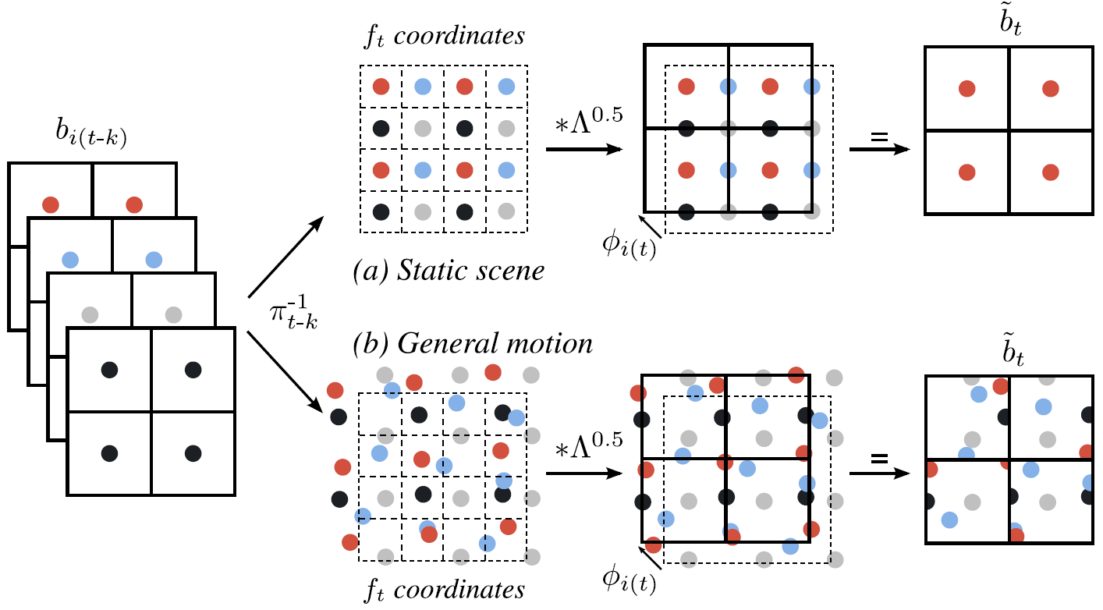
Reconstruction scheme
Notes:
This diagram shows the reconstruction process. The top row shows that in a perfectly static scene, the forward reprojected subpixels remain stationary. So under a tent filter, the correct subpixel remains and all the others are given a zero weight. In the case of general motion, shown in the bottom row, the reprojected subpixel samples form an irregular pattern. So under a tent filter, their weights are given based on their distance to the center of interest. ((Samples that are farther from the center are given a lower weight so as to reduce their contribution to the reconstruction error and blur.)) In either case, our approach aims at making the best use of all the reprojected samples for reconstruction.

Slide 16
(3) Limiting blur via bounding α
Derive a relationship between
  Blur variance σ ²
  Motion velocity v and α
Analytic relationship is not attainable
  Numerical simulation and tabulate
Bound α for limiting σ ² no larger than τ_{b}
Notes:
Still, we have to keep in mind that our reconstruction scheme cannot remove the blur completely. Since \alpha normally takes a harmonic progression over time, the blur may resurface when \alpha becomes very small. So we have to set a lower bound for \alpha. To figure out the correct bound, we need to derive a relationship between the blur variance \sigma and the motion velocity v and \alpha. ((This relationship is more complicated than the previous one because of the complex subpixel update scheme that we have introduced, and)) it turns out that a simple analytic relationship cannot be obtained. For efficiency, we tabulate a numerical simulation of this relation. At runtime, we retrieve the \alpha bound from the table based on the motion velocity and a user set error tolerance \tau_b. This will guarantee that the blur variance \sigma^2 will not exceed \tau_b.

Slide 17
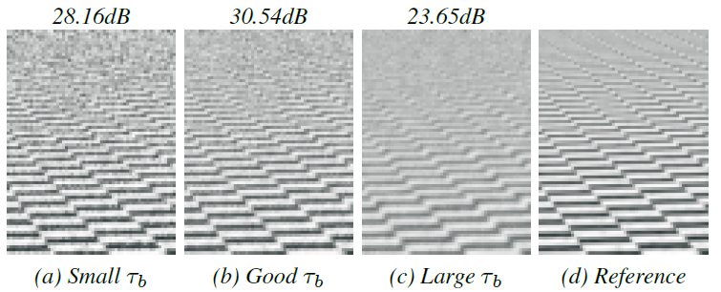
Tradeoff of blur and aliasing
Notes:
(VIDEO) Here we can see the effect of the user specified blur tolerance \tau_b. Too small a \tau_b generates a tight \alpha bound, which leads to visible aliasing, while a too large \tau_b doesn’t prevent blurring effectively. With a proper choice of \tau_b we achieve an acceptable tradeoff between blur and aliasing.

Slide 18
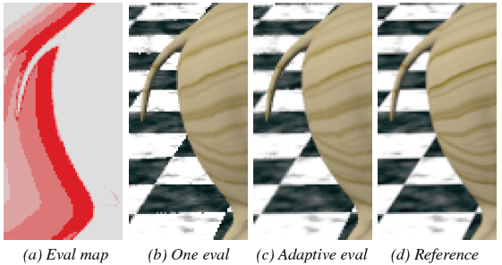
Adaptive evaluation
Newly disoccluded pixels are prone to aliasing
Additional shading for subpixels that fail in reconstruction
Notes:
Apart from the excessive blur, aliasing artifacts may show up at newly disoccluded surfaces where only a few or even no previous samples are obtained. In that case, we invoke the procedural shader for those subpixels that fail to get any reprojected sample. The shader may be evaluated from one to five times, as coded in light to dark red colors in the evaluation map on the left. As a result, aliasing is attenuated in those regions.

Slide 19
Accounting for signal changes
Detect fast signal change
  React by more aggressive update
Estimate residual ε between:
  Current sample s_{t}(aliased/noisy)
  History estimate f_{t}
Blur the residual estimate to remove aliasing/noise
Bound α for limiting ε no larger than τ_{ε}
Notes:
The last component of our algorithm is the mechanism of adapting to signal changes. In many cases the assumption that the signal doesn’t change or changes slowly doesn’t hold. To detect such cases and force quick updates, we first estimate the residual \epsilon between the current sample s_t and the history estimate f_t after they are computed. Because the current sample s_t is aliased and noisy, we apply spatial smoothing on the residual \epsilon to remove high-frequency variance. The result is a reasonable estimate of the quantity of lag present in the history buffer. Again, to bound that lag, we set a user specified threshold \tau_epsilon for it. \alpha is clamped to a lower bound based on this threshold, so that in the next frame \epsilon will be lower than \tau_epsilon. Again, a detailed derivation can be found in the paper.

Slide 20
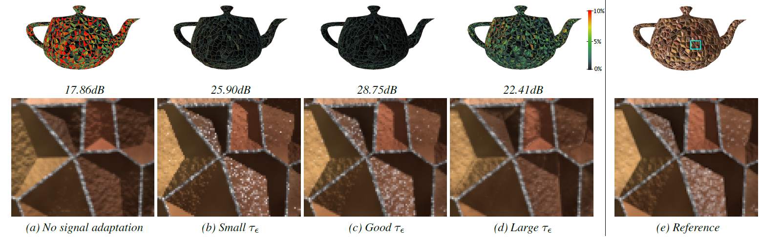
Tradeoff of signal lag and aliasing
Notes:
(VIDEO)Here we see the effect of \tau_epsilon on a stationary scene with fast changing illumination and flickering specular highlights. A large \tau_epsilon leads to visible signal lag and unresponsiveness, while a small value leads to aliasing. For signals that are not changing too fast, we can find a reasonable trade-off in between.

Slide 21
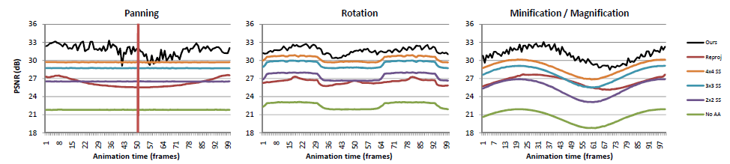
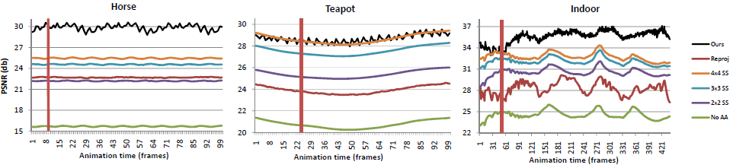
Results
Notes:
Next, I will show some results of our technique applied to a variety of scenes.
Here is the PSNR plot of our comparison to traditional supersampling methods and the original shader on several different scenes and motion types. Our method which is the black curve is almost always comparable to, if not better than, the traditional 4x4 supersampling, while being significantly faster.

Slide 22
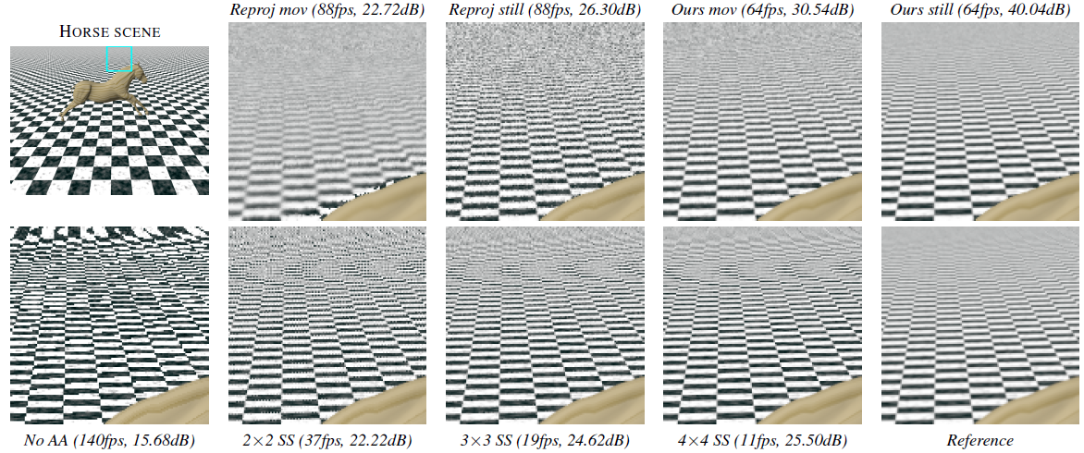
Results
Notes:
(VIDEO)Here is a video demonstration. All these scenes are completely procedurally generated and are reasonably complex in both geometry and pixel workload. The last two scenes also contains temporally changing signals, mainly diffuse and specular lighting changes. Notice that the moving specular highlights over the shiny objects at different scales are still properly antialiased without introducing noticeable temporal lag.
In extreme cases, such as the fast moving gobo lighting, where the history data is either quickly invalidated or becomes stale, the best solution is to bypass these fast changing components and apply our method to all of the remaining components.

Slide 23
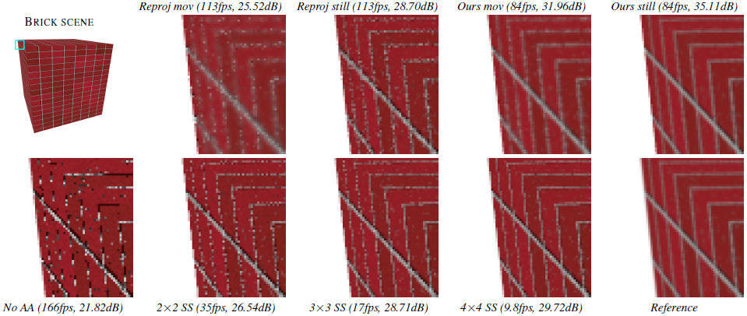
Results
Notes:
(Continuation of video)

Slide 24
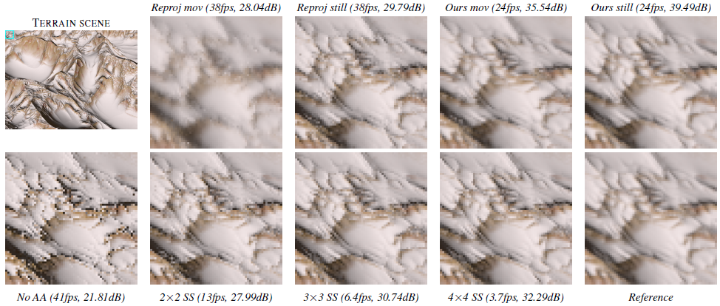
Results
Notes:
(Continuation of video)

Slide 25
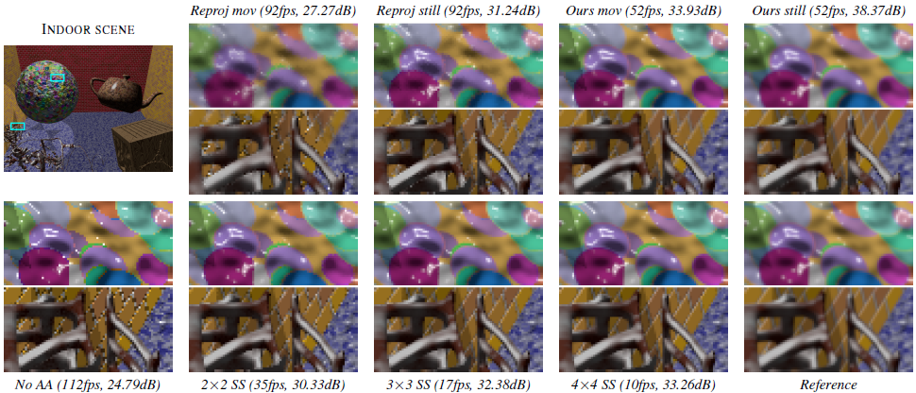
Results
Notes:
(Continuation of video)

Slide 26
Conclusion
A real-time scheme for amortizing supersampling costs
  Quality comparable to 4x4 stratified supersampling
  Speed is 5x-10x of 4x4 supersampling
  A single rendering pass
Notes:
In summary, we have described a real-time scheme for amortizing supersampling costs. The quality of our algorithm is at least comparable to traditional 4x4 stratified supersampling, while the speed is 5x-10x faster. Furthermore, the whole algorithm can be implemented in a single rendering pass, which can be conveniently combined with existing shaders.

Slide 27
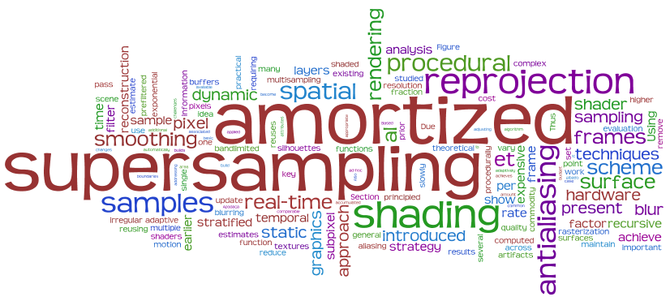
Questions?
Notes:
That’s the end of my talk. Thanks for your attention and I’d be happy to take any questions.

