Slide 1
Signal-Specialized Parameterization for Piecewise Linear Reconstruction
Geetika Tewari, Harvard University
John Snyder, Microsoft Research
Pedro V. Sander, ATI Research
Steven J. Gortler, Harvard University
Hugues Hoppe, Microsoft Research

Slide 2

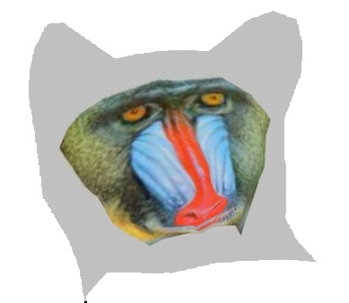
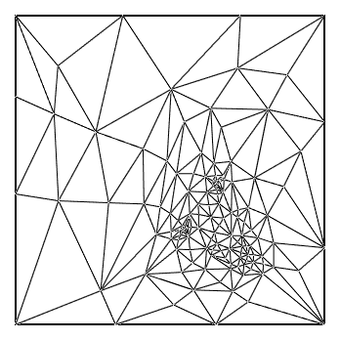
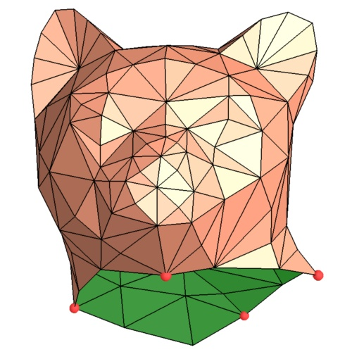
Two Scenarios
Authoring: map a texture image onto a surface
Sampling: store an existing surface signal
Notes:
Shlomo: the main point here is that one could want to store a surface signal in a texture domain.
authoring: goal is to minimize distortion of the image.
sampling: goal is to accurately capture and reconstruct the given surface signal.
Bothe these things require a mapping – parameterization from some domain to the surface

Slide 3
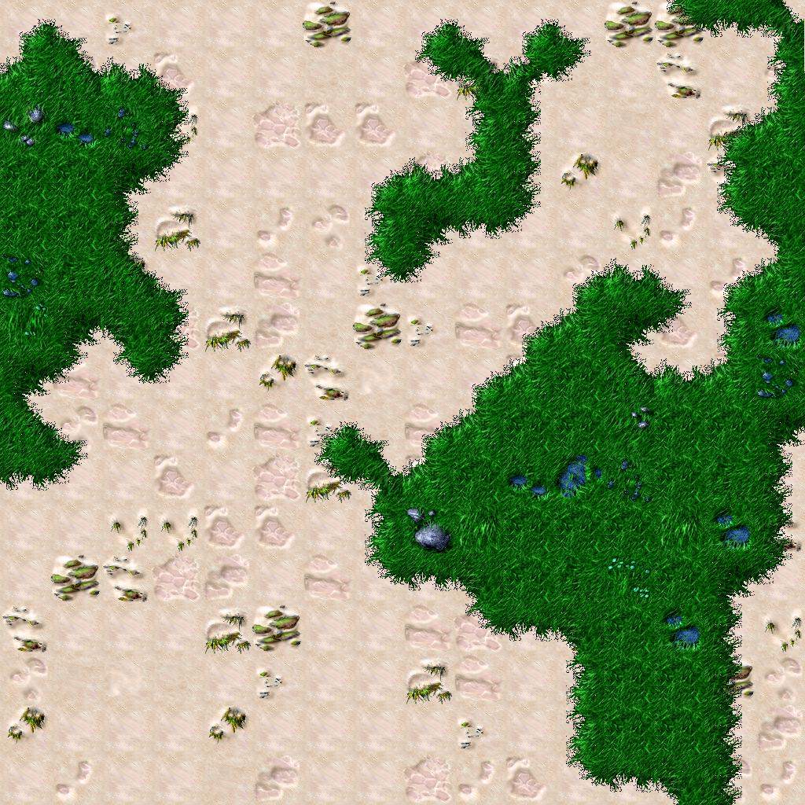
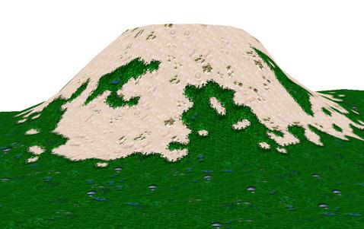

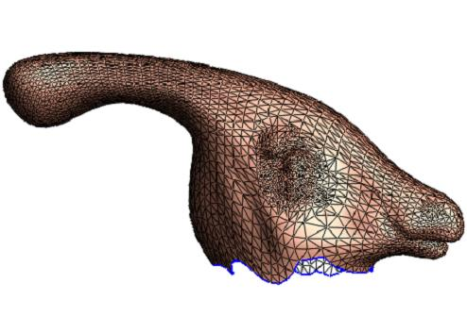
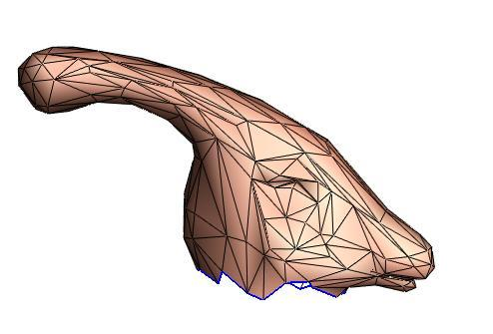

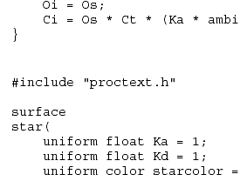
Signal Source
Procedural texture
High-resolution image texture
High-resolution geometry
Notes:
Parameterize S and sample domain
Parameterize S and resample at lower resolution
Define signal over lower resolution mesh by normal shooting to high resolution mesh
With the advent of more powerful rasterization hardware, like multi-texturing and programmable shaders,
being able to efficiently represent surface signals on a texture-map has become increasingly important.
As shown in this list, many types of signals can be represented, not jut ordinary color maps.

Slide 4
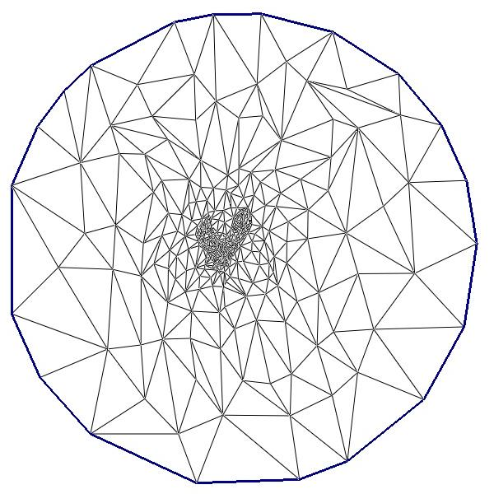
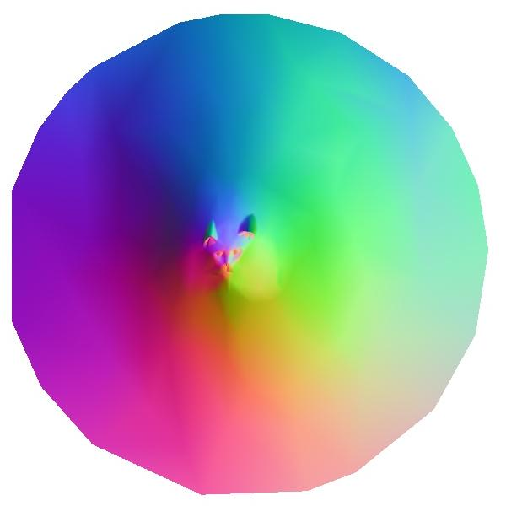
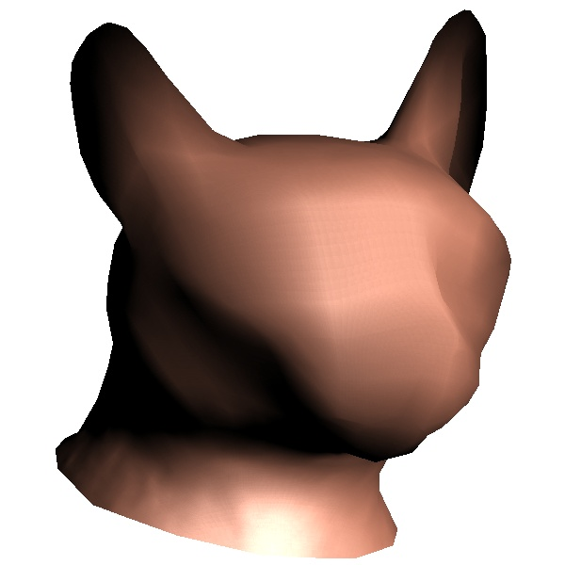
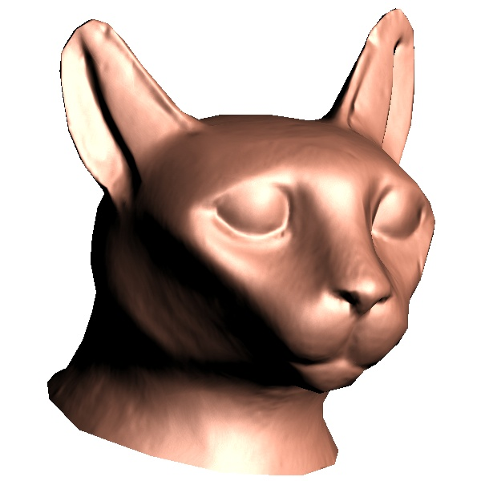
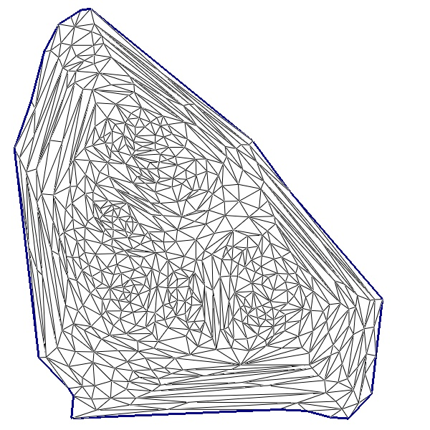
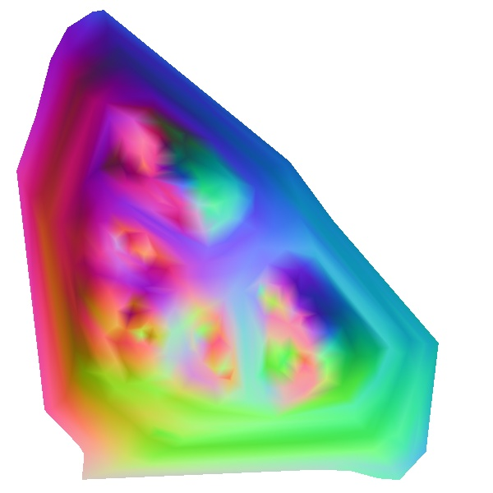
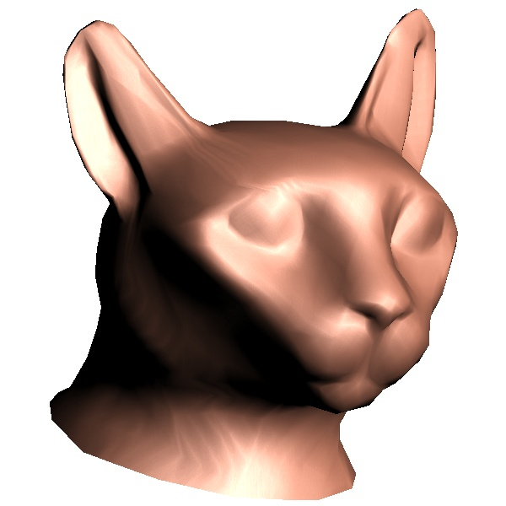
Our Goal
Reconstructed
Parameterization
Original
Original
Notes:
Thought question: why minimize error by metric. Why not create texture, resample, and reparameterize?
1) In order to find a good surface parameterization, f, we examine how well the function h = g.f is approximated when reconstructed from a discrete sampling over D.
2)for example if the signal varies a lot on some area of the surface, and that place is not allocated enough texture samples, then the local texture resolution on that region may be insufficient to represent the signal.
3) We define a metric for SAE defined as the ….
With the assumptions that

Slide 5
Related Work
Signal Independent Parameterization
Pinkall and Polthier. 1993. Computing Discrete Minimal Surfaces…
Eck et al. 1995. Multiresolution Analysis of Arbitrary Meshes.
Hormann and Greiner. 2000. MIPS – global parameterization method.
Levy et al. 2002. Least Squares Conformal Maps.
Desbrun et al. 2002. Intrinsic Parameterizations of Surface Meshes.
Signal Specialized Parameterization
Sloan et al. 1998. Importance Driven Texture Coordinate Optimization.
Hunter & Cohen. 2000. Uniform Frequency Images.
Balmelli et al. 2002. Space Optimized Texture Maps.
Sander et al. 2002. Signal-Specialized Parameterization.
Notes:
Looked at geometry.
Hormann and Greiner. 2000
MIPS - maximizes the conformality of a piecewise linear mapping with
no boundary constraints.
Levy et al. 2002
Formulate discrete conformality problem as unconstrained quadratic minimization problem
Desbrun et al. 2002
Intrinsic parameterization measures spanned by a discrete measure of the Dirichlet energy with no boundary constraints.
\Pinkall and Polthier: applied idea of minimizing conformal energy with Dirichlet boundary conditions with the goal of creating minimal surfaces
Eck et al applied this idea in parameterization literature.
Remember that you will be the one who will have read these papers recently and thoroughly.

Slide 6
Our Contribution
Sander et al. 2002
  Metric derived using piecewise constant reconstruction assumption
New metric for signal specialized parameterization
  Assumes piecewise linear reconstruction (more realistic).
  We empirically evaluate and compare our metric’s results with Sander et al.
Notes:
Terzopoulos and Vasilescu 1991
Approximate 2D image with warped grid using local complexity adjustment based on properties of input data.
Sloan et al. 1998
Warp texture domain onto itself guided by importance map.
Hunter and Cohen 2000
Compress image as set of texture-mapped rectangles to create uniform frequency images.
Balmelli et al. 2002
Warp texture on a separate grid and resample to create space-optimized texture maps.
Sander et al. 2002
Propose a metric for signal-specialized parameterization, assuming
piecewise constant reconstruction.

Slide 7
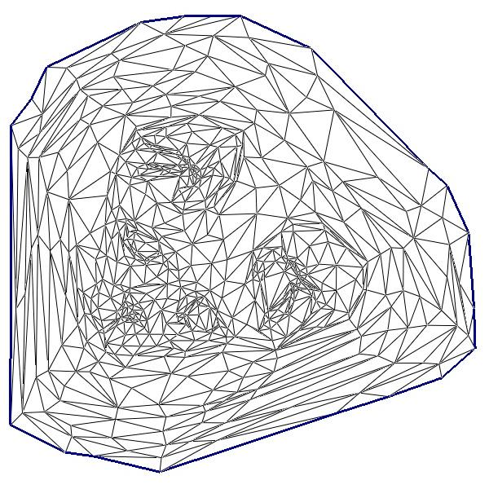
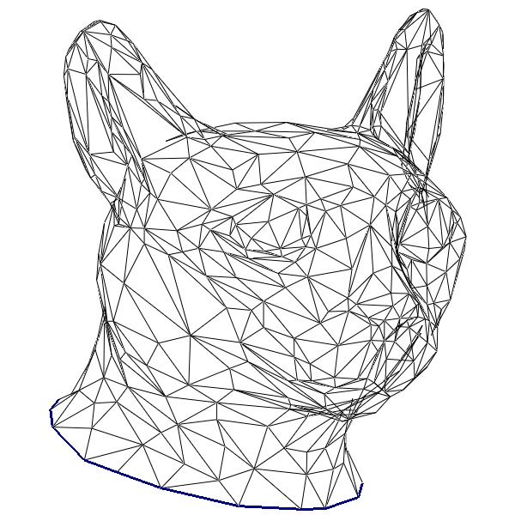

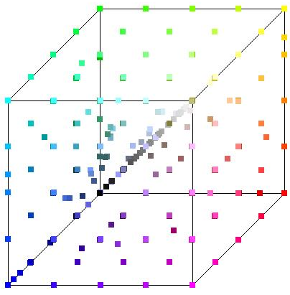
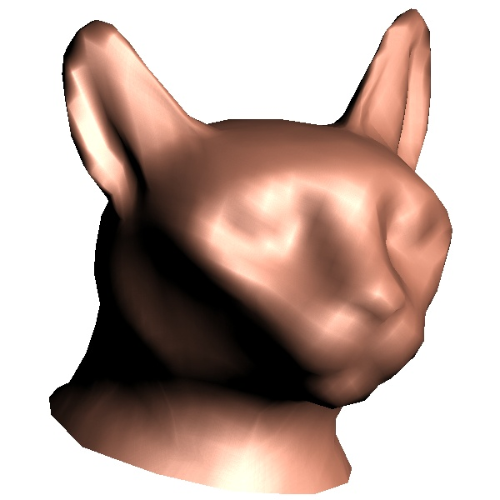
Signal-Specialized Parameterization
domain
surface
original
f
signal approximation error
reconstructed
h = g . f
g
Signal range
Notes:
Thought question: why minimize error by metric. Why not create texture, resample, and reparameterize?
1) In order to find a good surface parameterization, f, we examine how well the function h = g.f is approximated when reconstructed from a discrete sampling over D.
2)for example if the signal varies a lot on some area of the surface, and that place is not allocated enough texture samples, then the local texture resolution on that region may be insufficient to represent the signal.
3) We define a metric for SAE defined as the ….
With the assumptions that

Slide 8
Signal-Specialized Parameterization
domain
surface
original
f
signal approximation error
reconstructed
h = g . f
g
Signal
range
Piecewise constant reconstruction
Piecewise linear reconstruction
Signal height range on domain scanline
Notes:
Thought question: why minimize error by metric. Why not create texture, resample, and reparameterize?
1) In order to find a good surface parameterization, f, we examine how well the function h = g.f is approximated when reconstructed from a discrete sampling over D.
2)for example if the signal varies a lot on some area of the surface, and that place is not allocated enough texture samples, then the local texture resolution on that region may be insufficient to represent the signal.
3) We define a metric for SAE defined as the ….
With the assumptions that

Slide 9
Derivation of Metric
Texture domain
How well is h = g . f approximated when
reconstructed from a discrete
sampling over the texture domain D?
Single sample
Neighborhood
(single red square of area
Signal approximation error
= h – (reconstructed h)
t_{j}
ij
Assumptions:
  Reconstruction is piecewise linear
t
s_{i}
  Sampling is asymptotically dense
s
Notes:
a discrete sampling with spacing  in D)

Slide 10
Metric: how to derive
Texture domain
Define error at each point
  Represent signal as Taylor series
  Assume reconstruction is linear
  Error is dominated by 2nd order term
Derive error integrated over ij
Sum ij over whole surface
In the limit, (more and more samples) this sum becomes an integral
  ... And error vanishes
  Divide by ^4 to obtain convergence rate
  Use this as “energy” metric
Partition integral into sum over triangles.
t_{j}
ij
t
s_{i}
s

Slide 11
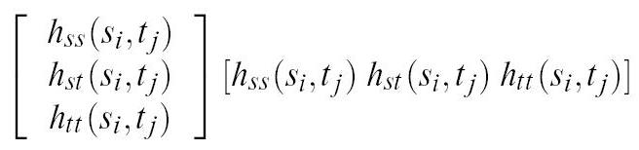
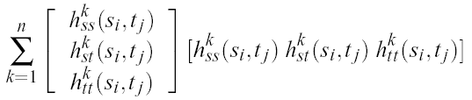


Error Metric: how to compute
=
=
Define 3 by 3 matrix at each point
Squares of second derivatives.
Notes:
This can be expressed in matrix notation as the product of second derivatives of the signal summed over every dimension of the signal.
We can integrate this expression over a sample’s neighborhood to obtain: 3d-Surface area * (expression)
The total error over all grid cells is simply the summation of this.
Its limit as delta->0 is a double integral wrt 3D surface area.
Therefore a measure of asymptotic approximation error with piecewise linear reconstruction is to find the rate of convergence. In other words since we want to make the assumption of very dense sampling, a measure of error when delta is very small is:
This can be expressed as the welsum, weighted element sum.
This can be expressed as a sum over domain triangles.

Slide 12
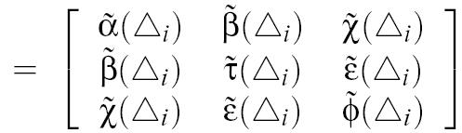

Error Metric
=
=
Integrate over each triangle to get “tilded” 3 by 3 matrix, for each triangle
Notes:
This can be expressed in matrix notation as the product of second derivatives of the signal summed over every dimension of the signal.
We can integrate this expression over a sample’s neighborhood to obtain: 3d-Surface area * (expression)
The total error over all grid cells is simply the summation of this.
Its limit as delta->0 is a double integral wrt 3D surface area.
Therefore a measure of asymptotic approximation error with piecewise linear reconstruction is to find the rate of convergence. In other words since we want to make the assumption of very dense sampling, a measure of error when delta is very small is:
This can be expressed as the welsum, weighted element sum.
This can be expressed as a sum over domain triangles.

Slide 13
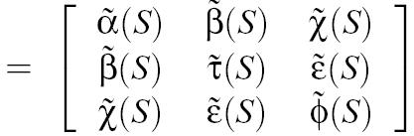

Error Metric
=
=
Sum over all all triangles to get “tilded” H for entire surface
Notes:
This can be expressed in matrix notation as the product of second derivatives of the signal summed over every dimension of the signal.
We can integrate this expression over a sample’s neighborhood to obtain: 3d-Surface area * (expression)
The total error over all grid cells is simply the summation of this.
Its limit as delta->0 is a double integral wrt 3D surface area.
Therefore a measure of asymptotic approximation error with piecewise linear reconstruction is to find the rate of convergence. In other words since we want to make the assumption of very dense sampling, a measure of error when delta is very small is:
This can be expressed as the welsum, weighted element sum.
This can be expressed as a sum over domain triangles.

Slide 14

Error Metric
=
=
Add up 4 of the terms in the matrix
(the entire matrix is kept for the upcoming affine transform rule
Notes:
This can be expressed in matrix notation as the product of second derivatives of the signal summed over every dimension of the signal.
We can integrate this expression over a sample’s neighborhood to obtain: 3d-Surface area * (expression)
The total error over all grid cells is simply the summation of this.
Its limit as delta->0 is a double integral wrt 3D surface area.
Therefore a measure of asymptotic approximation error with piecewise linear reconstruction is to find the rate of convergence. In other words since we want to make the assumption of very dense sampling, a measure of error when delta is very small is:
This can be expressed as the welsum, weighted element sum.
This can be expressed as a sum over domain triangles.

Slide 15

Numerical Computation of Metric
We need to compute
Compute :
  Numerical Integration of H
Compute H:
  Function Fitting
  Isometric flattening

Slide 16
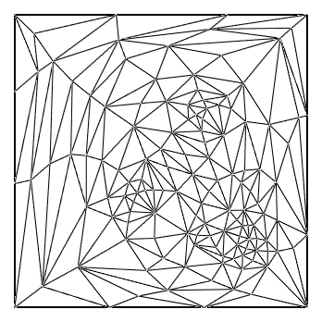

Numerical Integration
  Subdivide faces into subfaces (1-to-4)
  Compute H at center of each subface
  Multiply by corresponding surface area to get approximate
  Sum up matrices over all subfaces.
Notes:
Quadratic: any function could have been used, but we picked this because its
Second derivatives are non-linear.

Slide 17
Function Fitting
Assumption: the signal can be point sampled at parameter domain points (s,t)
least squares solver
A, B, C, D, E, F
As² + Bt² + Cst + Ds + Et + F
Second derivatives: 2A, 2B, C
recall
H =
Notes:
Say what the yellow dots are
Put yellow triangle in the center – dot in the middle of it
Put points 15 dots

Slide 18
Choosing points for Local Signal Fitting
During local signal fitting in numerical computation of H.
How do we choose (s,t) coordinates for local signal fitting?
Canonical parameterization
(0,1)
(0,0)
(1,0)

Slide 19
Isometric Flattening
It might be necessary to include samples over neighboring faces
  Isometrically map face to (s,t).
  Isometrically flatten three neighbors.
  For 3 subdivisions we use 15 points.
Notes:
Quadratic: any function could have been used, but we picked this because its
Second derivatives are non-linear.

Slide 20
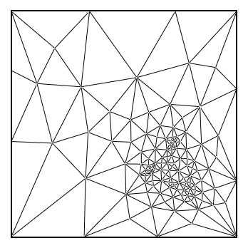
Parametrization algorithm
Start with uniform parametrization.
Iterate: for each vertex, try random line searches
Minimize:
But:
  This is too time consuming on large meshes - Need multigrid method.
  We modify the parameterization algorithm by Sander et al [2002]
Notes:
Drop the ¼ everywhere

Slide 21
Neighborhood Optimization
Optimization
H₂
H₁
H₂’
H₁’
H₃
H₅
H₃’
H₅’
H₄
H₄’

Slide 22
Affine Transformation Rule
needs to be evaluated every time we change the parameterization.
Useful trick: Precompute with respect to some chosen s,t coordinates.
When triangle is warped, can be updated in closed form without resampling the signal (affine transform rule).
`
Affine transform
Initial (fixed) parameterization
New parameterization
Notes:
Say H twidle – lot of intgration and time consumung

Slide 23
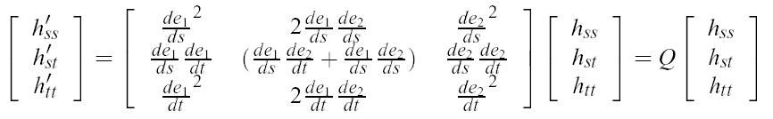


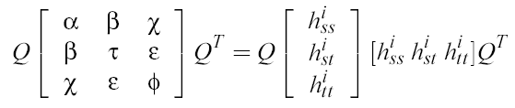

Affine Transformation Rule
Linear system of untransformed second derivatives:
Thus H can be transformed via
yielding
Summary:
Canonical triangle
New parameterization
Notes:
Where e is a local affine transform from the new triangle parameterization to the old, resulting in the new map: h’ = h . E
Components of the jacobian

Slide 24
Relationship to Approximation Theory
Approximation Thoery [Nadler 1986]
Goal: Approximate some bivariate scalar function g(x,y) using linear interpolation with a given number of triangles over the (x,y) plane.
Result Can minimize the error of piecewise linear approximation (L₂ sense) by [Nadler, 1986]:
As number of triangles
  An optimal orientation of a triangle is given by the eigenvectors of the Hessian of g
  An optimal aspect ratio of a triangle is given by:
Notes:
Locally minimizing our metric provides a good piecewise linear approximation of the surface signal
So the solutions are long and narrow in the directions of minimum and maximum second directional derivatives
Being inscribed in elipses with axes in these directions.
Long thin sliver triangles. Slivers can be bad in certain contexts but for our goal of minimizing the signal stretch error, they are optimal.

Slide 25



Correspondence with Nadler’s Result
If this bivariate scalar function is quadratic:
Hessian of g:
Nadler’s result: optimal triangles are axis aligned and with aspect ratio
These solutions minimize our energy functional
Notes:
Evaluting over canonical square

Slide 26
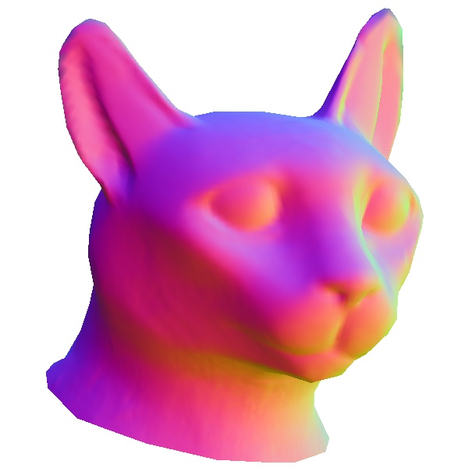
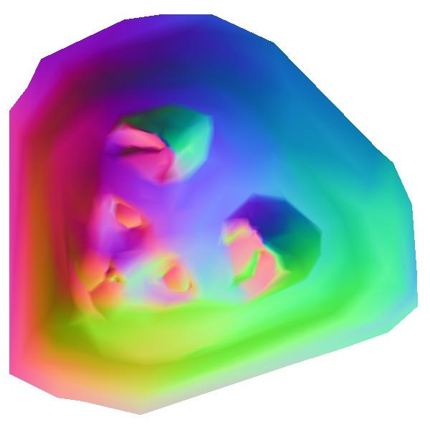
Experiments
Signal Approximation Error (SAE): RMS difference between the original signal and its bilinear reconstruction.
We compare our results with the signal-stretch metric of Sander et al. [2002]
Assume: linear
signal
Parameterization algorithm
reconstruction
reconstructed
surface
Hardware: Bilinear
Notes:
Root mean squared

Slide 27
Parasaur head
Sander et al.
Ours
Factor of 4 savings in texture area

Slide 28
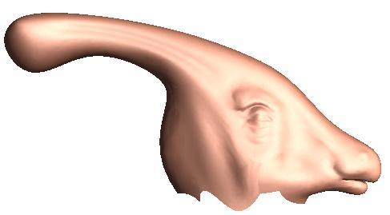
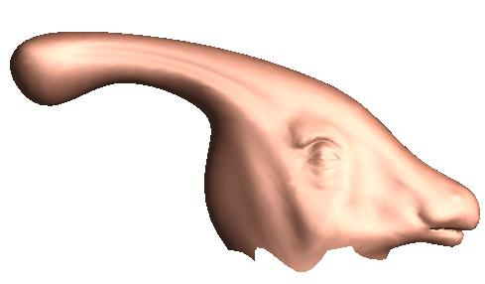
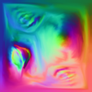
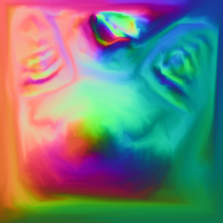
Sander et al.
Ours
SAE: 17.6
SAE: 11.5
128x128
256x256
Signal consists of surface normal.
Signal is obtained by normal-shooting from geometry to a high resolution mesh.

Slide 29
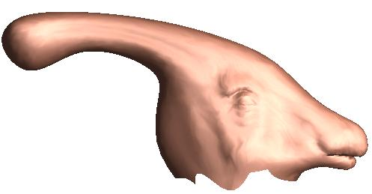
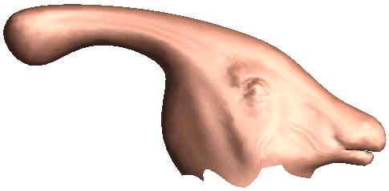

Parasaur head
Sander et al.
Ours
64x64
64x64
SAE: 11.5
SAE: 17.6
Signal consists of surface normal.
Signal is obtained by normal-shooting from geometry to a high resolution mesh.

Slide 30
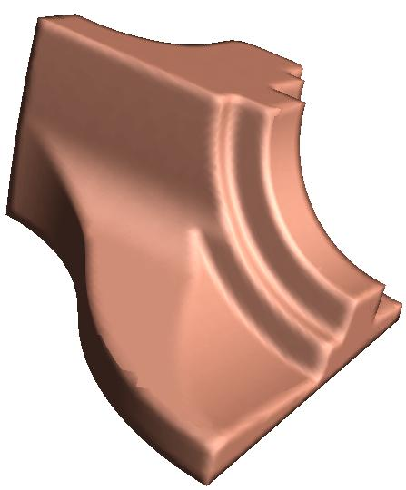
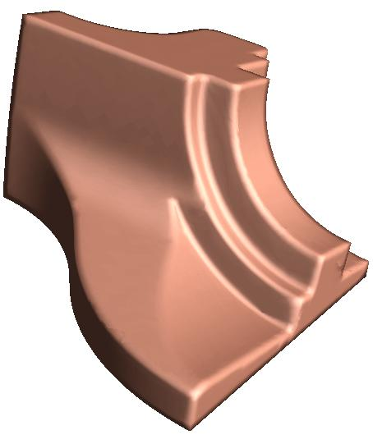


Fandisk
Sander et al.
Ours
128x128
128x128
SAE: 5.3
SAE: 2.9
Signal consists of surface normal.

Slide 31
Experiments
Sander et al. add in some amount of geometric stretch into their energy measure.
Geometric stretch serves two main purposes:
  It is needed by the solver to ensure enough space to place a vertex during multigrid refinement.
  It acts as regularizer which smooths out the result
In our experiments with:
  The fandisk: we use the minimum amount of geometric stretch needed for the multigrid solver to produce a valid parameterization.
  The parasaur’s head: no geometric stretch is needed.

Slide 32
Impact of Geometric Stretch
The amount of geometric stretch added depends upon the scale of the error functional and varies from model to model.
We examined the impact of adding geometric stretch to signal error on SAE.
Some optimal amount of geometric stretch
Cat Model (1000 vertices, Resolution 128x128)

Slide 33
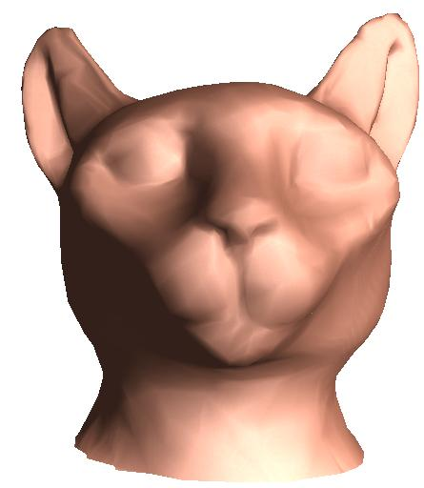
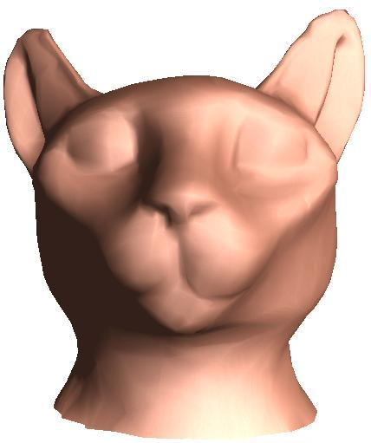


Cat head
Comparison of parameterizations created by both metrics combined with their optimal geometric stretch values (predetermined experimentally).
Sander et al.
Ours
64x64
64x64
SAE: 10.7
SAE: 9.1
Signal consists of surface normal.
Signal is obtained by normal-shooting from geometry to a high resolution mesh.

Slide 34
Timing Comparison (seconds)
Model | #Vertices | #Charts | Sander et al. (seconds) | Ours (seconds)
Parasaur’s head | 3,800 | 1 | 50 | 100
Face | 5,000 | 1 | 120 | 200
Cat | 1,000 | 1 | 10 | 25
Fandisk | 6,475 | 4 | 170 | 210

Slide 35
Comparison with Previous Work
Comparison Measure | Terzopoulos & Vasilescue 1991 | Sloan et al. 1998 | Hunter & Cohen 2000 | Balmelli et al. 2002 | Sander et al. 2002 |  | Ours
Applications | Adaptive sampling and reconstruction | Compact Texture Maps
Metric | Adjustable spring energy | Wavelets & User- specified scalar importance | Fourier | Wavelets | SAE (1st order Taylor) | SAE (2nd order Taylor)
Remarks | Requires optimization procedure | Allows user control | Fast greedy algorithm | Texture deviation | Constant re-construction Captures signal anisotropy | Linear re-constriction Slower
Notes:
Texture deviation: distortion in the limit
Terzopoulos and Vasilescu 1991
Approximate 2D image with warped grid using local complexity adjustment based on properties of input data.
Sloan et al. 1998
Warp texture domain onto itself guided by importance map.
Hunter and Cohen 2000
Compress image as set of texture-mapped rectangles to create uniform frequency images.
Balmelli et al. 2002
Warp texture on a separate grid and resample to create space-optimized texture maps.
Sander et al. 2002
Propose a metric for signal-specialized parameterization, assuming
piecewise constant reconstruction.

Slide 36
Conclusions and Future Work
Significant savings in texture space for the same level of signal approximation error compared to metric by Sander et al.
Future Directions
  Perceptual measures
  More optimal treatment of signal discontinuity.
  Non-asymptotic analysis.
  Optimization of texture samples.
Notes:
How smooth must the signal be to get benefit out of higher-order reconstruction?
Some other optimiation that sldes the samples around to out

