Slide 1
Poisson Surface Reconstruction and its Applications
Hugues Hoppe
Microsoft Research
SPM 2008

Slide 2
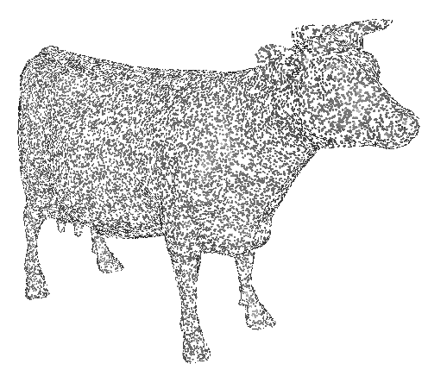
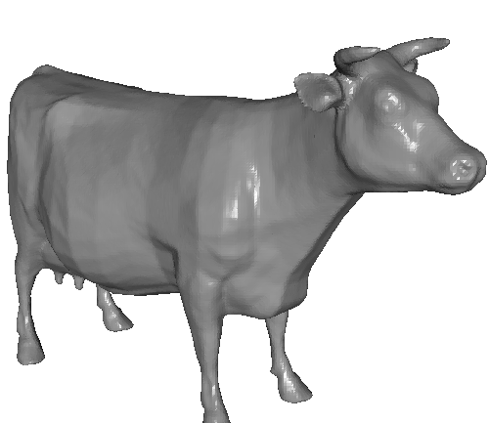
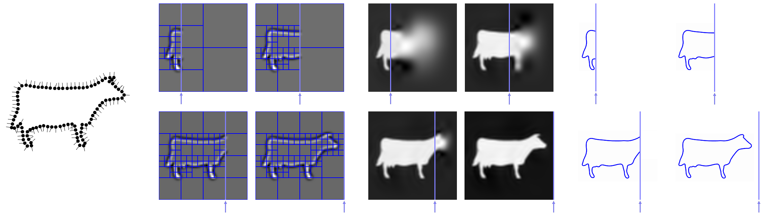
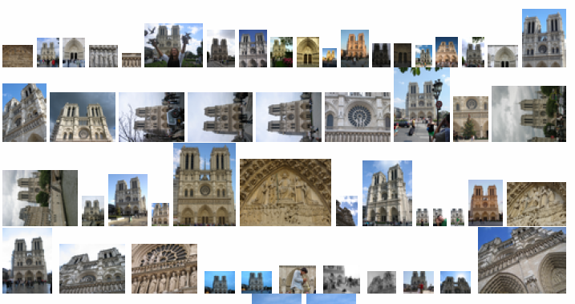
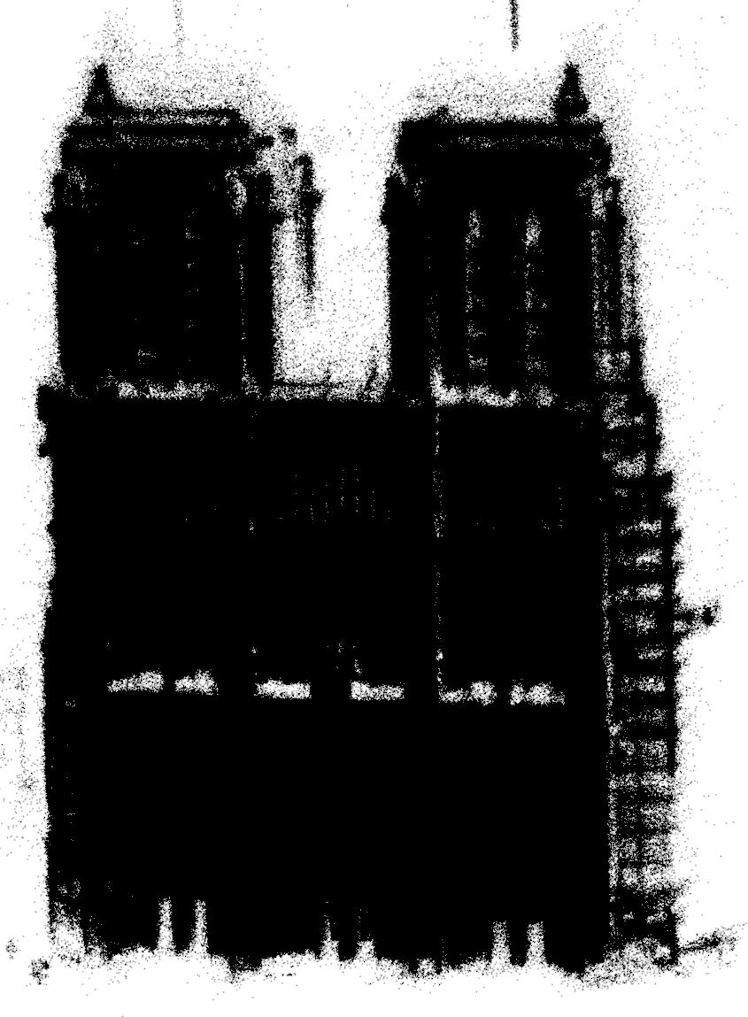
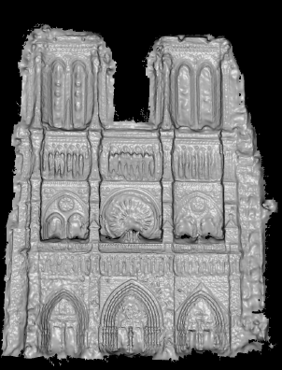
Poisson surface reconstruction
[Kazhdan, Bolitho, Hoppe. SGP 2006]
Multilevel streaming for out-of-core surface reconstruction
[Bolitho, Kazhdan, Burns, Hoppe. SGP 2007]
Multi-view stereo for community photo collections
[Goesele, Snavely, Curless, Hoppe, Seitz. ICCV 2007]

Slide 3
Poisson Surface
Reconstruction
Michael Kazhdan,
Matthew Bolitho,
Hugues Hoppe

Slide 4
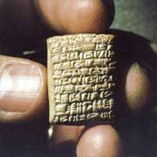
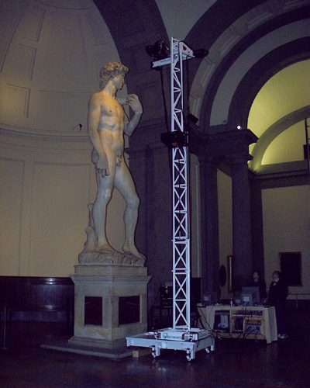
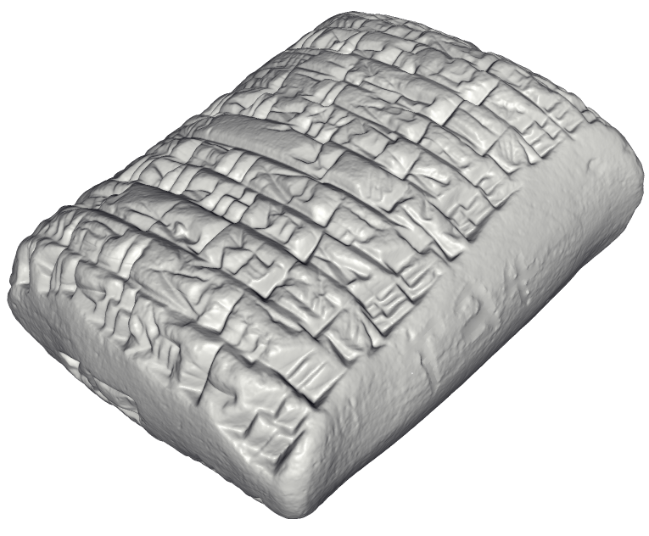
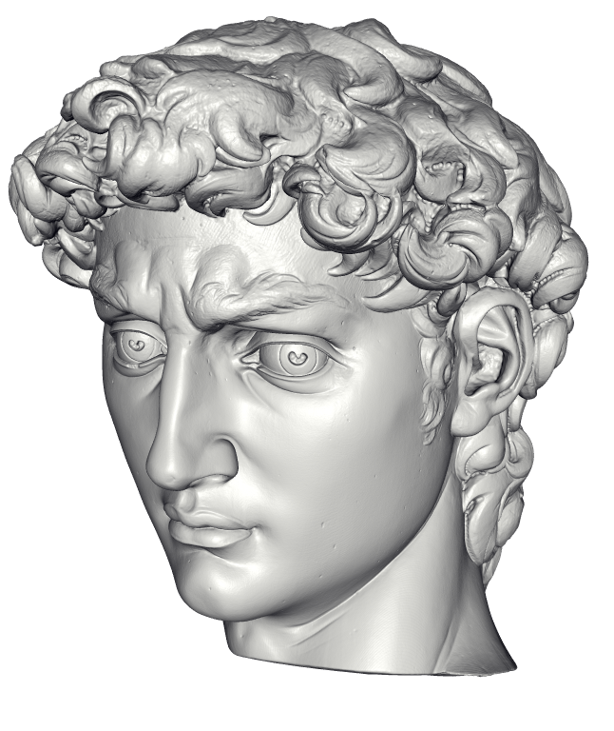
Motivation
http://www.jhu.edu/digitalhammurabi/
http://graphics.stanford.edu/projects/mich/
Archaeology
Cultural heritage
Reverse engineering
Films
Virtual environments
Medical imaging
Game content

Slide 5
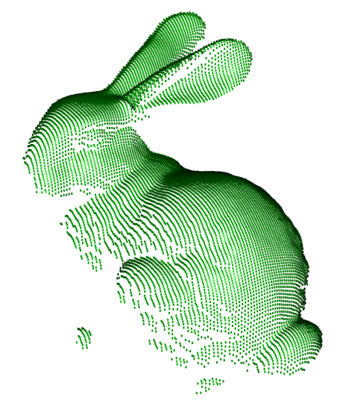
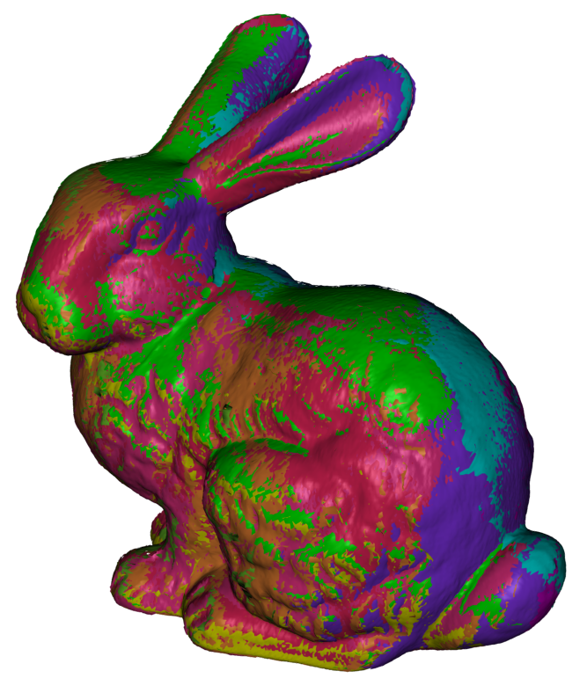
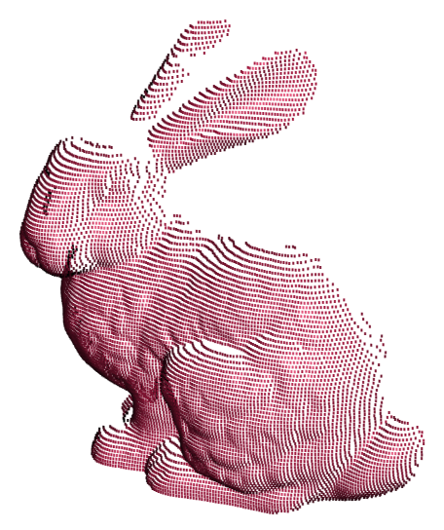
Reconstruction difficulties
Only local connectivity
Misregistration
Noisy data
Non-uniform sampling
Unsampled regions

Slide 6
General approaches
Computational geometry
    Boissonnat, 1984 Edelsbrunner, 1984
    Amenta et al., 1998 Dey et al., 2003
Parametric surface fitting
    Terzopoulos et al., 1991 Chen et al., 1995
Implicit function fitting
    Hoppe et al., 1992 Curless et al., 1996
    Whitaker, 1998 Carr et al., 2001
    Davis et al., 2002 Ohtake et al., 2004
    Turk et al., 2004 Shen et al., 2004
    Kazhdan, 2005 …

Slide 7
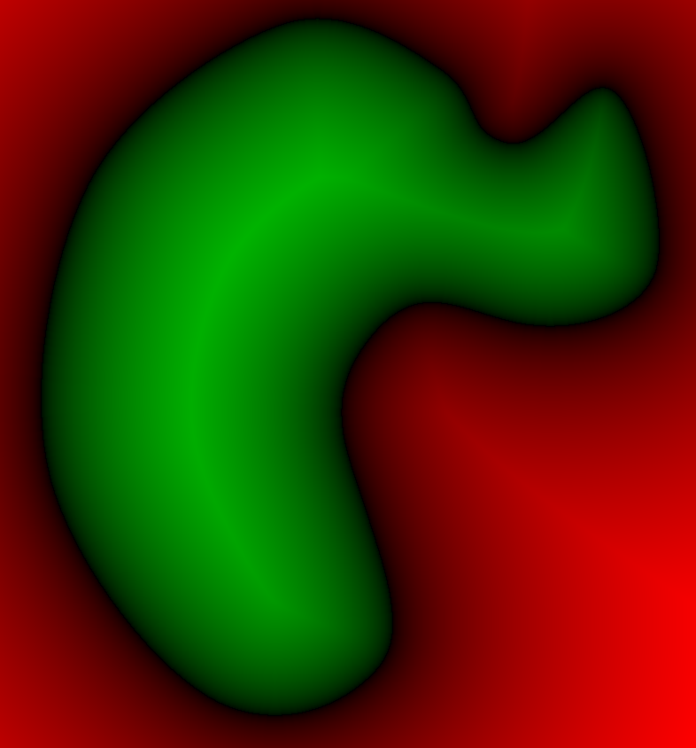
Implicit function approach
Define a function with value less than zero outside the model, and greater than zero inside.
Extract the zero set.
< 0
0
> 0

Slide 8
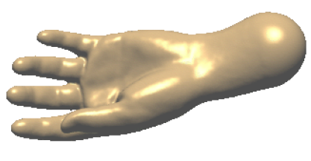
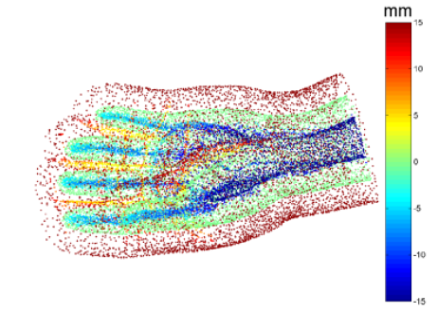
Tradeoffs: Global schemes
+ Considers all points together
– Involves large, dense system
– Difficult to control surface away from samples
Carr et al. 2001, FastRBF

Slide 9
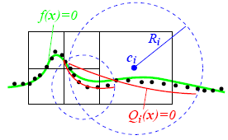
Tradeoffs: Local schemes
+ Only consider local neighborhood → fast
– Less robust to noise, outliers, misregistration, …
Ohtake et al. 2004, MPU

Slide 10
Our scheme
Global formulation for robustness
Sparse linear system for efficiency

Slide 11
Poisson surface reconstruction
0
0
0
α(s)
0
s.p
1
0
1
1
0
1
0
0
1
1
0
0
Unknown manifold
Indicator function
Indicator gradient
Oriented points
M
χ_{M}
∇χ_{M}
S
where
(least-squares solution)
(a Poisson equation)

Slide 12
Poisson approach
Represent the points by a vector field V.
Find the function χ whose gradient
best approximates V:
i.e. solve the Poisson equation:
Extract the isosurface χ⁻¹(0.5).

Slide 13
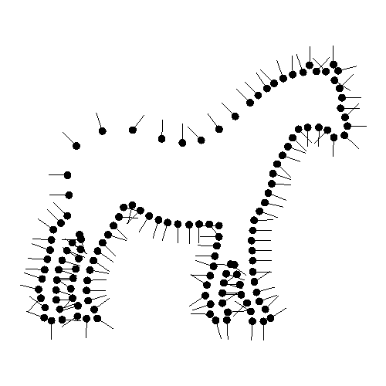
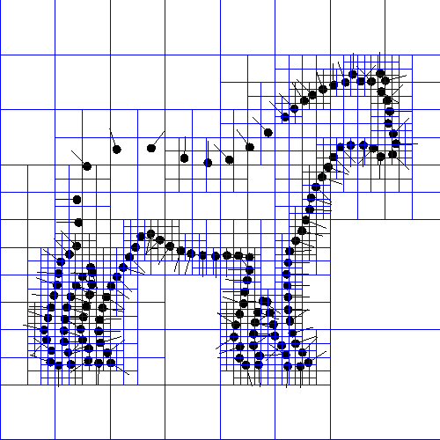
Discretization
Define function space for χ and V:
tensor-product B-splines (of degree 2) in 3D.
Accurate solution only needed near surface
→ sparse basis over adaptive octree

Slide 14
Implementation
Given the points:
Set octree
Compute vector field
Compute indicator function
Extract isosurface

Slide 15
Implementation: Adapted octree
Given the points:
Set octree
Compute vector field
Compute indicator function
Extract isosurface

Slide 16
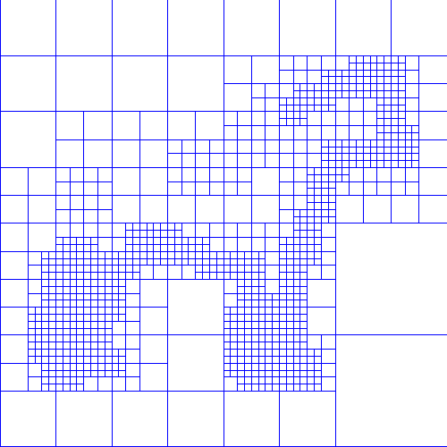

Implementation: Vector field
Given the points:
Set octree
Compute vector field
  Define a function space
  Splat the samples
Compute indicator function
Extract isosurface

Slide 17

Implementation: Vector field
Given the points:
Set octree
Compute vector field
  Define a function space
  Splat the samples
Compute indicator function
Extract isosurface

Slide 18

Implementation: Vector field
Given the points:
Set octree
Compute vector field
  Define a function space
  Splat the samples
Compute indicator function
Extract isosurface

Slide 19

Implementation: Vector field
Given the points:
Set octree
Compute vector field
  Define a function space
  Splat the samples
Compute indicator function
Extract isosurface

Slide 20
Implementation: Vector field
Given the points:
Set octree
Compute vector field
  Define a function basis
  Splat the samples
Compute indicator function
Extract isosurface

Slide 21
Implementation: Vector field
Given the points:
Set octree
Compute vector field
  Define a function basis
  Splat the samples
Compute indicator function
Extract isosurface

Slide 22
Implementation: Vector field
Given the points:
Set octree
Compute vector field
  Define a function basis
  Splat the samples
Compute indicator function
Extract isosurface

Slide 23
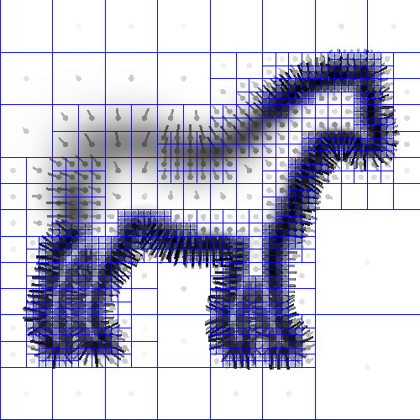
Implementation: Vector field
Given the points:
Set octree
Compute vector field
  Define a function space
  Splat the samples
Compute indicator function
Extract isosurface

Slide 24
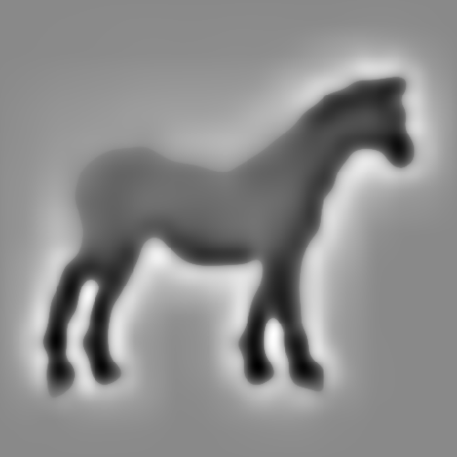
Implementation: Indicator function
Given the points:
Set octree
Compute vector field
Compute indicator function
  Compute divergence
  Solve Poisson equation
Extract isosurface

Slide 25
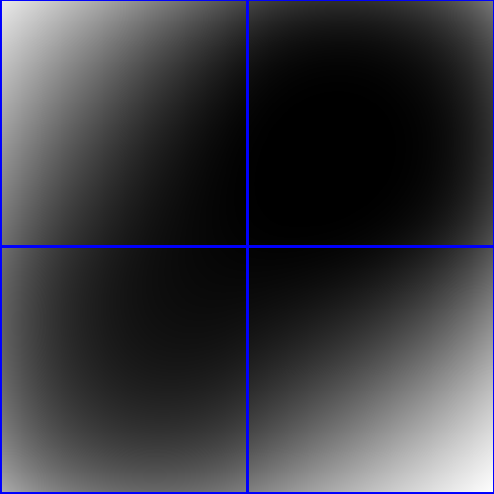
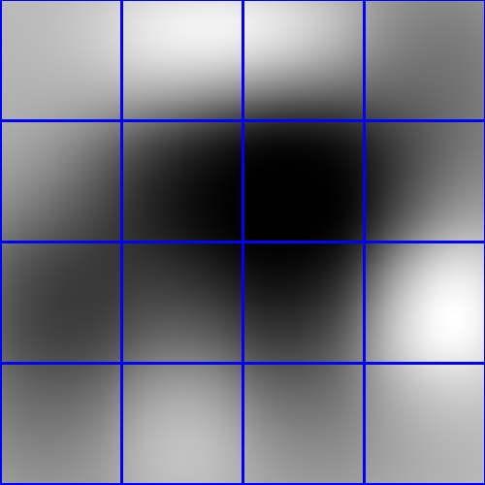
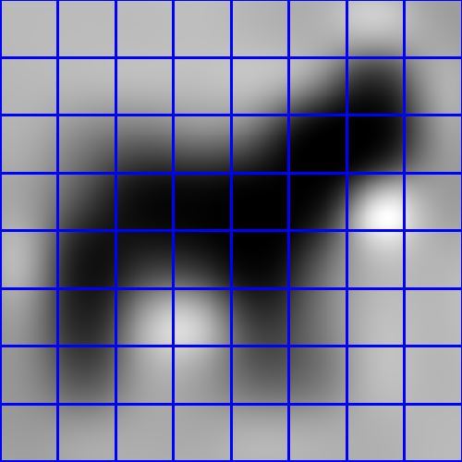
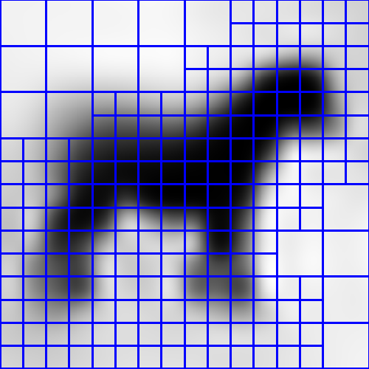
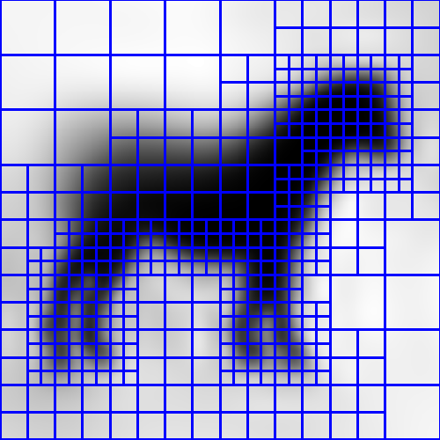
Implementation: Indicator function
Given the points:
Set octree
Compute vector field
Compute indicator function
  Compute divergence
  Solve Poisson equation
Extract isosurface

Slide 26
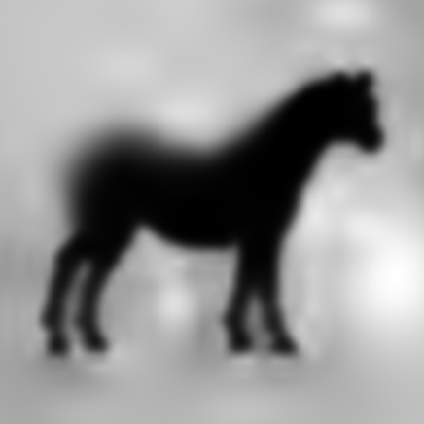
Implementation: Indicator function
Given the points:
Set octree
Compute vector field
Compute indicator function
  Compute divergence
  Solve Poisson equation
Extract isosurface

Slide 27
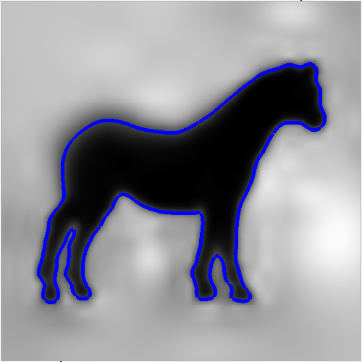
Implementation: Surface extraction
Given the points:
Set octree
Compute vector field
Compute indicator function
Extract isosurface

Slide 28
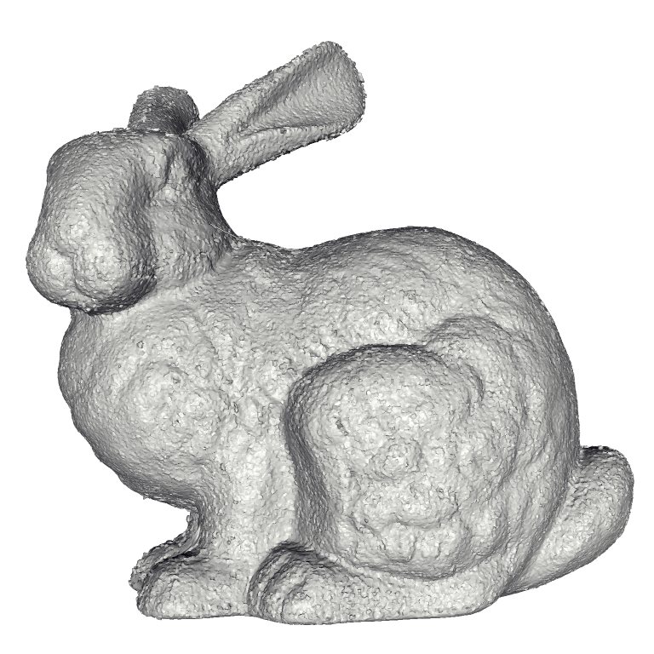
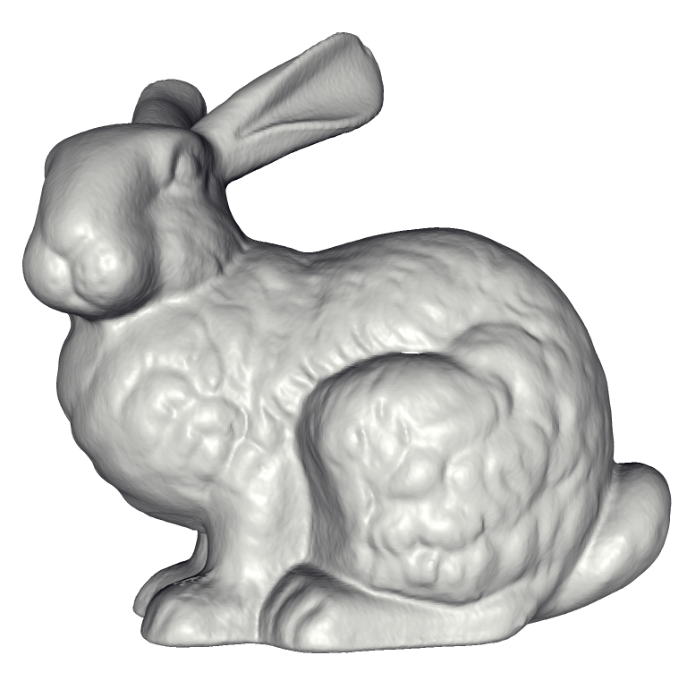
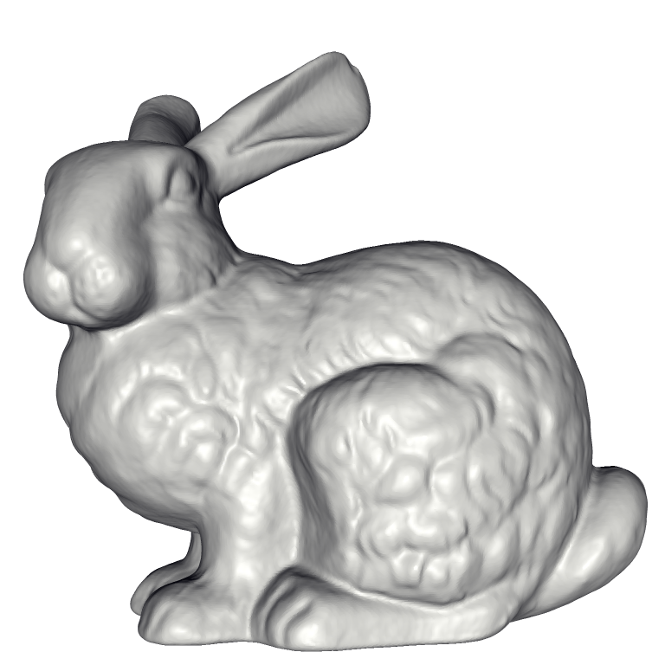
Comparison to earlier work
Power Crust
FastRBF
MPU
VRIP
FFT Reconstruction
Our Method

Slide 29
Performance comparison (on bunny)
Method | Triangles | Time (s) | Memory (MB)
Power Crust | 554,332 | 380 | 2653
Robust Cocone | 272,662 | 892 | 544
FastRBF | 1,798,154 | 4919 | 796
MPU | 925,240 | 28 | 260
Hoppe et al 1992 | 950,562 | 70 | 330
VRIP | 1,038,055 | 86 | 186
Kazhdan 2005 | 910,320 | 125 | 1684
Our Method | 911,390 | 263 | 310

Slide 30
VRIP comparison
VRIP
Our Method

Slide 31
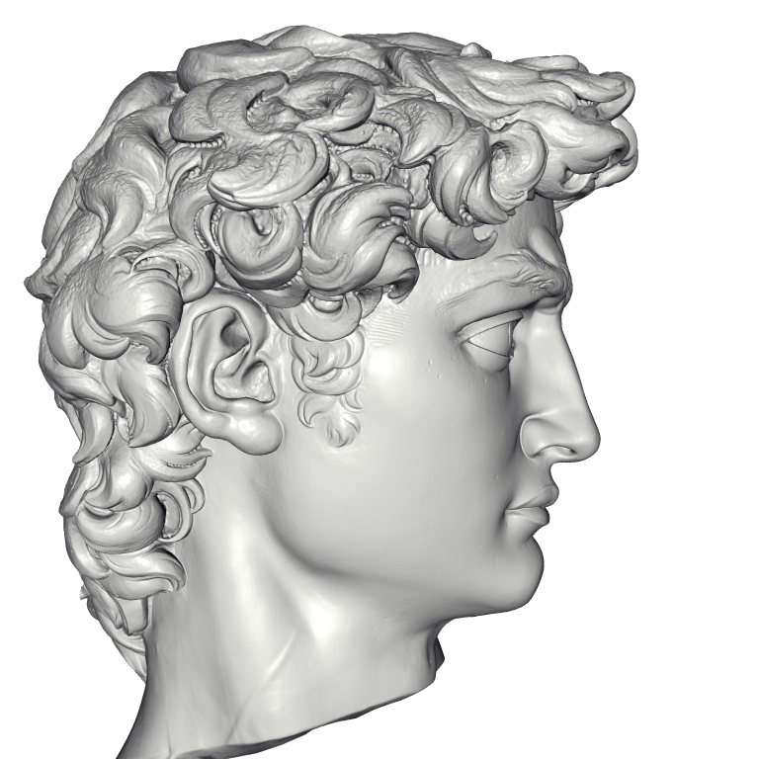
Result: Michelangelo’s David
215 million data points
from 1000 scans
22 million triangle reconstruction
Compute Time: 2.1 hours
Peak Memory: 6600MB

Slide 32
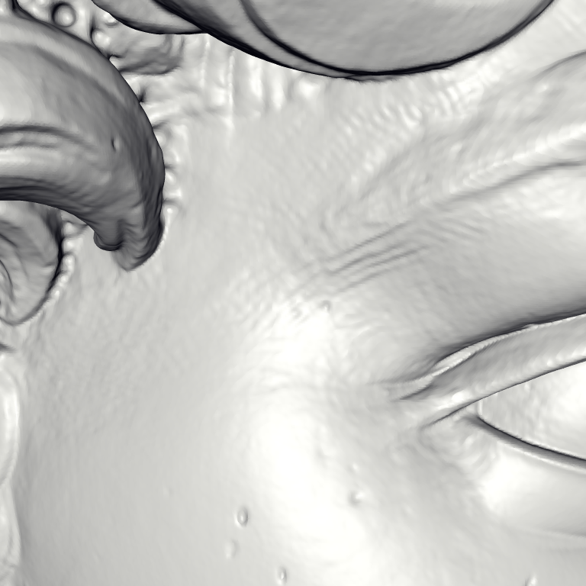
David – chisel marks

Slide 33
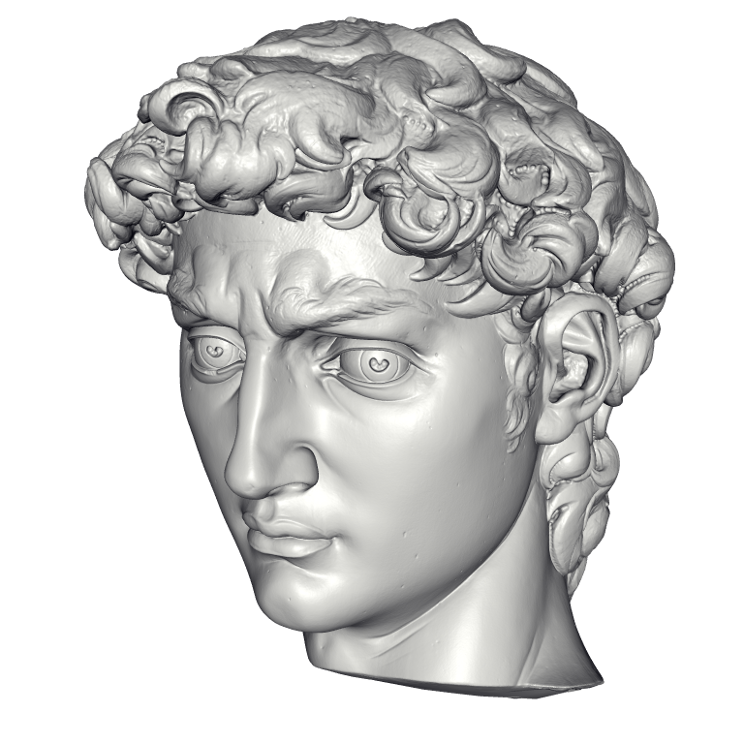
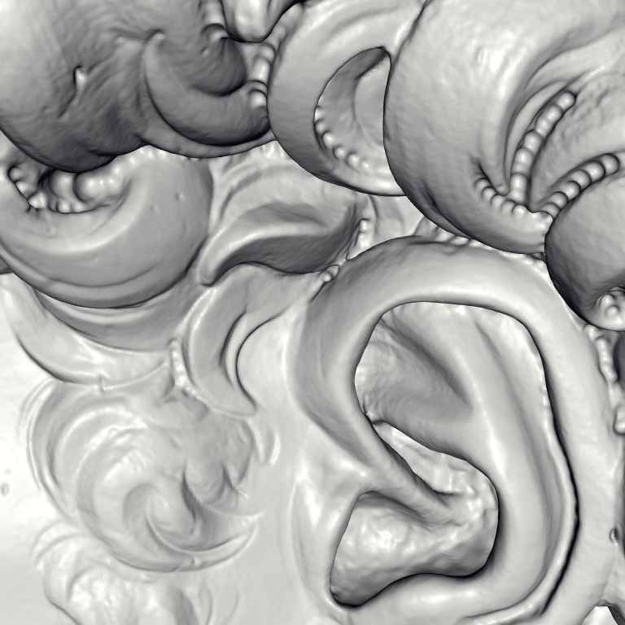
David – drill marks

Slide 34
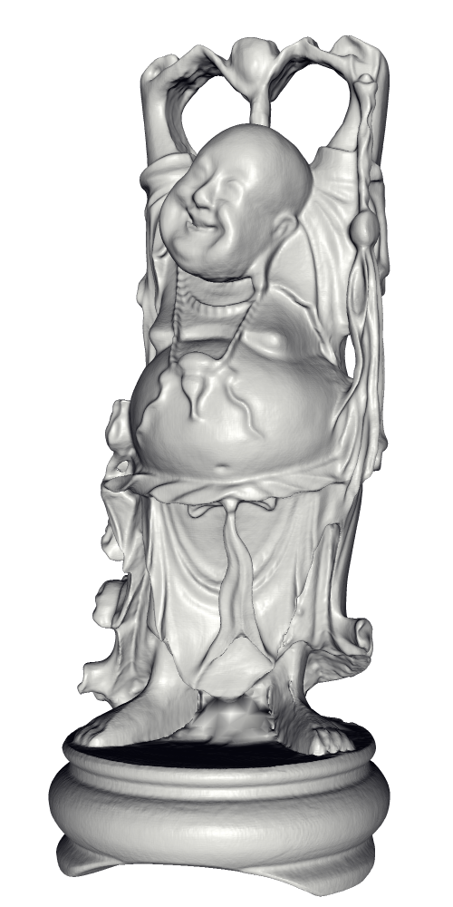
Scalability – Buddha model

Slide 35
Conclusion
Theoretical contributions:
  Oriented point samples ⇔ indicator gradient
  Reconstruction as global Poisson problem
  Yet sparse system
Empirical advantages:
  Robustness to noise
  Adaptive to sampling density

Slide 36
Multilevel Streaming for Out-of-Core
Surface Reconstruction
Matthew Bolitho,
Michael Kazhdan,
Randal Burns,
Hugues Hoppe

Slide 37
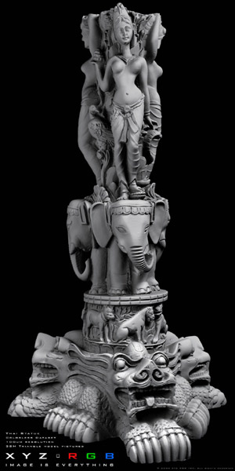
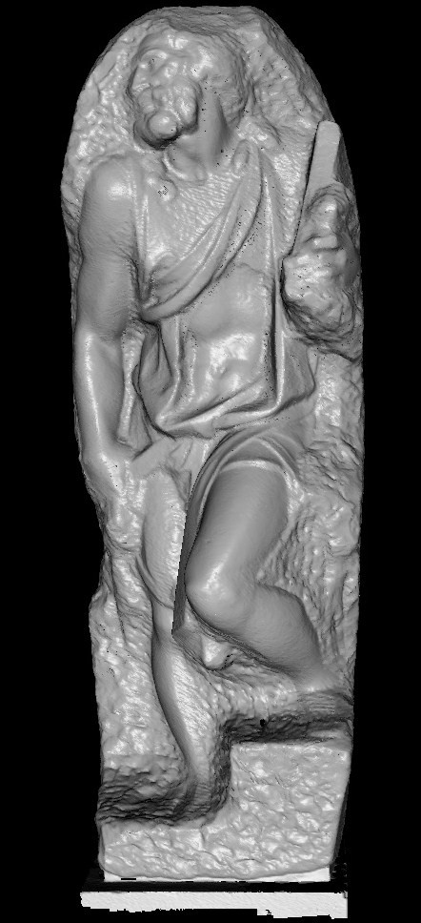
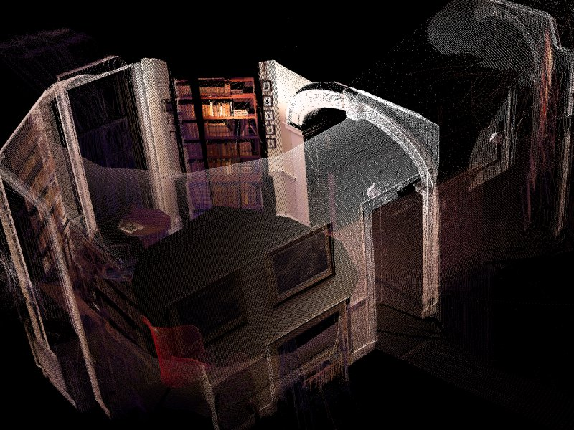
Motivation
UVA Monticello: 2.0x10⁷ points
XYZRGB Thai Statue:
3.4x10⁷ points
Stanford St. Mathew:
1.8x10⁸ points
So large that it is difficult to maintain the dataset
(let alone the data-structure) in working memory.

Slide 38
Streaming idea
Define traversal ordering
Perform local processing (in working set)
[Pajarola, 2005]

Slide 39
Earlier streaming applications
Simplification [Wu and Kobbelt, 2003]
Compression [Isenberg and Gumhold, 2003]
Smoothing [Pajarola, 2005]
Remeshing [Anh et al. 2006]
…

Slide 40
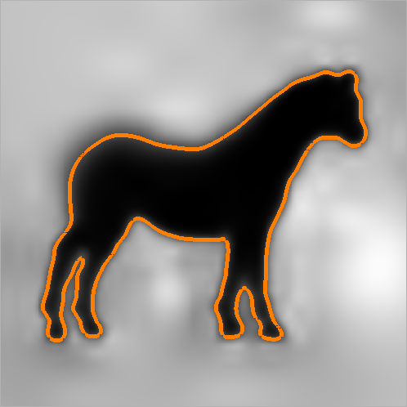
Poisson surface reconstruction
  (1) Splat samples to vector field
  (2) Compute divergence
  (3) Solve Poisson equation
  (4) Extract isosurface
(1)
(2)
(3)
(4)

Slide 41
Challenges
Data structure:
  Allow streaming over adaptive octree.
Algorithm:
  Implement all steps as streaming processes.

Slide 42
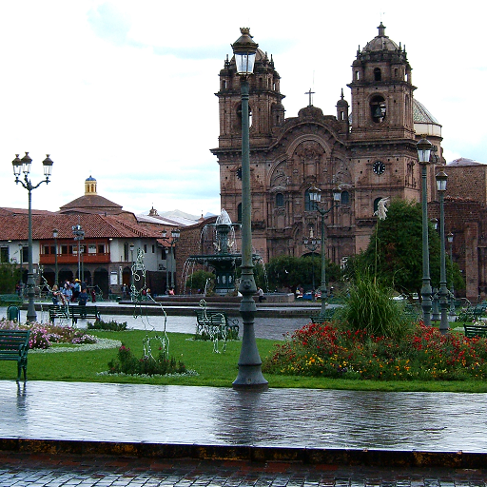
Streaming the octree
Regular grid
  Store as a set of successive pixel columns.
  Stream across x-axis, reading/writing blocks.

Slide 43
Streaming the octree
Regular grid
  Store as a set of successive pixel columns.
  Stream across x-axis, reading/writing blocks.
x=0
x=1
x=2

Slide 44
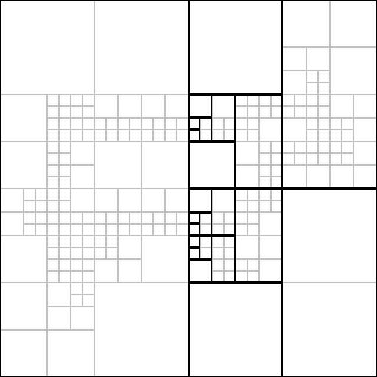
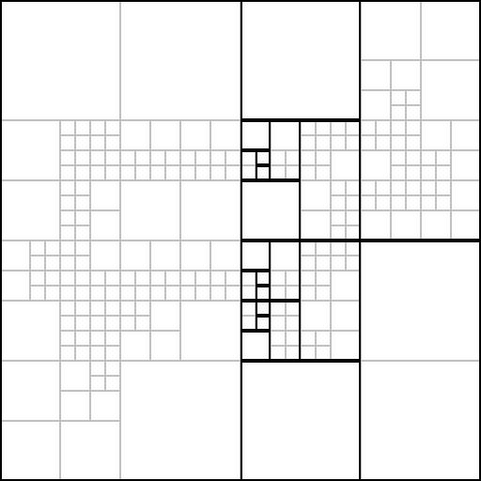
Streaming the octree
Adaptive octree
  Nodes at different depths persist for
  different time-spans.
x_{i}
x_{i+1}

Slide 45
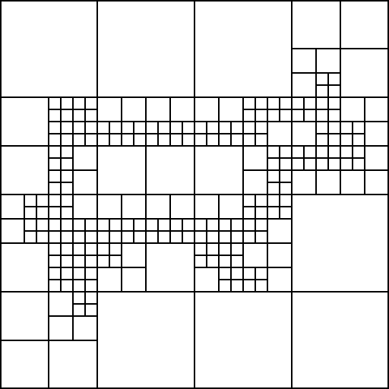

Streaming the octree
Adaptive octree
  Nodes at different depths persist for
  different time-spans.
  Define a separate stream for each depth.
d=0
d=1
d=2
d=3
d=4
d=5
Data Streams
Octree

Slide 46
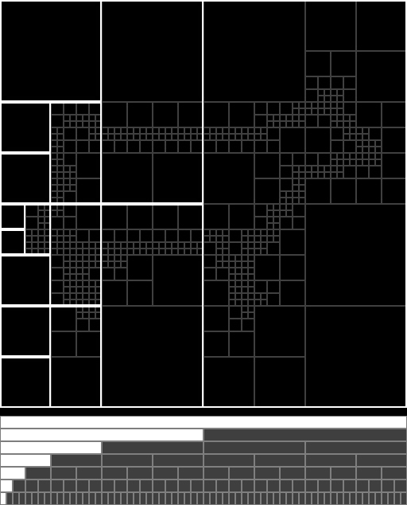
Streaming the octree
Advance through the streams at different speeds.
“Multi-level stream”

Slide 47
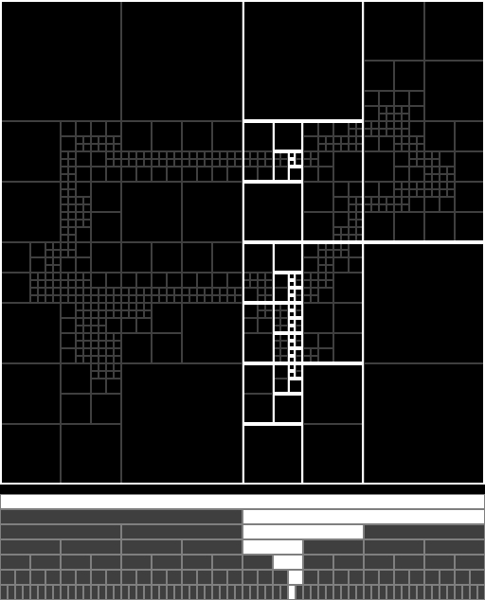
Streaming the octree
Advance through the streams at different speeds.
“Multi-level stream”
For an octree of height h:
- Resolution: r=2^{h}
- Domain grid O(r³)
- Octree size: O(r²)
- Working memory: O(r)
h
r

Slide 48
Challenges
Data structure:
  Allow streaming over adaptive octree.
Algorithm:
  Implement all steps as streaming processes.

Slide 49
Streaming the reconstruction
  (1) Splat samples to vector field
  (2) Compute divergence
  (3) Solve Poisson equation
  (4) Extract isosurface
✓
✓
?
not a local
process!
✓
(1)
(2)
(3)
(4)

Slide 50
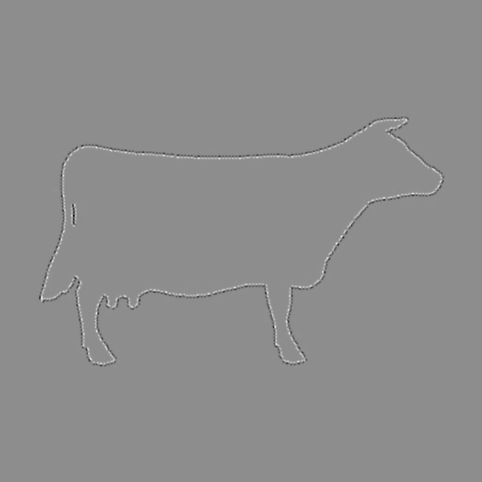
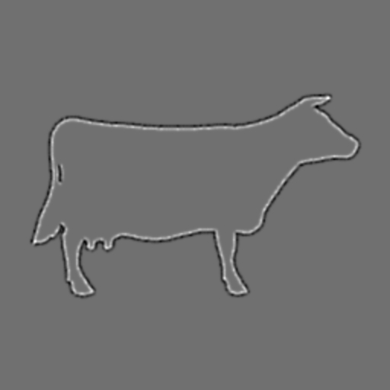

Streaming the solver
>2500 Gauss-Seidel
iterations
Iterative solvers can be implemented out-of-core
But, very slow convergence

Slide 51
Cascadic multigrid
Use streaming Gauss-Seidel solver.
Transfer coarser solution to trailing finer solver.
→ single “multi-level” streaming pass.
Sufficient accuracy in one pass!
  Only need precision near χ=0.5, where large ∇χ.

Slide 52
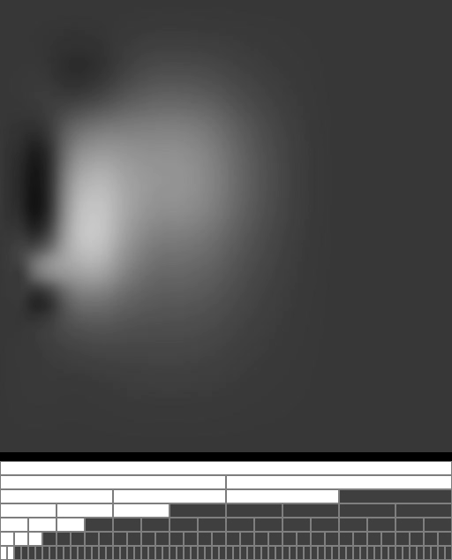
Single multi-level streaming pass
High-res solutions trail
the low-res solutions.

Slide 53

Total of 3 passes
(1) Construct octree & splat vector field.
(2) Accumulate divergence & solve Poisson equation.
(3) Extract isosurface.
(1)
(2)
(3)

Slide 54

Result: David
Res. | Octree space | Peak memory | Running time
256 | 48 49 | 521 309 | 0.53 0.50
512 | 168 188 | 278 442 | 0.68 0.65
1024 | 702 818 | 213 1,285 | 1.20 1.05
2048 | 3,070 3,695 | 212 4,442 | 3.33 2.65
4096 | 13,367 - | 427 - | 12.6 -
8192 | 39,452 - | 780 - | 32.3 -
Res. | Octree space | Peak memory | Running time
256 | 48 49 | 521 309 | 0.53 0.50
512 | 168 188 | 278 442 | 0.68 0.65
1024 | 702 818 | 213 1,285 | 1.20 1.05
2048 | 3,070 3,695 | 212 4,442 | 3.33 2.65
4096 | 13,367 - | 427 - | 12.6 -
8192 | 39,452 - | 780 - | 32.3 -
Out-of-core reconstruction
216x10⁶ points (4.8 GB)
In-core reconstruction

Slide 55




David comparison
In-core reconstruction
Peak memory: 4.4 GB
Out-of-core reconstruction
Peak memory: 0.8 GB

Slide 56





Even larger example: St. Matthew
Points (391x10⁶) Triangles (431x10⁶) Octree space | 9.8 GB 7.8 GB 106 GB
Working memory |  | 2 GB
…
Memory footprint smaller than:
  Size of input point set
  Size of output surface

Slide 57
Multi-View Stereo for
Community
Photo Collections
Michael Goesele
Noah Snavely
Brian Curless
Hugues Hoppe
Steven Seitz

Slide 58
Somehow avoid the laser scanner?

Slide 59


Photos from community collection

Slide 60


Multi-view stereo for CPC
Photo Tourism
Recover camera poses
and scene points (SfM)
[Snavely et al. 2006]
Multi-view stereo
Extract dense
set of points
Poisson reconstr.
Compute
surface
[Kazhdan et al. 2006]

Slide 61



Classical multi-view stereo
Reference view
Neighboring views
Typically, laboratory conditions.

Slide 62


Challenges for Community Photo Collections
Tremendous variation due to
  photographers and cameras
  time of day, lighting, weather
  foreground clutter
  scale
Reference view
Neighboring views

Slide 63
Optimizing per-pixel depth
Planar, Lambertian patch (5x5 pixels)
  Depth
  Normal
  Color scale per
  neighboring view
Iterative least-square optimization
  Replace outliers views
RGB
RGB

Slide 64




Prioritized region-growing
[Otto and Chao 1989]
Reference view
(Color code: confidence values)

Slide 65

Result : Notre Dame de Paris
653 images
313 photographers

Slide 66


Slide 67


Slide 68


































































































































Venus de Milo
129 images taken by 98 photographers

Slide 69
Venus de Milo

Slide 70



















































Duomo in Pisa
56 images taken by 8 photographers

Slide 71



Duomo (Pisa)
90% of reconstruction within 12.8 cm of ground truth
for a 51 m tall building using the metric of [Seitz et al. 2006]

Slide 72
Summary and future work
Poisson surface reconstruction
Multilevel streaming for out-of-core surface reconstruction
Multi-view stereo for community photo collections
- Higher dimensions?
- Temporal data?
- Parallel processing?
- Colored surfaces?

Slide 73







Thanks to my collaborators
Misha Kazhdan
Matt Bolitho
Randal Burns
Johns Hopkins University
Michael Goesele
Noah Snavely
Brian Curless
Steve Seitz
University of Darmstadt
University of Washington

Slide 74
Resource
Poisson surface reconstruction
source code:
  http://www.cs.jhu.edu/~misha/Code/
Thank you!

