Slide 1
Distributed Gradient-Domain Processing of Planar and Spherical Images
Michael Kazhdan Dinoj Surendran Hugues Hoppe
Johns Hopkins Univ.
Microsoft Research
Notes:
Good morning.
In this talk I will describe work, done in collaboration with Dinoj Surendran and Hugues Hoppe from Microsoft Research, on designing a distributed solver for processing huge planar and spherical imagery.

Slide 2
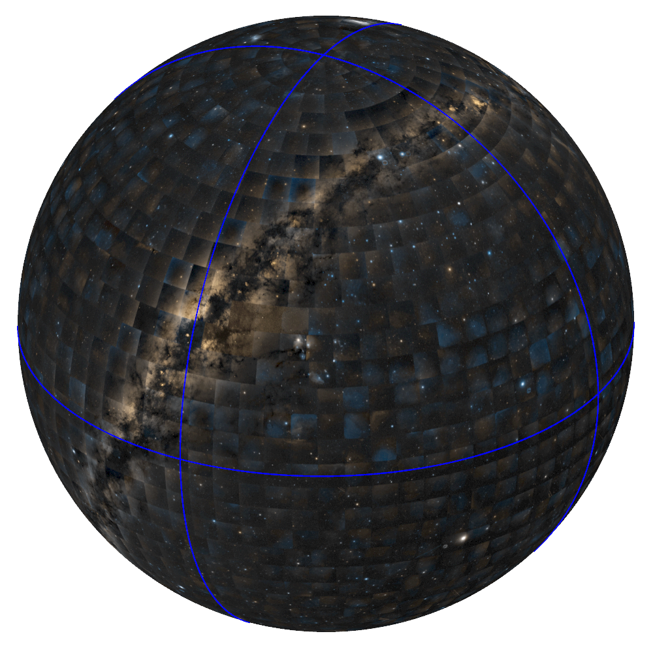
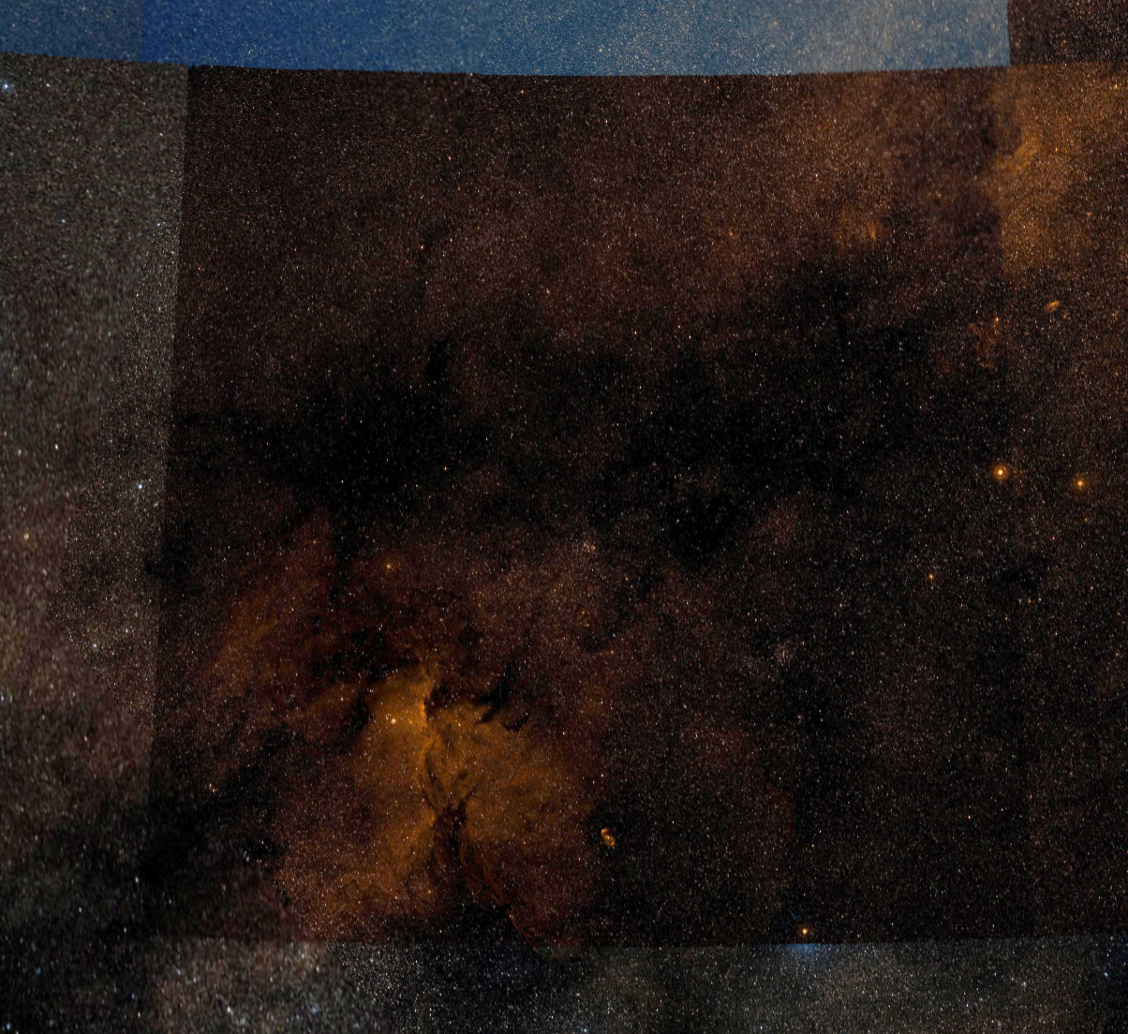
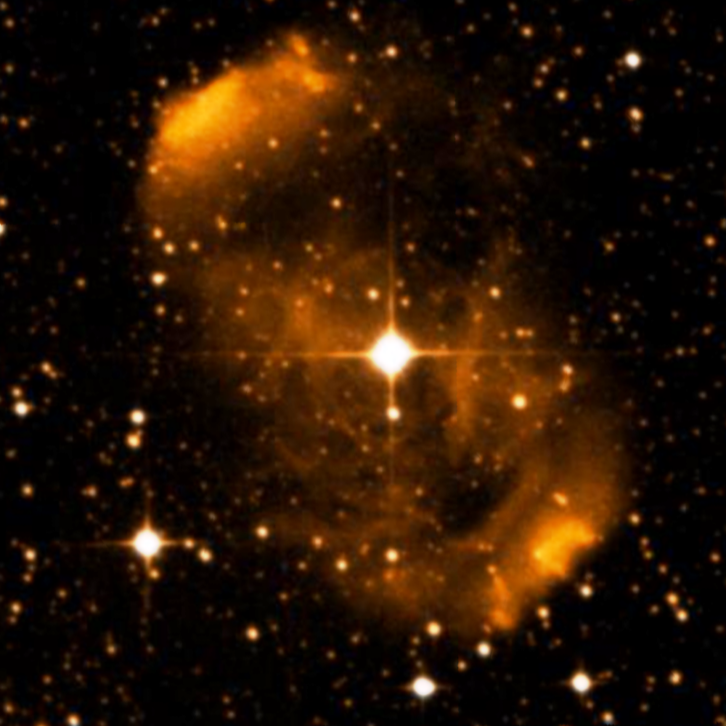
Motivation
Digitized Sky Survey:
2000 color plates
0.5 GP / plate
1 Terapixel spherical panorama
Goal:
Support image processing
Notes:
Our research is motivated by the Digitized Sky Survey.
A photographic atlas consisting of roughly 2000, half-gigapixel images.
[Click]
Considered together, these form a single terapixel panorama, providing a remarkably high-resolution image of the night sky.
Unfortunately, as you can see on the left, the varying exposure across the different images results in very apparent and unwanted seams.
In this work, our goal will be to remove these visual artifacts.
[Click]
We will do this by solving a more general problem – extending gradient-domain image-processing techniques to images of this shape and scale.

Slide 3
Gradient-Domain Image Processing
Gradient
Domain
Operator
Image₀
∇
Gradient
Domain
Operator
Image₀
∇
Grad₀
Grad₀
∇
∇
Solver
Image₁
Grad₁
Solver
Image₁
Grad₁
Grad
Image
Grad
Image
Image_{n}
∇
Grad_{n}
Image_{n}
∇
Grad_{n}
Notes:
To briefly review, gradient-domain processing works as follows:
[Click]
Starting with an image, or a set of images,
[Click]
We extract the gradients,
[Click]
Combine and modify them to obtain a gradient field characterizing the desired output,
[Click]
And then solve for the image satisfying the new gradient constraints.

Slide 4
Gradient-Domain Image Processing
Gradient
Domain
Operator
Image₀
∇
Gradient
Domain
Operator
Image₀
∇
Grad₀
Grad₀
∇
∇
Solver
Image₁
Grad₁
Solver
Image₁
Grad₁
Grad
Image
Grad
Image
Image_{n}
∇
Grad_{n}
Image_{n}
∇
Grad_{n}
Removing Lighting Effects
Range Compression
Image Compositing
Image Stitching
Saliency Modulation
[Horn ’74, Weiss ’01, Finlayson ’02, Agrawal ’05]
[Fattal ’02, Weyrich ’07]
[Perez ’03, Agarwala ’04, Jia ’06]
[Levin ’04, Agarwala ’07]
[Bhat ’08]
Notes:
Previous works have shown that by processing gradients in different ways, a variety of visual effects can be realized.

Slide 5
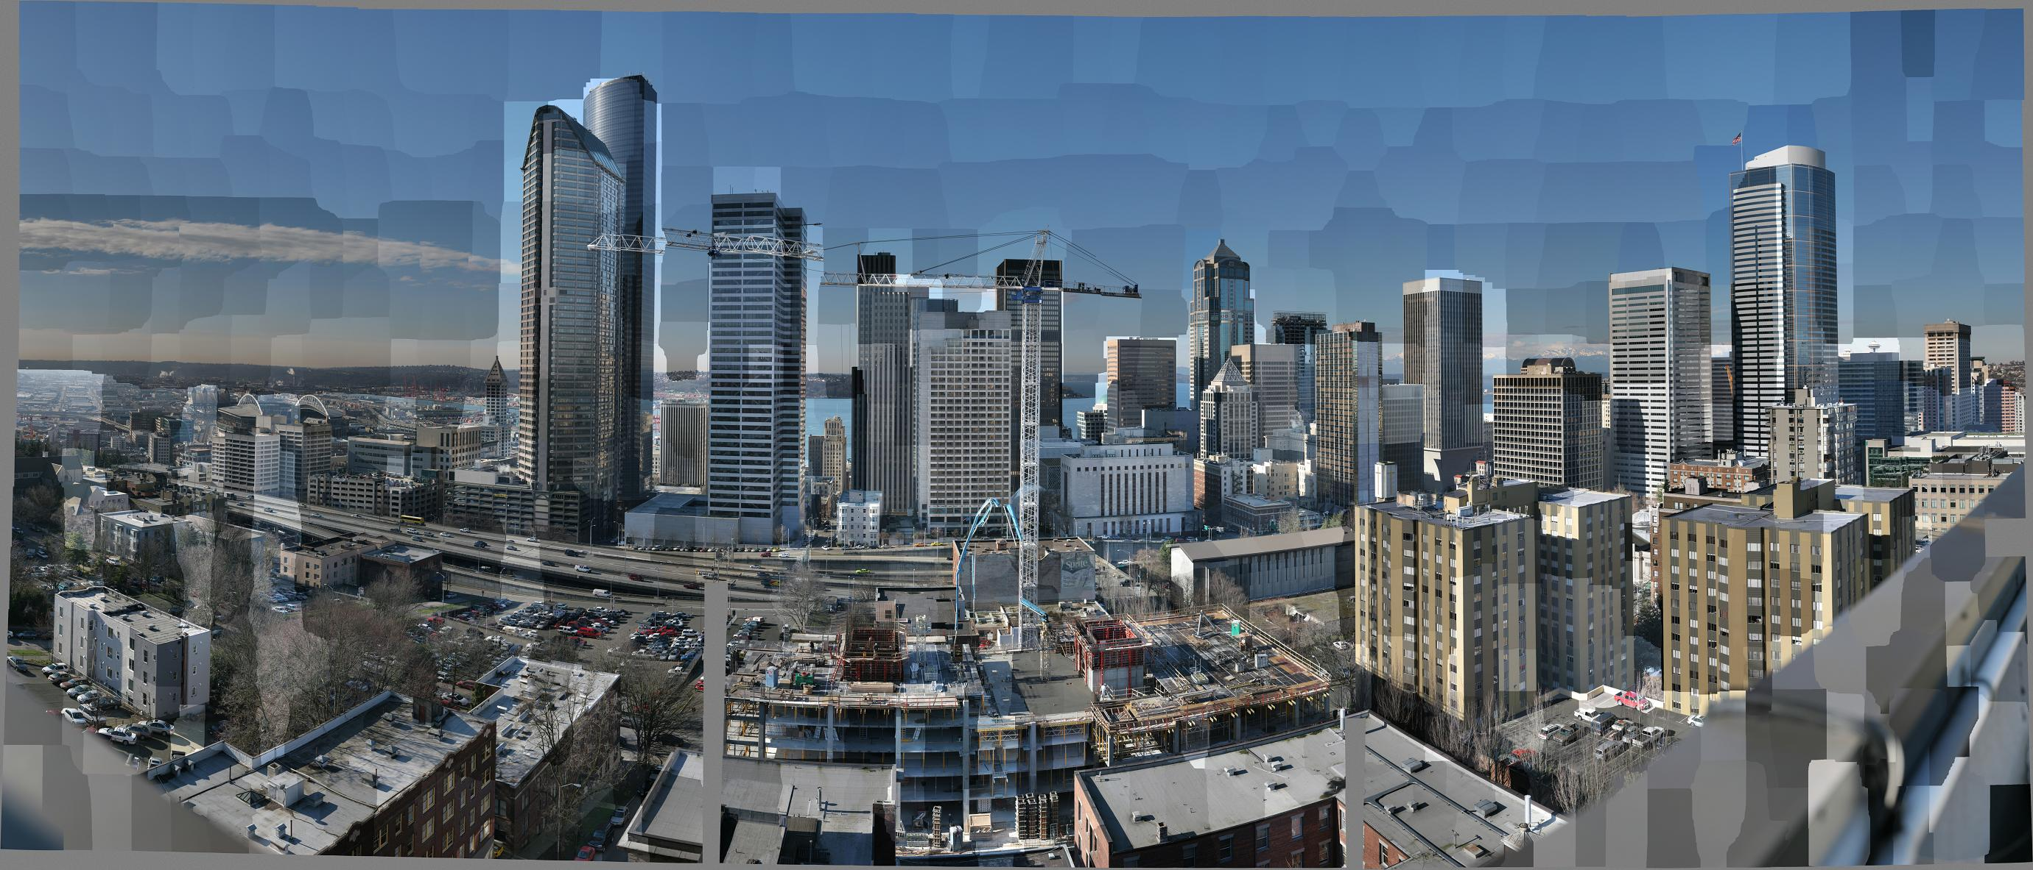
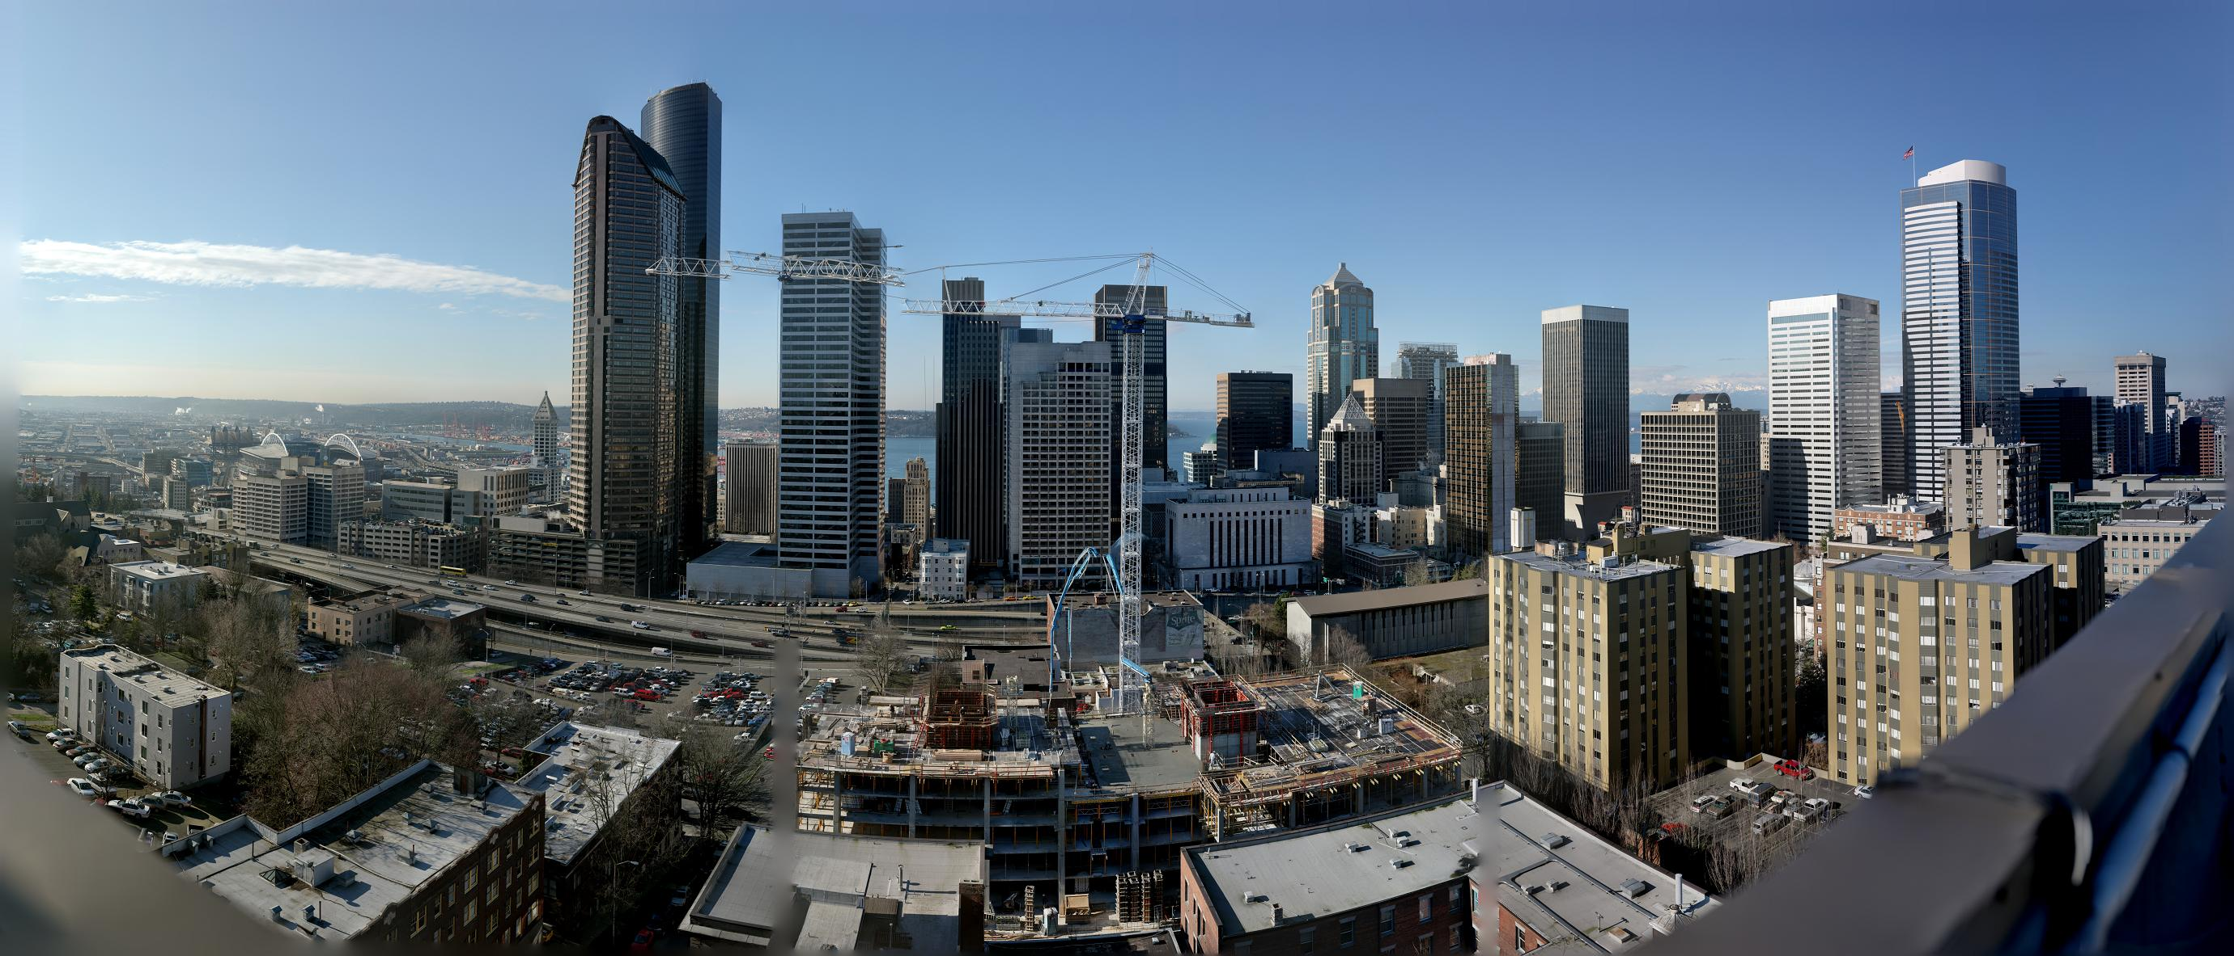
Gradient-Domain Image Processing:
Image Stitching
Notes:
For example, given a panorama composed of images taken at different exposures, gradient-domain processing can be used to remove the stitching artifacts by copying gradients from the interior of the images and setting the seam-crossing gradients to zero.
[Click]
Solving for the image that is the best-fit to the new gradients gives a result that captures the detail of the original images while removing the seams.

Slide 6
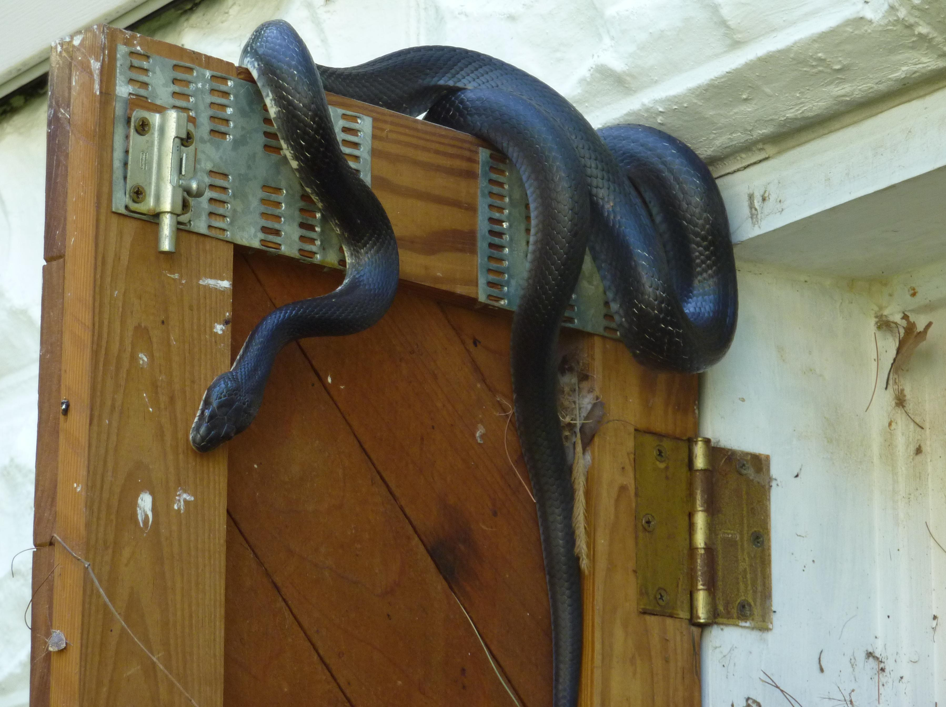


Gradient-Domain Image Processing:
Saliency Modulation
Gradient Dampening
Gradient Amplification
Notes:
As another example, gradient-domain image processing can be used to either enhance or blur the detail in an image.
[Click]
In this application, the colors of the output are constrained to mach the colors in the original image, while gradients are either dampened or amplified.

Slide 7
Gradient-Domain Image Processing
Gradients → Image:
Solving for the image that best fits the gradient constraints
reduces to solving a large system of equations.
Gradient
Domain
Operator
Gradient
Domain
Operator
Gradient
Domain
Operator
Image₀
∇
Gradient
Domain
Operator
Image₀
Image₀
Image₀
∇
∇
∇
Grad₀
Grad₀
Grad₀
Grad₀
Solver
∇
Solver
∇
∇
∇
Solver
Grad₁
Solver
Grad₁
Image₁
Grad₁
Image₁
Grad₁
Image₁
Image₁
Grad
Grad
Image
Grad
Image
Grad
Image
Image
∇
Grad_{n}
Grad_{n}
Image_{n}
Grad_{n}
Image_{n}
Grad_{n}
Image_{n}
Image_{n}
∇
∇
∇
Notes:
Regardless of the gradient-domain operator used, the key to performing image processing is solving a linear system that gives the image that best-fits the prescribed constraints.
Solving this system becomes challenging when the image is too large to fit into memory.

Slide 8
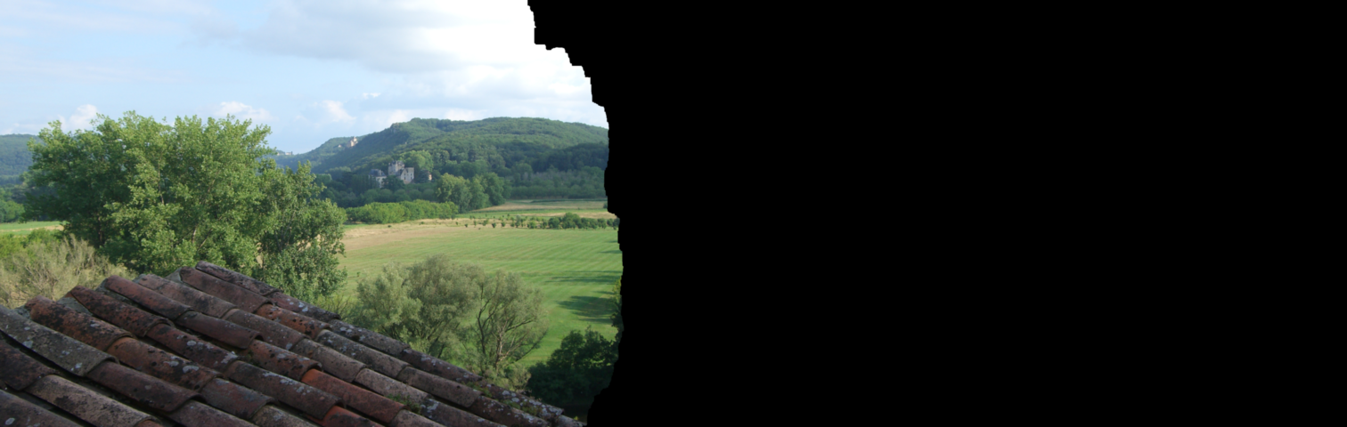
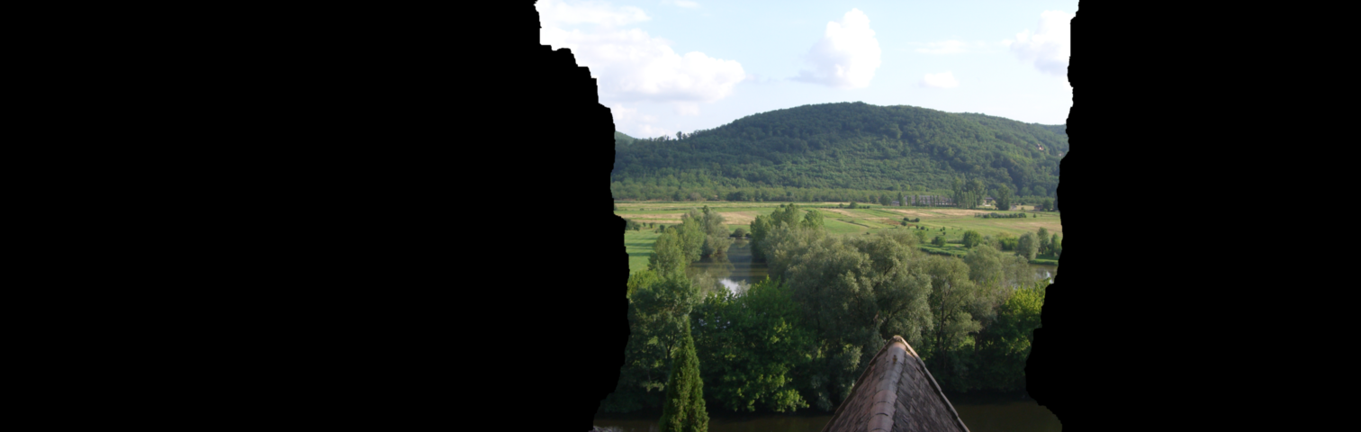
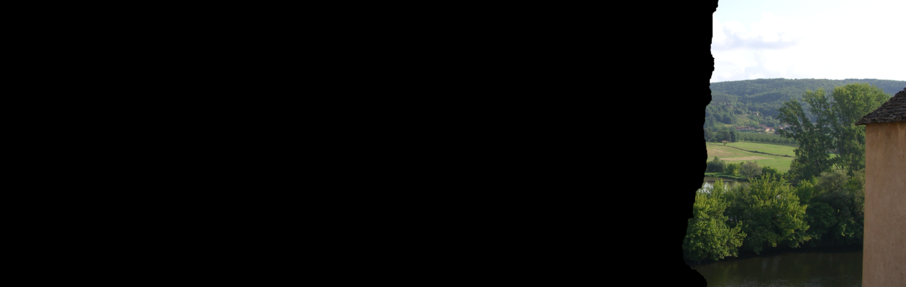
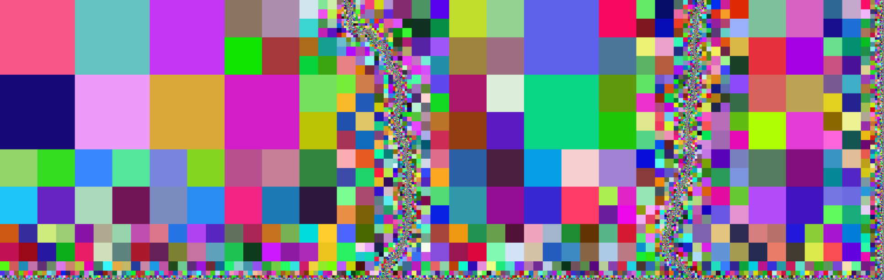
Large Gradient-Domain Image Processing
[Agarwala, 2007]
Solves linear system over a quadtree
Complexity determined by seam size
Image stitching only
In-core only
Notes:
The first method to consider the processing of images too large to fit into memory was the work of Aseem Agarwala.
The key observation was that for image stitching, a high-resolution correction solution is only required near the seams. As a result, the system can be solved over an adapted quadtree extending previous stitching techniques to panoramas made up of 100s of megapixels.
[Click]
However, the approach is specialized to image stitching and is not well-suited to an out-of-core solver.

Slide 9
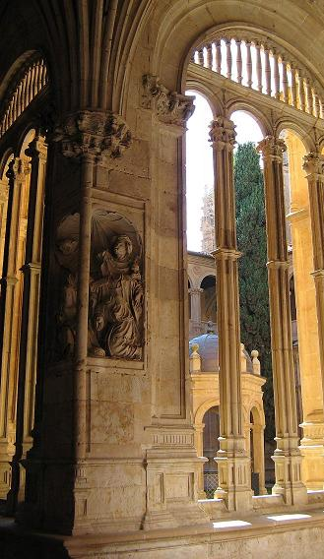

Large Gradient-Domain Image Processing
[Kazhdan and Hoppe, 2008]
Streaming multigrid solver
Sublinear working memory
General image processing
Planar image domain
Serial solver
For each multigrid level:
Disk
Memory
Notes:
In more recent work, we presented, a streaming multigrid solver that addresses these limitations.
The idea is to use an iterative Gauss-Seidel solver that only requires local data access.
The general structure of the solver, for a single multigrid level, is shown on the right:
[Click]
Initially, the data resides entirely on disk and the processing begins by streaming in the first few rows.
[Click]
Since a pixel update only requires access to neighboring values, there is enough data in memory to allow the pixels in the first row to be relaxed.
[Click]
Reading in the next row, the pixels in the second row can be relaxed as well.
[Click]
Since the pixel values in the first row will no longer be needed, they are written back out to disk.
[Click]
Continuing on in this fashion, the next row is read in to working memory, pixels in the middle row are updated, and the back row is written out to disk.
In addition to providing an implementation with a sublinear working memory, this implementation also defines a solver that supports general gradient-domain processing of out-of-core imagery.
[Click]
However, in the context of the Digitized Sky Survey, this approach remains inadequate for two reasons.
First, the method is restricted to planar images.
Second, the serial nature of the solver means that applying it to the DSS would take over 16 days of processing, would use more than 15 terabytes of local storage, and would require over 10 GB of working memory.
Time: 4:15

Slide 10
Outline
Motivation and Related Work
Processing Spherical Images
Distributing the Computation
Results and Conclusion
Notes:
In our work, we address both limitations.
We begin by describing a spherical parameterization that supports streaming multigrid and then we describe how to implement the solver in a distributed fashion.

Slide 11
Processing Spherical Images
Parameterization Goals:
Regular planar grid → Distributed solver
Local boundaries → Streaming
Low distortion → Accurate
Notes:
In choosing a parameterization, we would like it so satisfy several properties.
First, we would like the parameterization to be defined over a regular planar domain.
This makes it easier to extend planar image processing to the sphere, and facilitates the design of a distributed solver.
Next, since a planar parameterization of the sphere will necessarily generate stitching boundaries, we must ensure that the boundary-correspondences can be realized within a streaming context.
And finally, since mappings from the sphere to the plane cannot preserve the metric, we would like our parameterization to have low distortion so that the results of gradient-domain processing do not exhibit visual bias.

Slide 12
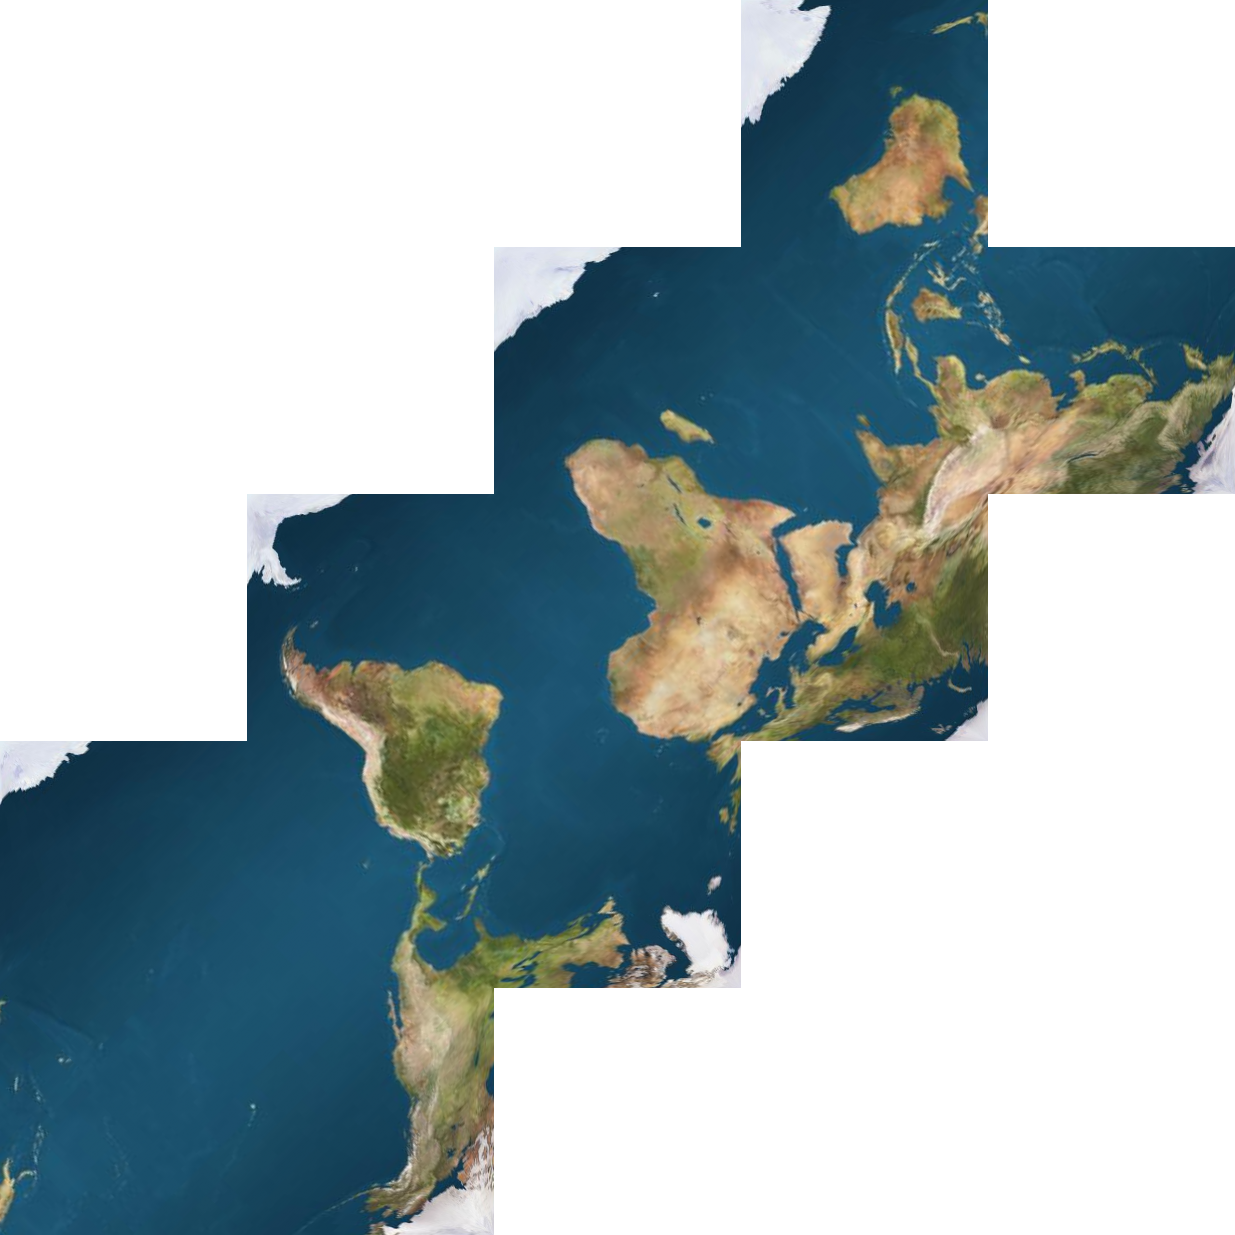
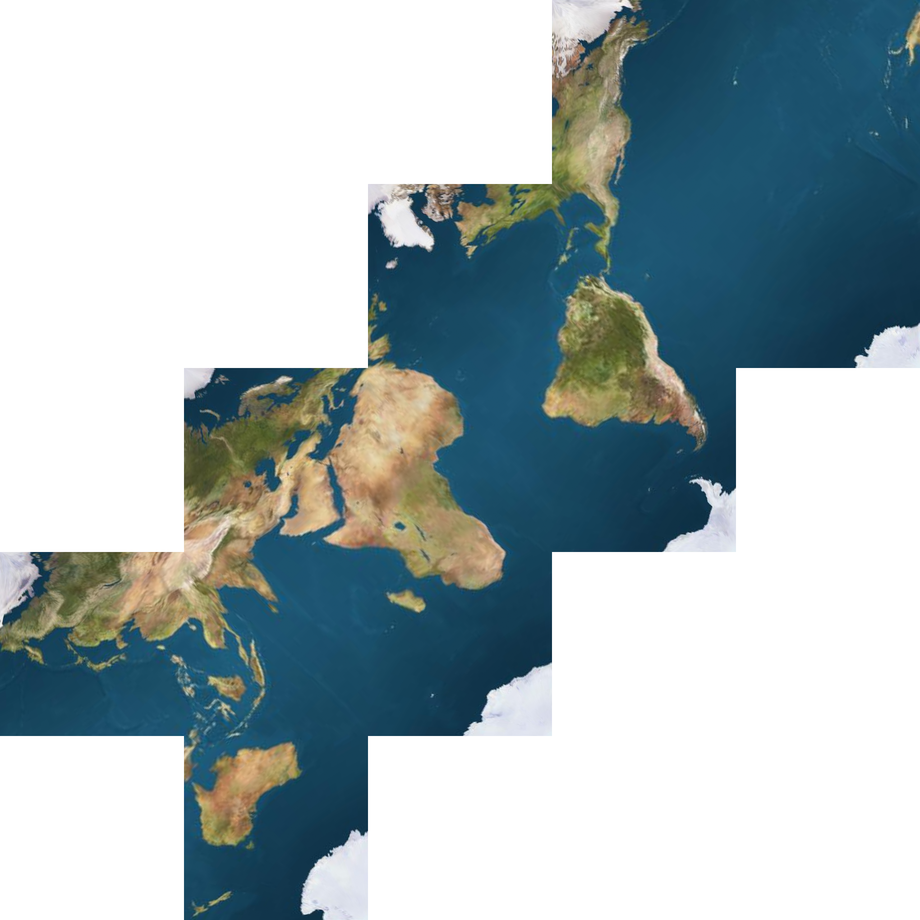
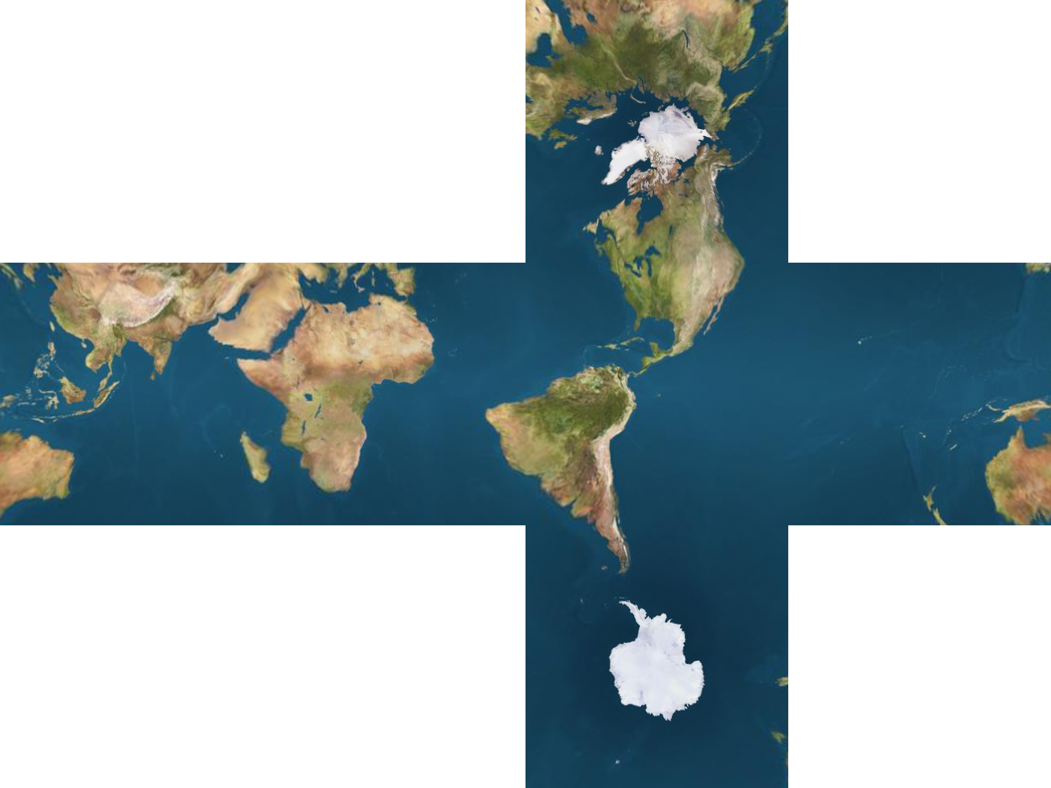
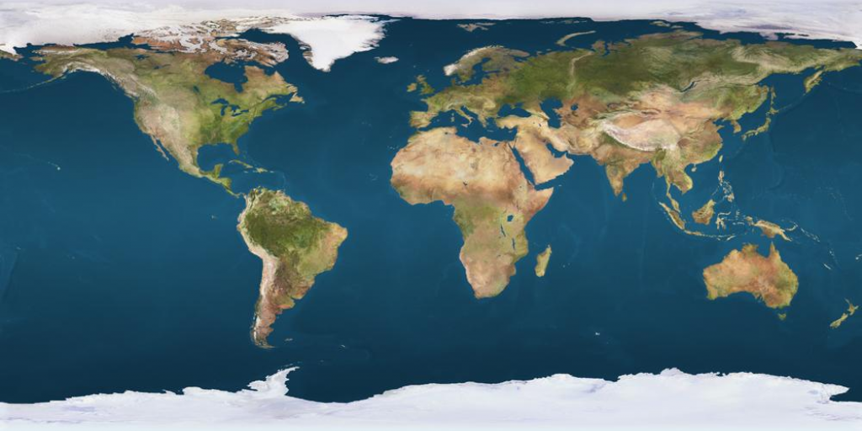
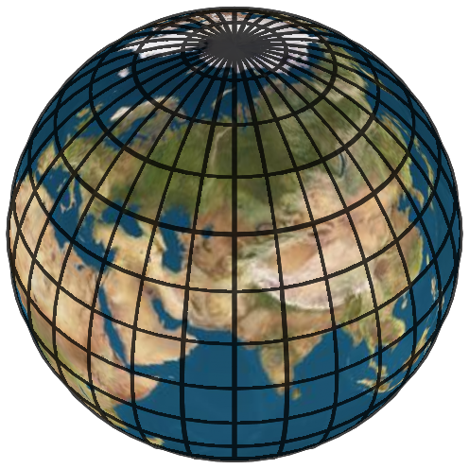
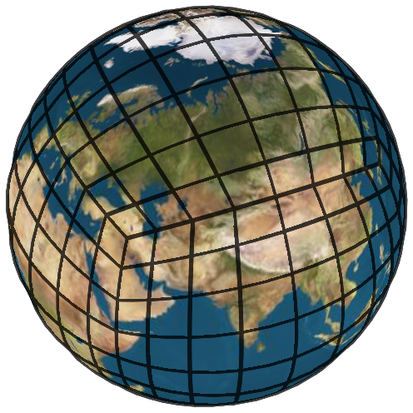
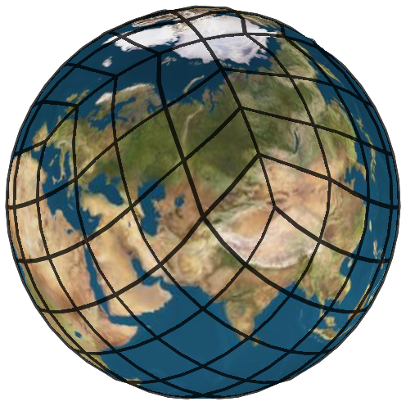
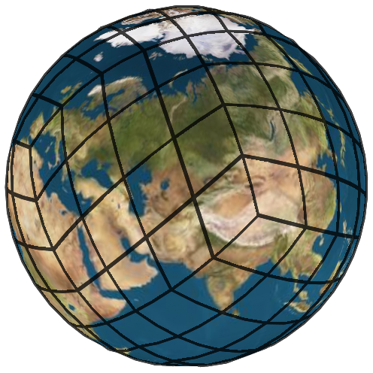
Choosing a Spherical Parameterization
Equirectangular
Regular grid
Unbounded distortion
Cube Map
[Greene, 1986]
Irregular domain
Small distortion
HEALPix
[Gorski et al., 2005]
Irregular domain
Small distortion
Rhombic
[Fu et al., 2009]
Irregular domain
Small distortion
Notes:
Perhaps the most obvious parameterization to consider is the equirectangular map, expressing positions on the sphere in terms of their angles of longitude and latitude.
Such a parameterization has the desirable property of being defined over a 2D rectangle.
Unfortunately, it exhibits unbounded distortion at the poles – with the areas of the grid cells collapsing to zero, and the aspect ratio exploding to infinity.
This distortion has motivated the development of alternate spherical parameterizations.
[Click]
These have included:
The cube-map, often used for representing environment maps in computer graphics,
The HEALPix parameterization, which guarantees that area is preserved everywhere,
And the more recent Rhombic Dodecahedral parameterization which minimizes both area and angle distortion.
Unfortunately, all three are parameterized over non-rectangular domains, making it challenging to incorporate them in a streaming and distributed solver.

Slide 13
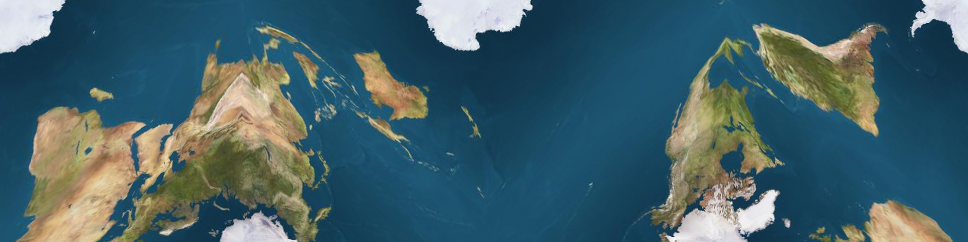
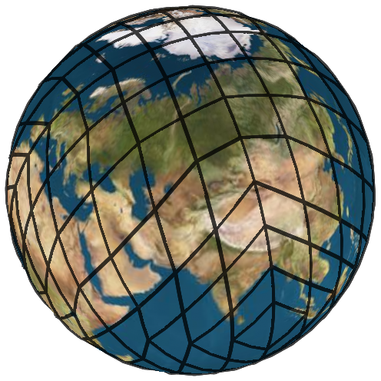
Choosing a Spherical Parameterization
Periodic Quincuncial
Regular grid
Small distortion
Notes:
In our work, we use an alternate parameterization, which we call the periodic quincuncial map. As we will show, the map is defined over a regular grid and has small distortion, providing a simple and robust framework for spherical image processing.

Slide 14
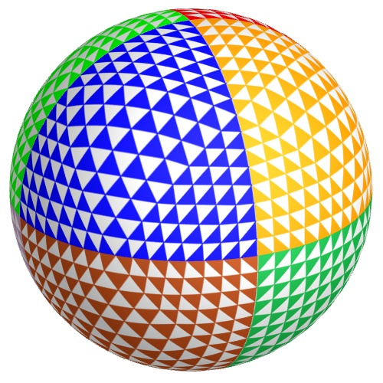
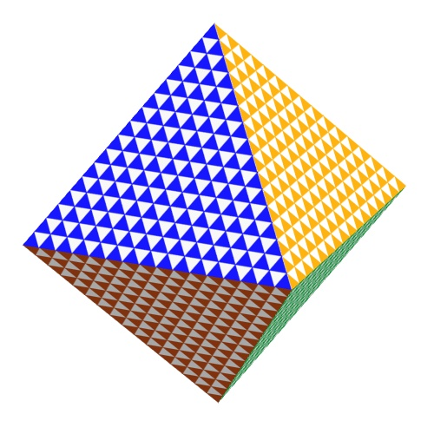
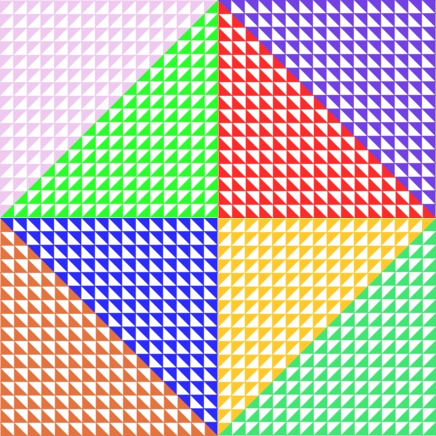
Periodic Quincuncial Map
N
Create a quincuncial parameterization
[Fekete, 1990; Schroeder and Sweldens, 1995; Kunszt et al., 2001]
  Parameterize over octahedron
  Unfold and flatten
Pivot to get horizontally periodic map
N
S
S
S
S
S
N
N
N
S
S
Notes:
Guided by earlier work, we begin with a parameterization of the sphere over an octahedron, obtained through recursive subdivision and projection of the triangular facets.
[Click]
Then, the parameterization is opened up at the South pole and the triangles are unfolded and flattened into the plane to obtain a parameterization over a square.
[Click]
Finally, we pivot the top half of the parameterization by 180 degrees to obtain a parameterization over a 4 by 1 rectangle.

Slide 15
Properties of the PQ Map
N
Regular planar tiling
  Horizontally periodic
  Vertically 180º rotated
Notes:
From the perspective of spherical image processing, this parameterization has several desirable properties.
First, the rectangular domain can be used to tile the plane.
Along the horizontal axis, the tiling is periodic.
[Click]
Along the vertical axis, the tiling is obtained by rotating and offsetting the rectangle.
[Click]
Because the parameterization domain can be used to tile the plane, the problem of spherical image processing can essentially be reduced to the problem of processing planar images.

Slide 16
Properties of the PQ Map
N
Regular planar tiling
Streaming solver
  Neighbors are row-local
Notes:
[Click]
In particular, the tiling allows us to use a streaming paradigm similar to the one used for planar image processing, maintaining a small window of image rows in memory as we perform the update of the pixels.
Note that the choice of parameterization ensures that neighboring pixel information is always in-core when we need it.
[Click]
For example, when updating the value of the pixel in blue, we have the first three rows in working memory, giving us access to the values of the one-ring neighbors, highlighted in red.
[Click]
As we near the left and right boundaries, some of the neighboring pixels map to points outside the rectangular domain.
[Click]
However, due to the horizontal periodicity, these values can still be obtained from data that is in-core.
[Click]
And finally, as we approach the top and bottom boundaries, we again require access to pixels outside the parameter domain.
[Click]
This time, due to the 180-degree rotation in the tiling, we are assured that the neighboring pixels are all contained within the working memory.

Slide 17
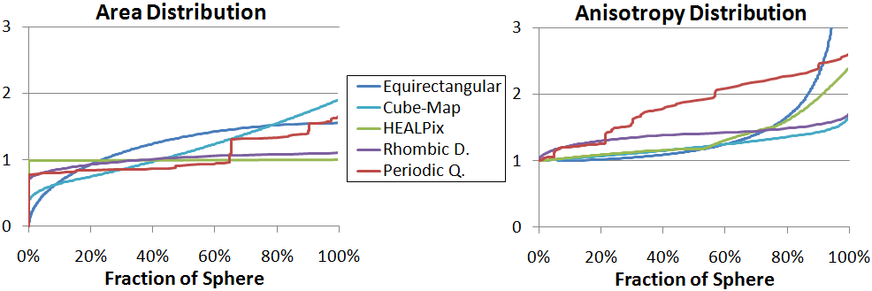
Properties of the PQ Map
N
Regular planar tiling
Streaming solver
Distortion is bounded
Notes:
In our work, we analyze the parameterizations, showing that both area and angular distortions are bounded.
In practice, this results in barely perceptible error while providing a regular structure that supports an efficient solver.
For more details, please see the discussion in the paper.
Time: 4:10

Slide 18
Outline
Motivation and Related Work
Processing Spherical Images
Distributing the Computation
Results and Conclusion
Notes:
We now describe our distributed implementation.
In doing so, we use the fact that the spherical parameterization is defined over a rectangular domain and focus on a planar solver.
Though we won’t explicitly discuss the details here, adapting the planar solver to support spherical images is a reasonably straight-forward, though somewhat technical, task.

Slide 19

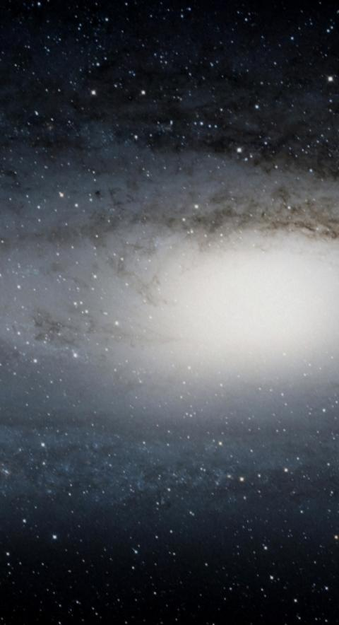
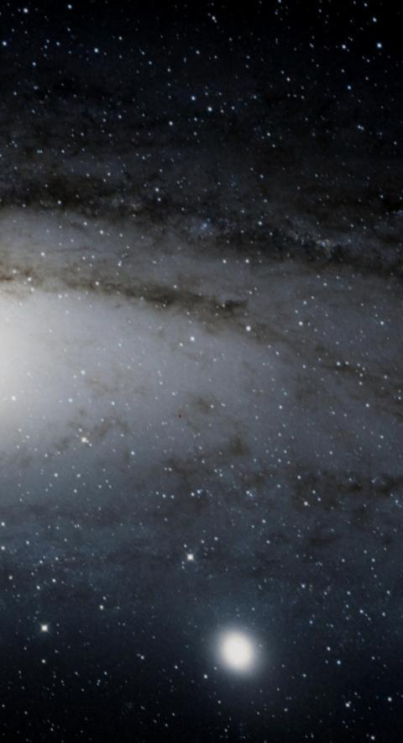
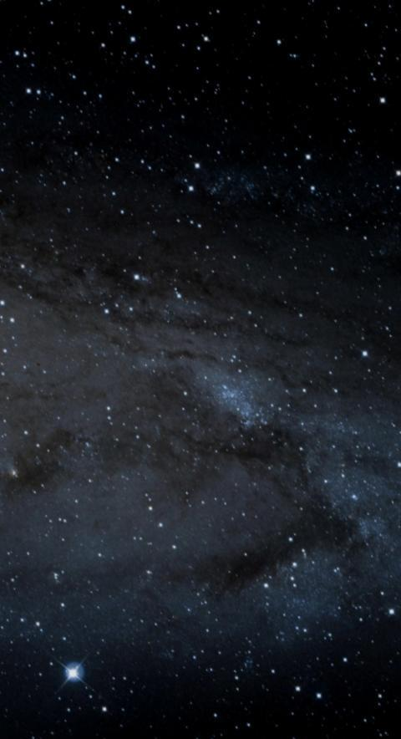

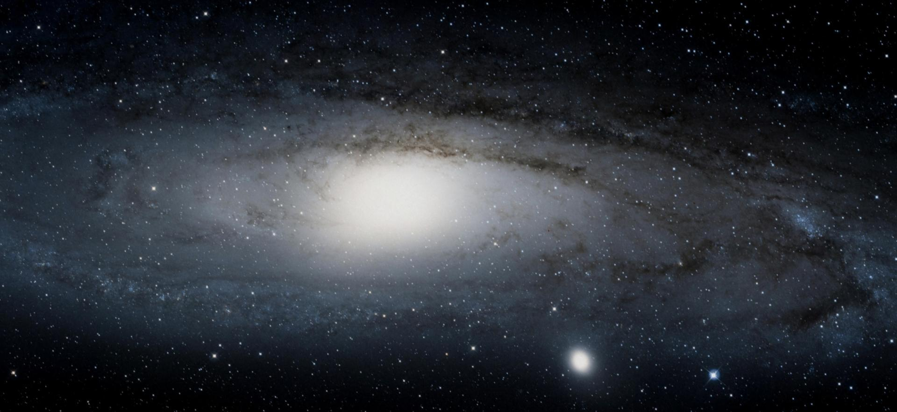



  Distributing the Computation
Partitioning the Data:
Splits the computation
Splits the disk I/O
Splits the memory
Notes:
We begin with choosing a strategy for distributing the work, and two natural ones avail themselves.
[Click]
In the first, we split the image into groups of rows, so that processors perform streaming updates of entire rows in tandem.
[Click]
Alternatively, we split the image into vertical bands, so that processors stream through a subset of each row.
[Click]
While both methods provide an implementation that splits the computation and the disk I/O across the different processors, we opt for the second partition to reduce the size of the working set.

Slide 20
  Distributing the Computation (Naïve)
Iterating over the rows:
Relax pixels (left)
Synchronize (left → right)
Relax pixels (right)
Synchronize (right → left)
Limitations:
Two synchs per row update
Network I/O is blocking
Notes:
Given such a partition, one could design a simple distributed solver as follows:
[Click]
Begin by having each processor update the values in a left-to-right fashion.
Since updates of the right-most pixels require access to the recently updated values from adjacent bands, the updates are paused while the bands synchronize.
[Click]
This is done by having each processor send the updated values along its left boundary to its left neighbor.
[Click]
Once this data is received, the updates of the pixels resumes.
[Click]
The processing is completed by having each band synchronize the recently updated values along its right boundary.
[Click]
The rest of the rows are processed in a similar manner, providing a streaming and distributed implementation of the solver.
[Click]
While this method works, it has two practical limitations.
First, the sharing of data implies a synchronization barrier, which can become too fine-grained when performed twice per row update.
Second, the implementation requires computation to stop as data is communicated between the processors, threatening to overwhelm running time with I/O latency.

Slide 21
  Boustrophedonic Processing
Alternate left-to-right and right-to-left processing:
Properties:
One synch per row update
Network I/O is blocking
Relax pixels (left)
Synchronize (left → right)
Relax pixels (right)
Relax pixels (right)
Synchronize (right → left)
Relax pixels (left)
Notes:
In our work, we address both challenges.
We begin by modifying the implementation to use a boustrophedonic ordering, so that updates of the rows alternate between being performed left-to-right and right-to-left.
As before, we begin by having each processor update the pixels in a left-to-right order, pausing the update so boundary values can be synchronized, and then processing the remaining pixels.
[Click]
At this point, we cannot perform a left-to-right processing of the next row without synchronizing boundary values.
However, the values across the right boundaries are up-to-date, as they haven’t been modified since the previous synchronization,
[Click]
so we can process in a right-to-left order.
[Click]
Again, we pause the updates part way through to synchronize the data, and then update the remaining pixels in the row.
[Click]
We continue in this manner until we have updated all the pixels in the image.
[Click]
The advantage of this implementation is that it relieves some of the overhead of fine-grained synchronization by removing unnecessary barriers.
Though we won’t go into details here, our paper describes how this approach can be modified so we only require one synchronization per row, regardless of the number of Gauss-Seidel iterations performed.

Slide 22
  Non-Blocking Processing
Split bands and synchronize while relaxing:
Properties:
One synch per row
Network latency tolerant
Relax pixels (left)
Synchronize (left → right)
Relax pixels (middle)
Relax pixels (right)
Relax pixels (right)
Synchronize (right → left)
Relax pixels (middle)
Relax pixels (left)
Notes:
Lastly, we address the issue of network latency by hiding the I/O behind the processing.
[Click]
To do this, we split each band into one wide center lane, and two narrow boundary lanes.
[Click]
We start our processing as before, updating pixels in a left-to-right fashion.
[Click]
After updating the left lane, we already have all data that we will need to synchronize. Since we don’t need this data for updating pixels in the middle lane, we update these pixels while simultaneously sending the data.
[Click]
Given the large size of the middle lane, the network I/O will have completed by the time the pixels in the middle row are updated, and we proceed to the processing of the left-most lanes.
[Click]
We repeat the process, but now using the boustrophedonic ordering, processing the next row in a right-to-left fashion, and so on.
[Click]
Using this approach, we obtain a distributed solver that only requires one synchronization per row without incurring the cost of network latency.

Slide 23
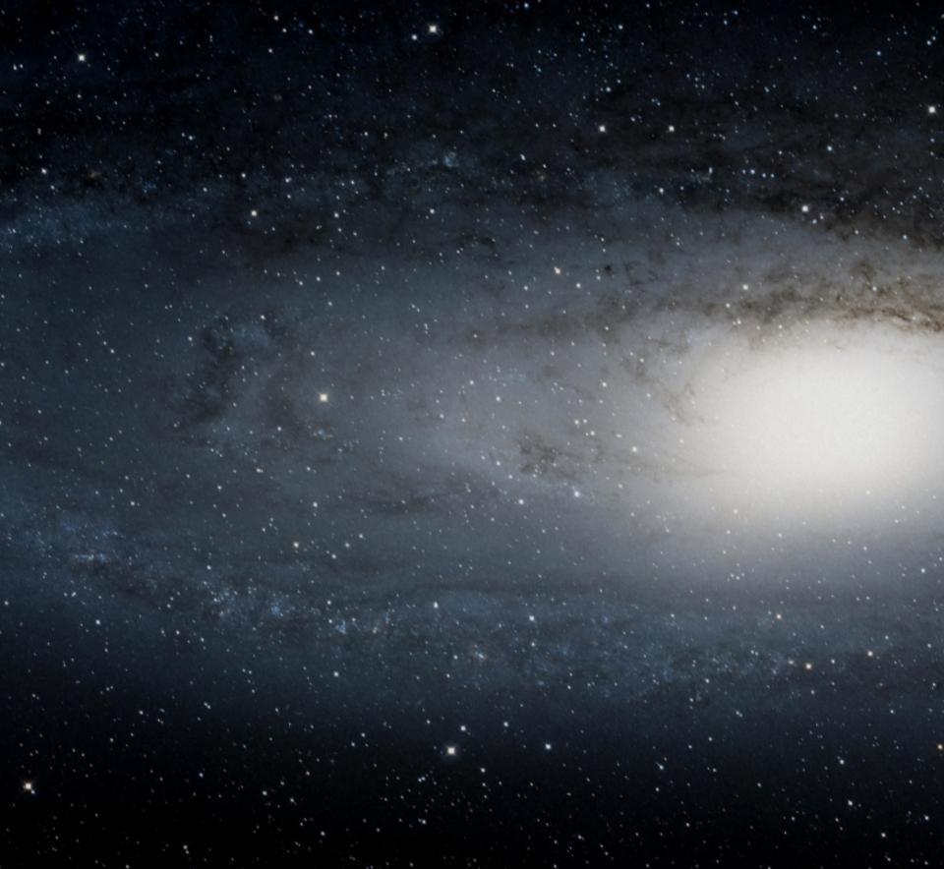
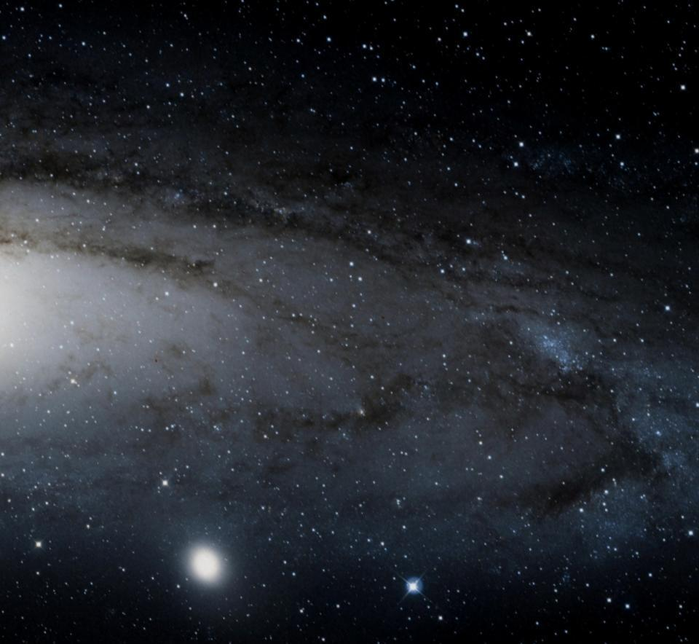
  Implementation
Node 1
Node 2
Core 1
Core 2
Core 1
Core 2
Clients:
  Relax multi-res bands
  Share between bands
  and across resolutions
Server:
  Manages bookkeeping
  Solves low-res grids
Server
Notes:
Putting this together, we design a client-server model for a streaming and distributed multigrid solver.
The clients update the finer resolution of the multigrid hierarchy, and communicate both with the processors immediately to the left and right, and with the processors above and below in the hierarchy.
The server establishes the connections between the clients and processes the lower resolutions of the hierarchy.
A simple 2x2 client configuration is shown to the right, with the bands distributed across two nodes and parallelized across two cores within each node.
Each core is assigned a band of pixels, with cores on the same node assigned consecutive bands.
[Click]
The processing then proceeds in parallel, with the cores communicating either via shared memory when they are both on the same node, or using the network when they are on different nodes.
[Click]
As the processing at the finer resolution is performed, the residual is down-sampled and sent to the next level of the hierarchy for processing.
[Click]
At a certain point, the down-sampled bands may become too narrow, in which case we merge consecutive pairs of bands and assign the merged band to a single core.
[Click]
And, once the image is coarse enough, all the remaining clients send their data to the server where it is merged and solved serially.
[Click]
Finally, the order of the processing is reversed to perform the upstroke of the V-cycle.
Time: 5:00

Slide 24
Outline
Motivation and Related Work
Processing Spherical Images
Distributing the Computation
Results and Conclusion
Notes:
To evaluate our approach, we consider both the correctness and the efficiency of the solver.

Slide 25
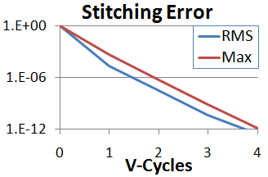
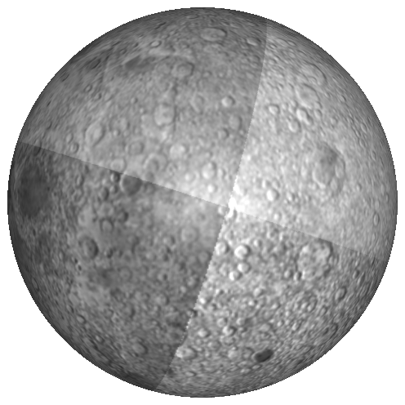
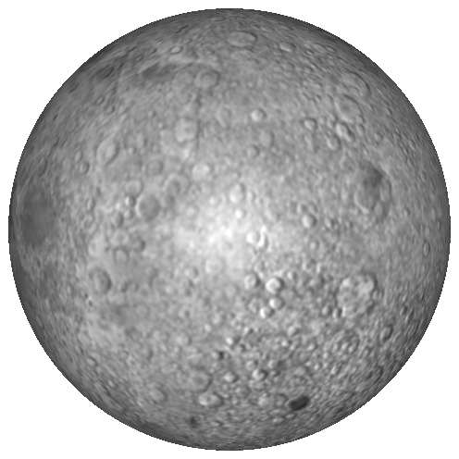
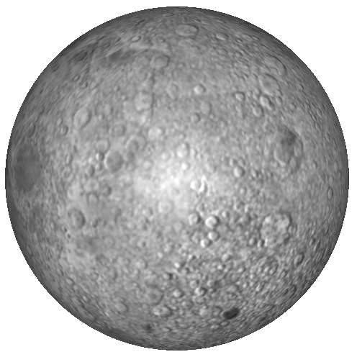
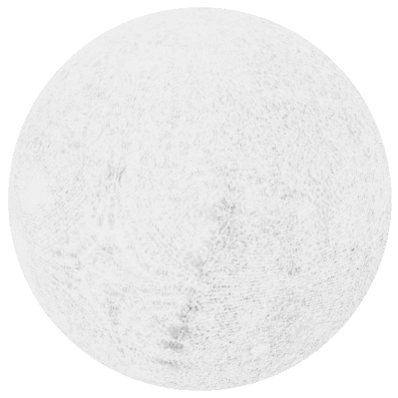
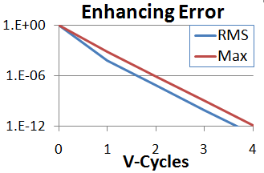
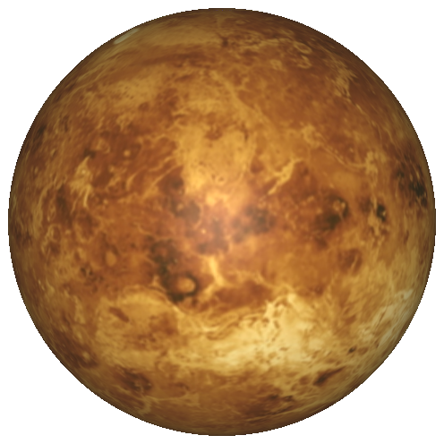
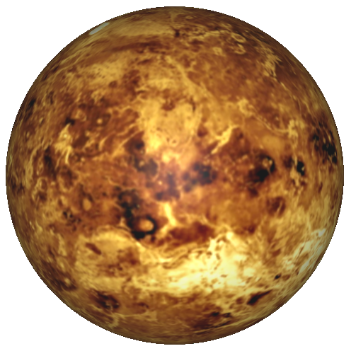

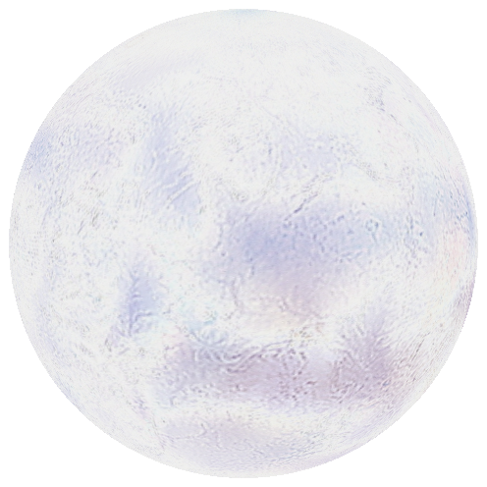
Correctness of the Solver
Image stitching
Saliency Enhancement
Metric-aware
Solution
Input
PQ Output
Difference (x5)
Metric-aware
Solution
Input
PQ Output
Difference (x5)
Notes:
We begin with the correctness, analyzing the behavior of our solver in two typical applications.
[Click]
In the first, we stitch together a panorama of the moon.
[Click]
and in the second, we use saliency enhancement to bring out the details of Venus.
[Click]
The performance graphs, measuring the error as a function of the number of V-cycles are shown on the right.
As the plots show, our solver has the correct convergence behavior, with the RMS and maximum error both decaying exponentially in the number of V-cycles.
Independent of the convergence of the solver, we also validate the correctness of the system itself.
That is, we show that the angle and area distortion do not generate undesirable artifacts in the output images.
[Click]
To this end, we perform analogous gradient-domain processing, but this time using an Equirectangular parameterization that explicitly corrects for distortion using the metric tensor.
As the figures to the right show, using the metric-aware system gives results that are barely distinguishable from those of our solver, with most of the differences either in the low-frequencies or due to the different sampling patterns employed by the different parameterizations.

Slide 26
Applications to Planar Images
Input Data:
  643 images
  3 Gpixels
Streaming MG
  Single core
  88 minutes
Distributed
  4 x 4 cores
  6 minutes
Notes:
To evaluate the efficiency of our solver, we start with a planar example, considering the stitching of the dataset shown on the right.
Using the streaming multigrid solver presented here two years ago, it took 88 minutes to perform the stitching.
Running the same dataset on a small 4 by 4 cluster, we reduce the processing time to just over six minutes, providing a nearly 15-fold speed up with a 16-way parallelization.

Slide 27
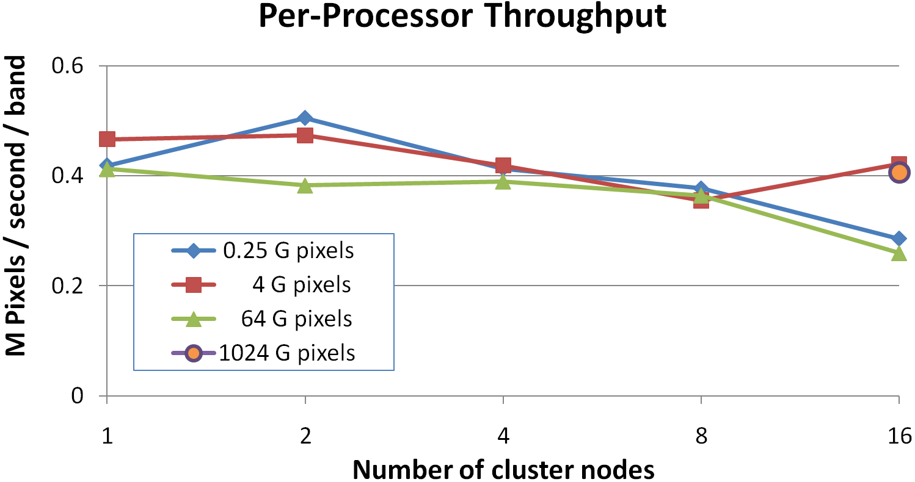
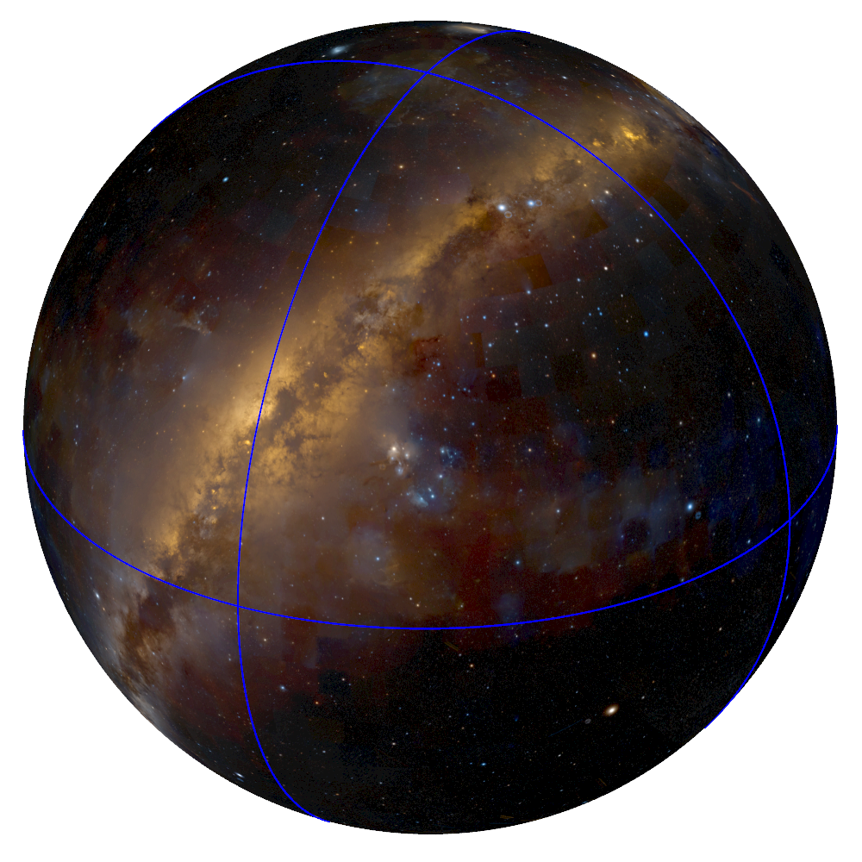
Stitching the Digitized Sky Survey
Input Data:
  2048K x 512K =1 Tpixel
Processing:
  16-node cluster
  4 processors per node
Output Image:
  Time: 9.3 hours
  Disk: 1 TB / node
  Memory: 200 MB / core
Notes:
Finally, to push our solver to its limit, we use it to stitch the spherical data in the terapixel Digitized Sky Survey.
The results obtained running on a 16 node cluster with 4 processors on each node can be seen on the right.
[Click]
With this configuration, the stitching of the spherical images took less than 10 hours, required one terabyte of disk storage on each node, and had a memory footprint that was less than 200 megabytes per core.
To get a broader sense of the performance, we also measured the throughput at different resolutions and using different numbers of nodes.
[Click]
As the plots show, the average processing speed of a core, measured in pixels per second, remains nearly consistent as we go from one to 16 nodes and as we change the image resolution from 256 megapixels to one terapixel, confirming the scalability of our method.

Slide 28
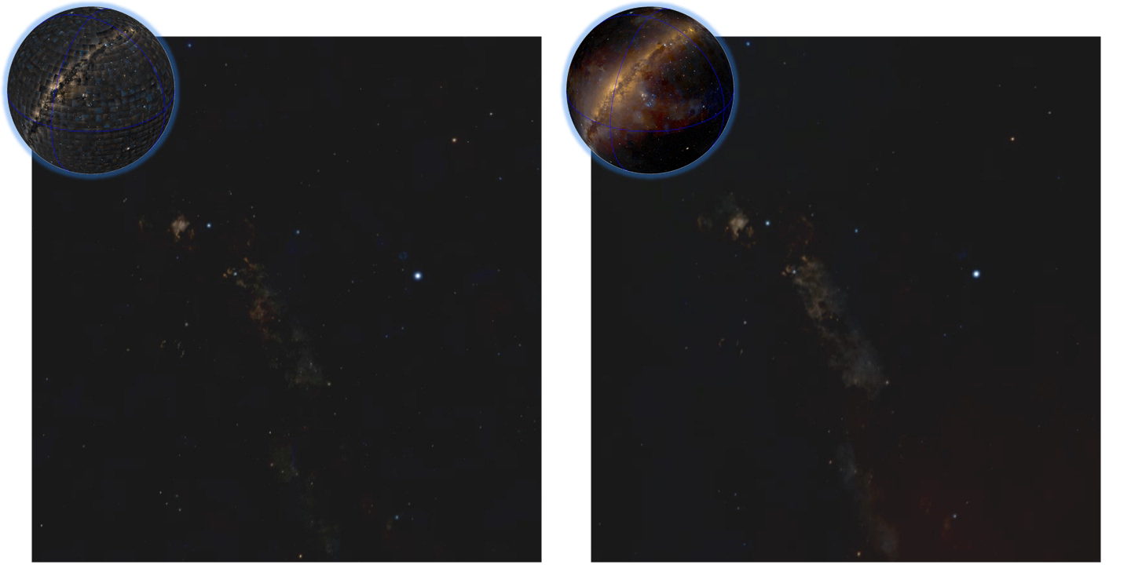
Stitching the Digitized Sky Survey
http://www.worldwidetelescope.org/
Notes:
To visualize the results of stitching the Digitized Sky Survey and to give a sense of the sheer magnitude of the dataset, we show a brief screen-capture from the WorldWide Telescope project.
The video on the left shows a virtual tour using the unstitched data, while the video on the right shows the same tour, but using the output of our gradient-domain stitching.

Slide 29
Summary
Gradient-domain for large and spherical images.
Spherical parameterization
  Rectangular grid
  Row-local boundary conditions
  Low distortion
Distributed multigrid solver
  Few synchronizations
  Network latency tolerant
Notes:
In summary, we have presented a new system for performing gradient domain processing of large planar and spherical imagery.
To support the processing of spherical imagery we use a map that parameterizes the sphere over a rectangular domain, ensuring that boundary constraints can be satisfied in a streaming context, and exhibiting low distortion.
To support processing of large images, we develop a distributed and streaming multigrid solver that has few synchronization barriers and is network latency tolerant.

Slide 30
Future Work
Incorporate the metric tensor
  Correct spherical image processing
  Computationally expensive
Explore partition tradeoffs
  Column-grouped:
    Low memory footprint
  Row-grouped:
    Fewer synchronizations
Notes:
In the future, we would like to extend on our work in two ways.
First, to get more precise solutions, we would like to incorporate the metric tensor in the definition of the linear system.
The challenge is that computing the metric-aware system could result in a situation where defining the system is more expensive than solving it.
Additionally, we would like to explore other distributed partitions of the data.
[Click]
Though we chose to group columns because this reduced the size of the working set, grouping the rows could have the benefit of reducing the total number of synchronization barriers.
In the future, we would like to explore the costs and benefits of these different partitioning schemes in greater depth.

Slide 31
Acknowledgments
  Jonathan Fay, Microsoft Research WorldWide Telescope
  Digitized Sky Survey
  Rick Szeliski, Michael Cohen, Matt Uyttendaele
  Aseem Agarwala
  NSF Career Award (#6801727)
Notes:
Finally, we would like to conclude by expressing our sincere gratitude to the researchers and agencies that have generously provided the data and the support that made this project possible.

Slide 32
Thank You!
http://www.cs.jhu.edu/~misha/Code/DMG/
Notes:
And of course, thank you for listening.
Time: 3:20

