Slide 1
Geometry Images:
Sampling Surfaces on Regular Grids
Hugues Hoppe
Microsoft Research
SGP 2004

Slide 2
My collaborators
Xianfeng Gu, Pedro Sander, Steven Gortler (Harvard)
Arul Asirvatham, John Schreiner, Emil Praun (Utah)
John Snyder (Microsoft Research)
Zoe Wood (Caltech)
Hector Briceno, Leonard McMillan (MIT)
Frank Losasso (Stanford)
Scott Schaefer, Joe Warren (Rice)

Slide 3
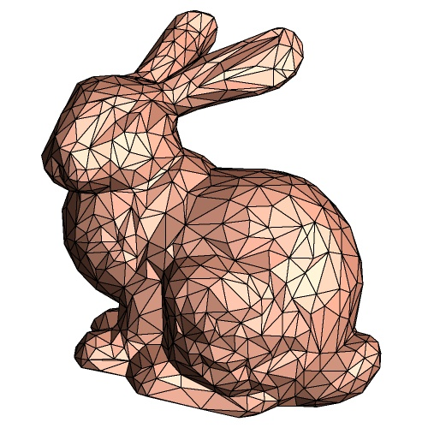
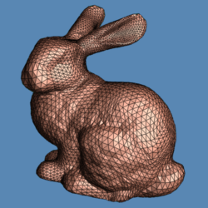
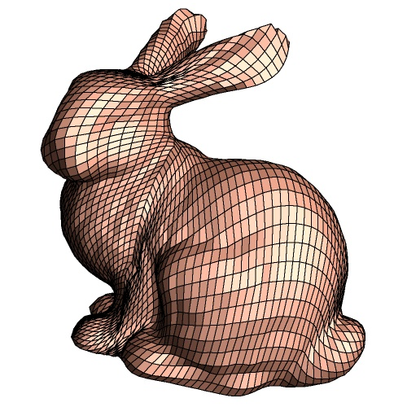
Mesh representation
irregular
semi-regular
completely regular

Slide 4
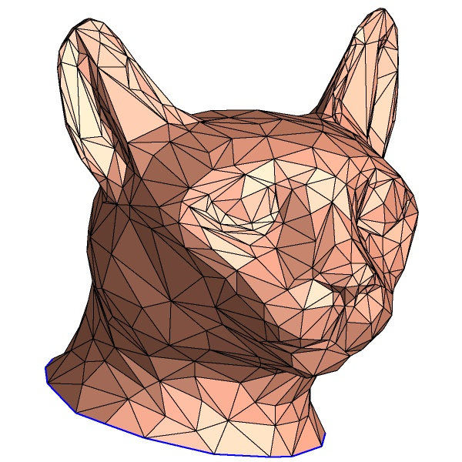
Irregular meshes
Vertex 1 x₁ y₁ z₁
Vertex 2 x₂ y₂ z₂
Vertex 3 x₃ y₃ z₃
…
Face 2 1 3
Face 4 2 3
…
Notes:
The standard geometric representation used in today’s graphics hardware is the irregular mesh.
A mesh consists of an array of vertices, and an array of triangles, where each triangle refers to three vertex indices.
<click> Here is such a mesh rendered with flat shading.

Slide 5

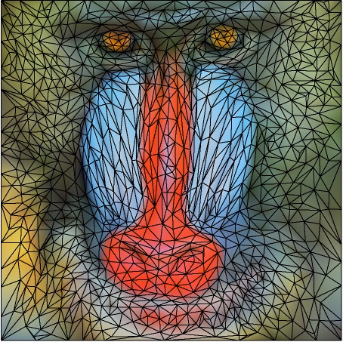
What if images were represented with irregular meshes?
Drawbacks:
storage of connectivity
no random lookup
rendering
compositing
filtering
compression
synthesis

Slide 6
Simple 2D grid
Advantages:
implicit connectivity
2D lookup
raster-scan
alpha blending
DSP
JPEG 2000
synthesis

Slide 7
Representations for media
Audio: uniform 1D grid
Images: uniform 2D grid
Video: uniform 3D grid
Geometry: irregular mesh
really necessary?

Slide 8
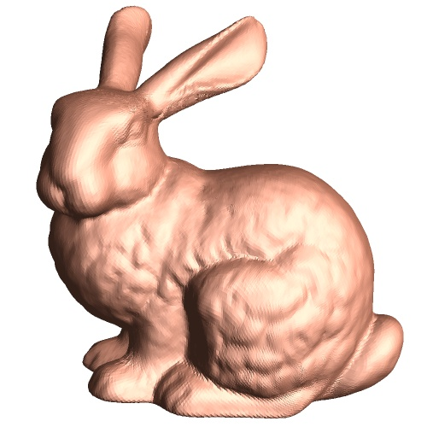
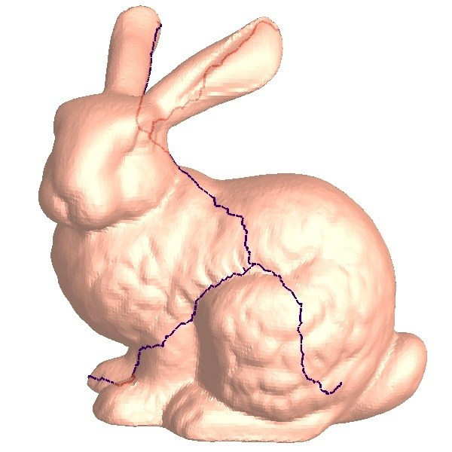
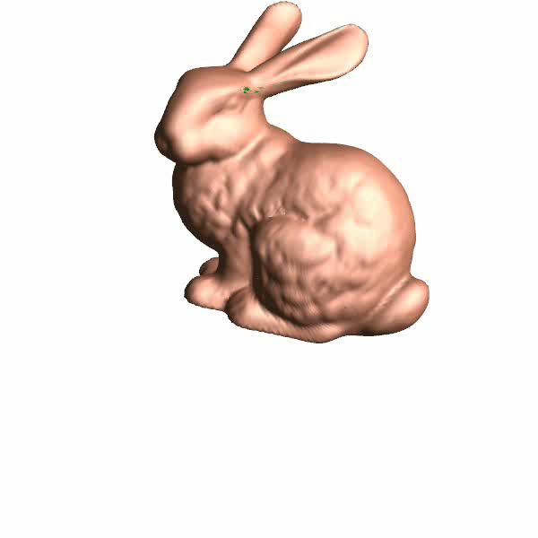

Geometry image
Notes:
Here is an outline of the basic steps involved in creating a geometry image.
First, we slice open the mesh along an appropriate set of cut paths, creating a surface with the topology of a disk.
<click> Second, we parametrize this cut surface onto the square domain of the geometry image.
To illustrate this parametrization, we’ll show a demo.
<demo> Here we see a morph between the cut bunny and its embedding in the square.
You can see how the cut in blue is being morphed into the boundary of the square.
Because this is so much fun, I’ll show the morph one more time.

Slide 9
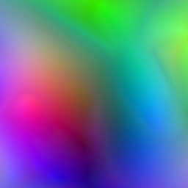
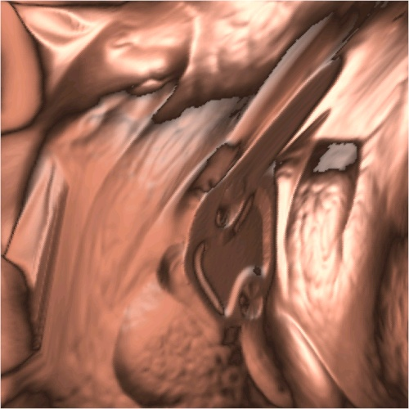
Geometry image
render
[r,g,b] = [x,y,z]
Notes:
Here is an outline of the basic steps involved in creating a geometry image.
First, we slice open the mesh along an appropriate set of cut paths, creating a surface with the topology of a disk.
<click> Second, we parametrize this cut surface onto the square domain of the geometry image.
To illustrate this parametrization, we’ll show a demo.
<demo> Here we see a morph between the cut bunny and its embedding in the square.
You can see how the cut in blue is being morphed into the boundary of the square.
Because this is so much fun, I’ll show the morph one more time.

Slide 10
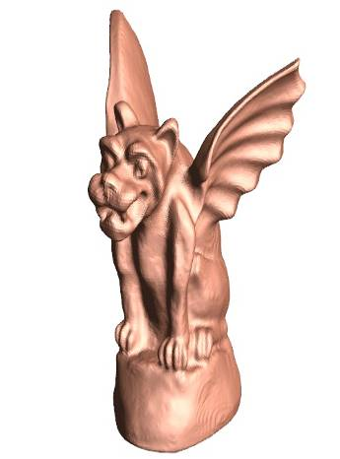
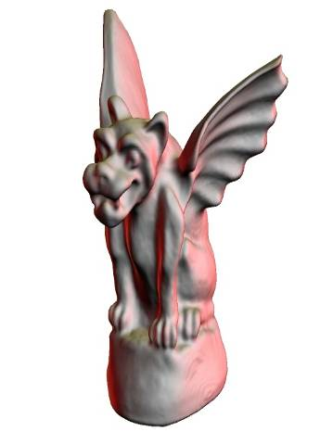
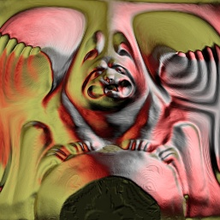
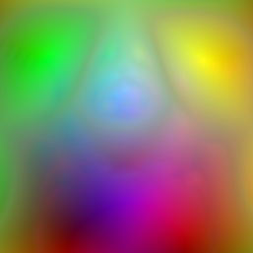
Simplicity for hardware rendering
Regular sampling → no vertex indices.
Sequential traversal of source data
Unified parametrization
Regular neighborhoods → derivatives

Slide 11
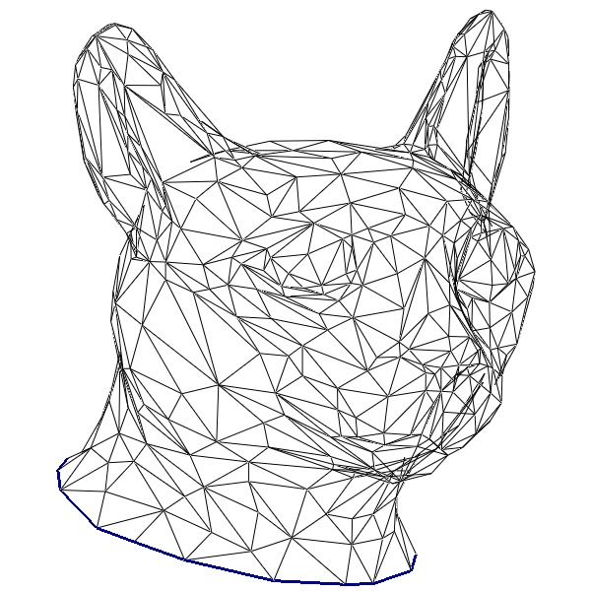
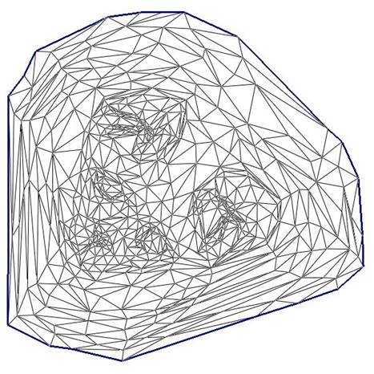
Irregular meshes: Texture mapping
Vertex 1 x₁ y₁ z₁
Vertex 2 x₂ y₂ z₂
…
s₁ t₁
s₂ t₂
Face 2 1 3
Face 4 2 3
…
t
s
Notes:
To represent more detail over meshes, it is common to use texture mapping.
The mesh vertices are assigned texture coordinates, defining a parametrization of the mesh onto an S,T domain.
<click> An image is placed on this domain,
<click> which is then mapped back to the surface.
In this case, the texture image represents surface normals,
<click> which can be used in per-pixel shading.

Slide 12
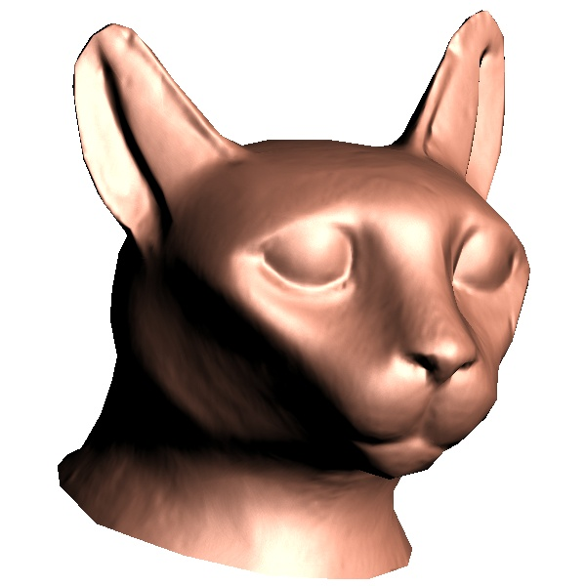
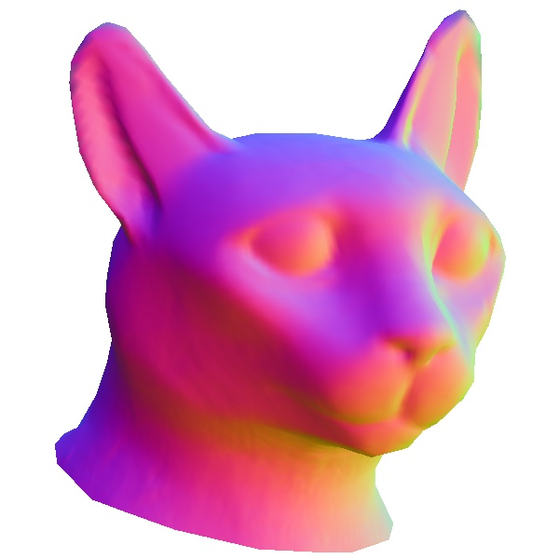
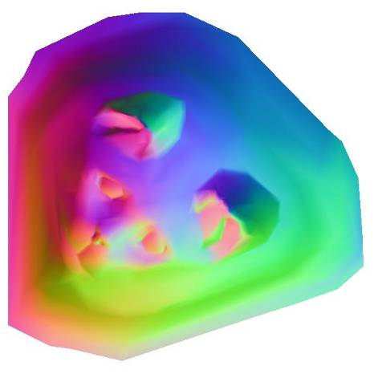
Irregular meshes: Texture mapping
Vertex 1 x₁ y₁ z₁
Vertex 2 x₂ y₂ z₂
…
s₁ t₁
s₂ t₂
Face 2 1 3
Face 4 2 3
…
irregular
random access
random access
regular
Notes:
To represent more detail over meshes, it is common to use texture mapping.
The mesh vertices are assigned texture coordinates, defining a parametrization of the mesh onto an S,T domain.
<click> An image is placed on this domain,
<click> which is then mapped back to the surface.
In this case, the texture image represents surface normals,
<click> which can be used in per-pixel shading.

Slide 13
Rendering process (and bandwidth)
Irregular mesh:
vertex indices
GPU
sequential
framebuffer
vertex data
$
random
~random
texture image
$/FIFO
random
compressed (VQ)
~100M verts/sec
3G pixels/sec
Geometry image:
geometry
& texture
image
GPU
framebuffer
sequential,
compressed (wav.)
~random
G verts/sec?

Slide 14
Data required for rendering
Irregular Meshes | Points / Splats | Geometry images
(graph) | (set) | (array)
connectivity | - | -
position p | position p extent Δp (if adaptive) | position p
normal=∇p | normal=∇p ∇²p (for Phong splatting) | -
color c | color c, ∇c | color c
param. u | ? | -
Δp

Slide 15
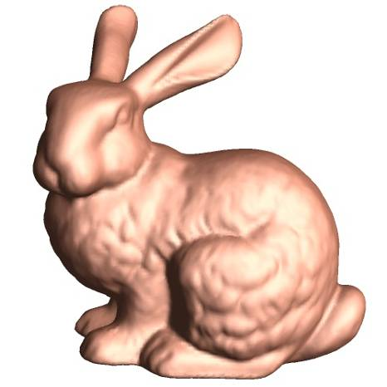

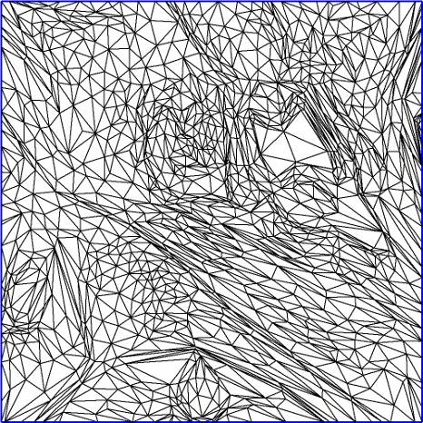
How to construct a geometry image?
cut?
parametrize?

Slide 16
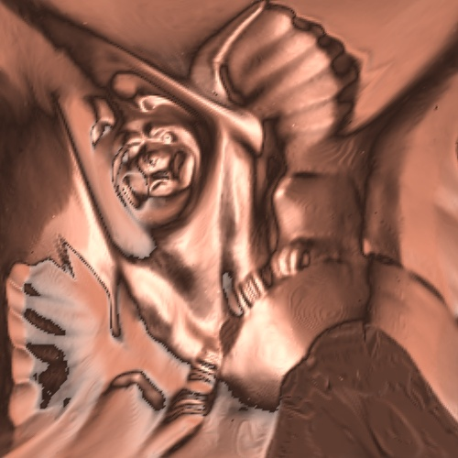
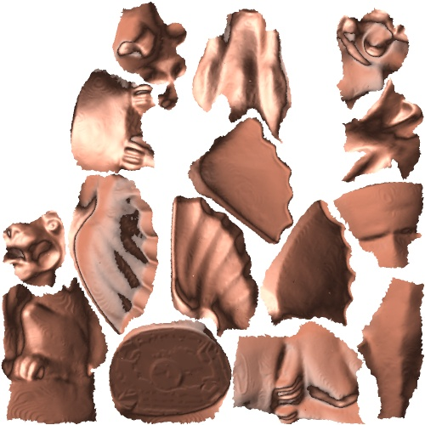
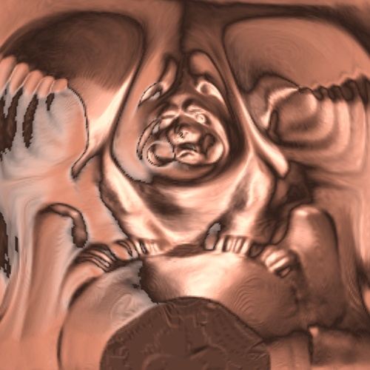
Construction approaches
General cut
Multi-chart
Spherical
[Gu et al. SIGGRAPH 2002]
[Sander et al. SGP 2003]
[Praun & Hoppe. SIGGRAPH 2003]
arbitrary surface
arbitrary surface
charts → zippering
genus-zero surface
→ cut symmetries

Slide 17
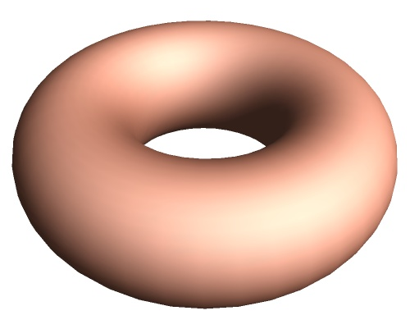
General cut
[Gu et al. SIGGRAPH 2002]
genus 0
genus 1
Genus-g surface → must include 2g cycles
Notes:
What about surfaces of higher genus?
<click> For this torus, which has genus 1, a valid cut must include two loops that generate its fundamental group.
<click> More generally, for a genus-g surface, the cut must include 2g independent loops.
<click> In addition to these two loops, the cut may also contain an arbitrary forest of edges.

Slide 18
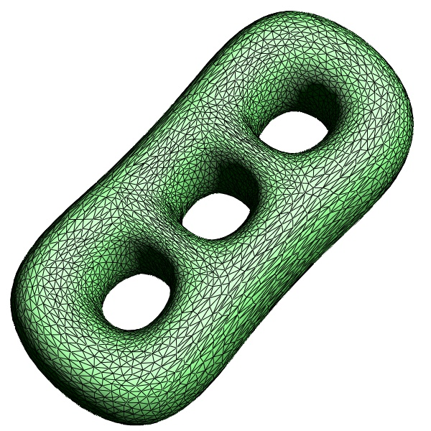
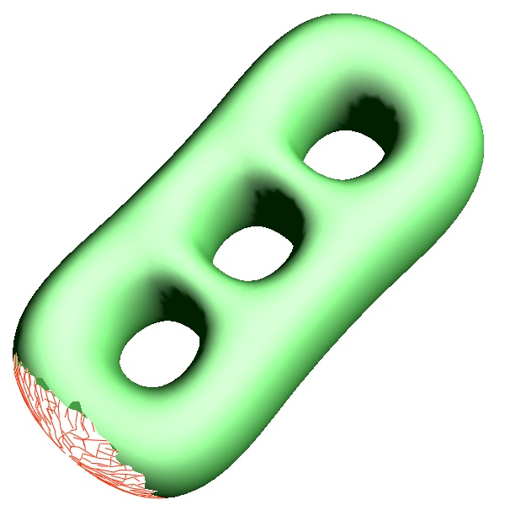
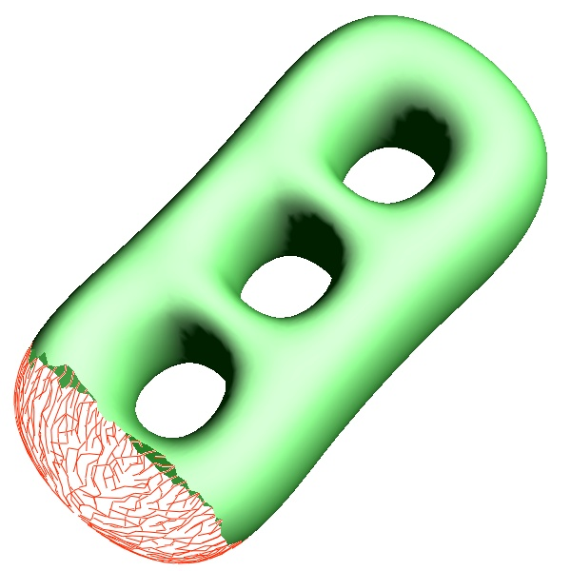
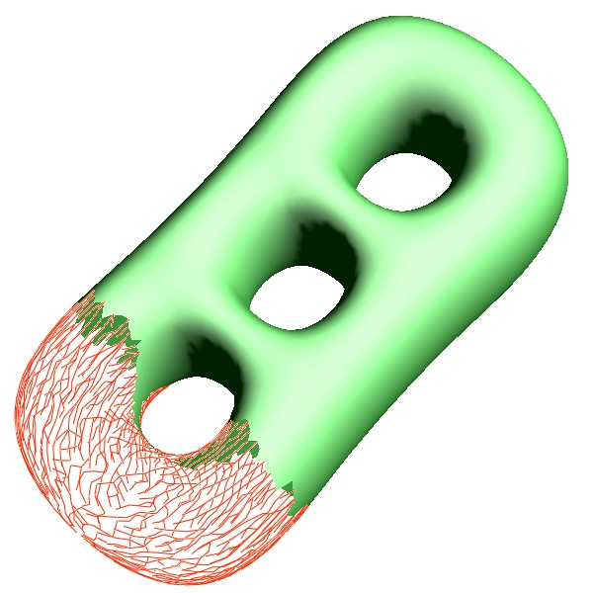
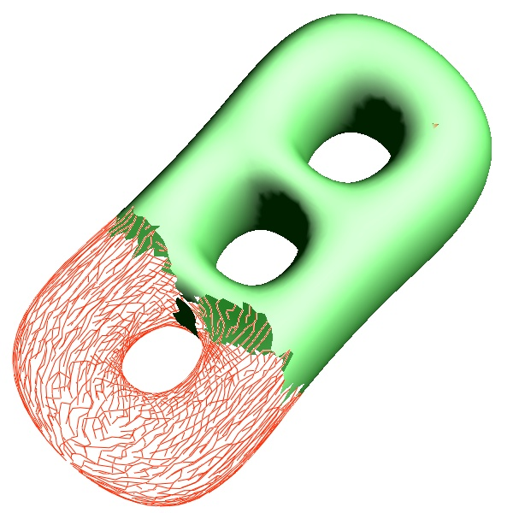
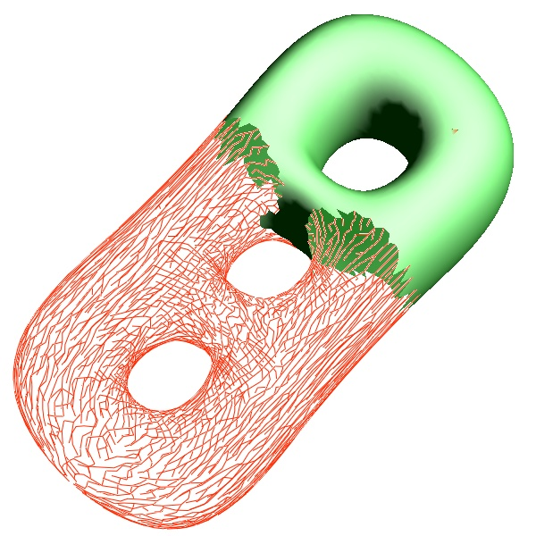
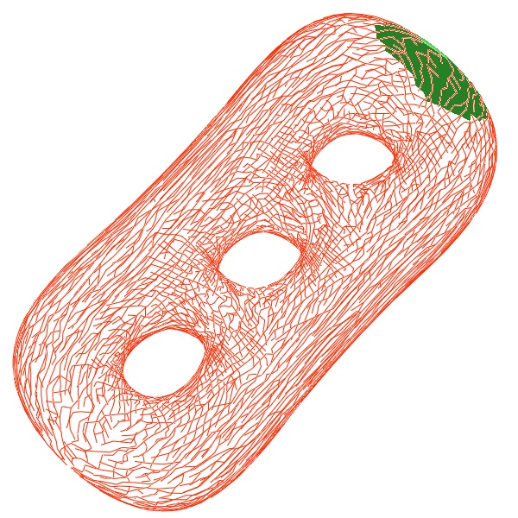
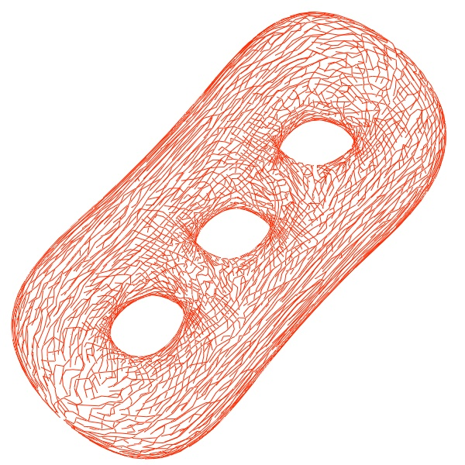
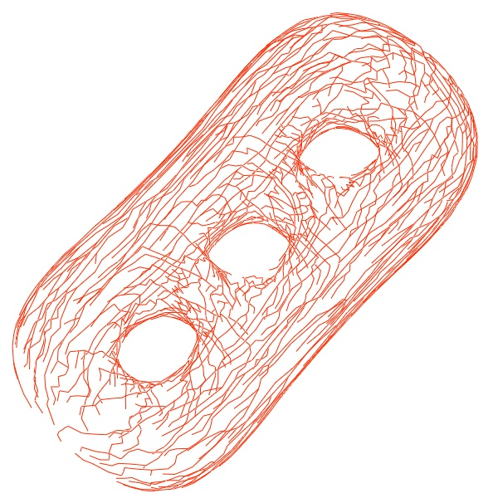
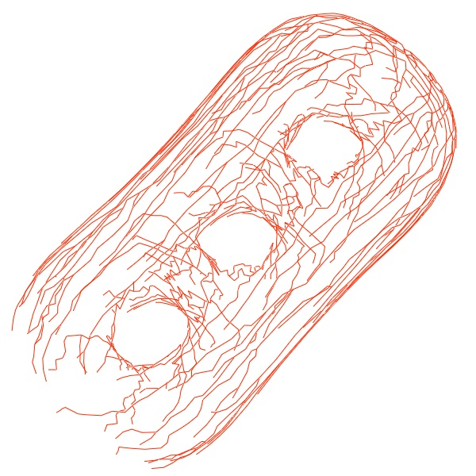
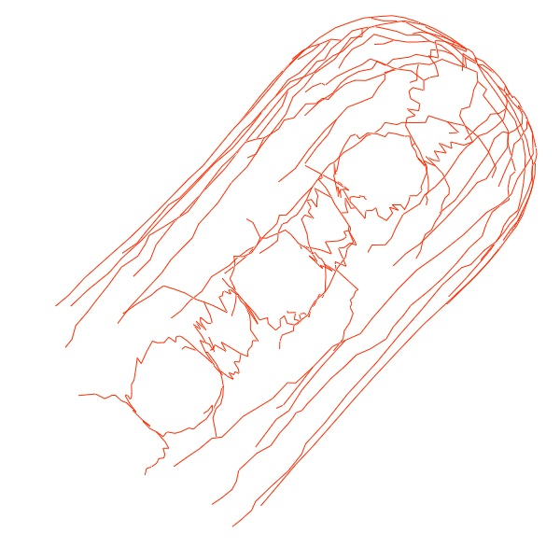
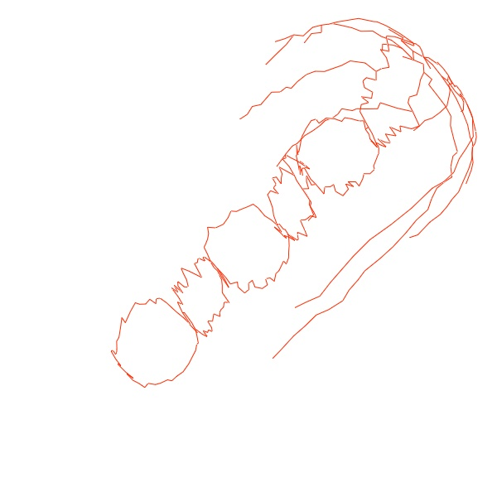
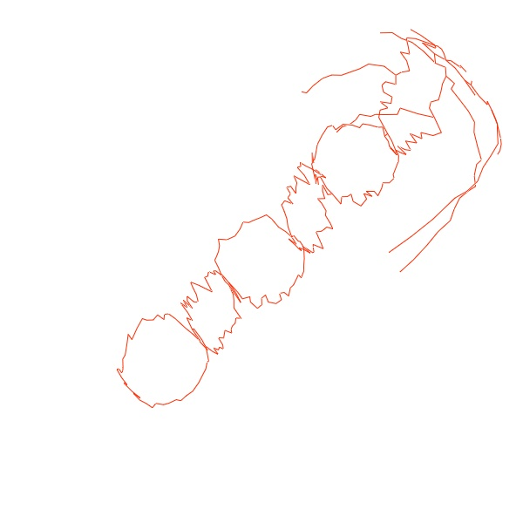
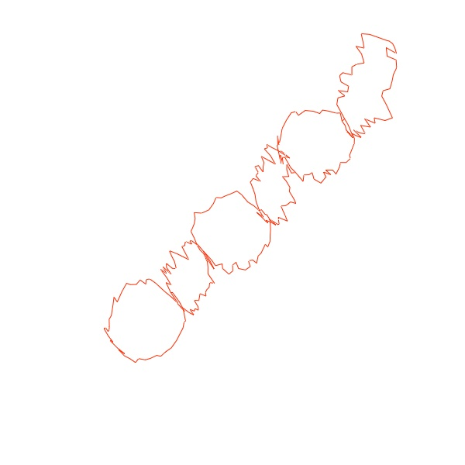
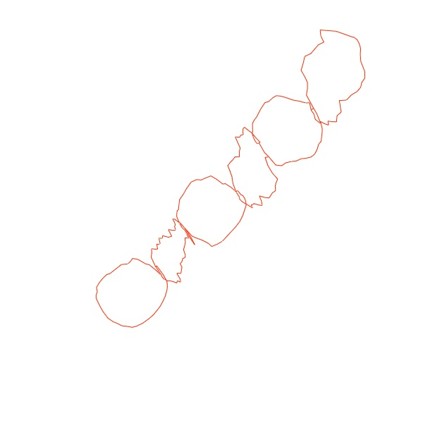
Finding 2g cycles
[Dey & Schipper 1995]
(a) retract 2-simplices
(b) retract 1-simplices
Notes:
To create a topologically-sufficient cut, we first remove a seed face. We then apply a 2-phase retraction algorithm.
<click> In the first phase, we iteratively remove any edge adjacent to a single face, as well as that face,
<click> as shown here. Note that the retraction leaves behind dangling edges.
<7 clicks> This sequence illustrates the process.
Since we have removed a topological disk, the remaining edges must form a topologically-sufficient cut.
However, the shape of the removed disk is quite convoluted, with every vertex on its boundary.
<click> Therefore, in the second phase, we iteratively retract each dangling edge,
<click> as shown here.
<6 clicks> This sequence illustrates the second phase.
Since the resulting cut may be serrated, we straighten the loops using shortest path computations, <click>, as shown here.

Slide 19
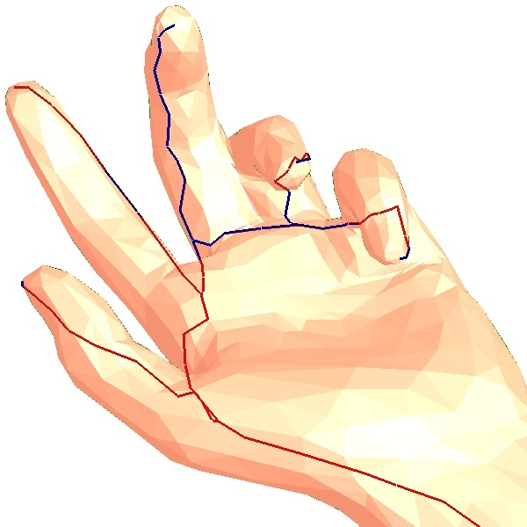
Augment cut
Make the cut pass through “extrema”.
Approach: parametrize and look for “bad” areas.
Notes:
To avoid under-sampling, we have found that it is important for the cut to pass through the various extrema of the mesh.
Extrema are not a local phenomena and are tricky to both define and discover.
In our approach, given a current cut, we find extrema by tentatively parametrizing the mesh, and then finding the region that will be most under-sampled.
The cut is then augmented to reach these extrema.

Slide 20
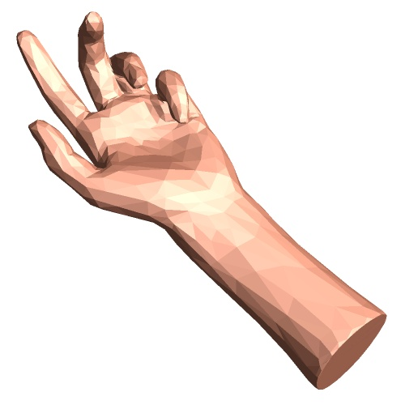
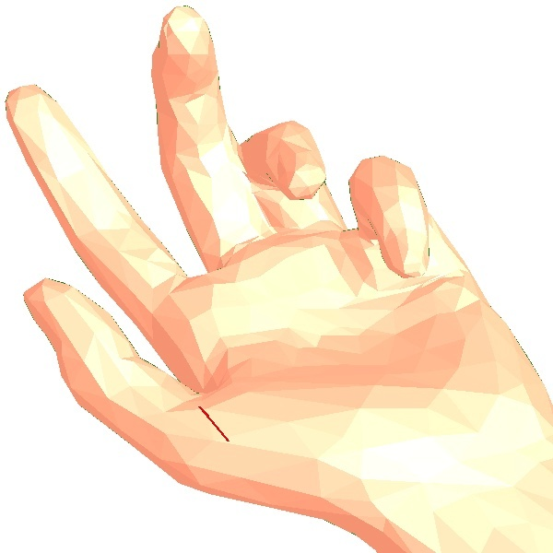



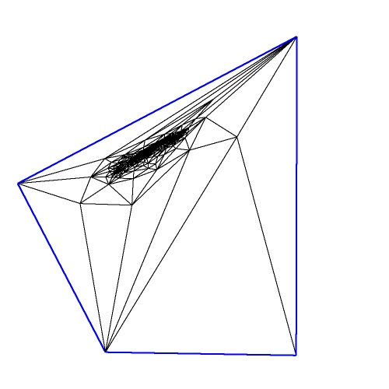
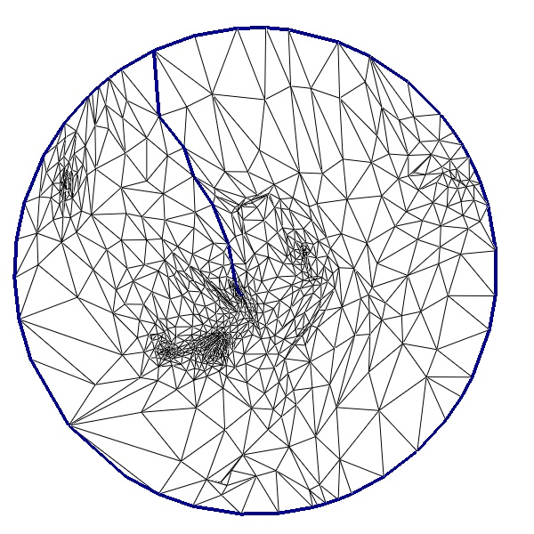
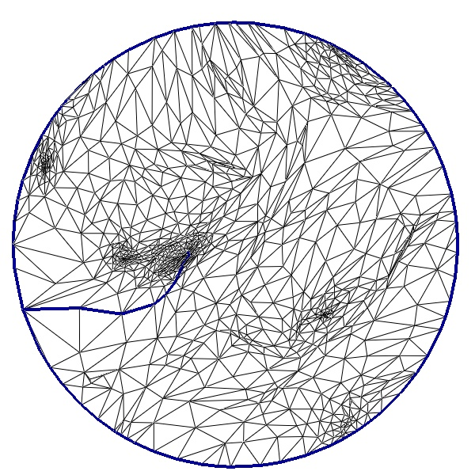
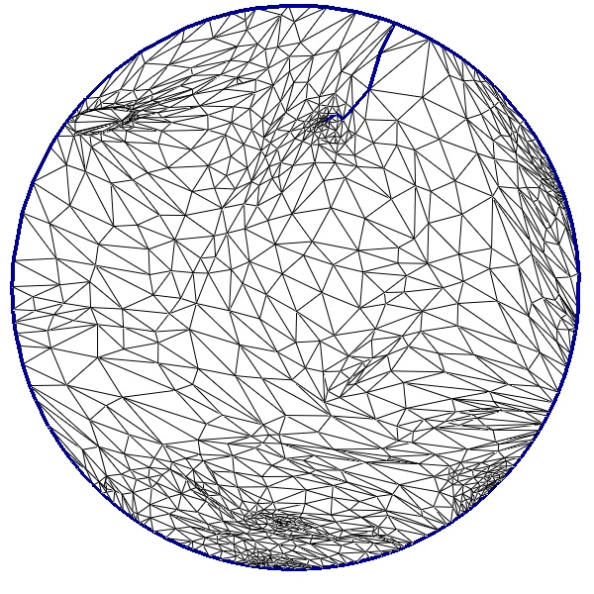
Augment cut
…iterate while parametrization improves
Notes:
We will use this genus-0 example to describe the details of the cut augmentation step.
<click> Here, the result of step 1 is simply two edges.
<click> We can therefore open and parametrize the mesh into a quadrilateral.
Note that the entire hand is hidden in the central dense mass of vertices.
Given this mapping, we locate the point where the mapping will have the greatest undersampling, <click> shown in yellow at the tip of middle finger.
<click> We extend the cut to include this point by finding the shortest path from it to the cut,
<click> and re-parametrize using the resulting cut mesh.
We repeat this process, as long as we can further improve the quality of the parametrization.
<6 clicks>

Slide 21
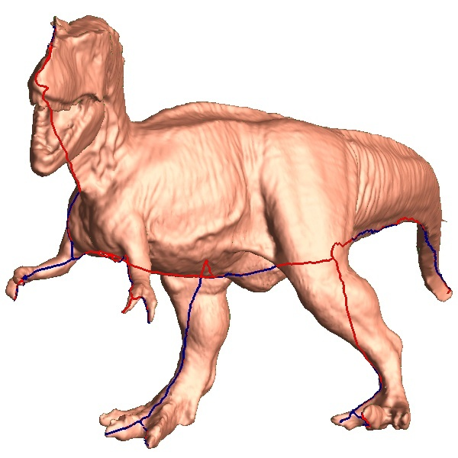
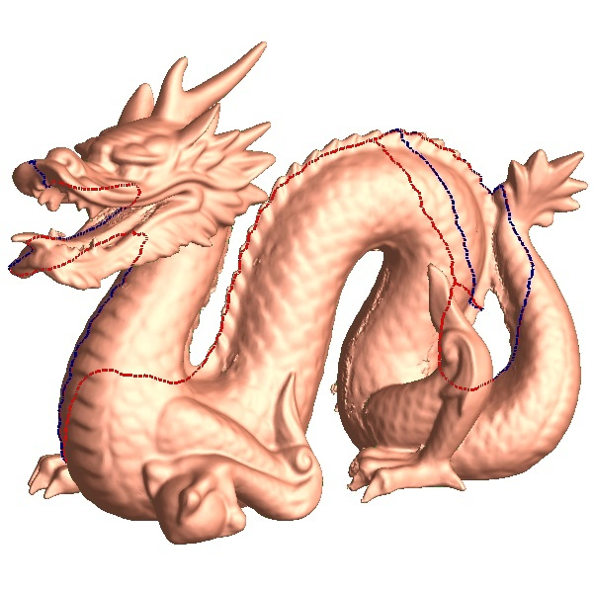
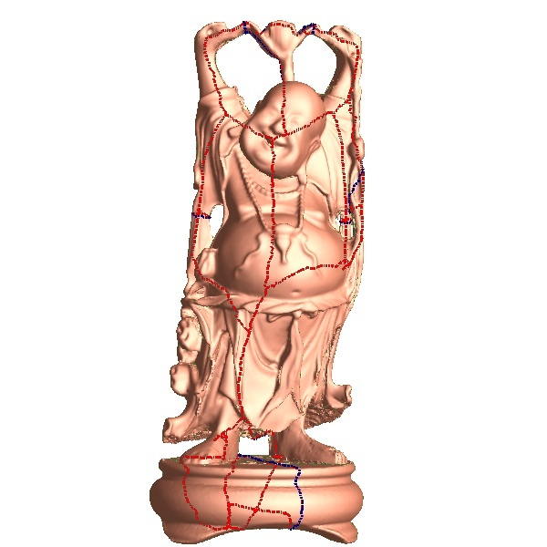
Examples of cuts
genus 0
genus 6
Notes:
Here are some examples showing the results of our complete cutting algorithm.
Observe that the cut reaches the fingertips of the tyrannosaur and the lip of the dragon.
<pause>

Slide 22

Parametrization
a
a’
a’
a
Boundary: constraints → no cracks
Notes:
We now have computed the cut for the mesh.
Our next task is to map the open mesh onto the unit square in 2D.
We first determine the parametrization of the boundary.
We must ensure that both sides of the cut will be sampled identically, so that the seams of the geometry image meet exactly, without cracks.
To achieve this, we enforce two boundary constraints.
First, each cut path is allocated the same boundary length as its mate, as shown here in blue.
Second, the endpoints of the cut paths, shown in orange, are forced to lie at grid points in 2D.
These constraints are generally easy to satisfy.

Slide 23


Parametrization
Boundary: constraints → no cracks
Interior: stretch parametrization [Sander et al 2001]
Notes:
We now have computed the cut for the mesh.
Our next task is to map the open mesh onto the unit square in 2D.
We first determine the parametrization of the boundary.
We must ensure that both sides of the cut will be sampled identically, so that the seams of the geometry image meet exactly, without cracks.
To achieve this, we enforce two boundary constraints.
First, each cut path is allocated the same boundary length as its mate, as shown here in blue.
Second, the endpoints of the cut paths, shown in orange, are forced to lie at grid points in 2D.
These constraints are generally easy to satisfy.

Slide 24


Stretch metric
linear map
2D texture domain
surface in 3D
singular values: γ , Γ
γ
Γ
Notes:
In a parametrization, <C>each triangle in the texture domain is linearly mapped to its respective triangle on the mesh surface.
<C>If we draw a unit circle on the triangle on the texture domain, it will map to an ellipse on the surface.
The lengths of the principal axes of this ellipse are the singular values of the linear map, little gamma, and big gamma.
<C>These singular values measure how much distances in texture space get stretched onto the surface.
We wish to avoid large singular values, as the resulting stretch leads to signal undersampling.

Slide 25
Stretch metric
T
linear map
2D texture domain
surface in 3D
singular values: γ , Γ
L²(T) = √(γ² + Γ²)/2
[Sander et al 2001]

Slide 26



Previous metrics
(conformal, uniform, MIPS, mean-value, …)
Stretch parametrization
Notes:
This slide shows the importance of using the stretch-minimizing parametrization, shown in the top row.
As shown on the bottom, if we were to use previous metrics found in the literature, regions of the surface would be under-sampled, resulting in a poor reconstruction.

Slide 27


General-cut results

Slide 28

General-cut results

Slide 29


General-cut results
distortion

Slide 30




Multi-chart
[Sander et al. SGP 2003]
irregular
400x160
piecewise regular

Slide 31






Discretization cracks → “snap & zipper”
undefined

Slide 32



Multi-chart result
genus 2; 50 charts
478x133
Rendering
PSNR 79.5

Slide 33
A better cut?
Gu et al 2002:
  Heuristics defined an a priori cut
  → constrains parametrization quality

Slide 34

Spherical parametrization
[Praun & Hoppe. SIGGRAPH 2003]
Genus-0 models:
  sphere is ideal
  no a priori cuts

Slide 35

Overall process

Slide 36









Steps
mesh M
sphere S
domain D
image I

Slide 37










Spherical parametrization algorithm
Convert to progressive mesh
Parametrize coarse-to-fine
(maintain embedding & minimize stretch)
[Hormann et al 1999; Sander et al 2002]
Notes:
We start by converting the model to a progressive mesh sequence, successively simplifying it using half-edge collapses, until we reach a tetrahedron. We embed the tetrahedron on the sphere and then we refine the model back to its original resolution. For each vertex split operation we assign a spherical coordinate to the newly introduced vertex, and also optimize the location of its neighbors in order to minimize map distortion.

Slide 38



Traditional conformal metric
Preserves angles but has “scale distortion”
Poor reconstruction under uniform sampling
Notes:
As I mentioned, to evaluate map distortion we use Sander’s stretch metric. The most popular metric for parametrization is conformality. This metric is not well suited for regular resampling since it suffers from area compression. In this example, the horse’s legs and head receive a very small area in the map, and therefore the remesh does a poor job at sampling those features.

Slide 39



Stretch metric
Penalizes undersampling
More accurate reconstruction
(See [Tewari et al 2004])
Notes:
By contrast, the stretch metric penalizes undersampling, by trying to map large distances on the sphere (and therefore many samples) to short distances on the mesh, so it doesn’t miss features. As you can see, this metric does a better job of capturing the horse geometry.

Slide 40




Spherical geometry images

Slide 41
Review: Construction approaches
General cut
Multi-chart
Spherical
[Gu et al. SIGGRAPH 2002]
[Sander et al. SGP 2003]
[Praun & Hoppe. SIGGRAPH 2003]
arbitrary surface
arbitrary surface
charts → zippering
genus-zero surface
→ cut symmetries

Slide 42
Applications of geometry images
Level-of-detail control
Morphing
Geometry amplification
Shape compression
Geometry clipmaps for terrain rendering

Slide 43














Level-of-detail control
Mipmap
n=1
n=2
n=4
n=8
n=16
n=32
n=64

Slide 44

Morphing
Interpolate the geometry images.
simple spherical alignment

Slide 45

Morphing
Interpolate the geometry images.
simple spherical alignment
constrained spherical param.

Slide 46







Geometry amplification
[Losasso et al. SGP 2003]
“Smooth geometry images”
simulation
CPU
GPU
33x33
65x65
129x129
floating-point
geometry image
257x257
+
257x257
scalar displacements

Slide 47

Geometry amplification
[Losasso et al. SGP 2003]

Slide 48






Shape compression: wavelets on 2D grid
spherical wavelets
image wavelets
[Schröder & Sweldens 1995]
[Davis 1995] [Antonini et al 1992]

Slide 49

Compression results

Slide 50
Geometry clipmaps:
Terrain rendering using nested regular grids
Frank Losasso (Stanford)
Hugues Hoppe (MSR)
[SIGGRAPH 2004]

Slide 51

Terrain rendering
Mount Rainier
U.S. at 30m spacing
216,000 × 93,600
→ 40GB
Olympic Mountains
Challenges:
  Concise storage (no paging hiccups)
  Fast rendering (60 frames/sec)
  Visual continuity (no pops)

Slide 52


Previous work: Irregular mesh
VDPM [Hoppe 1998], Delaunay [Cignoni et al 1997], …
Fewest triangles
CPU intensive

Slide 53


Previous work: Bin-trees
[Lindstrom et al 1996, …]
Simpler data structures & algorithms
Still CPU intensive

Slide 54

Previous work: Bin-tree regions
[Cignoni et al 2003]
Cached regions → reduced CPU cost
Temporal continuity difficult

Slide 55

Our approach: Geometry clipmap
LOD based on viewer distance, not data.
Simplicity of regular grids

Slide 56
Process terrain as an image
Mipmap [Williams 1983]
Clipmap [Tanner et al 1998]
coarsest
level
spatially
finest
level

Slide 57
Differences from texture clipmaps [Tanner 1998]
Texture clipmaps
Caches available data
LOD in screen-space
(per-pixel):
  distance from viewer
  surface orientation
Geometry clipmaps
Determines rendered data
LOD in world-space (nested rectangles):
  distance from viewer
Problem: screen-space geometry
depends on geometry LOD!

Slide 58

Video

Slide 59
Rendering of each level
Indexed triangle strips → efficient caching
Soon: vertex textures, vertices≡image
255x255 grid
60MΔ/sec

Slide 60



Need for smooth transitions
no transition
geometry transition
geometry + texture
transition
resolution
discontinuities
→
gaps
→

Slide 61


Transition regions
Vertex shader
  blend z, z_{c}
Pixel shader
  blend textures

Slide 62

Eliminating T-junctions
Numerical imprecision → dropped pixels
Simple solution: render zero-area triangles
Degenerate triangles

Slide 63

View-frustum culling
3X speedup

Slide 64
Clipmap update
Shift clipmap levels as user moves
coarsest
level
finest
level

Slide 65
Clipmap update
For each level:
  Fill exposed “L-shaped” region

Slide 66
Clipmap update
For each level:
  Fill exposed “L-shaped” region
  To avoid data shift, use toroidal access

Slide 67


Terrain data
Decompressed
Synthesized
Both are computed incrementally
→ at 60 frames/sec

Slide 68
Inter-level prediction
Predict finer level from coarser one:
T_{l} = U(T_{l-1})
  For U, use 16-point C¹ interpolant
  (tensor-product of 4-point scheme)
T_{l-1}
T_{l}
1
-9
-9
1
-1
-9
81
81
-9
9
-9
81
81
-9
9
1
-9
-9
1
-1

Slide 69
Terrain compression
Create mipmap fine-to-coarse:
    T_{l-1} = D(T_{l})
  Find optimal D using training data:
  min_{D} || T_{l} - U(D(T_{l})) ||
  Example:
T_{l-1}
T_{l}
0.01274 0.00625 -0.00507 0.01790 -0.00507 0.00625 0.01274
0.00625 -0.00041 -0.06591 -0.06754 -0.06591 -0.00041 0.00625
-0.00507 -0.06591 0.19674 0.08041 0.19674 -0.06591 -0.00507
0.01790 -0.06754 0.08041 0.55850 0.08041 -0.06754 0.01790
-0.00507 -0.06591 0.19674 0.08041 0.19674 -0.06591 -0.00507
0.00625 -0.00041 -0.06591 -0.06754 -0.06591 -0.00041 0.00625
0.01274 0.00625 -0.00507 0.01790 -0.00507 0.00625 0.01274
D_{7x7} =

Slide 70
Terrain compression
Create mipmap fine-to-coarse:
    T_{l-1} = D(T_{l})
  Find optimal D on training data:
  min_{D} || T_{l} - U(D(T_{l})) ||
Compress coarse-to-fine:
  Upsample and compute inter-level residual
    R_{l} = T_{l} – U(T_{l-1})
  Compress residual
    R_{l} = compress(R_{l})
  Replace approximation
    T_{l} ← U(T_{l-1}) + R_{l}
T_{l-1}
T_{l}

Slide 71

Compression result
U.S. height map
  30m spacing
  1m vertical resolution
  216,000 x 93,600 grid
Result:
  40GB → 350MB (factor 100!)
  rms error 1.8m (6% of sample spacing)

Slide 72

Terrain synthesis
Infinite extent & resolution
“for free”
Upsample & add Gaussian noise
T_{l} = U(T_{l-1}) + noise
  precomputed 50x50 noise texture
  per-octave amplitude from real terrain

Slide 73

Importance of letting U be C¹
bilinear interpolant (non-C¹)
16-point interpolant (C¹)

Slide 74
Screen-space level-of-detail error
Analyzed statistically
  see paper
For U.S. terrain (640x480 window)
  rms error = 0.15 pixels
  max error = 12 pixels
  99.9th percentile = 0.90 pixels

Slide 75
Limitations of geometry clipmaps
Statistical LOD error
  assumes bounded spectral density
Rendered mesh is more complex
  assumes uniformly detailed terrain
…but, optimal rendering throughput

Slide 76
Advantages of geometry clipmaps
Simplicity
Optimal throughput
Visual continuity
Steady rendering
Graceful degradation
Surface shading
Compression
Synthesis
New

Slide 77
Conclusions
Geometry image
  Simplicity of 2D grid
  Grids allow efficient traversal, random access, convolution, composition, down-sampling, compression, and synthesis.
Convergence in hardware
  Vertex textures (DirectX 9.0c)
  Unified vertex and image buffers (DirectX 10?)

Slide 79


Spherical parametrization
[Kent et al. 1992]
[Haker et al. 2000]
[Alexa 2002]
[Grimm 2002]
[Sheffer et al. 2003]
[Gotsman et al. 2003]
mesh M
sphere S
Two challenges:
  robustness
  good sampling
  ← coarse-to-fine
  ← stretch metric
[Hormann et al. 1999]
[Sander et al. 2001]
[Sander et al. 2002]
Notes:
To parameterize a model onto the sphere we want to assign to each vertex a coordinate on the sphere. Edges will correspond to great circle arcs, and mesh triangles to spherical triangles. There are two principal goals for such a map: robustness and good sampling rate. Robustness implies that the resulting map is guaranteed to be one-to-one, meaning that no triangles overlap on the sphere. By good sampling rate we mean that interesting features of the model receive enough real estate on the sphere in order to be accurately sampled. We achieve these goals by using a coarse-to-fine strategy, and minimizing map distortion using Sander et al.’s stretch metric.

Slide 80

Geometry videos
[Briceño et al. SCA 2003]
common texture
geometry images
(2,4,8 bits/vertex)

