Slide 1
Screened Poisson
Surface Reconstruction
Misha Kazhdan
Johns Hopkins University
Hugues Hoppe
Microsoft Research
Notes:
Good afternoon.
In this talk I will describe work, done in collaboration with Hugues Hoppe of Microsoft Research, on extending the Poisson surface reconstruction algorithm.

Slide 2
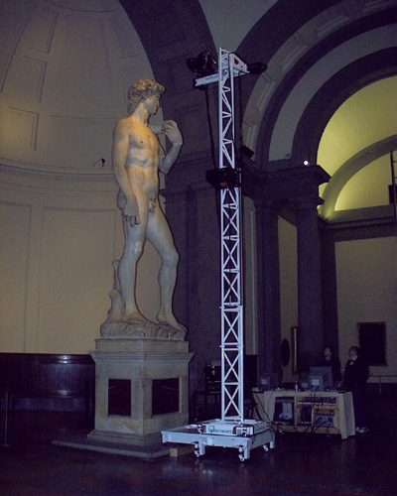
Motivation
3D scanners are everywhere:
Time of flight
Structured light
Stereo images
Shape from shading
Etc.
http://graphics.stanford.edu/projects/mich/
Notes:
Over the last few years, 3D scanners have become ubiquitous, providing a fast and inexpensive way for acquiring 3D data.

Slide 3
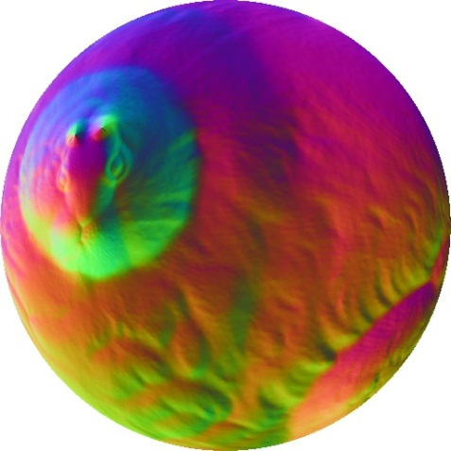
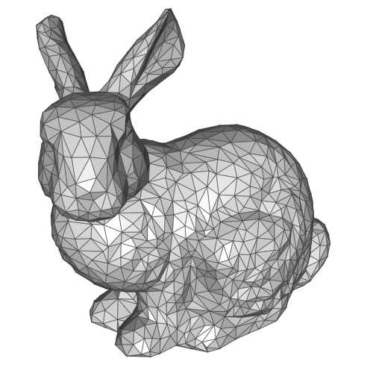
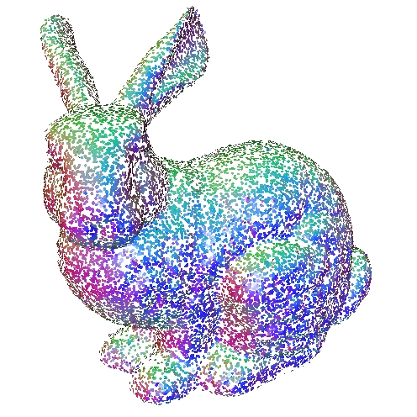
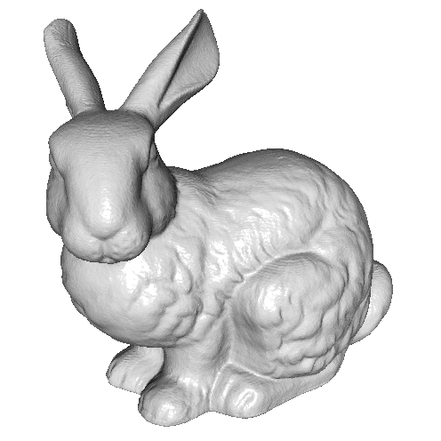
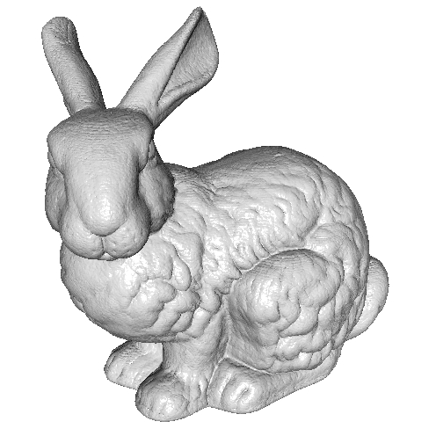
Motivation
Surface
reconstruction
Geometry
processing
Parameterization
Decimation
Filtering
etc.
Notes:
One of the challenges related to the area of scanning has been transforming the raw data returned by the scanners into manifold surface geometry.
This process of surface reconstruction enables further downstream geometry processing such as
Mesh parameterization for texture mapping
Decimation to obtain lower complexity models,
Filtering for exaggerating detail in the model,
And so on

Slide 4
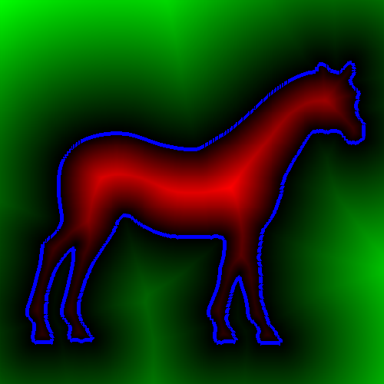

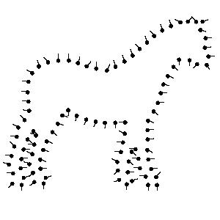
Implicit Function Fitting
  Given point samples:
  Define a function with value zero at the points.
  Extract the zero isosurface.
>0
F(q) =0
F(q)<0
0
F(q)>0
Sample points
<0
F(q)
Notes:
One common ways to address this problem has been to represent the surface by an implicit function.
Given the scanned points, a 3D scalar function is fit to the data, with value less than zero inside the model and value greater than zero outside.
Then
[CLICK]
The reconstructed surface is obtained by extracting the subset of points at which the function equals zero.

Slide 5
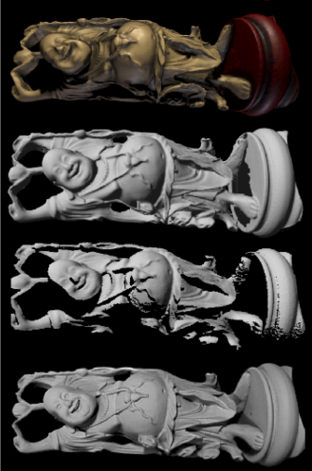
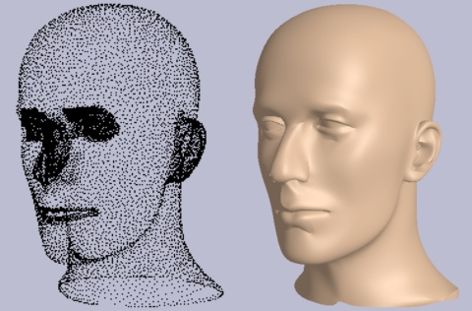
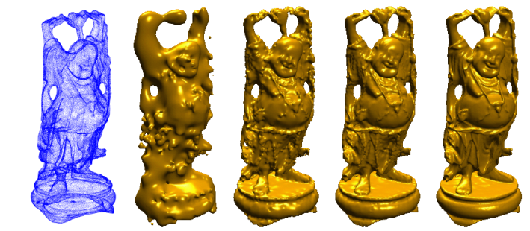
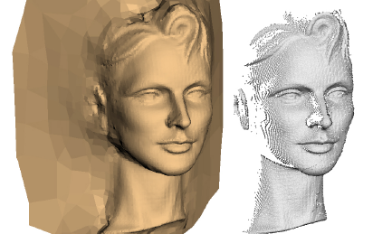
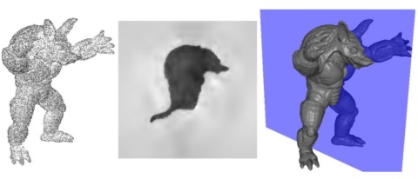
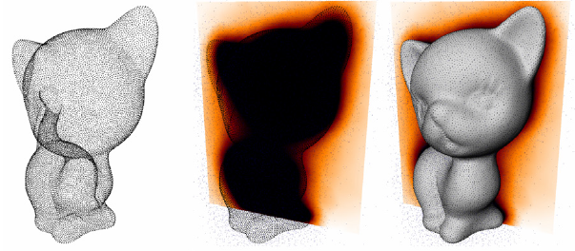
Related work
[Hoppe et al. 1992]
[Curless and Levoy 1996]
[Carr et al. 2001]
[Kazhdan et al. 2006]
[Alliez et al. 2007]
[Calakli and Taubin 2011]
… and many more …
Notes:
Due to the importance of the reconstruction problem, numerous implicit techniques have been proposed for addressing the problem.
[CLICK]
In this work we focus on the Poisson reconstruction algorithm, which we describe in more detail.

Slide 6
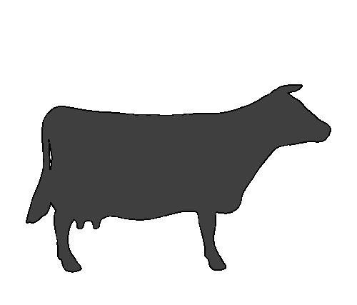
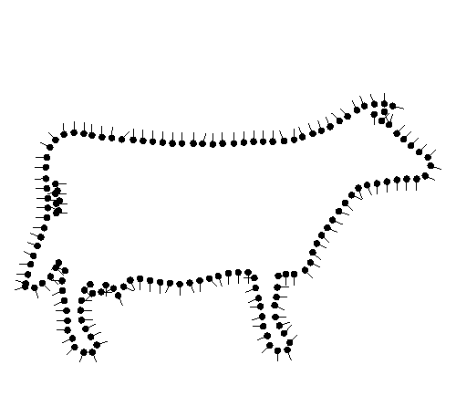




Poisson Surface Reconstruction [2006]
  Oriented points ≈ samples of indicator gradient.
  Fit a scalar field to the gradients.
$$χ=\min_{F}{{\left\|\text{∇}F−\vec{V}\right\|}^{2}}$$
$$\text{∇}χ=\vec{V}$$
χ(q)=0.5
χ(q)=-0.5
$$χ\left(q\right)$$
$$\vec{V}\left(q\right)$$
Notes:
The idea behind this approach is as follows:
If one considers the indicator function with constant negative value inside the model and constant positive value outside, the gradient of this function will be zero away from the boundary, and the oriented samples can be understood to be a discretization of the gradient.
[CLICK]
Thus, the problem of surface reconstruction can be solved by inverting the process:
Finding the scalar function whose gradients best fit the scanned point samples.

Slide 7
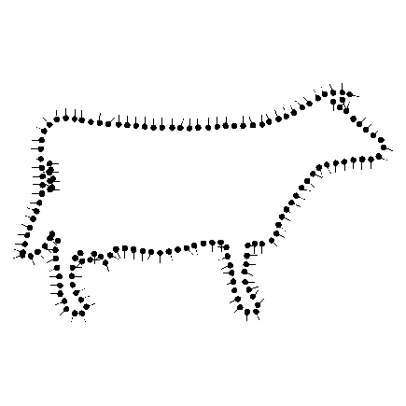

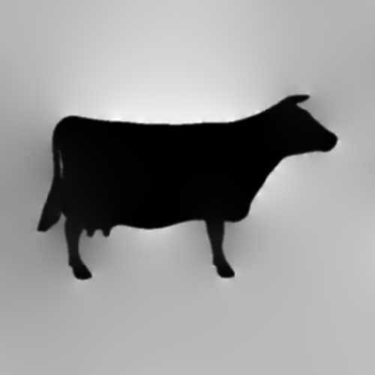




Poisson Surface Reconstruction [2006]
  Compute the divergence
  Solve the Poisson equation
$$\vec{V}\left(q\right)$$
$$χ\left(q\right)$$
$$\text{∇⋅}$$
$$Δ^{−1}$$
Notes:
In practice, the reconstruction is performed as follows.
First, the point samples are extended into a continuous vector field and the divergence of the vector field is computed.
[CLICK]
Then, the Poisson equation is solved to get back the scalar field with best-fitting gradients.

Slide 8
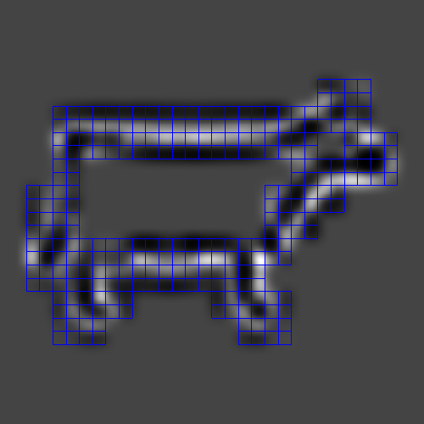
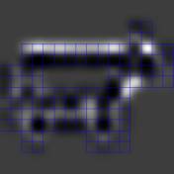
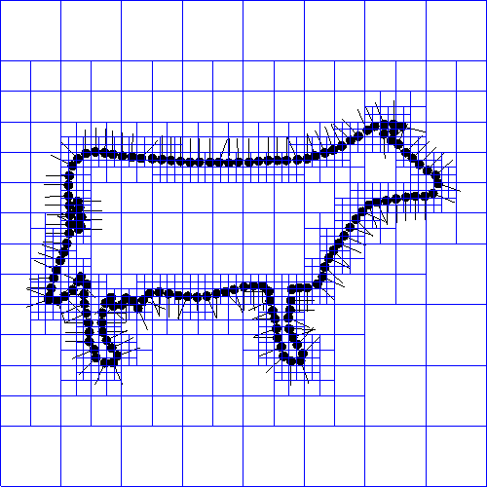
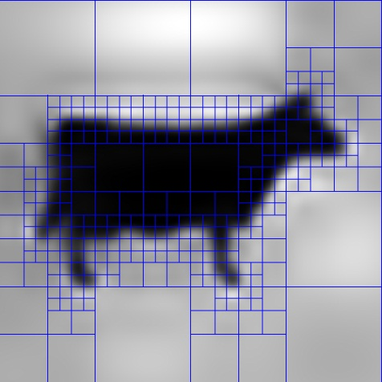
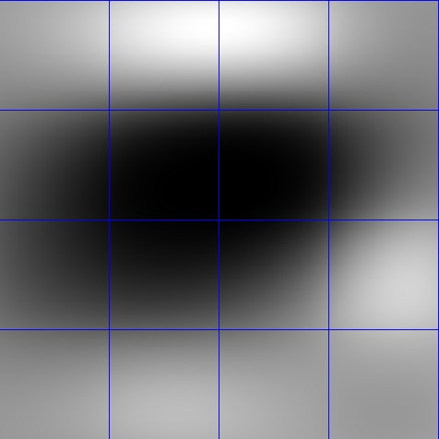
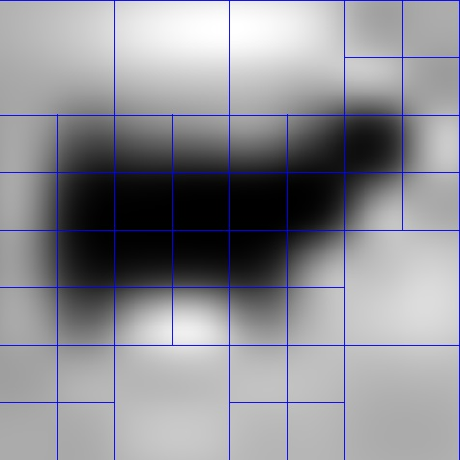
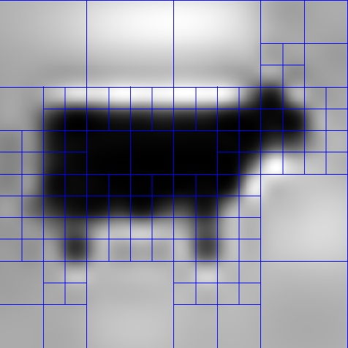
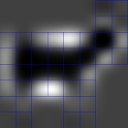
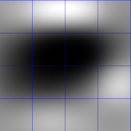
Poisson Surface Reconstruction [2006]
  Compute the divergence
  Solve the Poisson equation
    Discretize over an octree
    Update coarse → fine
fine
+
+
$$\vec{V}\left(q\right)$$
$$χ\left(q\right)$$
+
$$\text{∇⋅}$$
$$Δ^{−1}$$
+
coarse
Solution
Correction
Notes:
The system is solved by discretizing over an adapted octree, and proceeds as follows:
Starting at the coarsest resolution,
[CLICK]
We obtain an initial estimate of the solution.
Then, proceeding to the next finer level of the hierarchy,
[CLICK]
We first subtract off the divergence constraints already met at the coarser resolution, and then
[CLICK]
Compute the solution to the residual system, obtaining finer details of the implicit function.
Iterating over successively finer resolutions,
[CLICK]
We subtract off the met constraints, and solve the residual system to obtain the finer correction term…
… obtaining the indicator function as the sum of the solutions from the different levels.

Slide 9
Poisson Surface Reconstruction [2006]
  Properties:
  Supports noisy, non-uniform data
  Over-smoothes
  Solver time is super-linear
Notes:
We have chosen this approach, in part, because it has been shown to be quite robust in the presence of noise and non-uniform sampling.
However it suffers from two limitations:
First, it generates reconstructions that have less detail than the input point samples.
And second, the running time is not optimal.

Slide 10
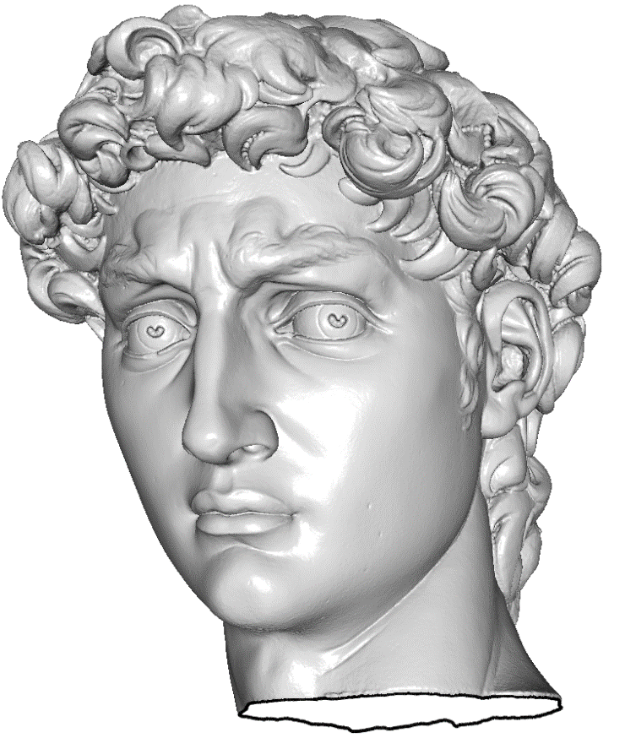
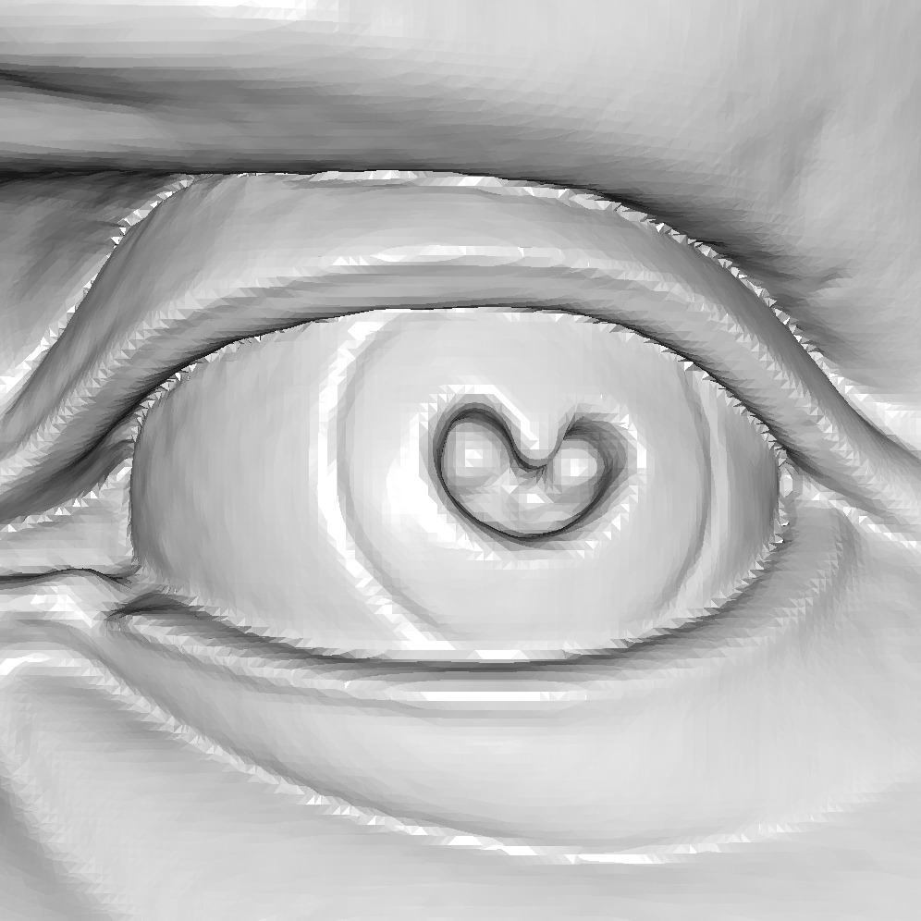
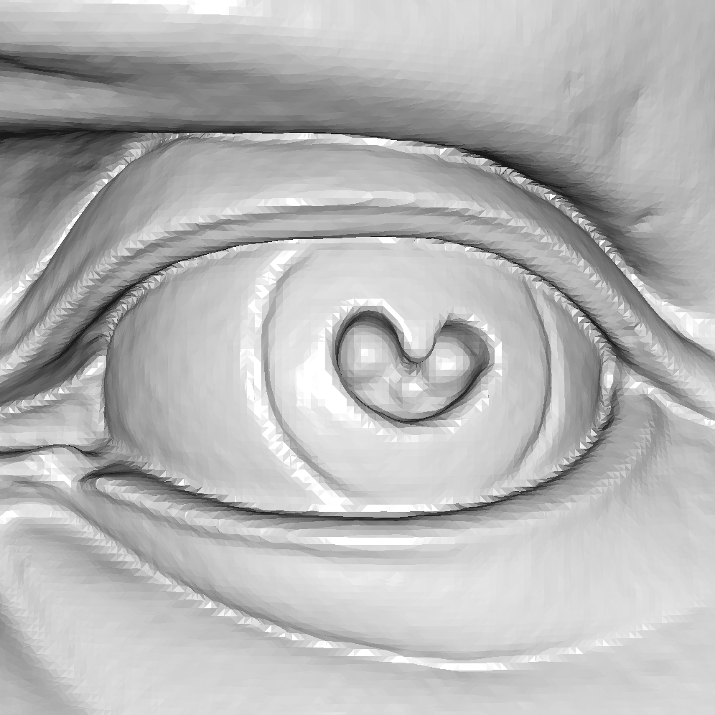
Screened Poisson Reconstruction
Higher fidelity – at same triangle count
Faster – solver time is linear
Poisson
Screened Poisson
Notes:
In this work, we address both concerns.
We show how to obtain sharp reconstructions, with the same triangle budget.
And we show that this can be done more efficiently, by designing a linear time solver.

Slide 11
Outline
Introduction
Better / faster reconstruction
Evaluation
Conclusion
Notes:
We will look at both of these contributions in turn, starting with higher quality reconstructions.

Slide 12


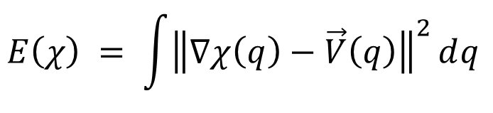
Better Reconstruction
Add discrete interpolation to the energy:
  $χ$ encouraged to be zero at samples
Adds a bilinear SPD term to the energy
Introduces inhomogeneity into the system
$$E\left(χ\right) = \int{{\left\|\text{∇}χ\left(q\right)−\vec{V}\left(q\right)\right\|}^{2}ⅆq }$$
$$+ λ\sum_{p∈P}{\left\|χ\left(p\right)−0\right\|2}$$
Gradient fitting
Sample interpolation
[Carr et al.,…,Calakli and Taubin]
Notes:
In the original algorithm, the implicit function is obtained by finding the scalar function whose gradient best matches the point samples.
Inspired by earlier approaches,
[CLICK]
We modify the optimization by incorporating a screening energy that explicitly encourages the function to be zero-valued at the sample positions.
[CLICK]
The advantage of this approach is that the added energy is still positive and quadratic, so the system is still characterized by a symmetric positive definite matrix, and the same multigrid hierarchy used to solve the original Poisson equation can be used to solve the screened equation.
[CLICK]
On the other hand, the modified energy is inhomogeneous, making it more difficult to formulate and solve the system efficiently.

Slide 13
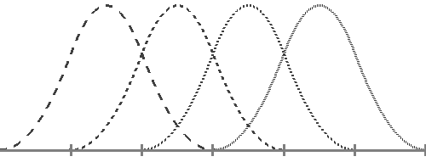
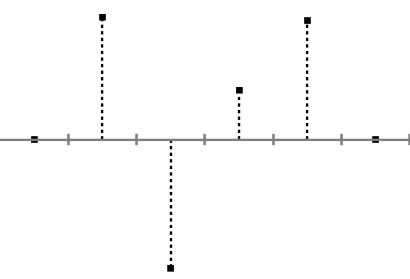
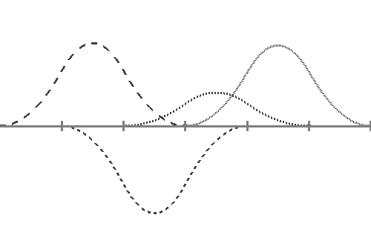
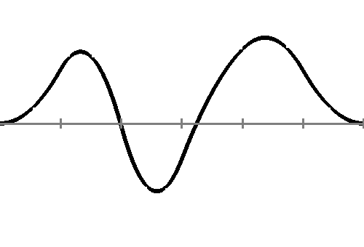
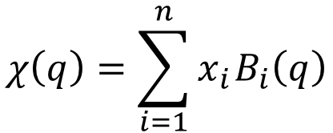




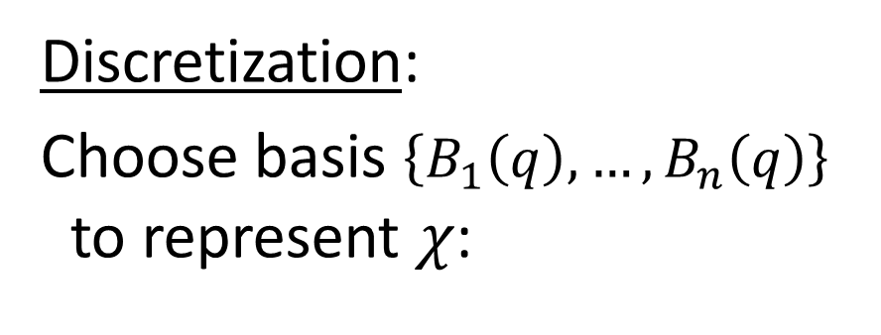




Better Reconstruction
Discretization:
Choose basis $\left\{B_{1}\left(q\right),…,B_{n}\left(q\right)\right\}$
to represent $χ$:
$$B_{i−1}\left(q\right)$$
$$B_{i}\left(q\right)$$
$$B_{i+1}\left(q\right)$$
$$B_{i+2}\left(q\right)$$
$$x_{i−1}$$
$$x_{i+2}$$
$$χ\left(q\right)=\sum_{i=1}^{n}{x_{i} B_{i}\left(q\right)}$$
$$x_{i+1}$$
$$x_{i}$$
Notes:
To see why this is, recall the finite elements framework.
The idea is to transform the continuous system of equations into a finite-dimensional system by discretizing over a finite basis.
[CLICK]
This way, the problem of finding the indicator function reduces to solving a linear system for its coefficients.

Slide 14
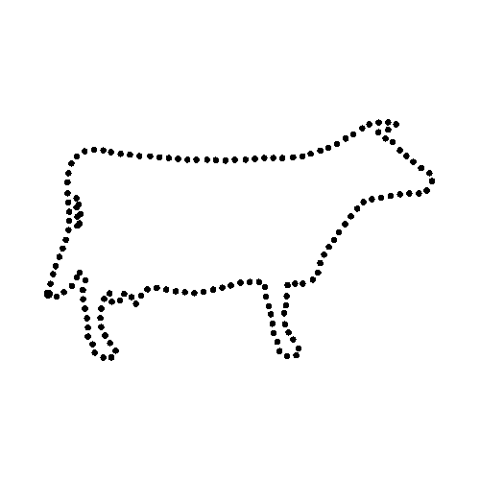
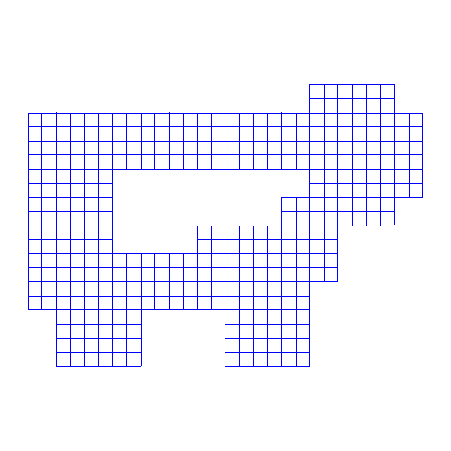
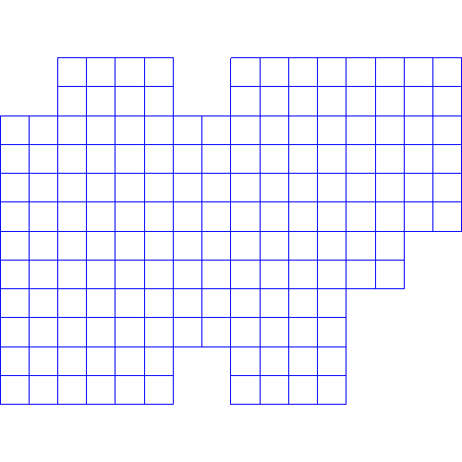

Better Reconstruction
Discretization:
For an octree, use B-splines:
  centered on each node
  scaled to the node size
Notes:
In the context of surface reconstruction, the basis we use is made up of B-splines indexed by the cells of the octree.
That is,
[CLICK]
To each cell of the tree, we assign a tri-variate B-spline that is centered on the cell and scaled to match the cell’s extent.
[CLICK]
Thus, there are fewer B-splines associated with coarser cells, they are smoother, and have larger support.

Slide 15
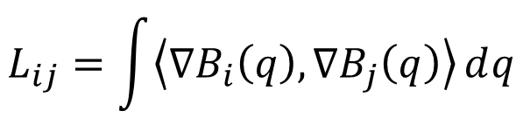
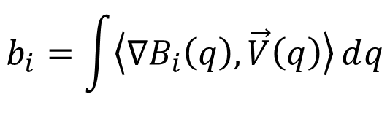

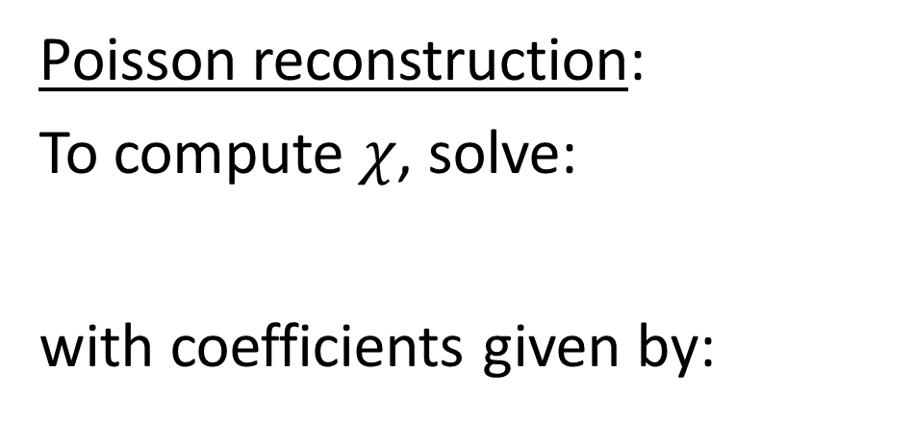
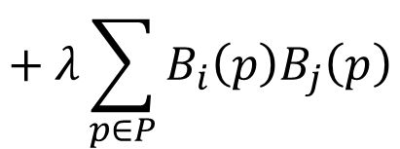
Better Reconstruction
Screened
Poisson reconstruction:
To compute $χ$, solve:
with coefficients given by:
^
$$L x=b$$
B_{j}
B_{i}
$$L_{ij}=\int{\left\langle \text{∇}B_{i}\left(q\right),\text{∇}B_{j}\left(q\right)\right\rangle ⅆq}$$
$$+ λ\sum_{p∈P}{B_{i}\left(p\right)B_{j}\left(p\right)}$$
$$b_{i}=\int{\left\langle \text{∇}B_{i}\left(q\right),\vec{V}\left(q\right)\right\rangle ⅆq}$$
Notes:
For the original Poisson reconstruction, this defines a linear system, Lx=b, where the matrix entries are obtained by integrating the dot-product of gradients of the basis function.
[CLICK]
For the screened Poisson reconstruction, the coefficients are modified by adding the sum of the product of basis function, taken over the point-set.

Slide 16
Better Reconstruction
Screened
Poisson reconstruction:
  Sparsity is unchanged
  Entries are data-dependent
^
B_{j}
B_{i}
B_{j}
B_{i}
$$L_{ij}=\int{\left\langle \text{∇}B_{i}\left(q\right),\text{∇}B_{j}\left(q\right)\right\rangle ⅆq}$$
$$+ λ\sum_{p∈P}{B_{i}\left(p\right)B_{j}\left(p\right)}$$
$$b_{i}=\int{\left\langle \text{∇}B_{i}\left(q\right),\vec{V}\left(q\right)\right\rangle ⅆq}$$
Notes:
The advantage of this approach is that, conceptually, modifying the system is straightforward.
Moreover, a matrix entry will only be modified if the original, unscreened coefficient was non-zero – so the sparsity of the linear system doesn’t change.
However,
[CLICK]
Now the matrix coefficients depend not only the relative position of the cells, but also on how the point samples are distributed within them.
This makes defining the linear system inefficient because:
We can’t represent the matrix by a fixed stencil, and
[CLICK]
The definition of the coarser matrix entries becomes computationally expensive, as more points fall within the supports of the basis functions.

Slide 17
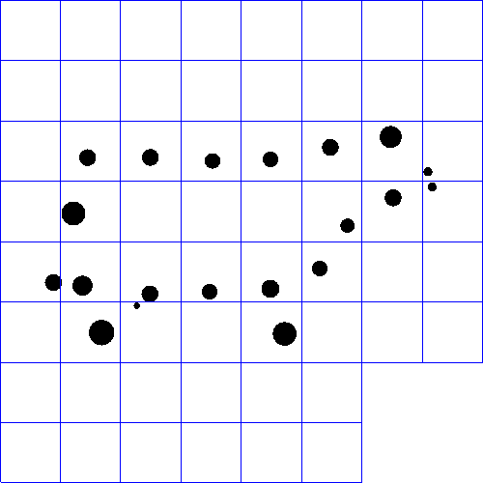
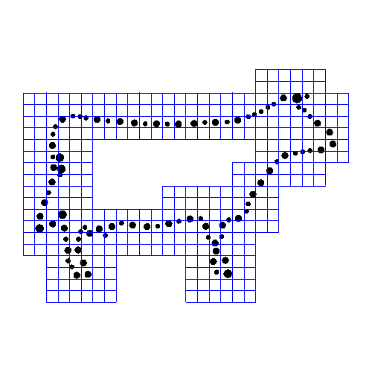
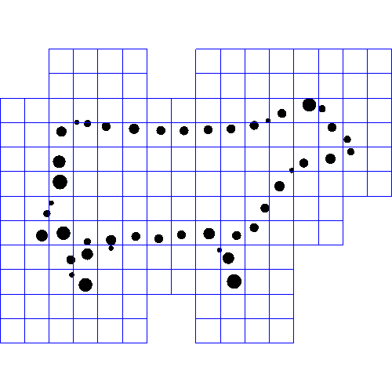
Faster Screened Reconstruction
Observation:
At coarse resolutions, no need
to screen as precisely.
⇒ Use average position,
weighted by point count.
B_{j}
B_{i}
B_{j}
B_{i}
B_{j}
B_{i}
Notes:
To make the computation of the new system matrices more efficient, we recall that at coarser resolutions, we have fewer basis functions and they are smoother.
[CLICK]
So we don’t need to constrain the positions of the zero-crossing as precisely.
[CLICK]
We take advantage of this by replacing the multiple samples falling within a cell with a single weighted point, with weight proportional to the number of points in the cell.
Then when we incorporate the screening constraints,
[CLICK]
we only have to take the sum over a small number of points
[CLICK]
Regardless of the level of the octree

Slide 18



Faster Reconstruction
Solver inefficiency:
  Before updating, subtract constraints
  met at all coarser levels of the octree.
  ⇒ $O\left(n log n\right)$ complexity
fine
+
$$χ\left(q\right)$$
+
+
coarse
Solution
Correction
Notes:
Independent of the screening, there is still the issue of the log-linear complexity of the original Poisson solver:
[CLICK]
Prior to computing the correction term at a given resolution, we need to adjust the constraints to account for the corrections already obtained at all coarser resolutions.

Slide 19



Faster Reconstruction
Regular multigrid:
Function spaces nest
⇒ can upsample coarser solutions to finer levels
Notes:
This problem doesn’t arise in traditional multigrid because the function spaces nest.
That is,
[CLICK]
Given a B-spline at a coarser level of the hierarchy,
[CLICK]
We can always express it as the linear combination of B-splines at the next level.
[CLICK]
And those can be expressed as the linear combinations of still finer B-splines.
And so on.
[CLICK]
In particular, this means that we can always upsample the coarser solutions to finer levels of the tree, and don’t need to account for each solution separately.

Slide 20


Faster Reconstruction
Adaptive multigrid:
Function spaces do not nest
⇒ coarser solutions need to be stored explicitly
Notes:
In contrast, in the adaptive setting,
[CLICK]
A coarser basis function can’t necessarily be represented as the linear combination of finer basis functions, because not all of the required basis functions are in the space.
[CLICK]
Requiring us to store the coarser correction terms individually and adjust the system constraints using each one in term.
We address this problem by enriching the function spaces.

Slide 21
Faster Reconstruction
Naive enrichment:
⇒ Complete octree
Notes:
The naïve solution would be to enrich the function spaces by adding the basis function needed to support upsampling,
But this results in a complete octree.

Slide 22
Faster Reconstruction
Observation:
Only upsample the part of
the solution visible to the finer basis.
Notes:
Our key observation is that we only need to maintain the part of the coarser solution that can affect the constraints at finer resolutions.

Slide 23










Faster Reconstruction
Enrichment:
Iterate fine → coarse
    Identify support of next-finer level
    Add visible functions
Notes:
This motivates an following enrichment algorithm:
Working fine to coarse
[CLICK]
We identify the support of functions at the next finer level.
For each function at the current level we check if its support overlaps.
[CLICK]
If the support doesn’t overlap, then any part of the solution represented by that coarser function wouldn’t be seen at the finest level, so we can ignore it.
[CLICK]
If it does overlap, we add the coarser function to the basis.
[CLICK]
Continuing in this way, for the rest of the coarser functions,
[CLICK]
And then repeating the process for coarser levels, we obtain an enriched set of function spaces that support upsampling and are still adaptive.

Slide 24


Faster Reconstruction
Original
Enriched
Notes:
In terms of the octree representation, this amounts to refining the coarser levels of the tree near the samples.

Slide 25












Faster Reconstruction
Adaptive Poisson solver:
  Update coarse → fine
    Get supported solution
    Adjust constraints
    Solve residual
+
+
+
+
+
+
$$χ\left(q\right)$$
+
+
+
+
+
Solution
Correction
Visible Solution
Notes:
We can now modify the solver so that adjusting the constraints at each level only requires knowing the visible part of the solution that was upsampled to the previous level.
As before, we start at the coarsest level and compute the solution there.
[CLICK]
Since we are at the coarsest resolution, the solution, the correction, and the visible solution are equal.
[CLICK]
Using the visible solution, we modify the constraints at the next level
[CLICK]
And compute the correction term there
[CLICK]
We obtain the finer visible solution by upsampling the visible solution from the previous level and adding the correction term from the current level.
[CLICK]
Now we proceed as before, updating the constraints at the next level, computing the correction, and adding the correction term to the upsampled visible solution.
[CLICK]
This time, because of the adaptivity of the octree,
[CLICK]
the visible solution differs from the true solution.
However, the important point is that where they differ is precisely where the are no finer nodes in the octree. So the difference is imperceptible at the finer levels.
[CLICK]
And, we proceed as before.

Slide 26
Outline
Introduction
Better / faster reconstruction
Evaluation
Conclusion
Notes:
Let’s take a look at the implication of these changes.

Slide 27













Accuracy
Poisson
Screened Poisson
SSD [Calakli & Taubin]
$$z$$
z
z
$$z$$
$$z$$
$$x$$
$$x$$
$$x$$
Notes:
We begin with a visual inspection of the reconstructed surfaces.
[CLICK]
On the left you see the head of the Neptune model, obtained using the original Poisson reconstruction, and on the right you see our screened reconstruction.
At this resolution, it is hard to see the difference.
[CLICK]
We can get a better sense of what’s going on by zooming in on a small cross-section, showing both the section of the surface on the mustache and the input points around it.
As the figures on the bottom show, using our screened Poisson reconstruction gives a surface that more accurately fits the data.
[CLICK]
Comparing to the Smooth Signed Distance reconstruction of Calakli and Taubin, we see that our screening gives reconstructions competitive with recent techniques.

Slide 28












Accuracy
Poisson
Screened Poisson
SSD [Calakli & Taubin]
$$z$$
$$z$$
$$z$$
$$x$$
$$x$$
$$x$$
Notes:
Looking at the David model, and focusing on a cross-section of the pupil, we again see that screening results in a surface that more accurately fits in the data.
In this case, perhaps because of the noise in the data, the method of Calakli and Taubin has more trouble fitting the points.

Slide 29
Performance
Solver | Time | Space
Poisson | 89 sec | 422 MB
Poisson (optimized) | 36 sec | 604 MB
Screened Poisson | 44 sec
SSD [Calakli & Taubin] | 3302 sec | 1247 MB
Input: 2x10⁶ points
Notes:
We can also evaluate the performance of our implementation.
If we just consider the unscreened reconstruction
[CLICK]
We see that replacing the log-linear solver with a linear time solver solver results in an almost three-fold reduction in running time.
When we take screening into account,
[CLICK]
We see a small hit in running time, due to the enriched function space, the added cost of computing the matrix coefficients, and the inhomogeneity of the system.
For both systems, our use of a multigrid solver
[CLICK]
Provides significant gains over single-resolution methods that resort to the less efficient conjugate-gradients technique.
We also observe that even though we enrich the function space,
[CLICK]
The additional overhead in space is not significant.

Slide 30
Performance
Solver | Time | Space
Poisson | 412 sec | 1498 MB
Poisson (optimized) | 149 sec | 2194 MB
Screened Poisson | 172 sec
SSD [Calakli & Taubin] | 19,158 sec | 4895 MB
Input: 5x10⁶ points
Notes:
Looking at the performance numbers for the David head, we see similar results:
An almost three-fold improvement in the running time for the unscreened reconstruction due to the improved solver,
A negligible increase in running time and memory usage for the screened Poisson reconstruction,
And significant efficiency gains due to the use of a multigrid solver.

Slide 31






Limitations
Assumes clean data
$$z$$
$$x$$
Poisson
Screened Poisson
Notes:
While we have found that the method works well on many models, we stress that the method does not work for all datasets.
In particular, screening only makes sense when the point set has little noise, so that interpolation is desirable.
For models like the Lucy,
[CLICK]
Where the point samples are noisy and the scans aren’t well-registered, screening results in lower quality reconstructions.

Slide 32
Summary
Screened Poisson reconstruction:
Sharper reconstructions
Optimal-complexity solver
Notes:
In summary, this work has shown how to extend the Poisson reconstruction algorithm to better interpolate the samples.
We have shown that this results in higher-quality reconstructions,
And we have described an optimal, linear-time, implementation of a hierarchical solver that makes the method efficient.

Slide 33


Future Work
Robust handling of noise
(Non-watertight reconstruction)
Extension to full multigrid
Notes:
In the future, we would like to consider several challenges.
First,
[CLICK]
We would like to analyze the situation of noisy data better, exploring adaptively setting the screening weights to support better reconstruction where the data is good.
Following up on feedback from users
[CLICK]
We have also been looking at extending the technique to non-water-tight reconstruction, so as not to introduce surfaces where point samples are missing.
In fact, we put this in parentheses because this a problem we have just recently solved, and we have made this implementation publicly available.
[CLICK]
We are also exploring extensions of the solver. The current linear-time implementation supports a strictly coarse-to-fine approach. We would like to extend it to support more general multigrid, including multiple V- and W-cycles.

Slide 34



Thank You!
Data:
  Aim@Shape, Digne et al., EPFL,
  Stanford Shape Repository
Code:
  Berger et al., Calakli et al.,
  Manson et al.
Funding:
  NSF Career Grant (#6801727)
http://www.cs.jhu.edu/~misha/Code/PoissonRecon
Notes:
Finally, we would like to conclude by thanking everybody who has made this work possible, including sharing of data, code, and funds.
Thank you very much for your attention.

