Slide 1
Random-Access Rendering of
General Vector Graphics
Diego Nehab and Hugues Hoppe
Microsoft Research
Notes:
Resize this thing to fit all text!

Slide 2
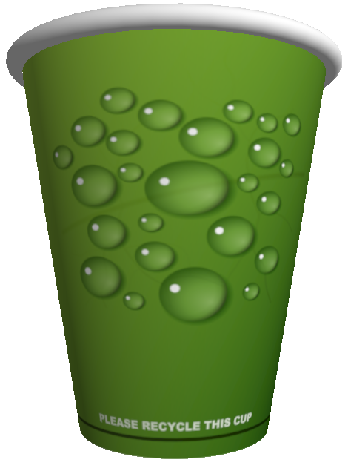



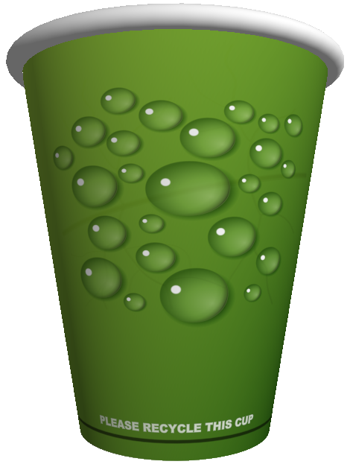



Vector graphics and resolution independence
Notes:
Let‘s say you want to map a figure over a 3D model. If you use regular texture mapping, as you zoom in, the boundaries become blurred, due to the finite texture resolution.
With vector graphics, no matter how much you magnify, the content remains sharp.

Slide 3
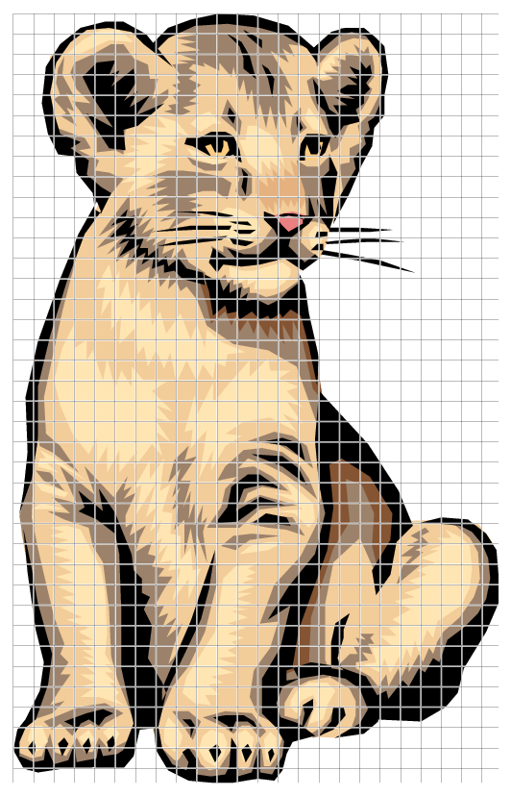

Random-access vector graphics
Color at a point depends only on neighborhood
Cell
Cell grid
Notes:
In order to use vector graphics as a textures, we need random access to the color at each point.
Fortunately, each point’s color depends only on local information. We can therefore divide the figure into cells, and compute the color of a point by looking only at the contents of the cell the point belongs to.
This greatly improves rendering speed.

Slide 4

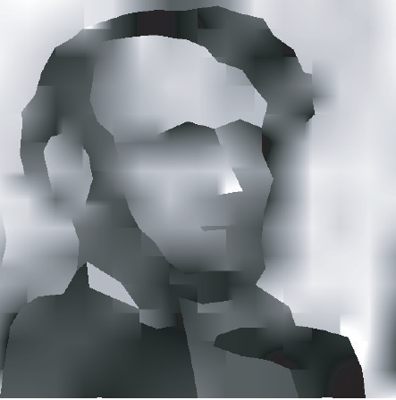



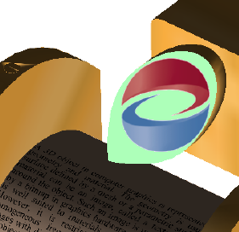
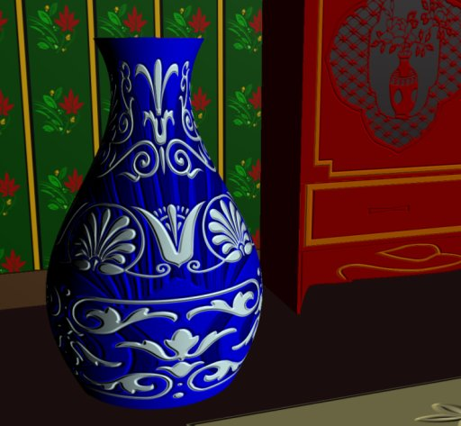
Previous work
Bixels
[Tumblin 2004]
Feature-based textures
[Ramanarayanan 2004]
Silhouette maps
[Sen 2004]
Pinchmaps
[Tarini 2005]
[Ray et al. 2005]
[Qin et al. 2006, 2008]
Notes:
Early work on vector textures brought sharp features to images, and ran on the CPU. These schemes were later adapted to run on the GPU, with a reduced set of supported primitives, or imposing limits on the maximum complexity of the input. Recent works have focused on removing these limitations. Our work is an effort to move the field a few steps forward in terms of both performance and generality.

Slide 5
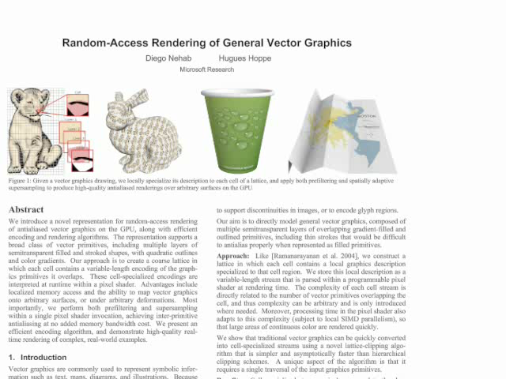
Random-Access Rendering of
General Vector Graphics
Notes:
Our goal is to render complex vector graphics in real-time, allowing smooth user interaction. By the way, this hidden text is actually in the paper.
We want to map vector graphics to surfaces. We want to support color gradients, transparency and strokes. We can also use random-access rendering
to implement a variety of effects, while still preserving resolution independence and high-quality anti-aliasing

Slide 6


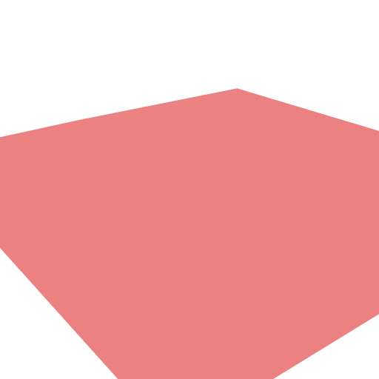

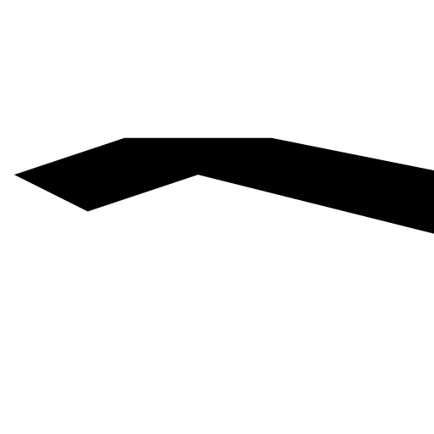
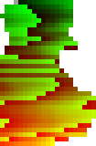
System overview
p
Rendering within pixel shader
Local coordinates
p
p
p
p
Cell
Pixel color
Localized
representation
Layer 1
Layer 2
Layer 3
Layer 4
Cell contents
1D memory buffer
Indirection table
Offline encoding
Cell grid
Notes:
Our system is divided into two components: an off-line encoder and a pixel shader for real-time rendering. The encoder clips the input vector graphics against each cell off a grid, and concatenates the contents of all cells into a linear array. When we want to compute the color of a point, the pixel shader goes through an indirection table to load the contents of the appropriate cell. It then computes the color of the point at each layer, back to front, and blends the results.

Slide 7
System overview
p
Rendering within pixel shader
Local coordinates
p
p
p
p
Cell
Pixel color
Localized
representation
Layer 1
Layer 2
Layer 3
Layer 4
Inside/outside test
Distance to curve
Pre-filtering for anti-aliasing
Super-sampling for anti-aliasing
Notes:
We start by describing the rendering stage, which will motivate the encoding stage described later. The inside/outside test for a shape is the fundamental problem to be solved. We will also describe how we compute distances to shapes, and our pre-filtering and super-sampling strategies.

Slide 8




Basic operations for rendering: in/out test
Filled shapes
Stroked outlines
Require segment intersection
Require distance to segment
p
w
p
d
v
Inside fill:
Inside stroke:
Notes:
To determine if a point is inside a filled shape, and find out if it should be colored with the layer’s color, we cast a ray to the right and count the number of intersections. If the number is odd, we are in. If it is even, we are out. This approach is more robust than trying to use the orientation of nearby segments.
To see if a point is inside a stroked outline, we check the distance from the point to the outline. If the distance is less than half the stroke width, we are in.
The basic operations we need are intersection between a ray and the segments composing an outline, and the distance between a point and the segments.
Of these, the only non-trivial operation is the computation of the distance between a point and the quadratic segments which we want to support.

Slide 9
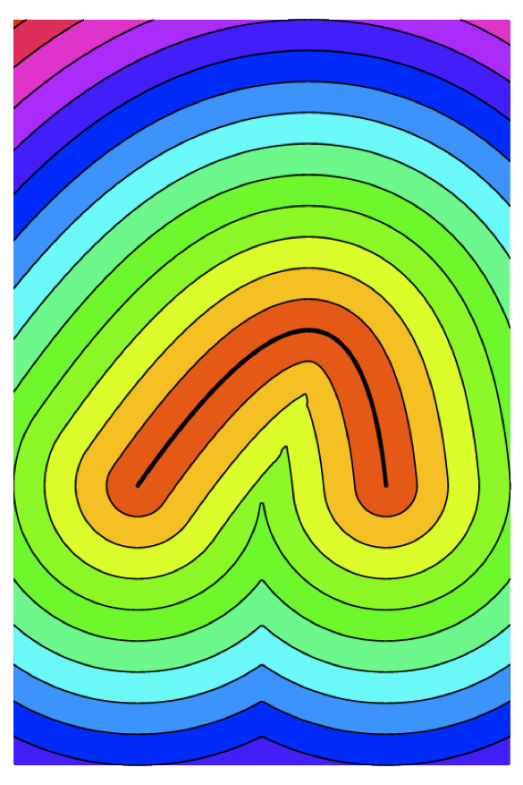
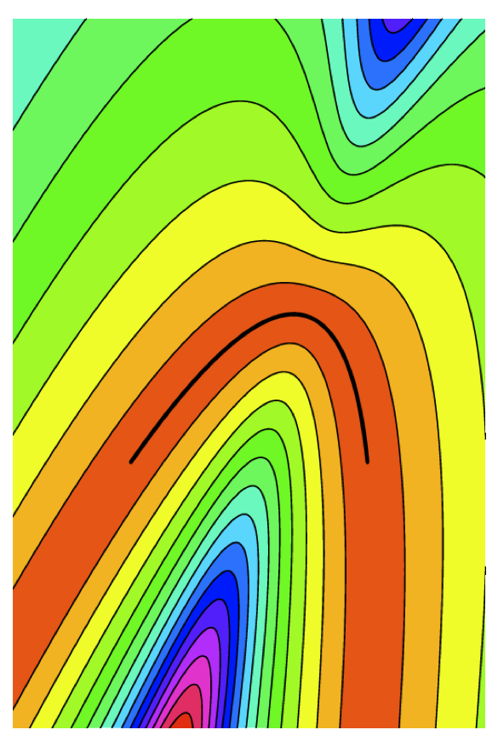
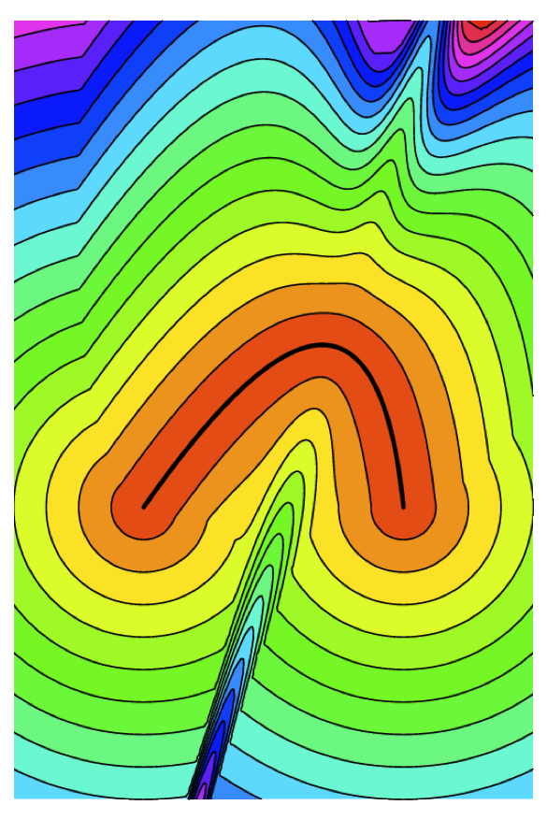
Distance to quadratic Bézier curve
Exact parametric:
solving the cubic
Linearized implicit approximation
Our approximate
parameter inversion
Notes:
There are two traditional approaches to the problem. The first is to solve it in parameter space. This amounts to solving for the roots of a cubic equation, either explicitly or iteratively. This can be expensive. The popular alternative is to linearize the implicit expression for the curve and to approximate the distance. Although much faster, this can be too imprecise and does not take the segment endpoints into account. Our approach is to combine the two strategies to reach an efficient approximation that is more precise.

Slide 10
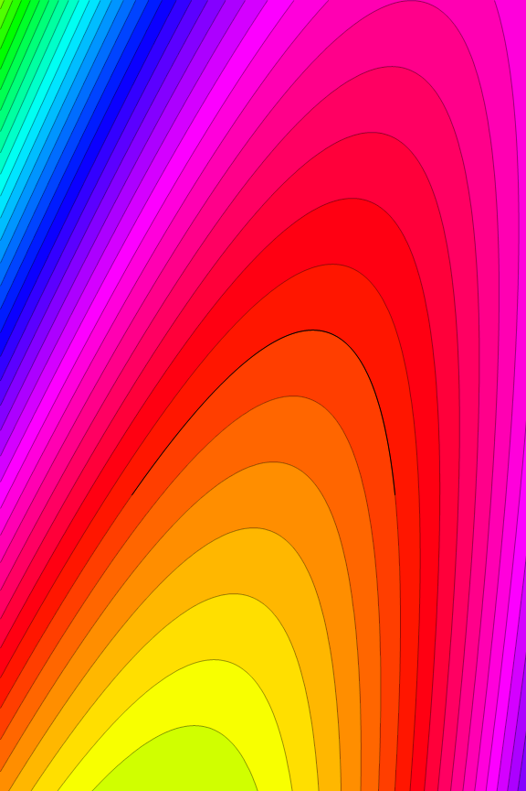




Linearized implicit distance
Implicit form
Linearize around p
Find q closest to p
  [Loop & Blinn 2005]
  [Qin et al. 2006]
Notes:
Just to review, the idea of implicitization is to find a polynomial expression that vanishes for every point that lies on the curve. Taking the first order expansion of that implicit expression about a given point p, we can equate the expression to zero and find a line that approximates the curve locally. The idea is to return the closest point q to p on that line.

Slide 11
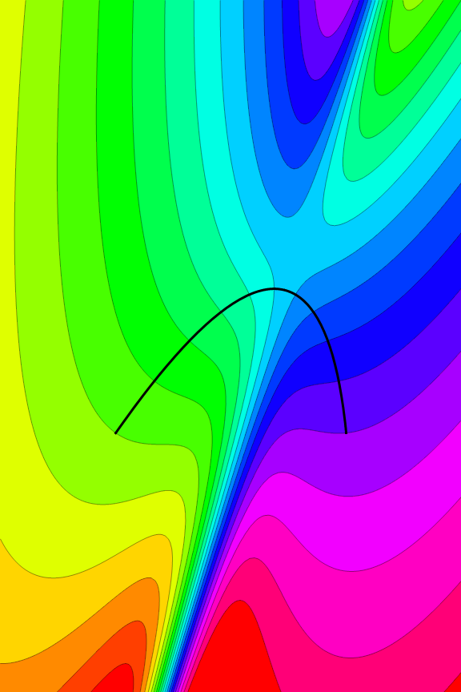




Our fast approximate distance
Take q from linearization
Find approximate inversion
Stable, explicit, efficient
Use to project q to curve
Return
Notes:
Our trick is to find an approximate parameter t bar corresponding to q resulting from the previous approximation. We use this parameter to project q into a point q bar that is actually on the curve. We return the projected q bar as the closest point to p on the curve. Our approximate parameter inversion strategy, detailed in the paper, is well behaved and reasonably accurate in the vicinity of the curve, which makes our distance computation more accurate than simple linearization. Besides allowing the rendering of strokes, the distance computation is also useful for anti-aliasing.

Slide 12



Anti-aliasing
Pixel may be close to layer boundary
Use fractional opacity instead of binary decision
Aliased
Anti-aliased
Notes:
If we directly use the inside/outside test to decide whether to paint a pixel with the shape color or not, we get the typical stair-stepping aliasing effect. Instead, when the pixel is close the the shape boundary, we blend it with a partial opacity.

Slide 13
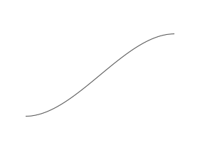

Pre-filtering filled shapes
Half-space approximation with aligned kernel
  [Gupta & Sproull 1981]
  [Qin et al. 2006]
Notes:
A simple and effective way to produce the partial opacity is to approximate the shape locally by a half-space. It then becomes easy to align a pre-filtering kernel to the half-space orientation and integrate to obtain the opacity. Here we show the expression that results as a function of the distance between the pixel and the shape, corresponding to convolution with a parabolic filter kernel.

Slide 14


Pre-filtering stroked shapes
Using two half-space approximations
Notes:
We can also pre-filter strokes using the same idea. Except now we use two half-space approximations. This approximation works well on the boundaries of thick strokes, and also works well when stroke widths are small relative to screen resolution.

Slide 15

Rendering multiple layers
Pseudo-code
Initialize pixel color to transparent
For each layer
For each segment
Increment number of intersections h
Update closest point v
Compute signed distance
Use signed distance to compute opacity
Composite layer fill and stroke on pixel color
Notes:
Putting everything together, here is what the rendering loop looks like for a pixel. The pixel starts transparent. For each layer, we find the number of intersections with a ray shot to the right and also the closest point on the boundary of the layer. Using that, we compute the signed distance, convert it to an opacity value and composite the current layer color on top the previous ones.

Slide 16
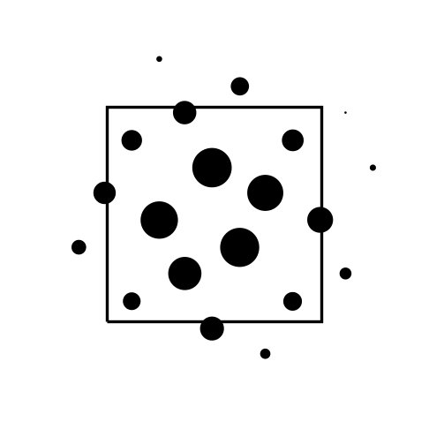

Super-sampling
When approximate pre-filtering breaks down
Notes:
Sometimes the half-space approximation is not accurate enough, for instance, when there is too much going on in the vicinity of the pixel. In that case, we can produce better anti-aliasing with super-sampling. Which is just the weighted sum of the color of many sub-pixels.

Slide 17

Single pass super-sampling
Pseudo-code
Initialize all samples to transparent
For each layer
For each segment
For each sample s
Increment number of intersections h_{s}
Update closest point v_{s}
For each sample s
Compute signed distance
Use signed distance to compute opacity
Composite layer fill and stroke on sample
Return weighted sample average color
Notes:
Fortunately, we can produce the color of all these samples without incurring any additional bandwidth. This is desirable because computing power is increasing faster than bandwidth. The idea is to allocate storage for each sample, and initialize them to transparent. As we process each segment in a layer, we update the closest point and the number of intersections for each sample independently. Once we are done with all layer segments, we compute the signed distance and opacity and independently blend the layer color over the samples. When all layers are done, we return the weighted average of all samples.

Slide 18

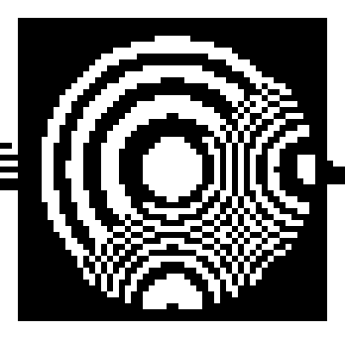
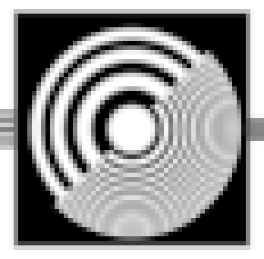
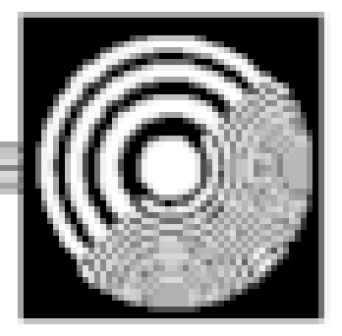
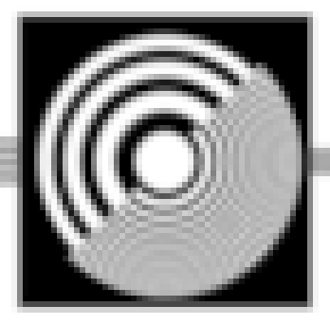
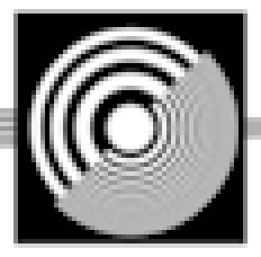
Anti-aliasing comparison
Original signal
Point sampled
Pre-filtered
8X super-sampling
Pre-filtering +
8X super-sampling
400X Super-sampling
Notes:
Here are the anti-aliasing results. The original signal has frequencies that can’t be represented at the chosen rendering resolution. Point sampling looks severely aliased. The pre-filtering idea we described earlier alleviates the problem substantially. In fact, compared to 8X super-sampling, it looks much nicer. We can do better by combining 8X super-sampling with pre-filtering. Results are almost as good as 400x super-sampling, which can be considered as the ground-truth rendering quality.

Slide 19
System overview
p
Rendering within pixel shader
Local coordinates
p
p
p
p
Cell
Pixel color
Localized
representation
Layer 1
Layer 2
Layer 3
Layer 4
Cell contents
1D memory buffer
Indirection table
Offline encoding
Cell grid
Notes:
So now we move on to the encoding stage.

Slide 20
System overview
Lattice-clipping algorithm
Shortcut segments
Extended cells
Localized
representation
Layer 1
Layer 2
Layer 3
Layer 4
Cell contents
1D memory buffer
Indirection table
Offline encoding
Input
Notes:
Here I will explain the lattice-clipping algorithm, one of our main contributions. The algorithm owes its speed to the concept of shortcut segments, which I will explain in detail. I will end by explaining the role of extended cells for correct anti-aliasing.

Slide 21
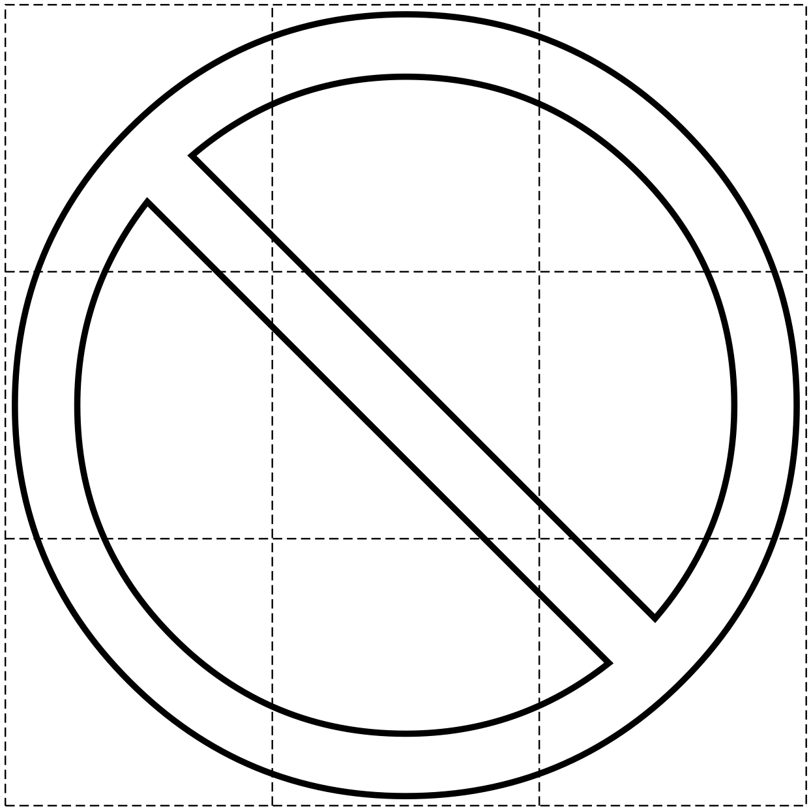
The encoding algorithm
Must “clip” shape against every cell
Notes:
As we have seen before, the encoding algorithm must clip each shape against every cell on a grid.

Slide 22
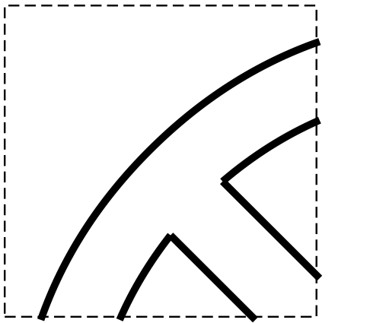
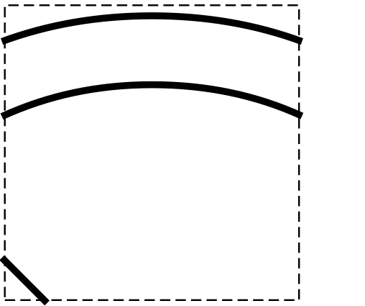
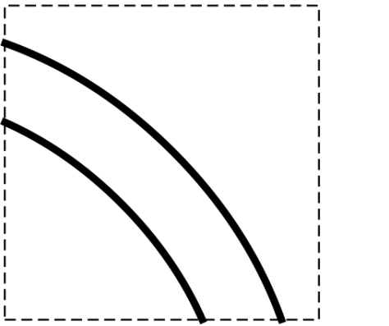
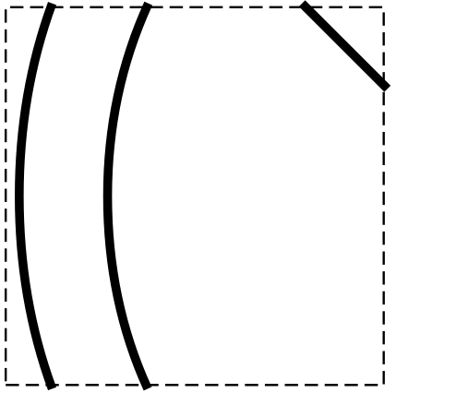
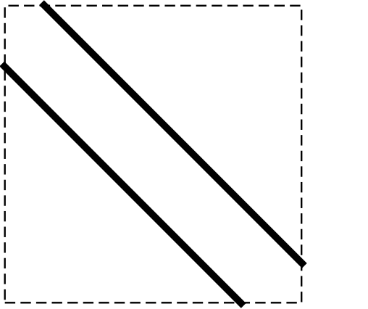
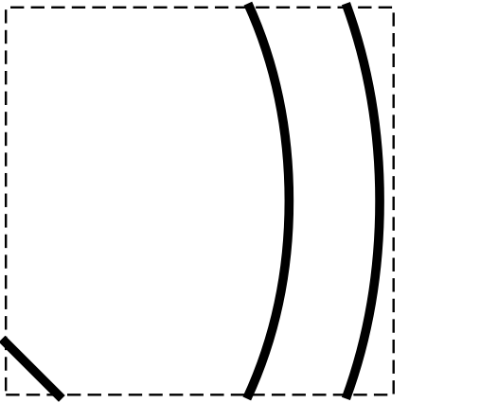
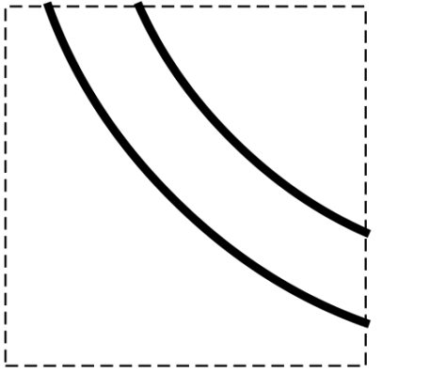
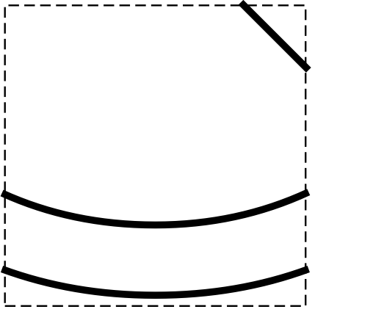
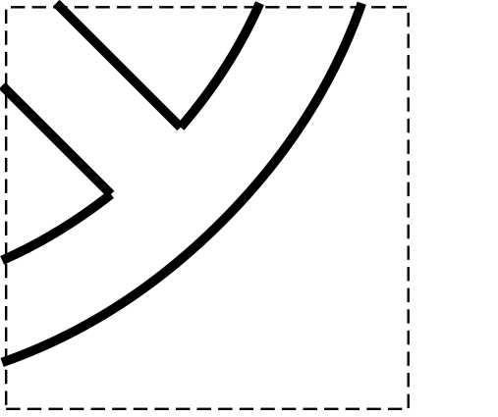
The encoding algorithm
Must “clip” shape against every cell

Slide 23



Alternatives
Brute force [Sutherland-Hodgman 74]
  Clip independently against each cell
Hierarchical subdivision [Warnock 69]
  Clip recursively using a quadtree structure
Lattice clipping [Our method]
  Visits each input vertex only once
  Visits only cells that have content
n input vertices
r ² grid cells
a output size
Notes:
So here are the alternatives.

Slide 24
The lattice-clipping algorithm
Rendering only casts rays to the right
Polygon clipping is overkill
Notes:
Since our rendering algorithm only casts rays to the right, many of the segments introduced by the clipping algorithm will never play a role in rendering. Here shown in red, no ray can ever intersect them. So polygon clipping is overkill.

Slide 25
The lattice-clipping algorithm
Segment clipping, however, is not enough
✕
✕
✕
✕
✕
✕
✕
✕
Notes:
Segment clipping, on the other hand, where we ignore everything that happens outside of each cell, is not enough. Here are examples where we would get an incorrect number of intersections.

Slide 26
The lattice-clipping algorithm
Segment clipping + shortcut segments
Enough for rendering, easier to generate
✓
✓
✓
✓
✓
✓
✓
✓
Notes:
What the lattice-clipping algorithm does is to include shortcut segments. The blue segments shown here. These are enough to guarantee correct rendering, but are easier to generate.

Slide 27
Generating shortcut segments
Computation requires non-local information
What happens to a contour once it leaves a cell?
Notes:
Nevertheless, generating them requires non-local information. In other words, we must know what happens to a contour once it leaves the cell towards the right. Does it go up? Does it go down? Does it come back in from the right?

Slide 28
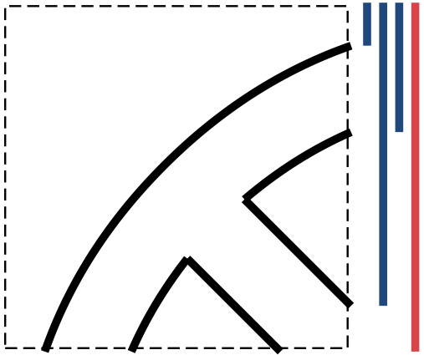
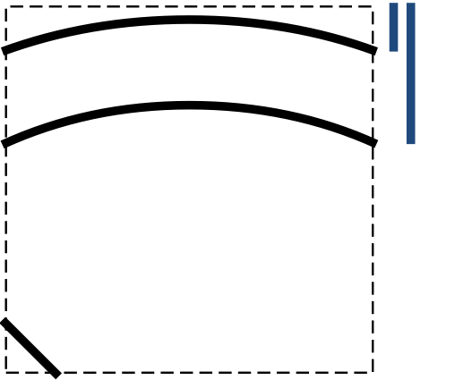
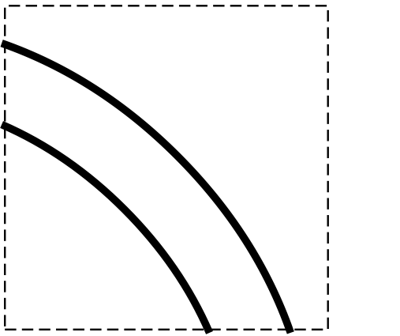
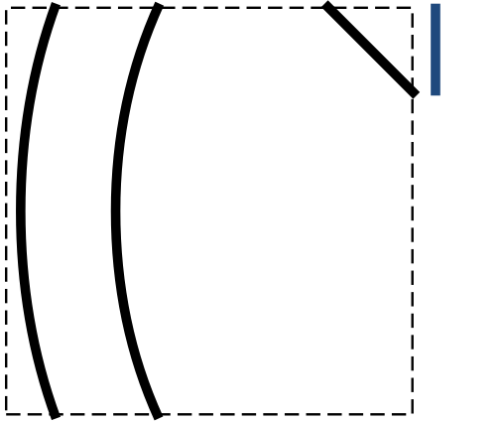
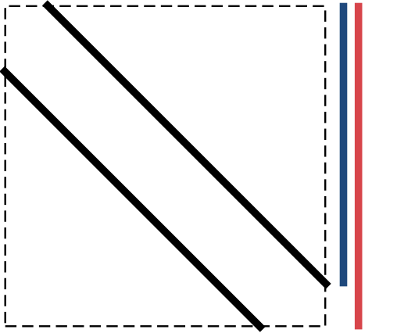
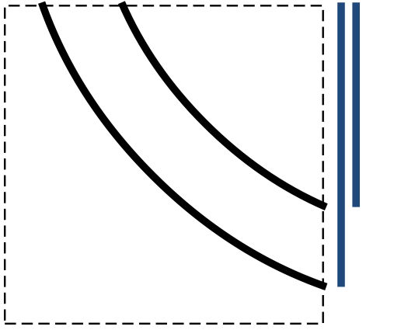
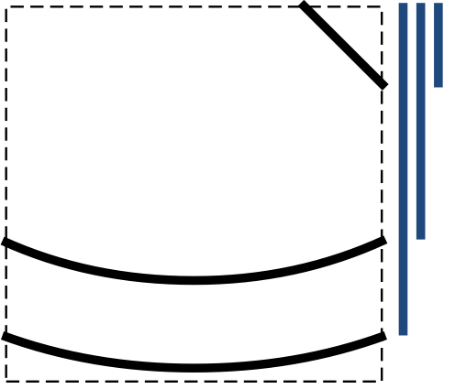
Generating shortcut segments
Delay decision, fix later
Start by assuming contours always go up
Notes:
Here the solution is to delay these considerations for later. While we traverse all segments in the contours, we always assume the contour will go up after crossing a right cell boundary. We just add a shortcut segment going up. This, of course may be wrong, so we have to fix things.

Slide 29
Generating shortcut segments
Identify violations
Notes:
To do that, at the same time we identify the cases where a contour crossed a lower cell boundary. These are relevant because, since we are assuming all contours go up, when a contour goes down, we know that every cell to its left made an incorrect assumption.

Slide 30
Generating shortcut segments
Consolidate violations right-to-left
← ⊕ 3
← ⊕ 1
← ⊕ 2
← ⊕ 2
← ⊕ 1
← ⊕ 1
Notes:
We can now count the number of violations for each cell, and consolidate them in a running sum, right to left. (To be more precise, a running XOR.)

Slide 31
Generating shortcut segments
Consolidate violations right-to-left
1
1
Notes:
Here in our example, only two cells ended up with a net non-zero number of violations.

Slide 32
Generating shortcut segments
Add shortcuts to cancel effect of violations
1
1
Notes:
To correct them, all we have to do is to add one shortcut segment that spans the entire right boundary of the cell.

Slide 33
Generating shortcut segments
Simplify shortcut segments
Notes:
We now have a representation that, for each cell, and each ray cast to the right, produces the correct number of intersections (or at least the correct value modulo 2). We can simplify these segments together, to produce an equivalent representation that is more concise.

Slide 34
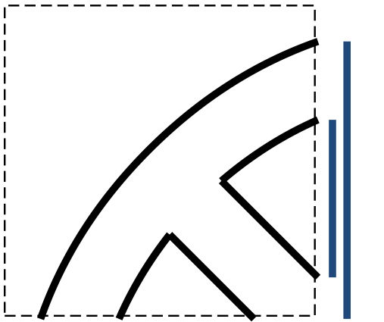
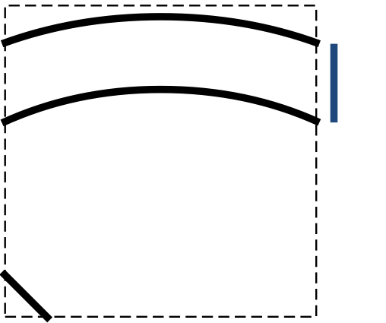

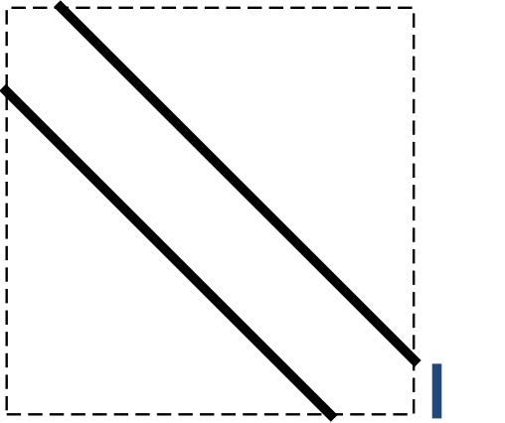
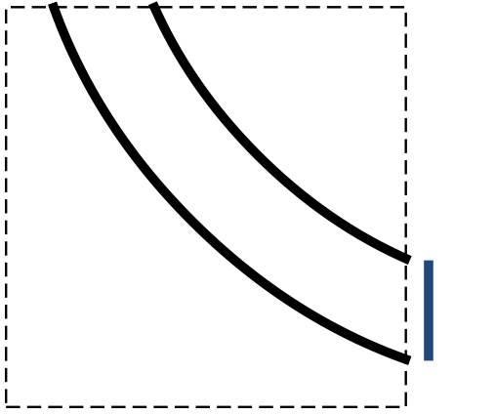
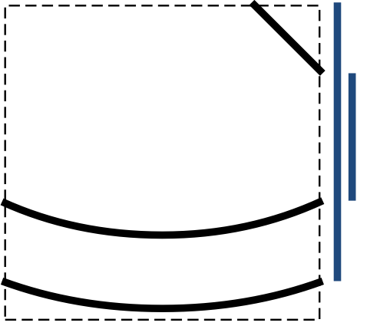
Generating shortcut segments
Simplify shortcut segments
Notes:
This representation is as simple as, and equivalent to what we were trying to produce.

Slide 35
Generating shortcut segments
Equivalent to desired results

Slide 36
Generating shortcut segments
Equivalent to desired results

Slide 37
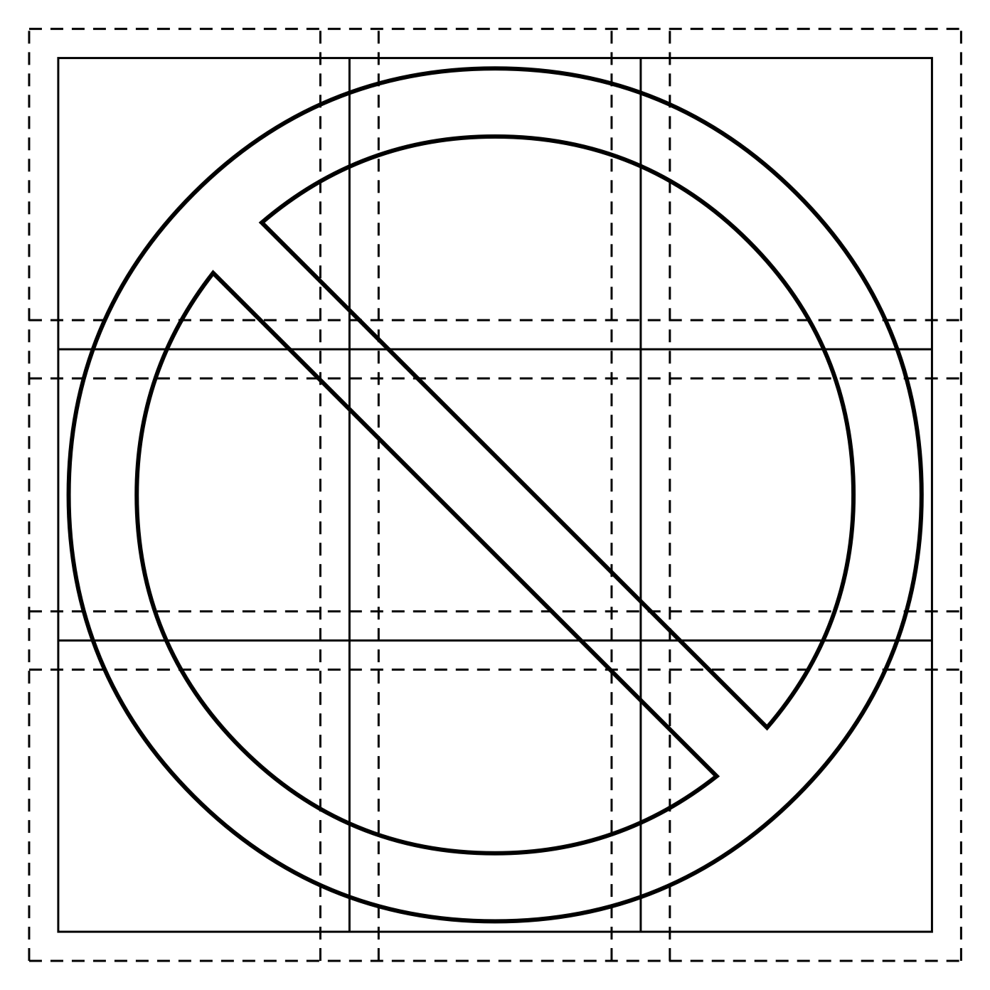
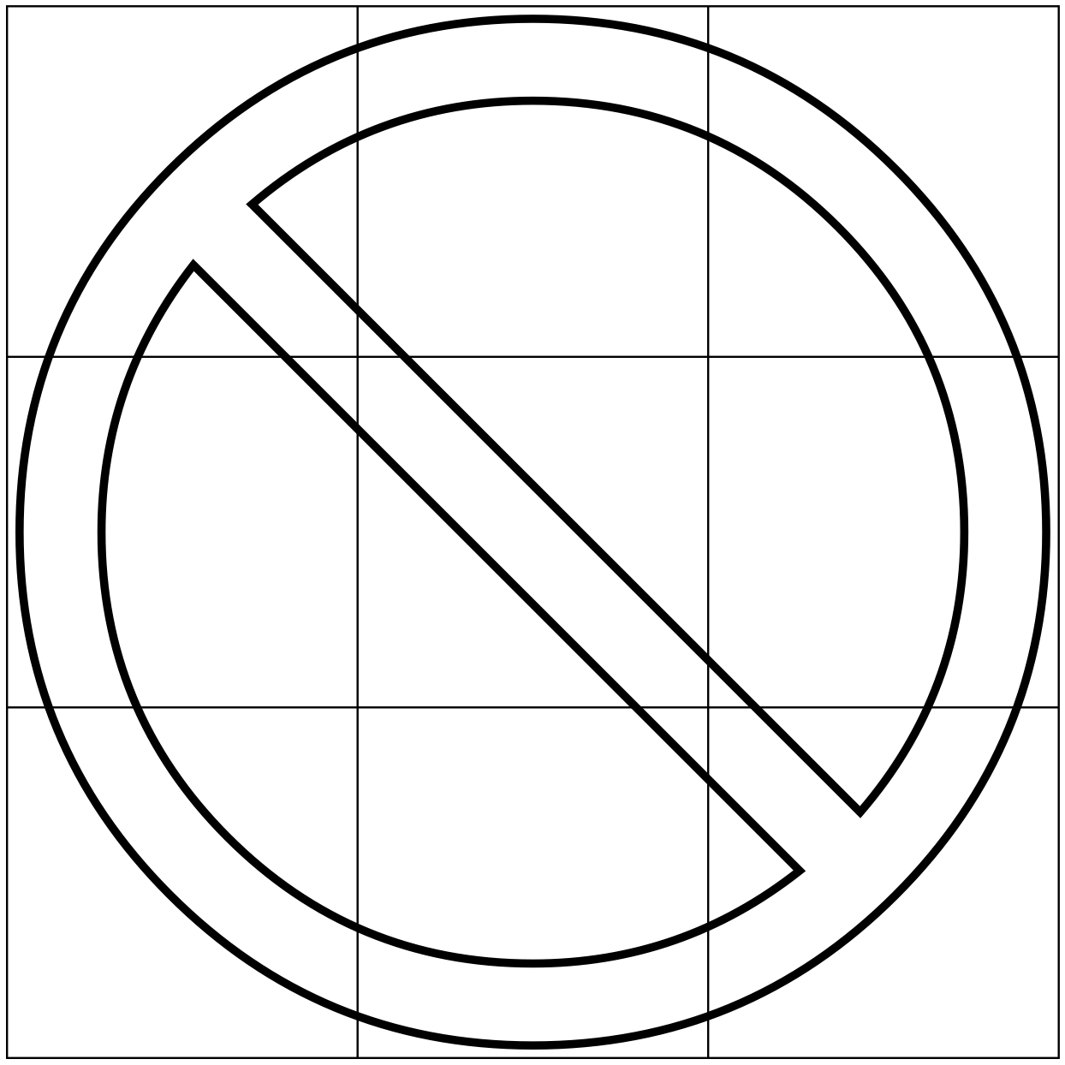
Extended cells
Anti-aliasing near cell edges
Requires overlap between cells
Notes:
If we only include in each cell the information required to compute the color of a point sample inside the cell, we may have trouble with anti-aliasing close to cell boundaries. Instead, we include in each cell the contents of a slightly wider area, which we call an “extended cell”. These overlap each other, so we can anti-alias correctly.

Slide 38
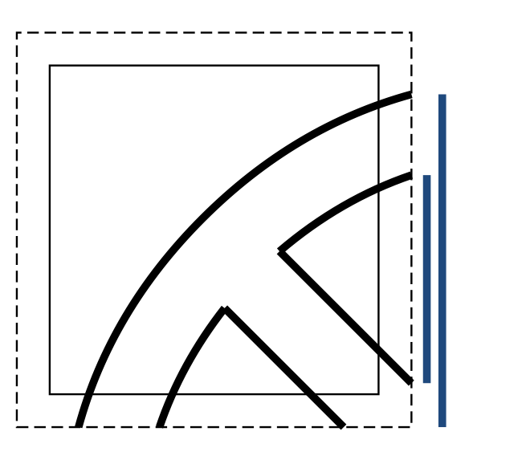
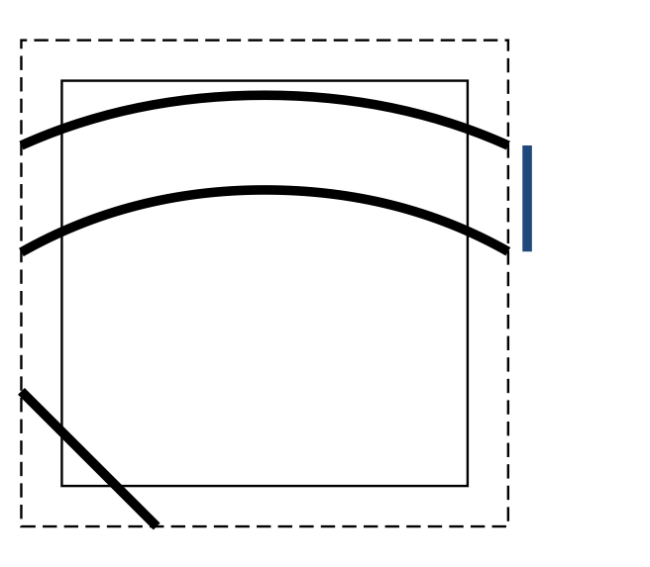
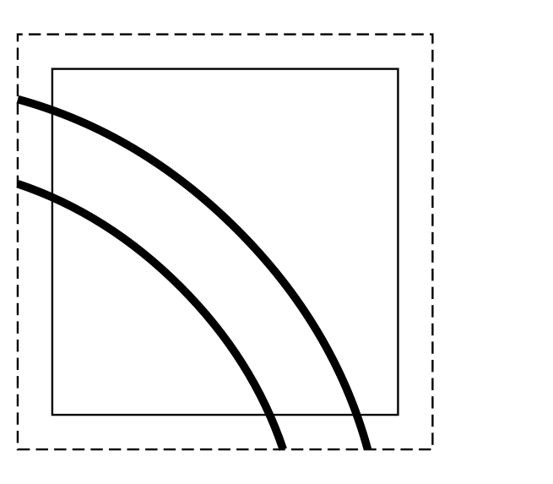
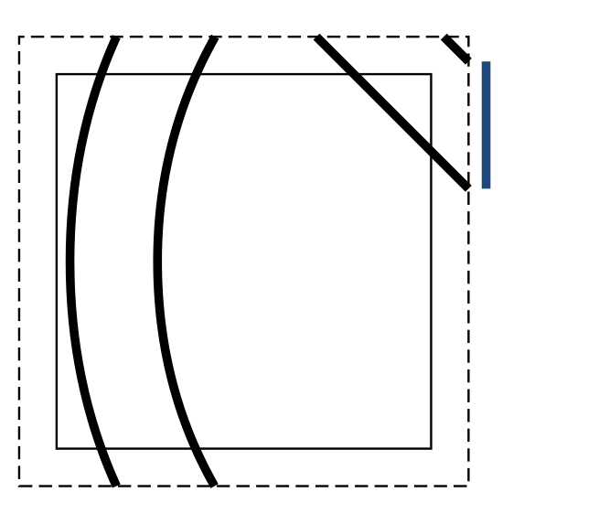





Extended cells
Lattice-clipping deals with extended cells
Notes:
Fortunately, it is not hard to adapt the lattice-clipping algorithm to deal with extended cells.

Slide 39
Summary of contributions
Rich set of primitives
  Multiple transparent layers
  Both fills and strokes
  Color gradients
High-quality anti-aliasing
  Fast distance to quadratics
  Thin strokes
  Single-pass super-sampling
Lattice-clipping algorithm
  Linear time on input/output size
Notes:
In summary, we present our approach to render random-access vector graphics in real-time, with a rich set of primitives. These include multiple transparent layers, fill and strokes, and color gradients. We introduced a fast method to compute approximate distance to quadratics, and a pre-filtering strategy for strokes. We also showed how to perform super-sampling in only one pass over the cell contents. Finally, we showed how to efficiently encode the vector graphics for random-access.

Slide 40
Future work
Focus on encoding stage
  Parallel implementation on CPU
  GPU implementation?
  Fast enough for dynamic content?
Support for blur
  Additional rendering passes?
Notes:
As future work, we would like to focus on speeding up the encoding stage even further. Perhaps, if we move to a parallel implementation, be it on the CPU or even entirely on the GPU, we can render animated content in real-time. Another direction in which to extend the current work is to add support for post-processing operations, such as blur filters that are commonly used in photo-realistic vector graphics. Here, we may have to resort to additional rendering passes.

Slide 41

More results
Notes:
We end with a few more results.

Slide 42


Thank You
Notes:
Thank you!

Slide 43




Color gradients
Mapping from global to gradient coordinates
Linear or radial mappings from gradient coordinates
Wrapping functions (repeat, mirror, clamp)
Linear by parts color ramp

