Slide 1
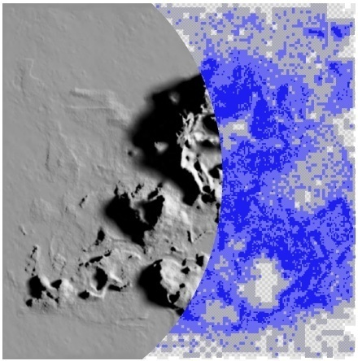
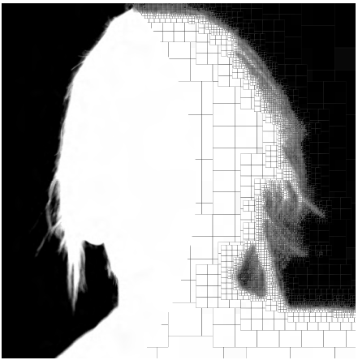
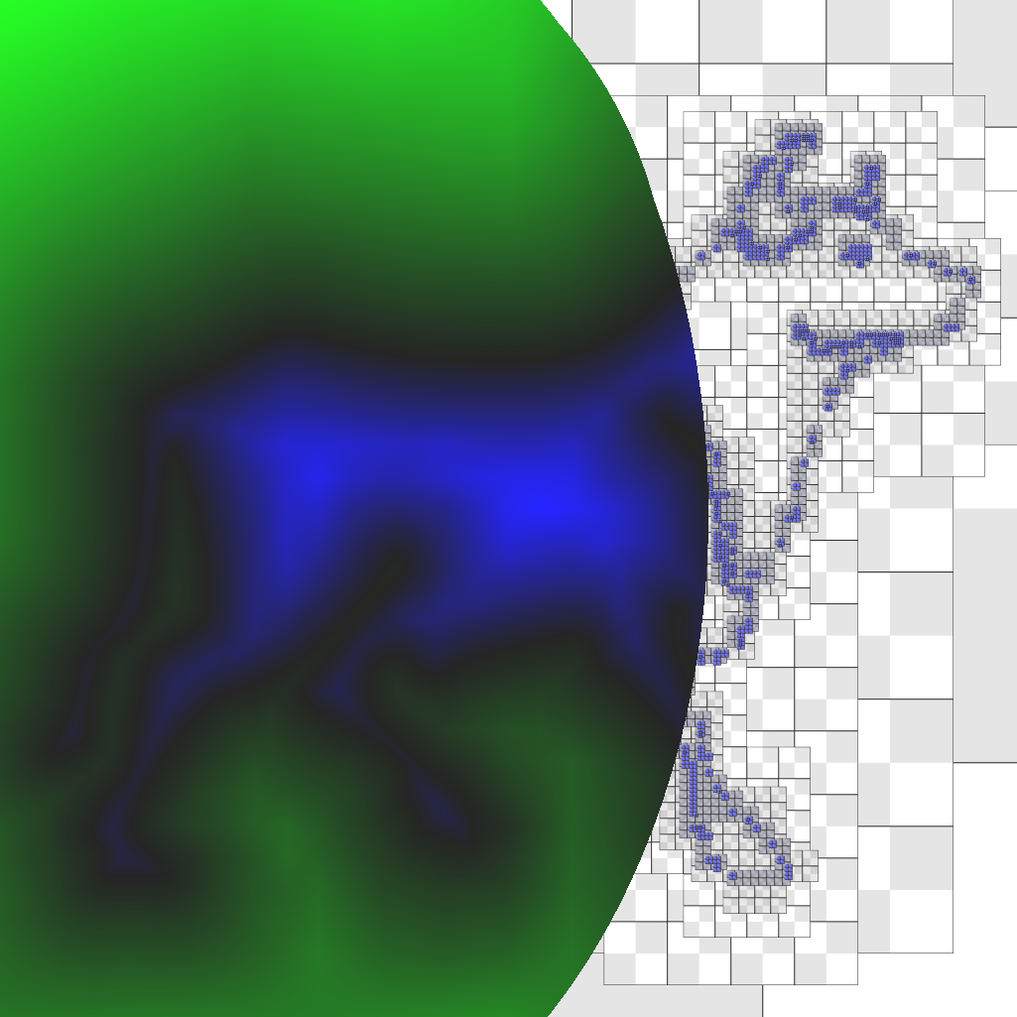
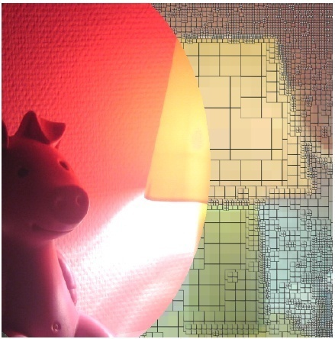
Compressed Random-Access Trees for Spatially Coherent Data
Sylvain Lefebvre Hugues Hoppe
INRIA Microsoft Research

Slide 2
Motivation: Spatially Coherent Images
Light map
Alpha matte
Distance field
HDR luminance
Goals:
Reduce space
Reduce bandwidth
Subject to graphics rendering constraints:
Random access
Filtering

Slide 3
Existing Compression Schemes
Sequential coding (JPEG, wavelets, …)
Excellent compression
No efficient fine-grain random access
Block-based (DXTC, VQ, indirection,…)
Fixed-rate compression
Fast random access
No hierarchical prediction
64 bits
too much
64 bits
too little

Slide 4
Compressed Random-Access Trees
Our data structure:
Hierarchical prediction (exploits coherence)
Adaptive
Aggressive compression
Trilinear interpolation
Efficient random access

Slide 5
Compressed Random-Access Trees
Our data structure:
Image pyramid (sparse)
Adaptive primal tree
Dual tree
Primal tree
3^{d} nodes
2^{d} nodes
p
p
Linear interpolation requires less data !

Slide 6
Compressed Random-Access Trees
Introduction
Encoding:
Compressing Tree Data
Compressing Tree Topology
Decoding:
Random access
Caching strategies
Applications and Results
Conclusion

Slide 7
Compressing Tree Data
2 steps:
Fine-to-coarse:
Compute desired colors
Coarse-to-fine:
Predict color from parents
Compute residuals
Compute codebook
➔ Opportunity to recover codebook loss
#0
#1
Level 0
+1
-1
-1
1
0.5
0.5
1
#0
#1
#0
Level 1
+1
-3
+2
-1
+1
#0
#1
#0
#1
#0
+1
-1
0
0
+2
-1
-1
-2
+1
Level 2
Level 3
Codebooks
Level 0
Level 1
Level 2
#0
+1
-1
#0
+1
-3
#0
+1
-1
#1
-1
+1
#1
+2
+1
#1
0
0

Slide 8
Compressing Tree Data
Level 0
#0
#1
After compression:
Crop last level
Prune the tree
#0
#1
#0
Level 1
#0
#1
#0
#1
#0
Level 2
Level 3
Codebooks
Level 0
Level 1
Level 2
#0
+1
-1
#0
+1
-3
#0
+1
-1
#1
-1
+1
#1
+2
+1
#1
0
0

Slide 9
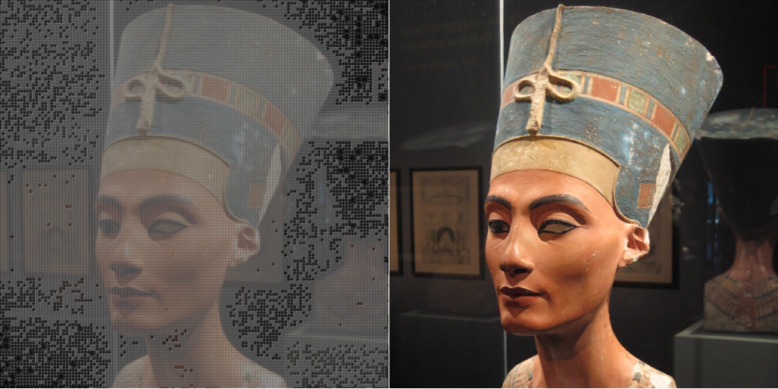
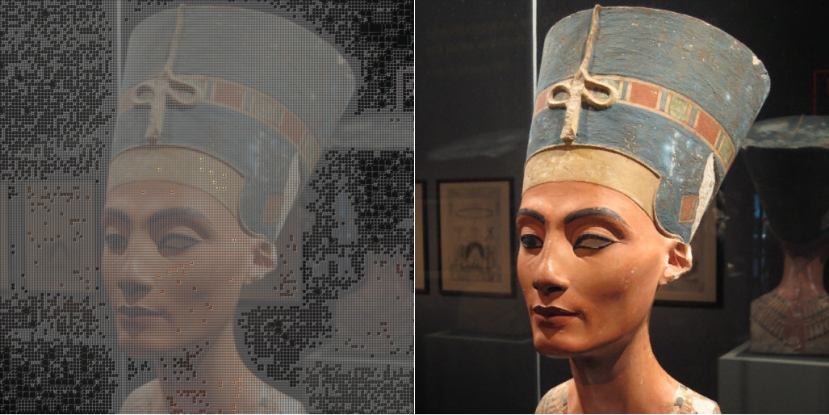
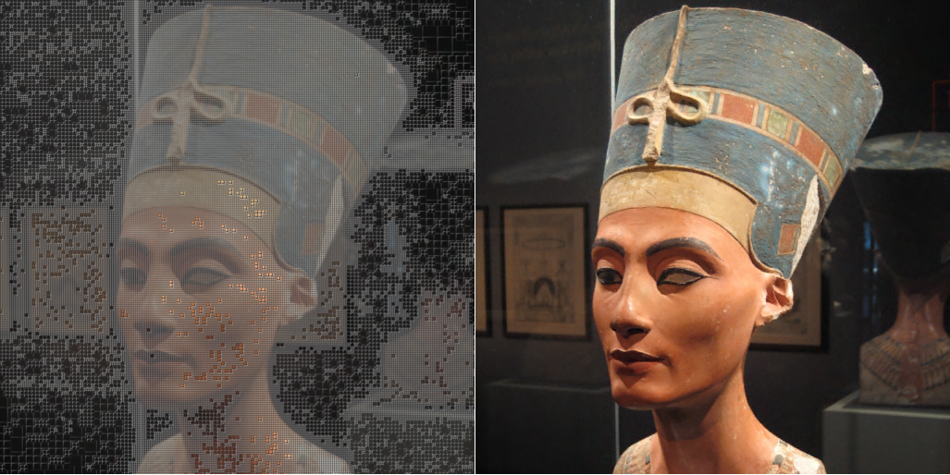
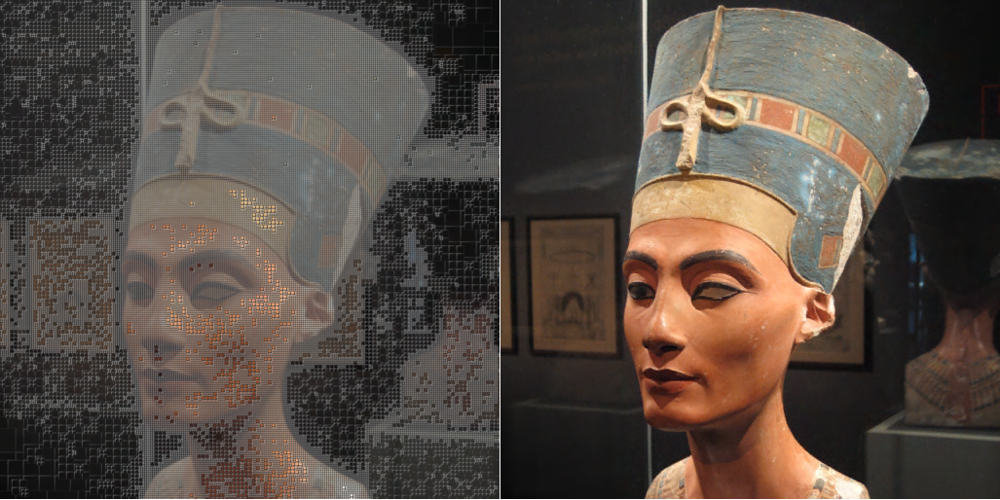
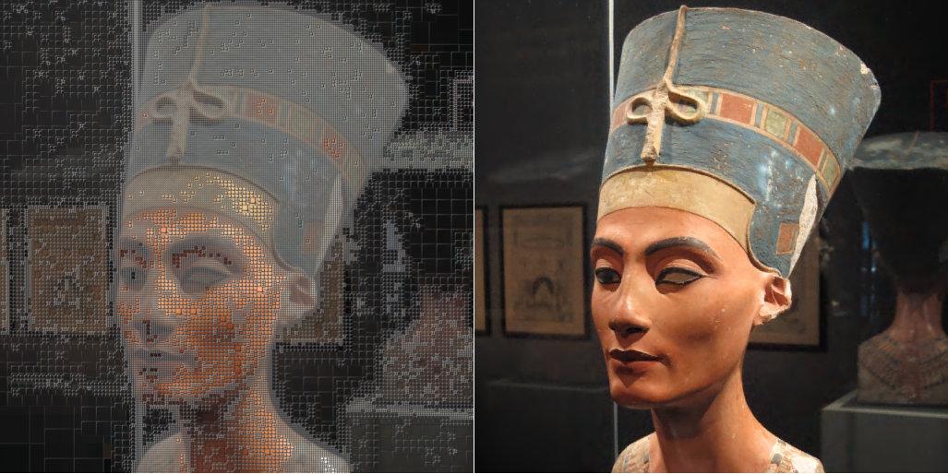
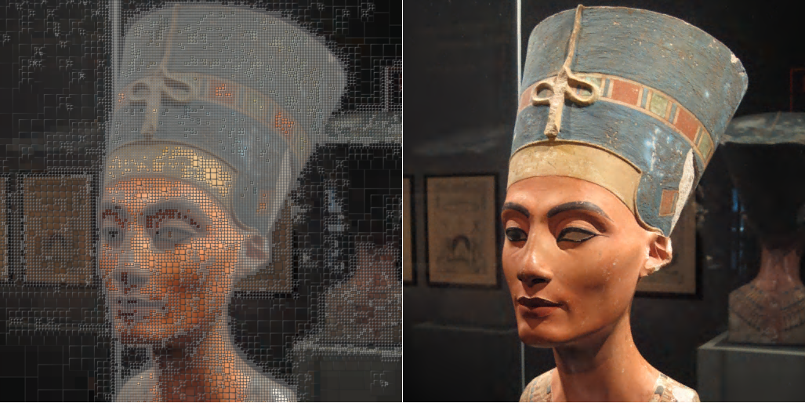
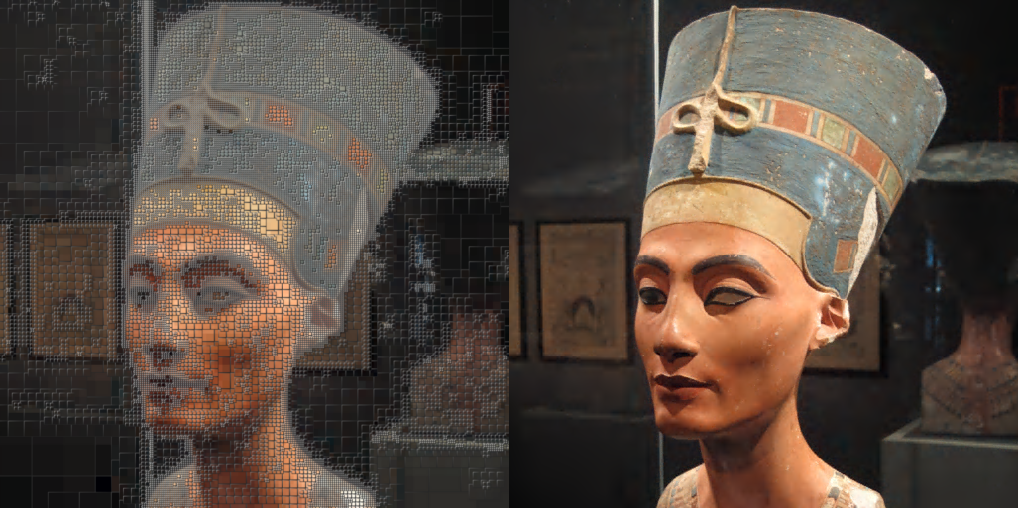
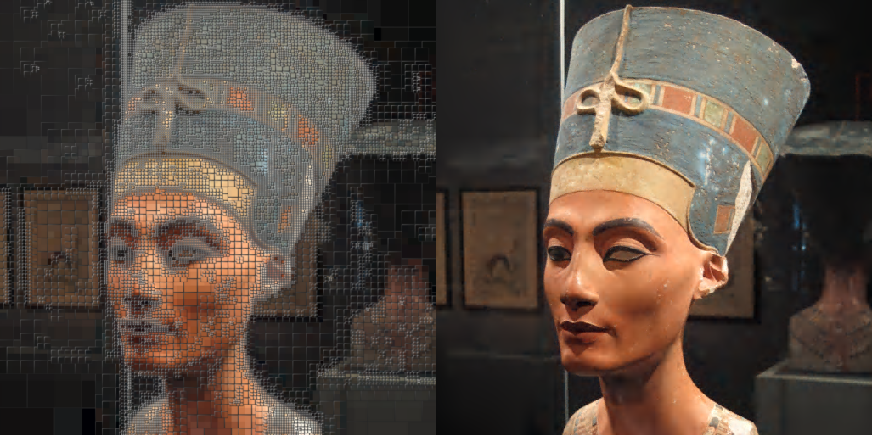
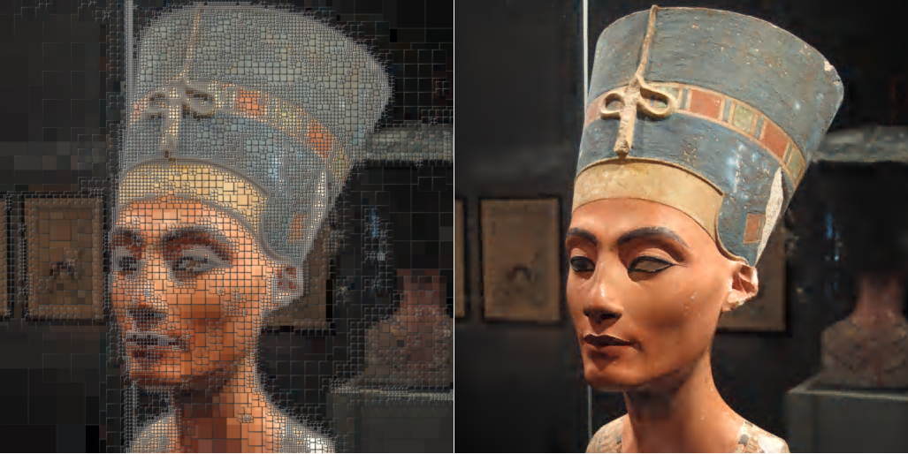
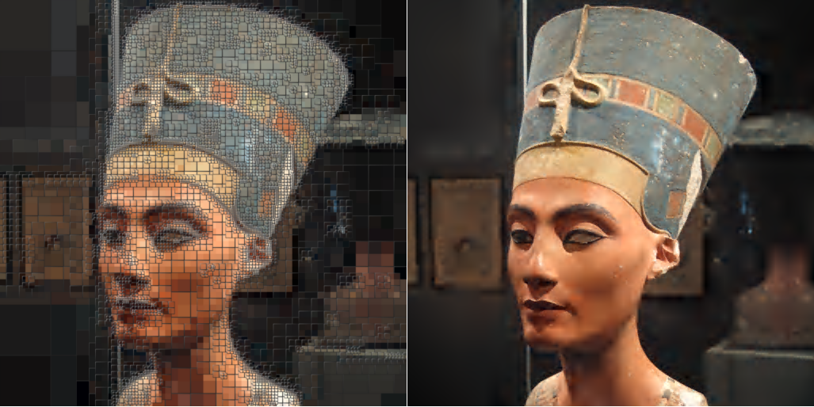
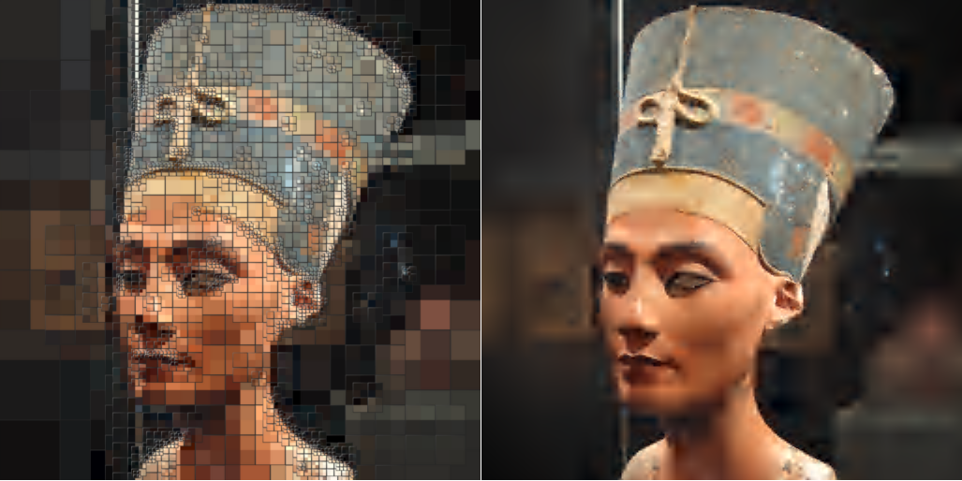
3.73 bits/pixel - 123 KB - 38.8 dB
3.25 bits/pixel - 109 KB - 38.7 dB
3.00 bits/pixel - 101 KB - 38.6 dB
2.75 bits/pixel - 93 KB - 38.4 dB
2.50 bits/pixel - 84 KB - 38.3 dB
2.25 bits/pixel - 75 KB - 38.0 dB
2.00 bits/pixel - 66 KB - 37.7 dB
1.75 bits/pixel - 58 KB - 37.3 dB
1.50 bits/pixel - 49 KB - 36.5 dB
1.25 bits/pixel - 41 KB - 35.6 dB
1.00 bits/pixel - 32 KB - 34.2 dB
0.75 bits/pixel - 22 KB - 31.9 dB
0.50 bits/pixel - 14 KB - 27.6 dB
*

Slide 10
Compressed Random-Access Trees
Introduction
Encoding:
Compressing Tree Data
Compressing Tree Topology
Decoding:
Random access
Caching strategies
Applications and Results
Conclusion

Slide 11
Compressing Tree Topology
Naïve tree:
A
A
→ B
→ C
B
C
→D
→E
D
→F
→G
E
F
G
B
C
Autumnal tree: [Fabbrini1986]
A
B
→ C
C
→D
E
D
F
G
D
E
Each child field has either data or pointer (based on 1 flag bit)
F
G
Both data & pointer encoded into 7 bits
- data: 128-entry VQ codebooks
- pointers: quantized relative offsets

Slide 12
Compressing Tree Topology
Relative offsets:
10123
10128
10332
10621
11113
A
Subtree A₁
Subtree A₂
Subtree A₃
Subtree A₄
Memory
10128
A
+0
10128
A
+204
= 17 * 12 12XX
10332
+493
10621
= 17 * 29 29XX
+985
11113
= 17 * 58 -1
A₁
A₂
A₃
A₄
Per-level scaling
(optimized)

Slide 13
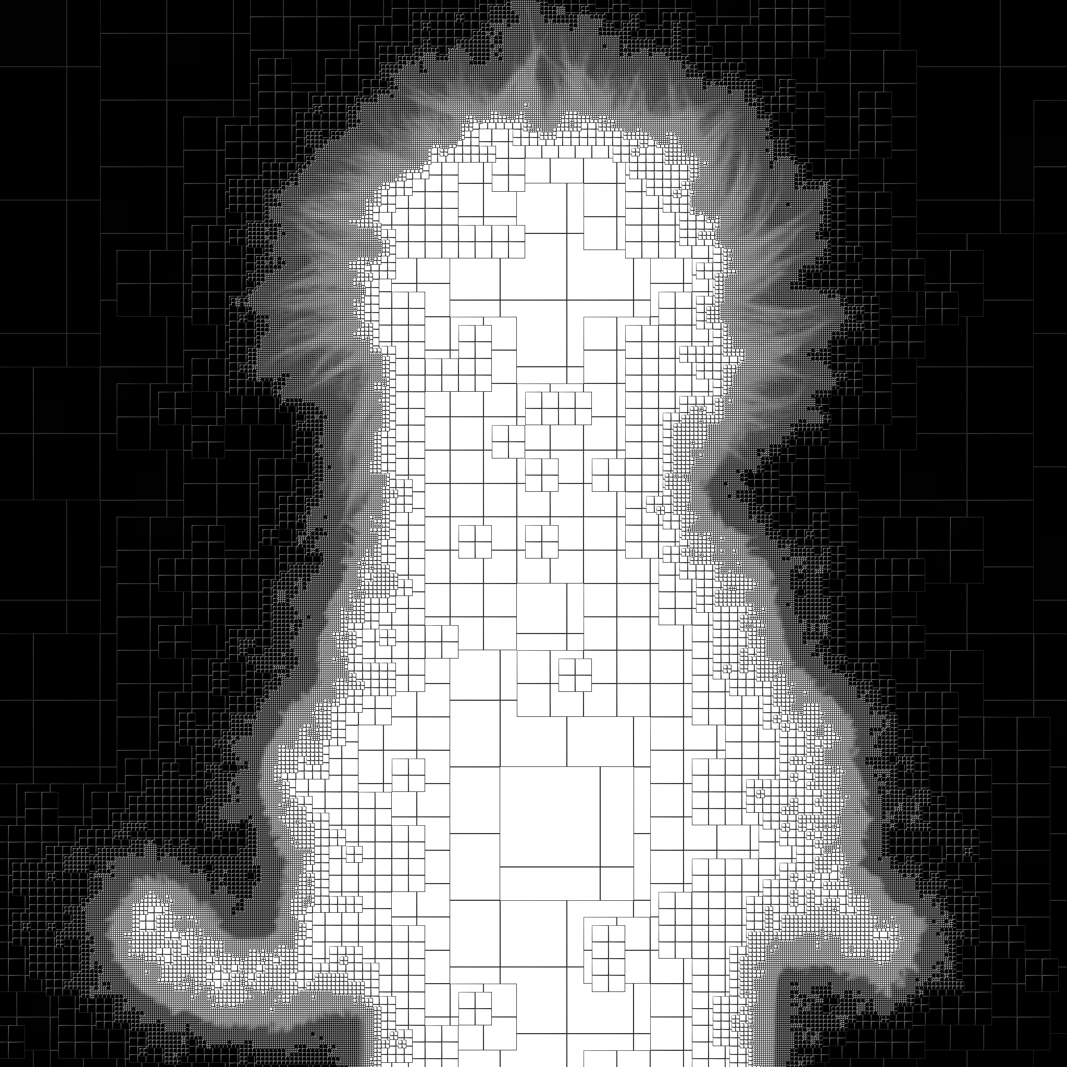
Compressing Tree Topology
0.36 bytes / node

Slide 14
Compressed Random-Access Trees
Introduction
Encoding:
Compressing Tree Data
Compressing Tree Topology
Decoding:
Efficient access
Caching strategies
Applications and Results
Conclusion

Slide 15
Efficient Access
Follow all 4 paths down the tree
Easy trilinear interpolation
Floating point

Slide 16
Caching strategies
LRU cache on nodes
Last query ‘stack’
➔ Restart descent as low as possible

Slide 17
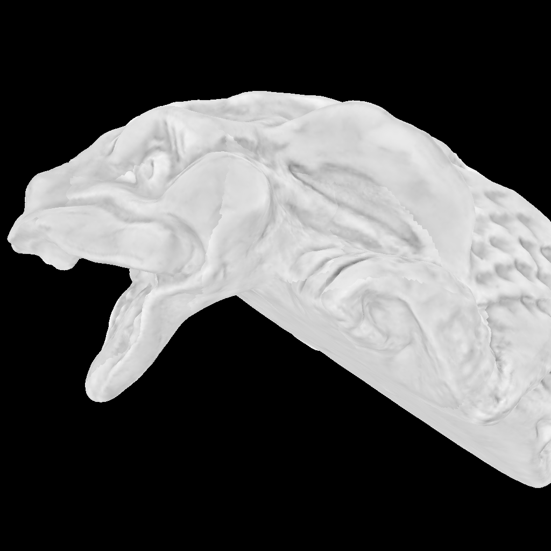
Efficient Access
Compressed lightmap
2.05 bits/pixel
 | Bandwidth bits/pixel | Average number of levels traversed
No cache | 270.7 | 4.8
With dedicated caches | 1.8 | 0.92
Mesh and texture from MIT CSAIL

Slide 18
Compressed Random-Access Trees
Introduction
Encoding:
Compressing Tree Data
Compressing Tree Topology
Decoding:
Efficient access
Caching strategies
Applications and Results
Conclusion

Slide 19
Applications
(BC4U: 4 bpp 48.8 dB
Our : 2.2 bpp)
Lightmap 1025²
1.0 bpp, 44.2 dB
Alpha matte 1025²
0.4 bpp, 51.2 dB
Distance field
0.07 bpp
HDR image
5 bpp
8 KB vs. bitmap 131 KB

Slide 20
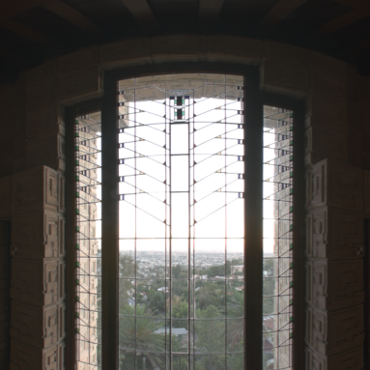
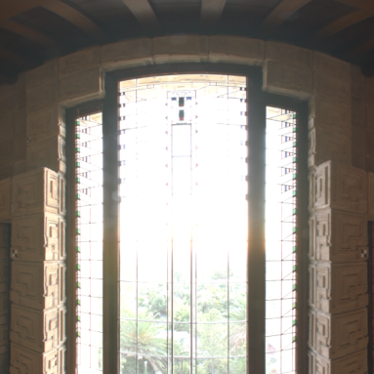
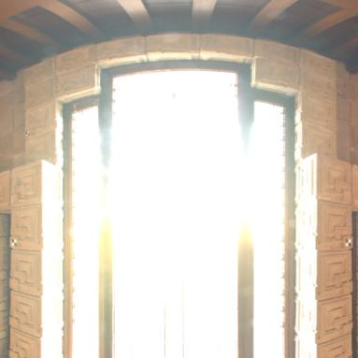
HDR Images
Luminance often coherent over large regions

Slide 21
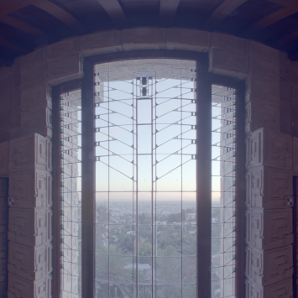
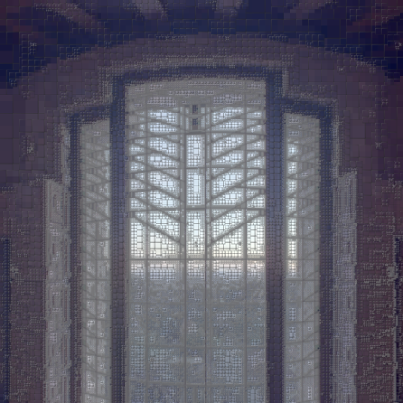
HDR Images
Compression:
Aggressive tree-compression of log(RGB)
DXT compression of LDR residuals
Original
log[RGB]
Tree-compressed (1 bpp)
log[RGB]
Residuals DXT (4 bpp)
(LDR)

Slide 22
GPU implementation of decoder
5 bpp instead of 48 bpp
650KB instead of 6.3MB

Slide 23
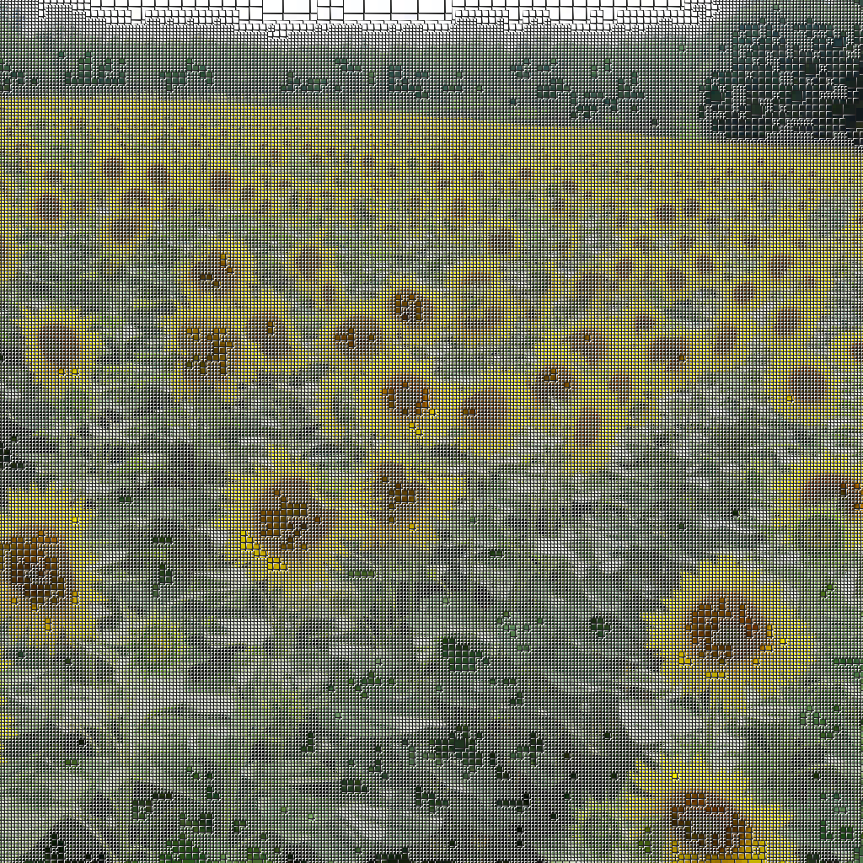
Limitations and Future Work
Uniform detail
e.g. Color images
Construction
Starts with complete tree
➔ Prune tree during compression
Access cost
Practical but slow nonetheless
Progressive loading
➔ Exploit relative offsets
3.52 bpp; 31 dB

Slide 24
Summary: Compressed random-access trees
Hierarchical prediction
Primal subdivision
Aggressive compression
Fast random access
Bandwidth reduction
Applications
1 bit/pixel
Lightmap
Alpha matte
Dist. field
HDR

