Slide 1
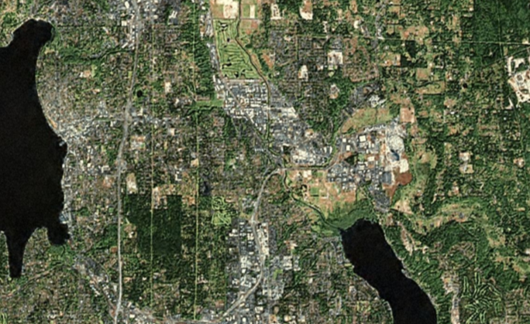
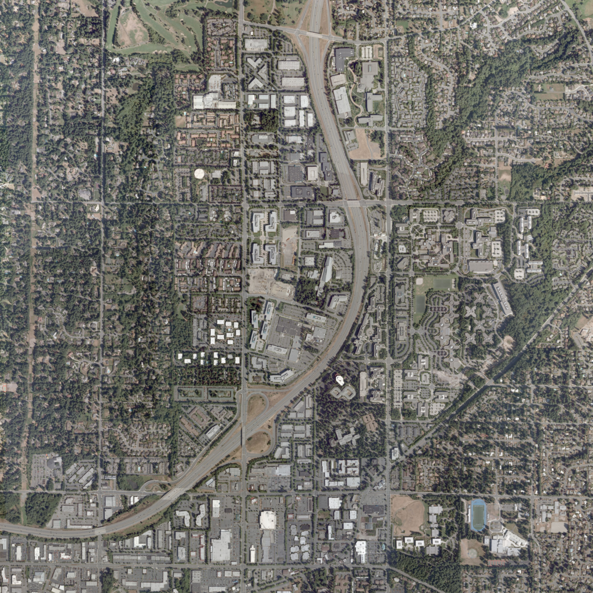
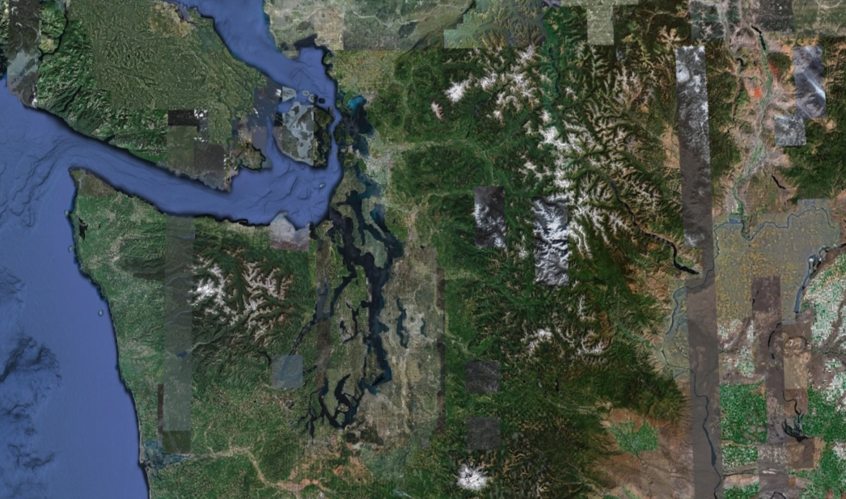
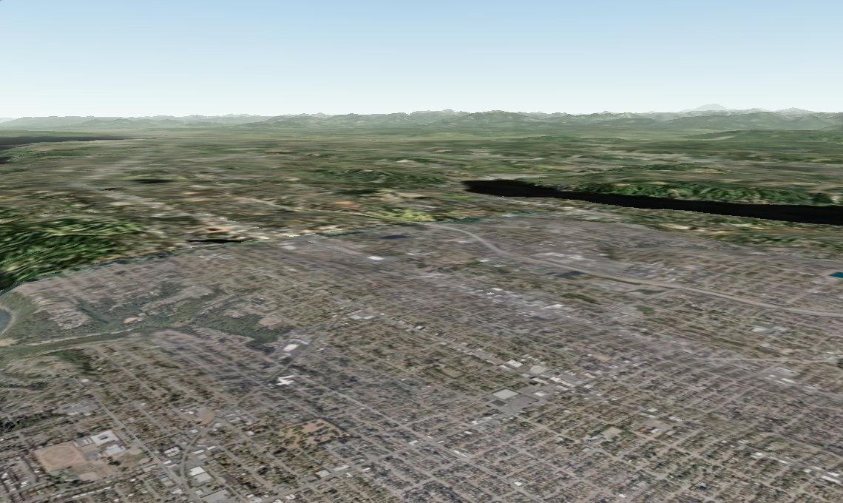
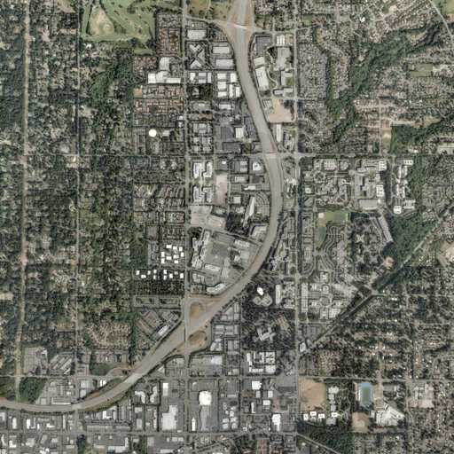
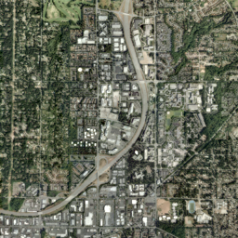
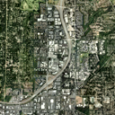
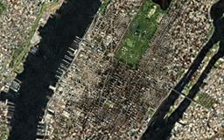
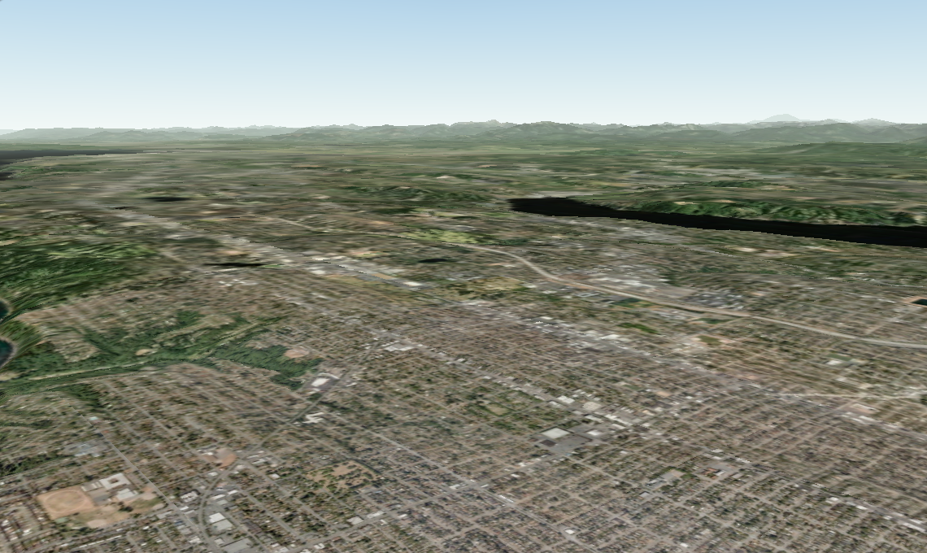
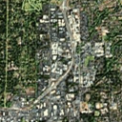
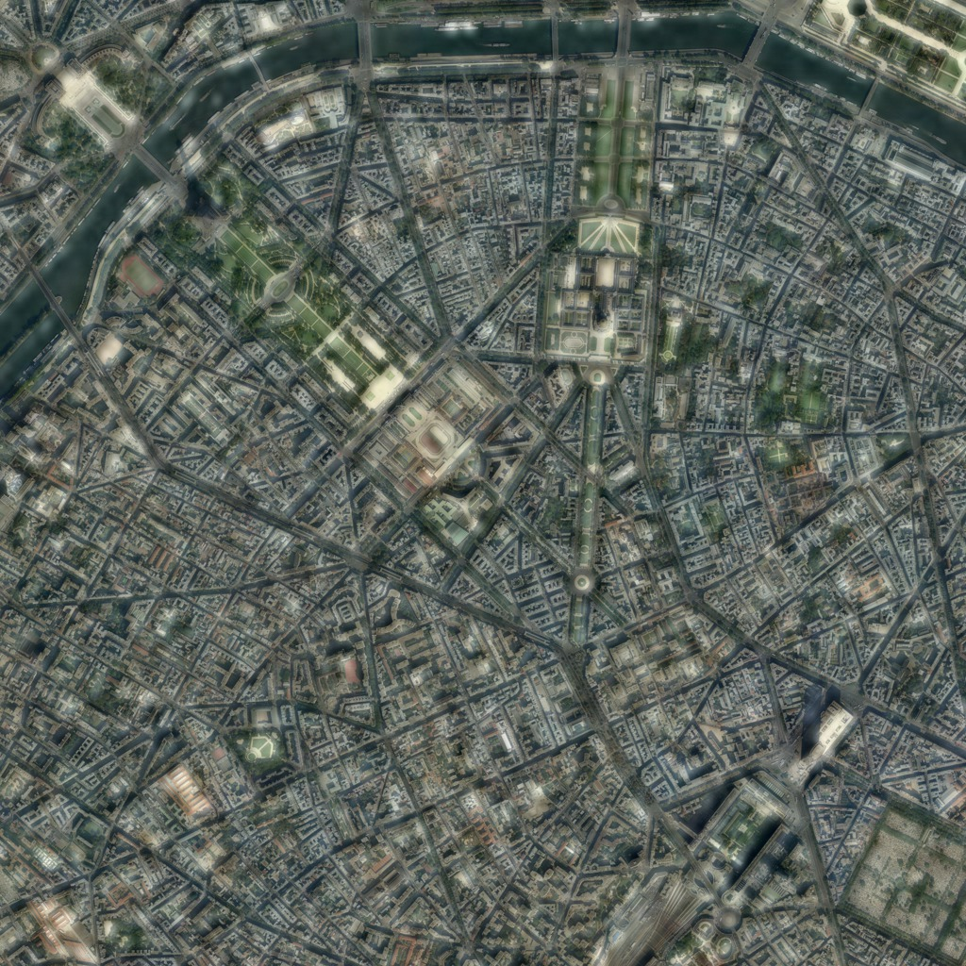
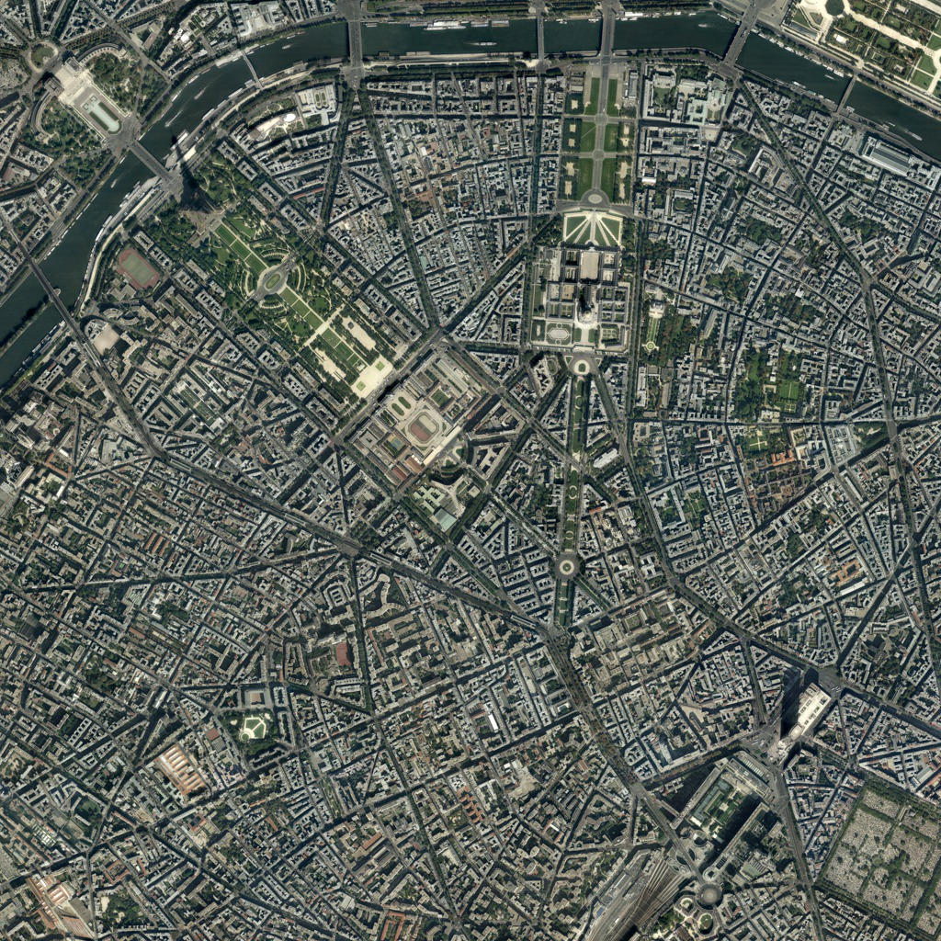
Multiscale Continuity in Bing Maps Imagery
(Charles Han & Hugues Hoppe)
Satellite imagery
Smooth transition
Google Earth: spatial discontinuities
Bing Maps: scale discontinuities
Aerial imagery
We optimize both spatial and scale continuity:
(1) Reduce ghosting
Output
x₀
Downsample
…
Input
x_{c-1}
Comparison of intermediate levels:
Coarse-scale image
x_{c}
Smooth image pyramid
Structure transfer
x_{c+1}
Downsample
Clipped Laplacian blending
…
…
Fine-scale image
x_{f-1}
Simple linear interpolation
Our structure transfer + clipped Laplacian blending
(2) Reduce blurring
[Booth 125]

