Slide 1
Poisson Surface Reconstruction
Michael Kazhdan, Matthew Bolitho
Johns Hopkins University
Hugues Hoppe
Microsoft Research

Slide 2
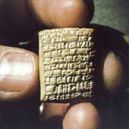
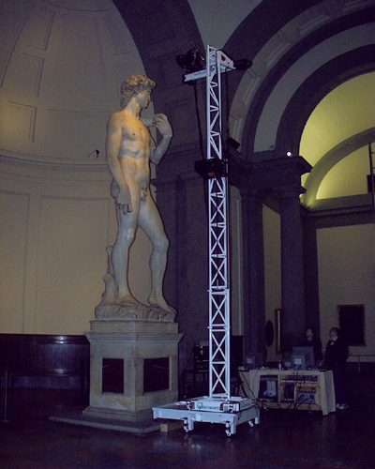
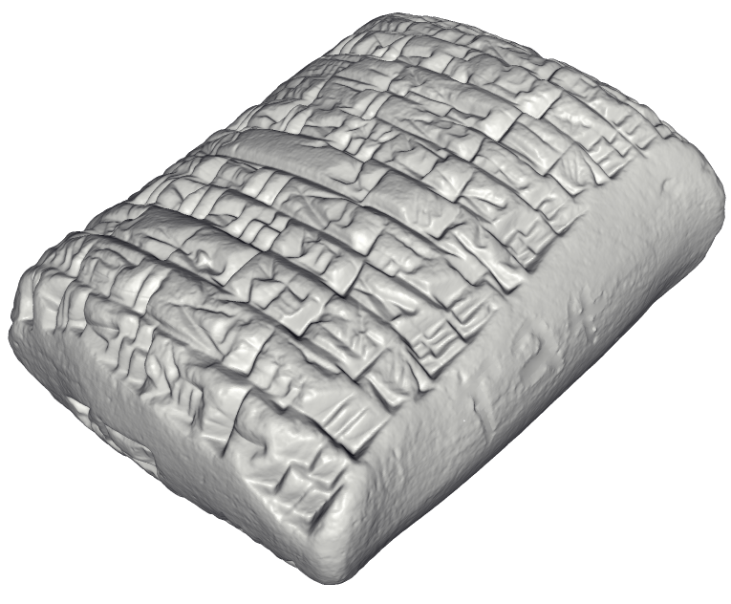
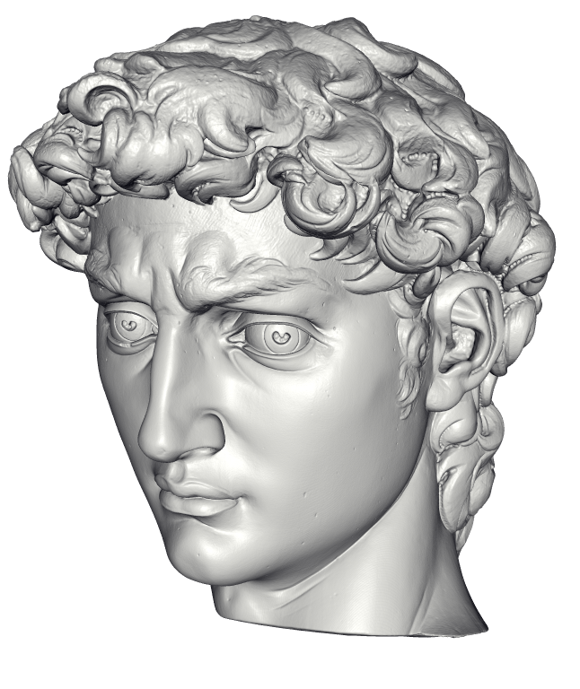
Motivation
In many domains, scanners are used to obtain virtual representations of 3D shapes
http://www.jhu.edu/digitalhammurabi/
http://graphics.stanford.edu/projects/mich/

Slide 3
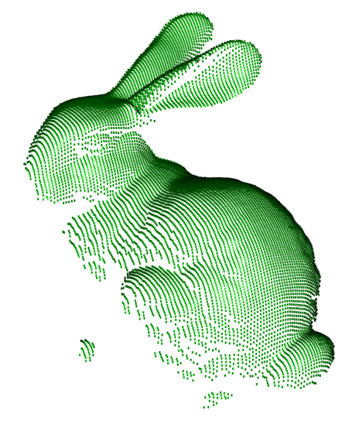
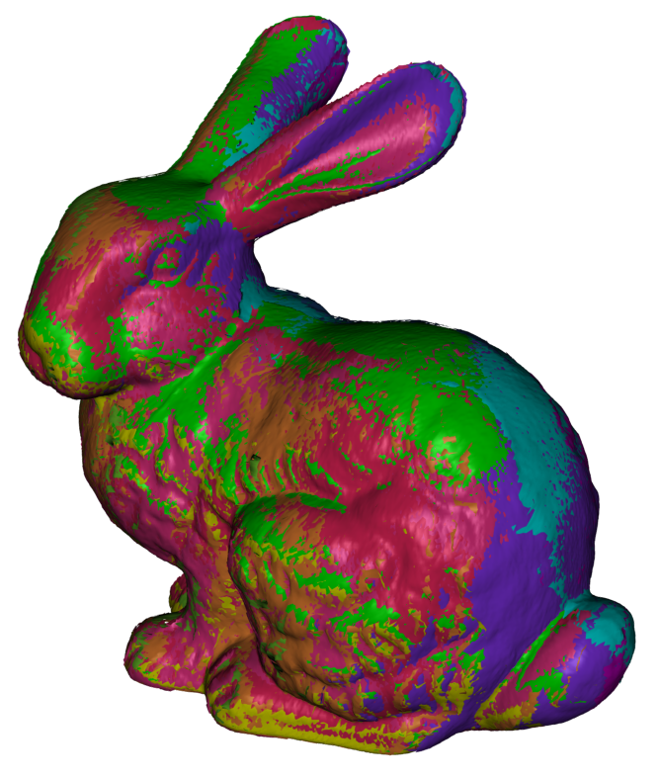
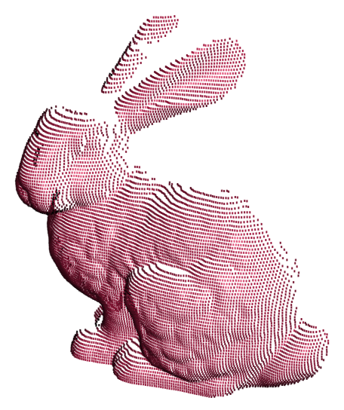
Motivation
Scanning often gives only local connectivity

Slide 4
Motivation
Scanning often gives only local connectivity
We want a 3D Mesh for:
  Parameterization
  Computational Analysis
  Rapid Prototyping
  Rendering
  Collision Detection

Slide 5
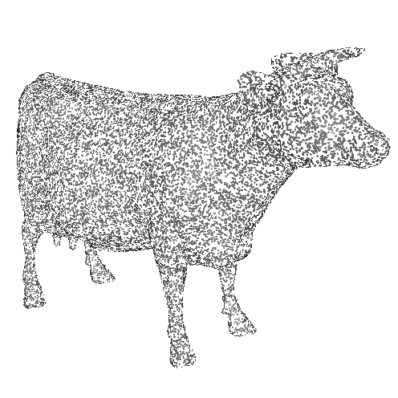
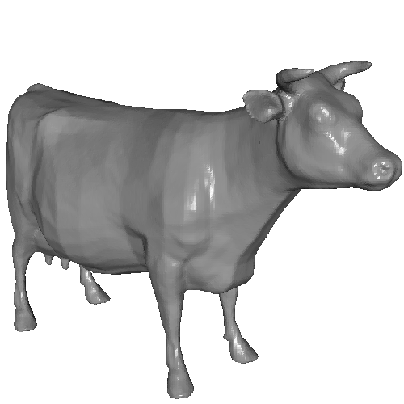
Surface Reconstruction
Generate a mesh from a set of surface samples

Slide 6
Surface Reconstruction
Generate a mesh from a set of surface samples
Three general approaches:
  Computational Geometry
      Boissonnat, 1984 Edelsbrunner, 1984
      Amenta et al., 1998 Dey et al., 2003
  Surface Fitting
      Terzopoulos et al., 1991 Chen et al., 1995
  Implicit Function Fitting
      Hoppe et al., 1992 Curless et al., 1996
      Whitaker, 1998 Carr et al., 2001
      Davis et al., 2002 Ohtake et al., 2004
      Turk et al., 2004 Shen et al., 2004
      Kazhdan, 2005

Slide 7
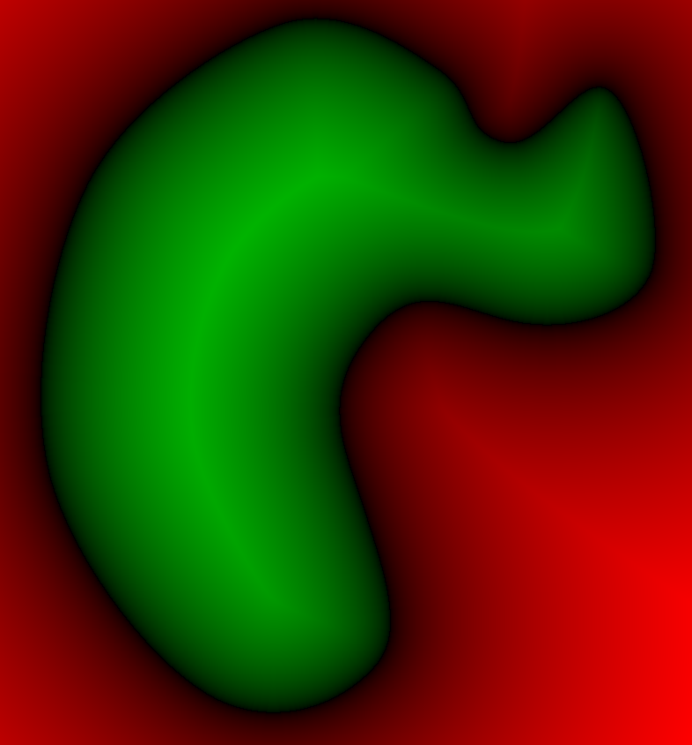
Implicit Function Approach
Define a function with value less than zero outside the model and greater than zero inside
< 0
0
> 0

Slide 8
Implicit Function Approach
Define a function with value less than zero outside the model and greater than zero inside
Extract the zero-set
< 0
0
> 0

Slide 9
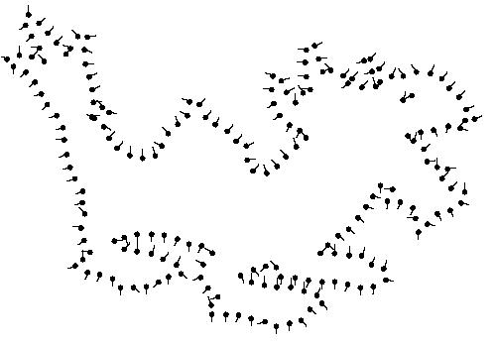
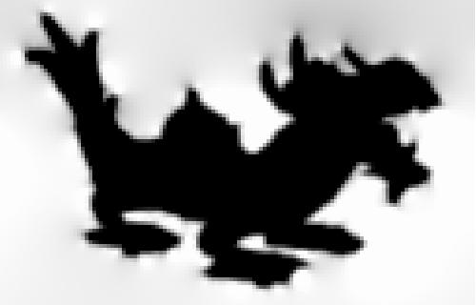
Accurate Reconstructions
To extract fine surface detail,
represent the implicit function
at a high resolution.
Limitation:
Regular voxel grids have
complexity proportional to
the volume not the surface.
Kazhdan 2005, FFT Reconstruction

Slide 10
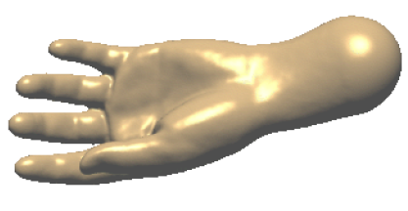
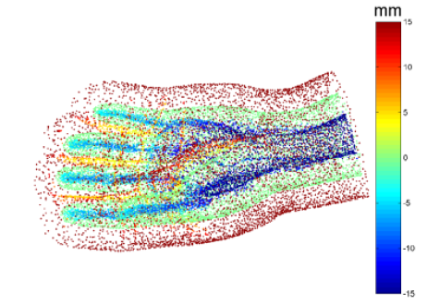
Accurate Reconstructions
An accurate representation is only required near the surface.
Limitations:
Solve large, dense linear systems
Hard to control away from samples
Carr et al. 2001, FastRBF

Slide 11
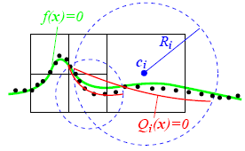
Accurate Reconstructions
An accurate representation is only required near the surface.
Limitations:
Solve large, dense linear systems
Hard to control away from samples
Local solutions are more susceptible to noise
Ohtake et al. 2004, MPU

Slide 12
Outline
Introduction
Approach
  Key Ideas
  Implementation
Results
Conclusion

Slide 13
The Indicator Function
We reconstruct the surface of the model by solving for the indicator function of the shape.
0
0
1
1
0
0
1
0
Indicator function
χ_{M}

Slide 14
Challenge
How to construct the indicator function?
Oriented points
Indicator function
χ_{M}

Slide 15
Gradient Relationship
There is a relationship between the normal field and gradient of indicator function
0
0
0
0
0
0
Oriented points
Indicator gradient
∇χ_{M}

Slide 16
Integration
Represent the points by a vector field
Find the function whose gradient best approximates :
χ

Slide 17
Integration as a Poisson Problem
Represent the points by a vector field
Find the function whose gradient best approximates :
Applying the divergence operator, we can transform this into a Poisson problem:
χ

Slide 18
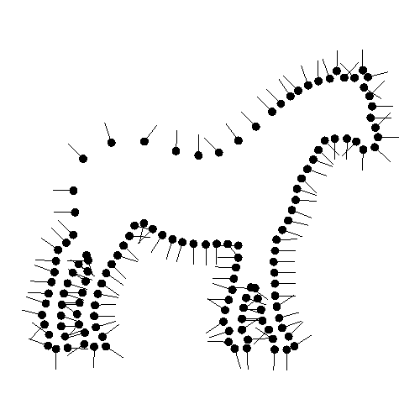
Implementation
Given the Points:
Set octree
Compute vector field
Compute indicator function
Extract iso-surface

Slide 19
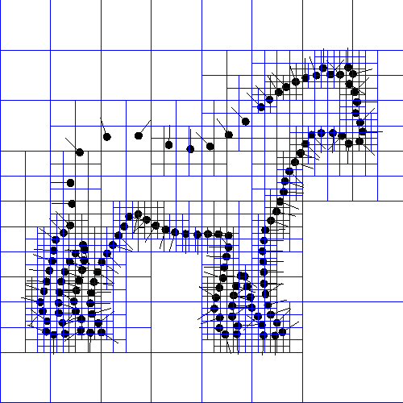
Implementation: Adapted Octree
Given the Points:
Set octree
Compute vector field
Compute indicator function
Extract iso-surface

Slide 20
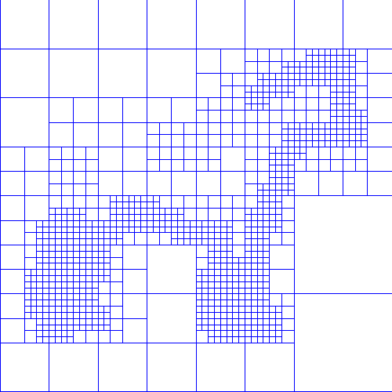

Implementation: Vector Field
Given the Points:
Set octree
Compute vector field
  Define a function space
  Splat the samples
Compute indicator function
Extract iso-surface

Slide 21

Implementation: Vector Field
Given the Points:
Set octree
Compute vector field
  Define a function space
  Splat the samples
Compute indicator function
Extract iso-surface

Slide 22

Implementation: Vector Field
Given the Points:
Set octree
Compute vector field
  Define a function space
  Splat the samples
Compute indicator function
Extract iso-surface

Slide 23

Implementation: Vector Field
Given the Points:
Set octree
Compute vector field
  Define a function space
  Splat the samples
Compute indicator function
Extract iso-surface

Slide 24
Implementation: Vector Field
Given the Points:
Set octree
Compute vector field
  Define a function basis
  Splat the samples
Compute indicator function
Extract iso-surface

Slide 25
Implementation: Vector Field
Given the Points:
Set octree
Compute vector field
  Define a function basis
  Splat the samples
Compute indicator function
Extract iso-surface

Slide 26
Implementation: Vector Field
Given the Points:
Set octree
Compute vector field
  Define a function basis
  Splat the samples
Compute indicator function
Extract iso-surface

Slide 27
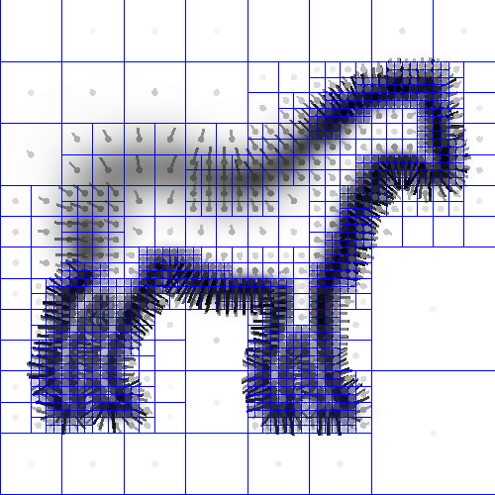
Implementation: Vector Field
Given the Points:
Set octree
Compute vector field
  Define a function space
  Splat the samples
Compute indicator function
Extract iso-surface

Slide 28
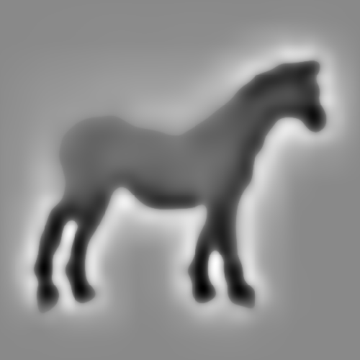
Implementation: Indicator Function
Given the Points:
Set octree
Compute vector field
Compute indicator function
  Compute divergence
  Solve Poisson equation
Extract iso-surface

Slide 29
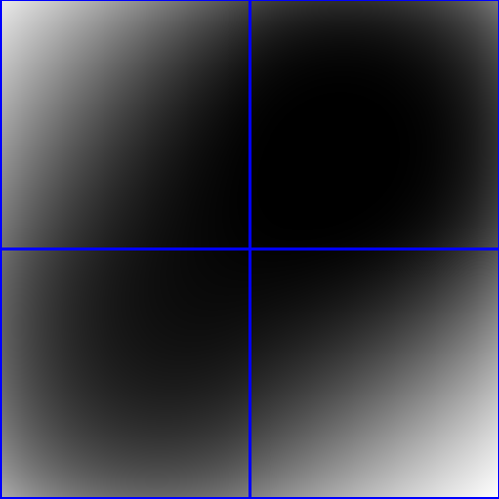
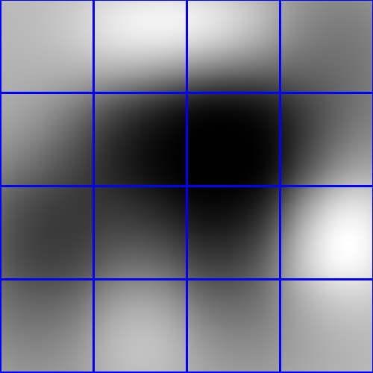
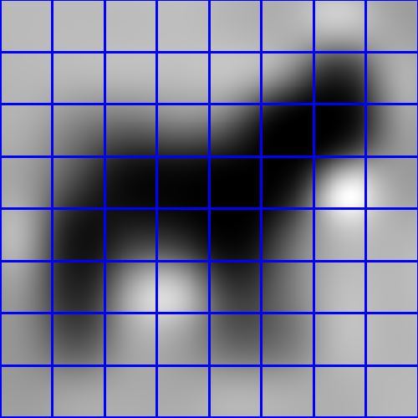
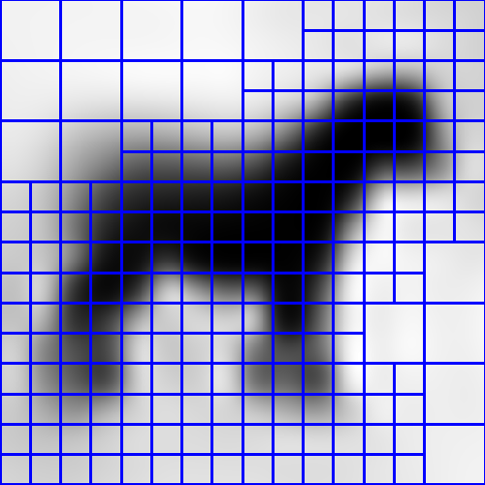
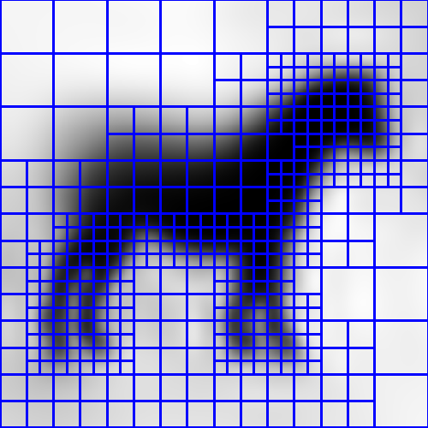
Implementation: Indicator Function
Given the Points:
Set octree
Compute vector field
Compute indicator function
  Compute divergence
  Solve Poisson equation
Extract iso-surface

Slide 30

Implementation: Indicator Function
Given the Points:
Set octree
Compute vector field
Compute indicator function
  Compute divergence
  Solve Poisson equation
Extract iso-surface

Slide 31
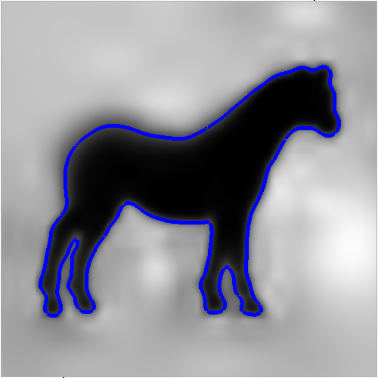
Implementation: Surface Extraction
Given the Points:
Set octree
Compute vector field
Compute indicator function
Extract iso-surface

Slide 32
Outline
Introduction
Approach
Results
  Evaluation of our approach
  Comparison to related work
Conclusion

Slide 33
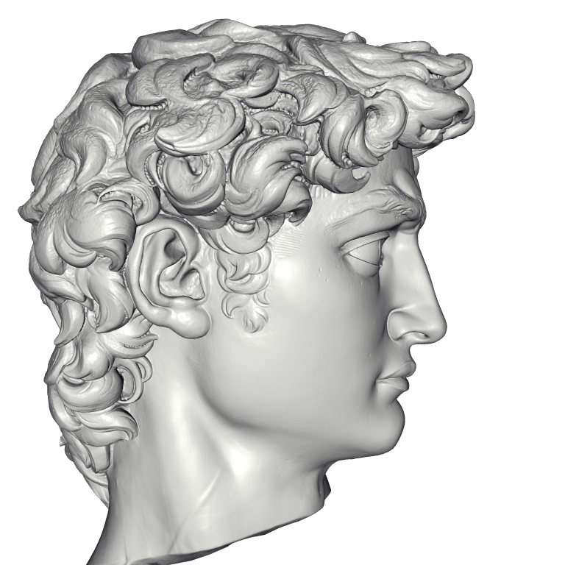
Michelangelo’s David
215 million data points from 1000 scans
22 million triangle reconstruction
Compute Time: 2.1 hours
Peak Memory: 6600MB

Slide 34
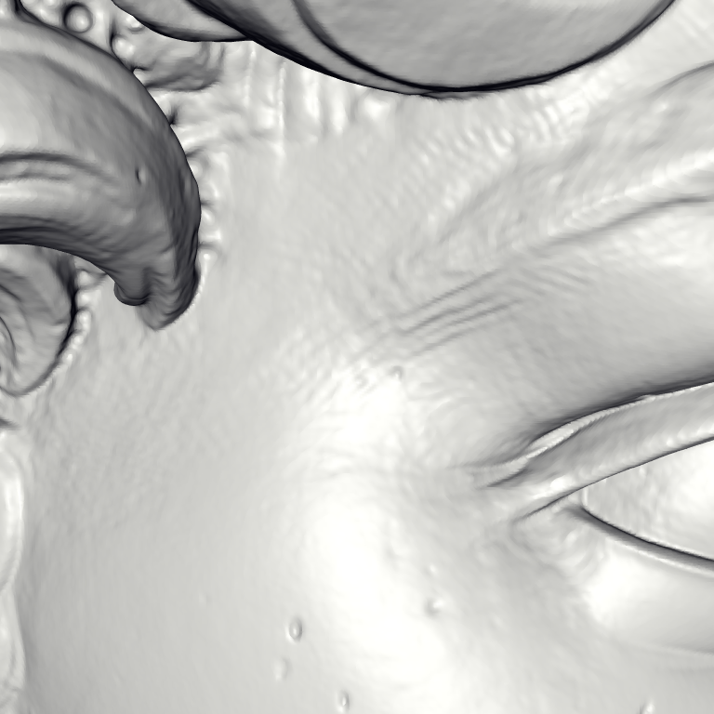
David – Chisel marks

Slide 35
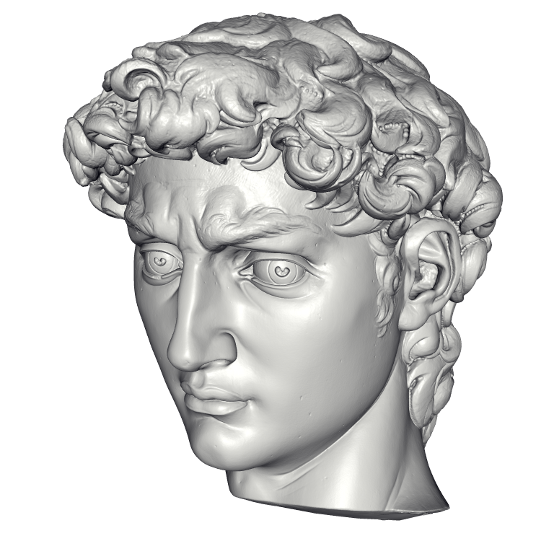
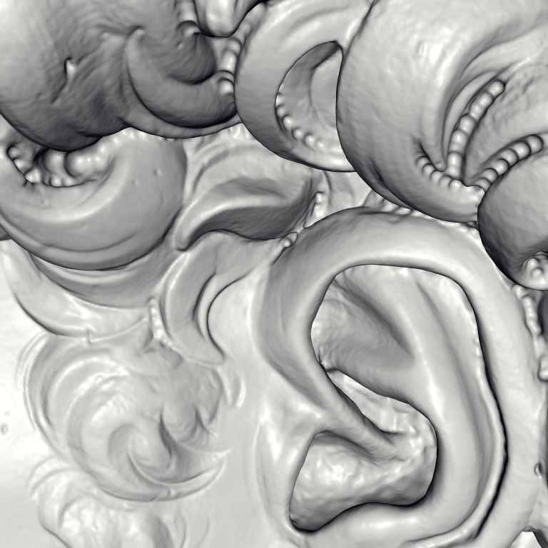
David – Drill Marks

Slide 36
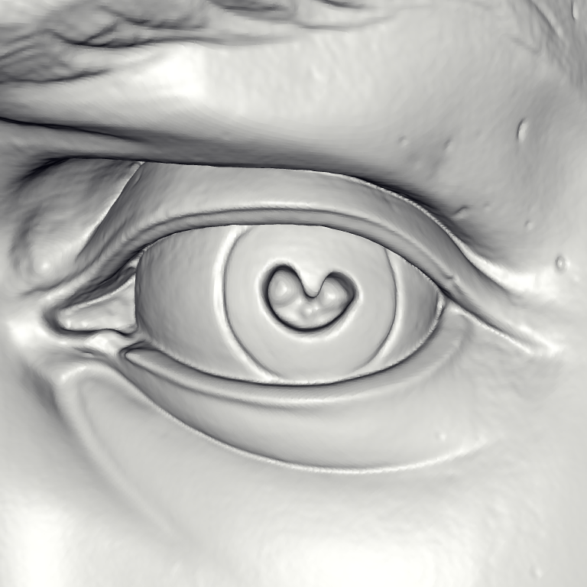
David – Eye

Slide 37
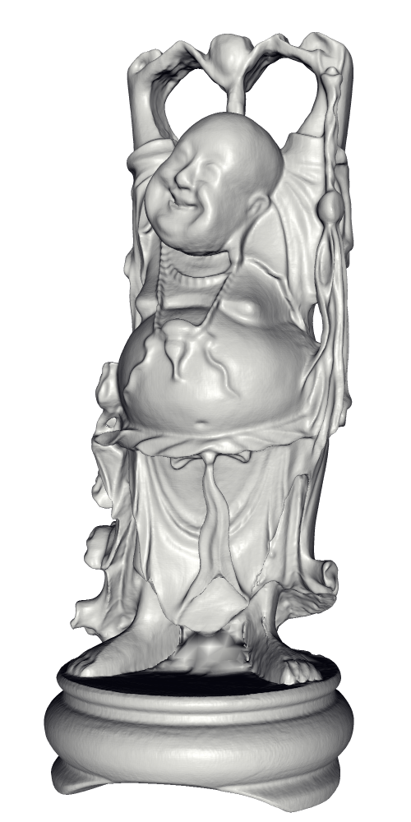
Scalability – Buddha Model

Slide 38
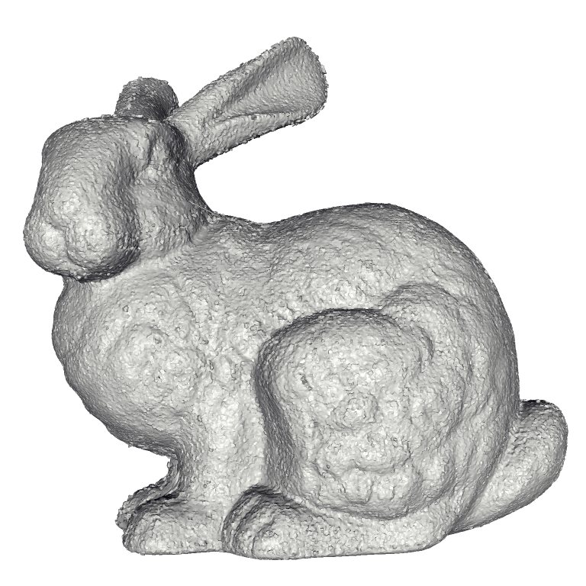
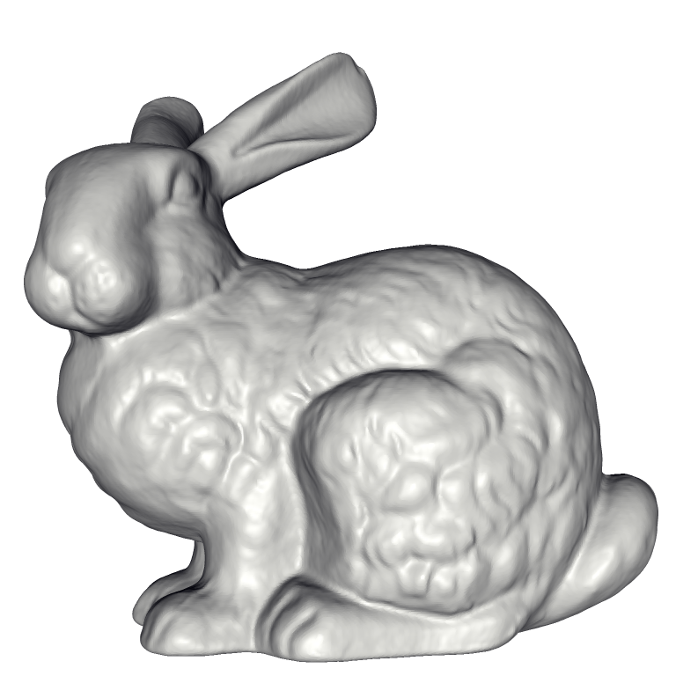
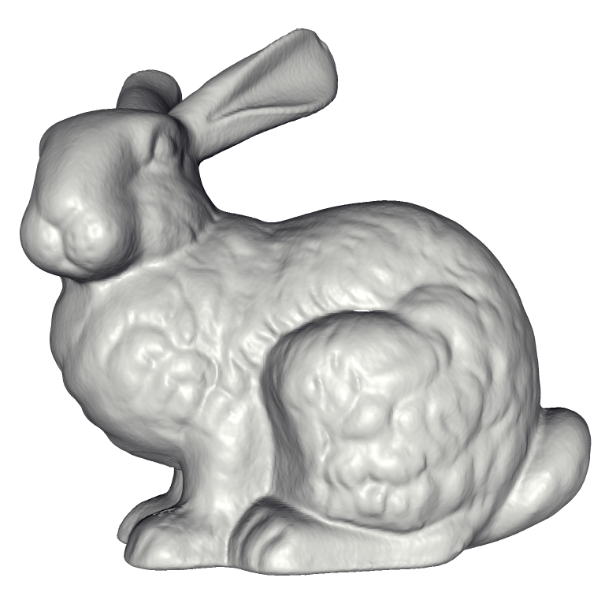
Stanford Bunny
Power Crust
FastRBF
MPU
VRIP
FFT Reconstruction
Our Method

Slide 39
VRIP Comparison
VRIP
Our Method

Slide 40
FFT Reconstruction Comparison

Slide 41
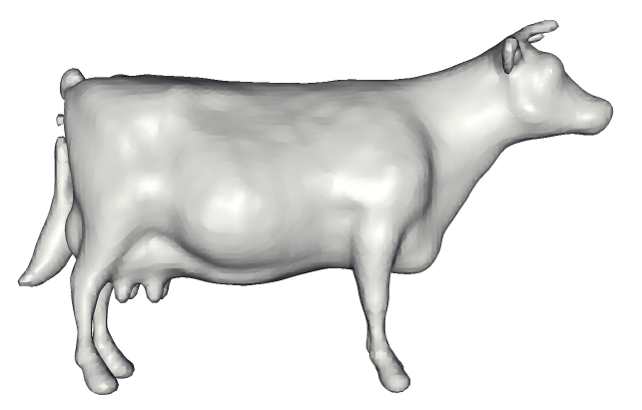
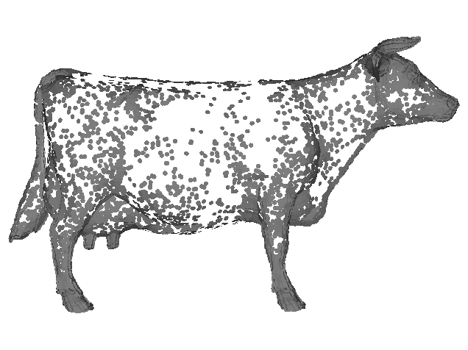
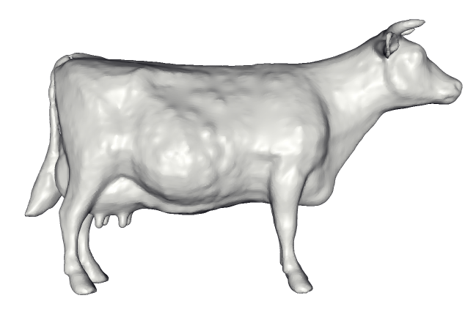
FFT Reconstruction Comparison
FFT: Fixed resolution
Low Resolution
High Resolution

Slide 42
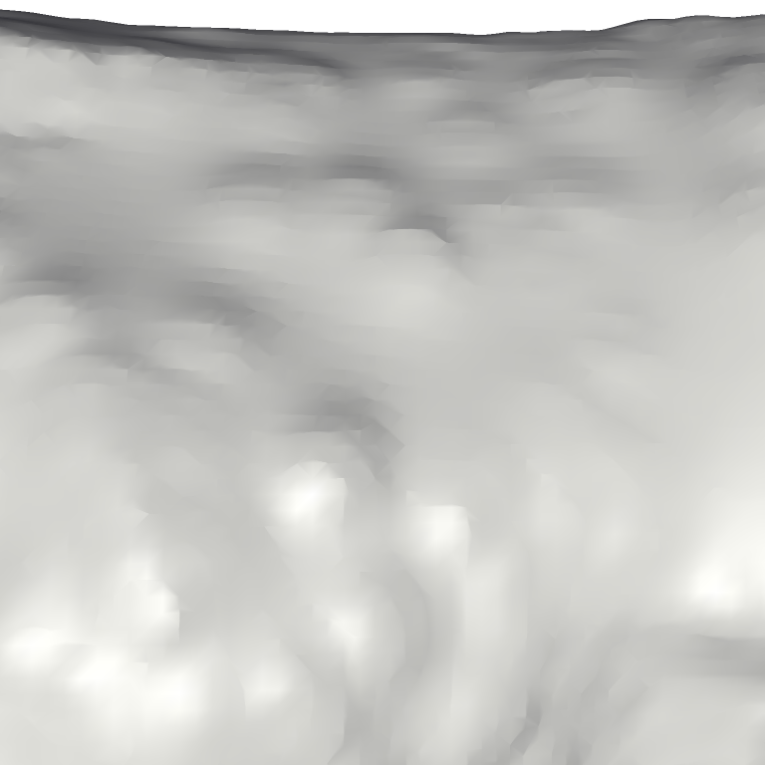
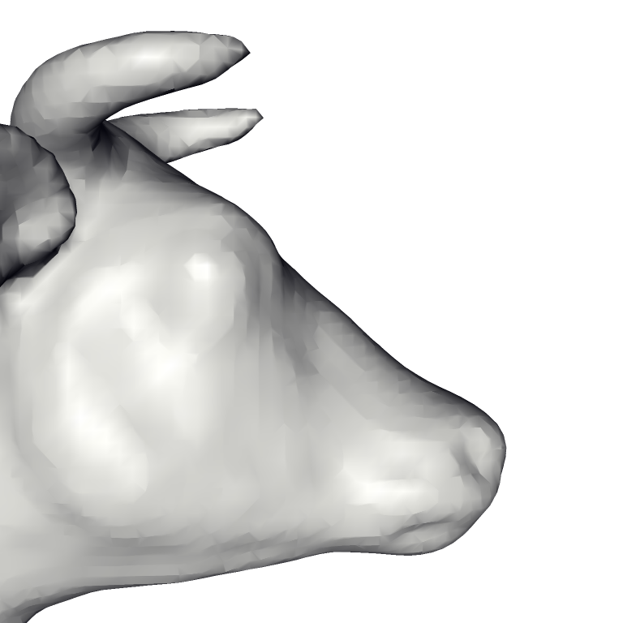
FFT Reconstruction Comparison
FFT: Fixed resolution
Low Resolution
High Resolution

Slide 43
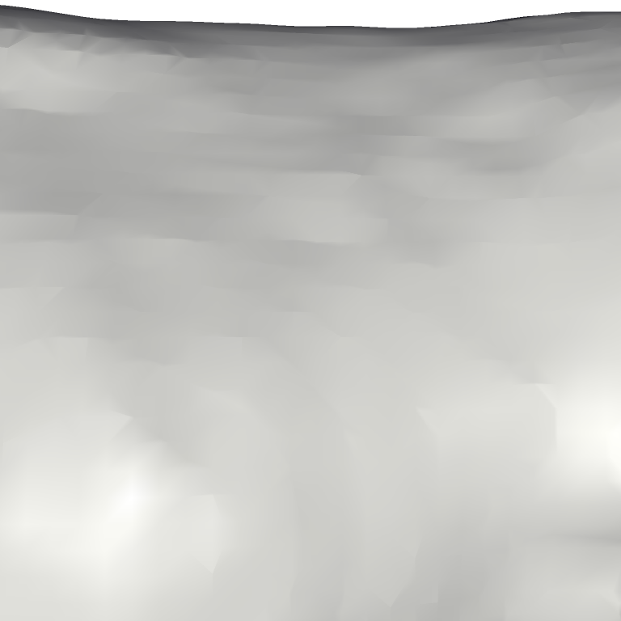
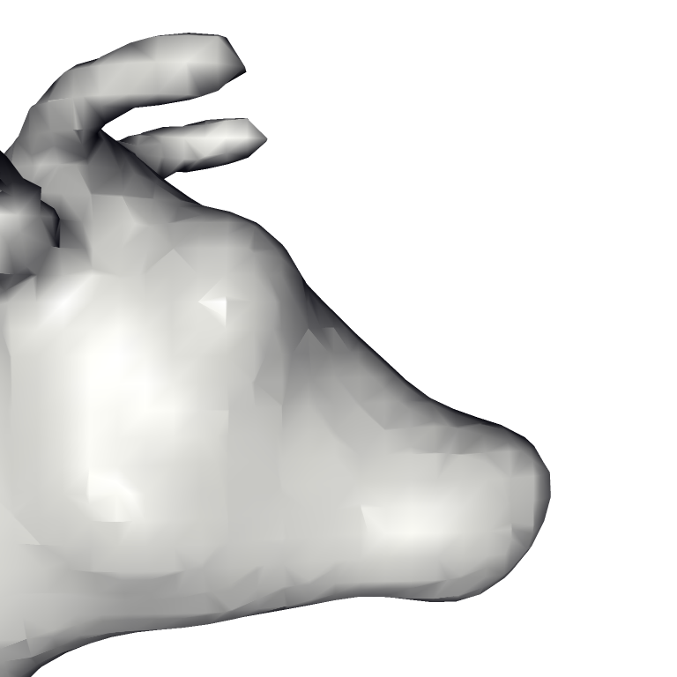
FFT Reconstruction Comparison
FFT: Fixed resolution
Low Resolution
High Resolution

Slide 44
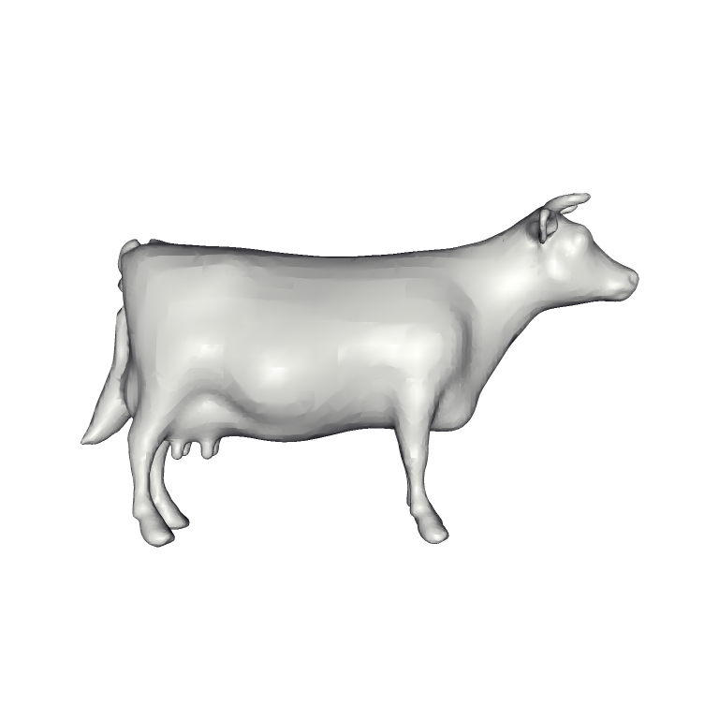
FFT Reconstruction Comparison
Poisson: Adaptive resolution

Slide 45

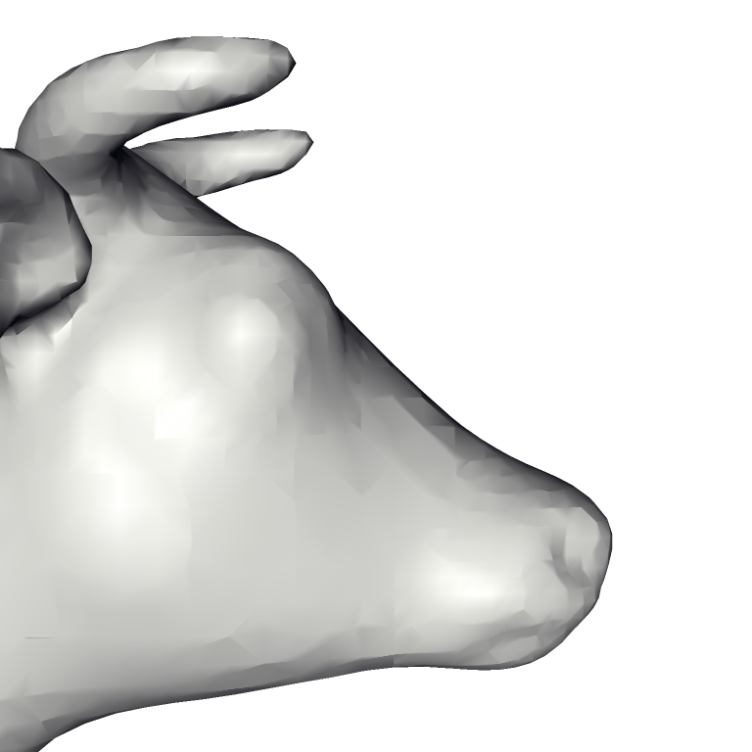
FFT Reconstruction Comparison
Poisson: Adaptive resolution

Slide 46
Conclusion
Theoretical Contributions:
  Relate oriented point samples to indicator gradient
  Express reconstruction as a Poisson problem
Empirical Advantages:
  Is robust to noise
  Adapts to the sampling density
  Can handle large models

Slide 47
Thank You

Slide 48
FFT Reconstruction Comparison
Both our method and the FFT Reconstruction solve by computing the indicator function:
  FFT Reconstruction:
    Convolve the points with a fixed filter
  Our Method:
    Compute the divergence and solve the Poisson equation
These two methods are equivalent

Slide 49
Comparison
Method | Triangles | Time (s) | Memory (MB)
Power Crust | 554,332 | 380 | 2653
Robust Cocone | 272,662 | 892 | 544
FastRBF | 1,798,154 | 4919 | 796
MPU | 925,240 | 28 | 260
Hoppe et al 1992 | 950,562 | 70 | 330
VRIP | 1,038,055 | 86 | 186
Kazhdan 2005 | 910,320 | 125 | 1684
Our Method | 911,390 | 263 | 310

