Slide 1
Perfect Spatial Hashing
Sylvain Lefebvre Hugues Hoppe
Microsoft Research
Notes:
Hi,
I am going to present the work we have done with Hugues Hoppe on Perfect Spatial Hashing.
First - a quick disclaimer - this work has nothing to do with shape matching or symmetry detection.

Slide 2

Motivation
data
empty
Sparse texture
Notes:
In this work we are interested in sparse texture compression.
# A sparse texture is a texture where only a small subset of pixels actually contain defined data.
It is therefore very inefficient to store such data as regular textures in memory.

Slide 3


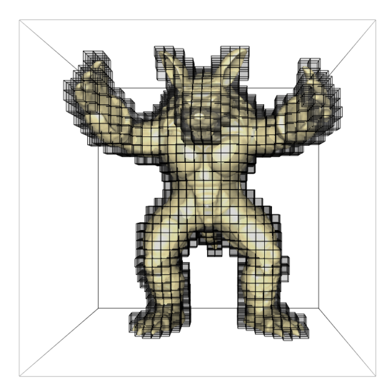
Motivation
line
equations
Vector images
3D Texturing
Notes:
Sparse textures have a growing number of applications in computer graphics,
# For instance, in 2d they are used to encode discontinuities in images by storing line equations in pixels.
# In 3D they are used to store color information as a sparse set of voxels within a volume surrounding the object. This removes the need for a texture atlas.

Slide 4
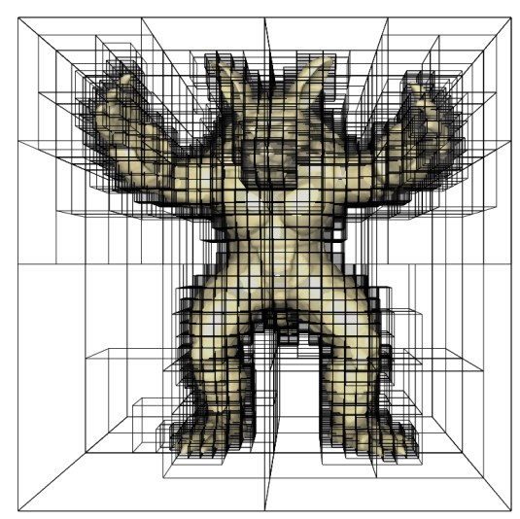
Previous Work
Challenges:
  Compact storage
  Efficient random access
Octree textures
[Benson and Davis 2002;…]
Adaptive texture maps
[Kraus and Ertl 2002]
N³-Trees
[Lefebvre et al. 2005]
Nested indirection grids
[Lefohn et al. 2006]
Overhead in space and time
  • Space: unused links and nodes
  • Time: chain of indirection pointers
Notes:
Several schemes have been proposed to encode such sparse textures for computer graphics applications.
# The challenges are to offer the # smallest possible storage, while # allowing efficient random access from the graphics processor.
These approaches, based on hierarchical data structures, all improve sparse texture storage. However space is wasted by unused pointers and unused nodes in the hierarchy.
In addition, the most compact structures such as octrees involves an expensive chain of dependent texture lookups.

Slide 5
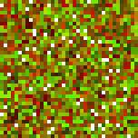
Minimal perfect hash
p
h(p)
hash h
Minimal
Perfect
h requires ~1.44n bits
Notes:
Our main contribution is to efficiently encode sparse textures using spatial hashing.
We store only the defined cells in a compact hash table.
The location of a cell within the table is given by a hash function applied to its coordinates.
Moreover, our goal is to find a minimal perfect hash.
A minimal hash is one where the hash table is full. In other words there are no unused slots.
# In addition a hash is said to be perfect when all defined cells map to a different location in the hash table. In other words, there are no collisions, which enables constant time access.
One important point is that the hash function itself needs to be encoded and this may take up a significant amount of memory.
# Minimal perfect hashes are extremely rare. In fact it has been shown that the description of such a hash requires a minimum of 1.44 bits per defined cell. However, this is a relatively small space overhead, especially compared to existing approaches.

Slide 6

Minimal perfect hash
Offset table Φ
q
p
:
  Efficient SIMD execution
  Only ~4 instructions on GPU
  Only ~4n bits
  Optimized spatial coherence
h(p)
Hash table H
Notes:
Building on previous work on perfect hashing, we encode our hash function using a small auxiliary table, called the offset table.
Our hash function is very simple.
We start by accessing the offset table. # The access is done using warp around adressing, so many cells will be mapped to the same location.
# We then add the retrieved offset to the coordinates of the cell, and use the perturbed address to access the hash table again with modulo addressing.
The challenge of course is to create an offset table so that the resulting hash function is perfect.
Our hash func. is extremly simple and well suited for GPU evaluation.
First it contains no branch instructions and therefore enables efficient SIMD execution.
It requires only four instructions in most cases,
and requires, on average, only 4 bits per entry, which is more than the theoretical lower bound but is still a much smaller overhead than previous schemes.
Finally, there remains some flexibility in the creation fo the hash func. so that we can optimize it to maintain some coherence through the access. This let us benefit from the texture cache of the GPU.

Slide 7
Using our hashing scheme
Hash construction
Preprocess
(seconds or minutes)
Hashed texture
Sparse texture
Rendering on
the GPU
Static sparsity structure
Modifiable data
Notes:
Ok, so let’s step back a little and see how an application can use our hashed textures.
First, given the sparse data we build the perfect hash. This is a pre-processing step, that takes seconds or minutes depending on the size of the data.
It outputs both the offset table and the hash table. These can be loaded into GPU memory and accessed efficiently from a fragment program as I just explained.
# One limitation of our scheme is that it does not support dynamic changes in the structure of the data: no additional pixels can be added once the hash has been constructed.
However, it is important to note that the content of the hash table can be of course dynamically updated.
So, let me know explain how we build the hash function and hash table.

Slide 8
Hash construction
Hash table
p → p mod m
Offset table Φ
p → p mod r
0
1
2
3
4
5
0
5
3
4
8
2
7
1
1
6
2
2
4
1
1
8
3
3
3
4
5
6
7
6
5
4
7
8
2
r=2x2
5
u=6x6
n=8
m=3x3
Notes:
ZERO OFFSETS
LEAST COMMON MULTIPLE
We have just seen that the runtime access to the data is extremely simple and efficient. Of course all the difficulty is now in building the perfect hash function.
Let us consider this simple example. (I think I tried do draw a chair …).
The domain grid is 6x6 pixels. There are only 8 defined cells or entries, numbered from 1 to 8.
[next]
We will use a hash table of size 3 by 3 (so it can hold all 8 entries) and an offset table of size 2 by 2.
[next]
Let’s first see how the entries map into the table through simple modulo access.
[next]
The first 3x3 cells of the domain are directly mapped onto the hash table. Entries 1 and 2 are thus mapped at these locations.
[next]
In the next 3x3 entries, mapped onto the hash table through the modulo operation, there are no defined entries.
[next]
Entries 3,4 and 7 are mapped to these locations, …
[next]
… and finally entries 5 6 and 8 are mapped into the hash table. As you can see, there are several collisions.
[next]
We can apply the same process to find out how entries collide within the offset table.
[next]
A key element to understand the approach is that entries colliding in the hash table do not collide in the offset table. So intuitively, we will be able to assign a different offset to each entry to uncollide them in the hash table.
Note that this property is ensured as long as the least common multiple of the table sizes is greater or equal to the domain size u.

Slide 9
Hash construction
Hash table
p → p + Φ[p] mod m
Offset table Φ
p → p mod r
0
1
2
3
4
5
0
5
3
4
8
2
7
1
1
6
+(1,0)
-(1,0)
2
2
4
6
1
5
3
1
8
3
3
4
5
6
7
+(0,2)
+(0,0)
4
7
8
2
[inspired by
Fox et al 1992]
5
Slightly modified for coherence optimization
If stuck, successively increase offset table size
➔ Always succeed!
Notes:
I will now explain how we compute the offsets to obtain a new hash function with no collision. Recall that the final hash function is the sum of the coordinates and the offset from the offset table.
As pointed out by Fox et al., the most difficult offsets to assign are those impacting the largest numbers of defined cells. So we assign offsets by decreasing order of number of dependent data.
Therefore in this example we start by assigning the offset impacting entries 1,5 and 3.
[next]
We will thus start by this cell, onto which entries 1,5 and 3 are mapped.
[next]
If we look to where entries 1,5 and 3 map into the hash table, we can see that there is room for each entry.
[next]
So the offset can be set to 0.
[next]
Now we consider this cell, onto which entries 4 and 6 are mapped.
If we look to where these entries are mapped into the hash table, we can see that 6 collides with 3. We will thus randomly find an offset so that 4 and 6 are not colliding with any entries already in the hash table.
Offset +(0,2) works here.
[next]
Next we consider entries 2 and 7. Offset –(1,0) works.
[next]
Next we consider the entry 8. Note that it is now very easy to assign an offset to the remaining single entries. Here, offset +(1,0) works.
[next]
We know have the final offset table and hash table.
[next]
Note that we modify the offset search process to try to preserve coherence through the final hash. Please refer to the paper for the details.
[next]
Also, as you may have already guessed, this construction process may fail, depending on the sizes of the hash table, the offset table and the data layout. In case of failure, we successively increase the size of the offset table.
We have different strategies for this increase, please refer to the paper, but it is important to note that success *is* guaranteed. However, the size of the offset table might be larger than it could. It is then up to the user to invest more time to search for smaller results.

Slide 10
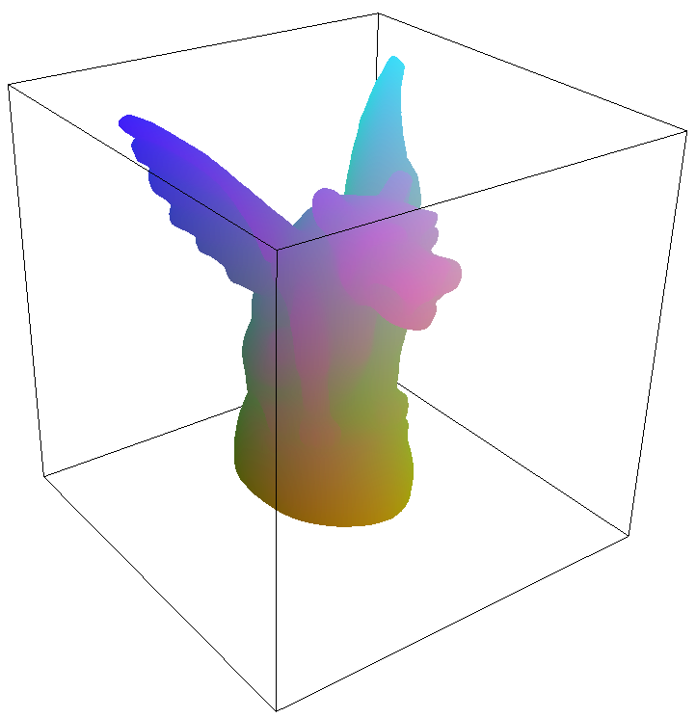
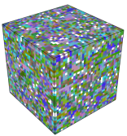
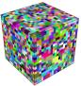
Generalization to 3D
2D
3D
Hash
table
Offset
table
Hash
table
Offset
table
2D sparse
3D sparse
Notes:
The hashing scheme I just described in 2D is easily extended to 3D. Runtime access has the exact same cost as GPUs perform vector arithmetic.

Slide 11
Overview
Our hashing scheme
Sparsity encoding
Filtering
Applications
Notes:
Here is how the remainder of the talk is organized.
Next I will introduce sparsity encoding.
Then, I will describe how we can filter the content of a hashed sparse texture.
Finally, I’ll describe applications that directly benefit from spatial hashing.

Slide 12

Access scenarios
Constrained access
Hash table
q
3D texturing
Arbitrary access
q
Notes:
There are two access scenarios.
In the first scenario, only defined cells are accessed. This is for instance the case for 3D texturing, as the surface is always enclosed inside defined cells of the volume.
In the second access scenario, undefined cells may be accessed. The problem is that these cells are going to map somewhere into the hash table, producing wrong results. So we need to distinguish between the defined and undefined cells – In other words we need to encode data sparsity.
We propose three different approaches to encode sparsity.

Slide 13
Sparsity encoding
Domain bit
Position tag
Position hash
Notes:
A first approach is to use a domain bit. It is a binary grid, flagging whether a given cell is defined or not.
While this is only one bit per cell, this grid has the size of the domain and may become too large to be practical.

Slide 14

Sparsity encoding
Domain bit
Position tag
Position hash
0=undefined,
1=defined
q
Domain
Hash table
Notes:
A first approach is to use a domain bit. It is a binary grid, flagging whether a given cell is defined or not.
While this is only one bit per cell, this grid has the size of the domain and may become too large to be practical.

Slide 15
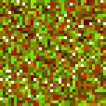
Sparsity encoding
Domain bit
Position tag
Position hash
Tag table
q
Domain
Hash table
Notes:
A second approach is to store a tag table alongside the hash table, where the tag contains the coordinates of the stored data.
# So if an undefined cell maps to the same location in the hash table, the position tag will let us detect this is not the stored defined cell.
Now, one issue with this approach is that the cell coordinates may require up to 32 bits. So depending on the sparsity of the data, this overhead might be costly.

Slide 16
Sparsity encoding
Domain bit
Position tag
Position hash
Position-hash table
q
Domain
Hash table
Notes:
The last approach we propose is to use a second level hash, called position-hash. A table stores the values of the position hash for the defined cells. This values have a smaller dynamic.
# The position hash is computed so that all the undefined entries mapping to a given hash slot will produce a different key than the stored cell.
It is thus easy to differentiate between the defined cell and the colliding undefined cells.
All the details on how to compute this hash are in the paper.

Slide 17
Overview
Our hashing scheme
Sparsity encoding
Filtering
Applications
Notes:
Here is how the remainder of the talk is organized.
Next I will introduce sparsity encoding.
Then, I will describe how we can filter the content of a hashed sparse texture.
Finally, I’ll describe applications that directly benefit from spatial hashing.

Slide 18
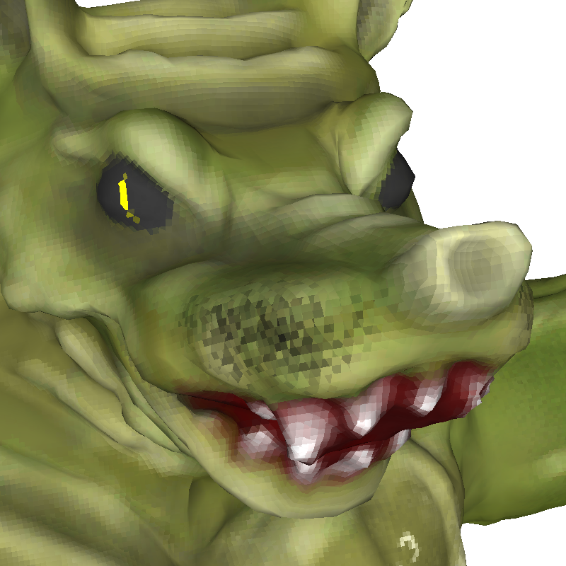

Filtering
Bilinear / trilinear interpolation
MIP-mapping
No interpolation
Trilinear interpolation

Slide 19
Interpolation
p
Hash table
Domain
In 3D, slower by a factor of 3 to 7
Notes:
So, let me start by explaining how we achieve interpolation. To simplify I’ll give all the explanations in 2D.
The simplest approach is to perform four lookups into the hash table, and to apply a simple bilinear interpolation formula.
Unfortunately, as this requires multiple evaluations of the hash function it is costly.
For instance in 3D this is slower by a factor from 3 to 7 depending on the hardware and the zoom factor.
This is especially unfortunate as graphics hardware does provide native bilinear and trilinear interpolation.

Slide 20
Interpolation with blocking
p
Hash table
Domain
Single hash evaluation
Native bilinear interpolation
But, duplication of border samples
[Kraus and Ertl 2002]
Notes:
To exploit this native capability, we store blocks of texture data into the hash table, instead of point wise colors.
A single hash evaluation retrieves the block. We then access it using native bilinear interpolation to obtain the final color.
However, as in other block-based schemes, border samples are duplicated so we incur a memory overhead.

Slide 21
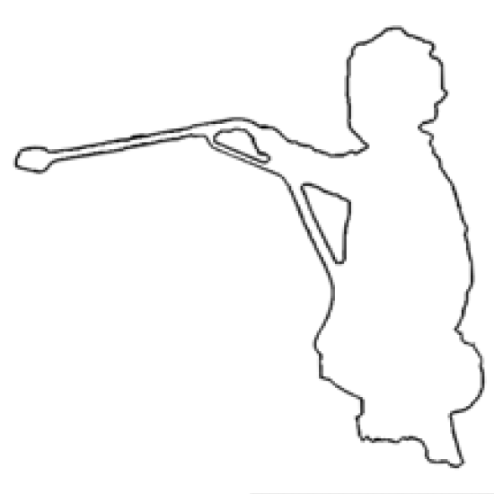
MIP-mapping
First approach:
Indexing
Notes:
Now that we can perform linear interpolation, the next step is MIP-mapping.
Briefly, the idea of MIP-mapping is to pre-compute a pyramid of the texture at different resolutions, and to access the correct resolution during rendering.
A first approach would be to hash each level independently, thus producing a set of hashed textures.
However, this would require indexing during rendering, which is not very efficient on GPUs.

Slide 22

MIP-mapping
Better approach:
Coordinate from level
Single hash table
Notes:
Instead, we flatten the MIP-mapping pyramid in a single sparse texture, using the level identifier to compute the new coordinates.
Thus we build and access a single hashed texture, which much more suitable to GPUs.

Slide 23
Overview
Our hashing scheme
Sparsity encoding
Filtering
Applications
Notes:
Here is how the remainder of the talk is organized.
Next I will introduce sparsity encoding.
Then, I will describe how we can filter the content of a hashed sparse texture.
Finally, I’ll describe applications that directly benefit from spatial hashing.

Slide 24

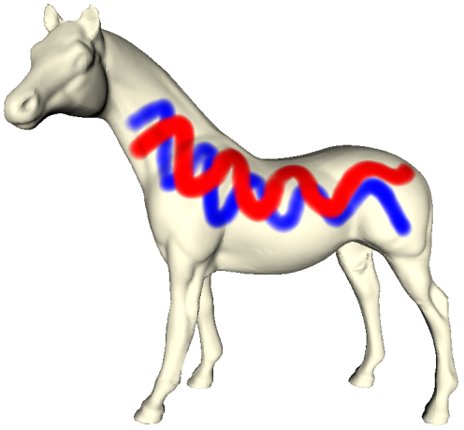

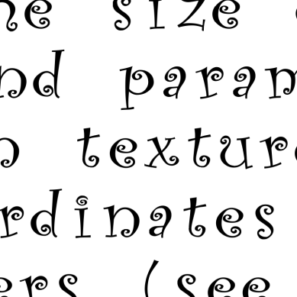
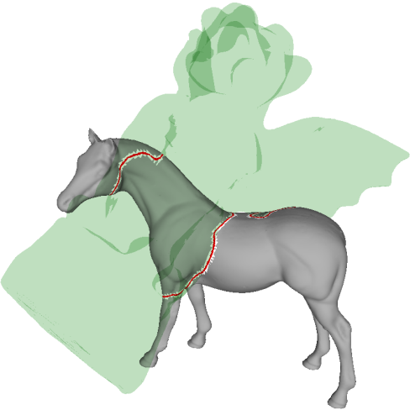
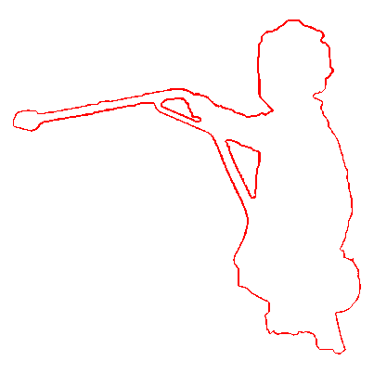
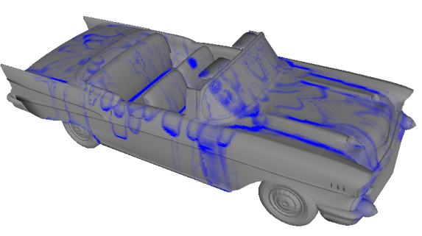
Applications
Vector images
Sprite maps
3D textures
3D painting
Alpha compression
Simulation
Collision detection
2D
3D
Notes:
Many applications can benefit from hashed textures. I will now review these applications first in 2d, then in 3d.

Slide 25

Application: Vector images
2 lines per cell
e.g.
,
[Sen et al 2003; Tumblin and Choudhury 2004; …]
Notes:
Several schemes have been proposed to encode vector graphics in images, to enable resolution independent rendering of sharp silhouettes on the GPU.
As a simple demonstration we are going to encode discontinuities with two line equations per image cell.

Slide 26
Application: Vector images
line coefficients
wasted memory
Notes:
Obviously these line coefficients are only useful at the boundary of the shape. All the information in the other cells is wasted. So we propose to use our hashing scheme to encode such sparse data.

Slide 27

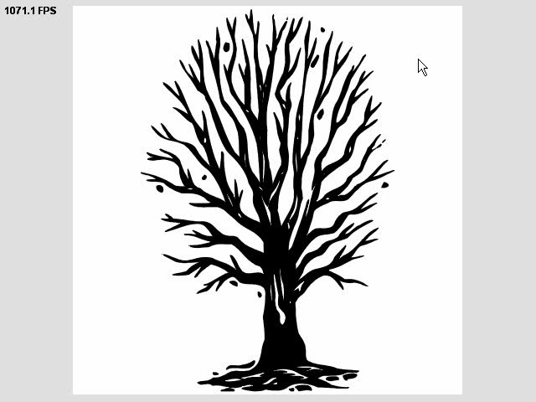

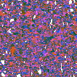
Application: Vector images
Domain image
256²×8bits, 64KB
Hash table
181²×2×24bits, 196KB
282KB
Offset table
106²×16bits, 22KB
(Uncompressed: 1.6 MB)
Notes:
Here you can see a real-time rendering of a complex vector image compactly encoded has a 280 KB hashed texture. The initial data was 1.6 MB. Rendering is performed on a GeForce 7800 Ultra, using two line equations per cell.

Slide 28
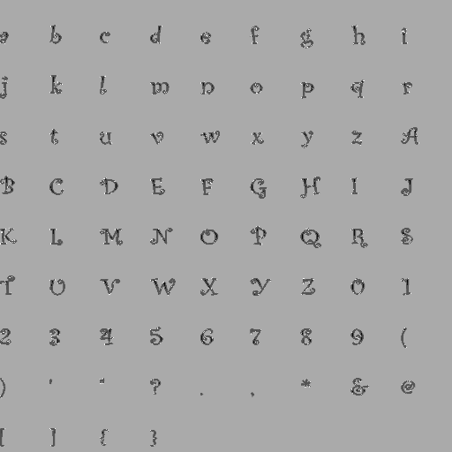



Application: Vector images
Domain image
512²×8bits, 256KB
Hash table
188²×2×24bits, 212KB
500KB
Offset table
124²×16bits, 31KB
(Uncompressed: 6.3 MB)
Notes:
Here is another example. Here we render a font table created from a True type font.
In this case the data sparsity structure has strong periodicity. This is a difficult case for hashed textures, and indeed the offset table is slightly larger than the average case – as can be seen in the bottom left corner it contains many unused entries.
Still, this entire resolution independent font table fits in only 500KB.

Slide 29

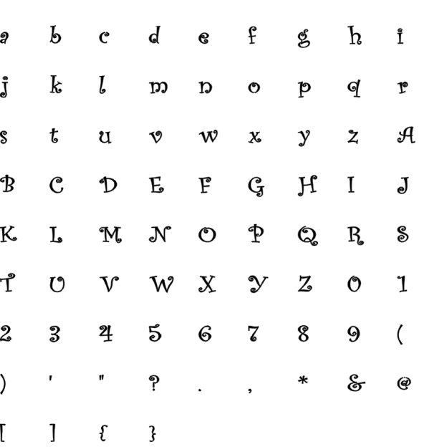

Application: Sprites
sprite pointers
Sprite map
512² image
2097KB
Sprites
1024² image
(hashed)
Notes:
In the next application, we use the font table to write pages of text. We use an indirection grid to position the letters. As this indirection grid is itself sparse, it is also stored as a hashed texture.

Slide 30


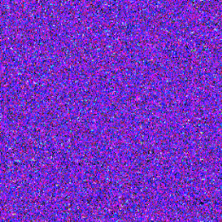
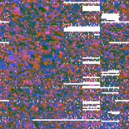
Application: Sprites
Domain image
128×256×8bits, 32KB
Hash table
313²×2×24bits, 784KB
500 KB + 900 KB = 1.4 MB
Offset table
200²×16bits, 80KB
(Uncompressed: 8.3 MB)
Notes:
So we have two levels of hashing, first for positioning the letters, second for the font table.
This full page is stored with only 1.4 MB. We can zoom on a single letter without suffering from any resolution artifact. Rendering is performed at around 400 FPS. Note that here the only geometric primitive is a single quad for the page.

Slide 31
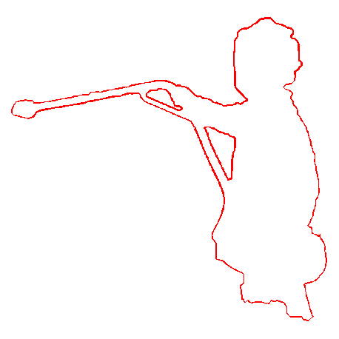
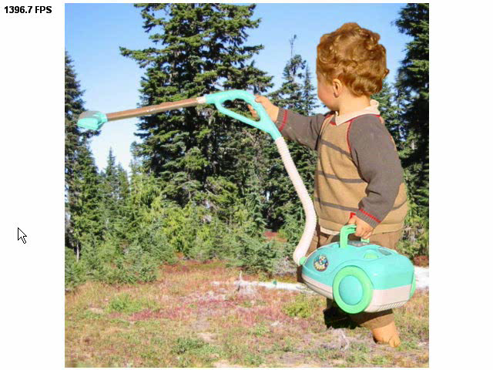


Application: Alpha compression
1.8%
Color image
566², 961KB
Hash table
41²×4²×8bits, 27KB
Alpha reduced from 8 to 0.9 bits/pixel
Offset table
24²×16bits, 1KB
Notes:
The last 2D application is alpha channel compression.
In many images with alpha channel, only a small subset of pixels have a fractional alpha value.
Using our spatial hashing the cost of the alpha channel in this example is reduced from 8 bits per pixel to 0.9 bits per pixel. The texture is rendered at more than a thousand frames per second.

Slide 32
Applications
Vector images
Sprite maps
3D textures
3D painting
Alpha compression
Simulation
Collision detection
2D
3D
Notes:
Many applications can benefit from hashed textures. I will now review these applications first in 2d, then in 3d.

Slide 33
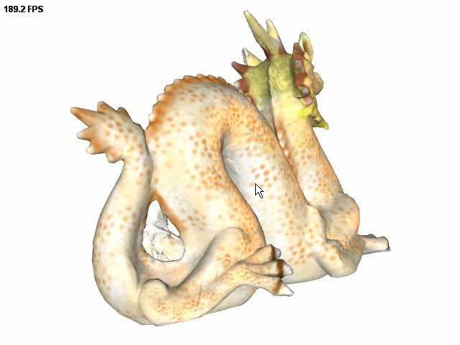
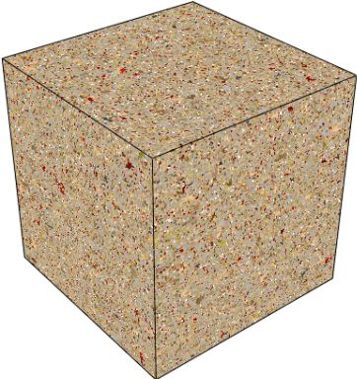
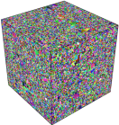
Application: 3D texture
Hash table
297³×24bits, 76.8MB
Offset table
52³×24bits, 421 KB
1024³ texture in 77 MB (MIP-mapped)
Block size = 2
(Uncompressed: 3 GB)
Notes:
The first 3d app is to avoid texture atlases and store color information as a set of sparse voxels in a volume surrounding the object. Only voxels intersecting the surface contain color information.
In this example the dragon is textured with a sparse 1k cubed volume.
Using a blocked hash for native trilinear interpolation, the texture fits in 77 MB, including MIP-mapping.

Slide 34
Application: 3D texture
Hash table
170³×24bits, 14.7MB
Offset table
91³×24bits, 2.3MB
17 MB without blocking
(Uncompressed: 3 GB)
Notes:
If we forgo blocking and perform filtering explicitly the texture entirely fits in 17 MB.

Slide 35
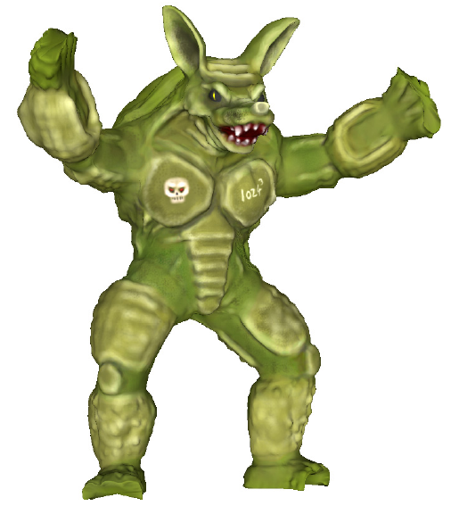
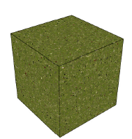

Comparisons
 | Block size (optimal) | Memory size | Access cost
Standard hash | none | 15.7 MB | O(1)
Octree texture [Benson 2002, DeBry 2002] | none | 25.6 MB | O(log u)
Blocked hash | 2 | 45.9 MB | O(1)
Blocked indirection [Kraus and Ertl 2002] | 6 | 75.9 MB | O(1)
u=1024³
13.7 MB of color data
Notes:
So let’s see how memory sizes compare to other methods.
We will consider this mesh textured by a 1k cube volume, containing 13.7 MB of defined color data.
First, a standard hash without blocking is 15.7 MB, which is rather good considering the data set already contains 13.7 MB of data.
An octree texture on the same data is 25.6 MB, almost twice as big. This is due to its internal nodes.
# Now, using blocking for native trilinear interpolation, the size of the hashed texture is 45.9 MB.
The indirection grids of Kraus and Ertl, also using blocking, have a size of 75.9 MB on this data, so we are also almost twice smaller.

Slide 36
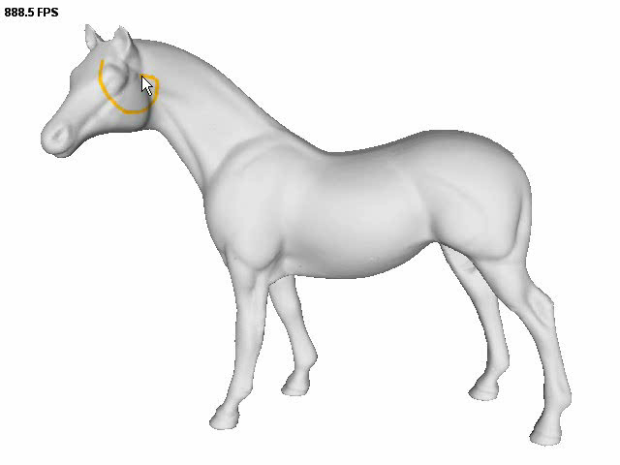
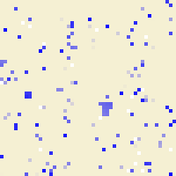
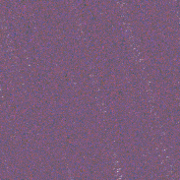
Application: 3D painting
Hash table
2437²
Offset table
1074²
2048³ texture in 20.1MB
Notes:
Other 3D applications includes 3D painting over the mesh surface. Here the surface is voxelized beforehand at a resolution of 2k cube. The voxel’s colors are updated directly in the hash table on the GPU – so the data never leaves GPU memory.
We are updating the entire hash data every frame, therefore the brush size can be arbitrarily large without impacting performance. It can be a procedure too.
(We have seen how we can create a hashed texture and use it to texture a mesh. Now, while the structure of the texture is static, we can still update its content to provide interactive painting.
We update the color of the cells through a rasterization pass into the hash table. However, we here hash the 3D cells into a 2D hash table, which introduces a slight complication of our basic hash function. Please refer to the paper for all details.)

Slide 37
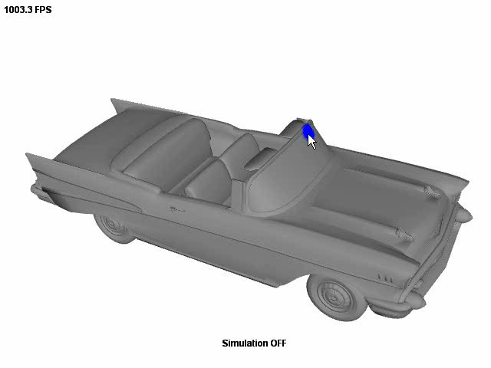
Application: 3D simulation
Sparse 256³ data
Notes:
Painting can be extended to simulation over a surface.
(As we can dynamically update the content of the cells, we can also run a simulation onto the mesh surface.)

Slide 38
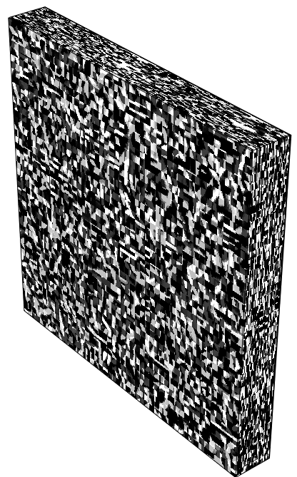
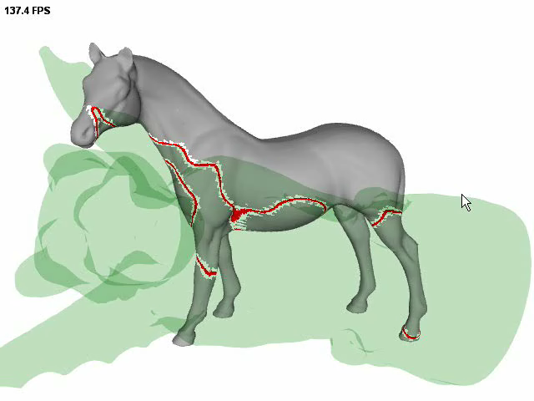

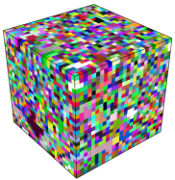
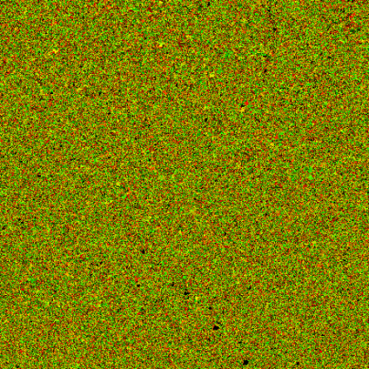
Application: Collision detection
Hash
table
Offset
table
Domain
bit
Voxel centers
1024³ resolution
Notes:
OBJECT SPACE
RED VOXELS SHOW A CONSERVATIVE ESTIMATE OF …
The last app is a scheme for object-space collision detection.
We voxelize both surfaces and test whether the voxels of one object are colliding with the voxels of the other using a hashed texture.
This provides a quick conservative collision test. We can also render the curve of intersection between the objects, here in red at 140 FPS. (one hundred and forty)

Slide 39

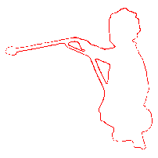




Results summary
Application | Dataset | Bits/entry | Construction time
Vector image |  | 4.7 | 2 sec.
Alpha |  | 4.2 | < 1 sec.
3D Texture |  | 3.4 | 6 min.
Painting |  | 3.1 | 23 min.
Simulation |  | 3.2 | 15 sec.
Collisions |  | 3.3 | 14 sec.
Notes:
This table summarize all results. You can see that the average number of bits per entry is around 4, compared to the theoretical lower bound of 1.4
The hash construction takes between a few seconds to a few minutes, depending on the data complexity.
ADD RATIO ?

Slide 40





Summary
Perfect spatial hashing
  Sparse data in compact tables
  Fast access from GPU
  Sparsity encoding
  Interpolation and MIP-mapping
Applications
  2D and 3D
p
h(p)
p
Notes:
…
We have explored several applications that can benefit from our hashing scheme both in 2D and 3D.

Slide 41


Perfect spatial hashing
Future work:
  Dynamic insertions
  Adaptive resolution
  Entropy coding for storage
  Higher-dimensional domains
Notes:
We’d like to add support for dynamic updates,
Adaptive resolution,
Entropy coding the storage,
Exploring application in higher dimensional domains.

Slide 42







Thank you !!!
Questions ?
Offset table Φ
p
h(p)

Slide 44
Table sizes
Initialization
  Hash table size: smallest m = m² ≥ n
  Offset table size: r = 0.25 n (4 bits / entry)
  r and m co-prime, and r m ≥ u
Fast method
  If construction fails r = 2 r
Compact method
  Binary search over r
  Several attempts (typically 5) for each r value
➔ Always succeed
Notes:
And first, I need to describe how we initialize the table sizes.
We initialize the hash table with the smallest size so that it can contain all the data while being a square texture.
We initialize the offset table to be 4 bits per entry, as we know this is the average result of our algorithm.
Then we run the hash construction I detailed before.
In case of failure, we have two different strategies.
First, if a result must be generated quickly, we simply increase the size of the offset table geometrically.
Our second approach is slower, but is better at minimizing the size of the offset table. Here we perform a binary search over the size. Because hash construction is based on an heuristic we perform multiple attempts for each value of r, typically 5.
It is important to note that in both cases the success is guaranteed. However, the size of the offset table might be larger than it could. It is then up to the user to invest more time to search for smaller results.

Slide 45
Previous work on minimal perfect hashing
Integers
  e.g. { 12, 37, 167, 218 } → { 2, 1, 0, 3 }
  Mostly theoretical…
  Chinese remainder theorem [Winters 1990]
  Linear space [Schmidt and Siegel 1990]
  [Fredman et al 1984; Brain and Tharp 1990; …]
Strings
  e.g. { “for”, “if”, “loop” } → { 2, 0, 1 }
  Not space-optimal, but highly practical
  [Sager et al 1985; Fox et al 1992]
  GNU tool…

Slide 46
Expected hash complexity
Domain
[Mehlhorn 1982]
Hash table
n elements
size n

Slide 47
Our contributions
Multidimensional hashing
Simple hash function
  Few memory accesses
  Few instructions
  No branching
Hash designed for coherence

Slide 48
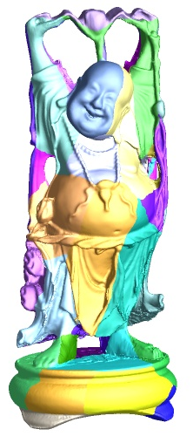
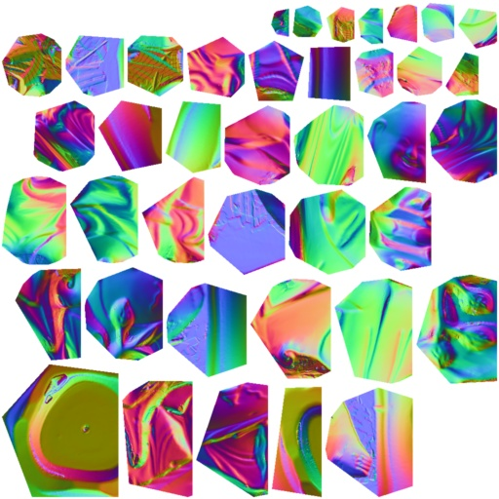
Traditional atlas parameterization
Drawbacks:
  Storage of texture coordinates
  Nonuniform sampling
  Texture seams (discontinuities)

