Slide 1
Parallel Controllable Texture Synthesis
Sylvain Lefebvre - Hugues Hoppe
Microsoft Research

Slide 2
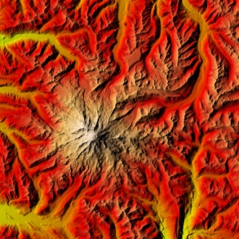
Exemplar-based texture synthesis
Exemplar
Synthesized
Notes:
Several techniques can synthesize large textures from a small exemplar image while avoiding obvious repetitions.

Slide 3
Exemplar-based texture synthesis
Notes:
Our goal is to make such techniques available in the context of runtime data amplification, where textures, or regions of large textures, are generated on-demand as needed for rendering.

Slide 4
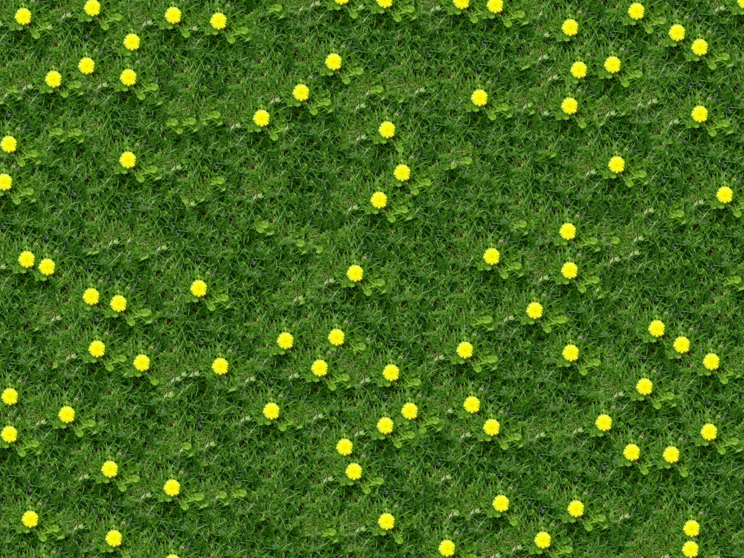
Contributions
Parallel synthesis
On-demand
GPU
Synthesis control
Synthesis magnification
Notes:
Our work has three contribution areas.
First, we introduce a Parallel Texture Synthesis algorithm.
[CLICK]
Our algorithm quickly generates any window from an infinite aperiodic texture.
Spatial determinism ensures that different windows can overlap seamlessly.
[CLICK]
Our technique is implemented on the GPU, so that textures are directly available for rendering and the CPU remains free for other tasks.

Slide 5
Contributions
Parallel synthesis
On-demand
GPU
Synthesis control
Spectral
Synthesis magnification
Notes:
Our secondary area of contribution is to explore a number of intuitive user controls.
[CLICK]
Spectral control lets the user adjust the amount of randomness introduced at different scales.

Slide 6
Contributions
Parallel synthesis
On-demand
GPU
Synthesis control
Spectral
Spatial
Synthesis magnification
Notes:
Spatial control lets randomness be modulated over different parts of the image.

Slide 7
Contributions
Parallel synthesis
On-demand
GPU
Synthesis control
Spectral
Spatial
Drag-and-drop
Synthesis magnification
Notes:
Drag-and-drop lets texture features be positioned explicitly through a simple user interface.

Slide 8
Contributions
Parallel synthesis
On-demand
GPU
Synthesis control
Spectral
Spatial
Drag-and-drop
Near-regularity
Synthesis magnification
Notes:
Finally, near-regular textures can be more faithfully reproduced by constraining the randomness.

Slide 9
Contributions
Parallel synthesis
On-demand
GPU
Synthesis control
Spectral
Spatial
Drag-and-drop
Near-regularity
Synthesis magnification
Notes:
Our third contribution area is Synthesis Magnification, which enhances the resolution of texture synthesis results at low cost.

Slide 10
Previous work
Tile-based
+ On-demand evaluation
- Variety limited by number of tiles
- Distinctive features reveal tiling structure
[Cohen et al. 2003, Lefebvre et al 2003, Wei 2004]
[Cohen et al. 2003]
[Wei 2004]
Tiles
Combined to form a texture
Notes:
I will now discuss existing approaches.
[CLICK]
Tile based texturing is a traditional approach to generate large textures at run-time.
A set of carefully designed tiles are combined to form larger textures.
However, the achievable variability is limited by the number of tiles.
Also, distinctive features tend to reveal the underlying regular tiling structure.

Slide 11
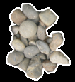
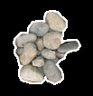
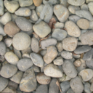
Traditional synthesis approaches
Exemplar based texture synthesis
Patch based
Pixel based
Patch based
- Sequential
+ Best results
- Little fine-scale variety
[Praun et al 2000, Liang et al 2001,
Efros and Freeman 2001,
Kwatra et al 2003]
Notes:
Exemplar based texture synthesis algorithms produce images with much more variety. However, as we will now discuss, most of them cannot perform on-demand synthesis.
[CLICK]
Patch based algorithms generate large textures by finding patches within the exemplar and pasting them together. The layout process is sequential.
While they provide some of the best results, patch based algorithms also suffer from a lack of fine scale variations, as small features tend to be duplicated exactly.

Slide 12
Traditional synthesis approaches
Pixel-based
+ Fine-scale variety
- Sequential
Multiresolution approach
[Garber 1981, Popat & Picard 1993, Efros & Leung 1999, Wei & Levoy 2000,
Ashikhmin 2001, Hertzmann et al 2001,
Tong et al 2002 …]
Exemplar
Synthesized
read/write
read/write
read/write
Level 0
Level 1
Level 2
Exemplar
Notes:
Pixel-based algorithms offer greater fine scale variety.
Typically they generate one pixel at a time in scanline order.
Since our algorithm is also pixel-based, I will give more details on these techniques.
[CLICK]
In order to add the next pixel to a partially generated texture, a per-pixel synthesis algorithm starts by extracting the already synthesized neighbors.
[CLICK]
Then, the exemplar is searched for a similar neighborhood.
Once the best matching neighborhood is found, the pixel color is directly updated.
[CLICK]
This process continues until all pixels are generated.
[CLICK]
Note that the final texture appearance is solely determined by the boundary conditions shown in orange, which are generally filled with random colors.
[CLICK]
Most recent algorithms perform multiresolution synthesis. The exemplar is stored as a Gaussian pyramid instead of a single image.
[CLICK]
Synthesis is performed one level at a time from coarse to fine resolutions.

Slide 13
Sequentiality hinders on-demand synthesis
Notes:
Most previous approaches are impractical for on-demand synthesis.
Indeed, if a small window is requested, synthesis must be performed on a much larger [CLICK] area in order to retrieve the correct boundary conditions and obtain a spatially deterministic result.

Slide 14
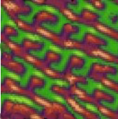
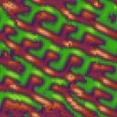
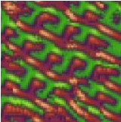
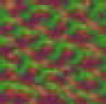
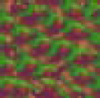
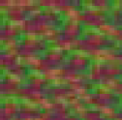
Solution: Order-independent synthesis
[Wei and Levoy 2003]
Synthesize all pixels independently
read
write
read
write
write
write
write
write
read
read
read
read
Gen 0
(init)
Gen 0
Gen 1
Gen 2
Gen 0
Gen 1
Gen 2
(result)
Level 0
Level 1
Level 2
Notes:
One solution proposed by Wei and Levoy is order-independent synthesis.
The idea is to apply synthesis to all pixels independently, reading pixel neighborhoods from a previous image. Here, pixels from level 1 generation 0 read their neighborhoods from level 0 generation 0.
Thus, pixels can be synthesized in any order since they do not influence each other during synthesis. The result will always be the same.
[CLICK]
However, order-independence reduces synthesis quality, and therefore requires several synthesis passes, or generations, at each level – 3 in this diagram.
[CLICK]
The boundary condition is level 0 generation 0, which completely determines the final appearance of the texture.

Slide 15
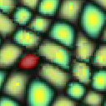
Our parallel synthesis algorithm
Improve speed, quality, and provide control
Coordinate upsampling
Jitter
Correction subpasses
Gaussian stack
Efficient parallel evaluation on GPU
Notes:
I will now introduce our Parallel Texture Synthesis algorithm.
It has the same overall structure as the order independent algorithm of Wei and Levoy.
However, the operations we perform at each level are fundamentally different.
[CLICK]
We improve speed, quality and provide user control over the synthesis result through four novel elements:
Coordinate upsampling, jitter, correction sub-passes and the Gaussian stack
Moreover, these allow efficient parallel evaluation on present GPUs.

Slide 16
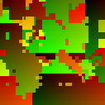
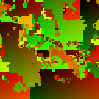
Our parallel synthesis algorithm
Operate on coordinates of exemplar pixels
Exemplar
Level 0
Level 1
Level 6
Exemplar
coordinates
Level 0
Level 1
Level 6
Notes:
One key idea in our contributions is to think of synthesis as acting not on colors [CLICK] but on coordinates of the exemplar pixels, which we represent using red and green.
After synthesis, colors are trivially retrieved with a simple lookup into the exemplar.

Slide 17
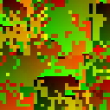
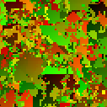
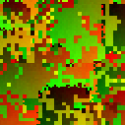
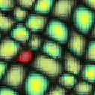
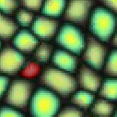
Parallel texture synthesis
Level l-2
Level l-1
Level l
3 steps at each level
l
l-1
Upsampling
Jitter
Correction
Notes:
There are three steps at each level.
[CLICK]
The first step, the upsampling, increases the resolution of the previous level's result.
[CLICK]
The second step, the jitter, introduces variation into the synthesized texture.
[CLICK]
The third and final step is the correction step. Its purpose is to make sure that the appearance of the synthesized texture remains similar to the appearance of the exemplar.
Let me now give more details on each of these three steps.

Slide 18
Upsampling
l-1
Upsampling
Goal: Increase resolution
Child inherit coordinates relative to parents
(0,0)
(1,0)
x2 +
(4,8)
(5,8)
(6,8)
(7,8)
(0,1)
(1,1)
(4,9)
(5,9)
(6,9)
(7,9)
(2,4)
(3,4)
(4,10)
(5,10)
(16,2)
(17,2)
(2,5)
(8,1)
(4,11)
(5,11)
(16,3)
(17,3)
l-1
Notes:
Upsampling increases the resolution of the previous level result.
Instead of performing a synthesis pass as other algorithms do, we rely on pixel coordinates.
Every pixel coordinate from the previous level must be replaced by four new pixel coordinates at the next level. To do so, we simply rely on the exemplar pyramid, replacing every pixel by its four children at the next level.
[CLICK]
This is a straight forward operation involving only simple arithmetic and which can be performed efficiently on the GPU.

Slide 19
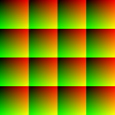
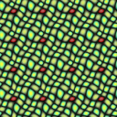
Upsampling
By itself, upsampling produces a tiling
Output
Corresponding colors
Notes:
If only upsampling is performed at every level, a regular tiling is produced.

Slide 20
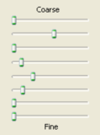
Jitter
Jitter
Goal: Create variation
Deterministic
Controllable
Perturb upsampled coordinates
Pseudorandom offsets (using 2D hash)
User-adjusted magnitude
Determines resulting appearance
Notes:
The jitter step introduces variation that is both spatially deterministic and controllable by the user.
The jitter adds a pseudo-random offset to the pixel coordinates.
The jitter amplitude is controlled by the user at every level through a set of sliders.
Note that contrary to other synthesis scheme, the appearance of the result is not determined by boundary conditions, and is instead solely determined by the jitter.
It enables strong, continuous control over the final result.

Slide 21
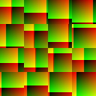
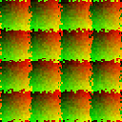
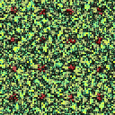
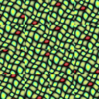
Upsampling + Jitter
Jitter
Jitter
Notes:
If only upsampling and jitter are applied at every level, then the result is a tiling where blocks of textures have been displaced.
If jitter is applied at a coarse level, then large blocks are displaced.
[CLICK]
If jitter is applied at a finer level then smaller blocks are displaced.

Slide 22
Correction
Correction
Goal: recover exemplar appearance
Pixels are corrected independently
We adapt neighborhood-matching techniques [Ashikhmin 2001; Hertzmann et al 2001; Tong et al 2002; …]
?
Exemplar
Previous buffer (from jitter)
Output
Candidates {
}
Notes:
The next step, the correction step, is in charge of recovering the exemplar appearance after upsampling and jittering.
Similarly to the order independent scheme, pixels are corrected independently.
Our correction process is based on well known neighborhood matching techniques.
[CLICK]
Let me give you an overview of the algorithm for a single pixel.
First, the 5x5 neighborhood of the pixel is extracted. Note that neighbors are read from the previous buffer, the output of the jitter step, since pixels are corrected independently.
[CLICK]
Then, a set of 16 candidates is determined. Please refer to the paper by Tong et al. or to our paper for more details on the candidates.
[CLICK]
Next, the neighborhoods of the candidates are compared with the neighborhood of the pixel being corrected.
[CLICK]
Once the candidate with the best matching neighborhood is found, its coordinate are written into the output.
This correction is performed on all pixels in parallel on the GPU.

Slide 23
Improving convergence
Problem
Pixels do not benefit from neighbors’ correction
➔ Reduces quality
Solution
Correct interleaved pixels in different subpasses
Standard approach
(1 subpass)
4 subpasses
Notes:
However, when pixels are corrected independently, they do not benefit from their neighbors’ correction, which reduces quality and requires multiple passes.
We improve this approach with correction subpasses.
[CLICK]
Our idea to improve this approach is to correct interleaved pixels in different subpasses, allowing information to be exchanged between neighbors.
Here, pixels with the same color are corrected within the same subpass. The left figure shows the standard approach while the right figure shows a correction pass divided in four subpasses.

Slide 24
Subpasses
Example
➔ Nearly same amount of computation
Previous buffer (from jitter)
Previous buffer
Subpass 1
Subpass 2
Subpass 3
Subpass 4
Notes:
During the first subpass, the orange pixels are corrected, other pixels are just copied.
[CLICK]
During the second subpass the blue pixels are corrected, and these benefit from the correction of their orange neighbors in subpass 1.
[CLICK]
The process continues with subpasses three,
[CLICK]
and subpass four,
until all pixels have been corrected.
[CLICK]
The cost of the subpasses is nearly the cost of a standard correction pass, since the same number of pixels is corrected.
[CLICK]
Now, because we want to avoid dynamic branching on the GPU, we pack pixels corrected in a same subpass together, as follows.
[CLICK]
This provides efficient subpass correction.

Slide 25
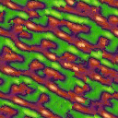
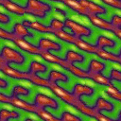
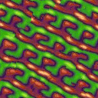
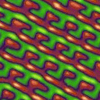
Subpasses
Number of correction passes
1 correction pass
2 correction passes
4.5 ms
8.1 ms
Full pass
(1 subpass)
5.6 ms
10.5 ms
4 subpasses
Number of
subpasses
Notes:
Here are the benefits, in terms of quality and performance, of subpasses.
The horizontal axis shows the number of correction passes.
The vertical axis shows the number of subpasses in each pass.
[CLICK]
Notice how subpasses improve the quality, even with only 1 correction pass.
[CLICK]
With 2 correction passes, subpasses remove all artifacts.
[CLICK]
We generally use the bottom right result as it is a good compromise between quality and efficiency. It corresponds to 4 subpasses and 2 correction passes.

Slide 26
Traditional Gaussian pyramid
Results in quantized feature positions
Notes:
Our last contribution for the synthesis process is the Gaussian stack.
We noticed that using a traditional Gaussian pyramid results in quantized positioning of features, as shown by this video.

Slide 27
Gaussian stack
Solution
Gaussian stack instead of pyramid
Level 0
Level 1
Level 2
Level 3
Level 4
Level 5
Level 6
Pyramid
Stack
Notes:
To solve this issue, we replace the pyramid by our Gaussian stack.
A Gaussian stack has the same number of levels as a pyramid and also contains successively filtered images. However it is computed without downsampling so that all levels have the same resolution.
[CLICK]
Combined to our synthesis scheme, it provides much finer resolution in the positioning of features.

Slide 28
GPU implementation
Several approximations
Dimensionality reduction
Quantization
… (➔ see paper)
Performance (64x64 exemplar; GeForce 6800 Ultra)
Window size | Full update | Incremental (1,1) pixel / frame
128x128 | 13.8 ms | 1.3 ms
256x256 | 25.6 ms | 1.4 ms
512x512 | 72.4 ms | 2.1 ms
Notes:
We implemented our texture synthesis algorithm on the GPU.
I won’t go into the details, but we had to perform several approximations through dimensionality reduction and quantization.
All the results shown in this talk are generated with the GPU implementation.
In term of performance we achieve synthesis of a 256x256 window in 25 msec on a GeForce 6800 Ultra.
Moreover, incremental update during continuous motion is done much faster.

Slide 29
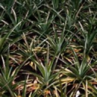
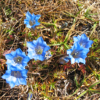
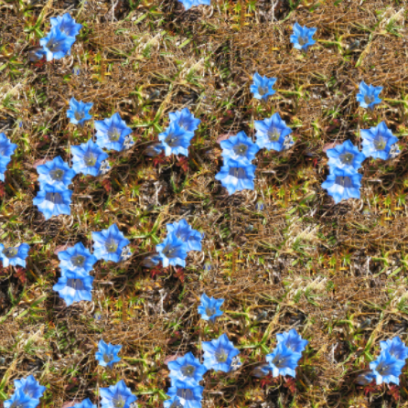
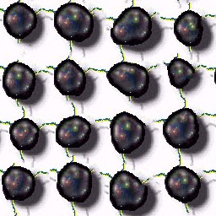
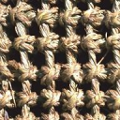
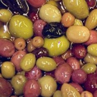
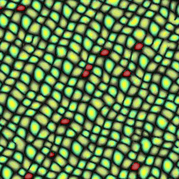
Results
http://research.microsoft.com/projects/ParaTexSyn/
Notes:
We have tested our algorithm on about 100 exemplars. These results are available on our web site, and a few are shown here.
The parameters for all 100 results were interactively adjusted in less than one hour.

Slide 30
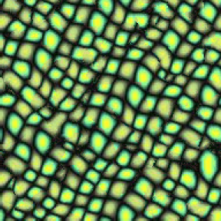
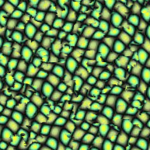
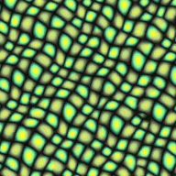
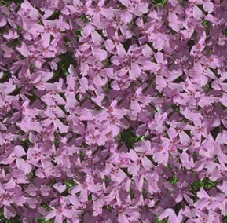
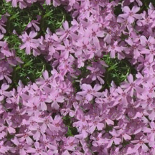
Comparisons
Wei and
Levoy [2003]
1.1 GHz CPU
Zelinka and
Garland [2002]
1.0 GHz CPU
Our technique
0.4 GHz GPU
64x64
3 sec
45 msec
19 msec
192x192
4 sec
47 msec
Notes:
Here is a comparison between our algorithm and other fast texture synthesis algorithms.
Note that we achieve both faster synthesis and higher quality.

Slide 31
Parallel synthesis
On-demand
GPU
Synthesis control
Spectral
Spatial
Drag-and-drop
Near-regularity
Synthesis magnification
Notes:
We have now seen all the elements of our parallel texture synthesis algorithm.
This second part of the talk focuses on the large variety of user control offered by our algorithm.
All these controls are achieved by operating on the explicit jitter.

Slide 32
Spectral control
Notes:
A set of sliders provides multiscale control over the jitter amplitude.
Introducing coarse-scale randomness displaces macro features, …
… while fine scale randomness alters the fine details.
And of course, many textures benefit from both, …
… while some other are better captured by a given scale range.
The user can also pan in real time over the infinite aperiodic texture thus defined.
The GPU updates the synthesis pyramid at every frame.

Slide 33
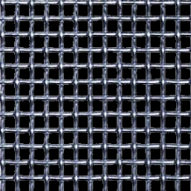
Spatial control
Exemplar
Notes:
Spatial control is obtained by modulating the amplitude of the jitter with respect to a user painted control layer.

Slide 34
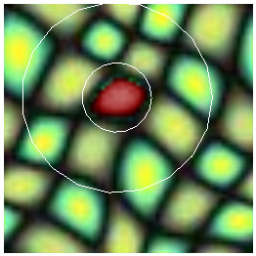
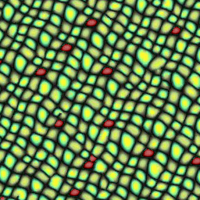
Drag-and-drop
Locally constrain synthesis
Override jitter
Multiscale extent
Exemplar
Positioning Layer
Notes:
Drag and drop is performed by locally overriding the jitter with user specified coordinates.
[CLICK]
To let the synthesis process adapt the surrounding texture, the constraint radius is larger at coarse levels and becomes smaller as resolution increases during synthesis.
[CLICK]
[CLICK]
The positioning layer used to encode drag and drop information is coarse and sparse.

Slide 35
Drag-and-drop
Notes:
Here, the user performs interactive drag and drop.
Here is the positioning layer used to locally override the jitter.
Notice how the surrounding texture adapts to the displaced features.
Since our algorithm is parallel, the modifications remain local.

Slide 36
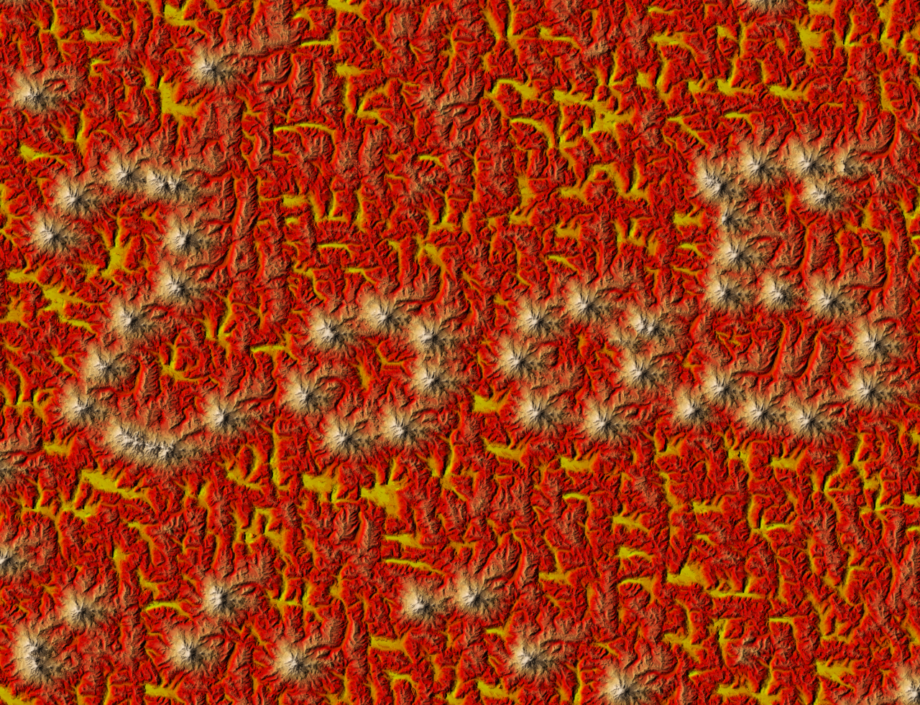
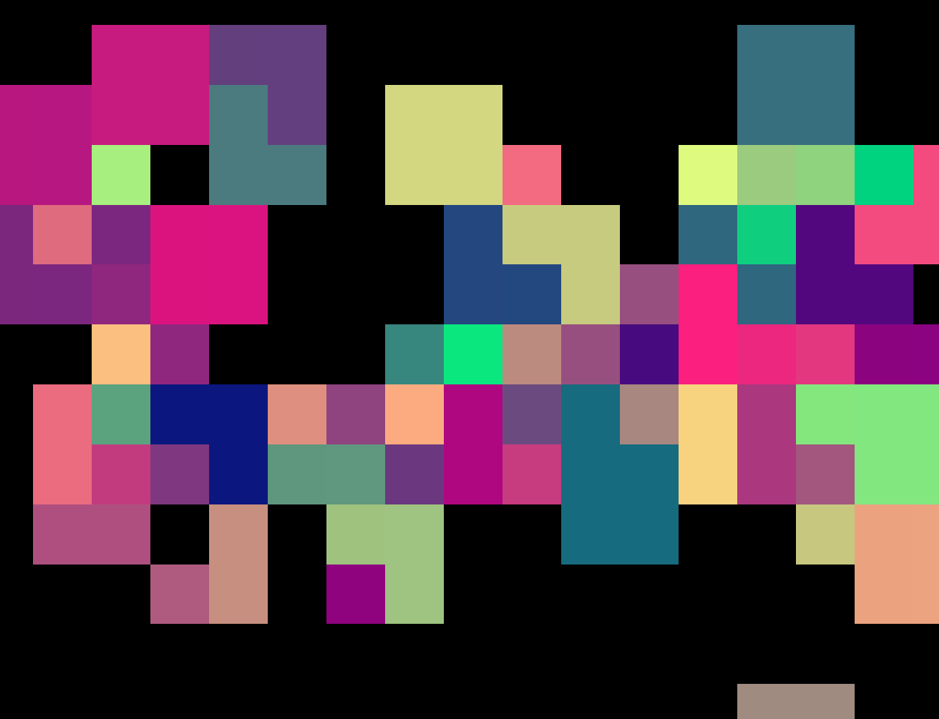
Drag-and-drop
Notes:
Here is an example where drag-and-drop has been used to position mountains in a large landscape.
This synthesized texture has a resolution of 1280x650 pixels,
[CLICK]
… while the control layer is only 20x10 pixels.

Slide 37
Near-regularity
Notes:
Finally, we enable support for near regular textures. We ensure that the offsets added by the jitter are not breaking the regular pattern of the exemplar. The exemplar periodicity is specified by the user.
Even though large scale variations are constrained, the user remains free to add fine scale variations in the result.

Slide 38
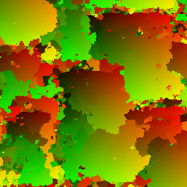
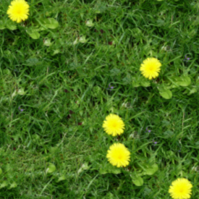
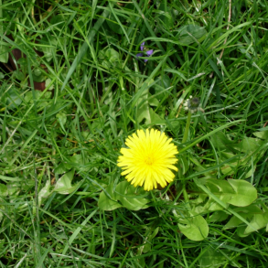
Synthesis magnification
Synthesis
Low-resolution
exemplar
Low resolution result
Magnification
High-resolution
exemplar
High-resolution result
Notes:
Our last contribution is synthesis magnification.
[CLICK]
We first downsample a high-resolution exemplar to obtain a low resolution version,
[CLICK]
…and use that to perform synthesis.
Although the result has coarse resolution, its overall structure is correct.
Recall that it contains not just colors but also pixel coordinates.
Our key idea is to interpret these coordinates as a 2D patch parameterization.
[CLICK]
This parameterization is then used to access the high-resolution exemplar, to produce a more detailed result.

Slide 39
Synthesis magnification
High-resolution exemplar
Synthesized Pixel Coordinates
Low-resolution exemplar
Δx
Δx
Δy
Δy
Result on screen (close-up)
seams
Blend(Δx, Δy,
Color1,
Color2,
Color3,
)
Color4
Notes:
Here is how it works.
The samples of the low-resolution result contain coordinates…
[CLICK]
…into the low-resolution exemplar.
[CLICK]
To increase the resolution we must determine the color of additional samples.
[CLICK]
A first approach is to access the high-res examplar by adding a relative offset to the coordinate of the top-left sample.
The effect is to replace coarse pixels by small tiles of the high-res exemplar.
[CLICK]
However, visible seams are present at patch boundaries.
[CLICK]
Indeed, the four corners disagree on which part of the exemplar should be used.
[CLICK]
To solve this issue, we simply blend between these four possibilities. This produces a seamless magnified result.

Slide 40
Synthesis magnification
Notes:
Here is an example where synthesis magnification is performed at runtime.
The magnification is directly performed at rendering time with a fill rate of more than 100 million pixels per second.

Slide 41
1024x768 with 4x magnification, 37 FPS
Notes:
This full screen texture is synthesized from scratch with 4x magnification at 37 FPS.

Slide 42
Future work
Improving quality
Terrain synthesis
Smaller memory usage
Guided synthesis
[Hertzmann et al 2001]
Notes:
As future work, we would like to improve synthesis quality – these images show limitations of the current scheme.
We are also working on terrain synthesis, directly using our synthesis scheme to feed data into a Geometry Clipmap.
Memory requirements of our current implementation can probably be reduced through compression.
Finally, guided synthesis would be a great addition to our scheme, especially in the context of terrain synthesis.

Slide 43
Summary
Parallel synthesis
On-demand
GPU
Synthesis control
Spectral
Spatial
Drag-and-drop
Near-regularity
Synthesis magnification
Notes:
In summary, we introduced a parallel texture synthesis algorithm, which quickly generates any window of an infinite aperiodic texture.
The algorithm is implemented on the GPU for fast texture synthesis.
It enables a number of intuitive user controls, including spectral and spatial randomness controls, drag-and-drop feature positioning, and periodicity constraints for near-regular textures.
Finally, synthesis magnification amplifies low-resolution synthesis results at rendering time, providing extremely detailed images at low cost.

Slide 44
The end
Thank you! Any questions ?

