Slide 1
Multi-View Stereo for
Community Photo Collections
Michael Goesele
Noah Snavely
Brian Curless
Hugues Hoppe
Steven M. Seitz
University of Washington
GRIS, TU Darmstadt
Microsoft Research

Slide 2
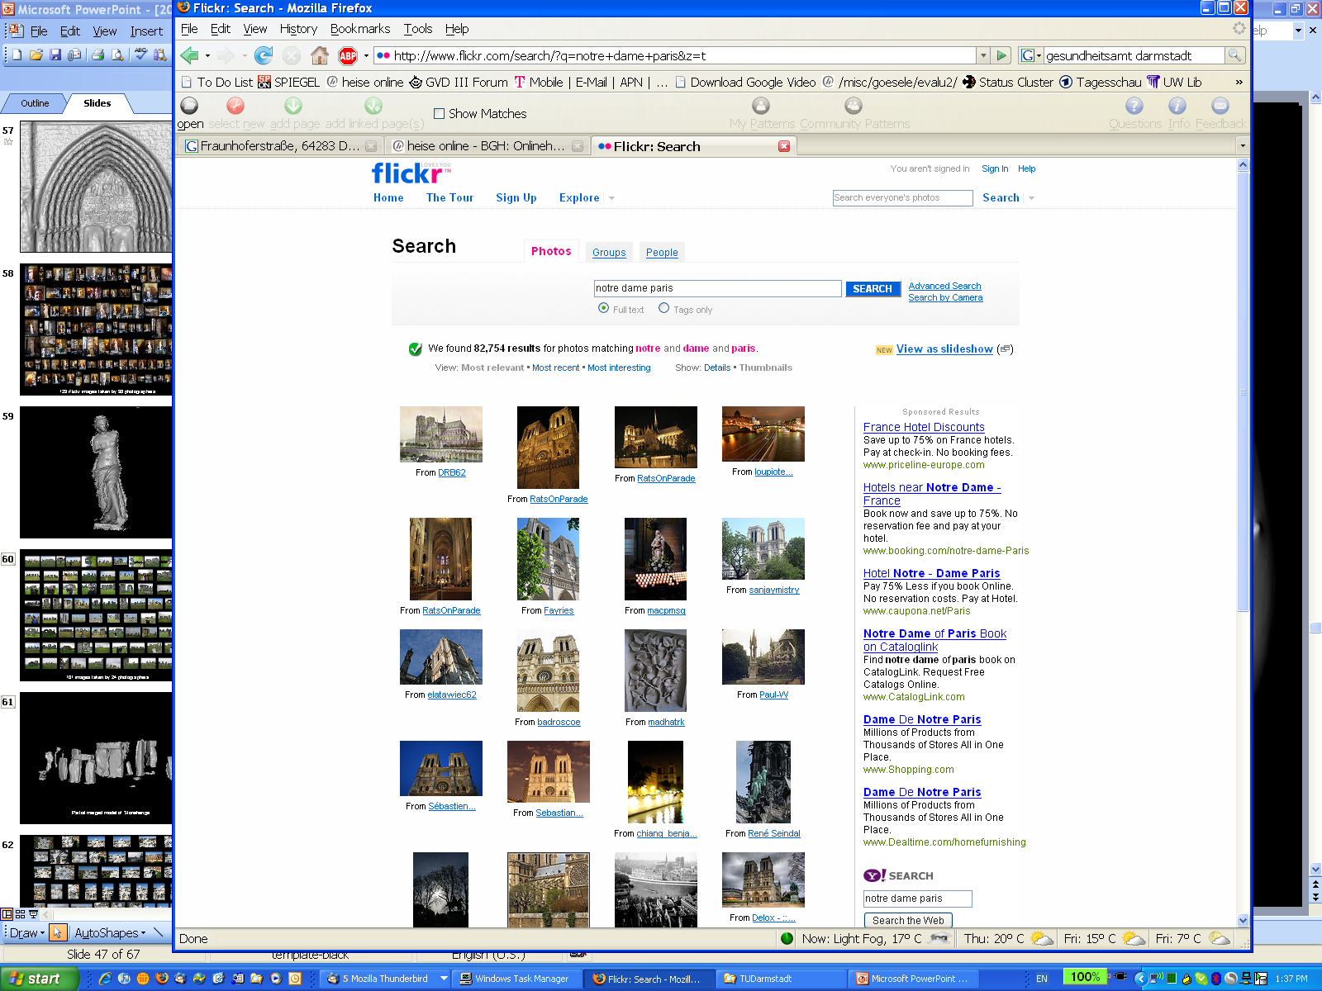
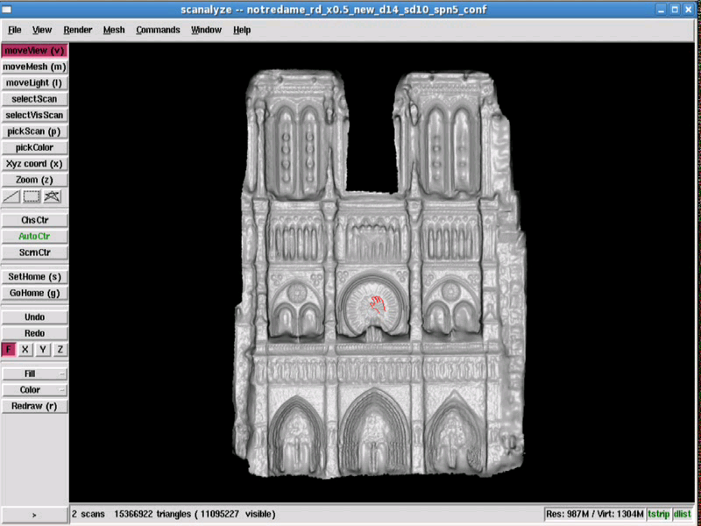
Multi-View Stereo for CPC

Slide 5
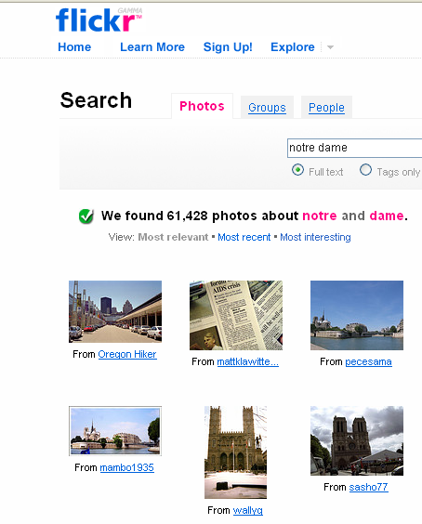
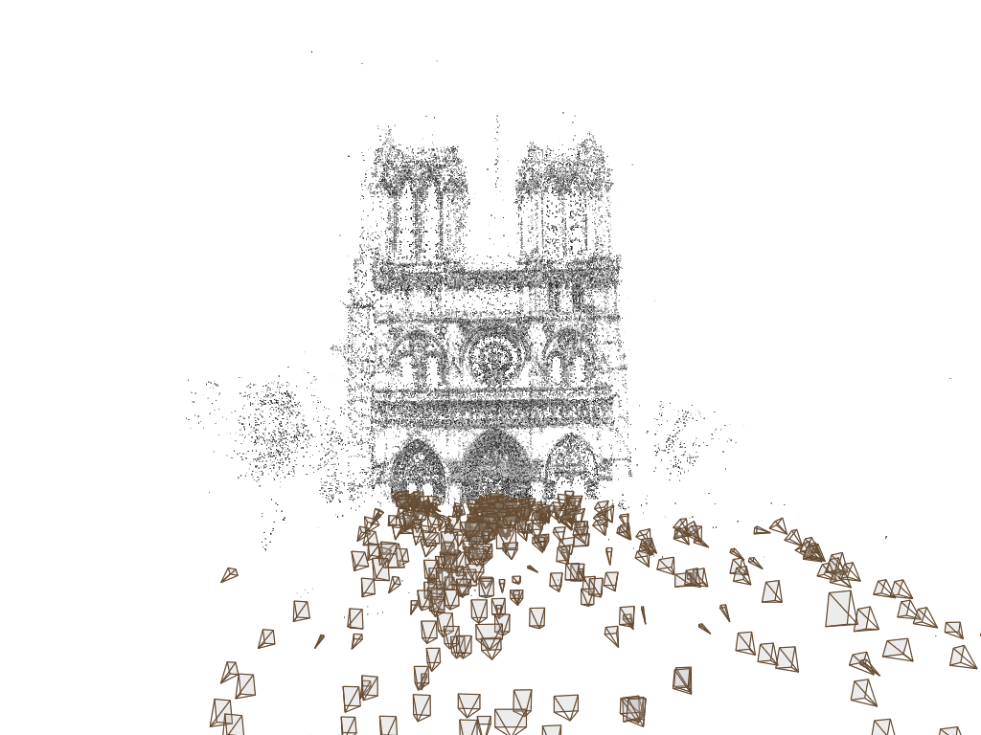
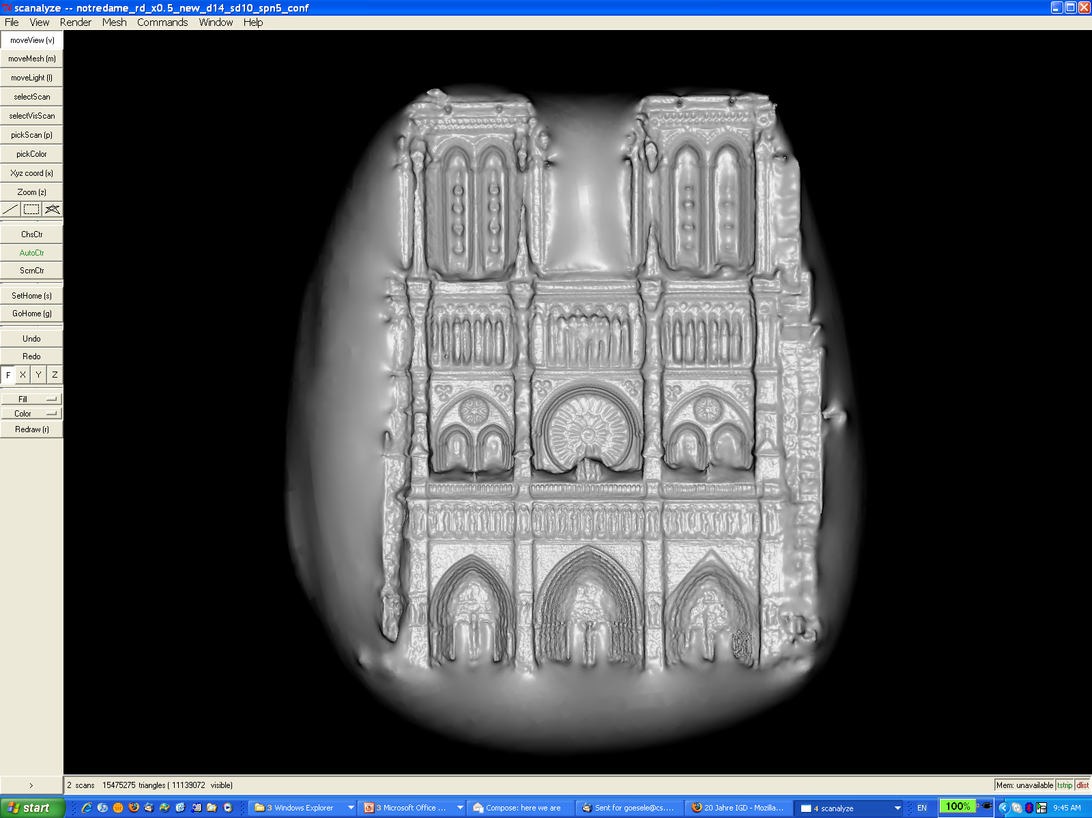
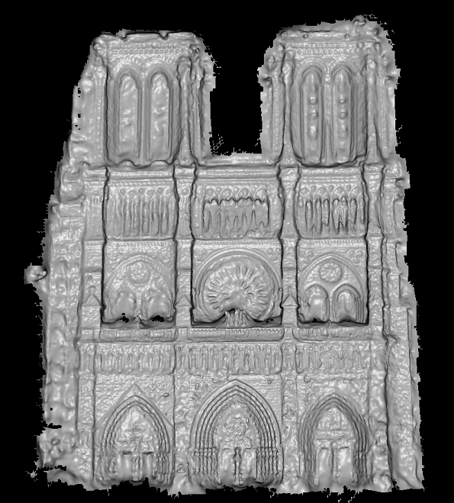
Multi-View Stereo for CPC
recover camera poses
and scene points (SfM)
[Snavely et al. 2006]
dense multi-view
stereo reconstruction

Slide 6
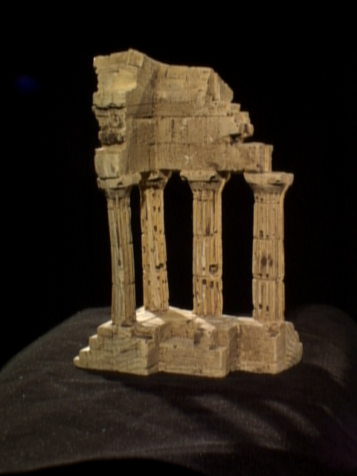
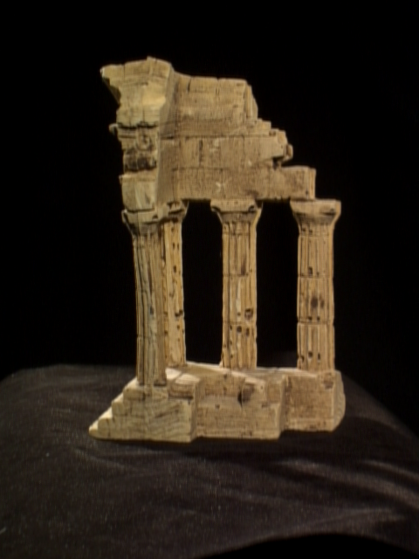
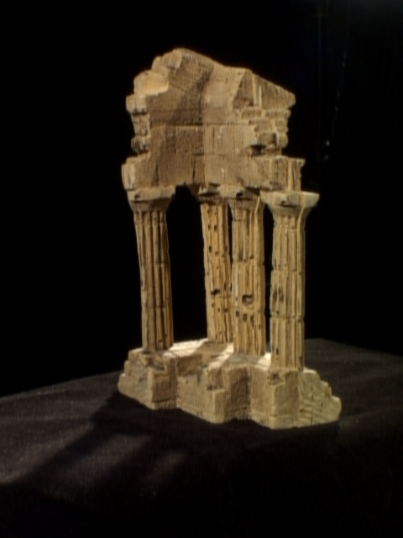
Classical MVS Example
x
reference view
neighboring views

Slide 7
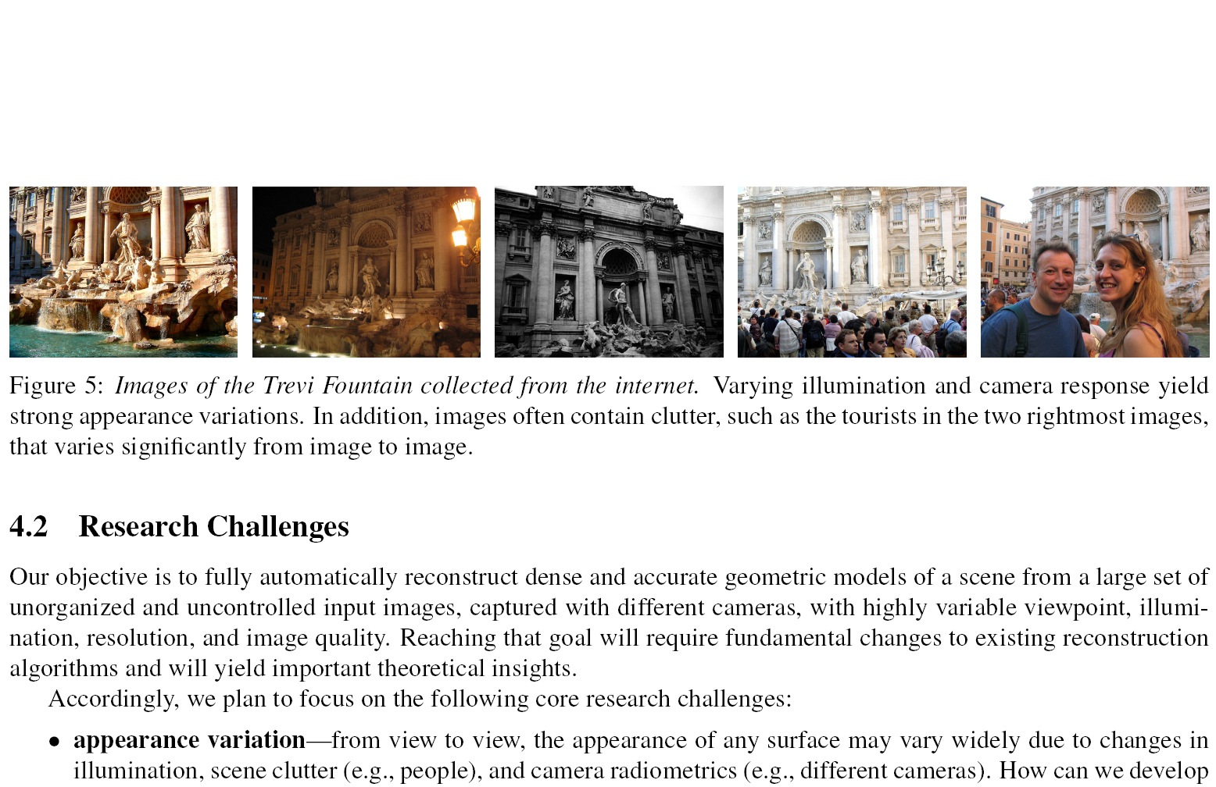
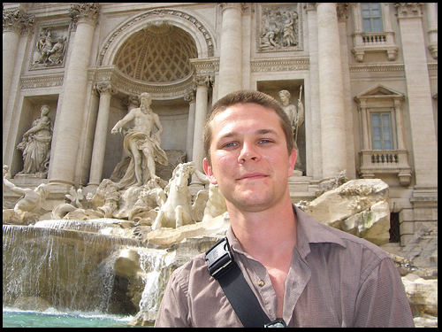
Multi-View Stereo for CPC
Tremendous variation due to
  photographers and cameras
  time of day, lighting, weather
  foreground clutter
reference view
neighboring views

Slide 8
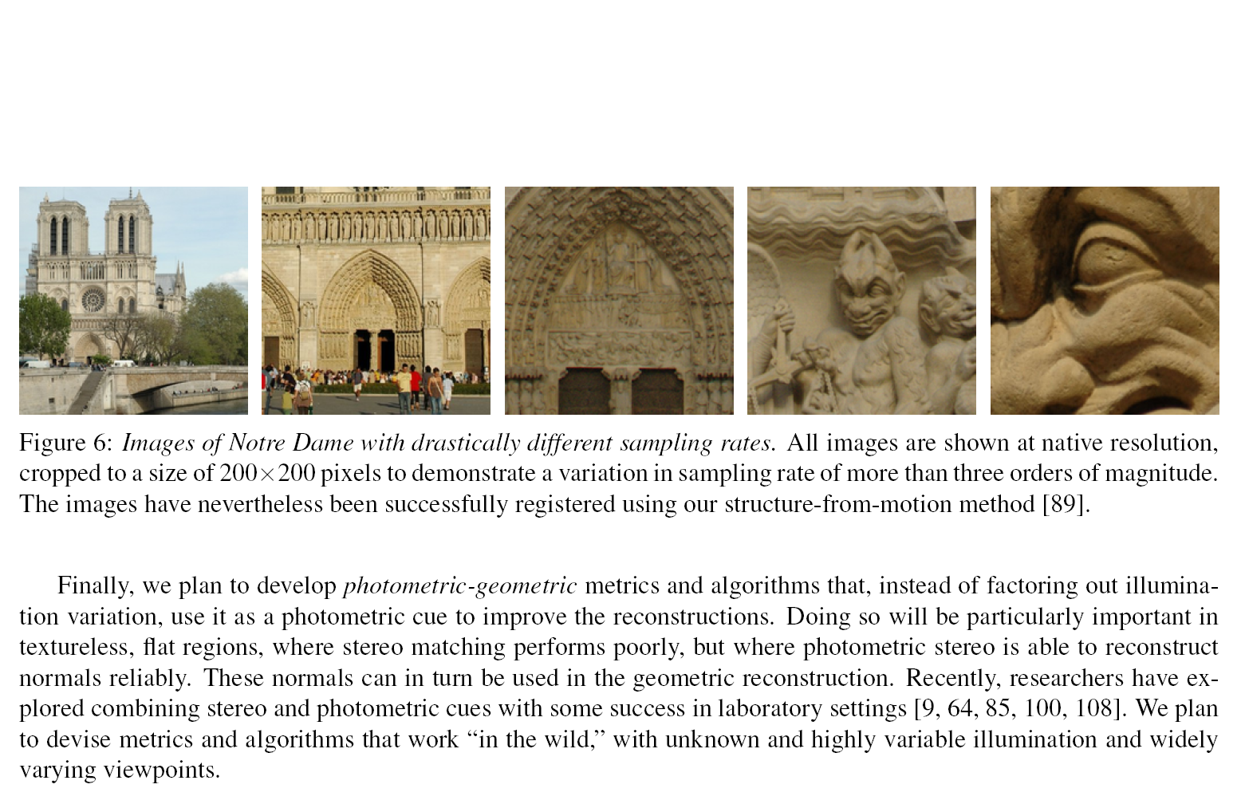
Multi-View Stereo for CPC
Tremendous variation due to
  photographers and cameras
  time of day, lighting, weather
  foreground clutter
  scale
reference view
neighboring views

Slide 9
Multi-View Stereo for CPC
unorganized image sets
[Kamberov et al. 2006]
wiki-based dense city
modeling
[Irschara et al. 2007]

Slide 10
Previous Work
  view selection handling occlusions, outlier rejection
  [Kang et al. 2001], [Estaban and Schmitt 2004], [Goesele et al. 2006]
  normal optimization
  [Gruen and Baltsavias 1988], [Zhang et al. 2004], [Hornung and Kobbelt 2006]
  region growing
  [Otto and Chau 1989], [Zhang and Shan 2001], [Lhuillier and Quan 2002], [Furukawa and Ponce 2007], [Habbecke and Kobbelt 2007]
  unorganized image sets
  [Kamberov et al. 2006]

Slide 11
Property of Community Photo Collections
in a large community photo collection
of a static scene, …
… for every image there are likely other images with similar appearance and scale

Slide 12
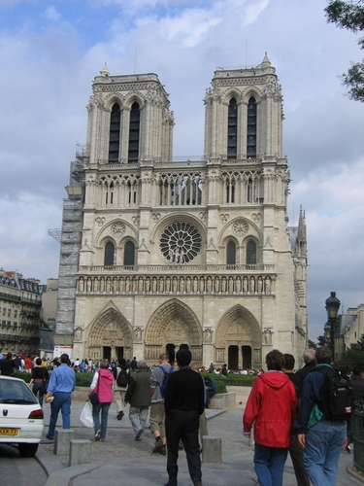
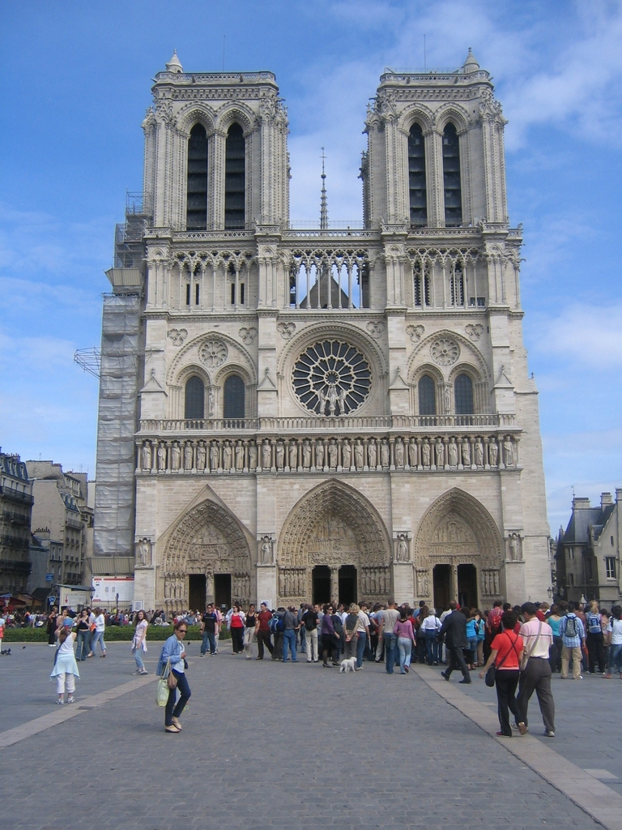
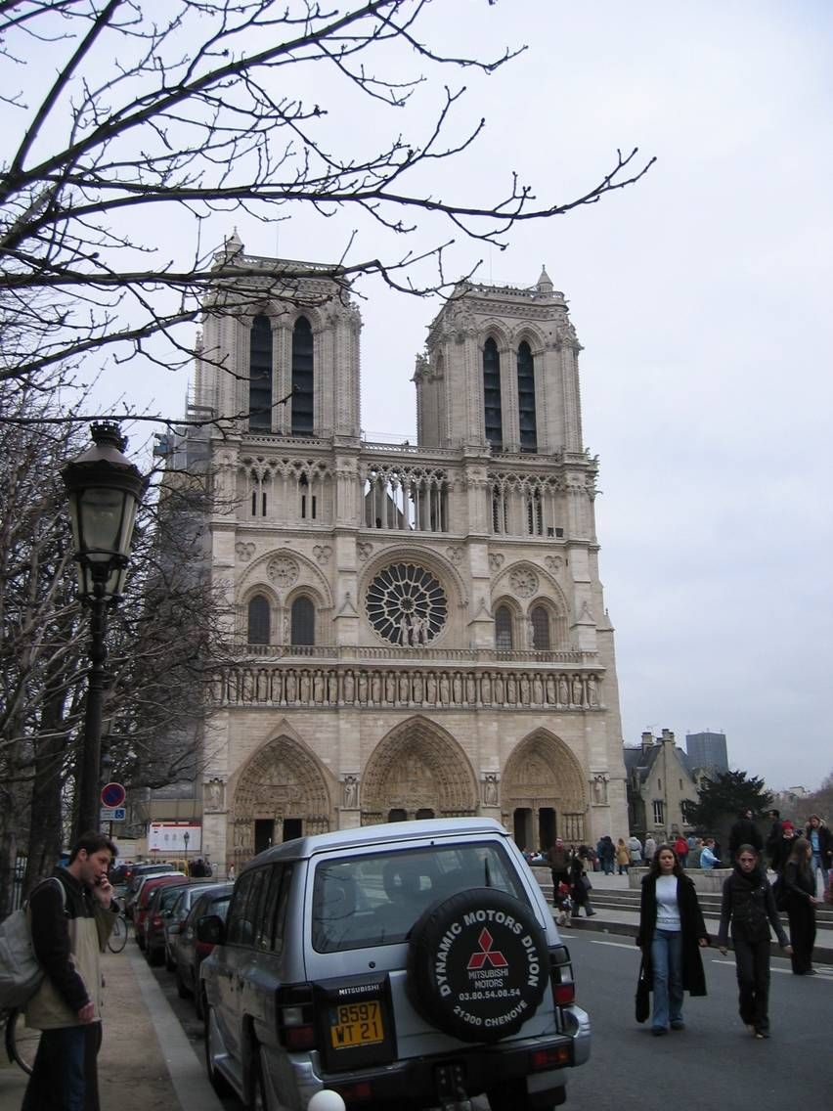

Slide 13
System Overview
for each image
select views to match (global)
for each pixel in prioritized order
select views to match (local)
optimize depth and normal
merge depth maps

Slide 14
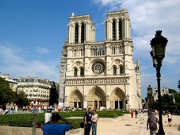
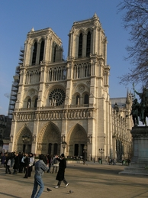
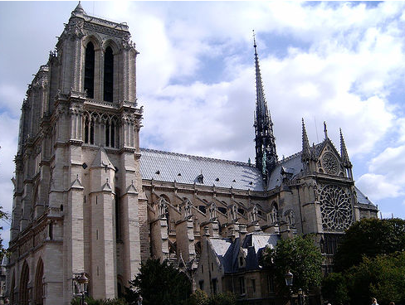

Global View Selection
Select compatible views for
each reference view
}
  scene content
  appearance
  scale
  parallax
# of shared features
reference view
}
use SfM information
SfM features based
on SIFT [Lowe 2004]
candidate neighboring views

Slide 15
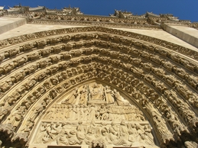
Global View Selection
Select compatible views for
each reference view
SfM features as proxy for
scene geometry
reference view
  scene content
  appearance
  scale
  parallax
}
shared SfM features
}
evaluate at SfM features
candidate neighboring view

Slide 16
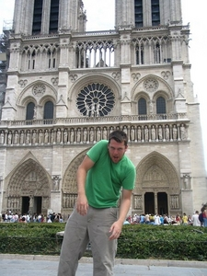
Local View Selection
matching problems
  clutter, occlusions
  local lighting effects
}
photoconsistency test
using mean-removed NCC
reference view
candidate neighboring view

Slide 17
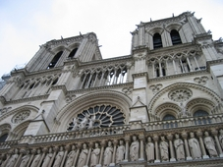
Local View Selection
matching problems
  clutter, occlusions
  local lighting effects
horizontal and vertical parallax
}
photoconsistency test
using mean-removed NCC
angular spread of epipolar lines in reference view
reference view
candidate neighboring views
reference view
candidate neighboring view

Slide 18
System Overview
for each image, compute depth map
select views to match (global)
for each pixel in prioritized order
select views to match (local)
optimize depth and normal
merge depth maps

Slide 19
Optimizing Depth and Normals
based on [Gruen and Baltsavias 1988]
planar, lambertian patch with uniform illumination
  depth
  normal
  color scale per
  neighboring view
iterative least square optimization
  replace outliers through local view selection
RGB
RGB

Slide 20
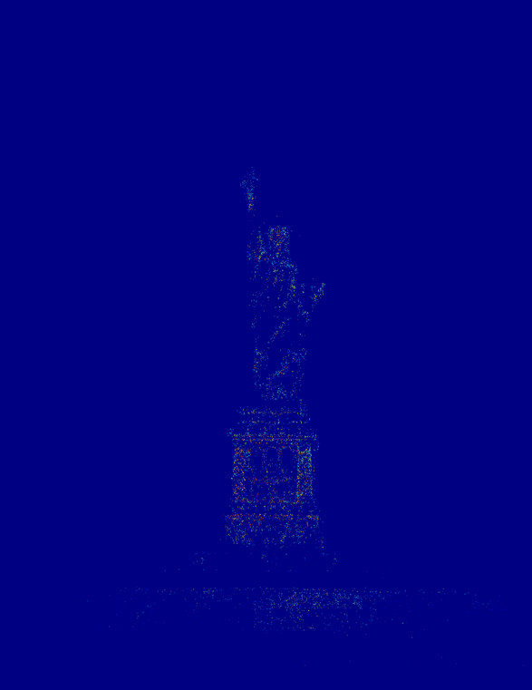
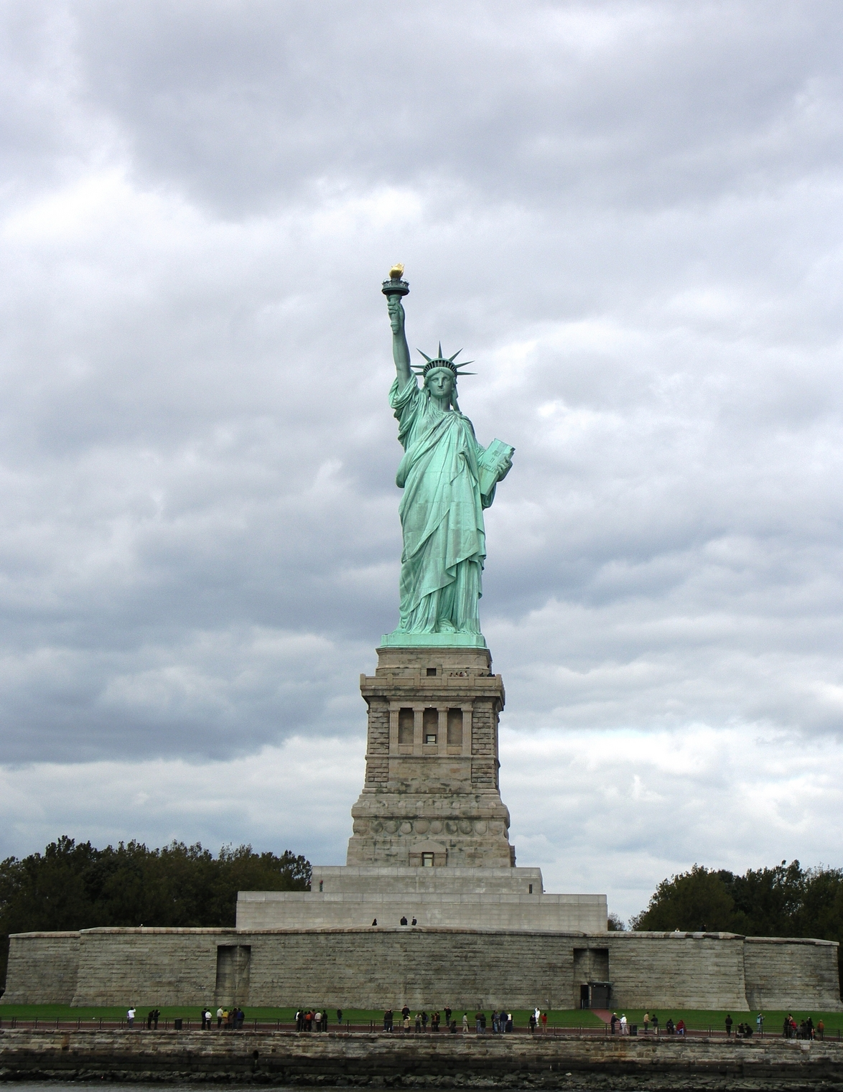

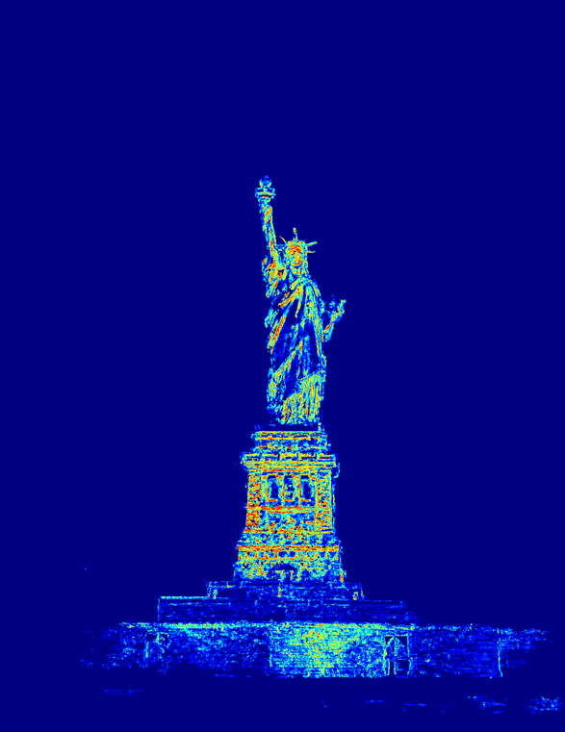
Region-Growing MVS
[Otto and Chao 1989]
reference view
region growing
(color code: confidence values)

Slide 21
System Overview
for each image, compute depth map
select views to match (global)
for each pixel in prioritized order
select views to match (local)
optimize depth and normal
merge depth maps

Slide 22
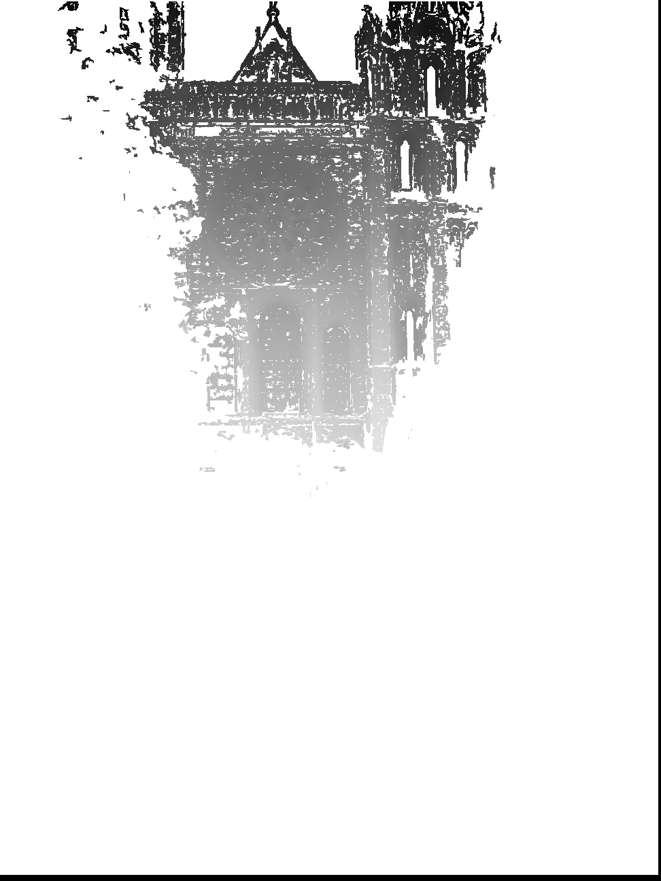
Chartres Cathedral

Slide 23
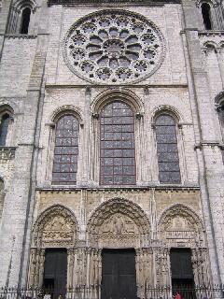
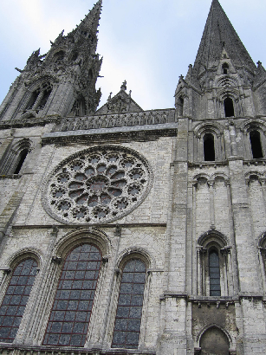
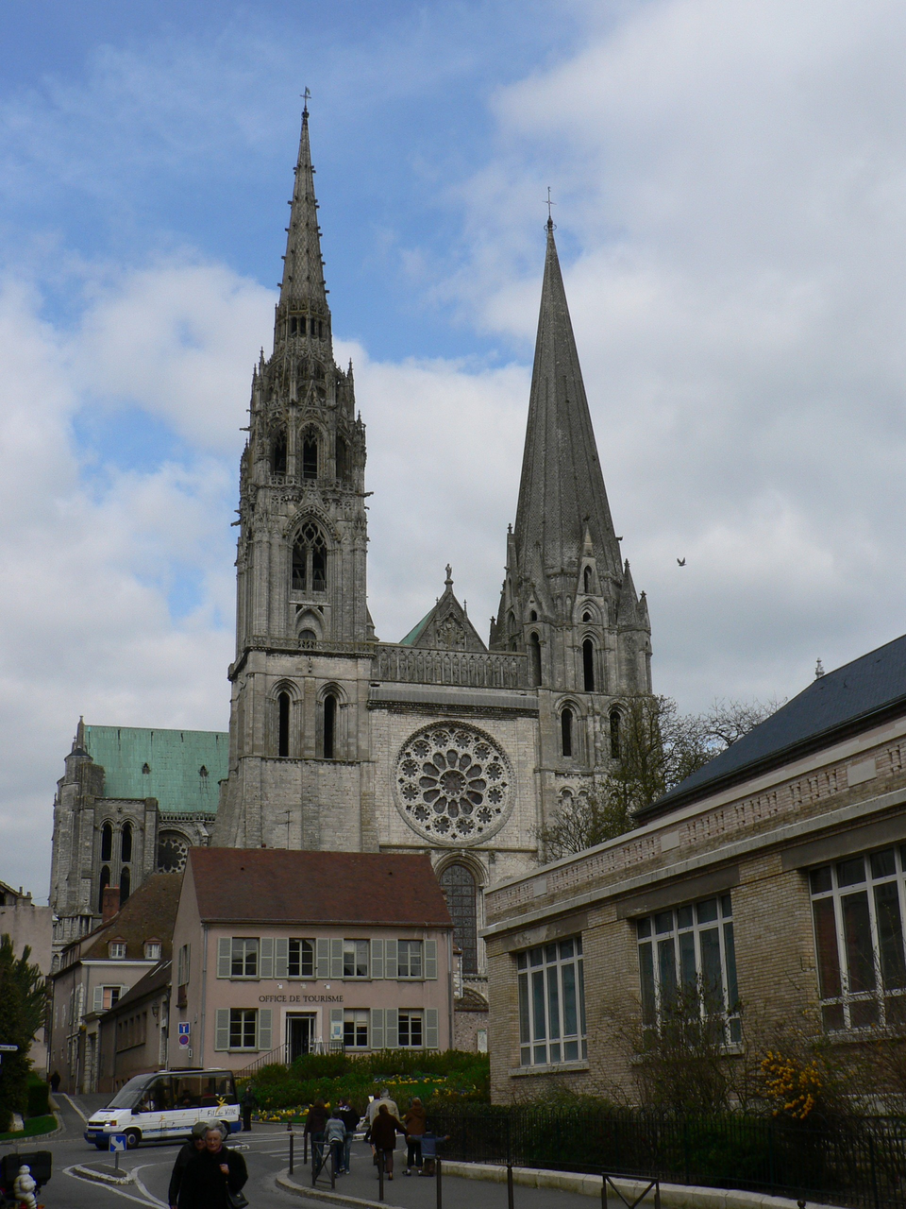
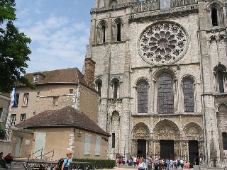
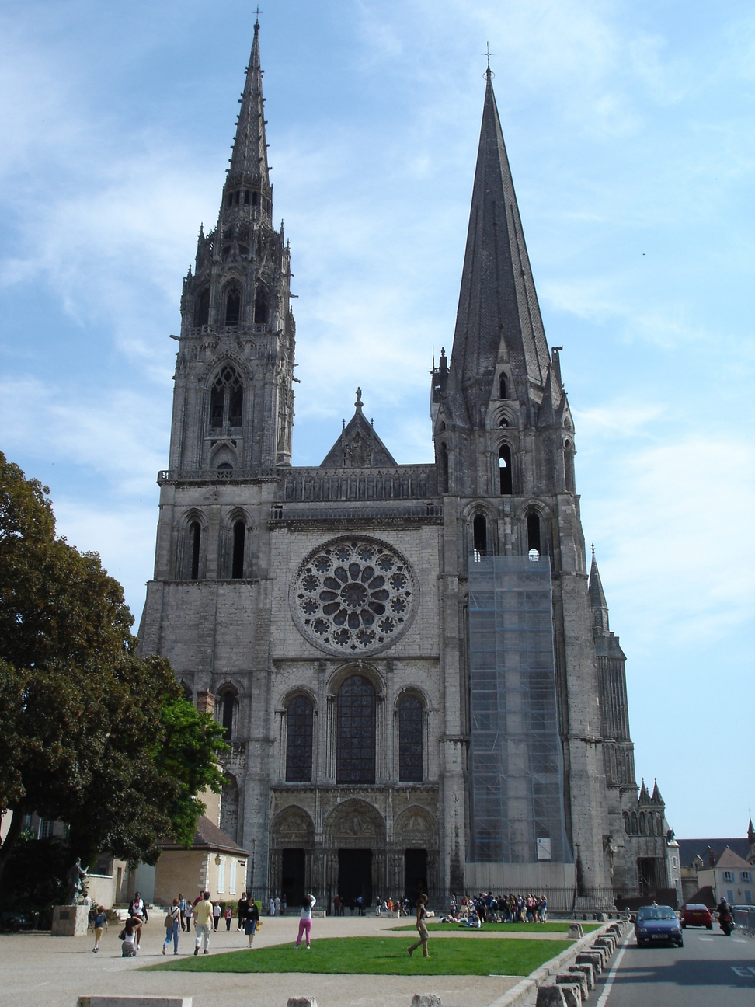
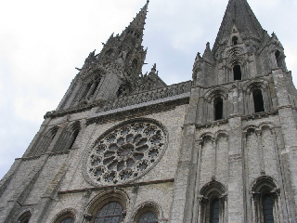
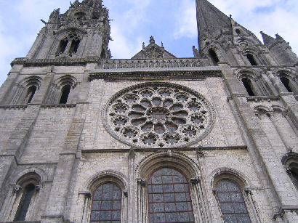

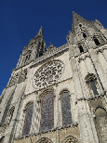
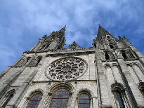
Chartres Cathedral
neighboring views

Slide 24
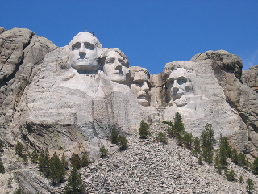
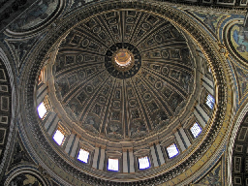
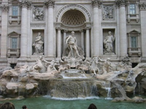
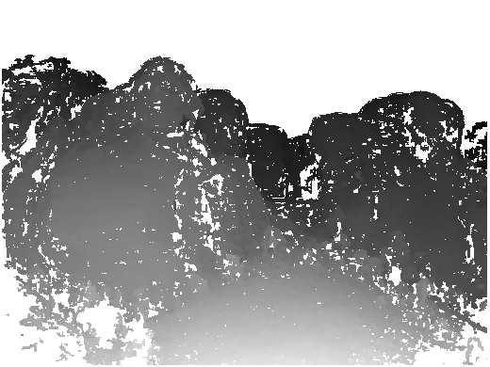
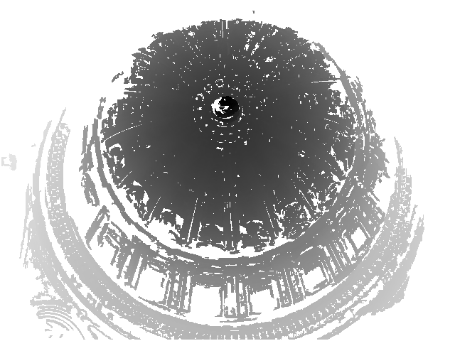

Results
Mt. Rushmore
160 images
60 photographers
St. Peter
151 images
50 photographers
Trevi Fountain
106 images
51 photographers

Slide 25
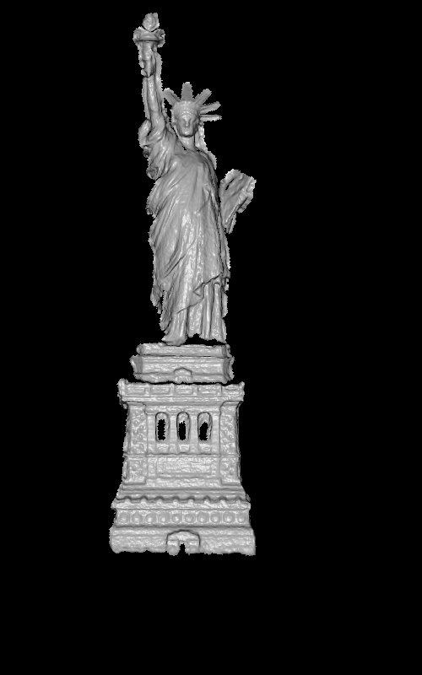
Statue of Liberty
  72 images taken by 29 photographers
  depth maps merged using Poisson surface reconstruction [Kazhdan et al 2006]
  cropped using standard mesh filtering operations

Slide 26
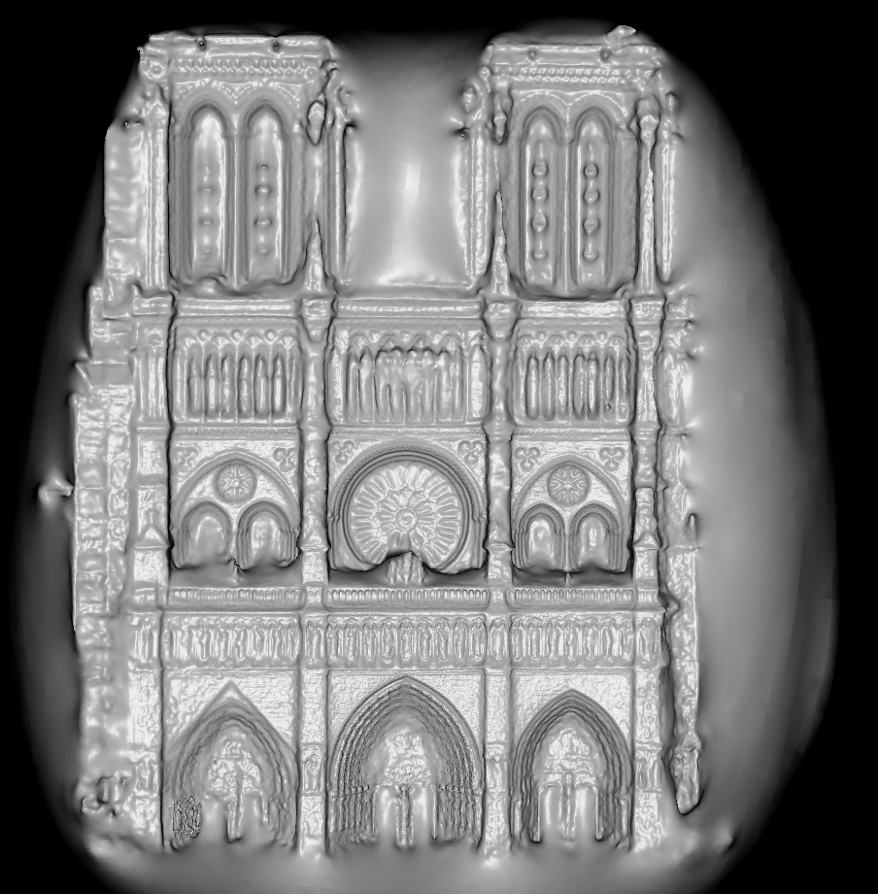
Notre Dame de Paris
653 images
313 photographers

Slide 27
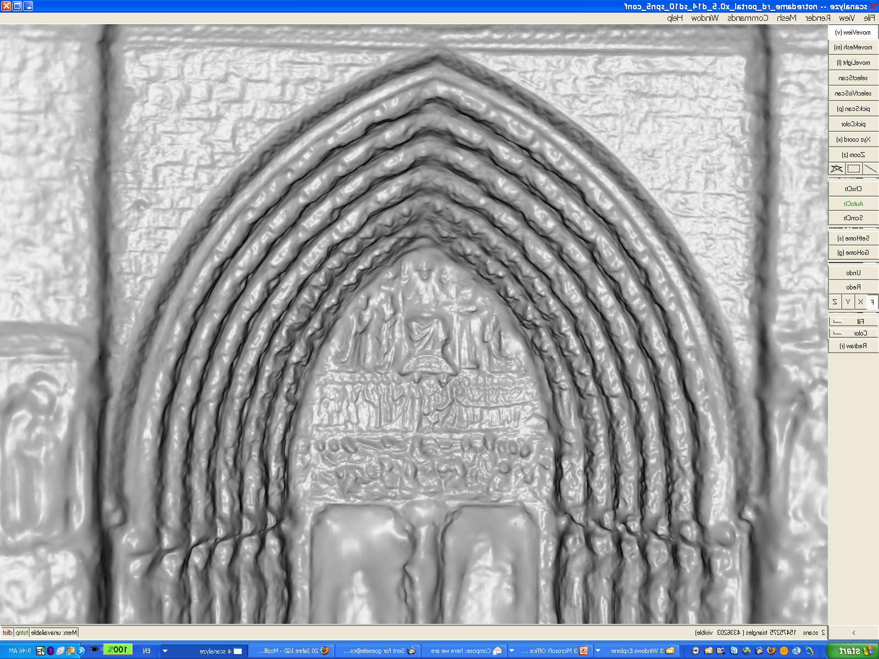

Slide 28
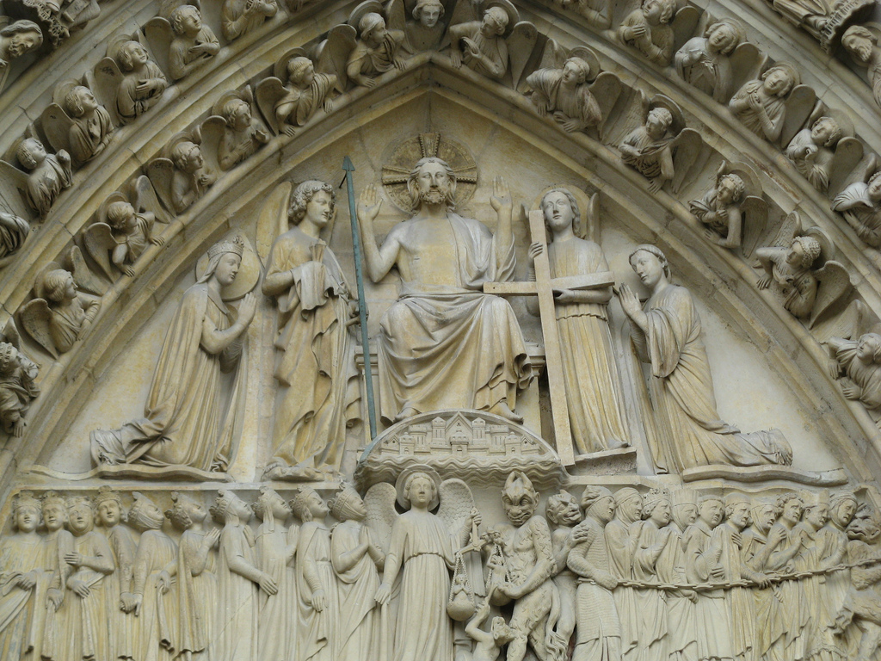

Slide 29
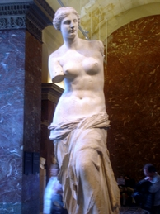

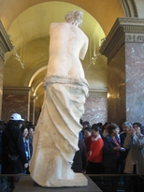
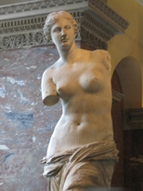

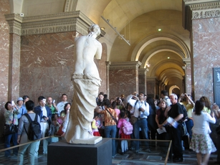
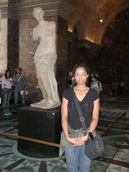



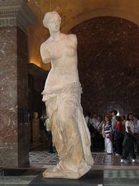
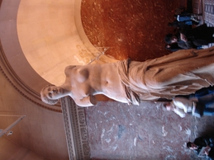






















































































































Venus de Milo
129 images taken by 98 photographers

Slide 30
Venus de Milo

Slide 31



















































Duomo (Pisa)
56 images taken by 8 photographers

Slide 32


Slide 33



Duomo (Pisa)
90% of reconstruction within 12.8 cm of ground truth
for a 51 m tall building using the metric of [Seitz et al. 2006]

Slide 34

Current
200 images of Rome

Slide 35

Future
300,000 images of Rome

Slide 36




Thanks to …
Flickr users providing the photographs
Yasutaka Furukawa and Jean Ponce (nskulla dataset)
Visual Computing Group, CNR Pisa (scanned Duomo model)
Rick Szeliski
my co-authors
Noah Snavely
Brian Curless
Steve Seitz
Hugues Hoppe
University of Washington
Microsoft Research

