Slide 1
Multilevel Streaming for Out-of-Core
Surface Reconstruction
Matthew Bolitho,
Michael Kazhdan,
Randal Burns,
Hugues Hoppe

Slide 2

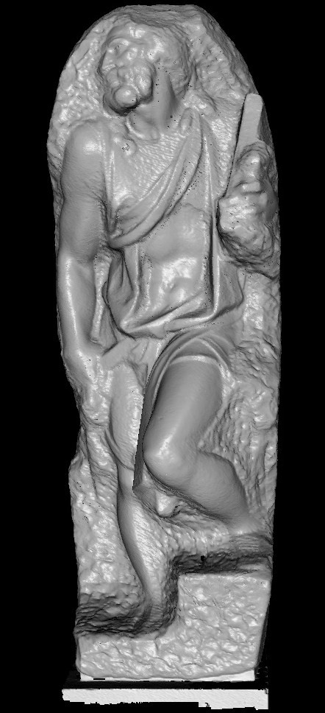
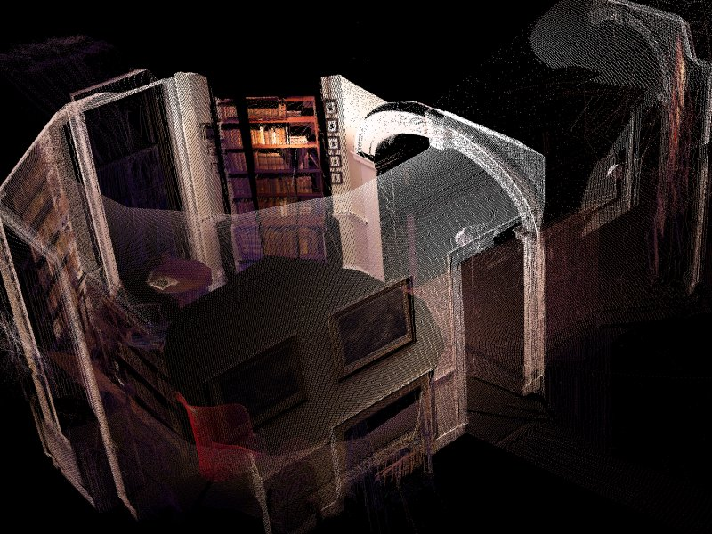
Motivation
With improvements in
acquisition technology,
huge datasets are now
available for processing.
USGS Earth: 2.2x10¹⁰ Points
UVA Monticello: 2.0x10⁷ Points
XYZRGB Thai Statue:
3.4x10⁷ Points
Stanford St. Mathew:
1.8x10⁸ Points

Slide 3
Motivation
With improvements in
acquisition technology,
huge datasets are now
available for processing.
USGS Earth: 2.2x10¹⁰ Points
Some of these models have becomes so large that it is hard to maintain the dataset
(let alone data-structure) in working memory.
UVA Monticello: 2.0x10⁷ Points
XYZRGB Thai Statue:
3.4x10⁷ Points
Stanford St. Mathew:
1.8x10⁸ Points

Slide 4
Streaming Approaches
If a traversal order is defined and the data is sorted, stream through the data:
  Processing data at the current position using only the data in the working set
  When advancing the stream, reading into the head of the working set and writing out the tail.

Slide 5
Streaming Approaches
If a traversal order is defined and the data is sorted, stream through the data:
  Processing data at the current position using only the data in the working set
  When advancing the stream, reading into the head of the working set and writing out the tail.
Locality of processing implies that the size of the working set remains small.

Slide 6
Streaming Approaches
If the processing is local, the algorithm may be implemented in a streaming framework:
  Define a traversal ordering on the data
  Stream through the data
    Process data at the current stream position using only the data in the current working set
    When advancing the stream, update the head of the working set and release the tail.
Locality of processing implies that the size of the working set remains small.
Pajarola, 2005

Slide 7
Streaming Approaches
A number of mesh processing applications are local and are well-suited for streaming implementations:
  Simplification [Wu and Kobbelt, 2003]
  Compression [Isenberg and Gumhold, 2003]
  Smoothing [Pajarola, 2005]
  Re-Meshing [Anh et al. 2006]

Slide 8
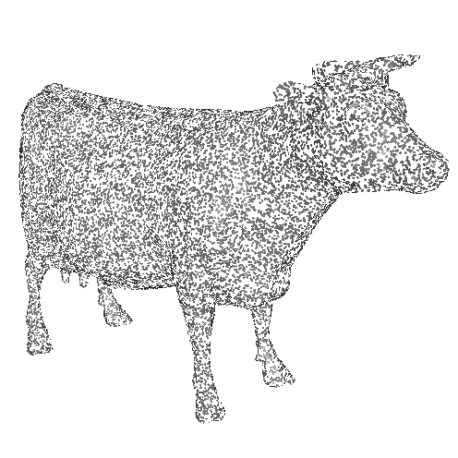
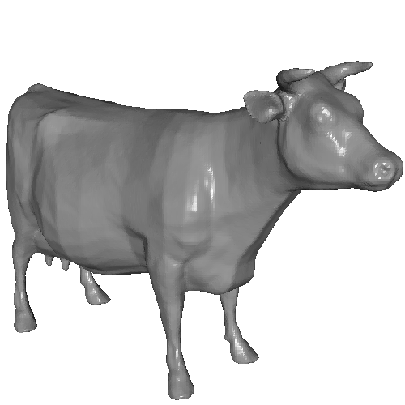
Surface Reconstruction
In general, scanners return samples (or local patches) from a 3D surface and one of the first steps to be performed is reconstruction.
Scanned Data
Point Samples
Reconstructed Model
Triangle Mesh

Slide 9
Outline
Introduction
Streaming Surface Reconstruction
  Octree-Based Poisson Reconstruction
  Streaming the Octree
  Streaming the Reconstruction
Results
Conclusion

Slide 10
In-Core Reconstruction
Reconstruction can be reduced to solving a Poisson equation [Kazhdan et al. 06]:
  Reconstruct by solving for the indicator function.
0
0
1
1
0
0
1
0
Indicator function
χ_{M}

Slide 11
In-Core Reconstruction
Reconstruction can be reduced to solving a Poisson equation [Kazhdan et al. 06]:
  Reconstruct by solving for the indicator function.
  Oriented points sample the gradient of the function.
0
0
0
0
0
0
Oriented points
Indicator gradient
∇χ_{M}

Slide 12
In-Core Reconstruction
Reconstruction can be reduced to solving a Poisson equation [Kazhdan et al. 06]:
  Reconstruct by solving for the indicator function.
  Oriented points sample the gradient of the function.
  Solve for the function χ whose gradient best approximates the surface samples V:

Slide 13
In-Core Reconstruction
Reconstruction can be reduced to solving a Poisson equation [Kazhdan et al. 06]:
  Reconstruct by solving for the indicator function.
  Oriented points sample the gradient of the function.
  Solve for the function χ whose gradient best approximates the surface samples V:

Slide 14
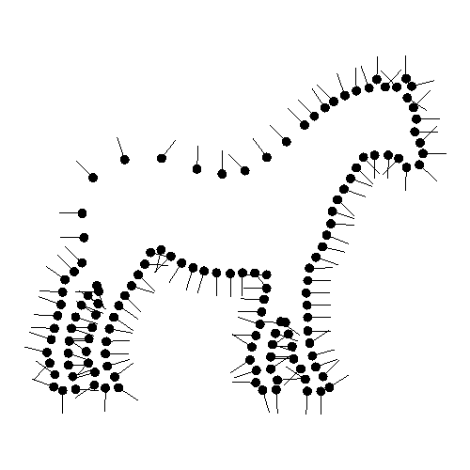
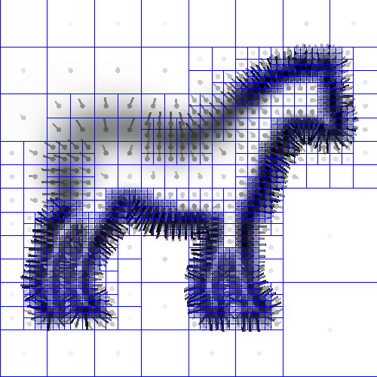



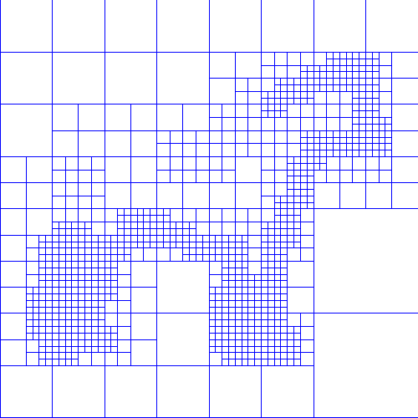
In-Core Reconstruction
Reconstruction can be reduced to solving a Poisson equation [Kazhdan et al. 06]:
  Extend oriented samples to vector field
  Compute divergence
  Solve Poisson equation
  Extract isosurface
(1)
(2)
(3)
(4)

Slide 15
In-Core Reconstruction
Advantages
  Reconstruction as a global problem:
    The solution is resilient to noise
  Poisson system over an octree:
    Storage adapted to surface complexity
(1)
(2)
(3)
(4)

Slide 16
In-Core Reconstruction
To extend Poisson reconstruction to a streaming context:
  Representation: We need a data-structure allowing for streaming through an octree
  Implementation: We need to implement Poisson reconstruction as a local system

Slide 17
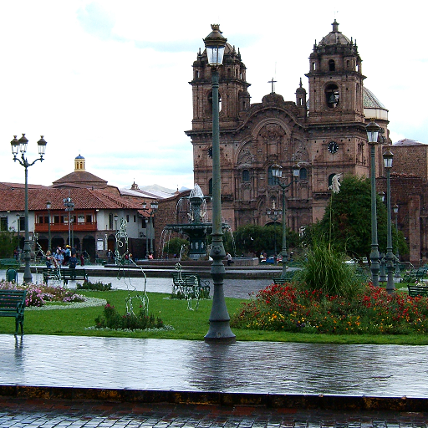
Streaming the Octree
Motivation (Regular Grid):
We can store the grid on disk as a set of successive pixel columns.

Slide 18
Streaming the Octree
Motivation (Regular Grid):
We can stream across the x-axis, reading/writing successive blocks.
x=0

Slide 19
Streaming the Octree
Motivation (Regular Grid):
We can stream across the x-axis, reading/writing successive blocks.
x=1

Slide 20
Streaming the Octree
Motivation (Regular Grid):
We can stream across the x-axis, reading/writing successive blocks.
x=2

Slide 21
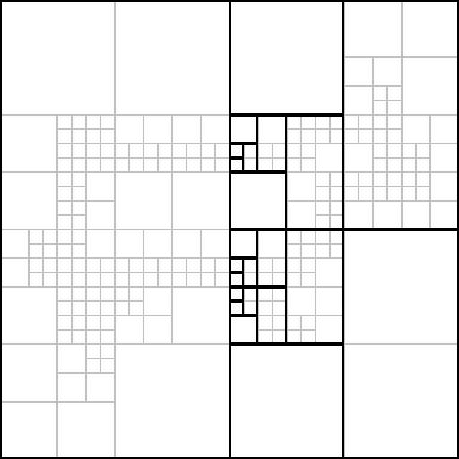
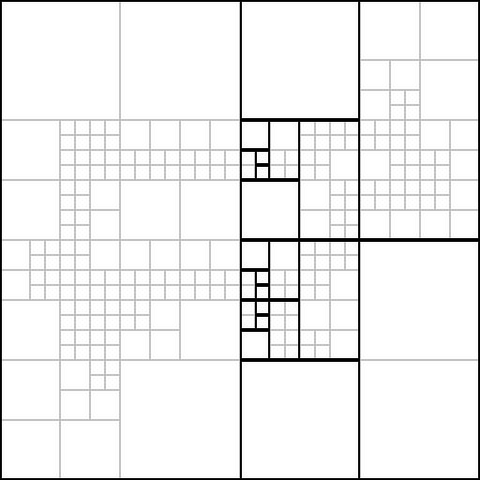
Streaming the Octree
Challenge:
In the case of an octree, nodes at different depths persist for different time-spans.
x=x₀
x=x₀+1

Slide 22
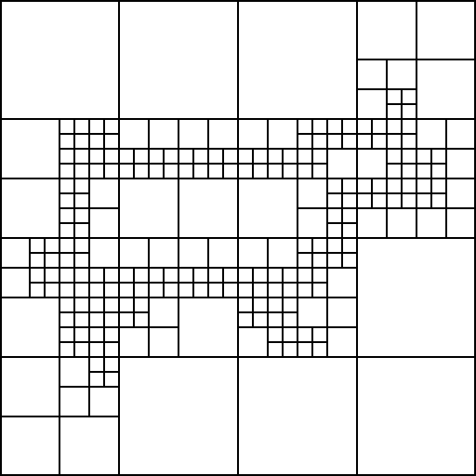

Streaming the Octree
Solution:
To manage depth-related-persistence, we define a separate stream for each depth.
d=0
d=1
d=2
d=3
d=4
d=5
Data Streams
Octree

Slide 23
Streaming the Octree
Solution:
To manage depth-related-persistence, we define a separate stream for each depth.
d=0
d=1
d=2
d=3
d=4
d=5
Data Streams
Octree

Slide 24
Streaming the Octree
Solution:
To manage depth-related-persistence, we define a separate stream for each depth.
d=0
d=1
d=2
d=3
d=4
d=5
Data Streams
Octree

Slide 25
Streaming the Octree
Solution:
To manage depth-related-persistence, we define a separate stream for each depth.
d=0
d=1
d=2
d=3
d=4
d=5
Data Streams
Octree

Slide 26
Streaming the Octree
Solution:
To manage depth-related-persistence, we define a separate stream for each depth.
d=0
d=1
d=2
d=3
d=4
d=5
Data Streams
Octree

Slide 27
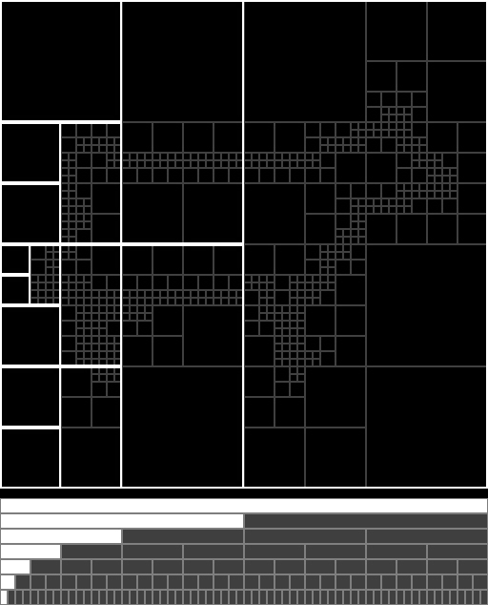
Streaming the Octree
Solution:
We can manage node persistence by advancing through the streams at different speeds.

Slide 28
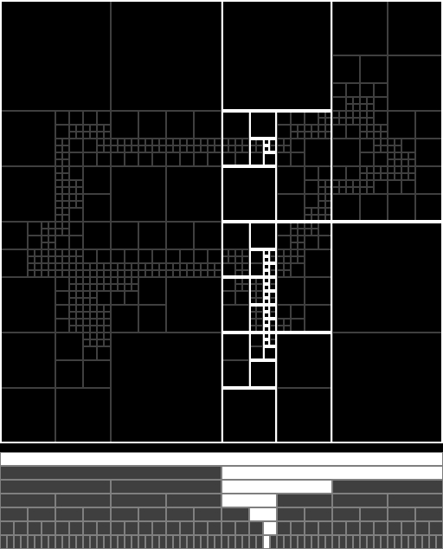
Streaming the Octree
Solution:
We can manage node persistence by advancing through the streams at different speeds.
For an octree of height h:
Resolution: R=2^{h}
Octree Size: O(R²)
Octree in Working Memory: O(R)

Slide 29
Streaming the Reconstruction
We must implement the reconstruction in a streaming fashion.
  Extend oriented samples to vector field
  Compute divergence
  Solve Poisson equation
  Extract isosurface
(1)
(2)
(3)
(4)

Slide 30
Streaming the Reconstruction
We must implement the reconstruction in a streaming fashion.
  Extend oriented samples to vector field
  Compute divergence
  Solve Poisson equation
  Extract isosurface
(1)
(2)
(3)
(4)

Slide 31
Streaming the Reconstruction
We must implement the reconstruction in a streaming fashion.
  Extend oriented samples to vector field
  Compute divergence
  Solve Poisson equation
  Extract isosurface
Solving a Poisson system is not a local process!
(1)
(2)
(3)
(4)

Slide 32


Streaming the Reconstruction
Reconstruction Locality:
Using iterative update methods, the Poisson system can be solved in a local manner.

Slide 33

Streaming the Reconstruction
Reconstruction Locality:
Using iterative update methods, the Poisson system can be solved in a local manner.
>2500 Jacobi Iterations

Slide 34
Streaming the Reconstruction
Reconstruction Efficiency:
Using cascadic multigrid, the system can be solved efficiently in a local manner:
  The solution is obtained by solving at coarser depths and updating/initializing the equation at finer depths.
  Within each depth, we use a Jacobi solver to update the solution coefficients in the working set.

Slide 35
Streaming the Reconstruction
Reconstruction Efficiency:
Using cascadic multigrid, the system can be solved efficiently in a local manner:
  The solution is obtained by solving at coarser depths and updating/initializing the equation at finer depths.
  Within each depth, we use a Jacobi solver to update the solution coefficients in the working set.
One pass suffices for an accurate solution!

Slide 36
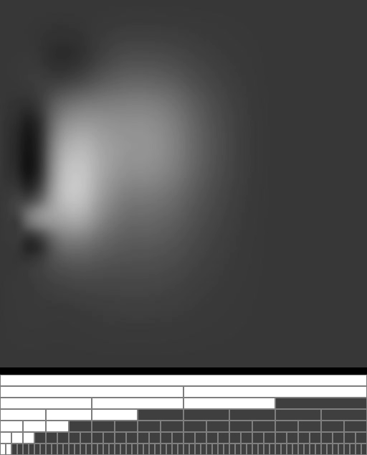
Streaming the Reconstruction
Implementation:
High-res solutions trail the low-res solutions.
A single pass suffices for accurate reconstruction.

Slide 37
Outline
Introduction
Streaming Surface Reconstruction
Results
Conclusion

Slide 38
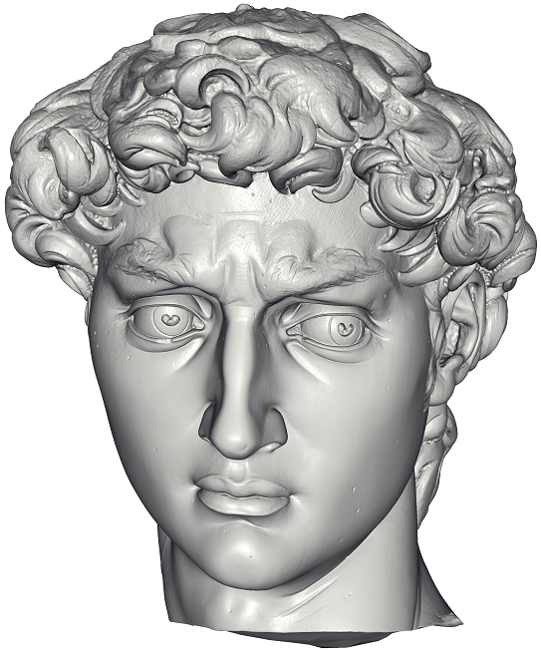
David (Complexity)
Res. | Octree Memory | Peak Memory | Running Time
256 | 48 | 521 | 0.53
512 | 168 | 278 | 0.68
1024 | 702 | 213 | 1.20
2048 | 3,070 | 212 | 3.33
4096 | 13,367 | 427 | 12.6
8192 | 39,452 | 780 | 32.3
Out-of-Core Reconstruction
216x10⁶ points (4.8 GB)

Slide 39
David (Complexity)
Res. | Octree Memory | Peak Memory | Running Time
256 | 48 49 | 521 309 | 0.53 0.50
512 | 168 188 | 278 442 | 0.68 0.65
1024 | 702 818 | 213 1,285 | 1.20 1.05
2048 | 3,070 3,695 | 212 4,442 | 3.33 2.65
4096 | 13,367 N/A | 427 N/A | 12.6 N/A
8192 | 39,452 N/A | 780 N/A | 32.3 N/A
Out-of-Core Reconstruction
In-Core Reconstruction
216x10⁶ points (4.8 GB)

Slide 40
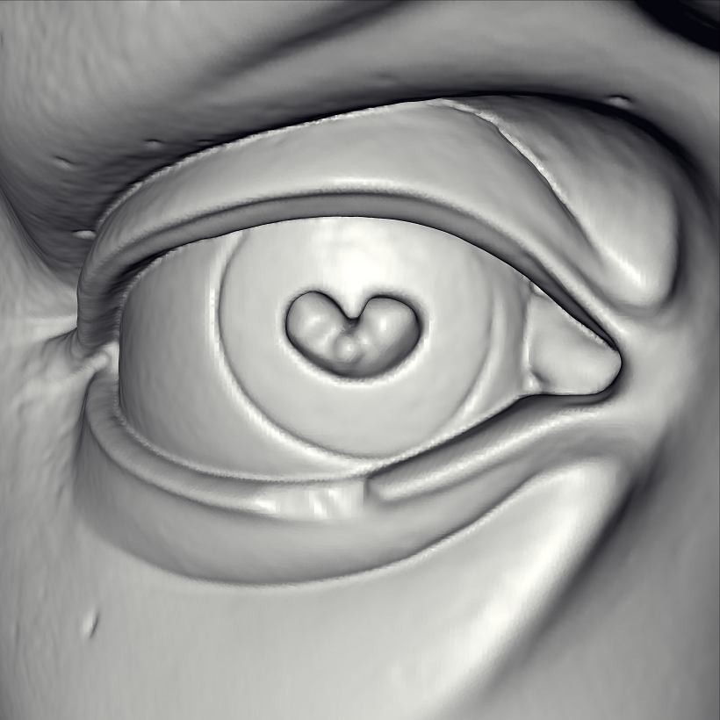
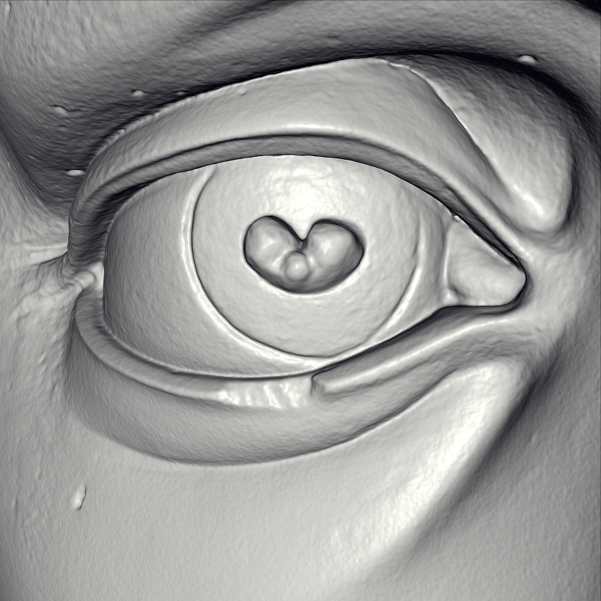
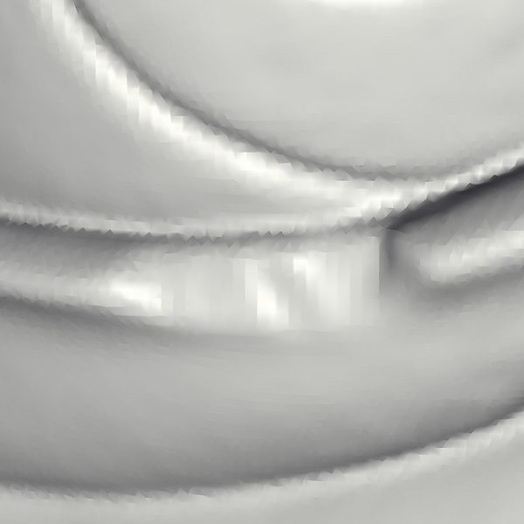
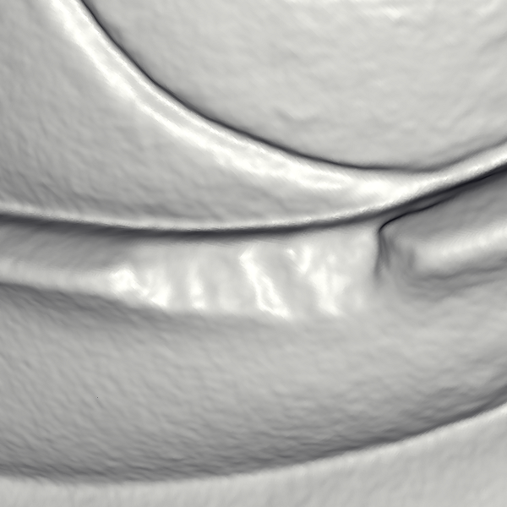
David (Comparison)
In-Core Reconstruction
Peak Mem: 4.4 GB
Out-of-Core Reconstruction
Peak Mem: 0.8 GB

Slide 41
Outline
Introduction
Streaming Surface Reconstruction
Results
Conclusion

Slide 42
Conclusion
Methodology:
We have presented a multilevel streaming framework for out-of-core processing of octrees
d=0
d=1
d=2
d=3
d=4
d=5
Data Streams
Octree

Slide 43
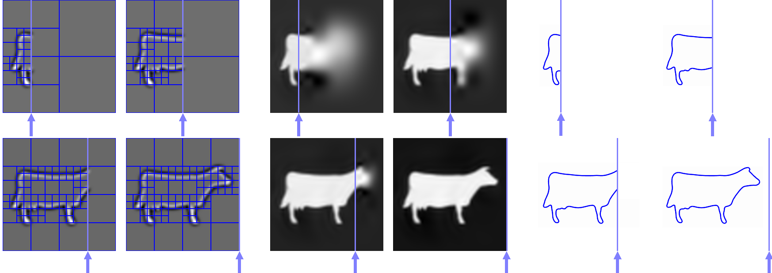
Conclusion
Application:
We have implemented streaming surface reconstruction in three passes through the data.

Slide 44
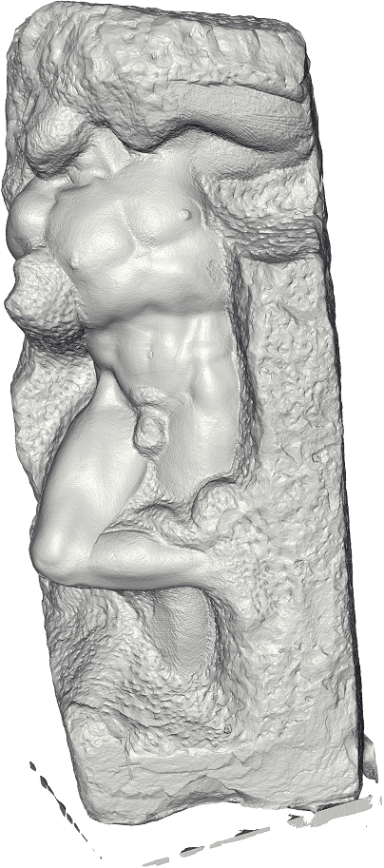
Conclusion
We can reconstruct watertight surface using a memory footprint smaller than:
  The total memory used
  The size of the input point set
  The size of the output surface
Points (391x10⁶) Triangles (431x10⁶) Total Memory | 9.8 GB 7.8 GB 106 GB
Working Memory |  | 2 GB

Slide 45
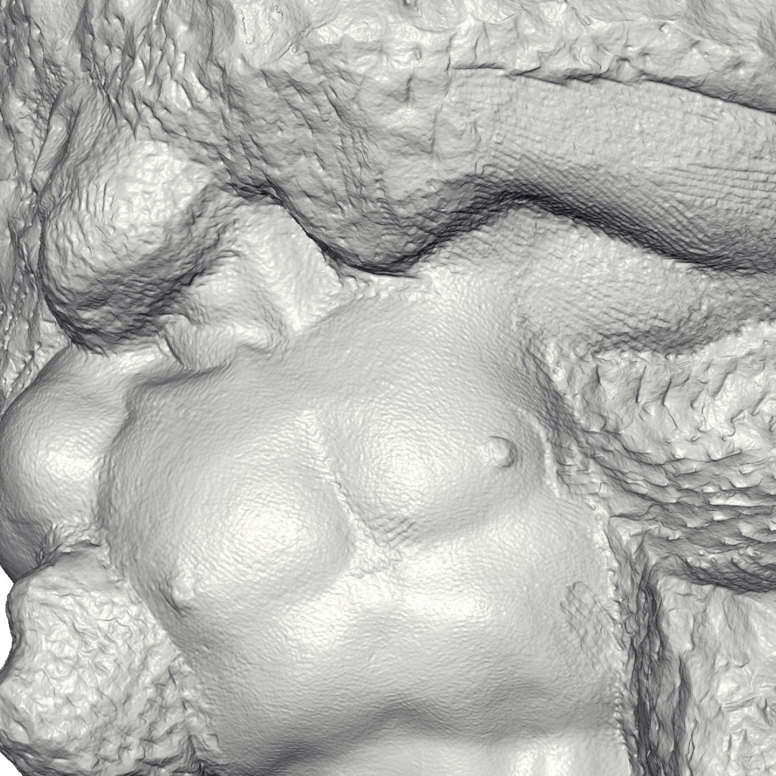
Conclusion
We can reconstruct watertight surface using a memory footprint smaller than:
  The total memory used
  The size of the input point set
  The size of the output surface
Points (391x10⁶) Triangles (431x10⁶) Total Memory | 9.8 GB 7.8 GB 106 GB
Working Memory |  | 2 GB

Slide 46
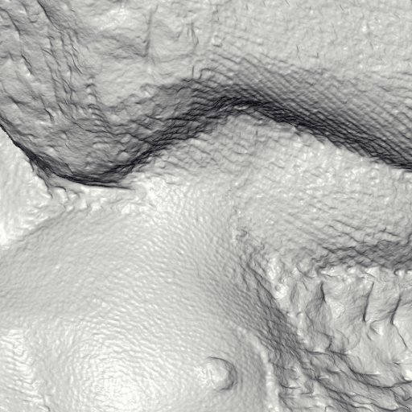
Conclusion
We can reconstruct watertight surface using a memory footprint smaller than:
  The total memory used
  The size of the input point set
  The size of the output surface
Points (391x10⁶) Triangles (431x10⁶) Total Memory | 9.8 GB 7.8 GB 106 GB
Working Memory |  | 2 GB

Slide 47
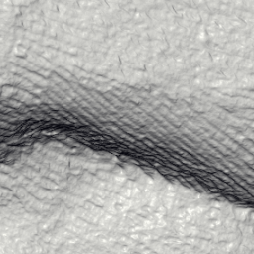
Conclusion
We can reconstruct watertight surface using a memory footprint smaller than:
  The total memory used
  The size of the input point set
  The size of the output surface
Points (391x10⁶) Triangles (431x10⁶) Total Memory | 9.8 GB 7.8 GB 106 GB
Working Memory |  | 2 GB

Slide 48
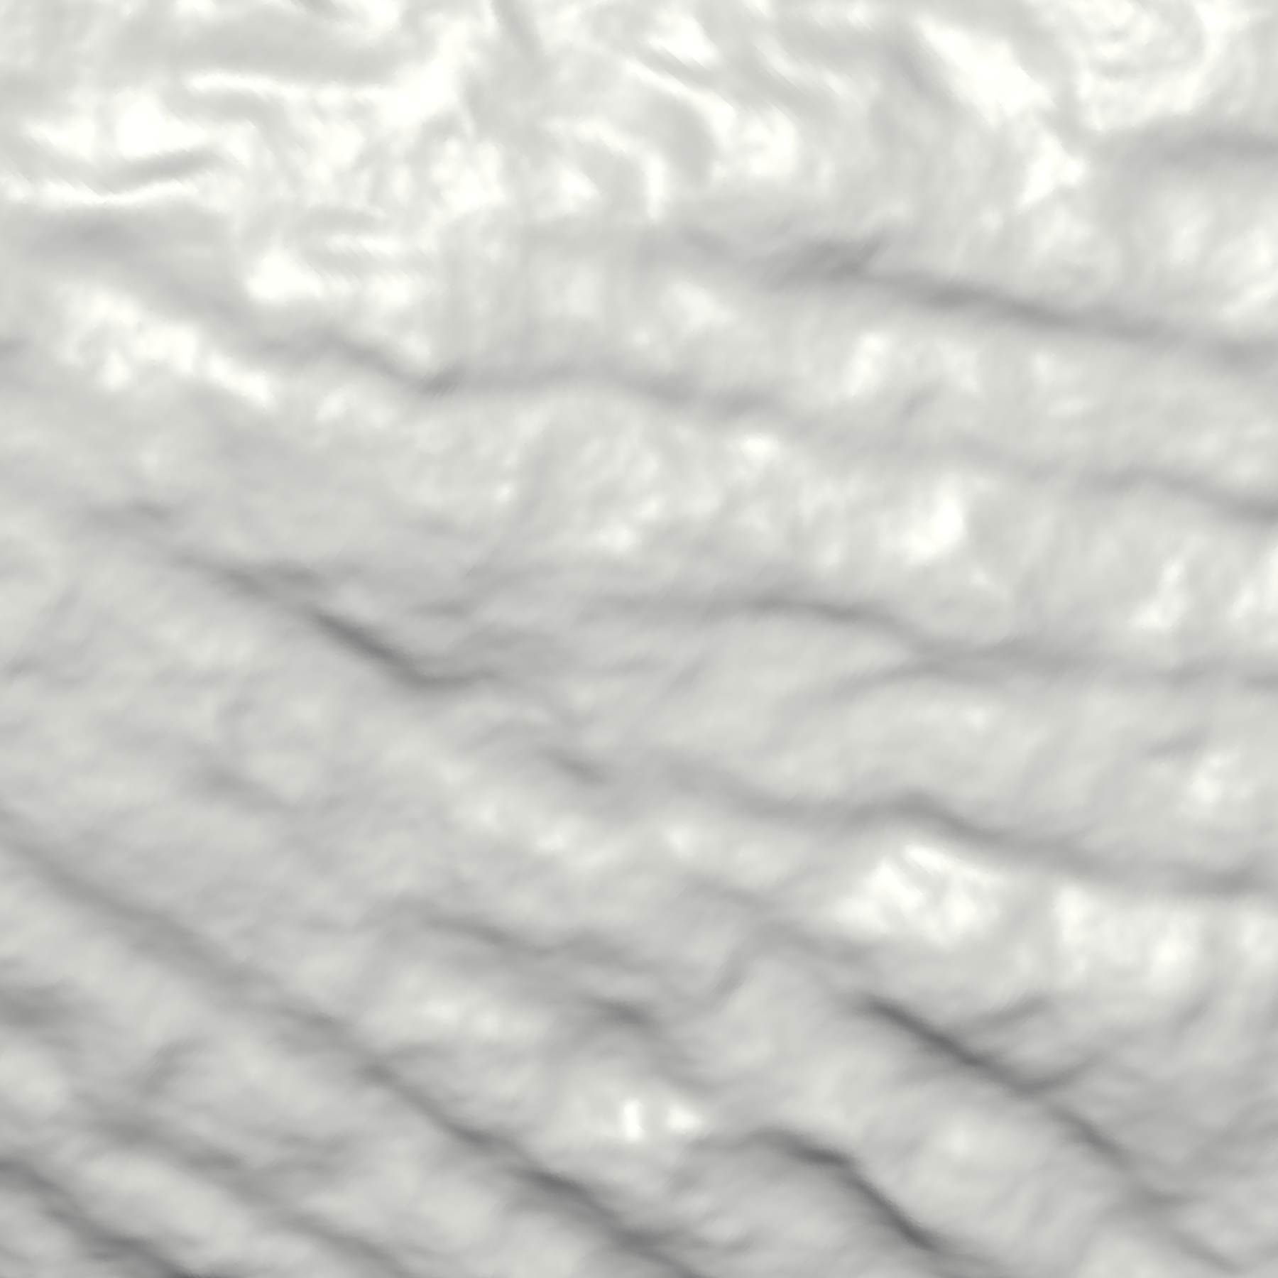
Conclusion
We can reconstruct watertight surface using a memory footprint smaller than:
  The total memory used
  The size of the input point set
  The size of the output surface
…
Points (391x10⁶) Triangles (431x10⁶) Total Memory | 9.8 GB 7.8 GB 106 GB
Working Memory |  | 2 GB

Slide 49
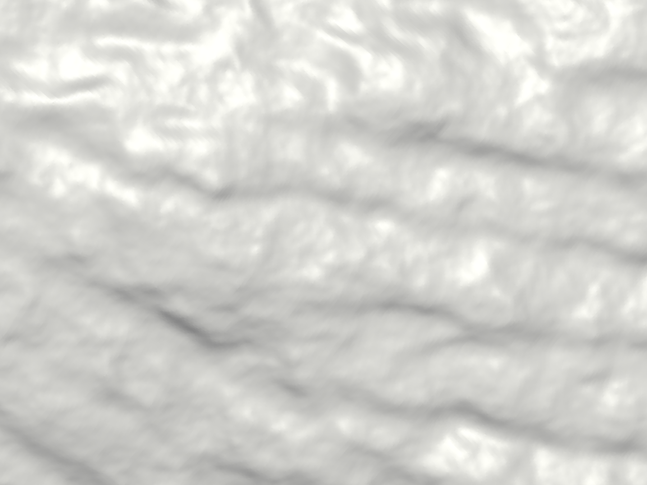
Thank You!
http://www.cs.jhu.edu/~misha/Code/OOCReconstruction
http://www.cs.jhu.edu/~bolitho/Research/StreamingSurfaceReconstruction

