Slide 1
Metric-Aware Processing of Spherical Imagery
Misha Kazhdan and Hugues Hoppe
Johns Hopkins University
Microsoft Research
Notes:
Good afternoon.
In this talk I will present work, done in collaboration with Hugues Hoppe from Microsoft Research, on the metric aware processing of spherical imagery.

Slide 2
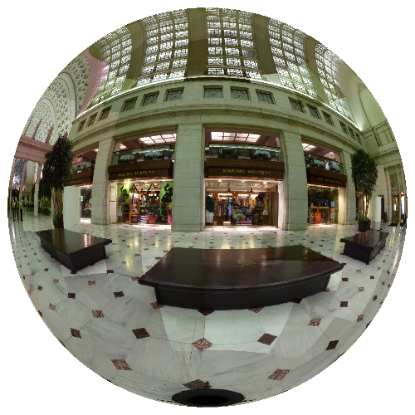
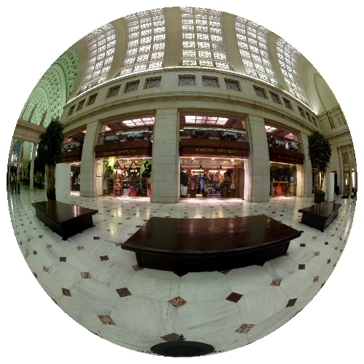
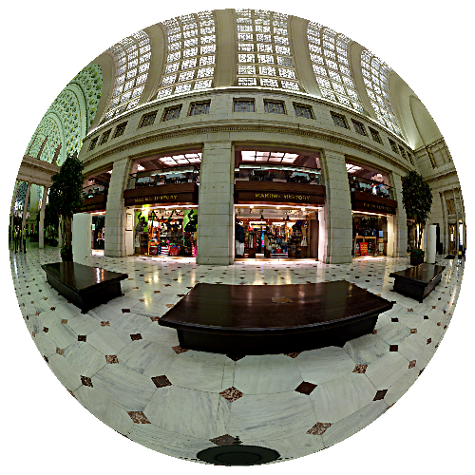
Motivation
Goal:
  Efficient and accurate spherical image processing
Approach:
  Extend gradient-domain methods to the sphere
stitching
contrast
enhancement
Notes:
The goal of this work to extend traditional image processing techniques to the processing of images defined over the sphere.
For example:
[Click]
Given a spherical panorama obtained by composing many individual images,
[Click]
We would like to remove the stitching seams.
Or, given a seamless image:
[Click]
We would like to be able to perform operations like contrast enhancement to accentuate the details.
[Click]
To do this, we describe an accurate and efficient method for supporting gradient-domain processing of spherical images.

Slide 3
Gradient-Domain Image Processing
Gradient
Domain
Operator
∇
Gradient
Domain
Operator
Image₀
∇
Image₀
Grad₀
Grad₀
∇
Solver
Image₁
∇
Solver
Image₁
Grad₁
Grad₁
Image
Grad
Image
Grad
∇
Image_{n}
∇
Image_{n}
Grad_{n}
Grad_{n}
Notes:
To briefly review, gradient-domain processing works as follows:
[Click]
Starting with an image, or a set of images,
[Click]
We extract the gradients,
[Click]
Combine and modify them to obtain a gradient field characterizing the desired output,
[Click]
And then solve for the image satisfying the new gradient constraints.

Slide 4
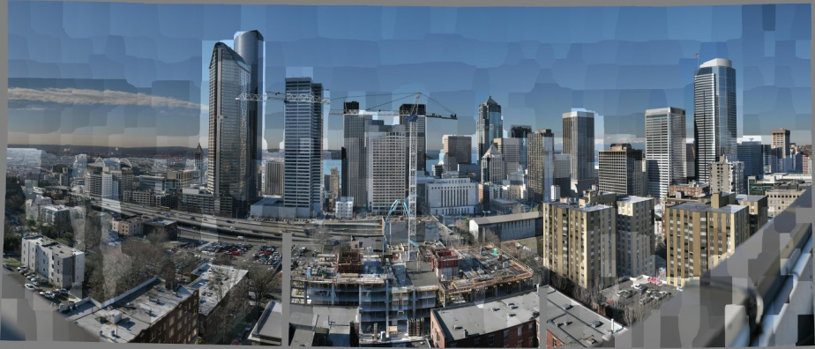
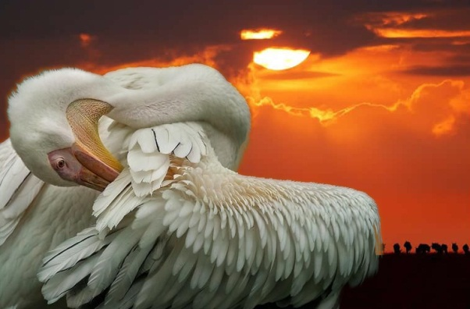
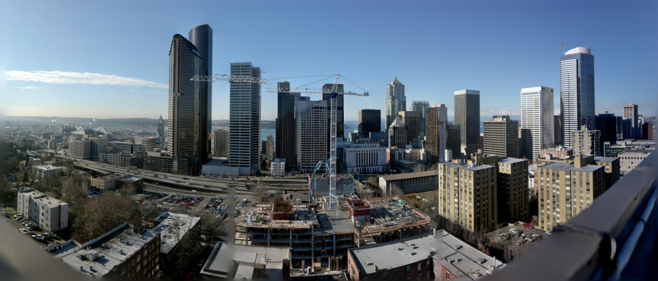

Gradient-Domain Image Processing
Gradient
Domain
Operator
∇
Gradient
Domain
Operator
Image₀
∇
Image₀
Grad₀
Grad₀
∇
Solver
Image₁
∇
Solver
Image₁
Grad₁
Grad₁
Image
Grad
Image
Grad
∇
Image_{n}
∇
Image_{n}
Grad_{n}
Grad_{n}
Removing lighting effects
Range compression
Image compositing
Image stitching
Image authoring
[Horn ’74, Weiss ’01, Finlayson ’02, Agrawal ’05]
[Fattal ’02, Weyrich ’07]
[Perez ’03, Agarwala ’04, Jia ’06]
[Levin ’04, Agarwala ’07, Kazhdan ’08]
[McCann ’08, Bhat ’08]
[Kazhdan et al. 2008]
[Bhat et al. 2008]
Notes:
Previous works have shown that by processing gradients in different ways, a variety of visual effects can be realized.
For example,
[Click]
A seamless panorama can be obtained from a composition of images by setting the gradients that cross image boundaries to zero.
Or,
[Click]
By amplifying gradients while constraining the pixels to preserve their original color values, the details of an image can be exaggerated

Slide 5
Gradient-Domain Image Processing
Gradients → Image:
  Solving for the image that best fits the constraints requires solving a large, sparse system of equations.
Gradient
Domain
Operator
∇
Gradient
Domain
Operator
Image₀
∇
Image₀
Grad₀
Grad₀
∇
Solver
Image₁
∇
Solver
Image₁
Grad₁
Grad₁
Image
Grad
Image
Grad
∇
Image_{n}
∇
Image_{n}
Grad_{n}
Grad_{n}
Notes:
Though the previous methods differ in how they process the gradients, they all must solve for the image that fits the new constraints, which requires solving a large, sparse, linear system of equations.

Slide 6
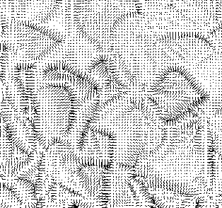
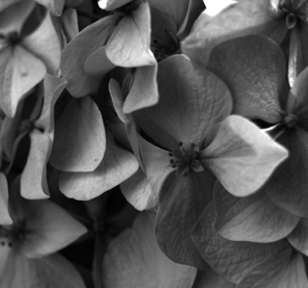
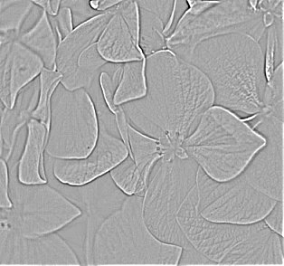

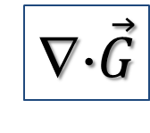
Gradients → Image
Fitting a function to gradient constraints reduces to solving a Poisson equation
∇⋅$\vec{G}$
$$\vec{G}$$
f
Notes:
To do this, we need to fit an image to a desired gradient field.
That is, we must invert the gradient operator.
The problem is that this system of equations is over-constrained.
At each pixel, there are two constraints and only one color value.
To address this problem, we apply the divergence operator to both sides.
[Click]
This transforms the constraints from a vector field…
[Click]
To a scalar field,
And changes the linear system…
[Click]
So that now we are left with the problem of solving the Poisson equation.

Slide 7
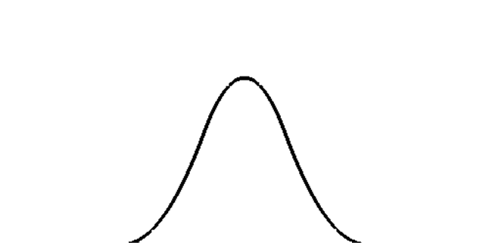
System Set-Up
B₁(p)
B₂(p)
B₃(p)
B₄(p)
Discretize the System:
  Partition the domain
  Associate a function with each element
  Solve for the closest solution in the span
Notes:
In its original formulation, this problem is defined as an optimization over the space of all differentiable functions.
To make the problem tractable, the problem is discretized to form a finite system of equations.
This is done by taking the original domain over which the problem is defined, in this case a line segment,
[Click]
And partitioning it into a finite set of regions, or elements.
Then,
[Click]
A function is associated with each element.
[Click]
Now, rather than solving over a continuous set of variables, the problem is solved over the finite-dimensional space spanned by these functions.
[Click]
This results in a linear system of equations, where the coefficients of the system are obtained by integrating appropriate functions over the domain.

Slide 8
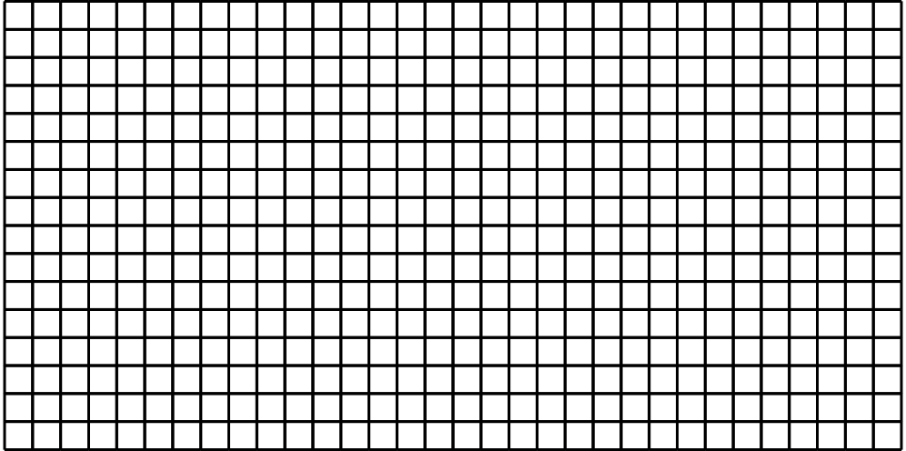
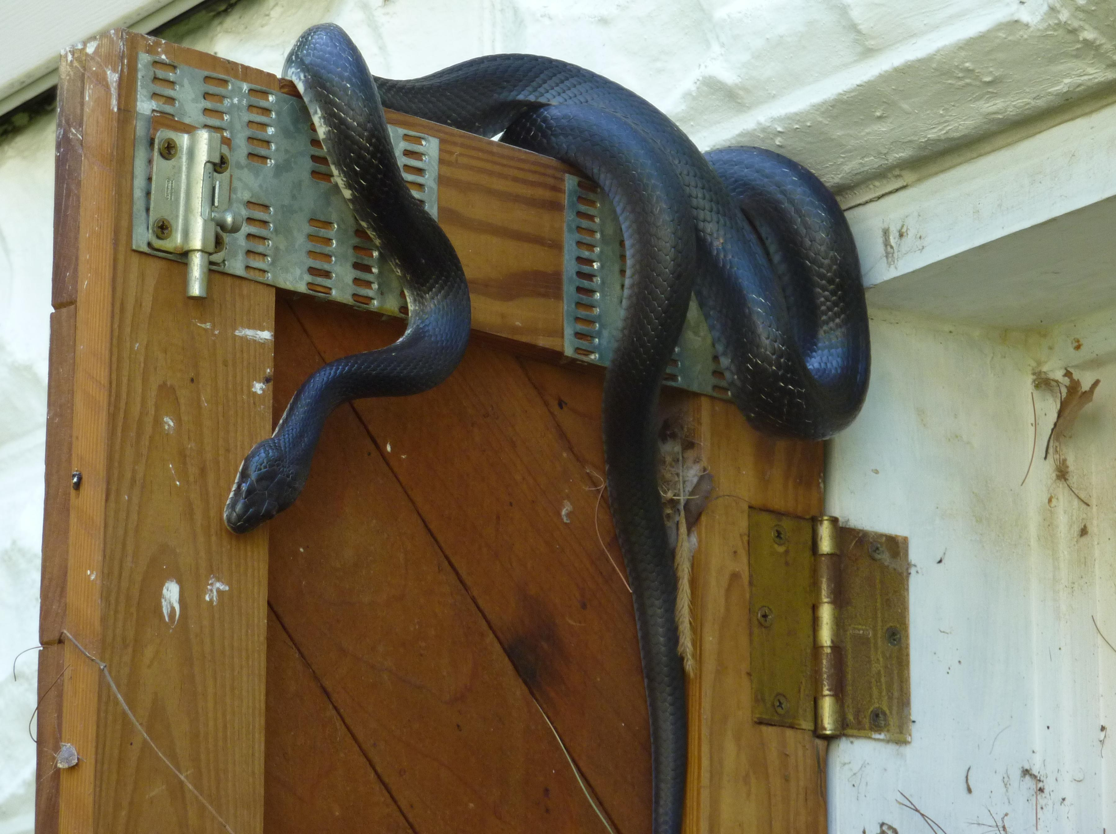
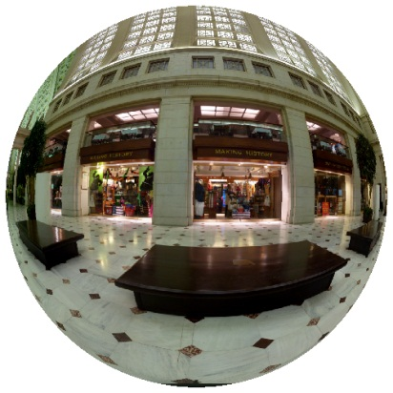
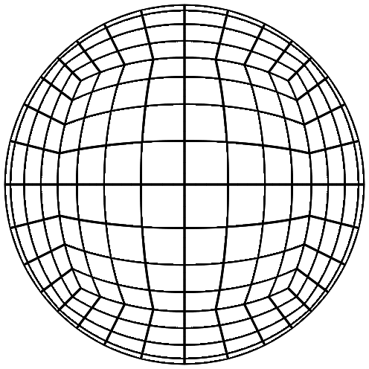
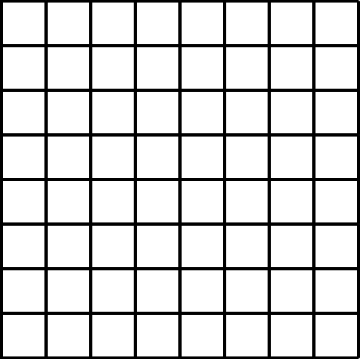
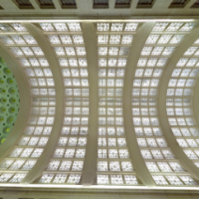
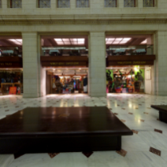
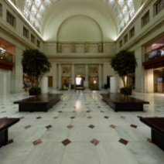
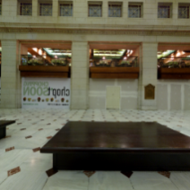
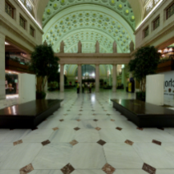
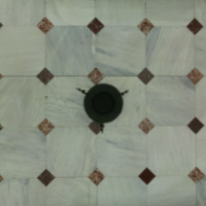
System Set-Up
Planar images:
  Trivial metric → Simple integrals
  Isotropic → Efficient set-up
Spherical Images:
  Spherical metric → Approximate integrals
  Non-uniform → Slow set-up
An accurate solution can require more time to set up than to solve.
Cube-map
Notes:
Formulating this system for planar images is reasonably straight-forward.
[Click]
Since the domain is flat, computing the system coefficients is a matter of integrating the appropriate functions.
[Click]
Furthermore, because the functions are just translations of each other, the integration performed to compute the entries in one row of the matrix can be re-used for all other rows.
[Click]
The problem becomes markedly more difficult when we consider spherical images.
First,
[Click]
Because we are performing the integration over a spherical domain, we must account for the curvature, which often results in integrals that cannot be evaluated analytically.
Worse still,
[Click]
Because the distortion is non-uniform, the integrals computed for one row cannot be re-used for the other rows.
[Click]
In practice, this means that even if we are able to compute the integrals accurately, they must be computed independently for each matrix coefficient, resulting in a situation in which it takes much longer to set up the system than it does to solve it.

Slide 9
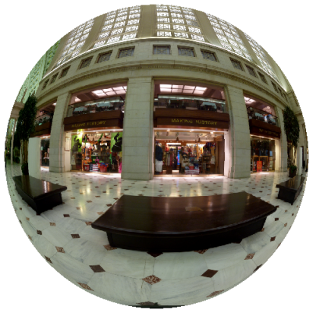
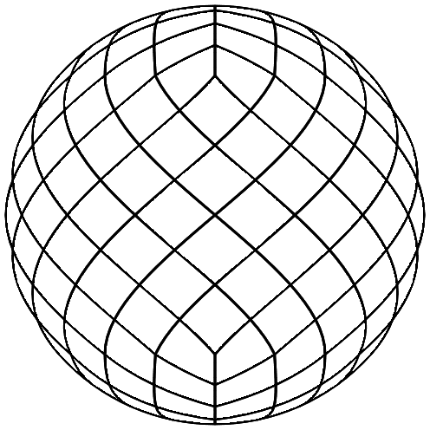
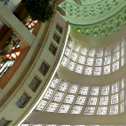
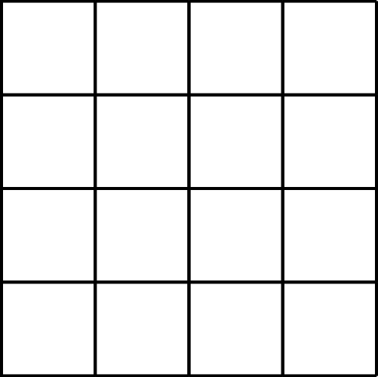
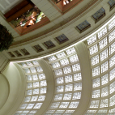
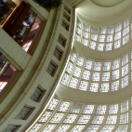
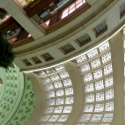
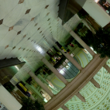
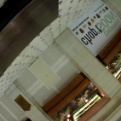
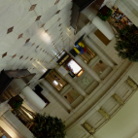
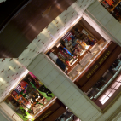
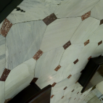
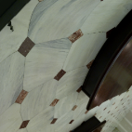
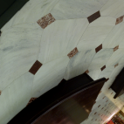
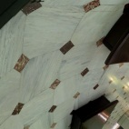


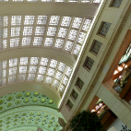
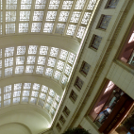
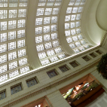
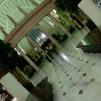
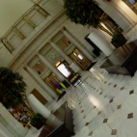
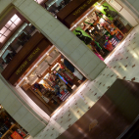
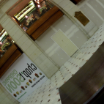
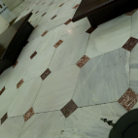
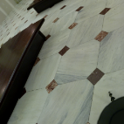
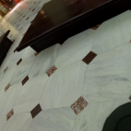
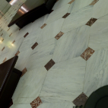
Related Work
Image Sampling:
  Use a mapping with small
  distortion so all pixels have
  the same “shape”.
Limitation:
  Maps from the plane cannot
  preserve areas and angles.
HEALPix [Gorski et al. 2005]
Rhombic Dodecahedron [Fu et al. 2009]
Notes:
Alternatively, one could try to leverage parameterizations that have been used to handle similar issues of non-uniformity in image sampling.
For example,
[Click]
The HEALPix parameterization provides a mapping that is everywhere area preserving
[Click]
And the Rhombic Dodecahedron parameterization balances between preserving area and isotropy.
Using the low distortion of these maps,
[Click]
One could ignore the metric and perform the integration over the parameterization domain, simplifying the integrals and allowing for the re-use of computation.
Unfortunately,
[Click]
Since maps from a flat domain to the sphere cannot preserve both areas and angles, some distortion is inevitable and the resulting system will have to be inaccurate.

Slide 10
Outline
Introduction
Related Work
Our Adapted Discretization
Evaluation + Results
Conclusion
Notes:
In this work, we present a solver that is based on a new discretization of the sphere.
We validate the correctness of our approach by demonstrating that it is both accurate and efficient, and we demonstrate its practical utility in a number of image processing applications.
We conclude by summarizing our contributions and describing possible areas for future work.

Slide 11

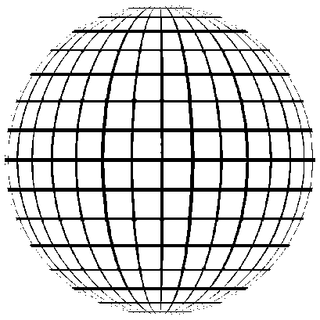
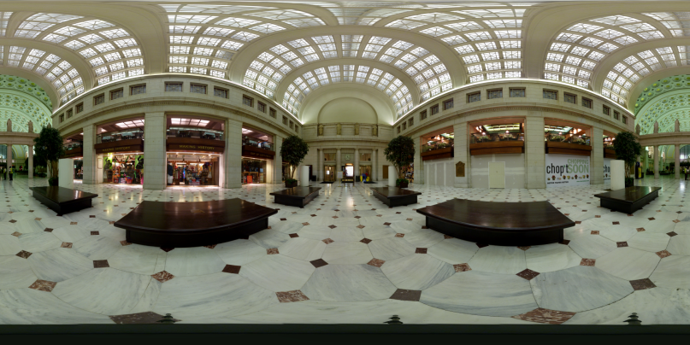
Approach
Use the equirectangular map to get:
  Common representation
  Closed-form integrals
  Efficient set-up
Adapt the discretization to get:
  Bounded distortion
Notes:
To design our discretization, we start from the equirectangular map, commonly used to represent points on the sphere in terms of their angles of longitude and latitude.
This gives us the benefits of developing a solver for a common image representation that supports the closed-form evaluation of integrals, and has enough symmetry to make the set-up of the linear system be efficient.
Then,
[Click]
We adapt the discretization to alleviate the problems with unbounded distortion at the poles.
We begin by describing how the linear system can be formulated using the equirectangular map.

Slide 12























Equirectangular Map
$$θ$$
$$Φ\left(θ, φ\right)$$
Defining a Function Space:
  B-spline functions
    Periodic φ-boundary
    Collapsed θ-boundary
  Unbounded distortion
$$φ$$
$$B_{I}\left(θ,φ\right)$$
$$B_{I}∘Φ^{−1}$$
$$B_{J}\left(θ,φ\right)$$
$$B_{J}∘Φ^{−1}$$
$$B_{K}\left(θ,φ\right)$$
$$B_{K}∘Φ^{−1}$$
Notes:
To form the matrix, we first define a function space over which to discretize the Poisson equation.
Using a regular decomposition of the parameter domain, we can define a set of regular B-splines on the grid and then use the parameterization to transform them into functions on the sphere.
[Click]
While this works well for grid cells interior to the domain, we need to define these functions so that they respect the boundaries.
Along the phi-boundaries,
[Click]
The mapping is periodic, so we modify the B-splines so that they wrap-around.
[Click]
Along the theta-boundaries,
[Click]
The mapping collapses so that all the points on these boundaries map to one of the two poles.
To define continuous functions,
[Click]
We merge the elements on the first and last parallels, to get two polar cap functions.
While this provides a function space with sufficient differentiability to discretize the Poisson system,
[Click]
It has the undesirable property of unbounded distortion at the poles.
In particular, the area of elements near the poles collapses to zero and, consequently, the derivatives blows up.

Slide 13








Approach
$$θ$$
$$Φ\left(θ, φ\right)$$
Observation:
  The distortion at the poles
  is due to over-sampling.
Solution:
  Adapt discretization to the
  length of the parallels to get
  coarser sampling at the poles.
$$φ$$
$$B_{I}\left(θ,φ\right)$$
$$B_{I}∘Φ^{−1}$$
$$B_{J}\left(θ,φ\right)$$
$$B_{J}∘Φ^{−1}$$
$$B_{K}\left(θ,φ\right)$$
$$B_{K}∘Φ^{−1}$$
Notes:
To resolve this issue, we observe that the difficulty at the poles is not the result of a lack of data at the poles, but rather an over-abundance of it.
We leverage this observation by adapting the discretization of the parameter domain to account for the changing lengths of the parallels,
[Click]
So that parallels closer to the poles are sampled more coarsely than parallels near the equator.
Using this discretization, we define anisotropically scaled B-splines in the parameterization domain,
[Click]
Which give near uniform functions on the sphere.
The advantage of this formulation
[Click]
Is that now the elements on the sphere have similar areas and the derivatives of the associated functions have similar magnitudes.

Slide 14
Properties
$$θ$$
$$Φ\left(θ, φ\right)$$
Regularity:
  Exact integrals
  Separable functions
  Integral re-use
  Pre-computation
  Multigrid hierarchy
  Out-of-core processing
Adaptivity:
  Well-conditioned system
$$φ$$
$$B_{I}\left(θ,φ\right)$$
$$B_{I}∘Φ^{−1}$$
$$B_{J}\left(θ,φ\right)$$
$$B_{J}∘Φ^{−1}$$
$$B_{K}\left(θ,φ\right)$$
$$B_{K}∘Φ^{−1}$$
Notes:
Using this discretization, has a number of beneficial properties.
From the regularity of the original equirectangular mapping we get
[Click]
A closed-form expression for the integrals.
[Click]
Separability of the 2D integrals into the products of 1D integrals.
[Click]
Axial symmetry that allows us to re-use the computed integral values, and makes it practical to store pre-computed integral values off-line.
[Click]
A nesting of elements that supports a multigrid solver,
And
[Click]
An ordering of the system coefficients that supports a streaming, out-of-core solver.
Furthermore, by adapting this discretization,
[Click]
We also ensure that the system is well-conditioned so that the solver converges efficiently.
Let’s look at these properties in more detail.

Slide 15
Regularity
Exact Integrals:
  We discretize the system using B-splines.
  The integrals are the products of polynomials with trig. functions:
Product Rule
Polylogarithms
Notes:
In defining our set of functions on the parameterization, we use second order B-splines, which are piecewise quadratic functions.
As a result,
[Click]
When we formulate our spherical integrals, the integrands are piecewise polynomial functions multiplied by trigonometric functions that account for the area distortion and the scaling of the derivative.
[Click]
The first of these integrands is straight-forward to compute using the product rule.
[Click]
The second is somewhat more messy due to the division by the sine function, but can still be expressed in closed form using polylogarithmic functions.

Slide 16


Regularity
Separable Functions:
  Bivariate B-splines are products of univariate B-splines.
  ⇒ The 2D integrals are products of 1D integrals.
Notes:
The use of the B-splines further facilitates the computation because each 2D B-spline is the product of two one-dimensional B-splines.
This is true both for the B-splines defined in the un-adapted regions
[Click]
And also the B-splines defined in the adapted regions
[Click]
As a result,
[Click]
The 2D integrals involving the B-splines and their derivatives can be expressed in terms of the products of 1D integrals.

Slide 17

Regularity
Axial Symmetry and Pre-Computation:
  The map is symmetric with respect to rotation about the y-axis.
  The system matrix has repeating values.
  For an NxN image, the number of
  distinct integrals computed is:
    O(N) for the θ integrals
    O(log N) for the φ integrals
B_{I}
B_{I’}
B_{I’’}
B_{I’’’}
B_{J’’}
B_{J’’’}
B_{J}
B_{J’}
Notes:
In addition to providing a closed-form expression for the integrands, the adapted discretization also preserves the axial symmetry of the equirectangular map.
As a result, the system matrix exhibits similar symmetry, allowing us to amortize the cost of integration across the parallels.
For example,
[Click]
Given the elements I and J defining the IJ-th matrix coefficient, if we rotate the elements about the y-axis,
[Click]
The values of the integrals will stay the same, so we can reuse them when setting the system coefficients.
As a result, the number of distinct integrals we need to compute is sub-linear in the image size.
[Click]
Thus we can either pay a comparably small cost and compute them on the fly.
Or, we can compute the values once off-line and then read them in every time we need to set the system.

Slide 18







Regularity
Multigrid Hierarchy:
  Rows are discretized into power-
  of-two bins based on length.
  Elements at finer levels nest
  within coarser elements.
Notes:
Our discretization also provides support for an efficient multigrid solver.
In particular, by discretizing each parallel into a power-of-two domains, the elements defined at the finer levels are contained within the elements defined at the coarser levels.
[Click]
This property, coupled with the definition of the B-splines, ensures that any function in the space defined by a coarse discretization can be expressed as a linear combination of functions defined by a finer discretization, thereby providing the multi-resolution structure required to define a multigrid solver.

Slide 19

Regularity
Out-of-Core Processing:
  Gauss-Seidel relaxation only requires access to neighboring values.
  Can solve within a small working window.
On Disk
In Memory
Notes:
Finally, using a row-major ordering of the elements, the system can support a streaming, out-of-core solver.
Following our earlier work, we use the fact that Gauss-Seidel relaxation of a pixel only requires access to the pixels values in its vicinity.
We start with all of the data out-of-core
[Click]
Then,
[Click]
We read in the first couple of rows from disk into main memory.
Once the first few rows are in-core,
[Click]
We update the value of the pixel in the first row, since all the necessary data is accessible.
Reading in the next row from disk,
[Click]
We update the values of the pixels in the second row.
As the window advances further,
[Click]
The values of pixels at the back of the window are no longer be needed, and we can write them to disk.
Continuing on in this fashion,
[Click]
We read the next row into main memory, update the pixels in the middle row, and write out the back row.
This allows us to update all of the pixel values in a streaming fashion, only requiring a small subset of the data to be in-core at any given time.

Slide 20
Regularity
Out-of-Core Processing:
  Gauss-Seidel relaxation only requires access to neighboring values.
  Can solve within a small working window.
  Can integrate into a streaming V-cycle.
f
u
Update
Update
Restrict
Prolong
Pass 1
Update
Update
Pass 2
Memory Streaming
Disk Streaming
Restrict
Prolong
Solve
Notes:
Using temporal blocking, and interleaving the computation within the different levels of the multigrid hierarchy, we are able to perform a single V-cycle with multiple Gauss-Seidel relaxations within each level in two streaming passes through the data.

Slide 21
Outline
Introduction
Related Work
Our Adapted Discretization
Evaluation + Results
Conclusion
Notes:
Now that we have the solver in place, we are ready to study how well it works in practice.
We begin by evaluating the accuracy of the solver and then consider some practical applications.

Slide 22






Evaluation: Spectral Error
Ground-Truth Solution:
  Sph. harmonics are eigenvectors of the Laplacian:
  Can measure solver accuracy
  by using the harmonics as
  constraints.
$$Y_{1}$$
$$Y_{2}$$
$$Y_{3}$$
Δ⁻¹/λ_{l}
Notes:
To measure the accuracy of the solver, we use the spherical harmonics.
These are functions defined on the sphere that are know to be the eigenvectors of the Laplace operator.
Thus, we know that if the constraint to the Poisson system is a spherical harmonic,
[Click]
Then the correct solution will be a scaled multiple of the constraint.
This gives us a ground-truth against we can measure the performance of different solvers.

Slide 23









Evaluation: Spectral Error
(Un)Bounded Distortion:
  Adapting the discretization makes the linear system well-conditioned.
$$Y_{2}$$
Regular
Adapted
Notes:
We begin by considering the effects of the unbounded distortion of the equirectangular map.
For this experiment,
[Click]
We provided a second order harmonic as the constraint to the Poisson system and solved using the discretizations derived from the regular and adapted equirectangular map.
At first glance, both discretizations return solutions that are similar to the input,
[Click]
However, a closer inspection of the results, visualized using reflection lines, shows that the equirectangular has trouble converging to the correct solution at the poles.

Slide 24



Evaluation: Spectral Error
(Un)Bounded Distortion:
Adapted grid
Regular grid
RMS residual for $Y_{2}$
Notes:
This behavior can be validated quantitatively by considering the convergence of a multigrid solver as the number of V-cycles is increased.
For the regular discretization, we see that the poor conditioning results is a solution that barely improves with increased number of V-cycles.
In contrast,
[Click]
Using our adapted discretization, we see that increasing the number of V-cycles results in a significantly improved solution.
In particular, our adapted solver demonstrates the expected exponential decay in error, with each additional V-cycle reducing the error roughly by a factor of one hundred.

Slide 25










Evaluation: Spectral Error
$$Y_{1}$$
$$Y_{2}$$
$$Y_{3}$$
Metric Aware Solvers:
Spherical harmonics
Seconds / MPixel
Cube map
HEALPix
RMS error for Y₂
Rhombic
Adapted
Notes:
We also compare the results of our adapted discretization to the results obtained using the cube-map, HEALPix, and the Rhombic Dodecahedron maps.
Although we do not have a closed-form expression for the system coefficients defined by these other discretizations, we approximate them using Monte Carlo integration.
As the figures to the right show, accounting for the metric by integrating over the spherical domain provides solutions that are close to the ground-truth.
However,
[Click]
For these other discretizations, this comes at a heavy computational cost, requiring roughly 20 seconds of computation per-megapixel, independent of the resolution of the grid.
In contrast, for our adapted discretization, the axial symmetry allows us to re-use much of the computation, resulting in a sub-linear cost for setting up the linear system.
Additionally,
[Click]
If we consider the actual error values, we see that even though the spherical integration makes the error of the cube-map, HEALPix, and Rhombic Dodecahedron decrease with resolution, the improvement of these methods with grid refinement is noticeably smaller than the improvement exhibited by our adapted discretization.

Slide 26









Evaluation: Spectral Error
$$Y_{1}$$
$$Y_{2}$$
$$Y_{3}$$
Metric Unaware Solvers:
Spherical harmonics
Seconds / MPixel
Cube map
HEALPix
RMS error for Y₂
Rhombic
Adapted
Notes:
As discussed earlier, an alternate approach for dealing with the efficiency problem is to perform the integration over the parameterization domain instead of over the sphere.
Although this allows for a more efficient system set-up, the system we obtain is inaccurate.
As expected,
[Click]
The cube-map, which was not designed to minimize parametric distortion, gives incorrect results.
However,
[Click]
Ever for the HEALPix and Rhombic Dodecahedron maps, which are designed to minimize distortion, we find that the returned solution differs noticeably from the ground truth.
We can also see this by considering the error values.
[Click]
As the table at the bottom shows, when the spherical metric is ignored, all three methods exhibit significant error, and do not improve when the discretization is refined.

Slide 27










Evaluation: Reaction Diffusion
Metric Unaware Solvers:
  Need to iteratively solve a Poisson
  equation to perform the diffusion.
Cube map
Metric-unaware
Rhombic
HEALPix
Metric-aware
[Turk 1991]
[Witkin-Kass 1991]
Adapted
Notes:
We can also obtain a qualitative interpretation of these errors by using these discretizations to perform reaction-diffusion.
This is a biologically motivated system of non-linear differential equations used for texture synthesis.
In this system, the texture is evolved over time and a Poisson equation is solved at each time step to diffuse the texture values.
Using the different discretizations to perform the diffusion, in the creation of a spotted pattern, we see that
[Click]
Ignoring the metric altogether results in the generation of a texture in which the spots vary in both size and shape.
Using a mapping that minimizes area and angle distortion,
[Click]
We get better results that exhibit less variability in size and shape.
Using a mapping that has no area distortion,
[Click]
The size of the dots remains uniform while the eccentricity of their circular outlines varies.
It is only when using a metric-aware system,
[Click]
That we get results which are both homogenous and isotropic.

Slide 28





Results: Spherical stitching
15 images; 32 Mpix;
45 seconds; 83 MB memory; 510 MB disk
Notes:
Returning to our initial goal of extending gradient domain processing to images defined over the sphere, we consider an example in which we stitch together 15 images by setting the seam crossing gradients to zero.
Solving the linear system
[Click]
We obtain a seamless panorama at a rate of about one and a half seconds per mega-pixel.
Furthermore, the out-of-core implementation of our solver means that even though we use half a gigabyte of data to perform the solve, only a small subset of this data is resident in working memory at any given time.

Slide 29





Results: Spherical stitching
153 images; 2 Gpix;
54 minutes; 207 MB memory; 32 GB disk
Notes:
To get a better sense of the benefits of our out-of-core solver, we consider the scaled up scenario in which we stitch together a two giga-pixel panorama from 153 images.
[Click]
We see that despite the increased problem size, our solver continues to perform at a rate of about a second and a half per mega-pixel.
Additionally, this example highlights the benefits of an out-of-core solver.
Though the total size of the data used by our solver exceeds the working memory of a commodity PC, our solver only requires about 200 megabytes of RAM to perform the stitching.

Slide 30




Results: Gradient-based sharpening
128 Mpix;
156 seconds; 100 MB memory; 2GB disk
Notes:
Finally, to demonstrate the versatility of our solver, we consider the problem of contrast enhancement, in which we simultaneously seek to amplify gradients while preserving the original color values.
Although the system now includes both value and gradient interpolation constraints,
[Click]
Our solver continues to exhibit similar performance characteristics, with a working memory that is sub-linear in the problem size and a throughput of about a second and half per megapixel.

Slide 31




Summary
A new discretization of the sphere:
  Derived from the equirectangular map
  Adapted to the parametric distortion
  Multilevel nesting hierarchy
  Axial symmetry
Properties:
  Processing without resampling
  Good conditioning
  Multigrid solver
  Re-use of computation
Notes:
In summary, our work presents a new discretization for defining a finite-elements system over the sphere.
This discretization is built up from the equirectangular map, adapting the discretization in a way that supports finite element nesting and axial symmetry.
As a result,
[Click]
The solver we define allows us to perform image processing with data represented over an equirectangular grid without requiring resampling.
[Click]
The linear system we define is well-conditioned.
[Click]
It supports efficient multigrid solvers.
[Click]
And, it provides accuracy without requiring computationally intensive system set-up.

Slide 32



Summary
Contribution:
First general purpose solver for elliptic PDEs on the sphere:
  Accurate
  Efficient
  Scalable
Future Work:
  Parallel and distributed solvers
  Higher order PDEs
Notes:
Taken together, we provide the first general purpose spherical solver that supports a rich class of image-processing and image-synthesis applications,
Providing an accurate solution without sacrificing efficiency or scalability.
[Click]
In future work, we would like to explore extending the solver in two ways.
First, we would like to support parallelization, allowing us to take advantage of the GPU when solving moderately sized problems, and allowing us to solve over a distributed cluster for larger images.
[Click]
Second, we would like to extend our finite-elements formulation to use a smoother function space, thereby supporting the solution of higher order systems like the biharmonic equation.

Slide 33
Special Thanks To:
  Alexandre Jenny (image and data)
  Greg Turk (reaction diffusion code)
  NSF (Career #6801727)
Thank You!
Code @ http://www.cs.jhu.edu/~misha/Code/MetricSphere/
Notes:
Finally, we would like to conclude by expressing particular gratitude to the people and institutions that have made this research possible by providing data, code, and funding.
And of course,
[Click]
Thank you for your attention.

Slide 35




Evaluation: Reaction Diffusion
Accuracy:
  The reaction-diffusion is seeded
  with random values.
Cube map
Metric-unaware
HEALPix
Rhombic
Metric-aware
[Turk 1991]
[Witkin-Kass 1991]
Adapted

