Slide 1
Computational topology Algorithms for
discrete 2-manifolds
Zoë Wood
Caltech

Slide 2
Outline
Overview
Background
Algorithms
Applications
Related Work
Summary

Slide 3
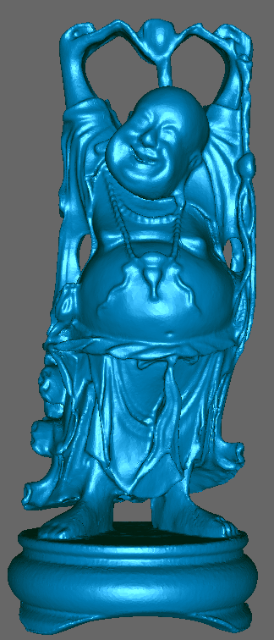
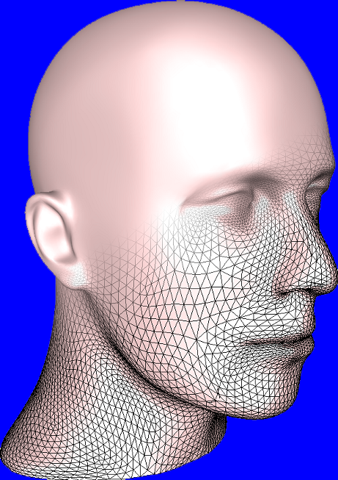
What are surfaces?
Surfaces can be
described as:
  geometry
  connectivity
  parameterization
topology
Image from Desbrun 2001

Slide 4
Determining Genus
Euler characteristic:
χ =F – E + V = 2(c-g) –b
    c: # of connected components
    b: # of boundaries
    g: genus
genus: minimum # of non-intersecting simple closed curves

Slide 5
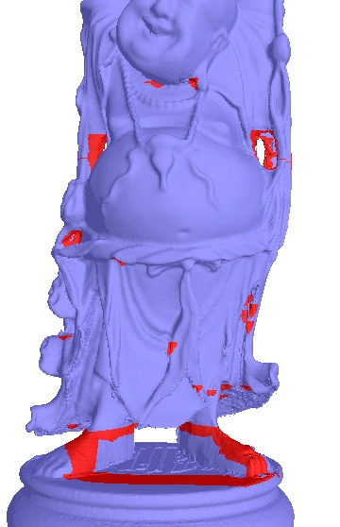
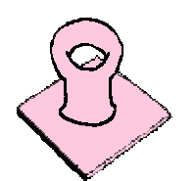
What does genus look like?
Genus is global, however…
Localize and isolate
geometric regions of
topological interest
Handles: region of
the surface with
genus = 1,
(torus with boundary)
Notes:
A handle is a topological structure which can be thought of as the object produced by puncturing a surface twice, attaching a zip around each puncture travelling in opposite directions, pulling the edges of the zips together, and then zipping up.

Slide 6
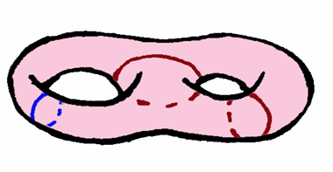
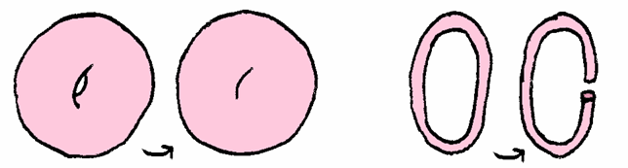
Contributions
Novel algorithms to:
  identify and isolate
  handles
  measure the
  size of handles
  simplify handles
  reconstruct handles

Slide 7
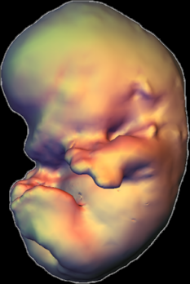
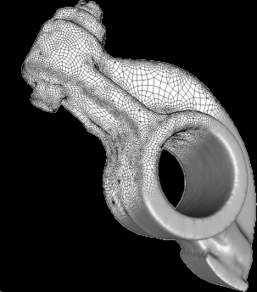
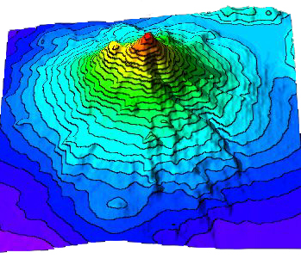
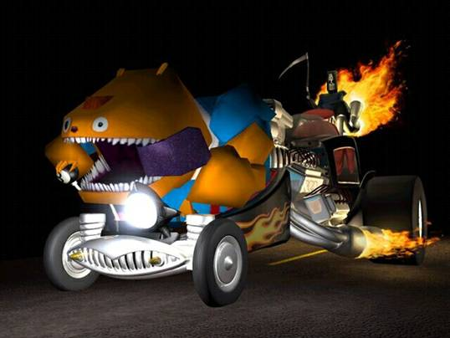
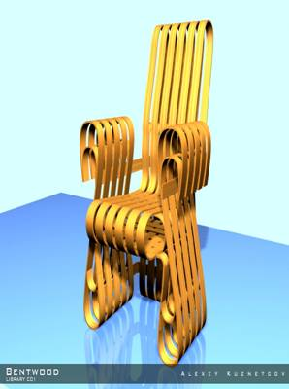
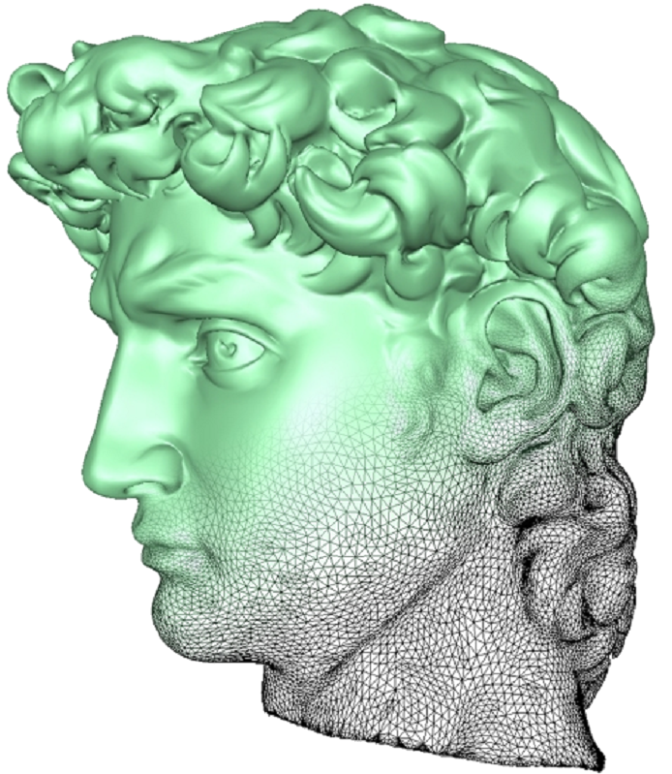
Geometric Modeling
Image from Desbrun et al. 2002
Image from Reynolds et al. 2000
Image from Desbrun et al. 2002
Medical
Art History
Engineering
Topography
Image from Grim Fandango, Lucas Arts 2002
Virtual
Worlds
games
Image from Kuznetcov 2002
Notes:
Game image from Grim Fandango by Lucas arts
Topography from ‘Virtual Topography’ Reynolds and Johnson – is Mt. Shasta in the Cascades range
Virtual worlds ‘Bentwood’ chair by A. Kuznetcov – from 3d02.com (which is a digital model subscription service)

Slide 8
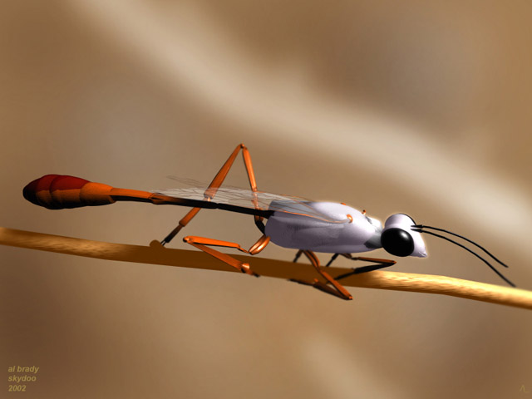
Model acquisition
How do we acquire 3D Models?
  artists
  acquired data
    laser scanners
    medical scanners
  simulations
Image from Al Brady, Skydoo 2002
Notes:
Image from Al Brady of Skydoo created using 3d studio max

Slide 9
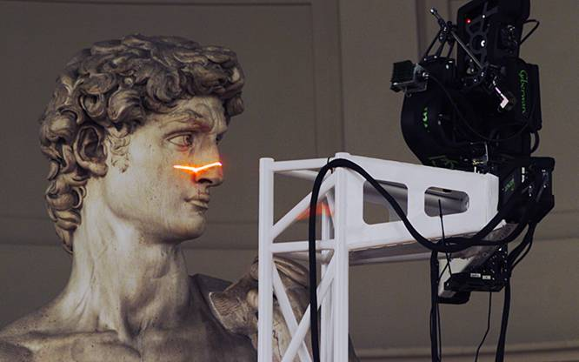
Acquired data
Scanners
  points (laser scanners, other 3d photography techniques)
  volumes
Image from Stanford Digital Michelangelo 2000
Image from Desbrun et al. 2002

Slide 10
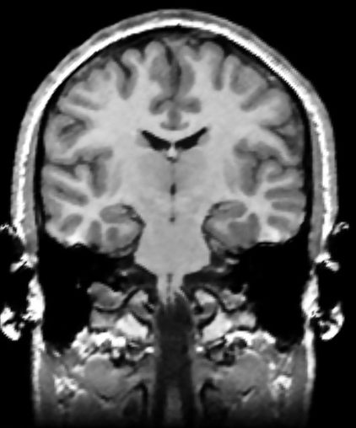
Volumes
A stack of images or grid of scalar values, compiled from:
  MRI/CT scanners
  implicit functions
  laser range
  scans

Slide 11
Geometric Models
What do we do with points or volumes?
  surfaces:
  oriented
  closed
  2-manifolds
Image from Desbrun 2001

Slide 12
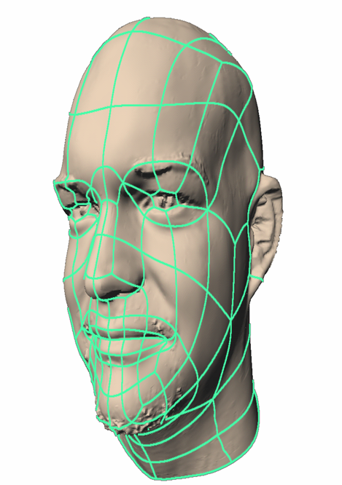
Setting I
Oriented closed 2-manifold:
  oriented: 2 sided
  closed: does not contain a boundary
  2: locally Euclidean: around every point, it appears to be planar
Manifolds are preferable
because they can be charted
to form an atlas
  like the earth
Image from Litke et al. 2001

Slide 13
Setting II
Surface: closed oriented 2-manifold, M
Discrete representation:
  triangulation
  isosurface in
  a volume

Slide 14
Triangulation
Generic term
  set of point positions P together with a complex K
    P = {{x₁, y₁, z₁}, {x₂, y₂, z_{z}}…} (geometric positions)
    K ={ {1}, {2}, {1,2},
    {1,2,3},…}
    (connectivity of vertices)

Slide 15
Isosurface in a volume
A regular 3D grid of scalar values
  for each grid point stores some scalar value, e.g., distance
  isosurface: the surface defined by a specific
  scalar value

Slide 16
What are surfaces?
Surfaces can be
described as:
  geometry
  connectivity
  parameterization
topology
Image from Desbrun 2001

Slide 17
What is topology?
The topology of a surface is characterized by:
  orientability
  number of connected components
  number of boundary components
  genus (# of handles)
genus=0
genus=1

Slide 18
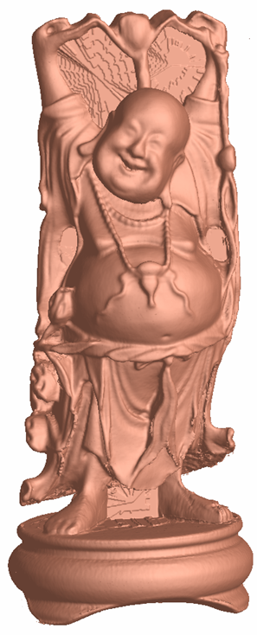
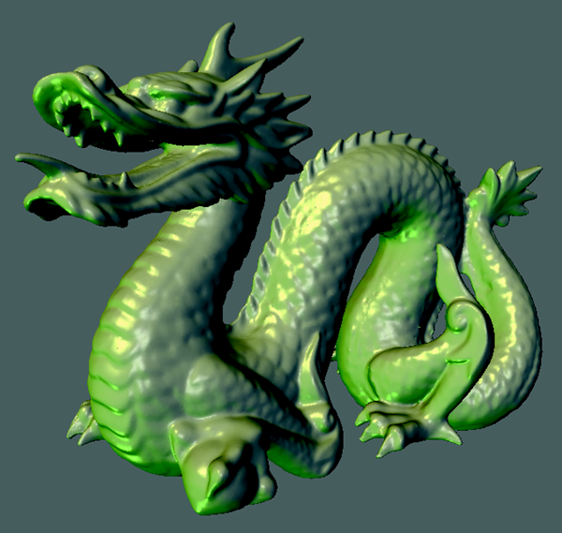
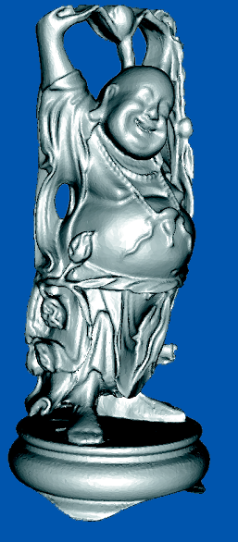
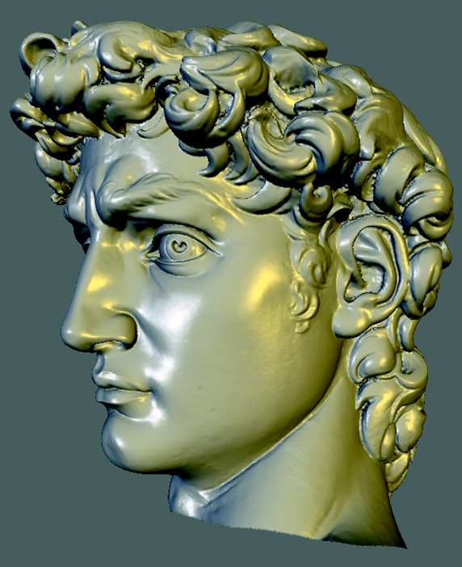
Why Topology?
Want to represent arbitrary topology
Genus 0
Genus 1
Genus 0
Genus 6

Slide 19
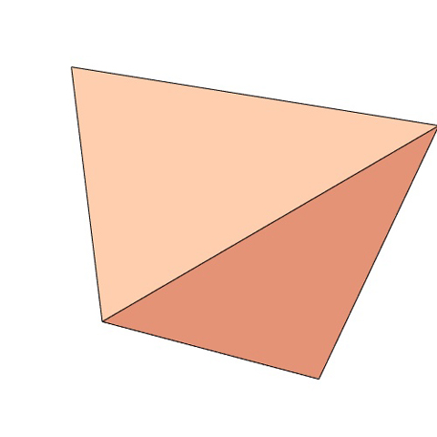
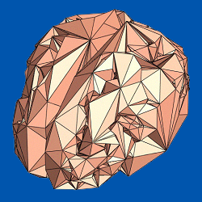
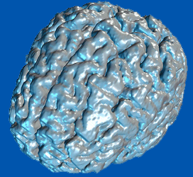
Why do we care?
Want to represent accurate topology
  a brain is a sphere
=
≠
Genus 0
Genus 366

Slide 20
Determining Genus
Euler characteristic:
χ =F – E + V = 2(c-g) –b
    c: # of connected components
    b: # of boundaries
    g: genus
genus: minimum # of non-intersecting simple closed curves

Slide 21
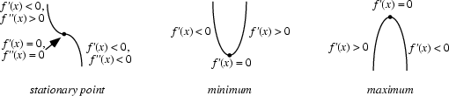
Identifying topology
Morse theory
Define a smooth function on a smooth manifold
  critical pts. of the function characterize the manifold’s connectivity

Slide 22
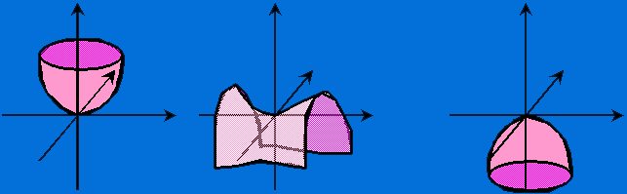
Morse theory I
Depending on the type of critical point…
  around the critical point the manifold looks like:
f=x²+y²+c
f=x²-y²+c
f=-x²-y²+c

Slide 23
Morse theory II
Between critical points the topology is guaranteed to not change
  example:
  between the
  minimum and
  the saddle point

Slide 24
Morse theory III
Geometric interpretation
  height function defines horizontal planes
  consider various tangent
  planes of the surface
  for critical points
  their tangent plane =
  horizontal plane

Slide 25
Considerations
Many more critical points than handles
Discrete setting… Can we generalize?
Wavefront traversal (Axen, Wood)
  Define a geodesic or height function f, for M

Slide 26
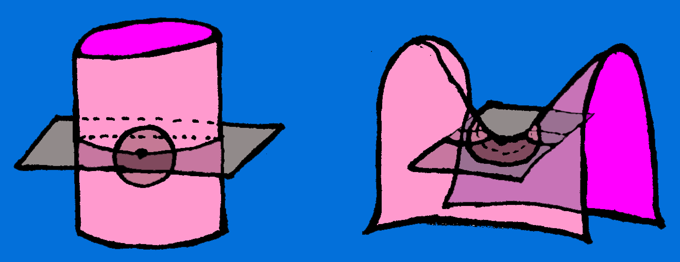
Morse theory Redux
Geometric analysis of critical points
trivial point
critical point (saddle point)

Slide 27
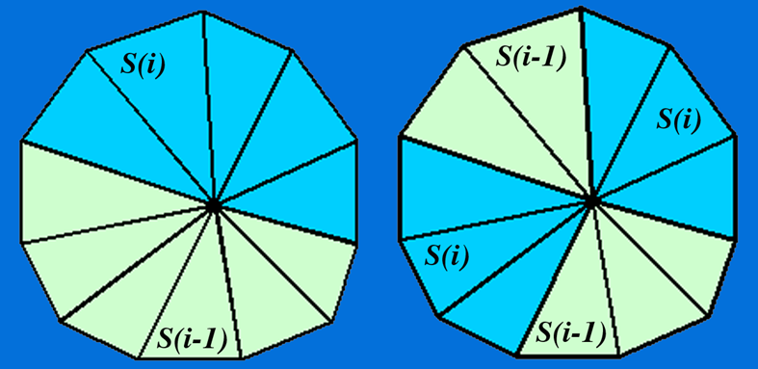
Related Work
Axen: Morse theory for discrete manifolds
  critical point analysis based on wavefront
  but there are still too many critical points – and
  we want to
  localize
  handles
trivial point
saddle point

Slide 28
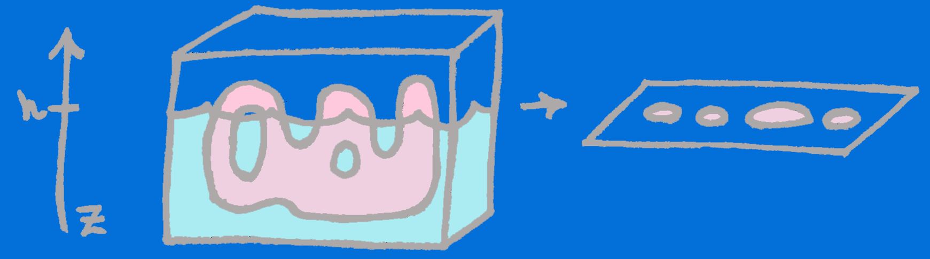
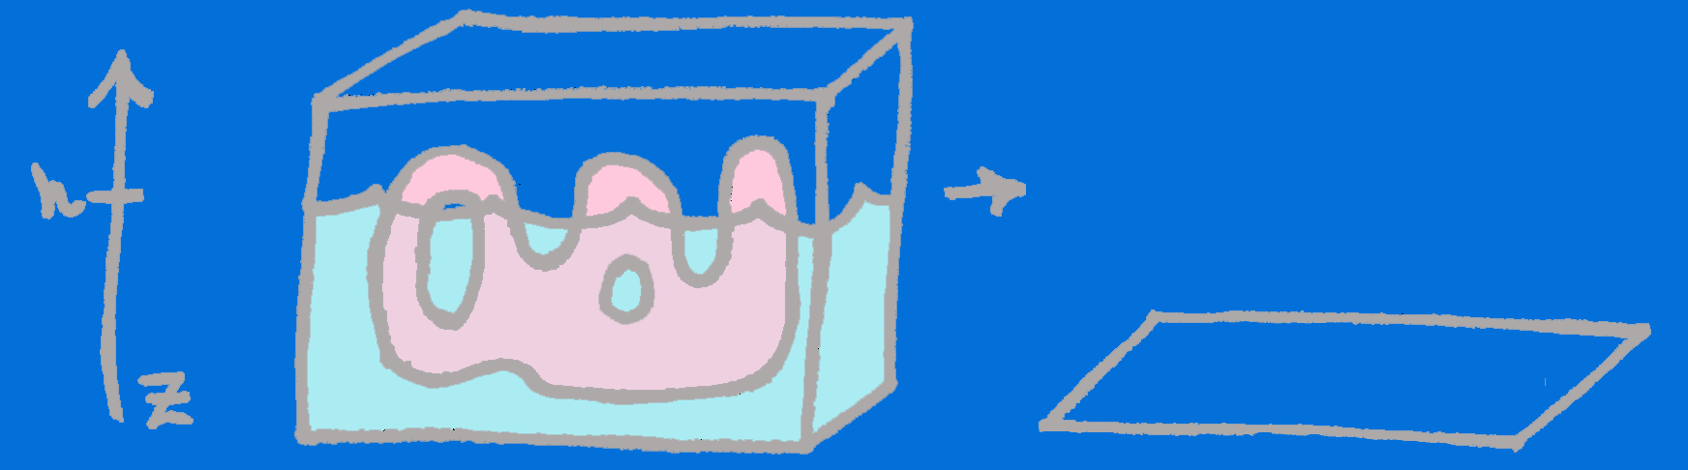
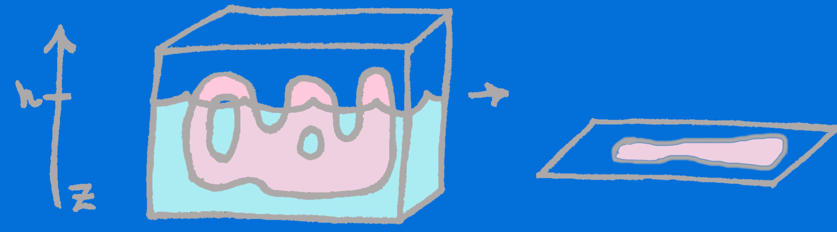
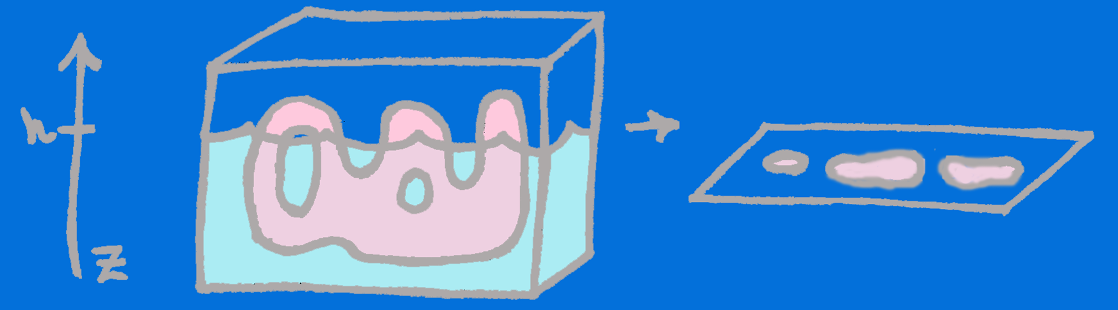
Interval analysis
Consider immersion (height fn.)
  analyze level sets
    pre-image: subset of M at height h
  topology of the level sets change

Slide 29
Identifying topology
How do changes to the topology of the level sets relate to the topology of the surface?
  level sets may be defined by different functions
  consider a function based on a face-by-face traversal
    level sets defined by adding face to the current region
Notes:
A handle is a topological structure which can be thought of as the object produced by puncturing a surface twice, attaching a zip around each puncture travelling in opposite directions, pulling the edges of the zips together, and then zipping up.

Slide 30
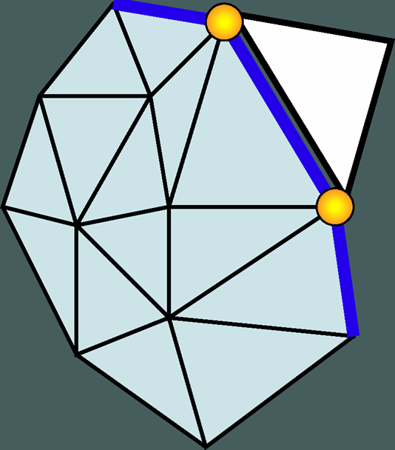
Face-by-Face traversal
Three possible operations: add-triangle, close-crack, merge-edge
Add-triangle:

Slide 31
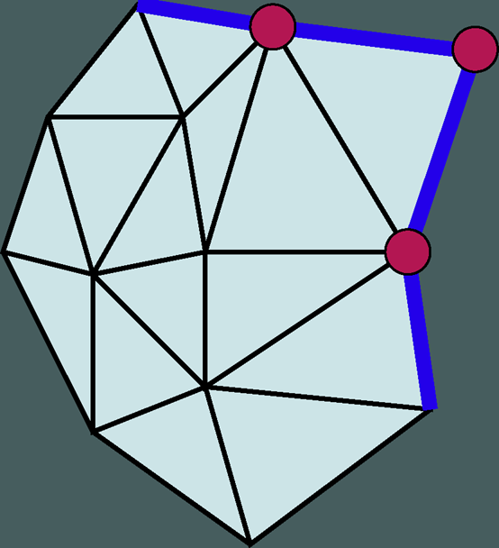
Face-by-Face traversal
Three possible operations: add-triangle, close-crack, merge-edge
Add-triangle:
Euler characteristic is
unchanged

Slide 32
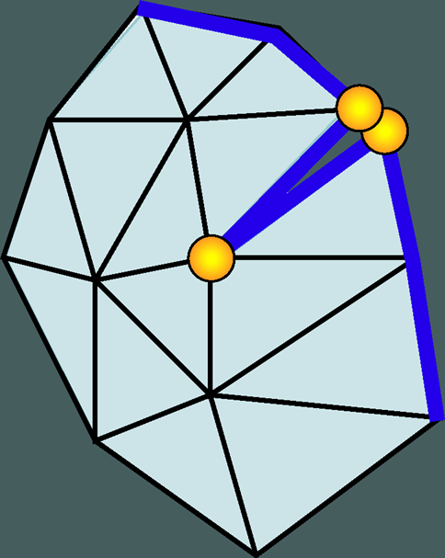
Face-by-Face traversal
Close-crack:
Account for self-adjacencies

Slide 33
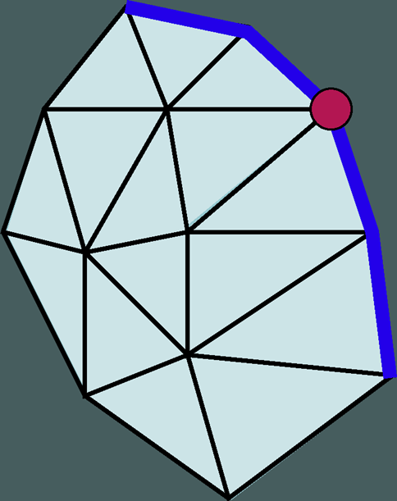
Face-by-Face traversal
Close-crack:
Account for self-adjacencies
Again Euler characteristic is
unchanged

Slide 34
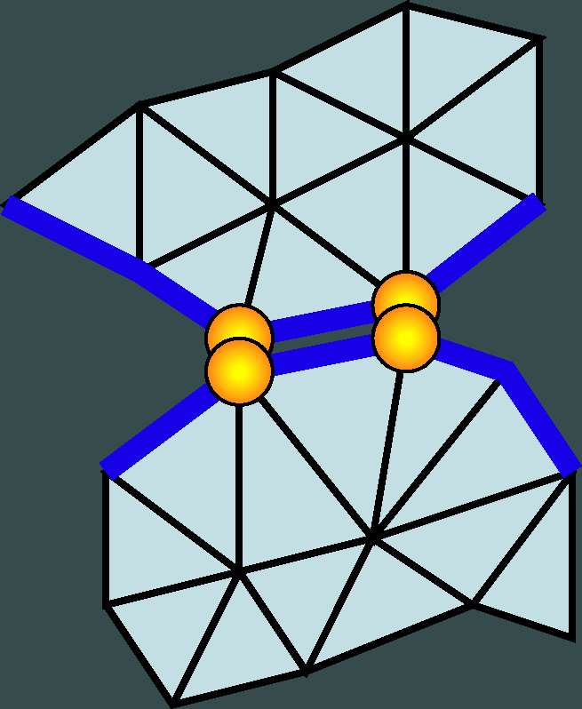
Face-by-Face traversal
Merge-edge:
Account for global adjacencies

Slide 35
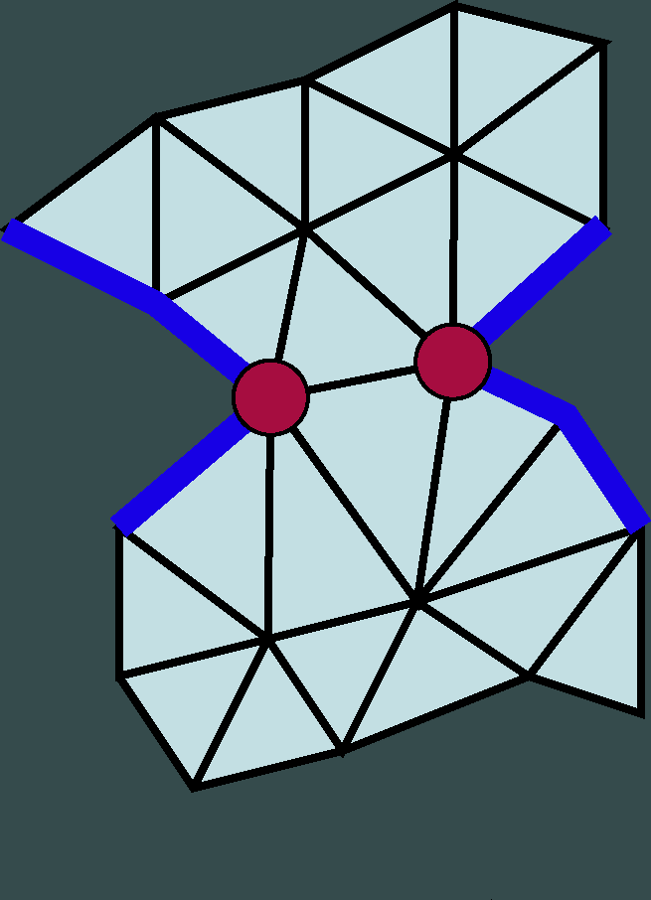
Face-by-Face traversal
Merge-edge:
Account for global adjacencies
Again Euler characteristic is
unchanged

Slide 36
Face-by-Face traversal
Merge-edge:
Account for global adjacencies

Slide 37
Face-by-Face traversal
Merge-edge:
Account for global adjacencies
Topology changes – genus
increases by one.

Slide 38
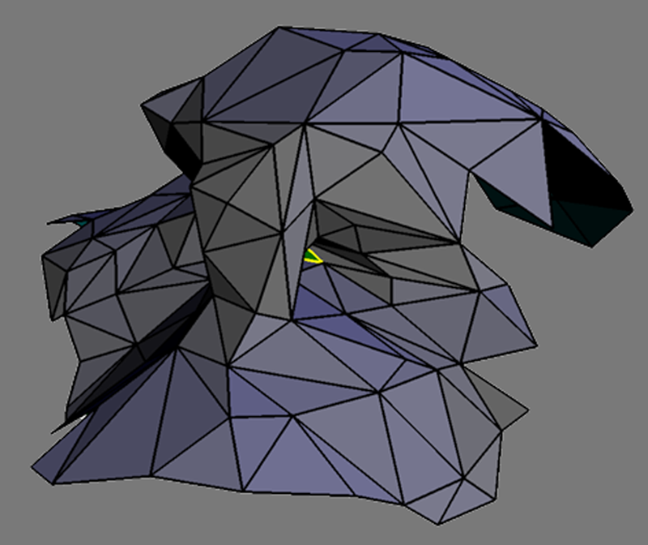
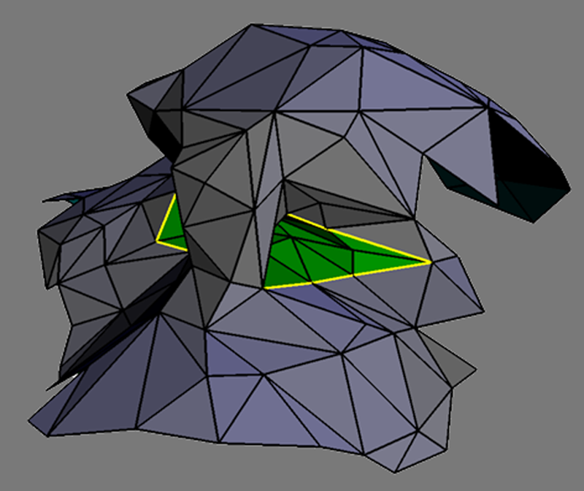
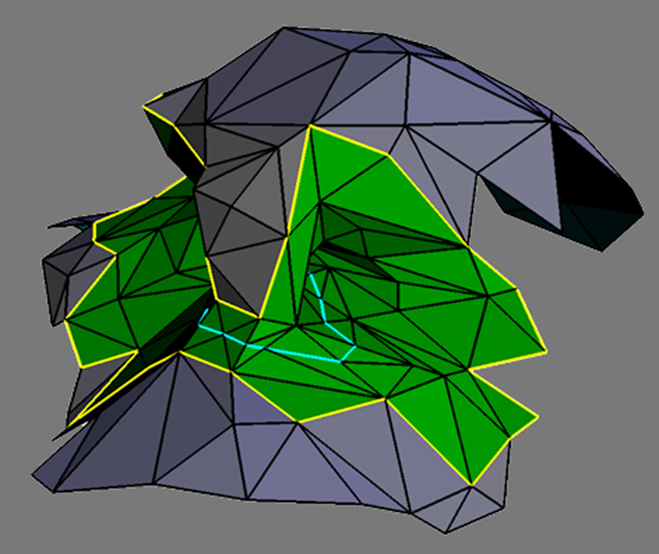
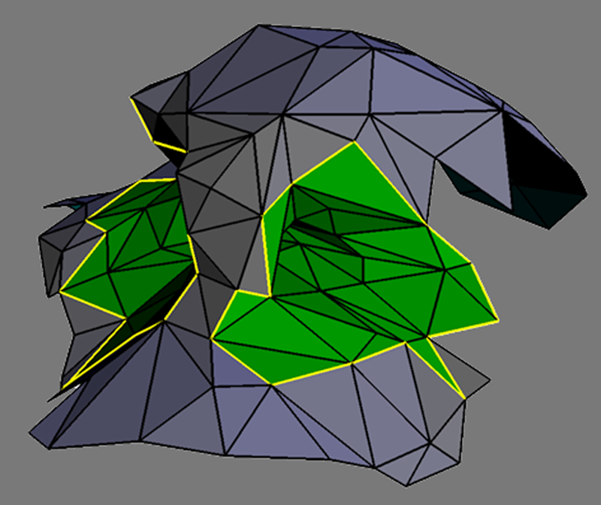
Interval traversal
Wavefront traversal (aka brush fire)
  geodesic function
  defined on the faces
  splits and merges
  of contours correspond
  to critical levels on
  the surface

Slide 39
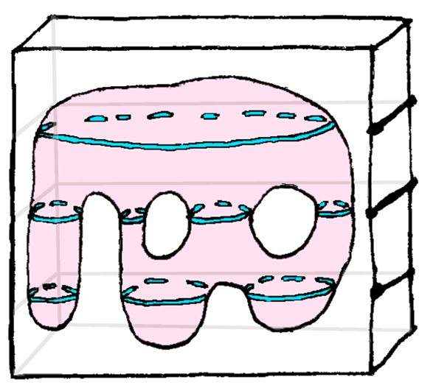
Traversal options
Triangle mesh: geodesic function
  defined on faces
Volume data: height function
  defined on volume grid
  allows for out-of-core
  traversal and coding

Slide 40
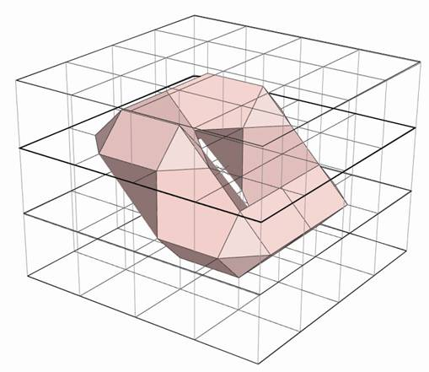
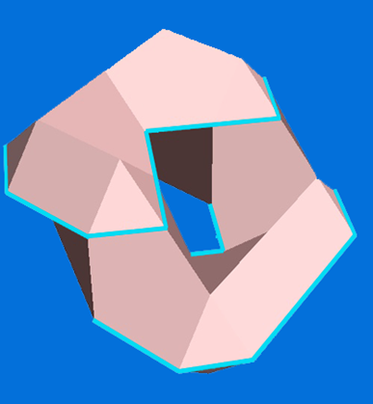
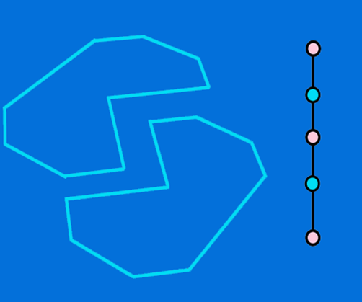
Intra-ribbon handles
Some intervals may contain handles!
Solution: keep track of the Euler Characteristic
  face-by-face traversal when necessary

Slide 41
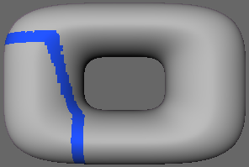
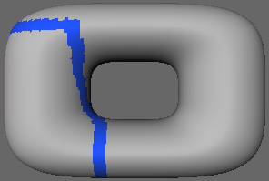
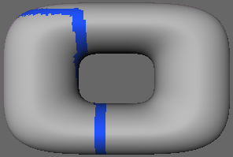
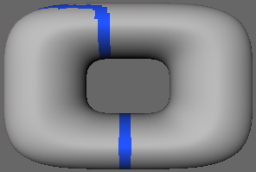
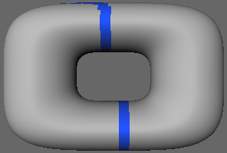



Coding level sets
Build a graph to represent the level sets
  nodes correspond to
  each contour of the
  level set
  edges represent the
  connected components
  of the surface

Slide 42
Representing topology
Traditional Reeb graph:
  nodes for critical points
  edges represent connected surface components between critical points

Slide 43

(Contour) Reeb graph
Example: If f is a height function, the Reeb graph codes the intersections of M at z intervals
Degenerate!
Degenerate!

Slide 44

Augemented Reeb graph
Code level-sets (contours) and Ribbons
  resolves ambiguous end regions
  stores additional geometric information

Slide 45

Augmented Reeb graph
Resolves degeneracies
Okay!
Okay!
Okay!

Slide 46

Representing topology
Cycles in the Reeb graph correspond to handles
  identify handles
  localize the handle
  within the surface

Slide 47

Combinatorial choices
Isolating handles is a combinatorial choice

Slide 48

Isolate handles
Cycles in the Reeb graph are geometrically succinct regions

Slide 49

Isolate handles
Explore all possible combinations for adjacent cycles
c2
c3
c1
c2
c3
c1
Isolate handles for
{c1, c2}, {c1, c3}, {c2, c3}

Slide 50

Measuring topology
For each handle we examine
  two non-separating cuts
    leave the surface
    connected
  Cutting and sealing such a loop reduces the genus of the handle
    measure length of two transverse loop

Slide 51


Measuring Topology
The loops are
  two transvers non-separating cuts
  locally minimal
  length cuts
Gives tight measure
of minimal geometric extent
of the handle

Slide 52

Finding shortest cycles
Start with arbitrary non-separating cut, L
  any contour will do
  find the shortest path from one side of L to the other

Slide 53


Tilings
In order to find the shortest overall, need to tile
  backtracking
  loops that cross L twice

Slide 54
Transverse loop
Given a shortest loop γ
  search for the shortest transverse loop from one side of γ to the other
    no need to tile
The path along γ
from a to b will
be shortest

Slide 55






Alternative Measure
Simple measure of topology
  confine traversal to ε-ball
  any handle within an ε radius would be treated as small
  repeatedly search
  the surface starting
  from different seed
  points

Slide 56


Simplify Topology
Remove topological artifacts
  scan-convert membrane into the loop to simplify
  only locally change the surface

Slide 57



Reconstruct topology
Re-sample the geometry - match global topology
  stitch together contours from critical levels
Coarse mesh must
include all the original handles

Slide 58
Why do we care?
Want to represent accurate topology
  A brain is a sphere
=
≠
Genus 0
Genus 366

Slide 59




Topological Artifacts
Error in acquisition
  sampling
  alignment
  noise
Original Buddha
reconstruction is
genus 106 – should
be genus 6

Slide 60


Artifacts II
Excess topology in isosurfaces

Slide 61



Why does this matter?
Parameterization: useful to have a mapping from 2D to 3D
  function from some region Ω ⊂ R² to the embedded surface M ⊂R³
Image from Sander et al. 2002

Slide 62




Parameterizations
Applications
  texture mapping
    piecewise linear
    interpolation of
    attributes across mesh
  resampling/remeshing
  simulation
    needs surface
    as function
Image from Guskov et al.19991
Image from Guskov et al. 2000
Image from Grinspun et al. 2001

Slide 63




Relevance
Parameterization affected by genus
  2*g cuts to decompose a surface into a disk
Images from Sander et al. 2002
353 charts
40 charts
Genus 106
Genus 6

Slide 64



Applications
Computational topology can be applied to computer graphics to enhance geometric models:
  isosurface topology simplification
  mesh topology
  simplification
  surface reconstruction
Images from Jaume et al. 2002

Slide 65


Results
Accuracy of models - consider simplified
models
2K triangle mesh
topologically
simplified Buddha
(genus 6)
2K triangle mesh
of the original Buddha
(genus 106)

Slide 66



Results
15K triangle mesh
Original data
Genus 957
15K triangle mesh
Topologically simplified
Genus 0
1 million triangles
Topologically simplified
Genus 0

Slide 67


Results
Dragon remesh: regular
quad mesh and geometry
image
Images from Gu et al. 2002

Slide 68

Results
Cortex labels transferred from one brain to the next using the clean
volume (Cortex labeling (Jaume et. Al.))
Images from Jaume et al. 2002

Slide 69
Related work
wavefront traversal (Axen)
global changes: simplification and smoothing (volume:Noorudin & Turk, surfaces: Hoppe et. al)
simplifying within alpha sphere (El-Sana et. al.)
cut-graphs(Lazarus, Erickson et. al, Gu et. al.)
identify topology with alpha-complexes (Zomorodian et. al)

Slide 70
Contributions
Identify & localize topology
  robust traversal tuned for discrete setting
  augmented Reeb graph for handle isolation

Slide 71
Contributions
Identify & localize topology
Measure
  locally shortest length non-separating cuts

Slide 72
Contributions
Identify & localize topology
Measure
Simplify topology
  simple method tuned to volume or mesh
  out-of-core method for volume data

Slide 73
Previous Contribution
Identify & localize topology
Measure
Simplify topology
Reconstruct topology
  coarse mesh construction

Slide 74
Future exploration
Topologically restricted surface reconstruction (segmentation)
Alternative loops and cutting criteria for parameterization
Exploring (graph) representations of topology for time varying data

Slide 75
Thank you

Slide 76
Tilings
In order to find the shortest overall, need to tile

Slide 77
Some loops
consider

Slide 78
Papers
Wood, Z., Desbrun, M., Schröder, P., and Breen, D.; Semi-regular mesh extraction from volumes. Proceedings of Visualization. 275--282. (2000).
Guskov, I. and Wood, Z.; Topological noise removal. Graphics Interface, 19--26. (2001).
Wood, Z., Hoppe, H., Desbrun, M. and Schröder, P. Isosurface Topology Simplification.(submitted). (2002).

Slide 79
Definitions
Genus:A topologically invariant property of a surface defined as the largest number of nonintersecting simple closed curves that can be drawn on the surface without separating it. Roughly speaking, it is the number of holes in a surface.
Hole: A hole in a mathematical object is a topological structure which prevents the object from being continuously shrunk to a point.

Slide 80
Morse Theory
Critical point = gradient = 0 (all partials are null)
rank of Hessian = which kind of critical point (index) (#of non-zero sing. values (linearly ind. rows/col.))
Non-full rank = degenerate c.p.

Slide 81

Simplicies
Simplex is the convex hull of a set of affine independent points
0-simplex (vertex)
1-simplex(edge)
2-simplex (triangle)
Face: subset of a simplex

Slide 82
Simplicial complexes
A simplicial complex is a finite collection K of simplices such that
  Every face of a simplex K is in K
  The intersection of any simplices in k is a face of each of them
Not a Simplicial
complex
Simplicial
complex

