Slide 1
Inter-Surface Mapping
John Schreiner, Arul Asirvatham, Emil Praun (University of Utah)
Hugues Hoppe (Microsoft Research)
Notes:
Hi, I and John will be presenting our work on inter surface mapping. This work was done with Emil Praun at University of Utah and Hugues Hoppe at Microsoft Research.

Slide 2
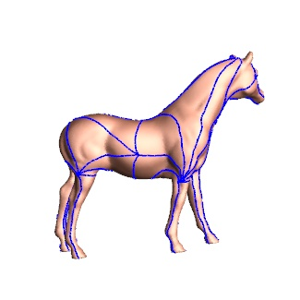
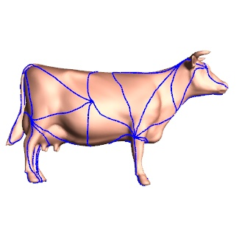
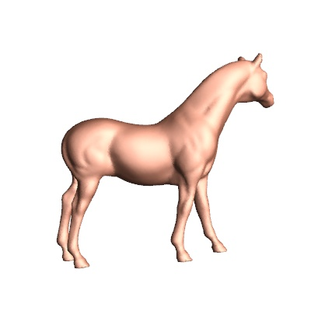
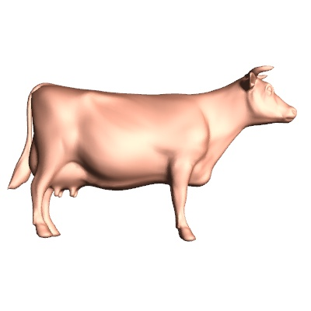
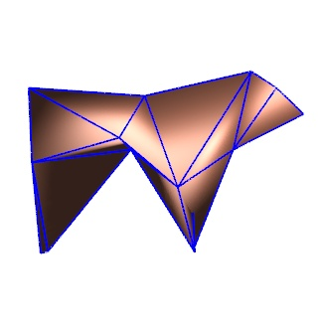
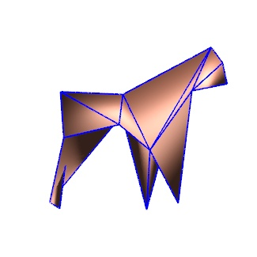
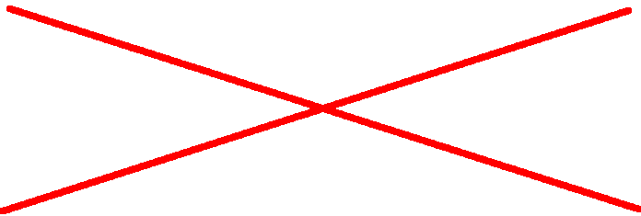
Introduction
No intermediate domain
  Reduced distortion
  Natural alignment of features
Notes:
We consider the problem of creating a map between 2 arbitrary surfaces of the same topology.
Earlier methods try to find a mapping from one surface to another by composing maps to simplicial base domains. Unlike these methods, we compute a direct map between two models without going through an intermediate base domain.
Using an intermediate domain may result in a poor intersurface map since each sub map ignores the non uniform distortion in the other. For eg when creating a map between a cow and a horse, the cow’s legs would not be encouraged to match with the horse’s legs. Since we do not use an intermediate domain, our map has reduced distortion. The main advantage of such a map is that it naturally favors feature alignment, allowing the user to specify very few correspondences.

Slide 3
Motivating Applications
Morphing
Digital geometry processing
Transfer of surface attributes
Deformation transfer
Notes:
Such a map would enable numerous applications including morphing, digital geometry processing, transfer of surface attributes, principal component anaylsis and deformation transfer.

Slide 4
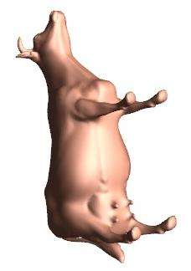
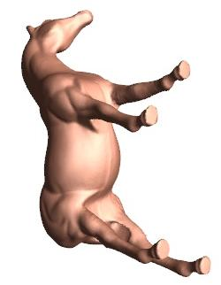
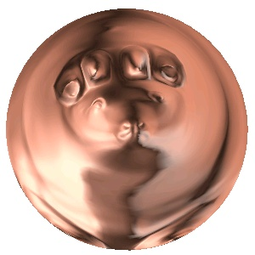
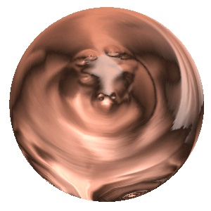
Related Work – Alexa 2000
≡
Composition of 2 maps
Only for genus 0 objects
Soft constraints
Notes:
Alexa’s method computes an intersurface map between two surfaces by parameterizing the meshes onto a unit sphere and combining the two maps. Feature correspondences are satisfied by deforming the embedding on the sphere.
Since the sphere is used as intermediate domain it works only for genus 0 objects.
It is not guaranteed to satisfy the constraints and the method is not very robust.

Slide 5
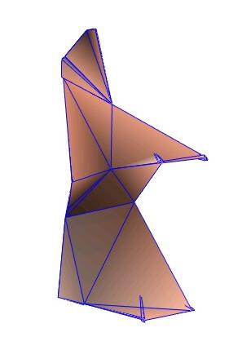
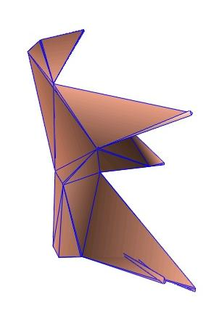
Related Work – Lee et al 1999
Composition of 3 maps
Significant user input required
Notes:
Lee et al create an inter-surface map between two surfaces by first constructing simplicial parametrizations from the two original meshes to their respective base domains. They define the intersurface map as the composition of the these simplicial maps and maps b/w the 2 base domains. Because the domain meshes D1, D2 are different, user assistance is required to form a good map between them, and this map construction is not robust.
This method supports hard constraints by using the feature correspondences as patch corners.

Slide 6
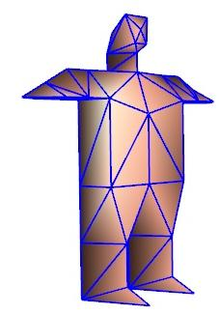
Related Work – Praun et al 2001
Robust mesh partitioning for genus 0
Requires user-defined simplicial complex
Notes:
Praun et al develop a simplicial parameterization method in which the connectivity o the simplicial complex can be specified a priori. Given a simplical complex and a set of meshes they construct consistent parameterizations over this shared simplicial complex. Because of the common base domain they can parameterize any number of models consistently. Their method works works robustly on genus 0 objects and produces reasonably good maps even between objects of different geometries.
One drawback is that this method requires a user-defined simplicial complex. Another drawback of this method is that the structure of the simplicial complex restricts the freedom of the parameterization.

Slide 7
Related Work – Kraevoy et al 2004
Simplicial complex inferred automatically
(robust for genus 0)
Composition of 2 maps, and optimization
Needs more correspondences
Notes:
The last talk in this session also deals with the same problem. They infer the simplicial complex automatically by consistently partitioning the meshes into triangular patches and using its connectivity. However their mesh partitioning method is robust only for genus 0 objects.
They construct the intersurface map by composing the two maps from the original meshes to this simplicial complex. They smooth the maps from the meshes to the simplicial complex to reduce the distortion of the combined parameterization. There method is fast and can be used to consistently parameterize more than 2 models.
However, there method requires more feature correspondences compared to our work.

Slide 8
How Is Our Method Different?
Directly create inter-surface map
  Symmetric coarse-to-fine optimization
  Symmetric stretch metric
→ Automatic geometric feature alignment
Robust
  Very little user input
  Arbitrary genus
  Hard constraints
Notes:
Our work tries to construct a high quality map between the surfaces with minimal user input.
We do this by directly creating and optimizing a map between the two meshes without using an intermediate domain.
We measure the map distortion using a new symmetric metric. This leads to natural alignment of features requiring the user to provide fewer correspondences.
Our method is robust and works even with a very few user specified constraints. It works robustly even on models with high genus and satisfies the hard constraints exactly.

Slide 9
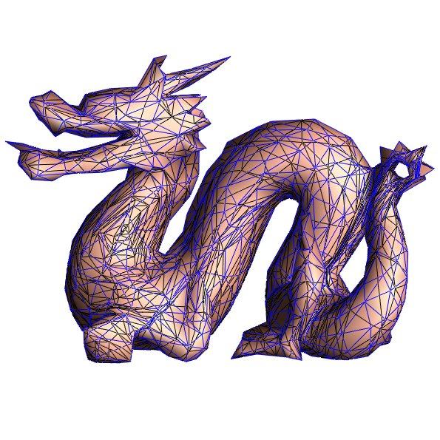
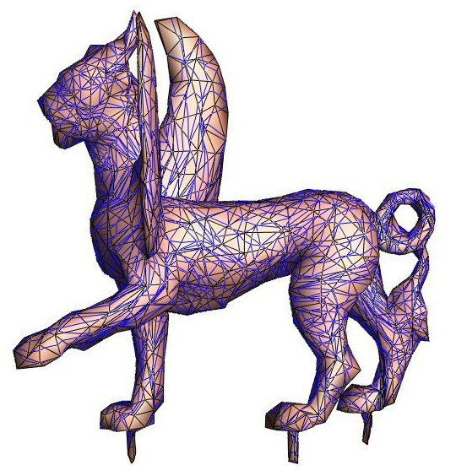
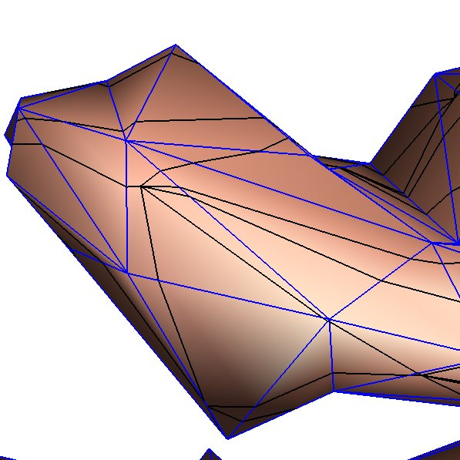
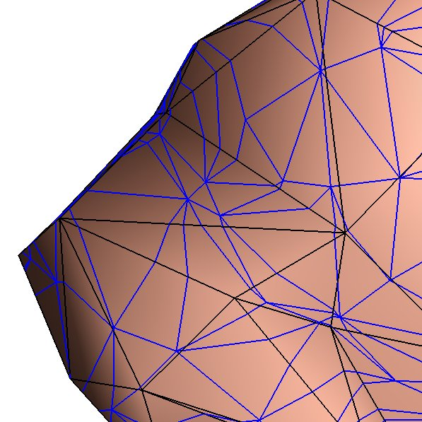
Map Representation
Vertices: Face, barycentric coordinates within face
Edge-edge intersections: split ratios
Notes:
Our output is a mutual tessellation of the two surfaces which include vertices of both the initial meshes as well as vertices formed by edges of one mesh intersecting with those of the other.
Here we show the meshes of the feline on the dragon and vice versa.
For each vertex we record the face of the other mesh to which it maps and the barycentric co-ordinates within that face.
For each edge-edge intersection we record the two ratios formed by the split point on each edge.

Slide 10
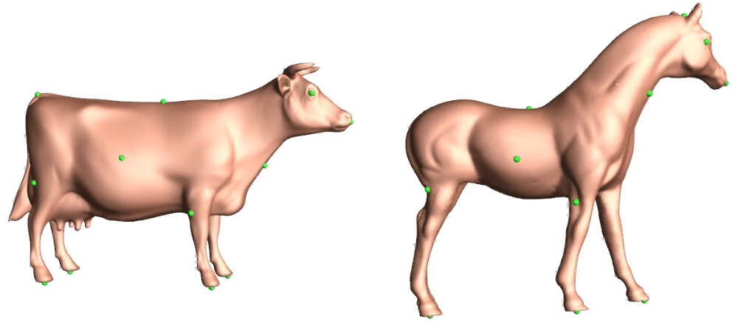
Algorithm Overview
Consistent mesh partitioning
Constrained Simplification
Trivial map between base meshes
Coarse-to-fine optimization
Notes:
Our algorithm works as follows:
First, the two meshes are consistently partitioned into a set of triangular patches. If user specified features are provided, these are chosen as the path endpoints.
In the 2nd step, we create progressive mesh representations of both the meshes, resulting in 2 base meshes with identical connectivities. The edge collapse sequence must preserve the topology of the paths. After step 2, we have a trivial 1-1 map on the 2 base mesh vertices. Finally we do a coarse to fine optimization, wherein after each vertex split, we update the inter surface map and optimize the parameterization of the local neighborhood.
We will now talk about each of these steps in more detail

Slide 11
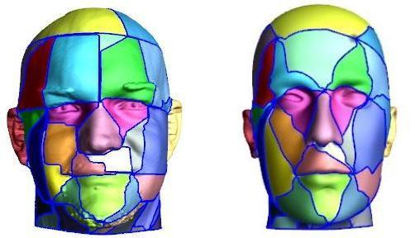
Consistent Mesh Partitioning
Compute matching shortest paths
(possibly introducing Steiner vertices)
Add paths not violating legality conditions
Notes:
We first compute the shortest path from each vertex to neighbors.
We keep adding paths in increasing order of length that do not violate the legality conditions on either mesh till the meshes are completely triangulated.
/*
Sometimes it might not be possible to like 2 feature vertices because of paths already added to the network. In such cases we introduce steiner vertices. Note that in our method it is always possible to link 2 vertices using steiner vertices. Our scheme does dijksta search on both mesh vertices and edge mid points. This corresponds to steiner vertices.
*/

Slide 12
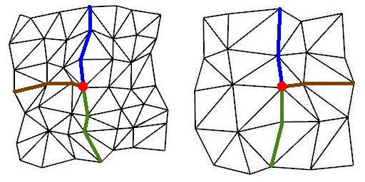
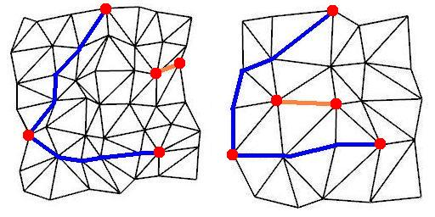
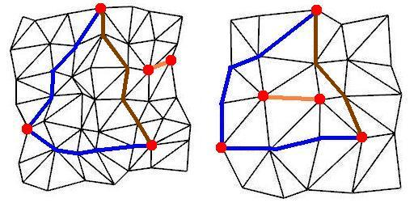
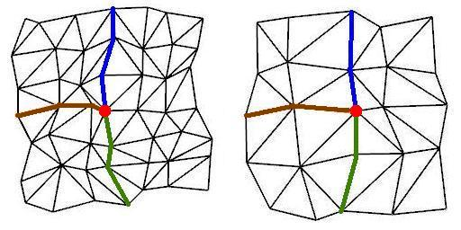
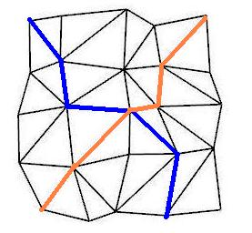
Legality Conditions
Paths don’t intersect
Consistent neighbor ordering
Cycles don’t enclose unconnected vertices
  build maximal graph without sep cycles
    genus 0: spanning tree
    genus > 0: spanning tree + 2g non-sep cycles
Notes:
Our first condition is that paths on either mesh should not intersect each other. If the path being added intersects any of the paths already in the network we simply trace another path between the vertices that does not intersect any of the existing paths.
The 2nd condition is that the ordering of paths around a vertex should be the same on both meshes. For eg the configuration shown is invalid because the ordering of paths around a vertices is different on the 2 meshes. If the brown path on the mesh on the right were redrawn as shown in the figure, we would get a valid configuration.
The final condition is that cycles should not enclose unconnected vertices as this might isolate the vertices from the rest of the network. In the eg shown, the two vertices linked by the orange path are enclosed on different sides of the cycle on the 2 meshes.
To avoid this, it is enough to build a maxmimal graph without any separating cycles. A separating cycle is one that breaks the surface into 2 disjoint components. For genus 0 objects, Praun et al observe that it is enough to build a spanning tree of the vertices before closing any cycle. For higher genus, we complete the 2g non separating cycles and the spanning tree before completing any separating cycle. We have more details in the paper.
Our first condition is that paths shouldn’t intersect each other. We enforce this by checking whether a path being added intersects any path already in the network. If so, we recompute the shortest path between the 2 corresponding vertices and add it back to the queue.
The 2nd condition is that the ordering of paths around a vertex should be the same on both meshes. While adding a path we check whether it is starts and ends in the same sector on both the meshes. If not, we trace the shortest path between the two vertices again and add it back to the queue. Since we do our search on both mesh vertices and edge mid points it is always possible to link the two vertices.
The final condition is that cycles should not enclose unconnected vertices as this might isolate the vertices from the rest of the network. This corresponds to building a maxmimal graph without any separating cycles. A separating cycle is one that breaks the surface into 2 disjoint components. For genus 0 objects, Praun et al observe that it is enough to build a spanning tree of the vertices before closing any cycle. For higher genus, we complete the 2g non separating cycles and the spanning tree before completing any separating cycle. We have more details in the paper.

Slide 13
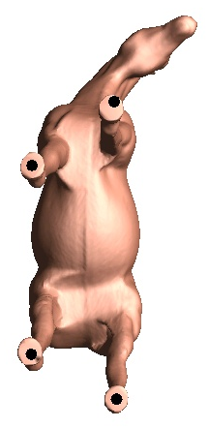
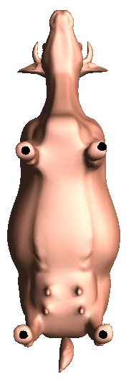
Minimal User Input
Few user-specified features
Useful for initial alignment
Not maintained during optimization
2
1
1
2
4
3
4
3
Notes:
The first phase of our algorithm i.e consistent partitioning needs very mininmal user input.
Also since we directly minimize the distortion of the inter surface map unlike in previous methods, the features match quite well.
We ask the user to provide a few feature points for initial alignment. These feature constraints need not be maintained during the optimization.

Slide 14
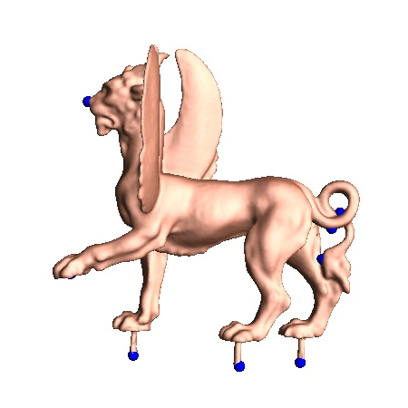

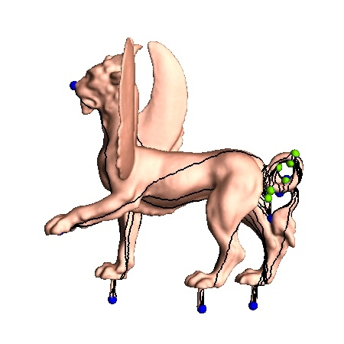
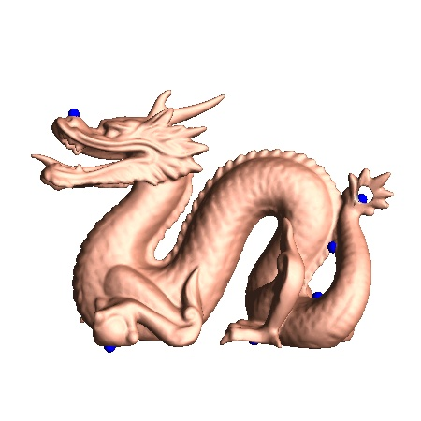
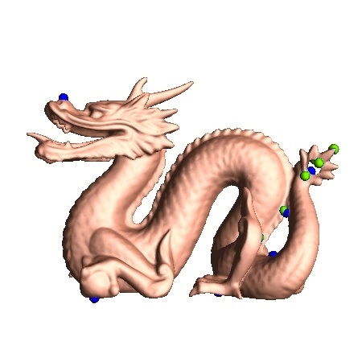
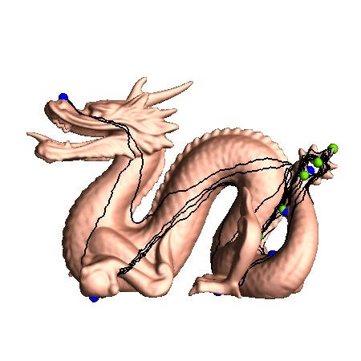
Automatic Insertion Of Feature Points
Add features if not enough to resolve genus
Notes:
In some cases, the number of feature points specified by the user is not enough to resolve the genus of the object. For eg. In case of genus 1 objects, the user needs to specify at least 7 feature points. In such cases we automatically add more feature points. We give details on this in the paper.
For the eg shown above we punched a hole in the dragons tail. The user specified 8 feature points – 4 at the bottom of the legs, 1 on the nose and 3 on the tail. The rest of the features were added automatically by our algorithm

Slide 15

Coarse-to-Fine Algorithm
Interleaved refinement
Vertex optimization
Notes:
Once both the meshes have been consistently partitioned and simplified, we can define the initial map. This is trivial to do since both the base meshes have the same connectivity and corresponding vertices. In this case, the initial map is between two tetrahedrons. <click> We then do an interleaved coarse-to-fine refinement of both models until both are at their full resolution, updating the map along the way.
When a new vertex is introduced during the refinement, we optimize it by moving it on the surface of the other mesh to minimize the distortion metric, and then optimize its neighbors. We also do occasional global passes over all of the vertices.

Slide 16
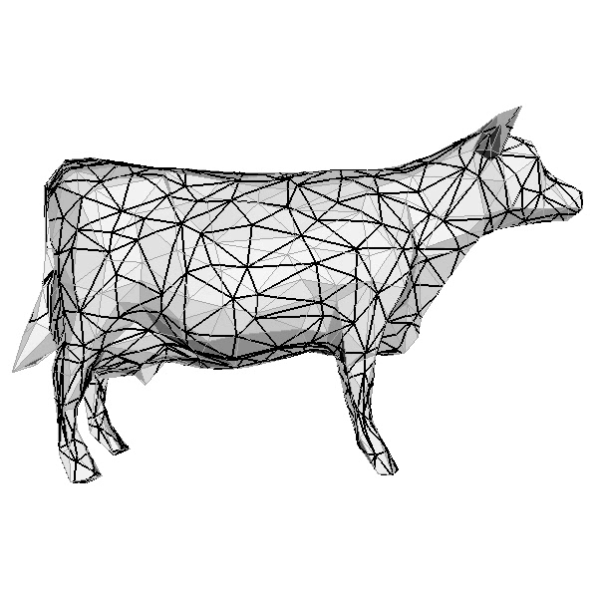
Vertex Optimization
Notes:
Here we show an example of a single vertex optimization. The light grey edges are those of the cow, and the black edges are the images of the edges of the horse on the cow. <click>
We optimize a vertex of the horse by moving it on the surface of the cow within its 1-ring neighborhood, shown in green.

Slide 17
Vertex Optimization
~
M¹
w
~
v’
~
u
~
v
M²
w
v
u
Notes:
Suppose we want to optimize the location of a vertex V of mesh M2 on <click> mesh M1.
The inter-surface map gives us the image of the 1-ring neighborhood of V, as it appears on M1. <click>
The inter-surface map also gives us the image of the part of M1 that lies inside this neighborhood, mapped back to M2. <click>
When a new location for the vertex is selected <click>, the inter-surface map is updated, and the image of each mesh on the other is changed. <click>
In order to guarantee that the map remains a bijection throughout the vertex optimization, we use a temporary 2d parameterization of the neighborhood.

Slide 18
2D Layout
^
w
I
I
R²
~
R²
M¹
w
~
u
~
v
^
^
v
u
M²
w
v
u
Notes:
We create the 2D parameterization by first laying out the neighborhood of V using the image of its edges on M1. <click>
Next we use the barycentric coordinates in our map representation to map the vertices and edges of M1 to 2D. <click>
Since the edge crossings within the neighborhood will be recalculated, we straighten the edges of M1. <click>

Slide 19
Line Searches
I
M¹
R²
M²
Notes:
We then do multiple line searches within the kernel of the boundary of the 2D parameterization. At each location during the line searches, we update the map by finding the new barycentric coordinates for the vertices and recalculating all the edge-edge intersections. This updates both the image of M1 on M2 and the image of M2 on M1 inside the neighborhood.

Slide 20
Stretch Evaluation
I
M¹
R²
M²
Notes:
To calculate the stretch at each location during the line searches we apply constrained delaunay triangulation to the overlay of the two meshes in 2D. <click>
We carry this triangulation back to both surfaces, <click> giving corresponding pairs of triangles <click>, which are simple to calculate the stretch for.
We then sum the stretch over all the triangles within the 1-ring neighborhood.

Slide 21
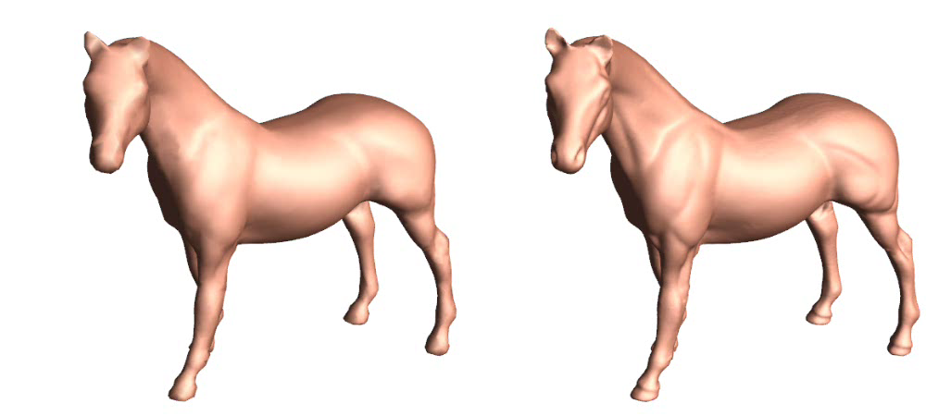
Stretch Metric
Automatically encourages feature correspondence
Conformal
Stretch
Notes:
All of our examples use a stretch metric, but we also experimented with a conformal metric. The conformal metric is less sensitive to differences in geometry and does not lead to natural correspondence of major geometric features. Using one feature correspondence at each hoof, on the left is a map computed using the conformal metric and on the right using our symmetric stretch metric. In case of the conformal metric, the whole head of each animal is mapped to a very small region on the neck of the other. The stretch metric was not only able to bring the heads into correspondence, but also matched the horse’s ears to the cow’s horns in this example.

Slide 22
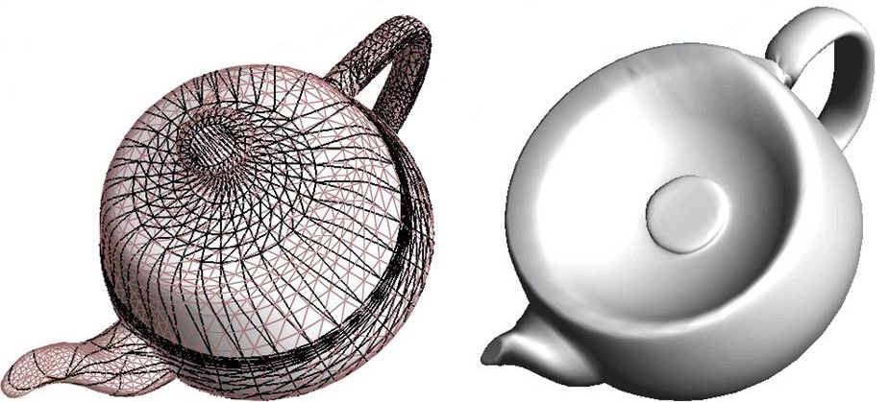
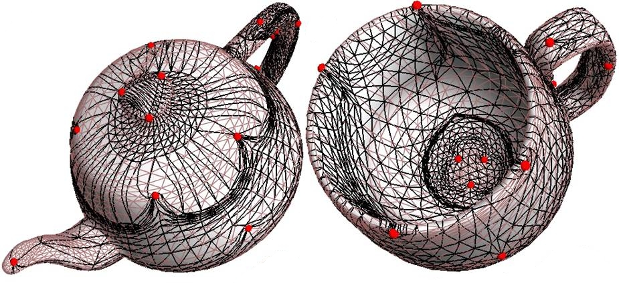
Results: Inter-Surface Mapping
Notes:
Here we see an example using two genus one objects.
Because the interior of the cup has much more surface area than the teapot lid, it flows around the feature constraints located on the teapot rim.
<click>
Here we see what happens if the features are only used to initialize the map, and are not treated as constraints. As you can see the interior of the cup unfolds nicely down the side of the teapot. On the right is a 50% morph demonstrating this inter-surface map.

Slide 23
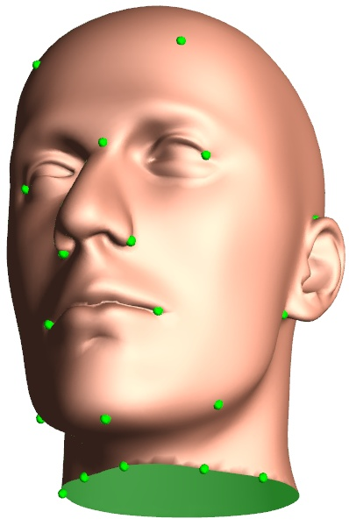
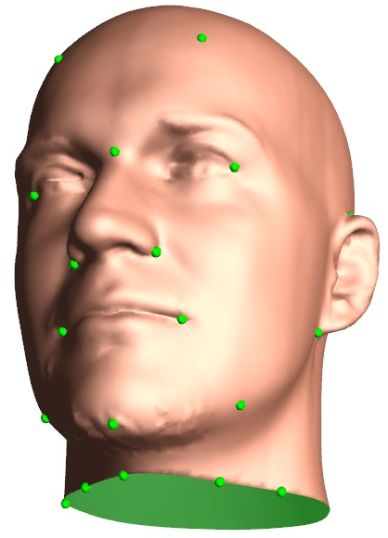
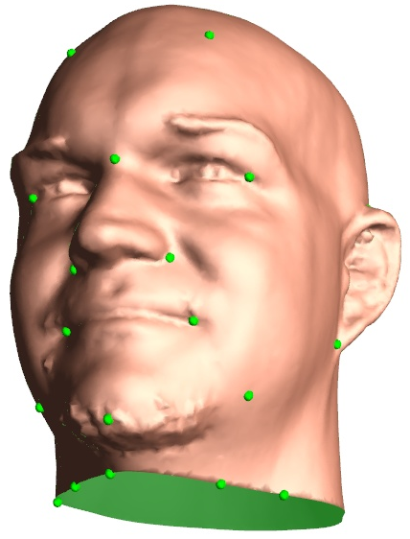
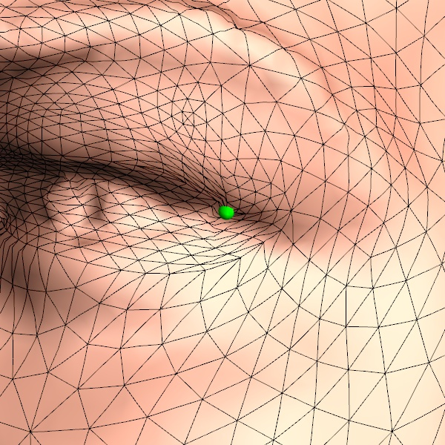
Results: Inter-Surface Mapping
Low distortion around hard constraints
Notes:
Here we have an inter-surface map between the mannequin head and a scanned head, with a 50% morph drawn between them. The close-up on the eye shows that there is very little distortion around point constraints when they are reasonable.

Slide 24
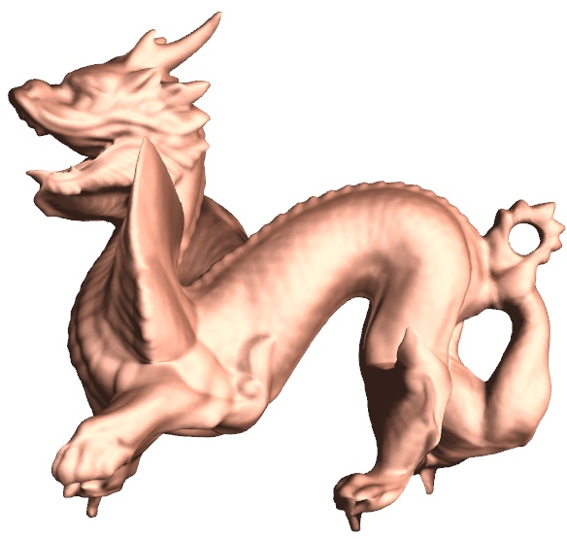
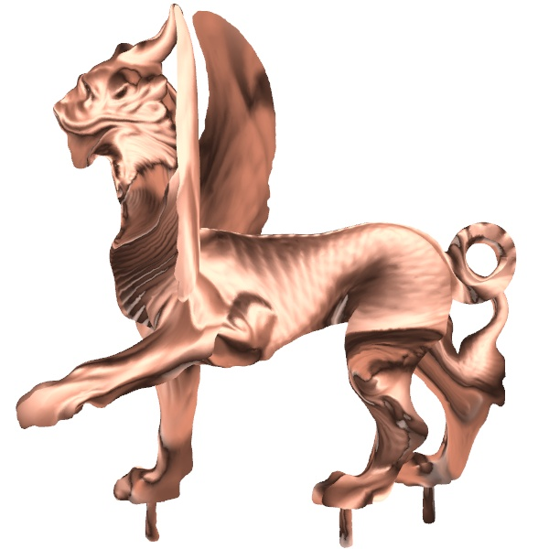
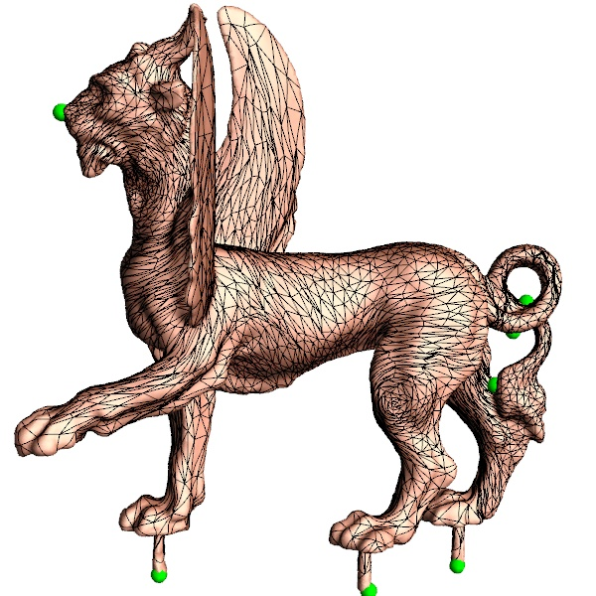
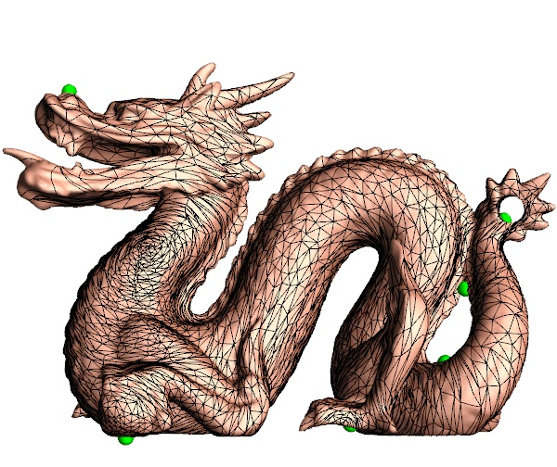
Results: Inter-Surface Mapping
Arbitrary genus (genus 2; 8 user feature points)
Notes:
Here we show an example of the map created between two genus 2 objects. You can see the left wing of the feline flattened on the neck of the dragon, and the spike at the left-rear knee of the dragon flattened near the knee of the feline. <click>
On the left we show the map with a 50% morph, and on the right we demonstrate attribute transfer, drawing the geometry of the feline drawn with the normals of the dragon.

Slide 25
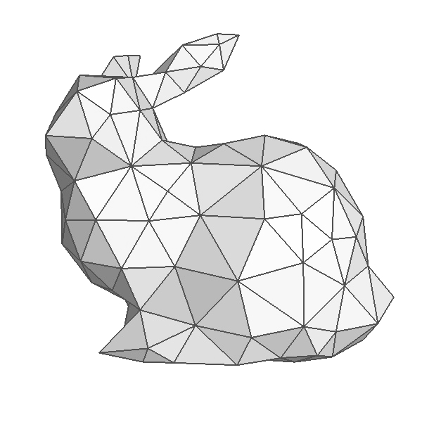
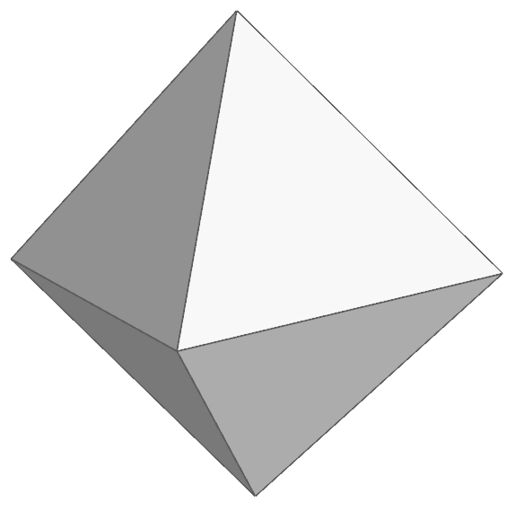
Additional Applications
Simplicial parameterization
Spherical geometry images
Toroidal geometry images
Notes:
Though our algorithm was initially intended to create an inter-surface map between two high-resolution models, we can also apply it to several other scenarios.
We do simplicial parameterization by mapping a surface to a coarse version of itself, which allows high quality resampling of the surface.
We can map a surface to a regular octahedron, which can be unfolded to create a geometry image of a genus-0 object.
We can also map a surface to a torus with the connectivity represented here, which can be unfolded to create a geometry image of a genus-1 object.

Slide 26
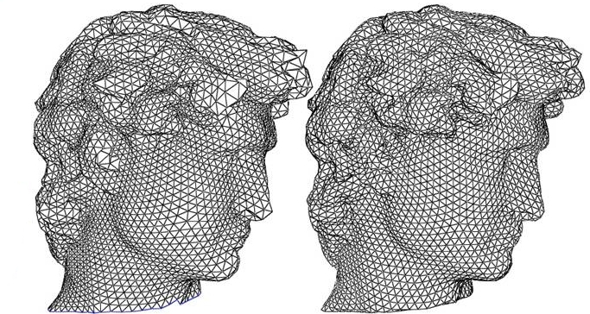
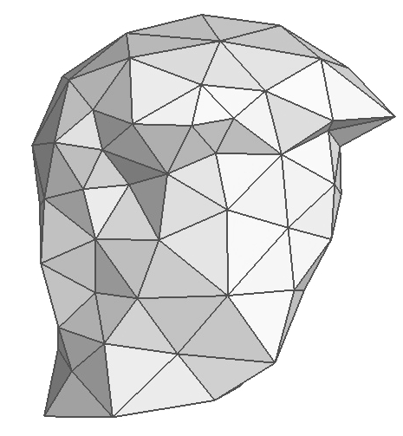
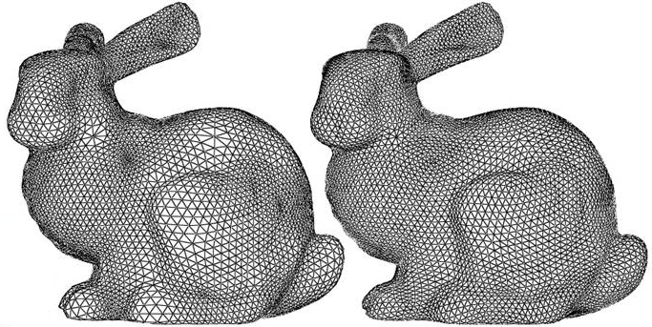
Results: Simplicial Parameterization
M¹
[Khodakovsky et al ’03]
Ours
Notes:
Our framework can easily be used for simplicial parameterization. To do this, we use the connectivity of M1, but consider its triangles to be equilateral during vertex optimizations. By doing this, we treat the base domain as if it were an abstract simplicial complex. After we map the surface to this base domain, we create a remesh by uniformly sampling the surface across each base domain triangle.
Here we show a comparison with the method of Khodkovsky et al. The figure on the left is a remesh using the globally smooth parameterization method and the figure on the right uses our method. <click>
The globally smooth method compresses the resulting remesh in the vicinity of low valence base domain vertices, and expands it near high valence vertices. However, our method is visually smooth everywhere and the extraordinary domain vertices have much less influence on the parameterization uniformity.

Slide 27
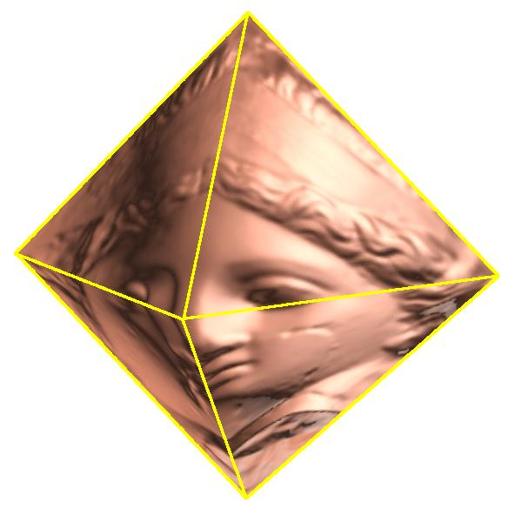






Results: Octahedral Parameterization
[Praun and Hoppe 2003]
M¹
M²
better parametrization efficiency
more accurate remesh
Notes:
Praun and Hoppe use a sphere as an intermediate domain to parameterize a surface onto an octahedron and then unfold the octahedron to create a geometry image. <click>
By directly optimizing the octahedron to surface map we create geometry images with better parametrization efficiencies and more accurate remeshes.

Slide 28


Results: Toroidal Parameterization
Geometry image remeshing
  All vertices valence 4
M¹
M²
Notes:
For toroidal parameterization, the domain is represented by a mesh with 9 vertices and 18 triangles. We use a 3D embedding of the domain, but consider the faces to be right-isosceles during vertex optimizations. The user specifies 9 feature points on the mesh to correspond with the domain vertices. These points are only used for the map initialization, and are not treated as constraints. The toroidal domain is unfolded to create a geometry image, which gives a fully regular sampling of the surface.

Slide 29

Results: Toroidal Parameterization
M¹
M²
Geometry image remeshing
  All vertices valence 4
Notes:
For toroidal parameterization, the domain is represented by a mesh with 9 vertices and 18 triangles. We use a 3D embedding of the domain, but consider the faces to be right-isosceles during vertex optimizations. The user specifies 9 feature points on the mesh to correspond with the domain vertices. These points are only used for the map initialization, and are not treated as constraints. The toroidal domain is unfolded to create a geometry image, which gives a fully regular sampling of the surface.

Slide 30


Robustness
Notes:
To demonstrate the robustness of our algorithm we added a second handle to the dragon model by placing a bar in its mouth, and then created the inter-surface map between these two models.

Slide 31

Robustness
Notes:
The black edges are those of the dragon, and the blue edges are those of the feline. The small area between the holes in the tail of the feline must be stretched all the way across the back of the dragon to reach its mouth. Even under this extreme geometric deformation, we still generate a valid bijection between the models, and the legs of the animals are still in a good correspondence.

Slide 32
Conclusion
Directly create inter-surface map
  Symmetric coarse-to-fine optimization
  Symmetric stretch metric
→ Automatic geometric feature alignment
Robust: guaranteed bijection
  Arbitrary genus
  Hard constraints
General tool with many applications
Notes:
To conclude, we have presented a method for creating maps between 2 surfaces without using an intermediate domain. Directly optimizing the map with a coarse to fine process and symmetric stretch metric naturally favors feature alignment.
Our method is robust and is guaranteed to produce a bijective map for models of arbitrary genus . It is also guaranteed to satisfy hard constraints if needed.
We feel that this is a very general and fundamental tool with many applications.

Slide 33
Future Work
Faster technique
  Currently: 64K faces, 2.4GHz → 2 hours
More than 2 models
Surfaces with different topologies
Notes:
We see three main avenues for future work.
Since execution time is one of the main drawbacks of our algorithm, finding a faster technique for directly optimizing the inter-surface map would be valuable.
Secondly, though the path tracing stage could naturally be extended to handle multiple models simultaneously, it is not immediately clear how this should be handled during the coarse to fine process. Though applications such as principle component analysis may be done by using multiple pair-wise inter-surface maps, directly handling multiple models would be more intuitive and produce better results.
Finally, we would like to be able to create an inter-surface map between surfaces with different topologies. Such a map that is not continuous, and would not fit directly into our current framework.
Thank You.

