Slide 1
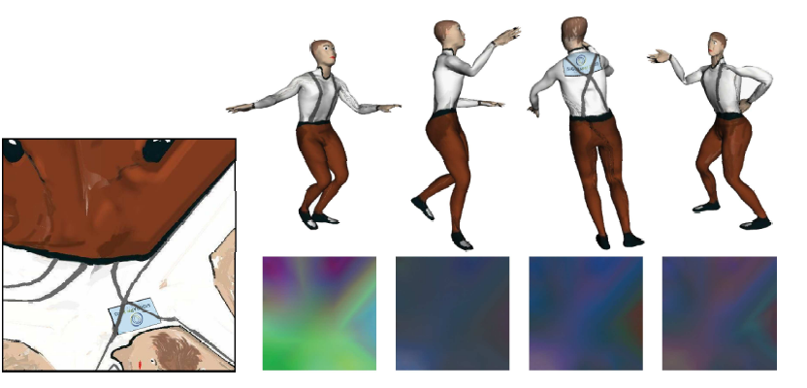
Geometry Videos
Symposium on Computer Animation 2003
Hector M. Briceño
Collaborators: Pedro V. Sander, Leonard McMillan, Steven Gortler, and Hugues Hoppe

Slide 2
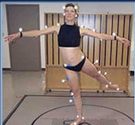
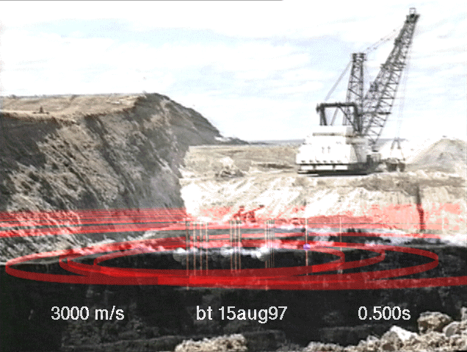
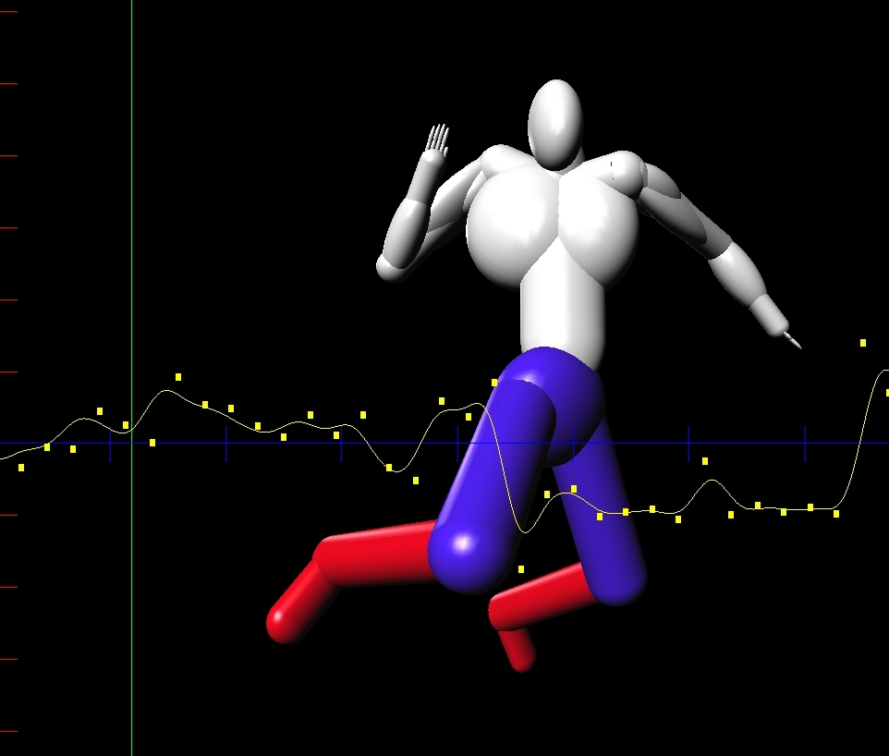
Motivation
Many sources of 3D Animation data:
  Motion Capture
  Visual Hulls
  Physical Simulations
  Sensor Data
  Skilled Animators
Wide variety of formats, data, and reconstruction schemes…
Notes:
People don’t realize how time consuming is the generation of these animations…
There are many sources 3d animations
Motion capture systems can be used to capture motion data from real actors
Sensor data can capture changes in the environment to be visualized with an animation
Skilled animators can generate animations by specifying keyframes and describing the motion between them.
They will also spend countless of hours tweaking the animations to obtain the exact behavior they want.
There is a lack of flexibility in communicating the resulting animations.
Motion capture: joint-angles, tag positions
Visual Hulls: sillouettes
Physical Simulations
Sensor Data: data
Skilled Animators: key-frames, interpolation functions

Slide 3
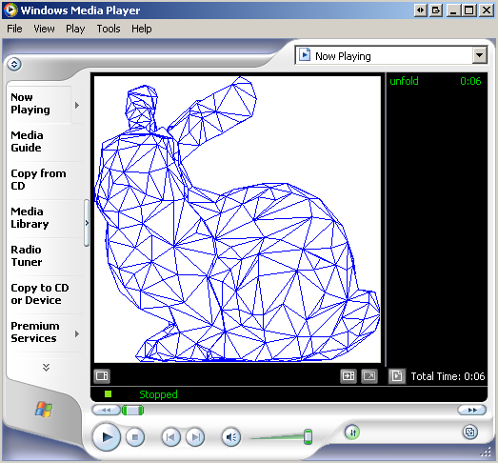
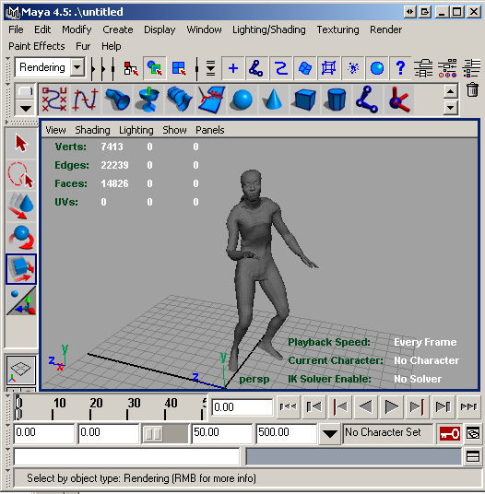
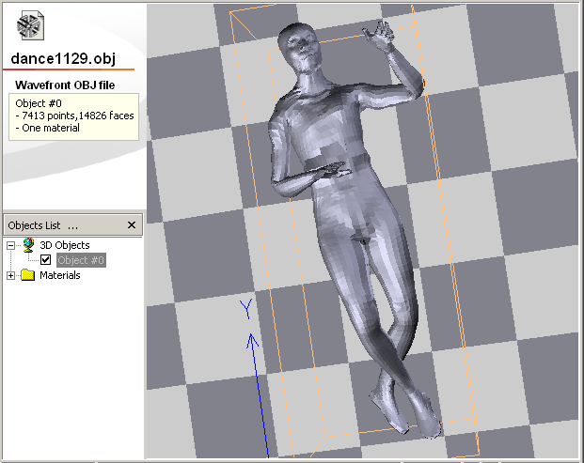
Problem: Sharing 3D Animations
Render a Video of the animation
Use the similar software and/or hardware
Use static mesh compression for each frame
DEMO
DEMO
Notes:
WHAT The fundamental way we currently share animations is by generating a video..
Essentially you are reducing this 3D medium to 2D…this is wrong!
Another way to share animations is to use the similar infrastructure, but this may not always be possible.
We present a new representation that transmit all the subtleties and advantages of the 3D Representation regardless of how the animation was generated.
A new media type 3D animated models, give the viewers control of the view point
DEMO, complicated finite element method … elastic deformations

Slide 4
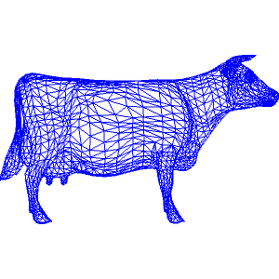
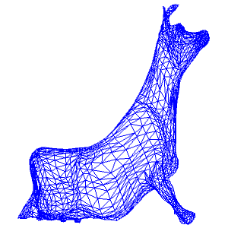
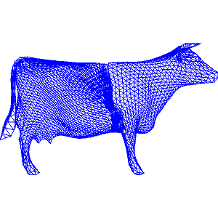
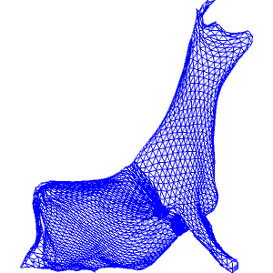


Approach:
By representing manifold 3D objects using a global 2D parametrization (mapping) it is possible to use existing video techniques to represent 3D animations.
Notes:
HOW we are going to do this?
Specifically going to present a method how to map any animated 3D manifold object to a 2D parametrization and apply standard video compression techniques to support this new form of media.
We are not projecting the 3D object to an image, but rather representing the 3D surface as an image.
If you only get one thing out of this talk is this…
I can say some of the contributions:
-full system
-set of parameters
-look at the tradeoffs of cuts and parametrizations…
-how to take advantage of the temporal coherence in this setup
-compare to other schemes

Slide 5
Assumptions of Geometry Videos
One or more manifold surfaces
Consistent connectivity through the duration of the animation
No changes in topology
Can undergo arbitrary deformations as well as rigid-body transformations
Notes:
Manifold is a 2D closed surface with a well defined outside and inside.
Each with consistent connectivity.

Slide 6
Outline
Related Work
Geometry Images and Geometry Videos
  Cuts
  Parametrization
  Compression
Exploiting Temporal Coherence
Results
Future Work and Conclusions

Slide 7
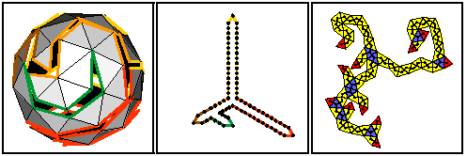
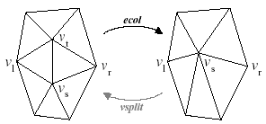
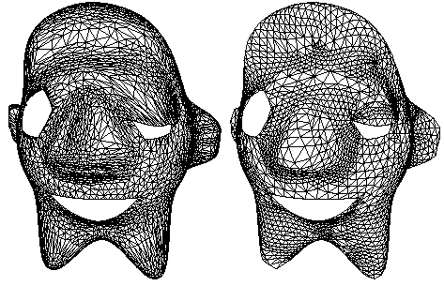
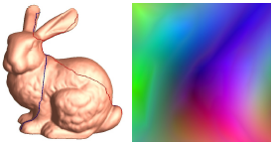
Related Work: Mesh Compression
Maintaining connectivity:
  Topological Surgery [Taubin98]
  Progressive Meshes [Hoppe96]
  Spectral Compression [Karni00]
Re-parametrizing:
  Semi-regular: Progressive Compression [Khodakovsky00]
  Fully regular: Geometry Images: fully regular [Gu02]
Notes:
The classical representation of 3D objects or meshes is
A list of vertices and connectivity describing faces of piecewise planar mesh.
Two basic approaches:
The first class of representation attempts to maintain the vertices themselves and the connectivity
Another methods is to think of the mesh representation as an approximation of the shape. And it is the final shape what we want to represent.
One method that stands out is the Khodakovsky where they remesh the model and apply wavelet technique to the vertex locations
Another method, is Geometry Images, A new approach takes a geometry and develops it into a global parametrization on the unit square, and this is what I base my approach.
Taubin is Topological surgery. Hughes is Progressive meshes
Point: by resampling/remeshing we can get better compression

Slide 8
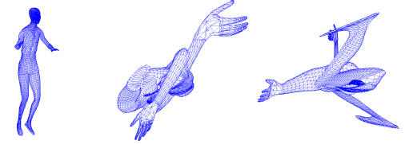
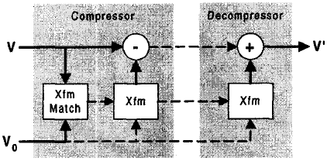
Related Work: Animated Meshes
MPEG4, VRML Animated Meshes
“Multi-Resolution Dynamic Meshes with Arbitrary Deformations” [Shamir00]
“Representing Animations by PCA” [Alexa00]
“Compression of Time-dependent geometry” [Lengyel99]
“Dynapack” [Ibarria03]
Notes:
There has been preliminary work on the compression of meshes
They are mostly based on maintaining the original connectivity, but were developed to extend the mentioned approaches.
MPEG4 and VRML include limited support for 3D animations… keyframes, rigid body motion
PCA represents Animated meshes by decomposing the each frame in the animation as a weighted sum of a set of basis frames.
Lengyel
Delta Encoding
Affine Transformations for predictor
Clustering for segmentation

Slide 9
Related Work: Video
MPEG
  Spatial, Temporal, SNR Scalability, Motion Compensation, High Compression, VBR…
Other…
  Layered Coding L-DCT [Amir96]
  Multi-resolution Video [Finkelstein96]
    LOD both time and space.
  NAIVE [Briceno99]
    Graceful degradation, error resilience
Notes:
We also draw heavily on previous work on video compression
Popular and mature video techniques like MPEG
These techniques have been further refined for different people with different network connectivity, different error and loss rates…
Point is video technology is very mature, it would be nice to retain these features in a 3D animation representation.
Multiresolution video, average between frames.
Basically just highlight some of the features of video encoding

Slide 10
Geometry Images
Represents a manifold surface in 3D space as an 2D array of 3D points.
Works in 3 steps:
  Cutting: maps 3D surfaces to manifold
  Parametrization
    Maps 3D space -> 2D parameter space
  Rasterization and Compression
Notes:
We’ll start our discussion with Geometry Images of Gu et al.
They take a 2D manifold embedded in 3D space and parametrizing it onto the unit square
This involves 3 steps:
First cutting the manifold which essential defines the boundary of the square
Second, defining the parametrization which defines the interior of the square
Lastly, rasterizing and scan converting the geometry and all other sideband information (textures, normals…) and applying compression to it.
I will first discuss parametrization and then come back to cutting.
The surface may be closed.
We produce sideband information from the cutting to generate a 3D surface from a manifold
We’ll explain parametrization first

Slide 11
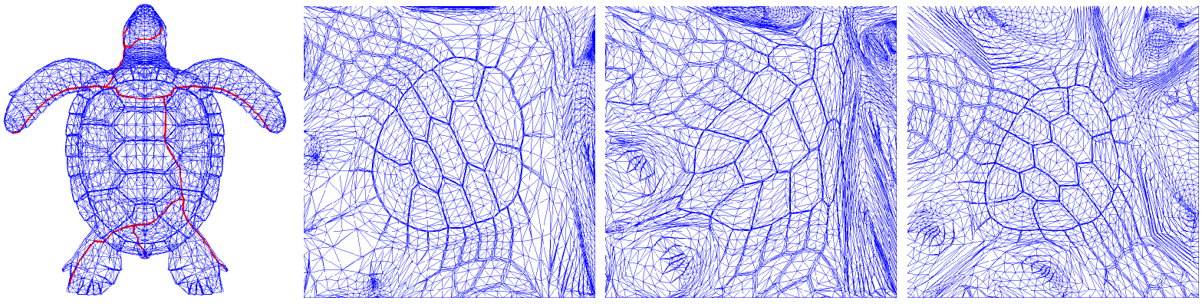
Parametrization
Maps 3D manifold surface onto 2D square
  Different criteria or metrics: Conformal, Area-preserving, Geometric-Stretch
Notes:
Once you defined the cut and the boundary there are many ways to parametrize the interior:
The classic approach is the conformal mapping which preserves the angles and shape of the original triangles. The problem with this approach is that triangles may map into really small triangles in the parametrization, large portion of the surface may map to a small area in the parametrization, leading to undersamping.
An obvious alternative one may consider is an area preserving mapping which can be achieved for any mesh. The problem with this approach, is that a given triangle in order to preserve the area a triangle may be mapped to a long skinny triangle in the parametrization which will lead to non-uniform sampling of the surface.
Ideally we would like a parametrization that is both shape preserving and area preserving. This is the classical mapmakers problem, generating a map that preserves both angles and areas.
Instead we are going use a newly defined parametrization by Sander called minimal stretch.
This parametrization directly tries to maintain uniform sampling in the parameter space and on the surface.

Slide 12

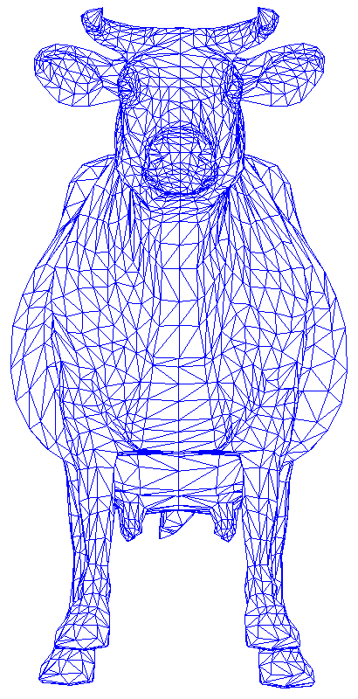
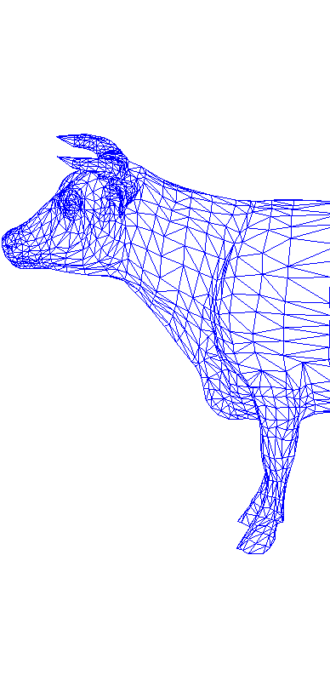
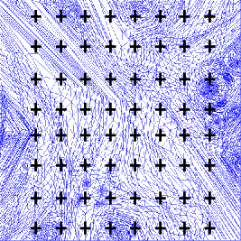
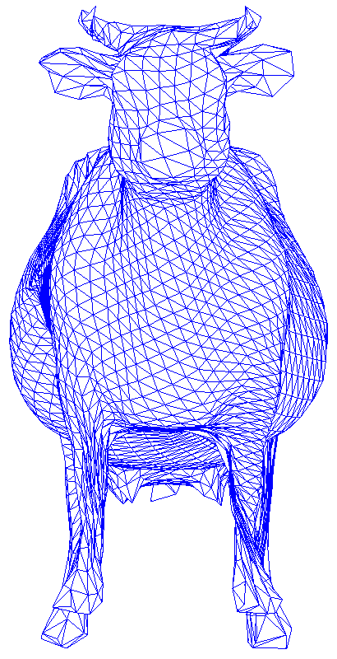
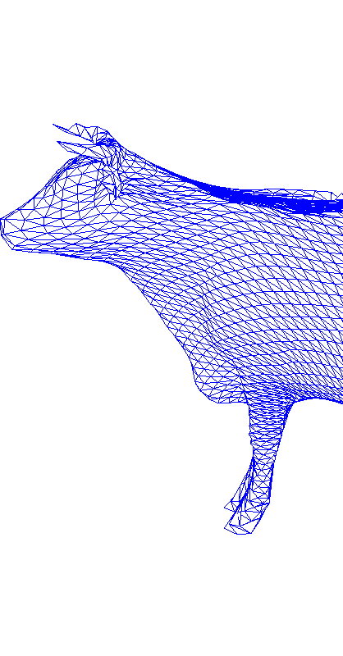
Rasterization/Compression
Sample points of parametrization obtain a 2D grid of triplets (x,y,z)
Compress resulting “image”
DEMO

Slide 13
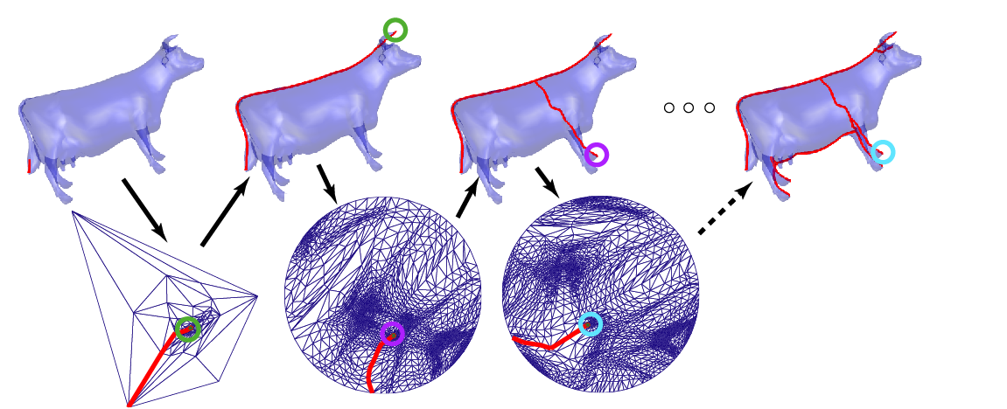
Cutting: Geometry Image
Iteratively Cut and Reparametrize
Final
Notes:
a for genus 0 object a minimal cut is any edge
For arbitrary genus n-object we need 2n cuts to develop it onto a disc.
Details of that are available on Gu’s dissertation.
We’ll focus on genus 0 objects.
If use a small cut, it will force a large region of the surface to be mapped to a small area in the parametrization, thus making the geometric-stretch metric in that area bad.
We can improve the cut by expanding the cut into these small undersampled areas in an effort to reduce the global minimal stretch metric.
Gu describes a greedy algorithm for this approach, it introduces cuts until the average distortion does not improve
In the context of the Geometry Images paper, this was done for a single mesh. For our purposes we have to extend this technique to handle a time sequence of meshes undergoing arbitrary changes in shape.

Slide 14
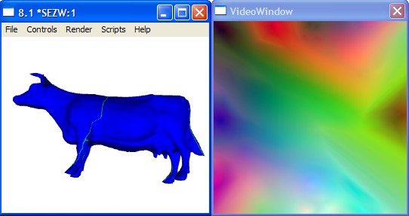
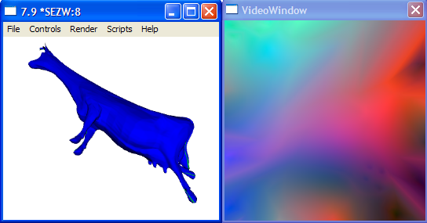
Animated Meshes: Approach
How do we cut, parametrize and compress considering a time-sequence of meshes?
Notes:
In my research I explored applying a different cut to each frame in the animation.
The problem of applying a different cut is that it changes the parametrization and cannot take adequate advantage of the temporal coherence.
I explored different cut on different frames but this does not lead to good compression and results in a new parametrization for every frame it disallows the reuse of sideband data such as textures and normals…
The problem for animated meshes is how to select
Disadvantages:
No temporal coherency
Not good for textures
Low compression

Slide 15
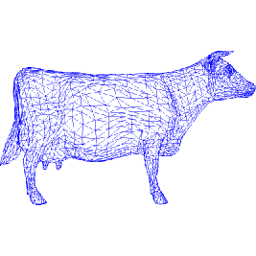
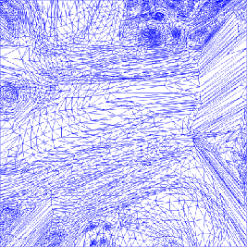
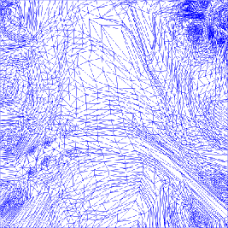
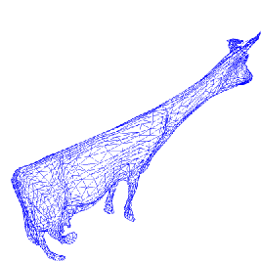
Cutting: Animations
Animation frames should have the same cut and parametrization
No Correspondence
Different Cuts and Parametrization
c
Notes:
We come the conclusion that we want a single cut and parametrization for every frame.
The advantage of this is that the same point on the surface corresponds to the same point in the parametrization even if the point moves.
Reusing texture maps, normal maps, material id…
Applying temporal techniques
But what cut and parametrization to use?
Switching between parametrizations and/or textures can lead to “slippage” and/or popping. Can’t reuse other attributes that remain the same like material id and lighting coefficients. Can’t reuse sideband data.

Slide 16
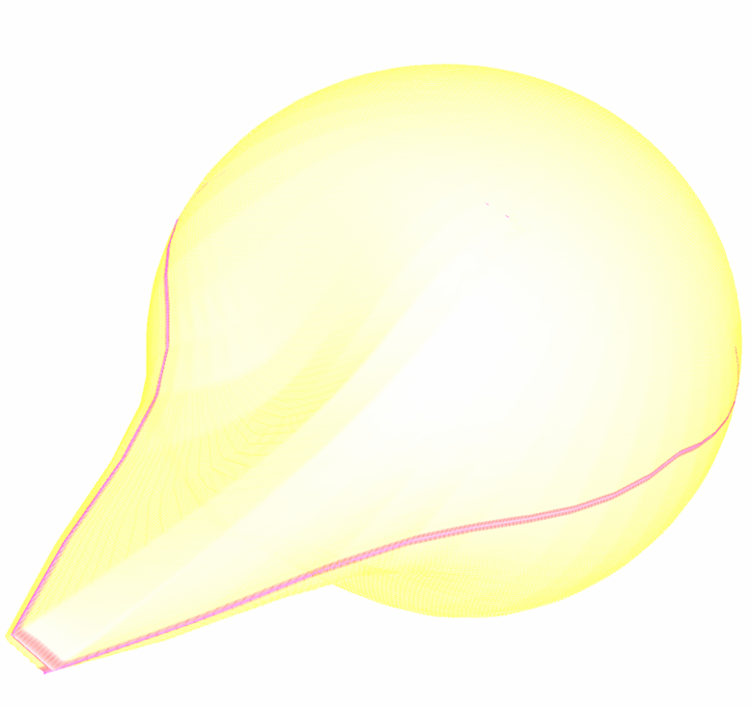
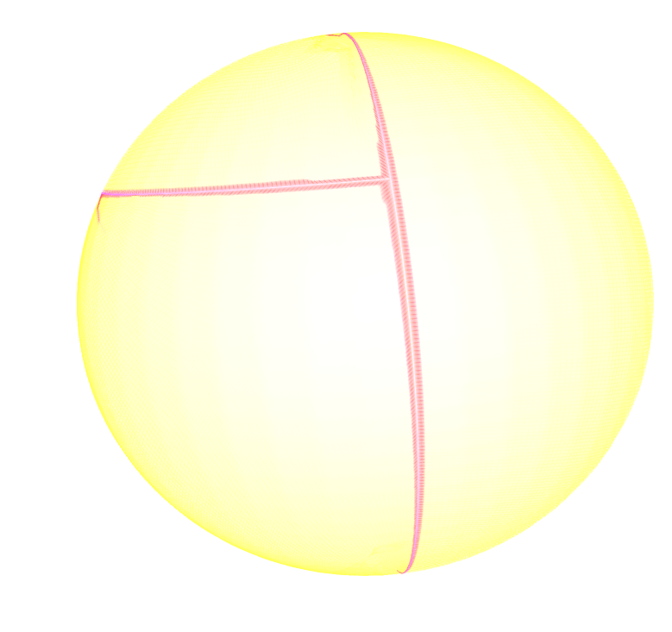

Cuts, how to pick?
Looking at single frame might miss something?
Approach: find a global cut considering all frames.
Notes:
How to pick the cut to minimize the overall geometric stretch.
Imagine this area three different frames of an animation, there is a protrusion that develops on the sphere, it becomes a sphere and then two new protrusions at a different location develop on the sphere.
No cut looking a single frame can assure a minimize the overall geometric stretch. If we use the cut from any one frame we will miss a protrusion on another frame…

Slide 17
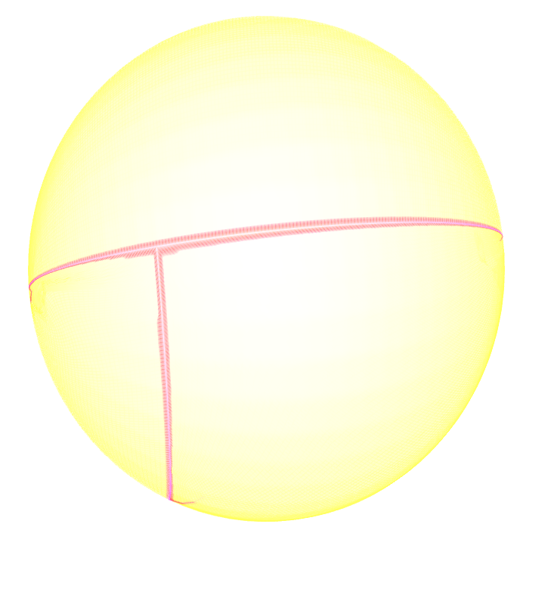
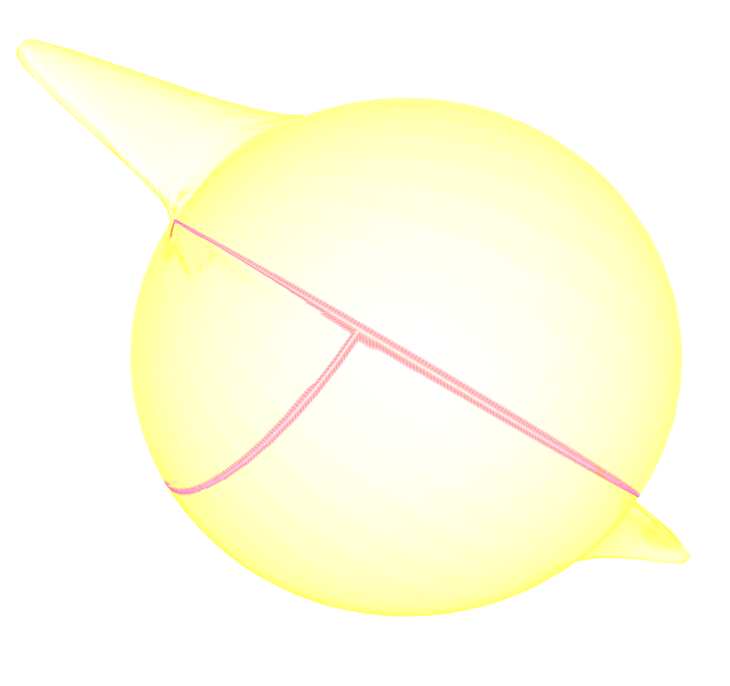
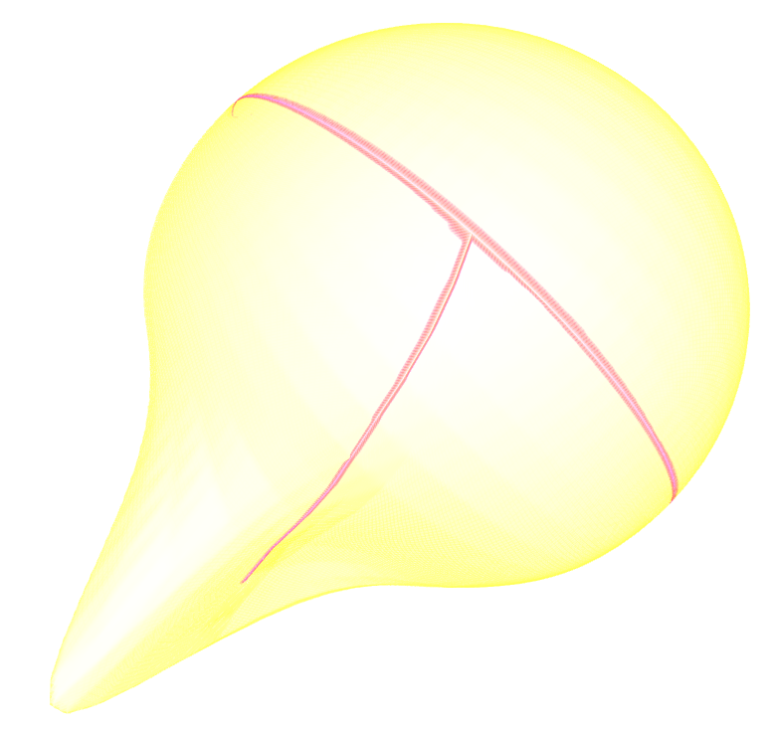

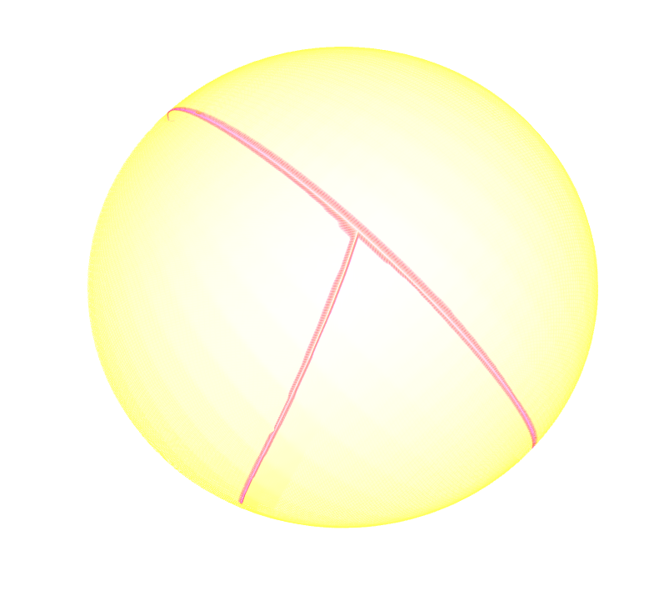
Global Cut
Cut from frame 2 misses spike on frame 1 and spikes on frame 3
Cut 2
Frame 1
Frame 2
Frame 3
Global Cut
Notes:
WHAT Out solution is a global cut that considers every frame, and introduce cuts at various places in order to assure uniform sampling throughout the animation.
Here we show the application of cut to the frames of the animation that have protrusions. It does not reach the areas with protrusions on frame 3.
Below we have the global cut which considers all the frames, it reaches the protrusions in all the frames.
Now we show how the global cut is computed.

Slide 18
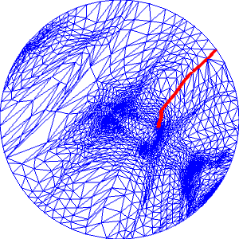
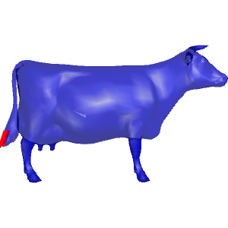
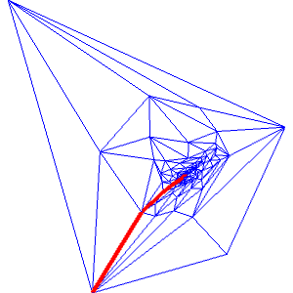
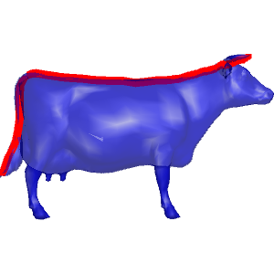
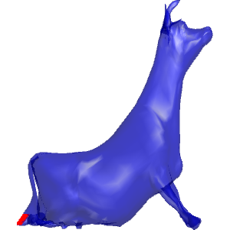
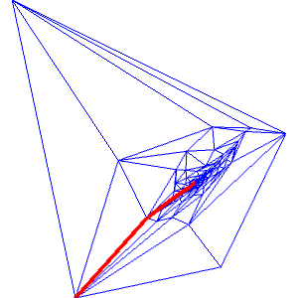
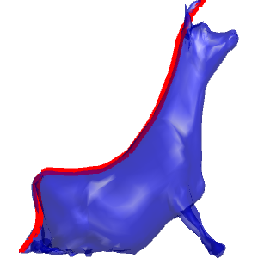
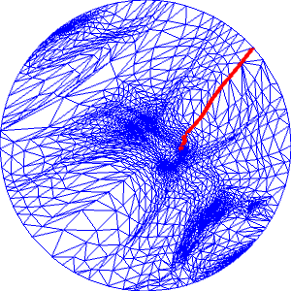
Global Cut: how it works
Run the iterative algorithm on all frames at the same time.
Pick worst avg. face on all parametrizations…
Frame 1
Frame 2
Notes:
HOW
The cut used in Geometry Images only considers a single frame. The global cutting algorithm is an extension of this approach which considers all the frames.
We apply the same cut to all frames of the animation and locate the face that has the average worst stretch and greedily insert a cut to that area. We repeat this until we cannot improve the average over all frames of average stretch of each frame parametrization
Now what parametrization do we use for the animation?

Slide 19

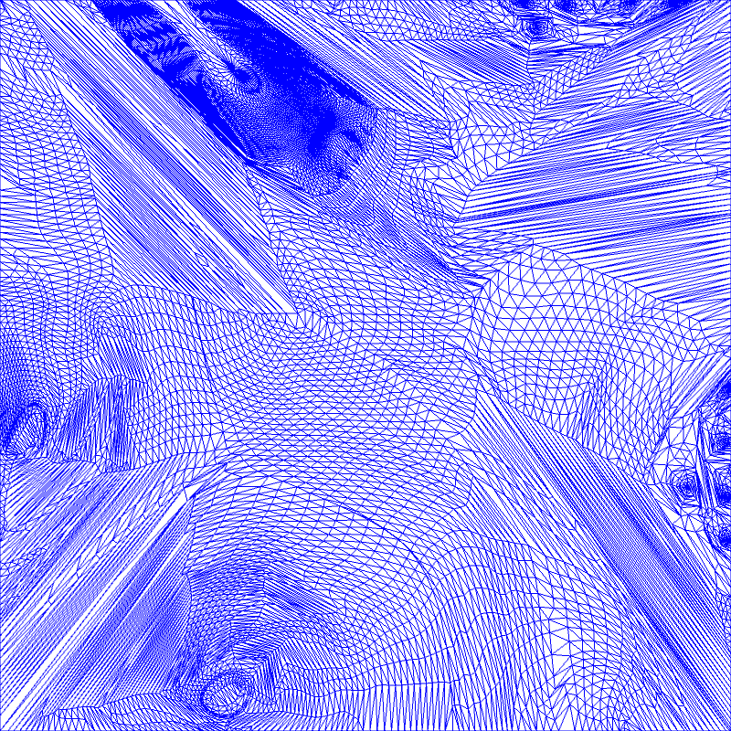
Parametrization: Animation
Cut and parametrization has to be fixed for all frames in order to use one texture for whole animation
We currently apply the global cut to the first frame and compute parametrization on that frame.
Notes:
How you select the appropriate parametrization for the entire animation
The ideal parametrization achieves good sampling on all frames, it has minimal average stretch over all frames.
There are two ways we can find this parametrization:
First, compute the parametrization for each frame individually and apply this to all other frames. Very costly N^2
Second, we can modify the parametrization to integrate over all the faces over all the frames instead of simply over all the faces of a single frame.
We explored both of these approaches, and surprisingly it was not always the case that the parametrization that minimizes the stretch over all the frames the that achieved the best reconstruction. In fact, there were few cases where the parametrization derived from a single frame achieved the better reconstruction even though it did not have the best global sampling. This is an open area for research.
There is not a globally optimal minimal stretch algorithm, the current algorithm is susceptible to local minima, and secondly having optimal sampling does not necessarily minimize the reconstruction error.

Slide 20
Compression
Spatial Compression:
  Wavelets: Can support multiple levels of detail…
Temporal Compression
  Predictive Coding similar to MPEG
  Use affine transformations for predictor
Notes:
At this point we have covered how to compute the cut for the whole animation, and we pick the parametrization, and how the scan-conversion, using the parametrization to generate a geometry image works. So now we have a sequence of images that are smooth and have correspondence.
The next step is how we compress them. As in video we obtain compression from the redundancy that occurs both in space and in time.
Points in space are near each other, and points in time tend to be in the same location
Spatial compression: use wavelets
Transformations: Global Transformations, Local transformations…for local changes similar to motion compensation in standard video compression.

Slide 21
Encoder Architecture
Input
Frame
Cut &
Parametrize
Rasterize/
Encode
Diff
Transform
Reference
Frame
Decode
Basic Delta Encoder
Uses affine transformations
Notes:
This a basic delta encoder structure
In which frames in the future are encoded relative to frames in the past
This is probably the most efficient aspect of standard video encoding.
Rather than doing straight differencing in standard video, there is a motion compensation step to capture translation and changes in objects in time.
For geometry videos, rather than doing an exhaustive search for the best motion vector, we can solve in closed form for the best affine transformation between the two corresponding parts of the geometry. By using a fixed parametrization, the same area in the parametrization in different frames corresponds to the same area in the surface regardless of how it has been deformed or moved.
We can use any transformation, ideally you want to match the one used to create the animation, but this sometimes can be hard and there are cases where no transformation was used in the case of sensor data.

Slide 22
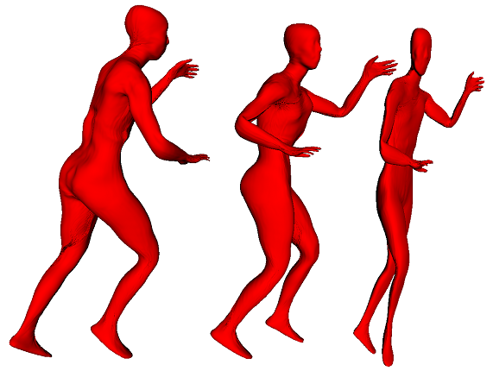
Transformations: Global
Global Trans. form a good approximation
Frame 1
Frame 2
Transformed Frame 1
Notes:
Here is a global affine transformation between frame one and frame 2
Leg move back.
Show an example of a good approximation 2 original frames and one transformation.
Real frames key.6 and 7.
But global transformation can be thrown off by changes in the bounding box. Still suprisingly the wavelet encoding can compensate for these changes.

Slide 23
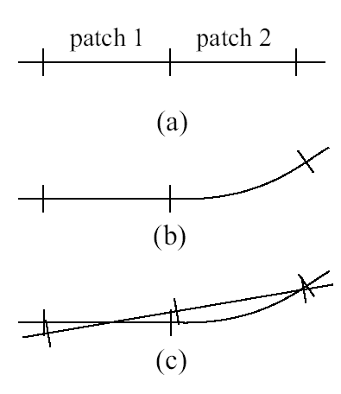
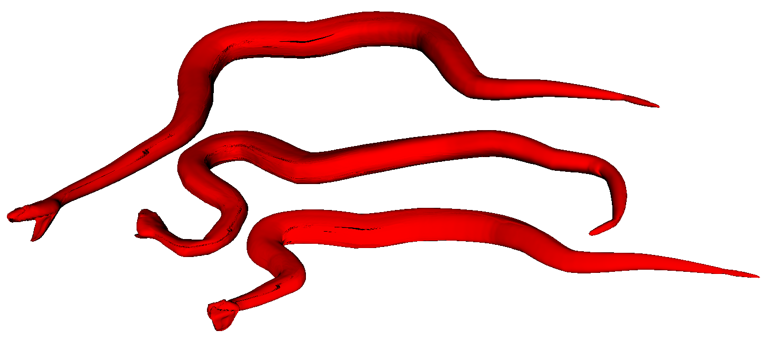
Transformations: Global con’t
Global cannot capture well deformations within the object
Frame 1
Frame 2
Predictor of Frame 2 from Frame 1
Notes:
Show a case where it has a hard time, maybe snake. Global will have a hard time capturing neck motion.
Snake key.4 and 5

Slide 24
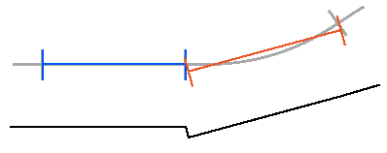
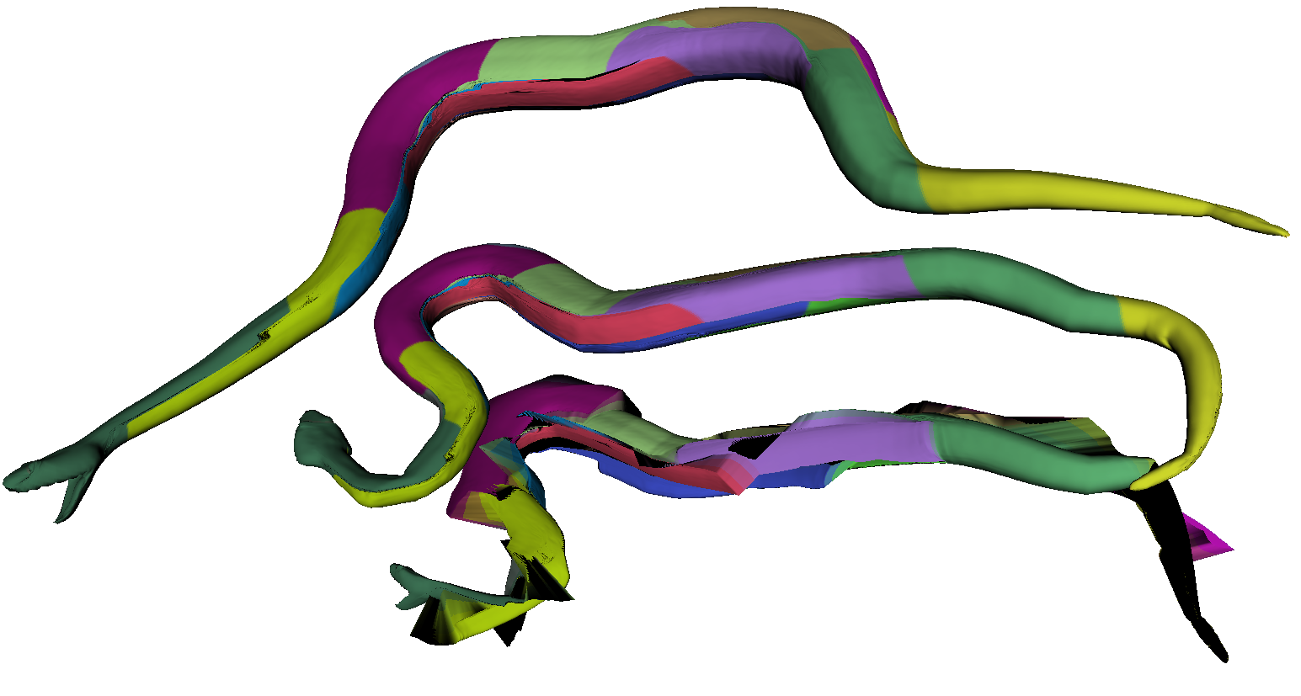

Transformations: Local
Apply transformation on charts
Frame 1
Frame 2
Predictor
Notes:
Motion compensation is done at the block level.
Idea: break the geometry image into charts and work on charts separately, like MPEG → problem boundaries
The neck area is better.
Piece wise rigid body. We choose square for simplicity and ease of processing. A separation into “significant” parts would be more appropriate
Raw prediction without deltas

Slide 25


Transformations: Local w/ Spread & Blend
Spread. Include neighbors in the computation of the transformation
Blend between patches.
Target
Predictor
No blend
No spread
Predictor
w/blend
w/spread
d
c
Notes:
DEMO of different overlaps just showing the reference/predictor frames.
The one in the middle is best.
Do dancer at low bitrates and keyframes

Slide 26
Results
Comparing Geometry Images
Comparison to PCA
Predictive Coding: Transformations
  Global
  Local
Timing/Performance
Level of Detail

Slide 27

Comparing Geometry Images: Snake

Slide 28

Comparison to PCA
Notes:
I show a highly compressed versions in order to show the artifacts that one sees. In very low bit rate geometry videos details become smoothed out. In PCA we get scaling artifacts is the number of basis are not enough to represent all frames.
PCA is still higher bitrate than geometry videos, but one can compress the basis function more. So it not a real apple to apples comparison.
16*12 frames. 16 basis = 8 bpv.

Slide 29


Transformations: Global vs. Local
Notes:
Local transformations buy you if you have major changes, only in few cases in our runs it helped.

Slide 30

Transformation Performance
2bpv P
8bpv I Baseline
4bpv P
8bpv B
8bpv P
DEMO
s
d
Notes:
DEMO: of animations using global transformations for compression against not using it.
Using predictive coding we get twice the quality for the same bitrate or we can halve the bitrate for the same quality.

Slide 31
Performance Timings
Finding Cut (one frame): 2-7 mins
Finding Cut (100 frames): 3-5 hrs
Parametrization: 2-6 mins
Encoding: 2-3 fps @ 256x256
Encoding: 6-16 fps @ 64x64
Decoding: 10 fps @ 256x256
Decoding: 30-60 fps @ 64x64
Notes:
Cutting and Encoding done in Matlab, Wavelet library reference

Slide 32

Level of Detail
Notes:
This method easily supports multiple levels of detail. This can be done in hardware and very fast. This example was generated by hand. DEMO?

Slide 33
Future Work
Video Compression
Transformations
Chartification
Parametrization
Non-manifold objects
Notes:
Improvements: frame scheduling, budget allocation, robust transmission, layering
Transformations: Free form deformations, skeletons
Chartification: we have shown how global transformations can be used to build predictors. We have used local transformations to improve these predictors by applying transformations to blocks. These blocks make the implementation simpler and are similar to video. We have evidence that using a decomposition of more meaningful parts (ie…) can yield better to better predictors and hence better compression
Improved Parametrization: global parametrization and using different metrics like signal-specialized.
Geometry Image compression: local coordinate frame compression
Polygon soups
Raytracing in the dynamic environment, use this data structure to speed up intersection calculation and clipping
Supertextures, because it is easy to supersample the input geometry and texture, really repeated tiled textures (bump maps) can be applied.

Slide 34
Conclusions
Geometry Video as way to encode and represent 3D animations
Can use many of the 2D Video Techniques/Features
  Spatial/Temporal scalability
  Error resiliency
Many other features to be exploited, i.e. fast clipping and hardware implementation…
Notes:
This unique representation can exploit the many years of research spent on videos.
Suitable for rendering in today’s commodity hardware

Slide 35
Acknowledgements
Collaborators: Pedro Sander, Leonard McMillan, Steven Gortler, Hughes Hoppe, and Gu Xianfen.
Animations: Matthias Mueller and Daniel Vlasic
Questions?
Notes:
I could not achieved this without the help of others, in particular my advisor, thesis committee and collaborators. I thank them all. Questions?

