Slide 1
Terrain Rendering using GPU-Based Geometry Clipmaps
Arul Prakash Hugues Hoppe
University of Utah Microsoft Research

Slide 2
Terrain Rendering Challenges
Regular grid (image) of height values
Concise storage → No paging hiccups
Real-Time frame rates → 60 fps
Visual continuity → No temporal pops
Notes:
Terrains are just grids of height values….
The trick is to find a good way to convert these height values into geometry that can be efficiently rendered by a computer

Slide 3
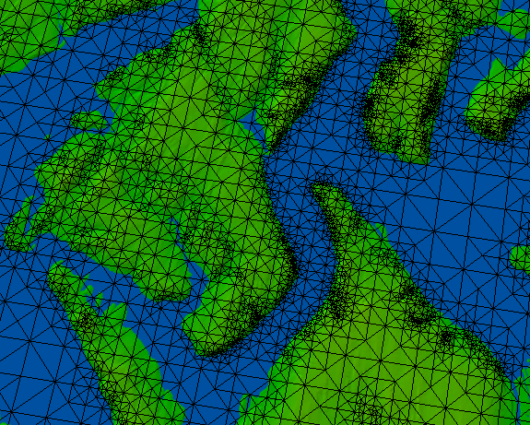
A Change of Focus
Hoppe 1998 – Highly irregular Connectivity
Lindstrom 1996 – Semi-regular Connectivity
Losasso & Hoppe 2004 – Totally regular Connectivity
Notes:
We want to get interactive frame rates
Traditionally, the rendering time was the limiting factor, so research focused on minimizing the polygon count
Now as rendering hardware becomes faster, the strict “number” of polygons is no longer a grave concern -- we need to look at other bottlenecks. Therefore, recent methods focus on geometry regularity, optimized for graphics hardware.
3 papers we see the evolution of this idea:
Hoppe 98 was very good at minimizing the number of triangles drawn to the screen, at the expense of having highly irregular geometry
Lindstrom had a somewhat more regular layout of the geometry, but triangle size was dependent on the topography of the terrain
Hoppe 04 has highly regular triangle sizes, irrespective of the terrain itself.

Slide 4
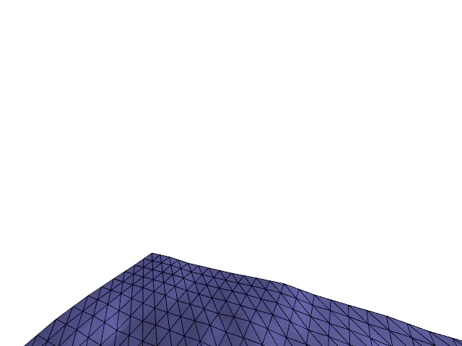
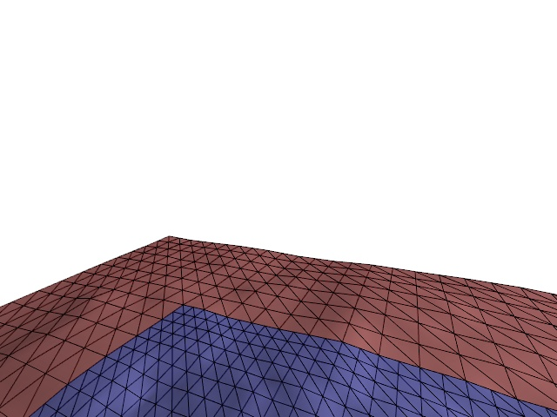
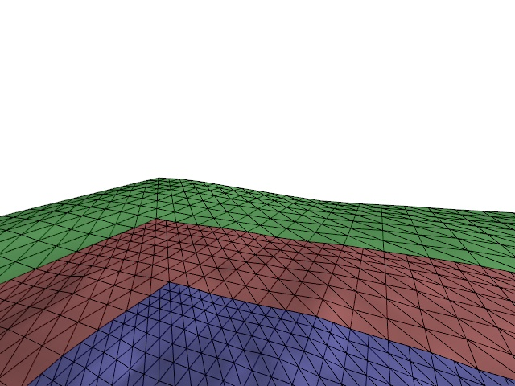
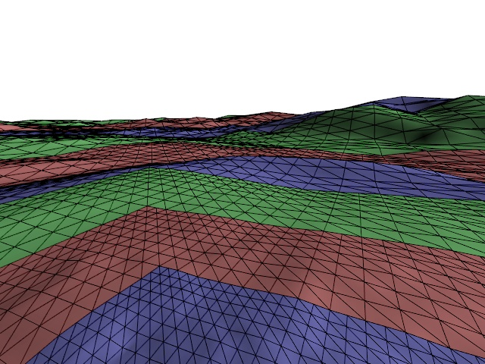
Geometry Clipmaps
Terrain as mipmap pyramid
LOD using nested grids
Coarsest Level
Finest Level
Notes:
The clipmap hierarchy itself can be seen as a pyramid similar to a mipmap pyramid.
The full hierarchy is a prefiltered sequence of power-of-two sized grids, where the finest level contains the whole terrain at the finest resolution.
<click> //The clipmap is a clipped version of this pyramid consisting of windows at each level.
The clipmap can be thought of as a window into this pyramid at each level.
Each cached and rendered level is of a predetermined size centered around the viewer.
<click> Here we see the finest level closest to the viewer
<click> The next coarser level, which has a region cut out where the next finer level would be rendered.
<click> <click> Which is the way it looks for all of the other levels
At the coarsest level, the entire terrain extents have been rendered.
Top right shows a coarse example.
As the viewer moves, clipmap levels incrementally updated and shifted.
I’ll be talking more about this later.

Slide 5
Why GPU?
Much less CPU utilization
Very little AGP/PCIe bus utilization
Small system memory requirement
Small video memory requirement
Significant rendering speedup
Notes:
The version of Geometry clipmaps that appeared at Siggraph this year had most of its components implemented on the CPU.
The current system has most of its components on the GPU. So why do we want to do this on the GPU?
Firstly, this leads to very little CPU utilization. The CPU is used only for decompression, which I’ll be talking about later. If the data is synthesized the CPU’s role is very minimal.
Secondly, there is very little bus utilization. The bus needs to be used only for upload of decompressed terrain residuals.
We used shared vertex and index buffers in all levels resulting in a very little video memory requirement. I’ll be talking more about this later duirng the talk.
Finally , we hope to attain much better frame-rates than a similar implementation on the CPU.
Please note that using the GPU is possible only because each of the clipmap levels is a fully regular grid.
Our implementation uses DirectX 9 and Shader model 3 supported by the nvidia geforce 6800 card.

Slide 6
GPU Implementation Overview
DirectX 9.0c – support for Shader Model 3.0
HLSL code on book’s CD
Store data as textures (in video memory)
Elevation data – 32-bit 1-channel texture
Normal data – 8-bit 4-channel texture
Update parts of texture that change

Slide 7
System Design
Vertex Textures
Supported in DirectX 9.0c & Shader Model 3.0 on NVIDIA
GeForce 6800
Update
Rendering
Vertex Shader
Predict fine level data from coarse level data
Add residuals
Update normal map texture
Use (x, y) to lookup z value in elevation texture
Compute α
Blend Geometry
Pixel Shader
- Blend normals
- Does the shading
- Texture lookup

Slide 8
Clipmap Update
Shift clipmap levels as user moves
coarsest level
finest level
Notes:
As the viewer moves, the clipmaps need to be shifted accordingly.

Slide 9
Upsample
GPU

Slide 10
Add residuals
System Memory
Compressed residuals (350MB for US)
ROI decompression (CPU)
GPU
+
Residual Image in video memory

Slide 11
Incremental update
Before update
Update region
After update

Slide 12
Individual Clipmap Levels
Example: n=15, m=4
m×m block
viewpoint
m×3 ring fix-up
(2m+1)×2 interior trim
n=15 vertices
outer degenerate tri.
See Section 2.3.2 in book
Notes:
Here we show the block structure of the clipmaps.
Each clipmap level of size nxn is represented by 16 blocks of size n/4xn/4 and a few more blocks o patch up the gaps between the blocks.
We create 1 index and vertex buffer for the block and reuse it for all levels, and within a level. The vertex buffer consist of x,y values which can be translated to different parts of the clipmap and then scaled based on the level it belongs to. The z value comes from a texture lookup in a 1 channel vertex texture containing the z value.
These blocks are made up of triangle strips whose lengths give optimal vertex caching.
Generally the clipmap is of size 255x255 leading to a block size of 64x64. In this case we found that a strip length of 22 was optimal for good cache performance on the GeForce 6800.
In addition to these blocks we need a few more blocks to fill in the holes between them shown here in green.
We also have an L shaped strip of triangle on inner perimeter of ring shown in blue. The location of this strip location varies with the viewpoint.
we render one of 4 static geometry buffers.
Finally, we have line of degenerate triangles on outer perimeter to avoid T-junctions with next coarser level here shown in red.

Slide 13
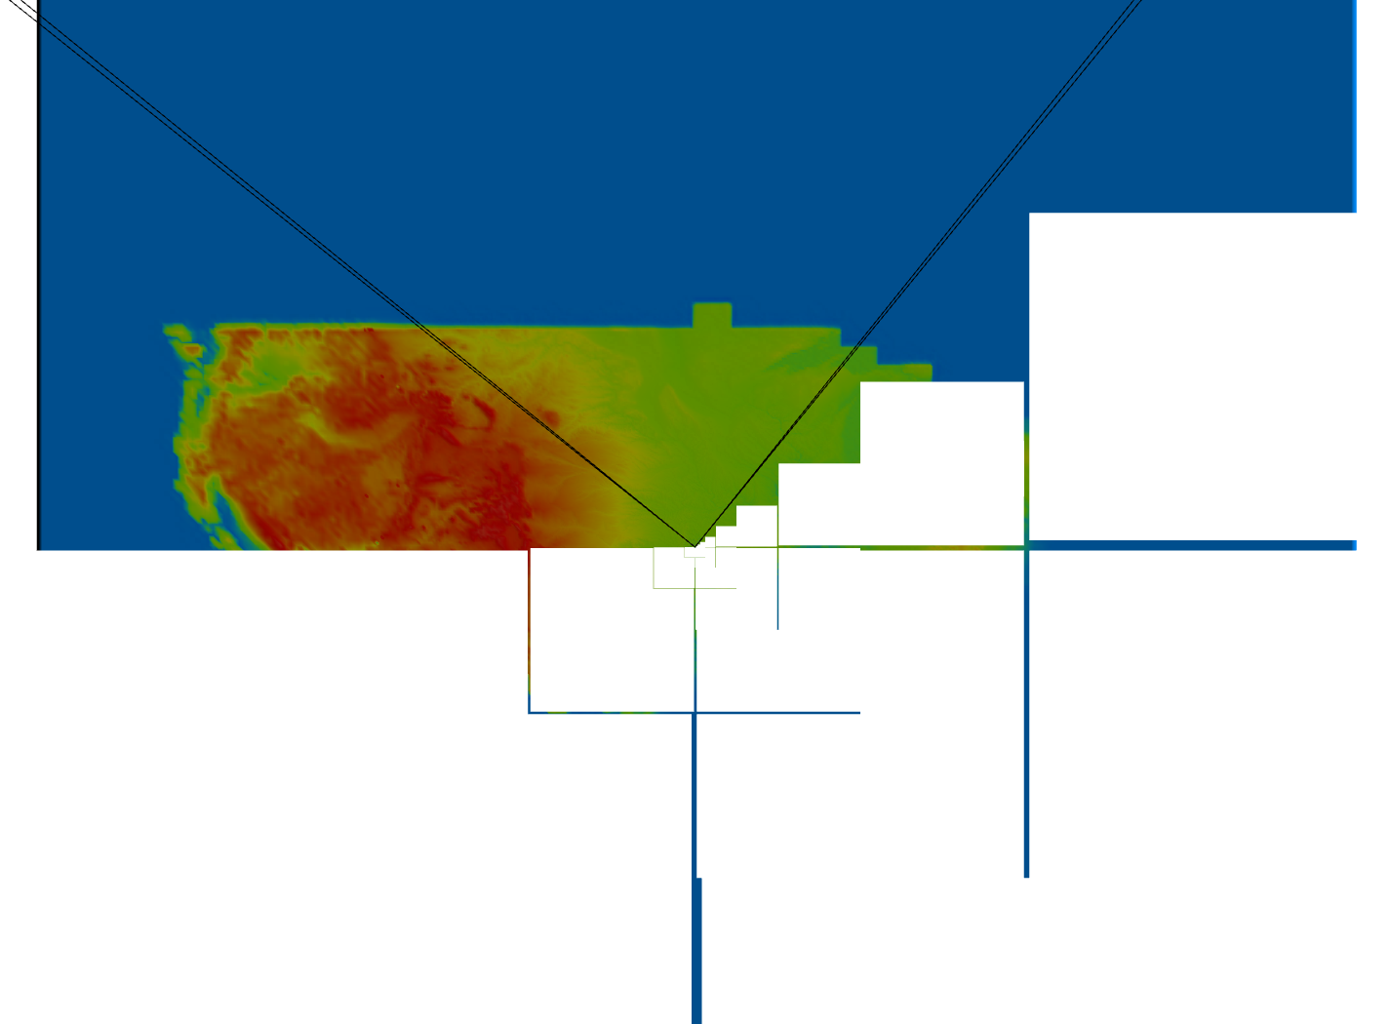
View-frustum culling
Culling done at block level on CPU
2-3x speedup
Notes:
We do view frustum culling at the block level. A complete block is rendered or discarded depending on whether it inside the view frustum. Depending on where the viewer is looking, we get a 2-3x speedup.

Slide 14
Timing Results
 | Previous Implementation | Current Implementation
Upsampling | 3 ms | 1.3ms
Decompression | 8 ms | 8 ms
Normal Map Computation | 11 ms | 0.6 ms

Slide 15
Performance
Synthesized terrain
130 frames/second (render-bound)
120 frames/second (synthesized)
60 million triangles per second
CPU utilization: ~0
AGP bus utilization: ~0
Decompressed terrain
87 frames/second during viewer motion
Decompression on CPU bottleneck

Slide 16
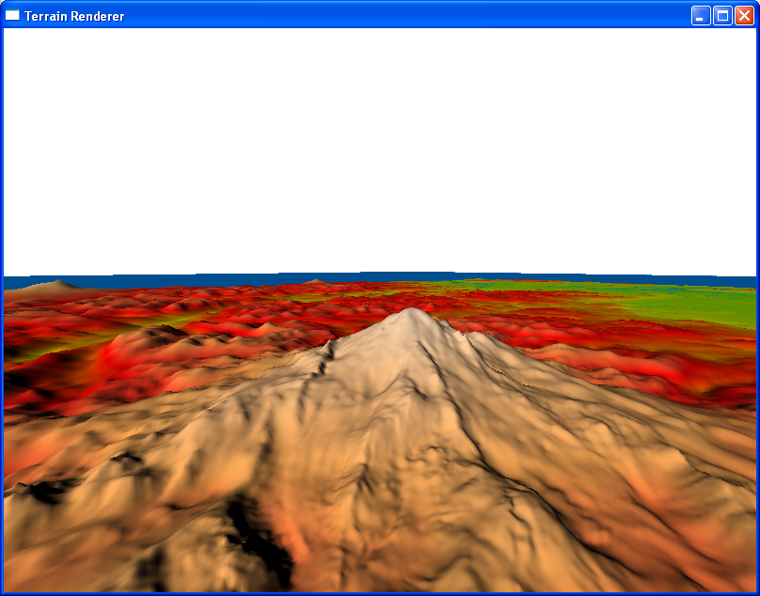
Demo
Notes:
I’ll start off by giving a demo of our terrain rendering system.

Slide 17
Summary
Simplicity
Optimal rendering throughput
Visual continuity
Steady rendering
Graceful degradation
Compression
Synthesis

Slide 18
Questions?
See GPU Gems 2, Chapter 2
http://developer.nvidia.com The Source for GPU Programming
arul@cs.utah.edu
Slides available online

Slide 19
GPU Gems 2 Programming Techniques for High-Performance Graphics and General-Purpose Computation
880 full-color pages, 330 figures, hard cover
$59.99
Experts from universities and industry
“The topics covered in GPU Gems 2 are critical to the next generation of game engines.”
— Gary McTaggart, Software Engineer at Valve, Creators of Half-Life and Counter-Strike
“GPU Gems 2 isn’t meant to simply adorn your bookshelf—it’s required reading for anyone trying to keep pace with the rapid evolution of programmable graphics. If you’re serious about graphics, this book will take you to the edge of what the GPU can do.”
—Rémi Arnaud, Graphics Architect at Sony Computer Entertainment

