Slide 1
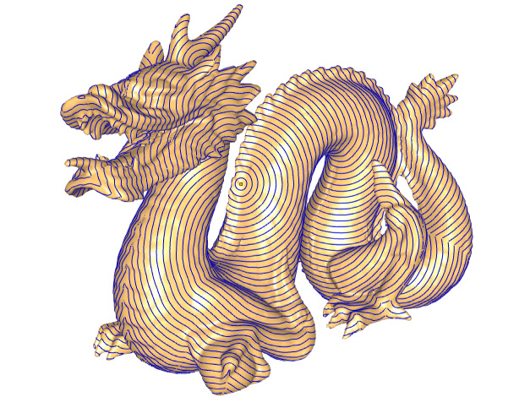

Fast Exact and Approximate Geodesics on Meshes
Vitaly Surazhsky
University of Oslo, CMA
Tatiana Surazhsky
University of Oslo, CMA
Danil Kirsanov
Harvard University
Steven J. Gortler
Harvard University
Hugues Hoppe
Microsoft Research
Notes:
The title of my talk …

Slide 2
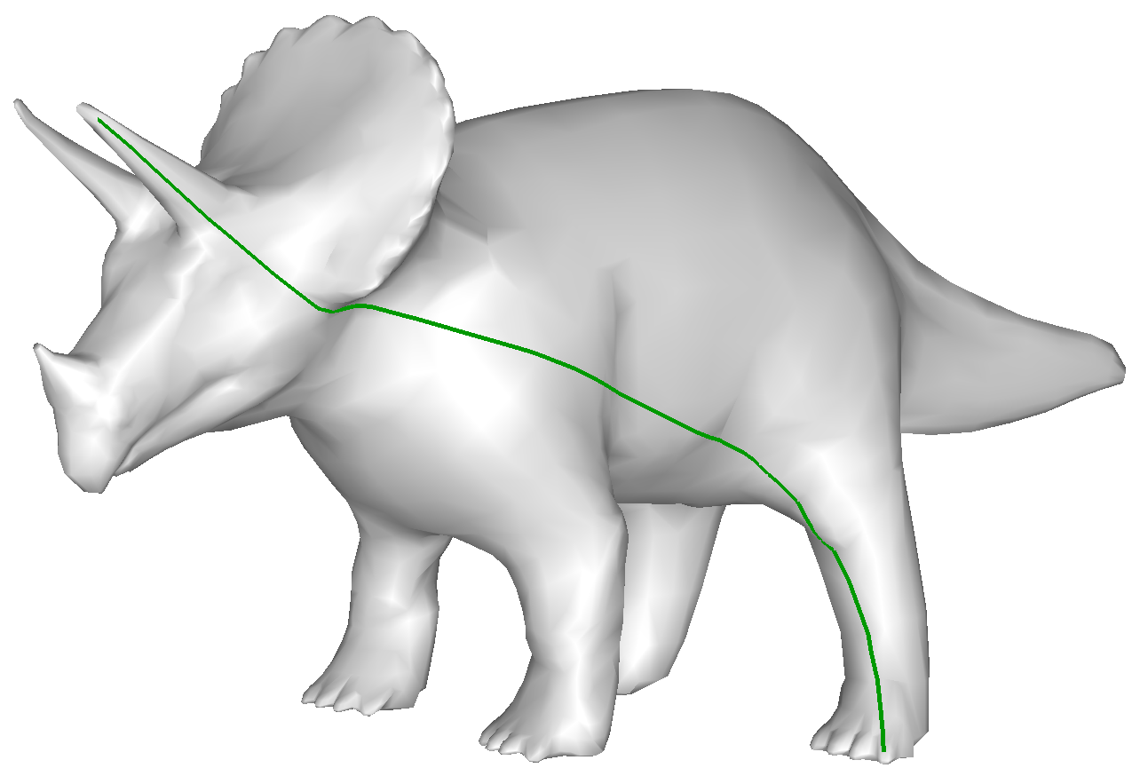
Shortest path problem on meshes
Geodesic on mesh  is shortest path between two points on .
Given source vertex v_{s} we find geodesic paths to all points on surface
Geodesics typically cut across faces in mesh
Geodesics cannot be found by traditional graph-based Dijkstra algorithm for shortest paths
Notes:
The term “geodesics” refers to shortest paths and distances over the meshes.
In our work we fix the source vertex v_s on the mesh and compute shortest distances to all other points (not necessarily vertices) on the mesh.
The shortest path between two vertices usually cuts across the faces,
and therefore the traditional Dijkstra algorithm cannot be used for the problem.

Slide 3
Outline
Introduction
The algorithm computing exact shortest paths and distances
on a triangular mesh (Mitchell et. al. [1987])
Approximation algorithm
Exact geodesic between two vertices
Experimental results
Conclusions
Notes:
I’ll talk about shortest path on the mesh problem in general and
present three separate algorithms.
First is the exact algorithm, which is actually an interpretation of the MMP algorithm.
Our interpretation allows us to extend the exact algorithm and
define the approximating algorithm that runs faster, consumes less memory
than the exact algorithm and has guaranteed bounded error!
We combine both the exact and the approximating algorithms to introduce
a method to compute an exact shortest path between the two vertices.
Finally I’ll present some experimental results and conclude the talk.

Slide 4
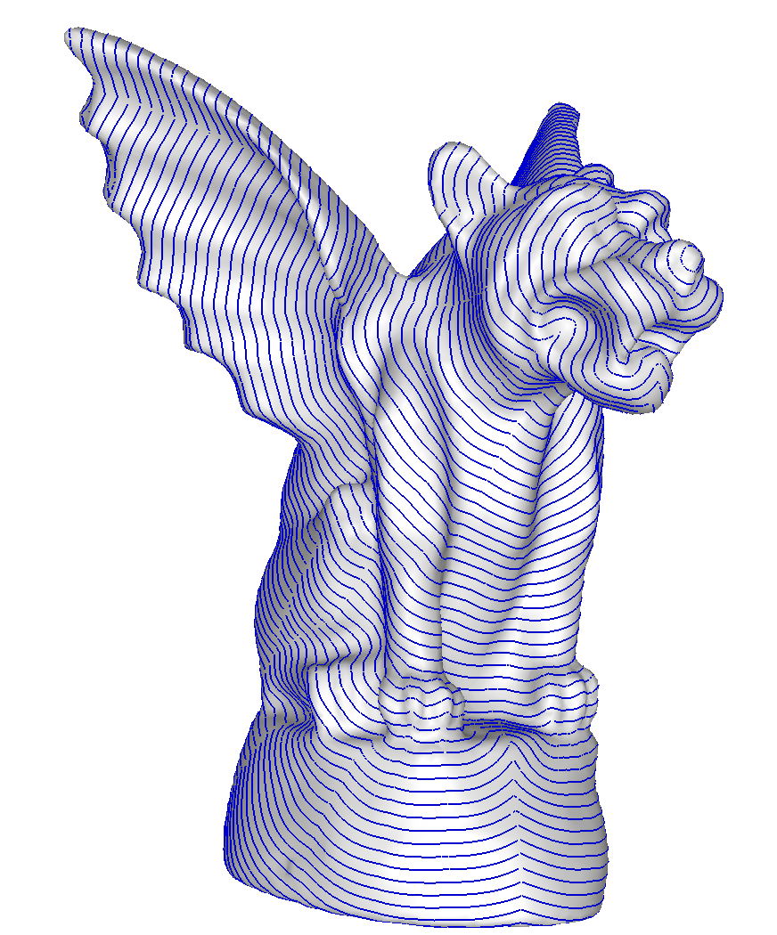
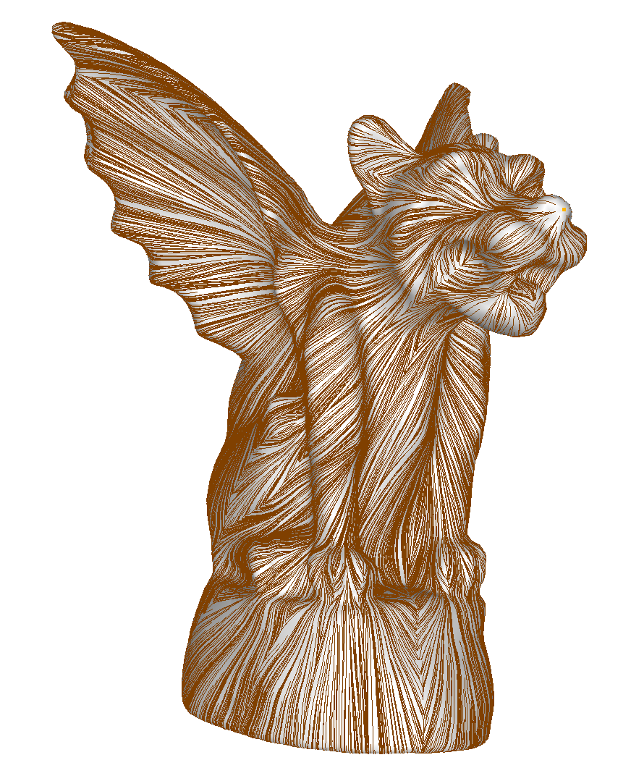
Shortest path and distances
geodesic distance on : length of shortest path from v_{s}
shortest paths directions
Notes:
Given the source vertex we find shortest paths to all other points on the mesh.
The lengths of the shortest paths on the mesh define a (geodesic) distance function on the mesh.
For example, here there are iso-distance contours as well as shortest path directions for a given source vertex.

Slide 5
Motivation
Shortest paths:
  Mesh partitioning (for atlas parameterization) [Krishnamurthy and Levoy 1996; Sander et al. 2003]
  Mesh segmentation [Katz and Tal 2003; Funkhouser et al. 2004]
  Mesh editing (delineating edit operation) [Kobbelt et al. 1998]
Shortest distance metric
  radial-basis interpolation over mesh
  skinning [Sloan et al. 2001];
  mesh watermarking [Praun et al. 1999]
Notes:
Shortest paths are necessary for many comp. graphics applications.
Geodesics are used for parameterization for cutting mesh into charts or segmenting mesh into subparts.
For mesh editing geodesics are employed to delineate the extents of editing.
Simulation of fire on a mesh also required the use of geodesics.
The shortest distances between the points on the mesh are used in
radial-basis interpolation over a mesh, skinning, mesh watermarking…

Slide 6
Previous work – exact geodesics
Mitchell, Mount, Papadimitriou [MMP 1987]
  worst case complexity: O(n² log n)
  never implemented
Chen and Han [1996]
  complexity O(n²)
  partially implemented by Kaneva and O’Rourke [2000]
Kapoor [1999]
  “single source, single destination”
  complexity: O(n log² n)
Notes:
There are different approaches for the geodesic problem: some works find the exact shortest paths on the meshes.
MMP presented an algorithm for computing exact geodesics on meshes.
however, this algorithm was never implemented because it is difficult and
the resulting complexity of (n^2 log n) seems impractical.
we show that the algorithm can be implemented in an efficient way,
and that the worst-case complexity is overly pessimistic.
indeed, for typical meshes the algorithm is quite fast.

Slide 7
Previous work – approximate geodesics
Lanthier et al. [1997]
  guaranteed error bounds
  by adding extra edges
Kanai and Suzuki [2001]; Martinez et al. [2004]
  iterative optimization (depends on initial approximate path)
Kimmel and Sethian [1998]: fast marching method
  require special processing of triangles with obtuse angles
  time complexity: O(n log n)
Novotni and Klein [2002]; Kirsanov [2004]; Reimers [2004]
  employ improved update rule
Polthier and Schmies [1998] – “straightest path”
…
Notes:
While others seek the approximated geodesics.
The advantage of our approximate algorithm is that we provide accurate solutions with bounded error: in particular we outperform the fast marching method

Slide 8
Mitchell et. al. [MMP 1987]
Unfolded geodesics are straight
Each edge is partitioned into windows: geodesics to all window points follow same unfolded faces
Each window can atomically summarize information for all its points
Algorithm propagates windows across mesh in a continuous Dijkstra-like sweep
Windows provide geodesic distance along edges, and therefore at all mesh points
Geodesics are reconstructed by backtracing by iteratively jumping from window to window
Global unfolding is never needed!
Notes:
Here is a short overview of the Mitchel et. al. algorithm:
1: shortest paths are straight lines when they are unfolded into a plane
2: each edge can be partitioned into windows, such that shortest paths to all window points follow same unfolded faces
3: each window can atomically summarize geodesic distance information for all its points
4: the basic flow of the algorithm is to propagate these windows across the mesh in a continuous-Dijkstra-like sweep.
5: from the windows info, we can directly compute geodesic distance along edge, and therefore at all points of the mesh
moreover we can backtrace shortest paths to the source from any point, by iteratively jumping from window to window.
note Global unfolding is never needed in algorithm.

Slide 9
Geodesics on meshes
Shortest paths can be visualized as rays emanating from v_{s} in all directions:
  Interior to triangle, shortest path must be straight line
  Crossing edge, shortest path corresponds to straight line when two triangles are unfolded into common plane.
Notes:
Shortest paths can be visualized as rays emanating from the source vertex v_s in all tangent directions.
These shortest paths have the following properties.
Interior to a triangle, a shortest path must be a straight line.
When crossing over an edge, a shortest path must correspond to a straight line
when the two adjacent faces sharing the edge are unfolded into a common plane.

Slide 10
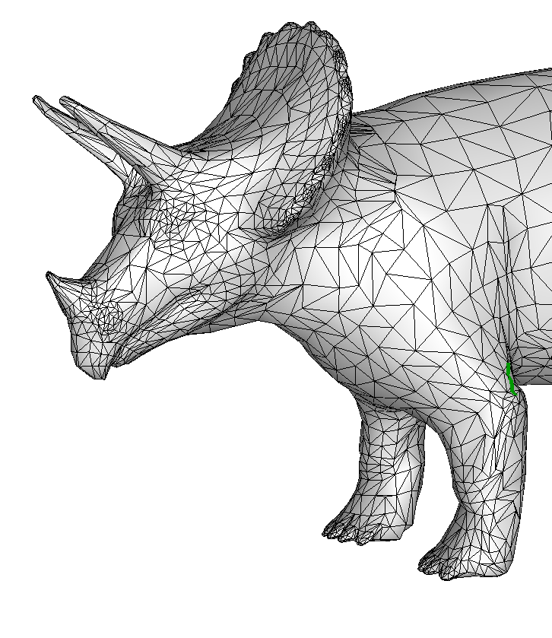
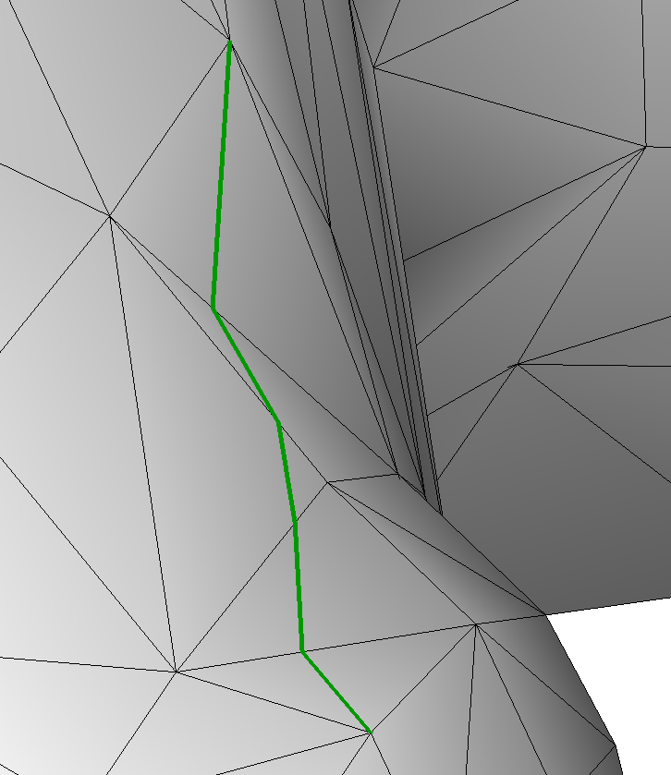
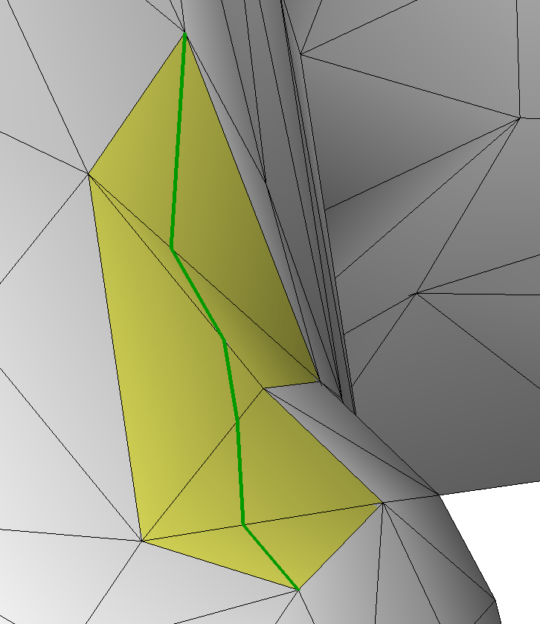
Exact shortest path on mesh – unfolding
Notes:
Our algorithm is based on the idea of unfolding the sequence of 3D triangles
containing this path into the plane.
If the path does not contain any vertices it should be unfolded into a straight line,
which is natural since the shortest path between two points in the plane is a straight line.

Slide 11
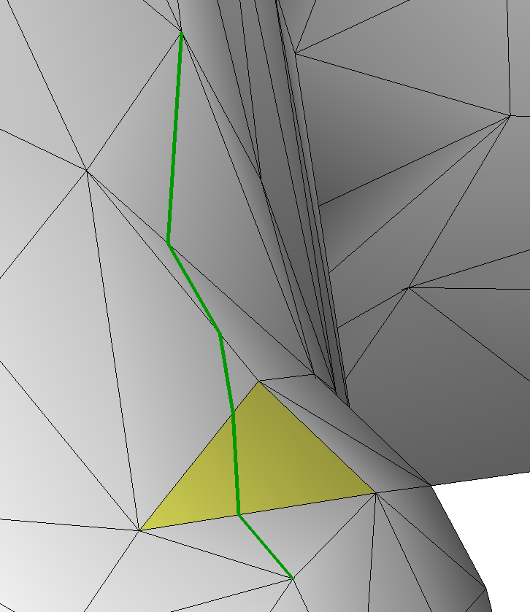
Local source reconstruction in plane of triangle
Notes:
We can unfold the source vertex into the plane of a triangle that contains the part of the geodesic.
The unfolded source in the plane of this triangle can be computed using the distances from the two different points of the triangle to the source.

Slide 12
Source reconstruction
Given two distances d₀, d₁
Recover the source s = (x, y)
Computation is simple using local coordinate system
Notes:
Given two points on the edge P_0P_1 and the distances d_0 and d_1 from these points to the source we can
find the 2D coordinates of the unfolded source in the plane of the triangle.
This computation is simple if we use appropriate local coordinate system.

Slide 13
Basic definitions – window
Window is a segment of edge over which exact distance computation can be performed atomically
Notes:
The basic concept that we use for the algorithm is a window.
Technically it is defined as a segments of the edge over which the exact distance computation can be performed atomically.
or using one unfolded source.

Slide 14
Basic definitions – window (cont’d)
b₀, b₁: local x-coordinates of end-points on edge
d₀, d₁: distances from end-points to source
τ : direction to source (side of edge where v_{s} lies)
Notes:
We associate the following scalar attributes with each window:
b_0 and b_1 are local x-coordinates of the end-points
d_0 and d_1 are the distances from the end-points to the source
and \tau - binary direction to the source.

Slide 15
Basic idea: window propagation
Propagate window to edges of the next triangle
Can result in one, two or three new windows
Notes:
The main step of our algorithm is propagating existing windows to the edges of the adjacent triangle further from the source.
We reconstruct the unfolded source in the plane of the new triangle and create new windows
that are illuminated by this source on its edges.
This can result in either one, or two, or even 3 new windows.
The last case is special since we add may two additional red windows “around the corner” when an end-point of the window coincides
with an end-point of the edge.

Slide 16
Basic idea: window propagation (cont’d)
Window:
{ b₀, b₁, d₀, d₁, σ, τ}
σ : distance from
pseudo-source
to source
Not all unfolded geodesics are straight!
v_{s}
σ
s
d₀
d₁
Notes:
We mentioned before that the geodesics that does not contain vertices are unfolded into a straight line.
But some geodesics actually pass through the vertices and are not unfolded into straight lines.
Here you see the example of the window propagation.
Suppose we have the source vertex and the following triangular mesh.
First we create windows on the opposite edges of the adjacent triangles and
then propagate them.
Here we get the “hole”, the propagated windows do not cover the entire edge.
If we unfold this mesh into the plane of the last triangle we get the following:
None of the two unfolded sources “illuminates” the points in the hole.
This happens when we have a saddle vertex (total angle = the sum of incident angles is more than 2 pi),
such vertices are also called hyperbolic vertices.
Thus the shortest paths from the source vertex to the red window go through the saddle vertex.
Therefore this vertex can be considered as a new source for the red window where we must add an additional distance
term - distance from the original source vertex to the saddle vertex, or a pseudo-source.
Boundary vertices can also cause the same situation and become pseudo-sources.
So we represent a window by 6 scalar values: local x-coordinates of the end-points, distances from
the pseudo-source to the end-points, the distance from the pseudo-source to the source - \sigma, and
binary direction to the source.

Slide 17
Intersection of the overlapping windows
Find equidistant point on edge
Cut off overlapping parts that define larger distances
Distance function is continuous on edge
Notes:
After propagation new windows may overlap with the existing ones.
We must decide which windows define the shortest distances on the edge and cover the edge with the set of mutually disjoint windows.
We discard the parts of the window that defines larger distances in the intersection.
We find the equidistant point on the edge and cut off the parts defining larger distances.
Note that the distance function is continuous on the edge.

Slide 18
Intersection of the overlapping windows (cont’d)
Find equidistant point on edge
Cut off overlapping parts that define larger distances
Distance function is continuous on edge
Notes:
An example of window intersection.
We get unfolded sources in the plane of the triangle, …

Slide 19
The algorithm
Initialize queue Q with a window for each edge adjacent to source v_{s}
Until Q is empty:
  select (and remove) a window from Q
  propagate selected window
  update queue with new windows
The algorithm produces full coverage for each edge by mutually disjoint windows
Notes:
We propagate the distance information from the source in Dijkstra-like fashion.
Windows are placed in a priority queue sorted by the distance from the source.
First we initialize the queue Q with a window for each edge adjacent to the source v_{s}
Then we select (and remove) a window from the queue; propagate the selected window,
cut overlapping windows and update the queue.
The algorithm produces full coverage for each edge by mutually disjoint windows

Slide 20
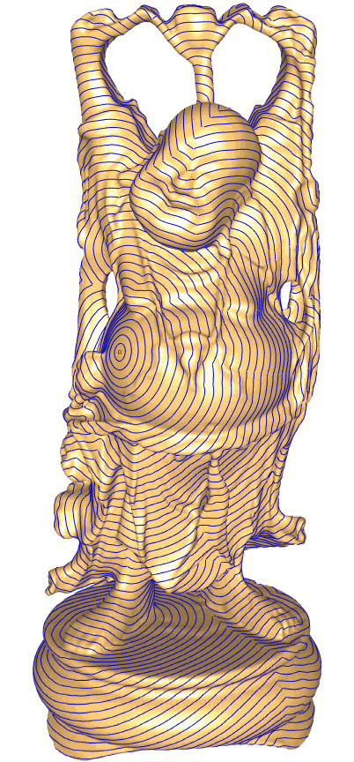
Exact algorithm – discussion
 | Time | Space
Worst case [MMP] | O(n²log n) | O(n²)
Typical case
Shortest path from any point back to source is obtained using backtracing
More geometric detail → fewer windows
Bottleneck is memory requirement: 700K triangles is biggest mesh for 1GB RAM.
Model with 400K faces runs on Pentium M 1.6GHz PC with 1GB RAM in 75 sec; 17 WPE
Notes:
Worst case complexity O(n^2 log n) is reached for the meshes that resemble a long strip, since the path may cross O(n) edges,
but usually the longest shortest path on the typical mesh crosses order square root of n edges, not n edges.
The shortest path from any surface point back to the source is reconstructed using backtracing: we reconstruct the path
using the unfolded source in the plane of each of successive triangles.
Less smooth models contain plenty of bumpy features, and adjacent windows annihilate each other when they are propagated over the humps or bumps on the mesh.
Model with 400K faces ran on a Pentium M 1.6GHz PC with 1GB RAM in 75.1 seconds which is not critical, but 700K triangles is the biggest mesh for 1GB RAM.

Slide 21
Approximating algorithm
Basic idea: merge windows
  two original windows must have direction values τ in agreement
  original windows must define similar distances on their union
  distance function along edge must be continuous
  visibility region of new window must cover the union of visibility regions of original windows
Notes:
Our algorithm for approximate shortest distances and shortest paths is based on
our exact algorithm.
The only difference is that for approximation we try to merge each window with its neighbors before propagating it.
The two adjacent windows on the edge qualify for merging if they have the same propagation direction and define similar
distances on their union.
The resulting window must define a continuous distance function on the edge,
that is the distances at the end-points of the union must stay unchanged
and the visibility region of the new window must at least cover the union of the visibility regions of the original windows
otherwise we can get not full coverage for the further edges.

Slide 22
Merging windows
Find a new source s = (x, y) and σ,
for which the distances at the end-points b₀ and b₁ are preserved:
s = (x, y) lies on a conic curve (quadratic algebraic curve)
s = (x, y) must lie in the yellow area – visibility must not be reduced) with
y > 0
σ > 0 corresponds to the pink area

Slide 23
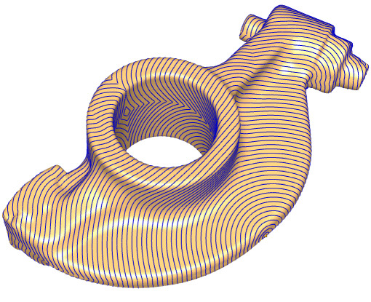
Approximating algorithm – discussion
Requires less time and space: time complexity is
Backtracing correctly finds shortest path (without looping)
Defines lower bound for geodesic distances
Guaranteed bounded error
Notes:
Our approximation algorithm has time complexity O(n log n) and space complexity O(n)
Thus it is faster than the exact algorithm and can be used for larger models.
Unlike many other approximating algorithms we can easily find the shortest paths from
any point on the mesh to the source by backtracing, using our window structure.
Our approximating algorithm provides a tight lower bound for the geodesic distances,
This property allows us to use this algorithm later on for computing exact path between two points on the mesh.
We can also control the error, or bound the maximal difference between the exact length of
the shortest path and the approximate distance that is output of the algorithm.

Slide 24
Shortest path between two vertices
Sequence of pruned searches to locate exact shortest path
Exact algorithm is invoked only on a thin region surrounding geodesic
Upper bound is the length of the current approximate path
Lower bound can be represented by Euclidean distance, and by the output of the approximating algorithm
Notes:
We use a sequence of pruned searches with narrowing distance bounds to locate the exact shortest path,
so that the exact algorithm need only be invoked on a thin region surrounding the solution.
For this algorithm we use upper and lower bounds for the geodesic distances.
upper bound comes current computed “short” path.
lower bound comes from Euclidean distance, and later from our approximation algorithm.

Slide 25
Shortest path between two vertices (cont’d)
D_{s}(p) + D_{t}(p) = D_{st}
L_{s}(p) + L_{t}(p) ≤ U_{st}
L_{s}(p) + L_{t}(p) ≤ D_{st}
Notes:
When we have the path between source and target the length of this path is
equal to the sum of the length of the path from the source to any point p on the path and
the length of the path from this point p to the target.
Therefore the sum of the lower bounds of these lengths is not larger then the length of the whole path and
is certainly not larger than the upper bound of the whole path’s length.
This inequality we use to build fast algorithm for finding an exact shortest path between two vertices on the mesh.

Slide 26
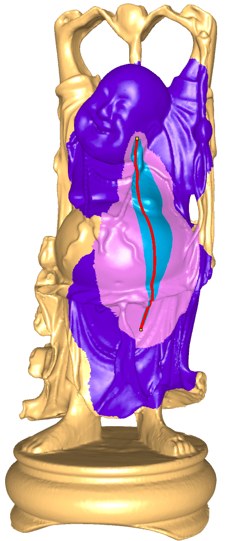
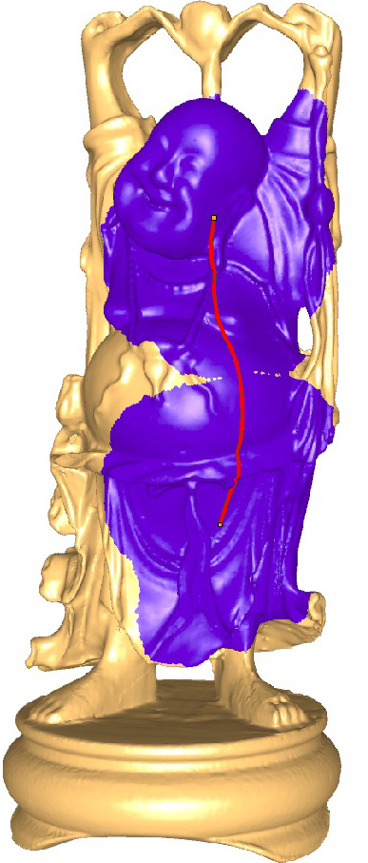
Shortest path between two vertices (cont’d)
Using Dijkstra search on edges, compute an U_{st} – use two simultaneous Dijkstra searches from v_{s} and v_{t} until they both meet a common vertex (violet).
Start our approximation search from v_{t} to v_{s} to define L_{t} in the region L_{t}(p) + |p – v_{s}| ≤ U_{st}
Using windows from approximation search we reconstruct the approximated path, define tight U_{st} as its length
Start our exact search from v_{s} to v_{t} and compute exact distances in the
region D_{s}(p) + L_{t}(p) ≤ U_{st}
Reconstruct the exact shortest path using windows from exact search
continuous A* search
Notes:
To find the exact shortest path between source and target vertices on the mesh, we first
compute the upper bound using Dijkstra algorithm.
We run two simultaneous Dijkstra searches from source and target until they meet a common vertex
and set the value of U_st as the sum of the lengths of the Dijkstra paths to this vertex.
Next we run the approximation algorithm from target to source only for edges that satisfy this inequality:
L_t is the lower bound computed by the approximation algorithm that we add to Euclidean distance to the source
and U_st is the length of the Dijkstra path.
Then we get the tighter upper bound value as the length of the approximated path, reconstructed by backtracing
from the windows of the approximation search.
Finally we run our exact search from source to the target in the region where exact distance plus approximated
distance do not exceed the tight upper bound.
The exact path is reconstructed using windows from the exact search.
The violet color marks the area covered by the Dijkstra search, pink corresponds
to the approximation search and the exact algorithm ran only in the narrow blue region.
The path on 1M triangle Buddha model, shown on the picture, was computed in 4 seconds.

Slide 27
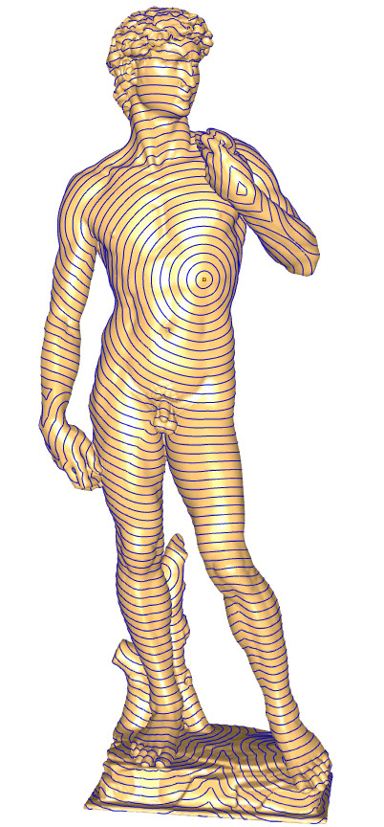
Experimental results
David model: 400K faces
on a Pentium M 1.6GHz PC with 1GB RAM
exact: 75 sec approx: 11 sec
exact: 17 WPE approx: 1.5 WPE
error: abs. max = 0.1% of the diameter
rel. ave = 0.05% of the diameter
very accurate!
Notes:
This David model contains 400K triangles.
The exact algorithm computed the distances from the source vertex to all points on the mesh in 75 seconds and produced in average 16 windows per edge.
The approximation with the error bound of 0.1% of the diameter (the difference between computed distance and the real shortest path length)
was computed in 11 seconds and the average relative error was equal to 0.05% of the model diameter.
The approximate algorithm produced one and a half windows per edge in average.

Slide 28
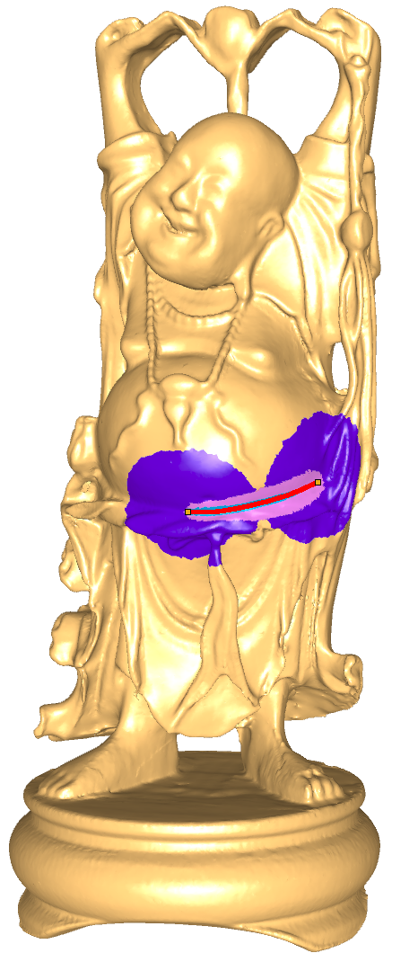
Experimental results (cont’d)
Buddha model: 1M faces
 | Dijkstra (sec) | Approx (sec) | Exact (sec) | Total (sec)
long | 0.5 | 1.3 | 2.6 | 4.4
short | 0.1 | 0.2 | 0.2 | 0.5
long short
Notes:
These are two examples of the computation of the exact shortest path on 1M Buddha model
The long path took a bit more than 4 seconds and the shorter one just half of a second.
Most time was spent for the most expensive exact algorithm although it ran just in a small region.

Slide 29
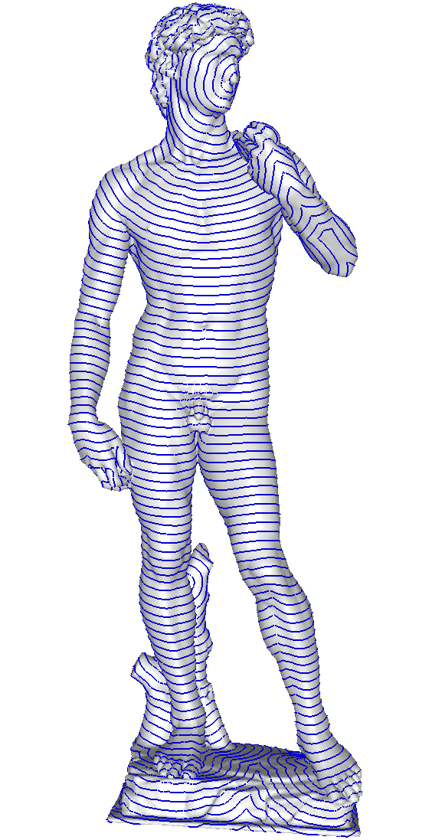
Conclusions
Practical exact algorithm
  Typical time complexity:
  Smoother meshes → more windows
  The bottleneck is memory
Even more practical approximating algorithm
  Guaranteed bounded error
  Computationally efficient: time complexity:
  Provides lower bound for geodesic distance function
Algorithm finding exact geodesic path between two vertices
Notes:
We have presented a practical algorithm for finding exact shortest paths and minimal distances on a mesh.
The algorithm runs faster for noisy meshes and demands more time and memory for smoother meshes.
The bottleneck of the algorithm is memory requirement.
Even more practical is the presented approximating algorithm.
It runs faster, requires much less memory and provides control over the error.
It also provides a lower bound for the geodesic distance function, i.e. the output distances do not exceed the actual geodesic distance.
This property is used for fast finding the exact shortest path between two vertices on the mesh that works for
very large meshes.

Slide 30
Thank you!

