Slide 1
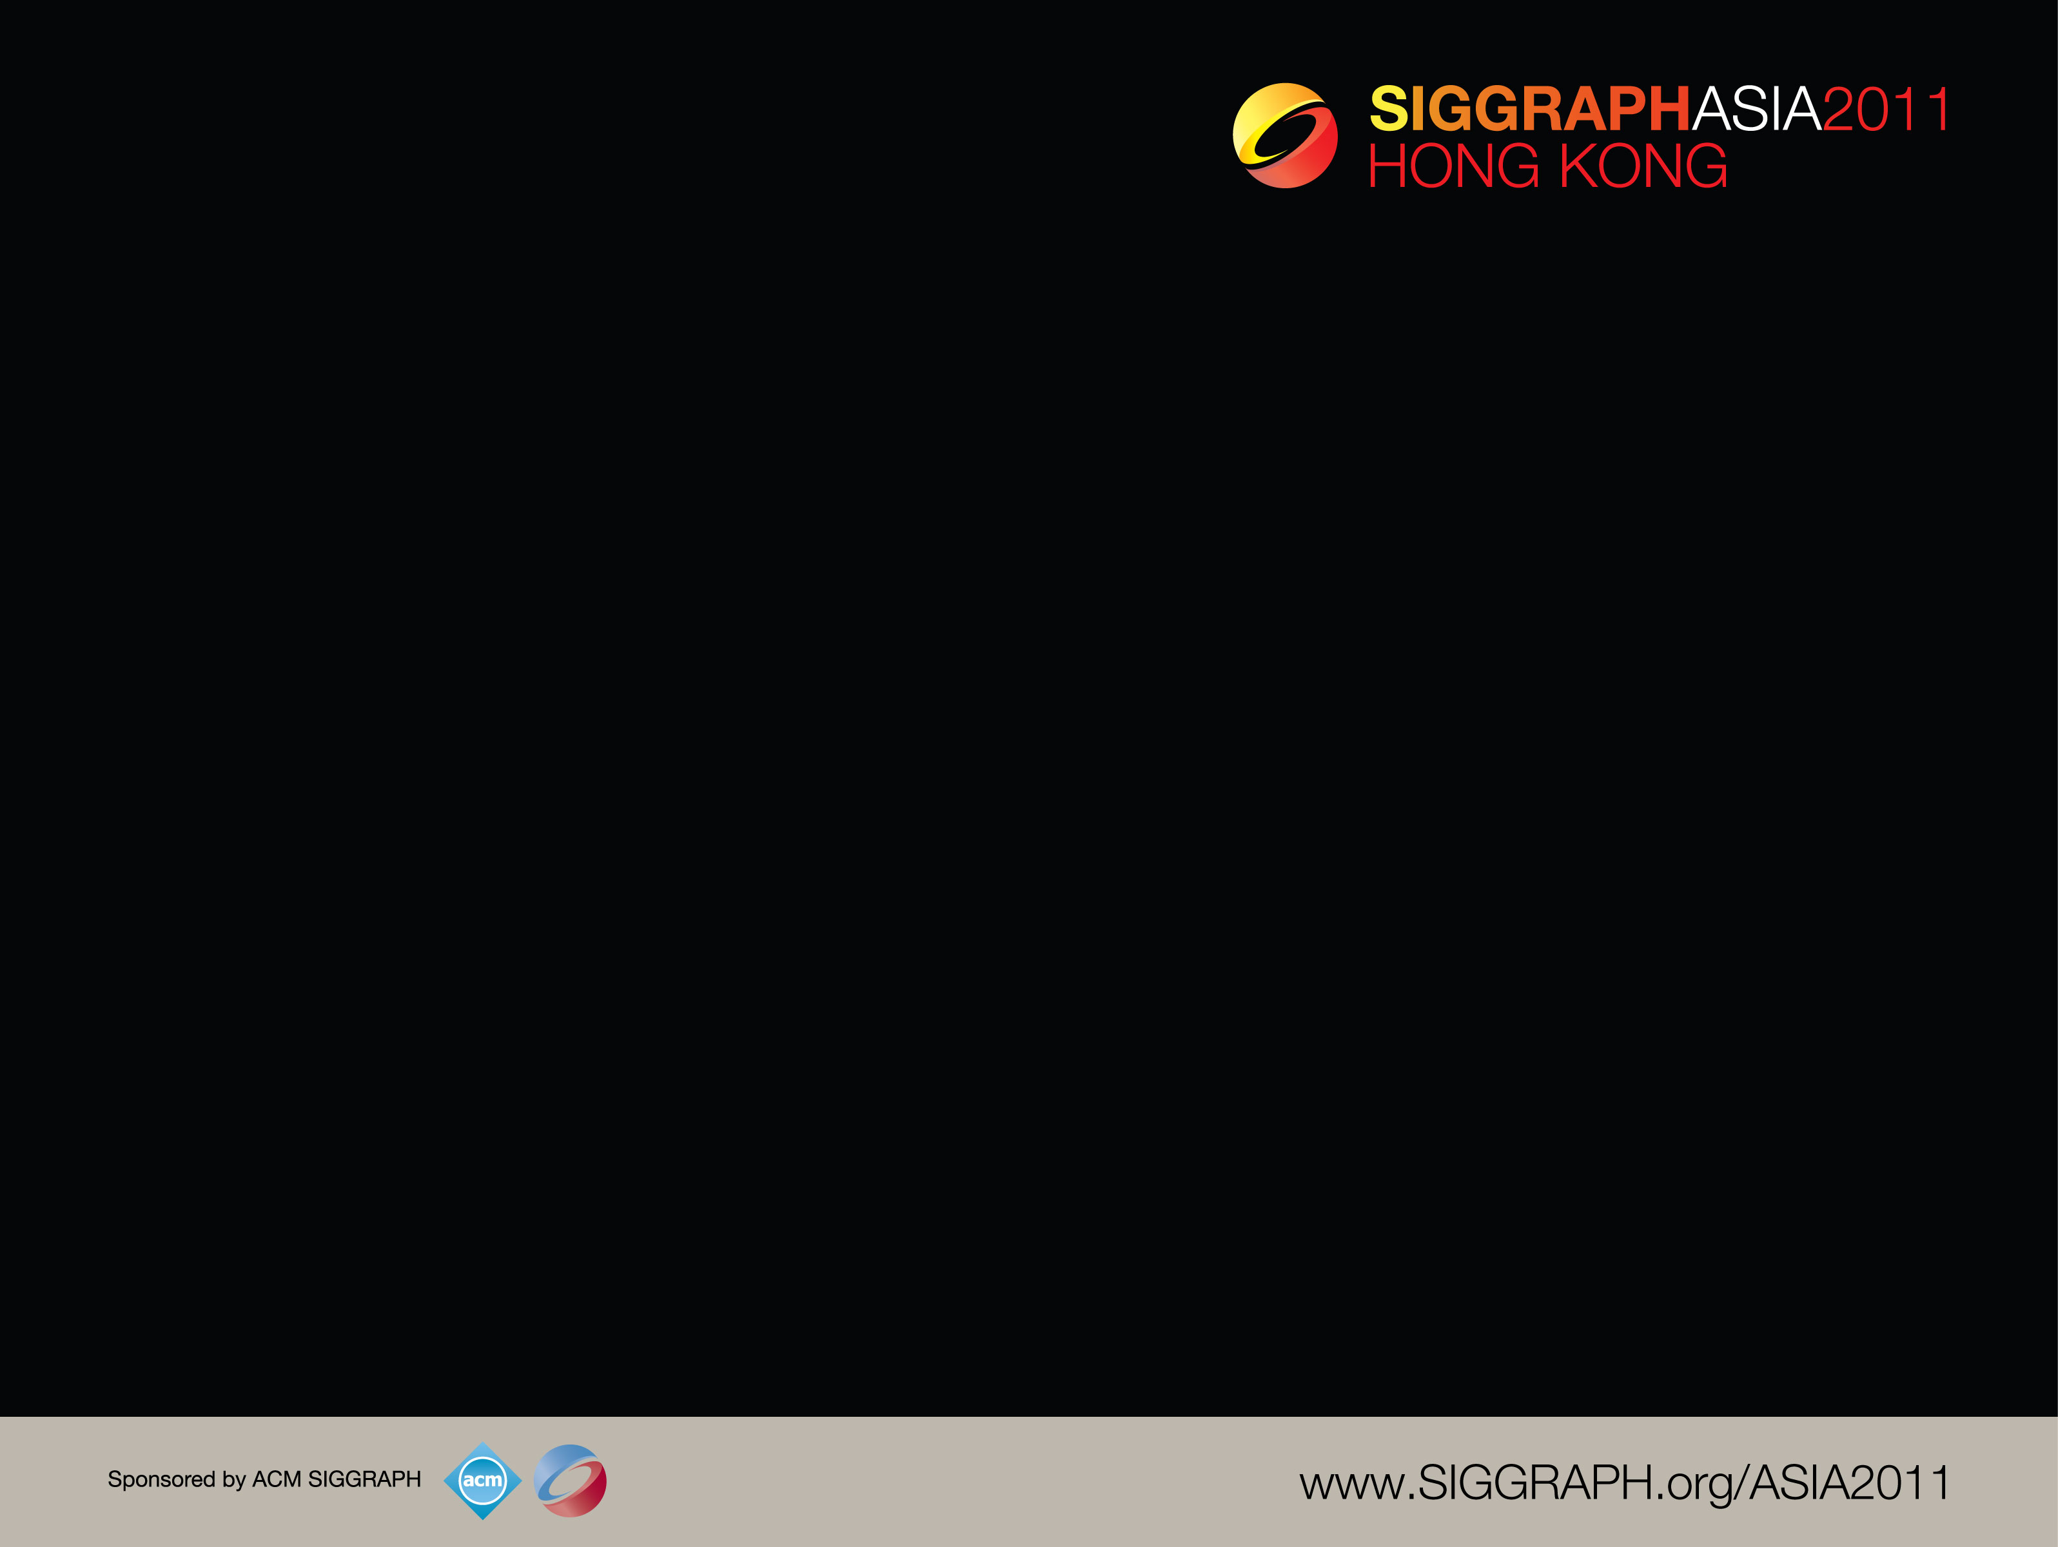
Freeform Vector Graphics with Controlled Thin-Plate Splines
Mark Finch John Snyder Hugues Hoppe
Microsoft Research

Slide 2
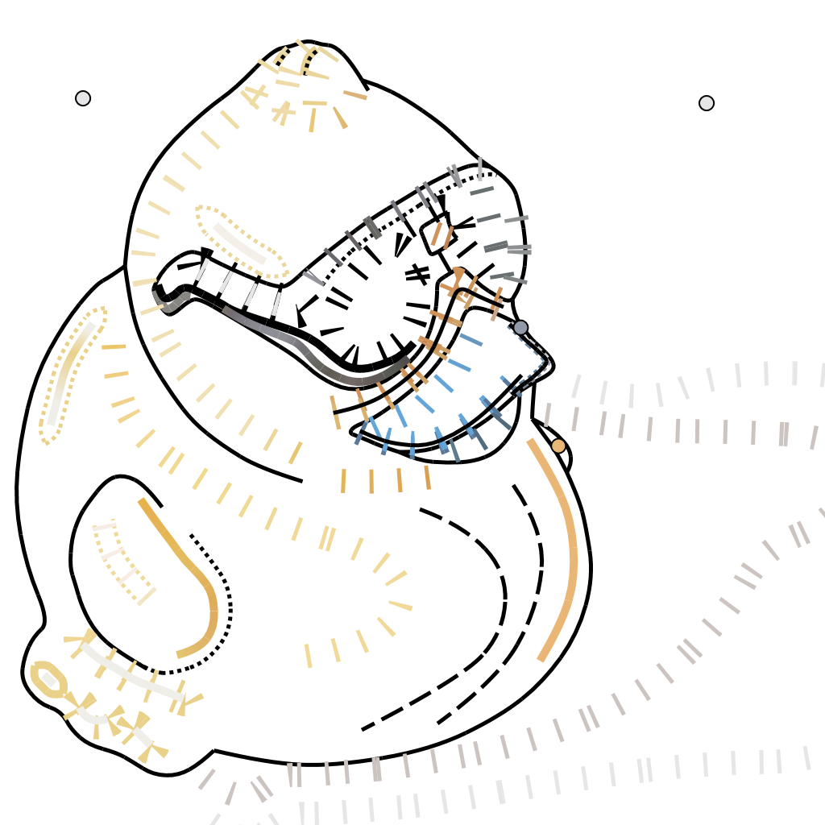
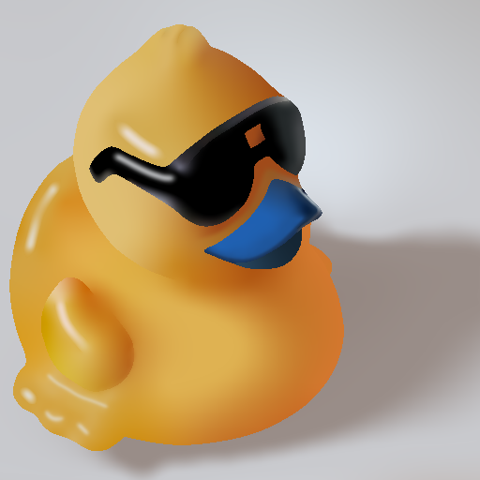
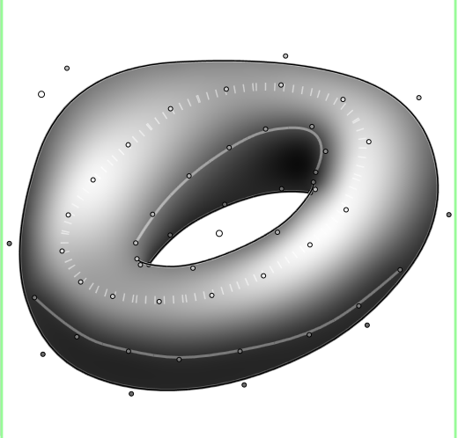
Freeform Vector Graphics
Notes:
We present a variational system of freeform vector graphics which extends the range of imagery representable by vector graphics while simplifying user input.
Vector graphics offer several key advantages over other image formats; being compact, easy to edit, and highly scalable. This last feature is of especial importance with today’s wide range of displays from smart phones to hi-definition monitors.

Slide 3
Traditional Vector Graphics
Notes:
Traditional vector graphics independently fill each closed shape with a simple function. In practice, this limits the variety of images that can be created.

Slide 4
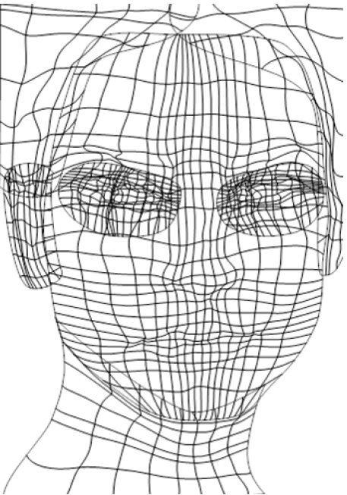
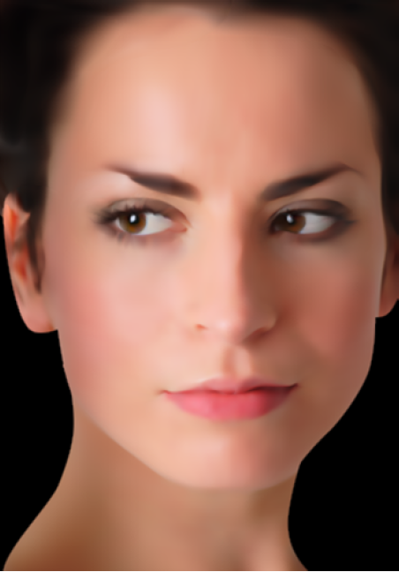
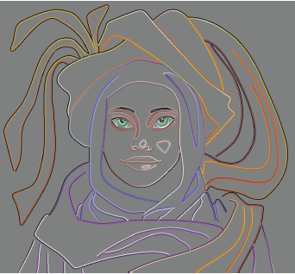

Previous Work
gradient meshes
[Adobe Illustrator]
diffusion curves (DCs)
[Orzan et al. 2008]
[Jeschke et al. 2009]
[Bezerra et al. 2010]
…
Notes:
Some exciting recent work has developed more global methods.
Gradient meshes smoothly interpolate colors between specified curves, but depend on regular quad meshes that can be cumbersome to manipulate.
Diffusion curves (or “DCs” for short) allow a more flexible curve network and interpolate colors along each side of the curves and across intervening areas. Our work builds on this variational notion of color interpolation.

Slide 5
Contributions
Thin plate spline interpolation
Derivative constraints
Efficient solver
Compound curves
Notes:
Our contributions to this body of work include:
<*> A higher order interpolation to provide smoother results
<*> The addition of derivative constraints, to give explicit control over color flow
<*> An efficient solver to allow interactive editing
<*> And compound curve types to allow greater control from less user input.

Slide 6
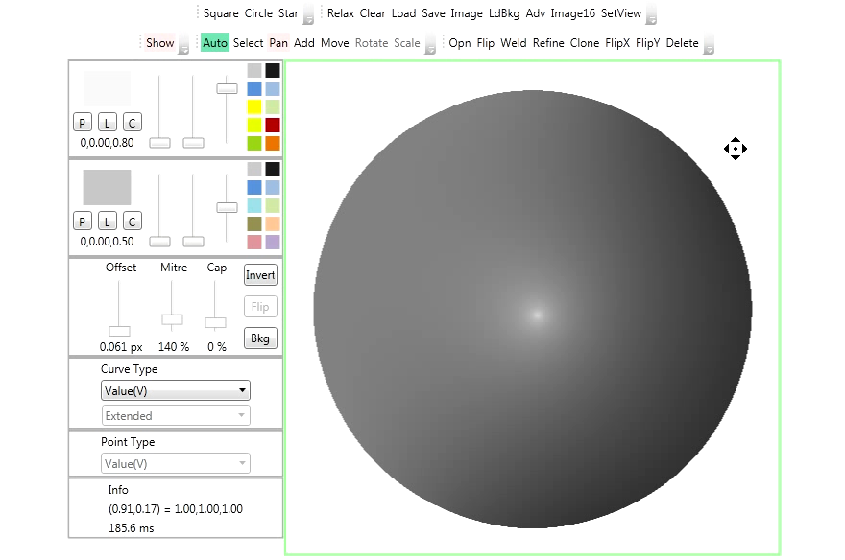
Point Constraints with Diffusion
Notes:
Diffusion curves are based on Laplacian diffusion. One of its problems is that it causes a derivative discontinuity at constraints.
Here, the center point is constrained to have a bright value. The result is a tent-like reconstruction which looks unnatural.

Slide 7
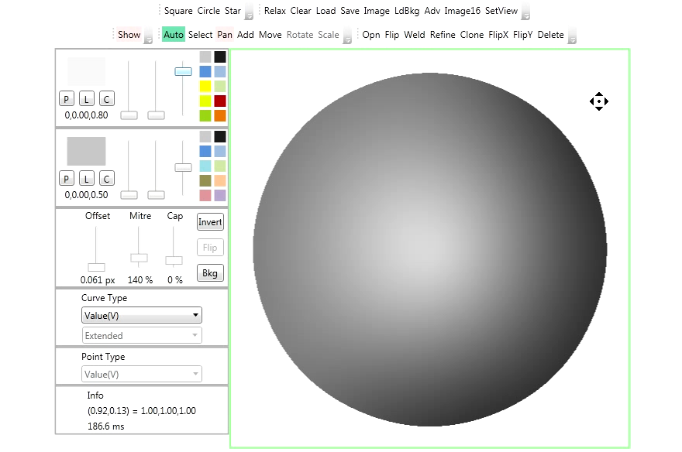
Point Constraints with TPS
Notes:
Our method adapts thin-plate splines (or “TPS” for short).
Notice the smooth interpolation through the bright point constraint.

Slide 8
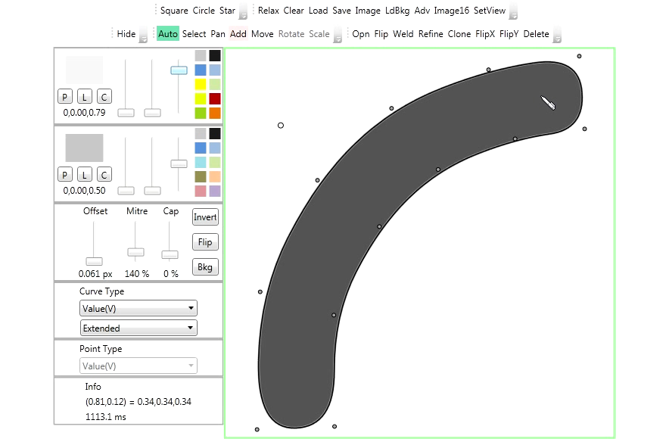
Curve Constraints with Diffusion
Notes:
Diffusion curves create similar artifacts at curve constraints. The bright value along this middle curve becomes an unwanted crease.

Slide 9
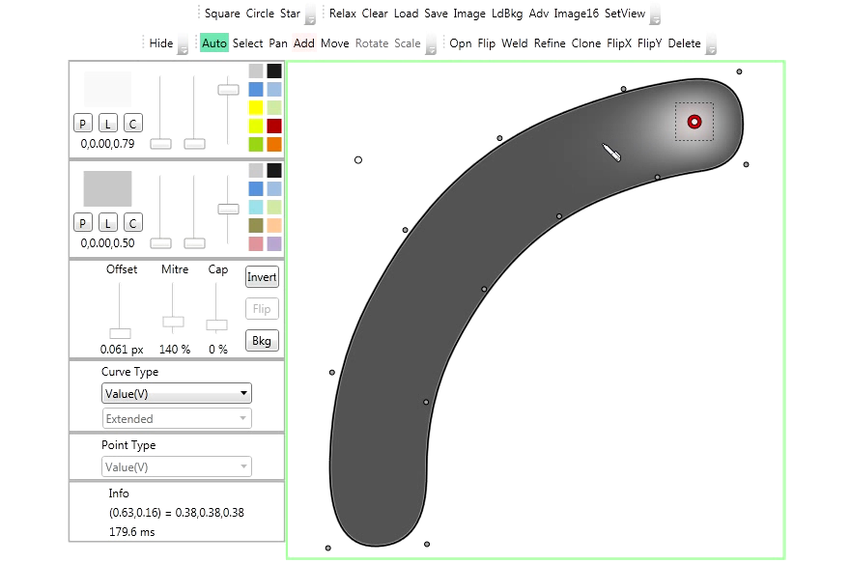
Curve Constraints with TPS
Notes:
Thin plate spline interpolation eliminates this smoothness discontinuity.

Slide 10
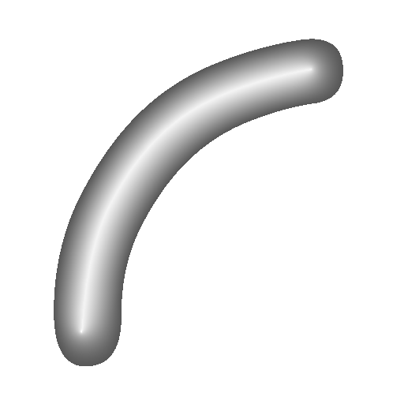
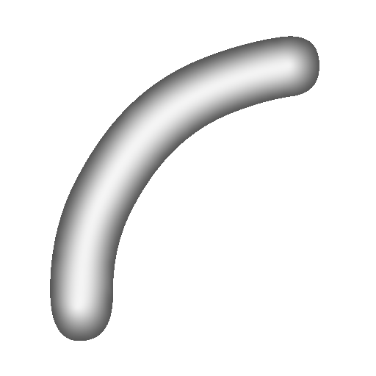
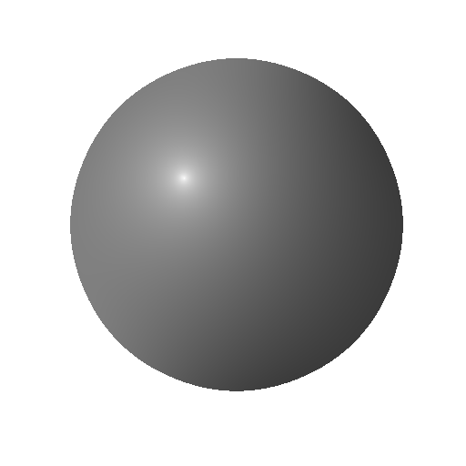
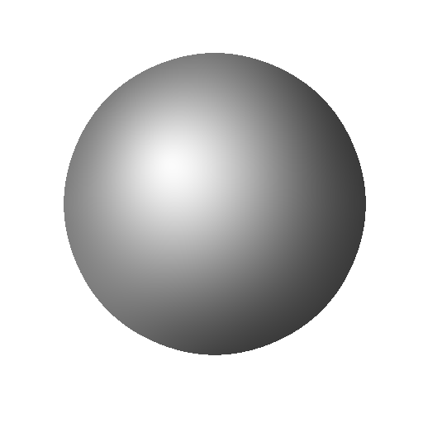
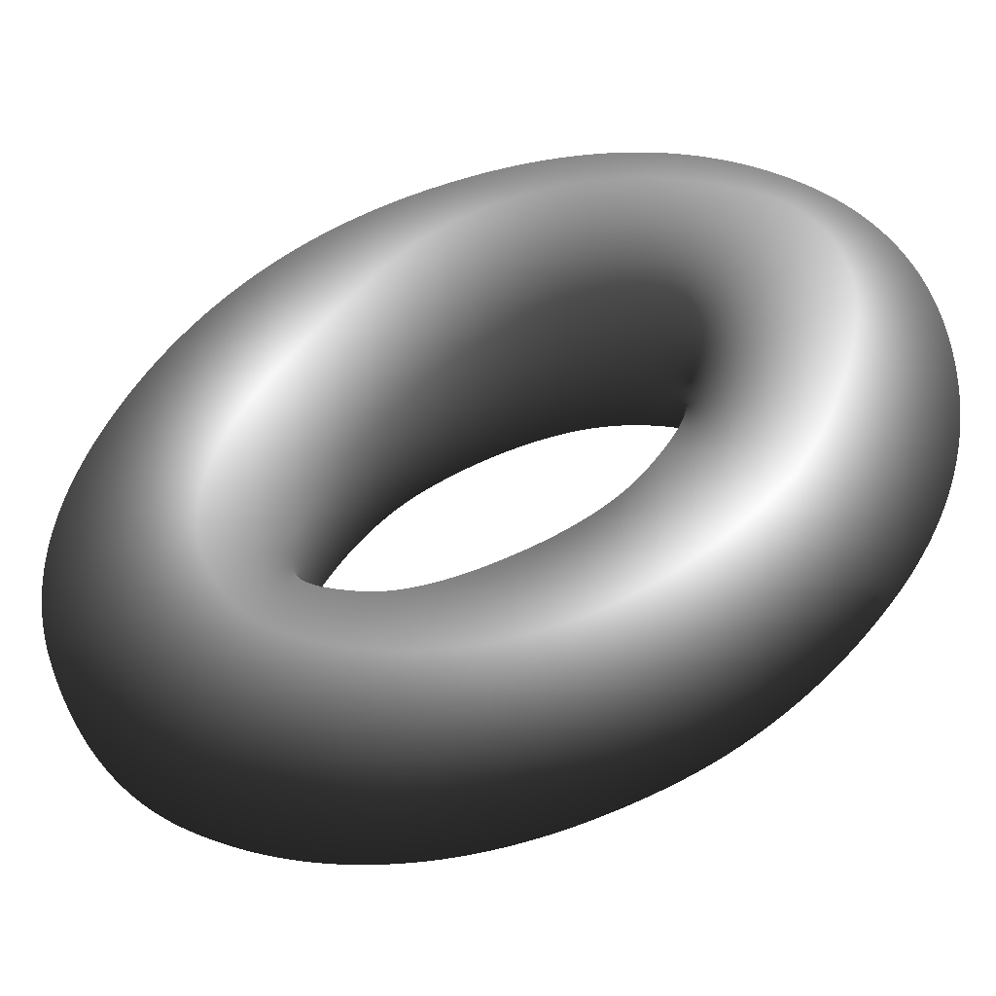
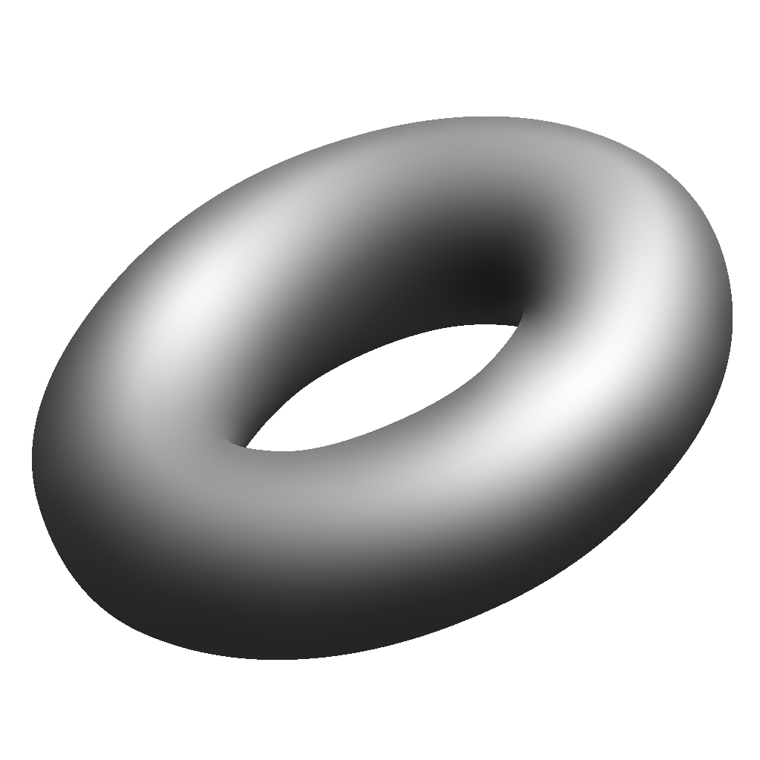
Smoothness Comparison
diffusion
TPS
Notes:
Here is a side-by-side comparison.
We get a “fuller”, “rounder”, more natural-looking interpolation with thin plate splines than with Laplacian diffusion, and without unwanted tents and creases.
When they are wanted, creases can still be specified explicitly in our method.

Slide 11
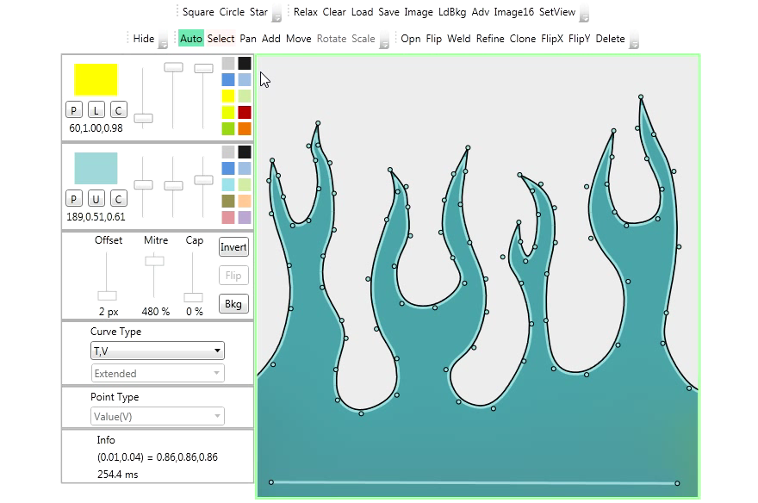
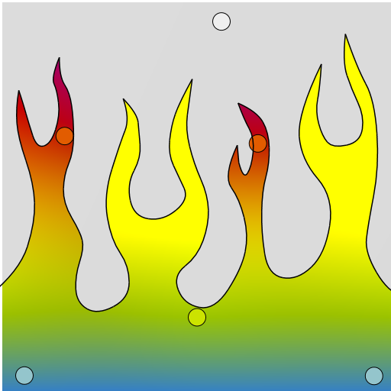
Filling with Diffusion
Notes:
Another problem with Laplacian diffusion is that it makes filling an irregularly-shaped region tedious. Colors must be specified along the complicated boundary.
That’s because smoothness is broken at diffusion curve value constraints.

Slide 12
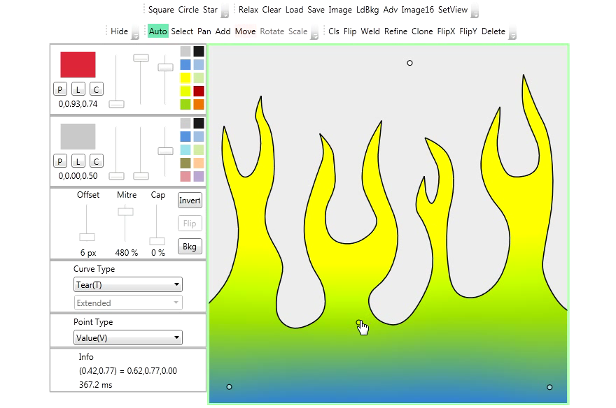
Filling with TPS
Notes:
Thin-plate interpolation, with just a few point constraints, smoothly fills an arbitrary shape, right up to its boundary.

Slide 13
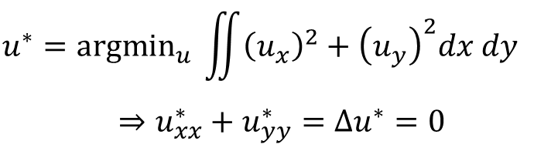
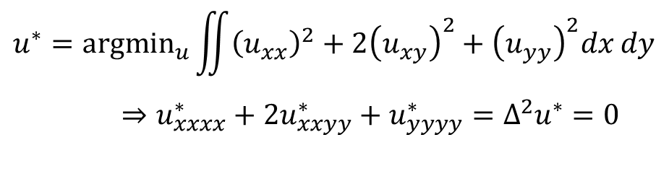
Diffusion vs. TPS
Laplacian diffusion:
as constant as possible
$$u^{∗}={argmin}_{u} \iint{{\left(u_{x}\right)}^{2}+{\left(u_{y}\right)}^{2}dx dy}⇒u_{xx}^{∗}+u_{yy}^{∗}=Δu^{∗}=0$$
TPS:
as harmonic as possible
$$u^{∗}={argmin}_{u}\iint{{\left(u_{xx}\right)}^{2}+2{\left(u_{xy}\right)}^{2}+{\left(u_{yy}\right)}^{2}dx dy}⇒u_{xxxx}^{∗}+2u_{xxyy}^{∗}+u_{yyyy}^{∗}=Δ^{2}u^{∗}=0$$
Notes:
We’ll begin by looking at the math in the continuous setting, without any constraints.
Laplacian diffusion minimizes the sum of squares of first derivatives in x and y. The minimum thus wants to be as constant as possible. The solution is a PDE in which the harmonic or sum of second derivatives is 0.
The thin-plate spline minimizes the sum of squares of second derivatives, and seeks a solution that is as harmonic, or as smooth, as possible. The resulting PDE is the biharmonic equation, involving sums of fourth derivatives.

Slide 14


Laplacian Diffusion (in 1D)
membrane energy: $\min_{u}{\int{{(u_{x})}^{2}dx }}$
diffusion curves
color $u$
1D spatial coordinate $x$
Notes:
Let’s look more closely in a 1D setting.
Diffusion minimizes squared first derivatives.
<*> In 1D, the solution is piecewise-linear.
<*> Notice that a diffusion curve with two identical colors on each side <*> leads to a discontinuous derivative, breaking apparent smoothness.
Also, beyond an outermost constraint, <*> the function remains constant rather than extrapolating.

Slide 15

Our Approach: TPS (in 1D)
thin-plate energy: $\min_{u}{\int{{(u_{xx})}^{2}}dx}$
constraints
color $u$
$$\frac{∂u}{∂x}=0$$
1D spatial coordinate $x$
Notes:
A thin-plate spline minimizes an objective based on second derivatives.
The <*> reconstruction passes smoothly <*> through specified values, and extrapolates <*> naturally.
<*> Derivatives can also be constrained, <*> and the solution adapts accordingly.

Slide 16

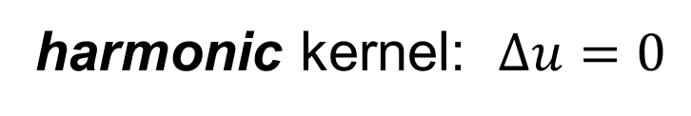












Diffusion Discretization (2D)
$$\min{∑pixels{(D}_{x}^{2}+D_{y}^{2}})$$
$$D_{x}$$
$$\text{−1}$$
$$\text{+1}$$
$$\text{+}\text{1}$$
$$D_{y}$$
$$\text{−1}$$
pixels
$$Δ$$
harmonic kernel: $Δu=0$
$$\text{−}\text{1}$$
$$\text{−}\text{1}$$
$$\text{4}$$
$$\text{−}\text{1}$$
$$\text{−}\text{1}$$
Notes:
Now let’s look at the 2D discretization, first examining the simpler Laplacian diffusion. Like our approach, it uses a regular grid.
The Laplacian objective sums terms based on pairs of adjacent pixels, representing the numerical derivative in x or y.
To solve the global problem, we collect all the objective terms that a particular pixel participates in, and compute their partial derivatives with respect to the pixel’s value.
This should be zero at the minimizing solution, for every pixel.
<*> The solution satisfies this harmonic kernel: every pixel must equal the average of its four neighbors.

Slide 17












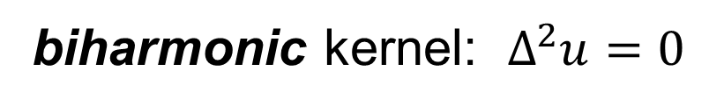

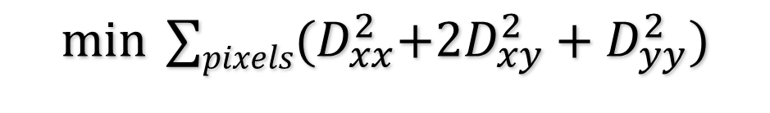













TPS Discretization (2D)
$$\min{∑pixels{(D}_{xx}^{2}+2D_{xy}^{2}+D_{yy}^{2}})$$
$$D_{xx}$$
$$D_{xy}$$
$$\text{−1}$$
$$\text{2}$$
$$\text{−1}$$
$$\text{−1}$$
$$\text{1}$$
$$\text{−1}$$
$$D_{yy}$$
$$\text{1}$$
$$\text{−1}$$
pixels
$$\text{2}$$
$$\text{−1}$$
$$Δ^{2}$$
$$\text{1}$$
biharmonic kernel: $Δ^{2}u=0$
$$\text{2}$$
$$\text{−8}$$
$$\text{2}$$
$$\text{1}$$
$$\text{−8}$$
$$\text{20}$$
$$\text{−8}$$
$$\text{1}$$
$$\text{2}$$
$$\text{−8}$$
$$\text{2}$$
$$\text{1}$$
Notes:
The thin plate spline objective uses three different terms for second derivatives in x, y, or mixed.
In the absence of features, <*> the solution is biharmonic, satisfying this larger kernel.
Constraints or discontinuities modify or remove objective terms, which in turn will adjust this kernel at different pixels.

Slide 18



Building the TPS Kernel:
$$D_{xx}$$
$$D_{yy}$$
$$D_{xy}$$
Notes:
Lets take a closer look at how this biharmonic kernel is built up, at a particular pixel <*> shown here in red.
This pixel participates in 3 <*> second derivative objective terms along x, which we called Dxx terms, one to each side and one centered over the pixel.
<*> There are 3 analogous Dyy terms in the y direction.
<*> Finally, there are 4 objective components from mixed partials, which we call Dxy terms.

Slide 19





Building the TPS Kernel:
Total
1
2
$$−8$$
2
1
$$−8$$
$$20$$
$$−8$$
1
2
$$−8$$
2
1
Notes:
Taking the sum of partial derivatives over all of these components of the objective function, with respect to that particular pixel’s value, yields this biharmonic kernel.
Again, this kernel will be modified if the pixel is near some feature like a discontinuity or constraint.

Slide 20
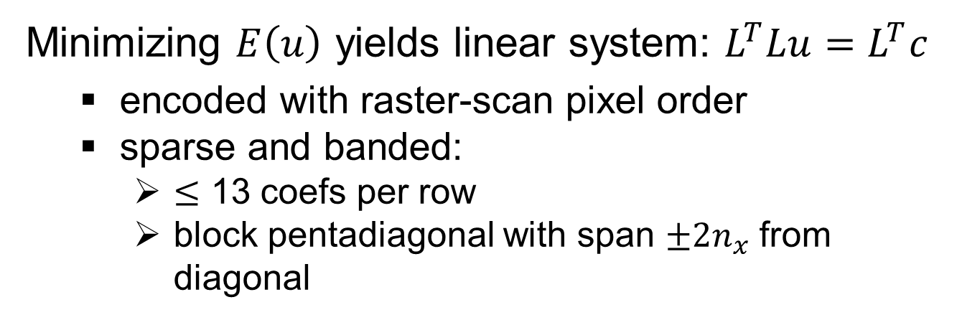
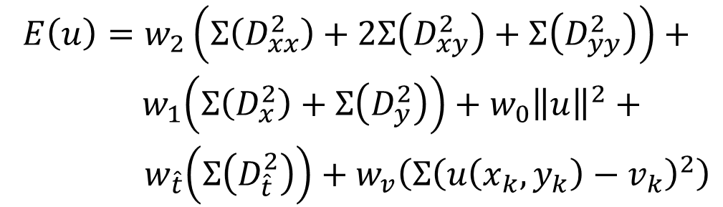

Overall System
$$\begin{matrix}E\left(u\right)=w_{2}\left(Σ\left(D_{xx}^{2}\right)+2Σ\left(D_{xy}^{2}\right)+Σ\left(D_{yy}^{2}\right)\right)+ \\ { w}_{1}\left(Σ\left(D_{x}^{2}\right)+Σ\left(D_{y}^{2}\right)\right)+w_{0}{\left\|u\right\|}^{2}+ \\ { w}_{\hat{t}}\left(Σ\left(D_{\hat{t}}^{2}\right)\right)+w_{v}\left(Σ{\left(u\left(x_{k},y_{k}\right)−v_{k}\right)}^{2}\right)\end{matrix}$$
TPS
Smoothness
Regularize
Constant
Regularize
Zero
Constrain
Derivatives
Constrain
Values
$$={\left\|Lu−c\right\|}^{2}$$
Minimizing $E\left(u\right)$ yields linear system: $L^{T}Lu=L^{T}c$
  encoded with raster-scan pixel order
  sparse and banded:
    $≤$ 13 coefs per row
    block pentadiagonal with span $±2n_{x}$ from diagonal
Notes:
Putting everything together, the overall objective we minimize looks like this.
<*> It consists of terms involving thin plate spline smoothness,
<*> a regularization term with a very small weight that drives the solution to be constant,
<*> and a second regularization term, also with a very small weight, that drives it to zero,
These two regularization terms keep the system well behaved when under-constrained.
<*> These terms, which we’ll look at more closely in a moment, constrain derivatives,
<*> and finally we have terms to constrain values.
<*> E(u) is a quadratic function; minimizing it yields a linear system to solve.
The system we obtain is sparse and banded. It contains no more than 13 nonzero coefficients per row, with a span of +/-2 image rows away from the diagonal.
[JMS: Include diagrams for banding structure, suitably narrated ;)]
Make diagram showing overall matrix structure?
Compare to Laplacian with 5 coefs per row, $±n_{x}$ span from diagonal.
Regularization?

Slide 21
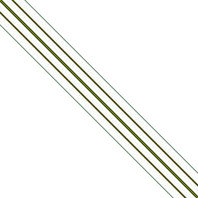
Overall System
Minimizing $E\left(u\right)$ yields linear system: $L^{T}Lu=L^{T}c$
  encoded with raster-scan pixel order
  sparse and banded:
    $≤$ 13 coefs per row
    block pentadiagonal with span $±2n_{x}$ from diagonal
Notes:
For a 16 by 16 image, we obtain a 64 by 64 matrix, whose structure is depicted here with non-zero elements as colored pixels.

Slide 22
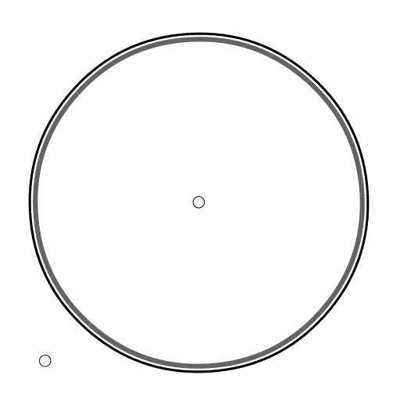
Curve Types
Notes:
To illustrate the basic curve types, we’ll examine a simple test case. We have here a circle which has a dark value along the inside perimeter, and a light point in the center… <*>

Slide 23
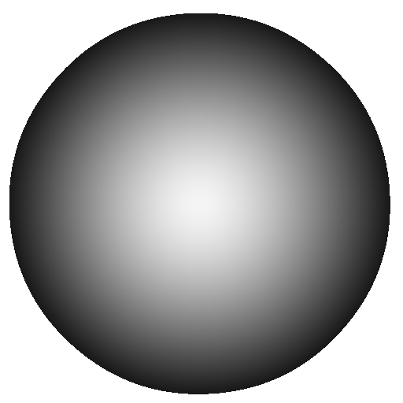
Curve Types
Notes:
… creating this smooth radial gradient.

Slide 24
Curve Types
Notes:
We’ll now add a tear curve to break the smoothness. <*>

Slide 25
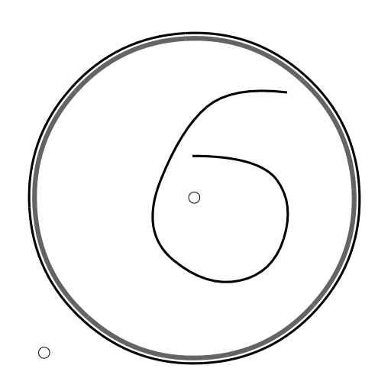

Tear Curves
Notes:
A tear curve breaks all continuity across the curve. It is analogous to the “diffusion barrier” of Bezerra and company.
This tear is roughly the shape of the number six. It breaks the flow to the left from the light point, but makes a gradient through the opening to the right.

Slide 26
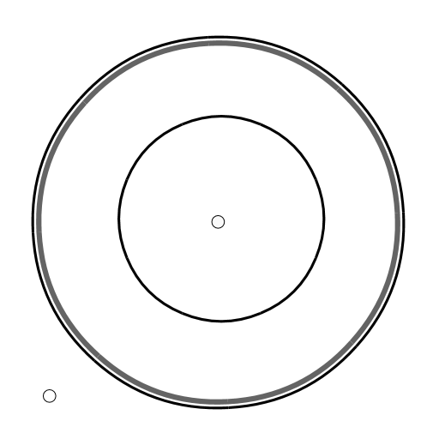

Tear Curves
Notes:
Because this circular tear isolates the light point from the dark perimeter, it creates two flat shaded regions.

Slide 27
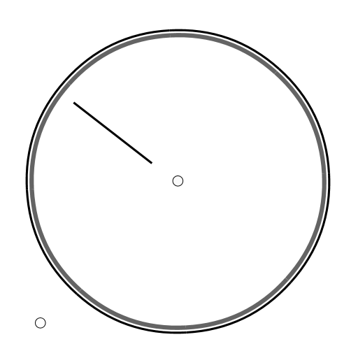
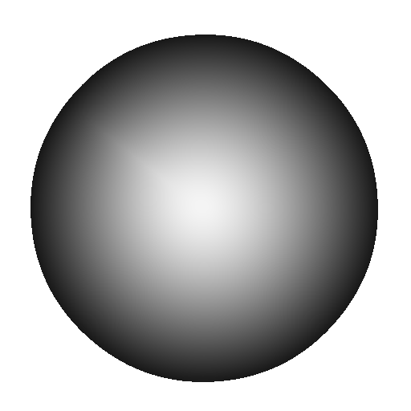
Tear Curves
Notes:
Here, this radial tear has very little effect. The colors remain continuous, because the symmetry makes the solution the same on either side of the line. But it does break the smoothness.

Slide 28
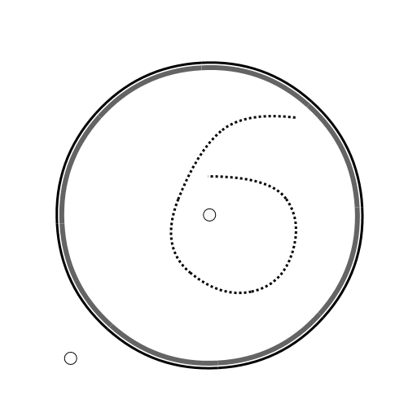
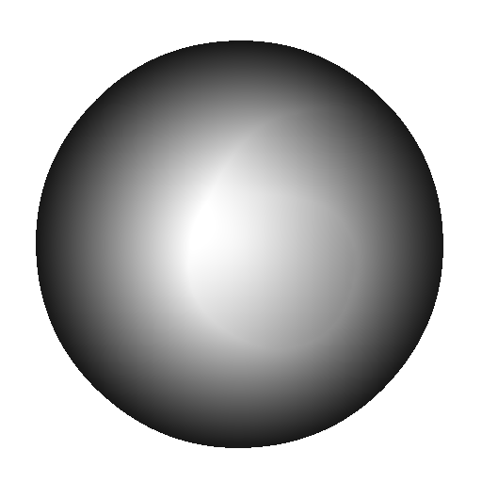
Crease Curves
Notes:
Now let’s look at the effect of crease curves. Crease curves retain continuity across the curve, but break smoothness, creating a more subtle effect than the tear curve. The six here is just visible.

Slide 29
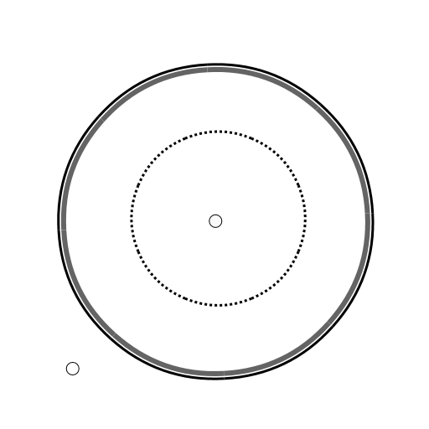
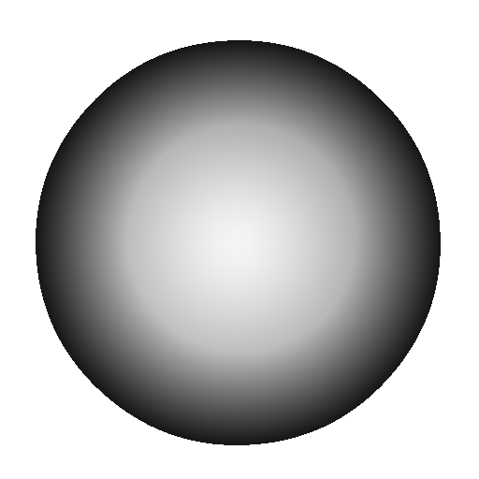
Crease Curves
Notes:
This circular crease forms a mock band around the center.

Slide 30
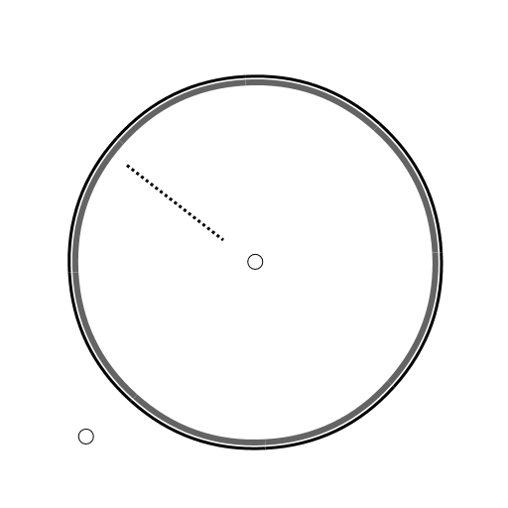

Crease Curves
Notes:
Again, because of symmetry, this radial crease is visually identical to the radial tear, marked only by a break in smoothness.

Slide 31
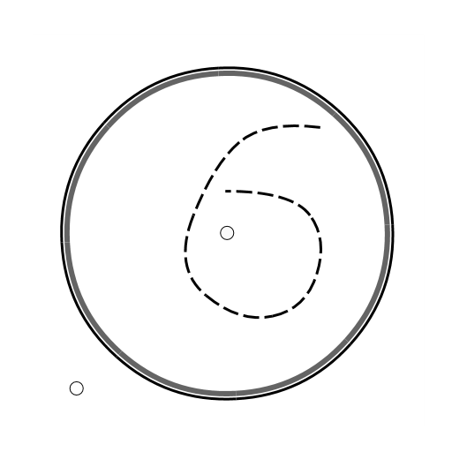
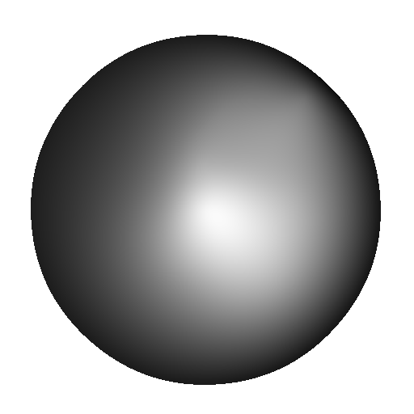
Contour Curves
Notes:
The contour curve creates a directional zero derivative along the curve. This maximizes a constant value along the curve.

Slide 32

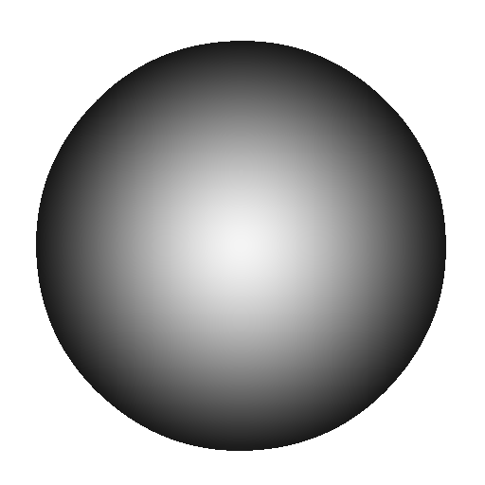
Contour Curves
Notes:
The circular contour curve here has no effect, because the circle is already an iso-curve.

Slide 33

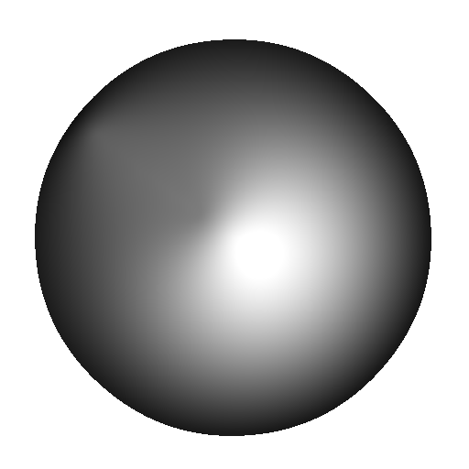
Contour Curves
Notes:
But it has a strong effect on the radial line, brightening the dark region in the upper left and darkening toward the center.

Slide 34

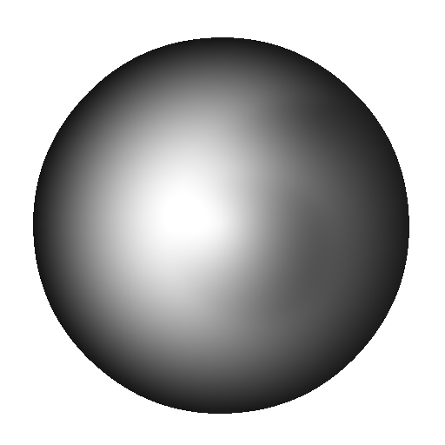
Slope Curves
Notes:
In contrast to the contour curve, the slope curve creates a zero derivative _across_ the curve. Here it forms a flat path along the six.

Slide 35
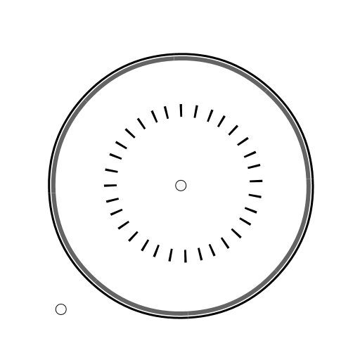
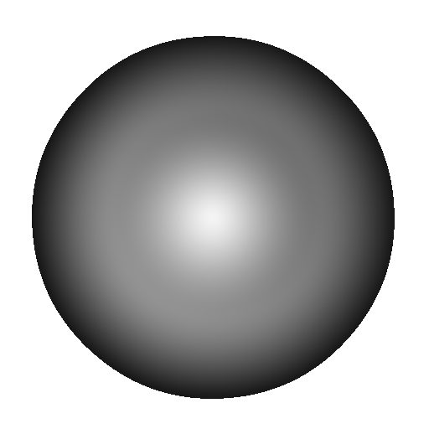
Slope Curves
Notes:
For the circle, it creates an inflection point in the gradient from dark to light.

Slide 36

Slope Curves
Notes:
And finally, the radial slope line has no effect, because the derivative across the curve is already zero for a radial gradient.

Slide 37


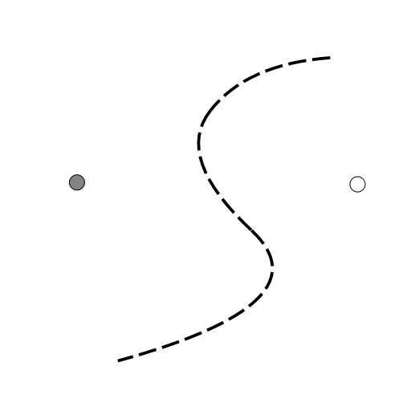

Controlling Shading with Contours
Notes:
Combining this contour curve with a linear ramp shows how it can subtly shape the color flow.
Note that the contour curve doesn’t specify any values, only derivatives. If the gradient end point colors are changed <*>…

Slide 38
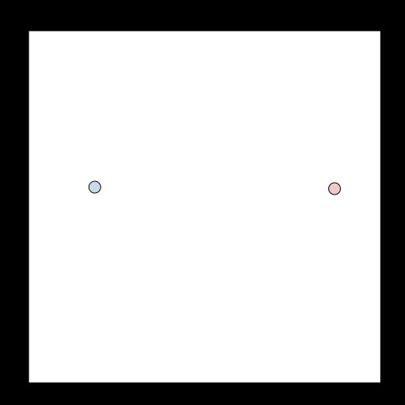

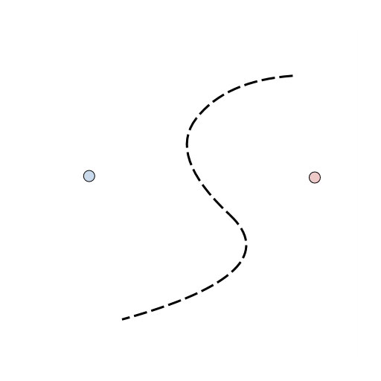

Controlling Shading with Contours
Notes:
… the new colors flow as before.

Slide 39
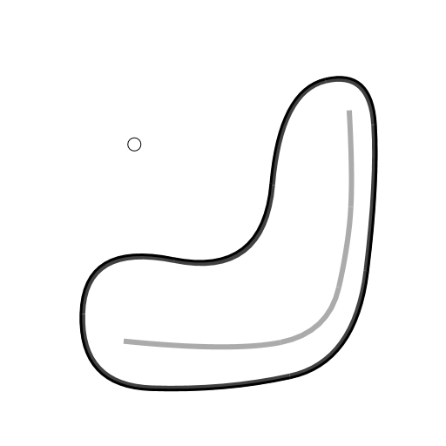



Controlling Highlights with Slope-Value
Notes:
By itself, a value curve constrains color but not the location of the shading maximum. In this case, the maximum naturally falls somewhere in the middle of the shape, and is not coincident with the value curve.
<*> Letting the same curve combine both a slope and a value constraint allows smooth and precise specification of a shading highlight.
Because the different curve effects are orthogonal, we can combine them into useful compound curves like this value slope curve.

Slide 40


Compound Curves
Notes:
Another compound curve, which was shown to be useful in Bezerra 2010, combines a value on one side and a tear on the other.

Slide 41


Compound Curves
Notes:
We can take this idea further by generating curves at an offset from the primary curve. For example, generating these two value slope lines creates a soft transition between the two regions.

Slide 42


Compound Curves
Notes:
The blurriness of the transition can be adjusted by widening the offset between the generated curves. The black medial line drawn by the user is a no-op here.

Slide 43


Compound Curves
Notes:
By generating an offset tear curve around the value curve, we form a fat line.

Slide 44


Compound Curves
Notes:
Again, the width of the line can be easily adjusted.

Slide 45


Compound Curves
Notes:
Here we’ve softened the line, by replacing the offset tear curves with value crease curves.

Slide 46


Compound Curves
Notes:
And adjust the offset to widen the line.

Slide 47

System Implementation
Notes:
At a high level, the system proceeds as follows.
We begin with the resolution independent set of points and curves supplied by the user.

Slide 48

System Implementation
Notes:
We rasterize these at a coarse level, typically 64 square while interactively editing, and 128 square for a final static image.

Slide 49
System Implementation
Notes:
The rasterization builds the matrix of objective terms, which would be 4K by 4k for a 64 square image. However, the sparse banded structure of the matrix makes its solution efficient.

Slide 50
System Implementation
Cholesky Solver
Notes:
We feed that system into a Cholesky solver <*>

Slide 51

System Implementation
Cholesky Solver
Notes:
to obtain a coarse version of the final image.

Slide 52

System Implementation
Upsample
Notes:
We use a discontinuity aware upsampler to create <*> an initial image at the next higher resolution.

Slide 53



System Implementation
Gauss-Seidel
Solver
Upsample
Notes:
We then rasterize the user curves again at this higher resolution. <*> We feed the new linear system and the initialization from the coarser level into a Gauss-Seidel solver for a small number of iterations <*> to produce a new image at this resolution.

Slide 54



System Implementation
Gauss-Seidel
Solver
Upsample
Notes:
We now upsample to initialize the next level <*>

Slide 55


System Implementation
Gauss-Seidel
Solver
Upsample
Notes:
… and repeat the process until the desired resolution is reached.

Slide 56
Tear Curve Removes Terms
Notes:
We’ve seen how the thin plate spline smoothness kernel is built up around each pixel. We now examine how it is adjusted in the presence of feature curves.
We’ll start with a tear curve removing smoothness terms.
Let’s see how this works for the example curve drawn here in red.

Slide 57
Tear Curve Removes Terms
Notes:
The curve first intersects this pixel edge.

Slide 58
Tear Curve Removes Terms
Notes:
No Dyy terms are affected because the edge is horizontal.

Slide 59
Tear Curve Removes Terms
Notes:
Two Dxx triplets <*> contain the torn edge. <*> Each of these is removed. <*>

Slide 60
Tear Curve Removes Terms
Notes:
Of the Dxy mixed terms, the ones above <*> and below <*> contain this edge and are also removed.

Slide 61
Tear Curve Removes Terms
Notes:
We advance to the next intersection, again a horizontal edge.

Slide 62
Tear Curve Removes Terms
Notes:
Again, two straddling Dxx terms are removed. Since one of the Dxy quad terms has already been removed, <*> we remove only the upper term now.

Slide 63
Tear Curve Removes Terms
Notes:
We advance forward and hit another horizontal edge.

Slide 64
Tear Curve Removes Terms
Notes:
And again remove two Dxx triplets and a single Dxy quad.

Slide 65
Tear Curve Removes Terms
Notes:
Now the curve hits a vertical edge, and we remove two Dyy terms and a Dxy term.

Slide 66
Tear Curve Removes Terms
Notes:
Continuing along the curve, we remove all terms which involve any intersected edge.

Slide 67
Bilinear Point Value Constraints
Notes:
Now let’s look at how our system handles value constraints.

Slide 68













Bilinear Point Value Constraints
$$(w_{00}p_{00}+w_{01}p_{01}+w_{10}p_{10}+w_{11}p_{11}−v^{2})$$
$$w_{00}$$
$$w_{10}$$
$$(1−0.5)(1−0.75)$$
$$0.5(1−0.75)$$
$$p_{00}$$
0.5
$$p_{10}$$
0.75
$$v$$
$$p_{01}$$
$$p_{11}$$
$$w_{01}$$
$$w_{11}$$
$$\left(1−0.5\right)0.75$$
$$0.5×0.75$$
Notes:
A value point <*> creates a soft bilinear constraint <*> on the surrounding four pixels <*>.

Slide 69



Bilinear Point Value Constraints
$$(w_{00}p_{00}+w_{01}p_{01}+0+w_{11}p_{11}−v^{2})$$
$$w_{00}$$
$$0$$
$$p_{00}$$
$$p_{10}$$
Tear Curve
$$v$$
$$p_{01}$$
$$p_{11}$$
$$w_{01}$$
$$w_{11}$$
Notes:
This constraint also interacts with any nearby tear curves
A tear curve between the point and a neighboring pixel <*> cancels the constraint on that pixel. The weights on the remaining pixels are normalized accordingly.
[JMS: I would color the dots by the bilinear weight, so 0 should go to black.]

Slide 70





Linear Curve Value Constraints
$$(w_{0}p_{0}+w_{1}p_{1}−v^{2})$$
$$w_{0}$$
$$w_{1}$$
0.33
0.66
$$p_{0}$$
$$p_{1}$$
0.5
0.5
0.75
0.25
Notes:
A value curve adds a constraint for each edge the curve intersects.
<*> The constraint weights are determined by the location of the intersection along that edge.
<*> This second intersection sums in another linear constraint.
<*> And this third yet another.
<*> Each soft constraint is the square of the difference between the linearly weighted pixel values along the edge and a desired color value.
All these penalties sum in the total objective function.
[JMS: Instead of drawing arrow, it might be better to draw blue edge as you did for the tear example, and then show the pair of weights associated with it. This will make it clearer that it is a pair of pixels that is affected by each linear constraint added.]

Slide 71


Linear Curve Value Constraints
$$(w_{0}p_{0}+0−v^{2})$$
$$w_{0}$$
$$0$$
$$p_{0}$$
$$p_{1}$$
Tear Curve
Notes:
As before, if a tear curve comes between a value curve and a pixel, <*> it cancels the effect on that pixel.

Slide 72






Generalized First-Derivative Term
$$D_{\hat{t}}$$
$$t_{y}$$
$$\hat{t}=(t_{x},t_{y})$$
$$\hat{t}=(t_{x},t_{y})$$
$$\text{−}t_{x}\text{−}t_{y}$$
$$t_{x}$$
$$P_{o}∗\left(−t_{x}−t_{y}\right)+P_{x}∗t_{x}+P_{y}∗t_{y}=0$$
Notes:
We also introduce a generalized term to constrain the solution’s first derivative in an arbitrary direction.
Using the components of the curve tangent at the edge intersection, we add a new term to the objective pushing the weighted sum to zero.

Slide 73
Generalized First-Derivative Term
$$D_{\hat{t}}$$
$$t_{y}$$
$$\hat{t}=(t_{x},t_{y})$$
$$\hat{t}=(t_{x},t_{y})$$
$$\text{−}t_{x}\text{−}t_{y}$$
$$t_{x}$$
Provides precise anisotropic control for:
  crease
  contour
  slope
Notes:
We use these derivative constraints for our crease, contour, and slope curves.

Slide 74
Discontinuity Aware Up-sampling
Notes:
Because of the slow convergence of the Gauss-Seidel solver, we must be very careful up-sampling from coarser to finer grids. <*> In this illustration we are resampling from the coarse red pixels to the double resolution blue pixels.

Slide 75
Discontinuity Aware Up-sampling
9
3
3
1
Notes:
We focus here on evaluating the color of the darker blue pixel from the surrounding red pixels from the coarser grid.
In the absence of discontinuities, it would be a weighted average of the neighbors based on distance.

Slide 76
Discontinuity Aware Up-sampling
9
0
3
Tear Curve
3
1
Notes:
The tear curve between the higher resolution pixel and the upper left coarse pixel cuts off the coarse pixel’s influence and zeros its weight.
This generates a higher resolution seed image much closer to the correct solution, producing more accurate output from the Gauss-Seidel solver.

Slide 77

Simple Example
(sped by 2x)
Notes:
Here are some examples of interactive editing.
We start with some scattered colors <*>, and now draw a value curve.
Drawing a tear curve breaks continuity. The tear can be manipulated independent of the rest of the image.
A crease curve maintains continuity but breaks smoothness.

Slide 78

Ink-then-Paint Authoring
(sped by 2x)
Notes:
In this example, the user has sketched tear curves, and now draws sparse point constraints to define smoothly varying fill functions,
<WAIT> and finally adjusts the interpolation derivatives by drawing some contour curves
<WAIT> and a crease curve for the crease in the hat.

Slide 79

Slope-Value Example
(sped by 2x)
Notes:
In this example, the user draws a set of slope-value curves.
These curves both assign a color, and constrain the cross-curve derivative to zero,
thus introducing a shading highlight and precisely controlling its position.

Slide 80

Terrain Example
(sped by 2x)
Notes:
To fine-tune this terrain, the user draws a slope curve to form a gully, a crease-value curve to form a flat lake with sharp sides, and a tear curve to form a cliff.
The resulting gray-scale image can represent a terrain height field.

Slide 81

Terrain Result
Notes:
Here is the result rendered in 3D.

Slide 82

More Examples
(sped by 2x)
Notes:
Note how this complicated example is generated from a small number of curves.

Slide 83

More Examples
(sped by 2x)
Notes:
Even as we yank the cup handle, radically distorting the cup, the shading remains smooth and natural, even when magnified.

Slide 84

More Examples
(sped by 2x)
Notes:
Here the user first draws a value curve to simulate lighting near the silhouette.
Next, a few compound curves, involving offset curves of both value and derivative constraints, create specular highlights and further convey 3D shape.

Slide 85
Conclusion
TPS effective for vector graphics:
  smooth value constraints
  easy region filling
  single PDE
  natural interpolation
Explicit, high-level control:
  value
  derivative (slopes and contours)
  discontinuities (tears and creases)
  compound curves
Coarse-to-fine solver for images
  regular 2D grid
  sparse, banded system matrix
  interactive editing
Notes:
We’ve shown the effectiveness of thin plate spline interpolation for vector graphics.
As a single integrated solution it allows the generation of smooth and interesting color fills and controllable color flows.
Our Freeform Vector Graphics system demonstrates an interactive implementation of the high level controls we have provided, and our sample artwork shows their usefulness.

Slide 86
Future Work
Parameter fields beyond color values
  Texture synthesis
  Shader inputs
  Procedural modeling
Antialiasing
Incorporating texture detail
Automatic image vectorization
2D -> 3D
Optimal UI
Notes:
For future work, there are other parameter fields which could benefit from smooth interpolation from sparse inputs.
Also, there are opportunities for very efficient antialiasing, since we’ve already determined where high frequencies occur during the rasterization phase.
The ability to incorporate texture detail, maybe involving diffusion of non-color parameters, would certainly be welcome by users.
Automatic image vectorization is always a popular topic.
Our work has been strictly 2D, but there has been very interesting work on 3D vector graphics, such as Takayama’s Diffusion Surfaces. There’s also a very cool work on Vector Volumes in the next talk in this very session.
And finally, our User Interface was designed to expose all the features of our system. But it would be very interesting to investigate the optimal UIs for both professional artists and crowd sources.

Slide 87






Questions?
Please see our paper and demo. Thank you. ☺
http://research.microsoft.com/en-us/um/redmond/projects/freeform/
Notes:
Thank you very much for your attention.

