Slide 1

Digital Photography with
Flash and No-Flash Image Pairs
Georg Petschnigg, Maneesh Agrawala, Hugues Hoppe, Richard Szeliski, Michael Cohen, Kentaro Toyama
Microsoft Corporation
Notes:
Good afternoon. I’m Georg Petschnigg and my talk is on digital photography with flash and no-flash image pairs. My co-authors are Maneesh Agrawala, Hugues Hoppe, Rick Szeliski, Michael Cohen and Kentaro Toyama.

Slide 2
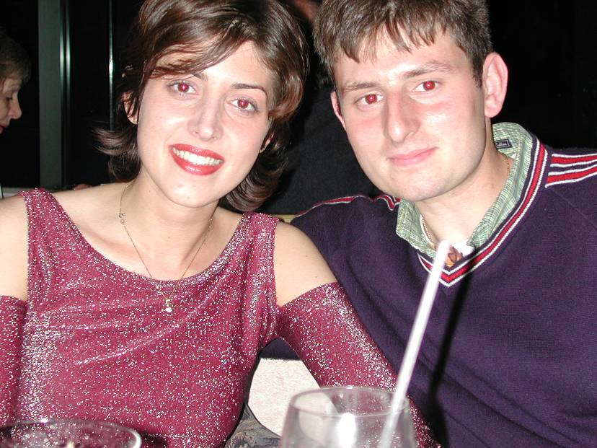
Red Eye
Notes:
Photography in low light environments is difficult and full of visual peril. A flash helps brighten the scene but can introduce unwanted artifacts. Here the flash inflicted red-eye on my friends.

Slide 3

Unflattering Lighting
Notes:
Even worse, the harsh lighting of the flash can add an extremely unflattering look. This image does not do justice to beauty of my aunt.

Slide 4
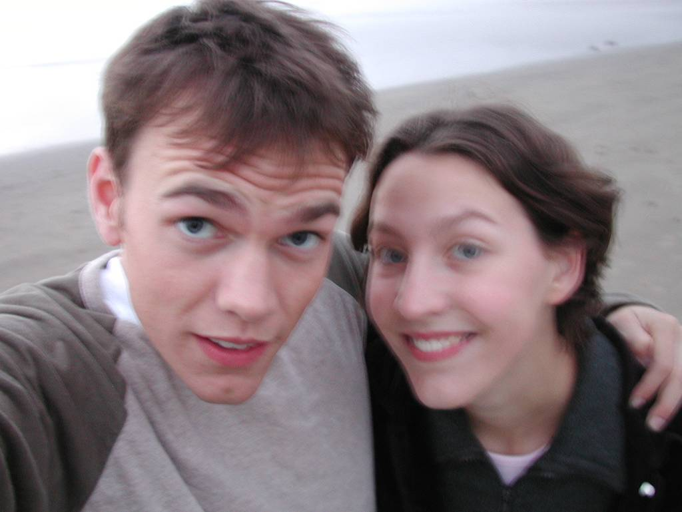
Motion Blur
Notes:
Instead of using a flash we can increase the exposure time. Here I capture the ambiance of this evening beach scene, but introduce motion blur because I could not hold the camera still over the long exposure.

Slide 5
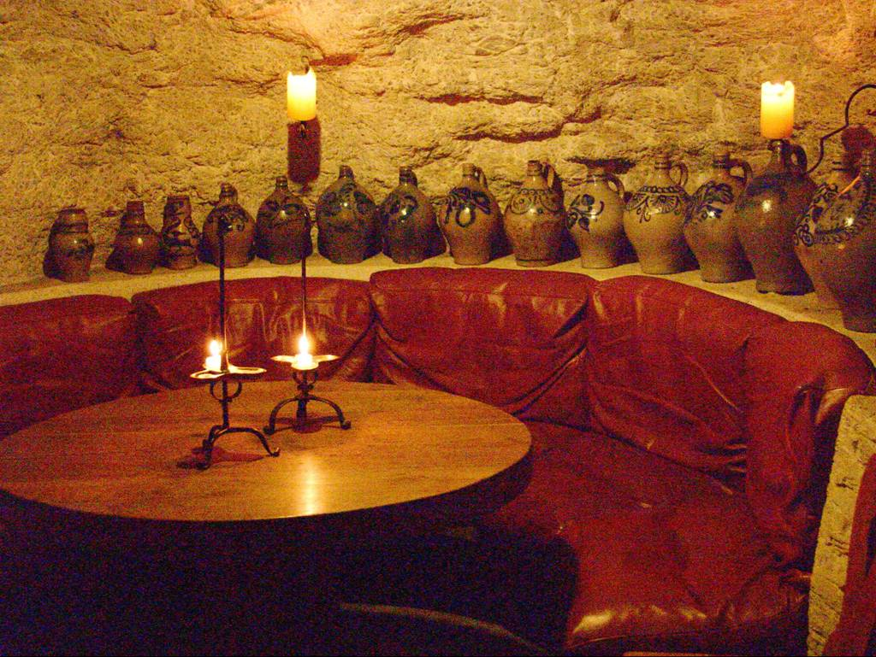
Noise
Notes:
Another approach is to increase the camera’s sensitivity or ISO and keep a short exposure time. Here I capture the romantic candle-lit look of this wine cave, but the image is noisy.

Slide 6
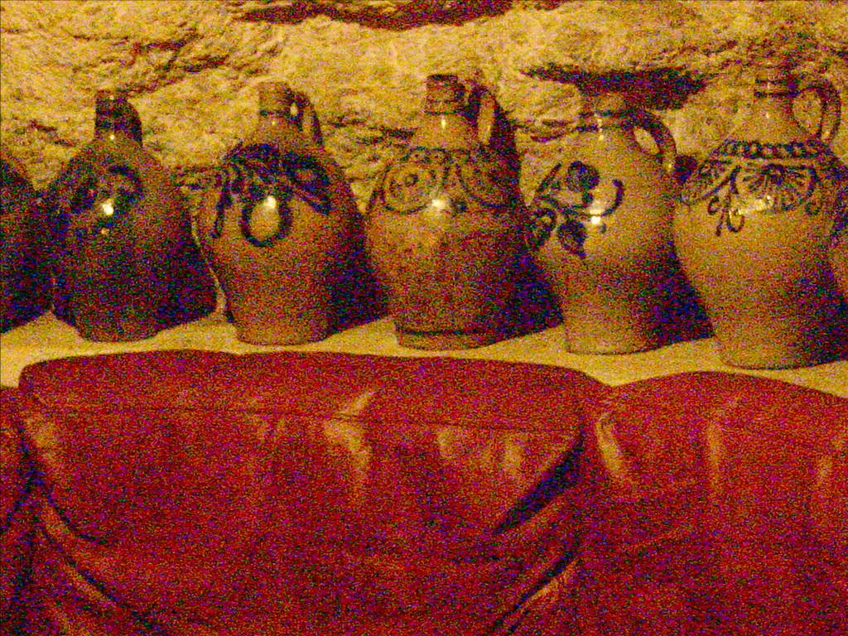
A lot of Noise
Notes:
In fact, very noisy.

Slide 7
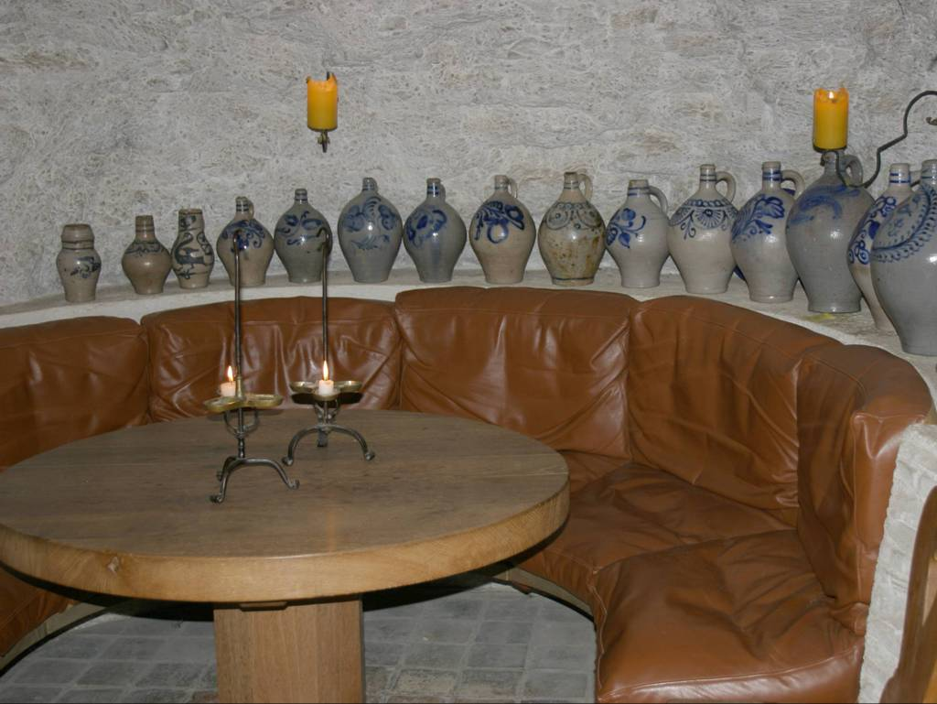
Ruined Ambiance
Notes:
Unfortunately, like most consumers in these cases I have to resort to using flash. This ruins the candle-light beauty of the image. Notice the gray walls and the overly pronounced specularities on the leather seats.

Slide 8
Flash
No-Flash
+ Low Noise
+ Sharp
- Artificial Light
- Jarring Look
- High Noise
- Lacks Detail
+ Ambient Light
+ Natural Look
Notes:
So as we’ve seen, photographers are faced with a choice when capturing low light environments. They can either use the flash for sharp, noise free images, but that will destroy the natural lighting. Or they can not use flash and capture the natural ambiance, but introduce motion blur or noise.
Our work is aimed at combining the best properties of flash and no-flash images.
For example, one thing we can do is to denoise the no-flash image using information from the flash image.

Slide 9
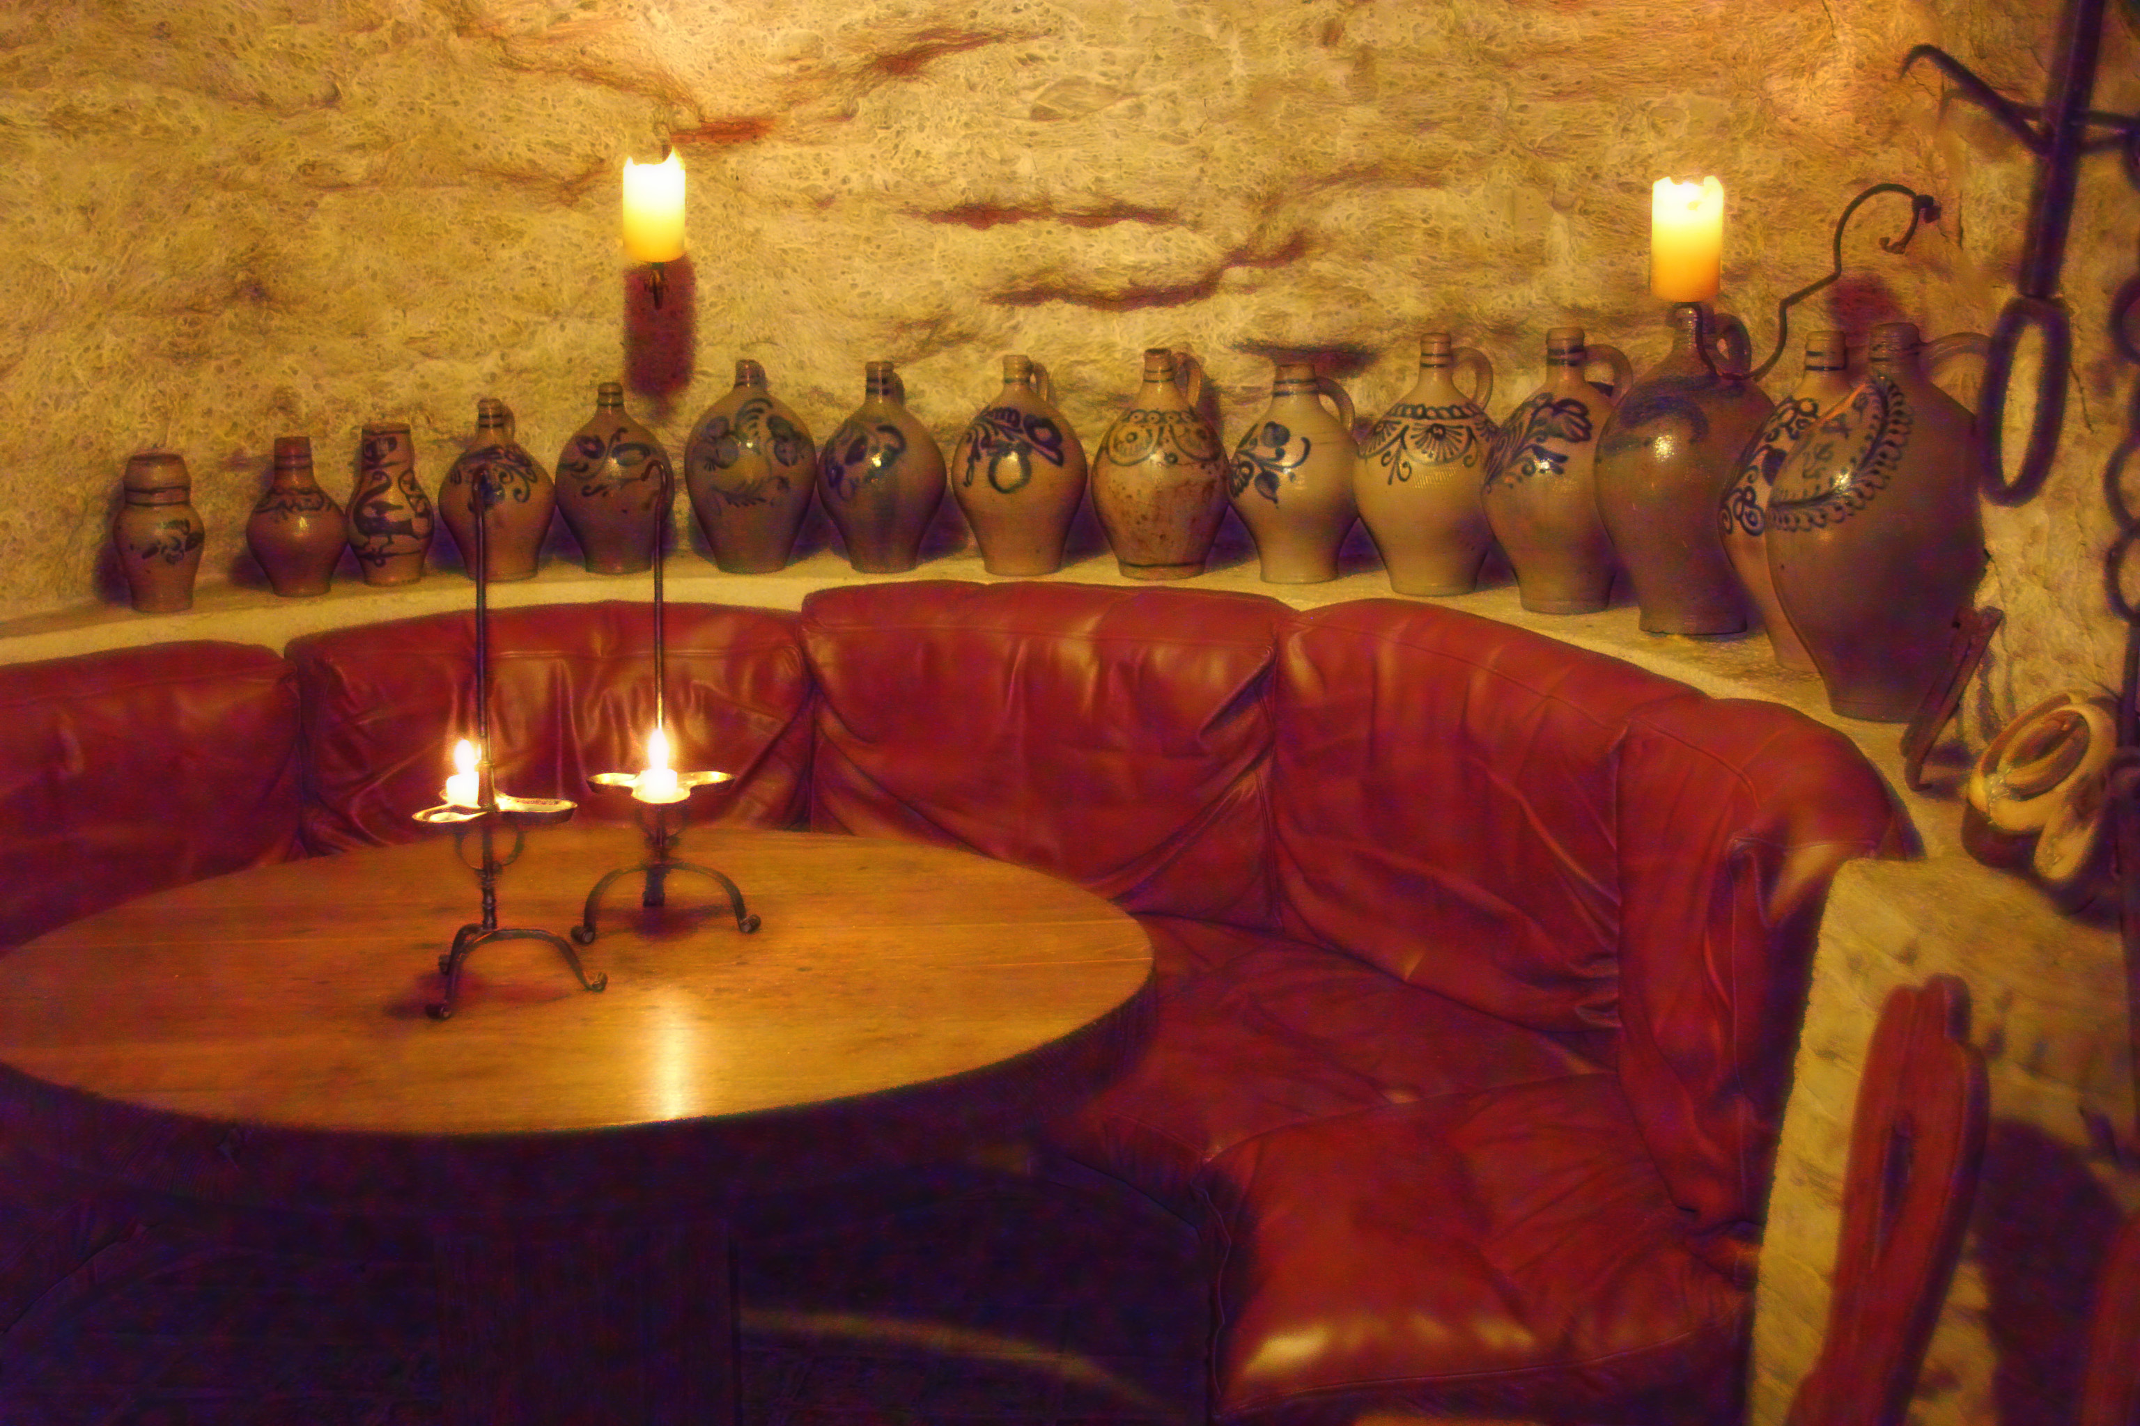
Denoising Result
Notes:
Notice how we maintain the overall candle-lit appeal of the wine cave, but remove the noise.

Slide 10
Show a larger result here
No-Flash
Notes:
Here the close up of the noisy image. Look at the leather seats how they are full of noise [point]

Slide 11
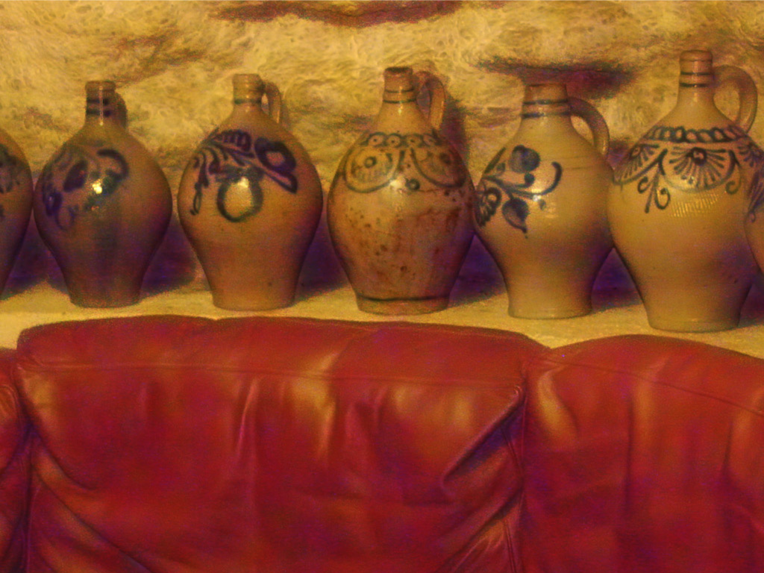
Denoising Result
Notes:
In our result the leather appears smooth and we bring out details [WAIT]

Slide 12
Applications
1. Denoising and Detail Transfer
2. White Balancing
3. Red Eye Removal
4. Continuous Flash
Notes:
Our work focuses on four applications of combining flash and no-flash image pairs. I will describe each of these applications in turn, placing the greatest emphasis on the denoising and detail transfer application. But let me first point out, that combining information from multiple images is not a new idea.

Slide 13
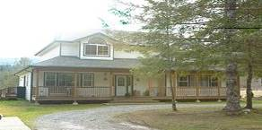
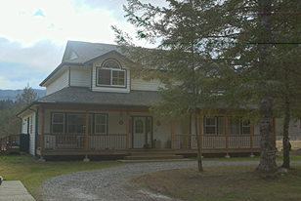
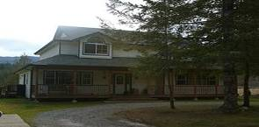
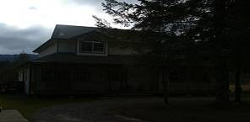
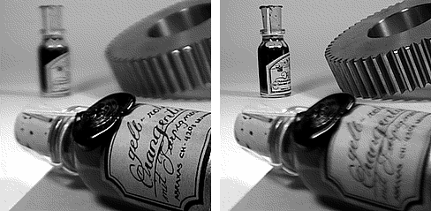
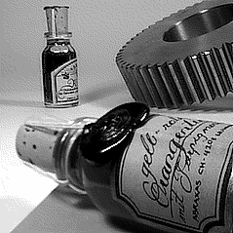
Related Work
Vary Exposure
Debevec97
Kang03
Vary Focus & Aperture
Haeberli94
Notes:
For example: taking multiple images and varying the exposure gives you a high dynamic range image.
Taking multiple images and varying the focus produces a high depth of field image. [space]

Slide 14
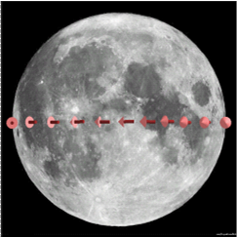
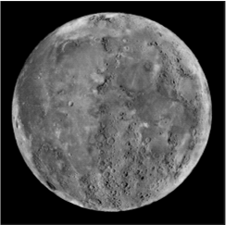






Related Work
Vary Orientation and Direction Levoy96
Gortler96
Szeliski97
+
+ . . . +
Vary Lighting
Debevec00
Akers03
Eisemann04
Raskar04
Notes:
Varying the camera position gives you a panorama or enables the synthesis of new views.
Finally, varying the lighting allows for post-capture relighting and other effects. In fact, in this session three of the papers including ours, are about combining flash and no-flash images. Ramesh Rasker synthesizes non-photorealistic rendering from multiple flash images. Elmar Eisemann improves flash images and presents an approach that shares many similarities with ours.
But let’s get back to our work and I’ll start with our acquisition process.

Slide 15
Image Acquisition
1
Lock Focus
& Aperture
time
Notes:
Our goal is to take the image pair in about 1/30s to accommodate hand-held camera operation. The short exposure time prevents camera shake and mis-registration. First we focus on the subject and fix the aperture.

Slide 16
Image Acquisition
1
2
Lock Focus
& Aperture
No-Flash Image
1/30 s
ISO 3200
time
Notes:
Then we take the no—flash image with a high ISO setting.

Slide 17
Image Acquisition
1
2
3
Lock Focus
& Aperture
No-Flash Image
Flash Image
1/30 s
ISO 3200
1/125 s
ISO 200
time
Notes:
And finish with the flash image at low ISO. In practice we had to use a tri-pod for our images, ```` but we fully expect that future cameras will support rapid multiple image aquisition.
We shot all images in RAW mode and perform most of our computations on tone-mapped versions. However, some operations require radiance space images and I will explicitly point out when we use linearized images.

Slide 18
1. Denoising and Detail Transfer
2. White Balancing
3. Red Eye Removal
4. Continuous Flash
Notes:
Our first application, is denoising and detail Transfer.

Slide 19
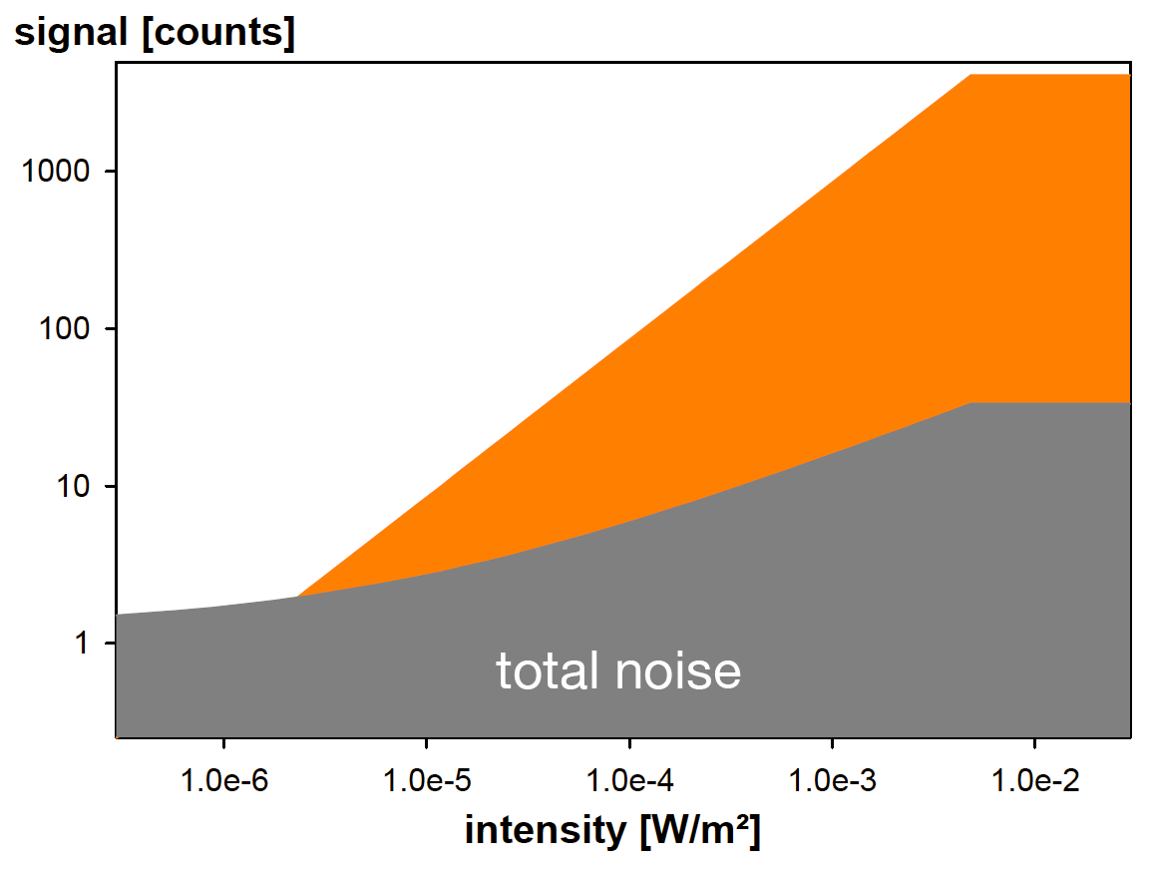
CCD Signal and Noise
Sensor Signal [e⁻]
Signal
Photon Noise
Sensor Noise
Irradiance [W/m²]
Notes:
Why does noise occur in low light images? Under ideal circumstances there is a linear relationship between incoming light and sensor output. Unfortunately both the camera’s electronics [space] and the probabilistic arrival rate of photons [space] add noise. For simplicity we focus on these two sources of noise, although many more exist. [space]

Slide 20
CCD Signal and Noise
Sensor Signal [e⁻]
Ambient +
Flash Light
Ambient
Light Only
Total Noise
Irradiance [W/m²]
Notes:
At low intensities, the signal to noise ratio is poor. For the no-flash image the noise, shown in gray, dwarfs the signal, which is shown in orange. [space] For the flash image the SNR is much better, since the flash added many more photons to the scene. Note that this plot is in log/log scale so the flash image actually has a signal to noise ratio of 100:1. We will exploit the better SNR in our denoising application.

Slide 21
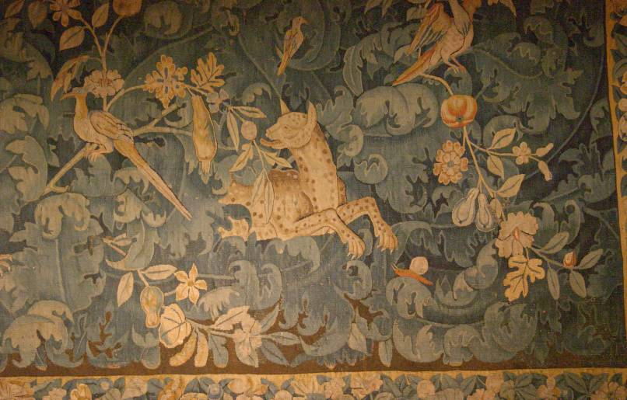
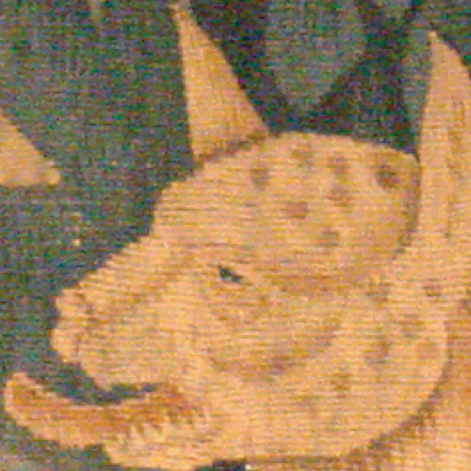
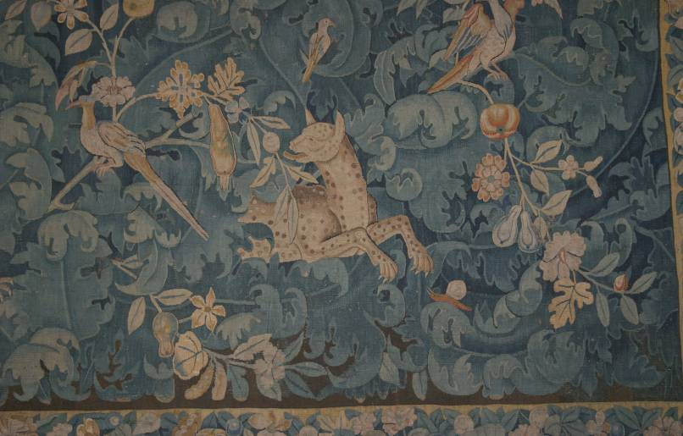
No-Flash
No-Flash
Flash
Notes:
I will explain our denoising pipeline using this image pair of an antique Belgian Goblin tapestry. Since these are six mega pixel images we will have to take a closer look.
[space – head zooms in]
Notice that the image overall appears noisy. This is evident in dark regions where it’s hard to distinguish the tapestry’s thread from noise. [space]
The flash image on the other hand is virtually noise free, but the colors look gray and dull.

Slide 22
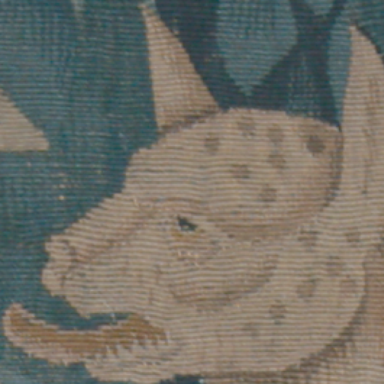
Flash
Notes:
Lets take a closer look of our denoising pipeline using this image pair of a belgian goblin tapestry.

Slide 23
No-Flash
Notes:
First, consider the single image case. We can denoise our no-flash image using a standard bilateral filter which is an approach proposed by Carlo Tomasi. [space]

Slide 24
No-Flash
Intensity
200
160
120
80
260
300
340
Location
[Tomasi98]
Notes:
Let me illustrate how the standard bilateral filter works on this scanline. [point to bumps – look up] These bumps are caused by tapestry thread, [point to pit – look up] the deep pit is the lions eye. [space – domain Gaussian appears]

Slide 25
No-Flash
Intensity
σ
d
200
160
120
80
260
300
340
Location
Notes:
In principle the standard bilateral filter acts like a Gaussian blur, averaging pixels in the spatial domain to remove noise.
[space - range Gaussian appears]

Slide 26
No-Flash
Intensity
σ
d
200
160
σ
r
120
80
260
300
340
Location
Notes:
However, the bilateral filter preserves edges by limiting averaging to pixels of similar intensity.
This edge stopping Gaussian determines the cut-off between noise and edges.

Slide 27
No-Flash
Intensity
σ
d
200
160
σ
r
120
80
260
300
340
Location
Notes:
[space] Set it too large [space] and you over-blur. [space]

Slide 28
No-Flash
Intensity
σ
d
200
σ
r
160
120
80
260
300
340
Location
Notes:
Set it too low [space] and you don’t remove noise.
[space –result plot appears]

Slide 29
No-Flash
Intensity
σ
d
200
160
σ
r
120
80
260
300
340
Location
Notes:
For this illustration we chose a value in-between that smooth the signal and preserves some edges. [point – look up] The eye is preserved, but the we over smooth the thread. [space]

Slide 30
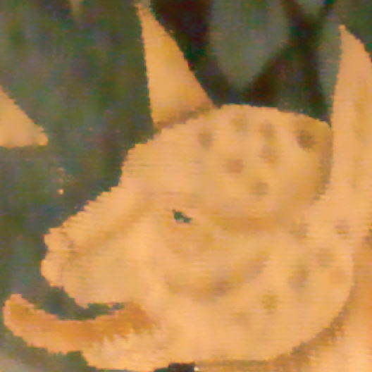
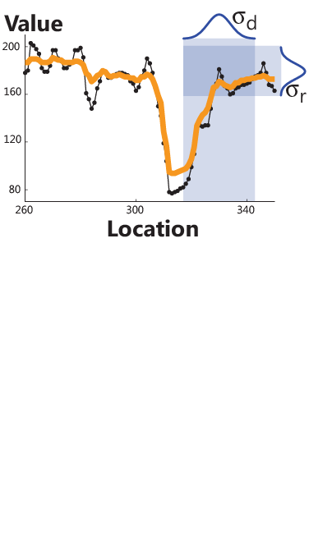
No-Flash
Bilateral Filter
Intensity
Notes:
Here is the bilateral filter applied to our crop [space]
[space – close up appears]

Slide 31
No-Flash
Bilateral Filter
Notes:
In the close up we see that the bilateral filtered image is less noisy and maintains strong edge features. [point] like the line between the lions head and background. However we still lack thread details.
What I’ve discussed so far is the single image case and we run into the problem that it is difficult to distinguish between noise and detail edges. Let’s see how the flash image can help us out.

Slide 32
Flash
Bilateral Filter
Notes:
[space]
As we saw earlier, the flash image contains more light and has more thread detail. Therefore it is a good and virtually noise free estimator of the edges in the scene. [space]

Slide 33
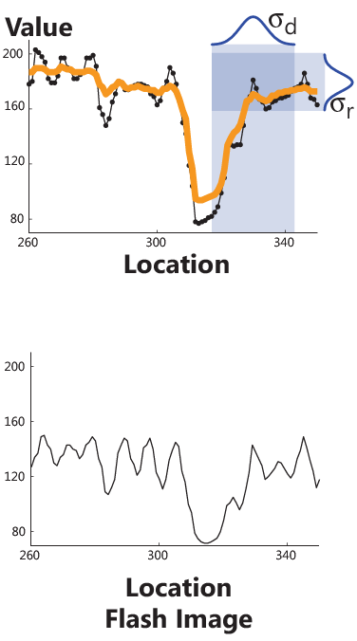
No-Flash
Bilateral Filter
Intensity
Flash
Notes:
Going back to our scanline, [space] we can see that we can exploit this advantage by using a much tighter Gaussian for the edge stopping function. [space]

Slide 34
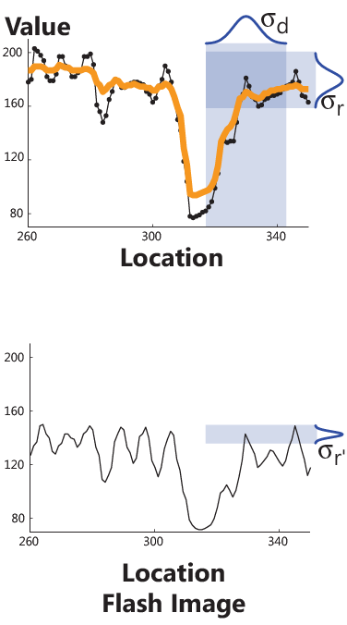
No-Flash
Bilateral Filter
Intensity
Flash
Notes:
In effect, we use the edges in the flash image to guide the averaging in the no-flash image.

Slide 35
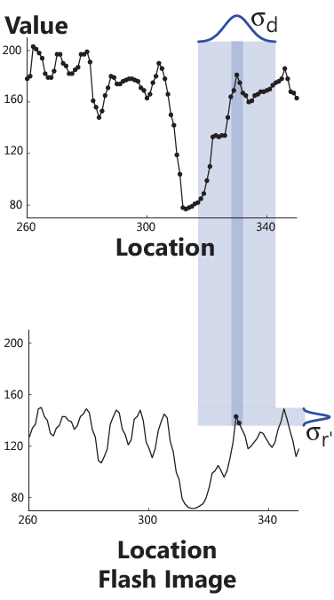
No-Flash
Bilateral Filter
Intensity
Flash
Notes:
We call this the bridge, the joint bilateral filter. [space]

Slide 36
No-Flash
Bilateral Filter
Intensity
Flash
Notes:
(Rectangle appears) Here we only average the pixels that fall on the dark-blue band. [space]

Slide 37
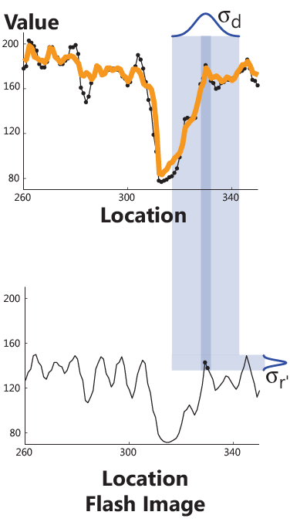
No-Flash
Bilateral Filter
Intensity
Flash
Notes:
This is the filtered result on the scanline. Notice how it more closely tracks the threads of the tapestry. [point]

Slide 38

No-Flash
Joint Bilateral Filter
Intensity
Flash
Notes:
Here is the joint bilateral filtered result [space]
[space – close up appears]

Slide 39
Bilateral Filter
Joint Bilateral Filter
[Eisemann04]
Notes:
In this comparison you can see that the JBF retains more detail and does not blur the image as much. [point to thread in forehead – look up] Notice how the Joint Bilateral Filter brings out more thread detail and starts to show some definition in dark regions.
Again, the Joint Bilateral Filter improves denoising by using the edge information of the flash image. Elmar Eisemann, who will talk next, calls this the cross bilateral filter.
[WAIT]

Slide 40
Flash
Joint Bilateral Filter
Notes:
Although the JBF performs well, there is room for improvement. This becomes evident in comparison with the flash image. [space – flash image appears]
Intuitively, we can further enhance our result by transferring the detail from the flash to the no-flash image [space].

Slide 41
No-Flash
Joint Bilateral Filter
Flash
Notes:
To do this we extract a detail layer from the flash image. [space]

Slide 42
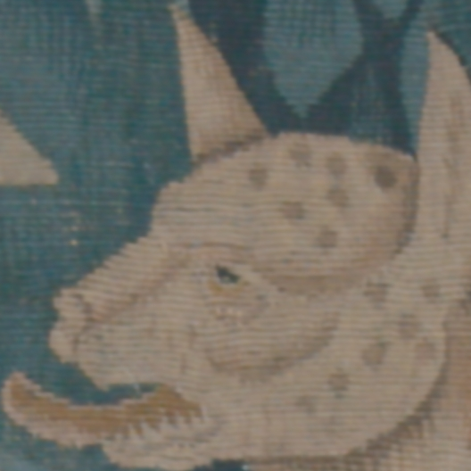
No-Flash
Joint Bilateral Filter
Flash
Bilateral Filter
Notes:
We first divide the image into large and small scale features using a standard bilateral filter. As seen earlier, the bilateral filter retains large features and strong edges. But our detail layer needs small scale, detail, features.

Slide 43
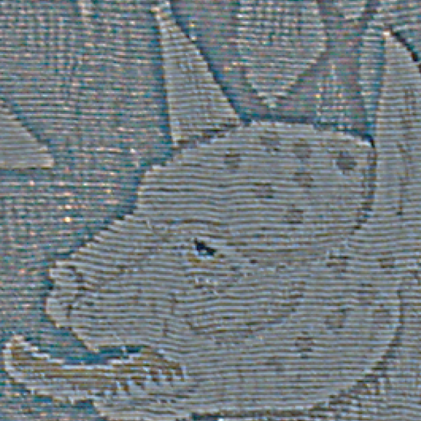
No-Flash
Joint Bilateral Filter
Flash
Bilateral Filter
Detail Layer
/
Notes:
[space] We get these small scale features by dividing the filtered images by the original. This becomes our detail layer.

Slide 44
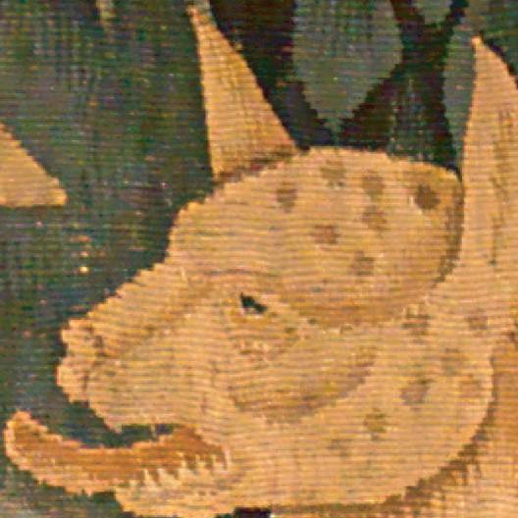
No-Flash
Joint Bilateral Filter
Result
X
Flash
Bilateral Filter
Detail Layer
/
[Durand02]
Notes:
[space]
We then multiply the detail layer with our joint bilateral filtered image to produce the final result. We multiply, rather than add, since our images lie at different absolute amplitudes. A similar decoupling approach was taken in Fredo Durand’s 2002 tone mapping paper. [space]

Slide 45
No-Flash
JBF & Detail Transfer
Notes:
Here is a close-up. Notice how noise is significantly reduced and the details are enhanced in our result [point out improvements].
Let’s look at some additional results of our denoising and detail transfer technique.

Slide 46
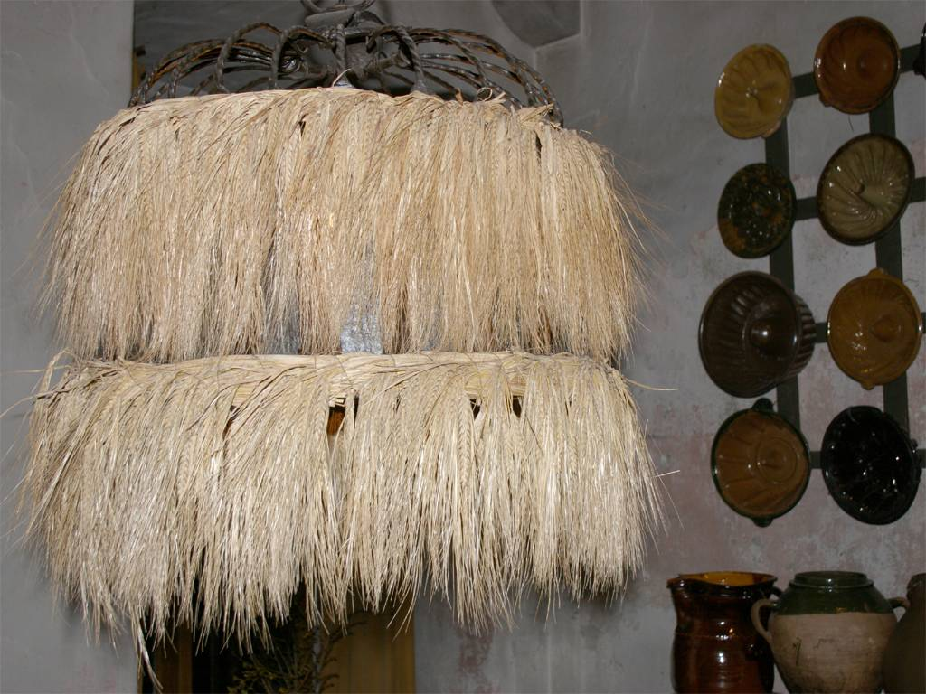
Flash
Notes:
Result – Hay Lamp
Here is a hay-lamp taken with flash which makes it look dreary. (The concept of a hay lamp may sounds somewhat strange, but yes this is a lamp made of hay and light-bulb inside. Make no mistake, it’s a dangerous proposition but at this German castle, it adds a certain country-side charm. [space] The no-flash version shows that this hay lamp is indeed illuminated from the inside. [space] The crop shows noise on the back of the wall [point – look-up] and a lack of definition in the hay strands. [space] Our result removes the noise from the background and adds crispness to the hay.

Slide 47
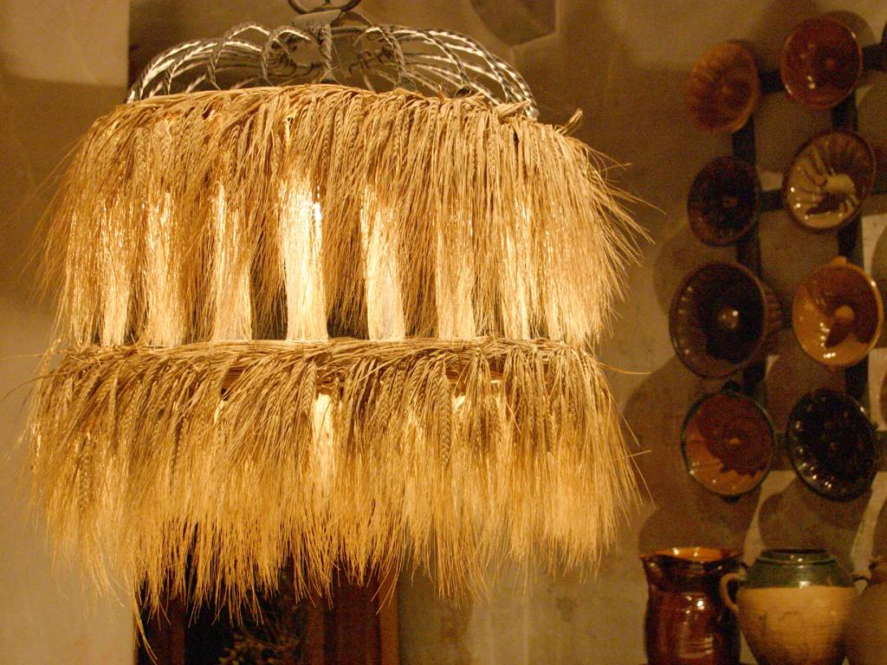
No-Flash

Slide 48
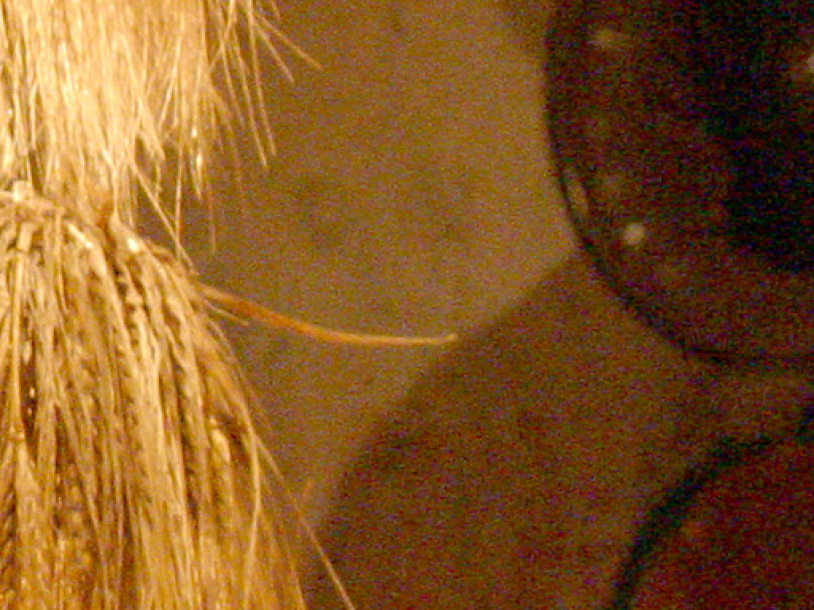
No-Flash

Slide 49
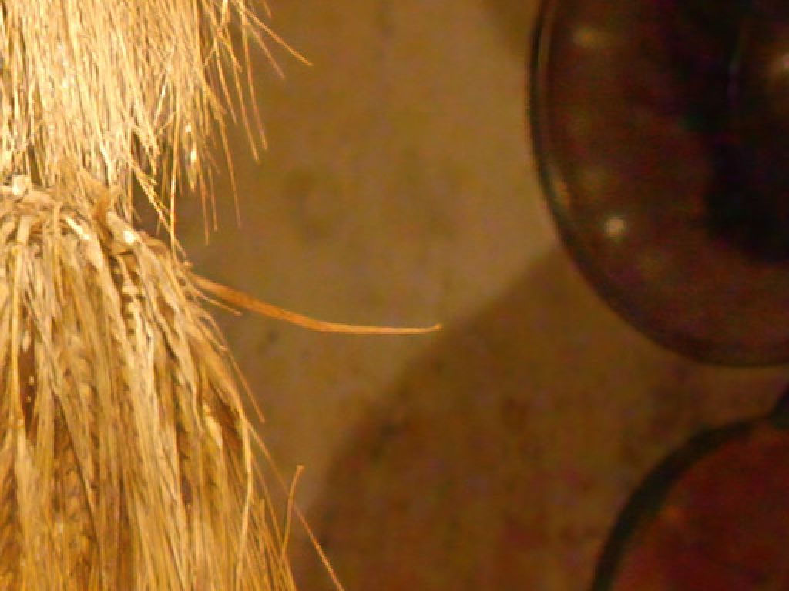
Result

Slide 50
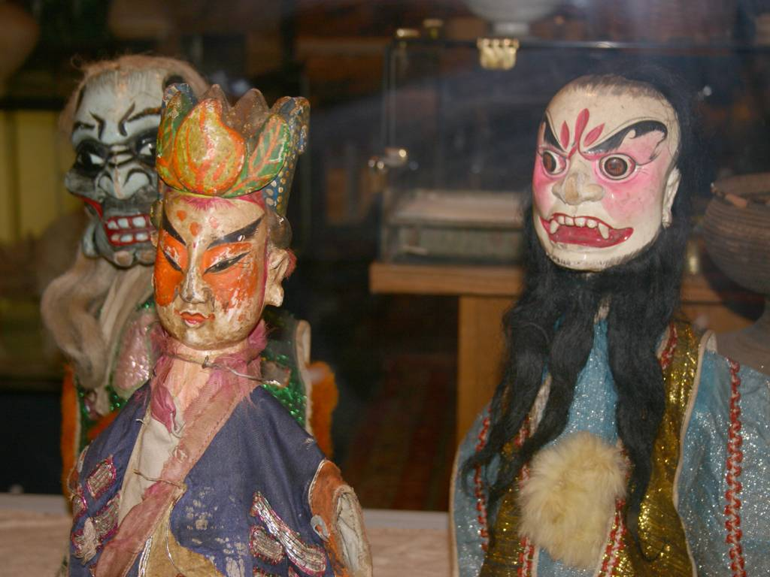
Flash
Notes:
Result - Puppet
Here is flash image of some puppets. [space] The no-flash version [space] And a detailed crop. [point-look-up] Notice the noise and the low definition of the plush around the right ear. [space]
Our result removes the noise and brings out the detail [space]

Slide 51
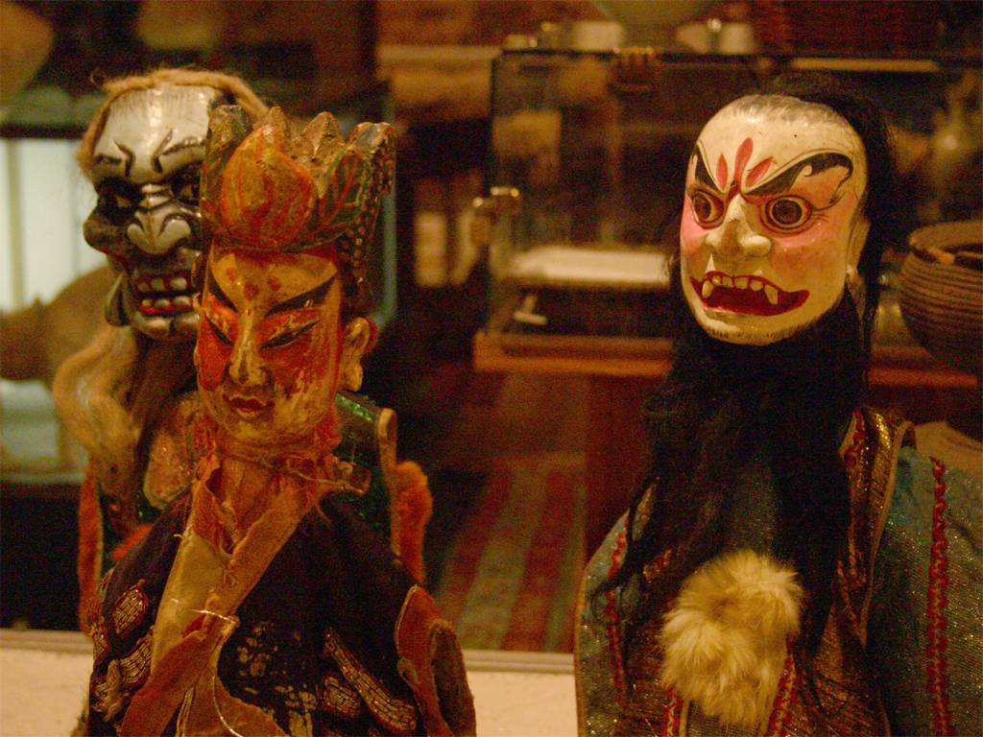
No-Flash

Slide 52
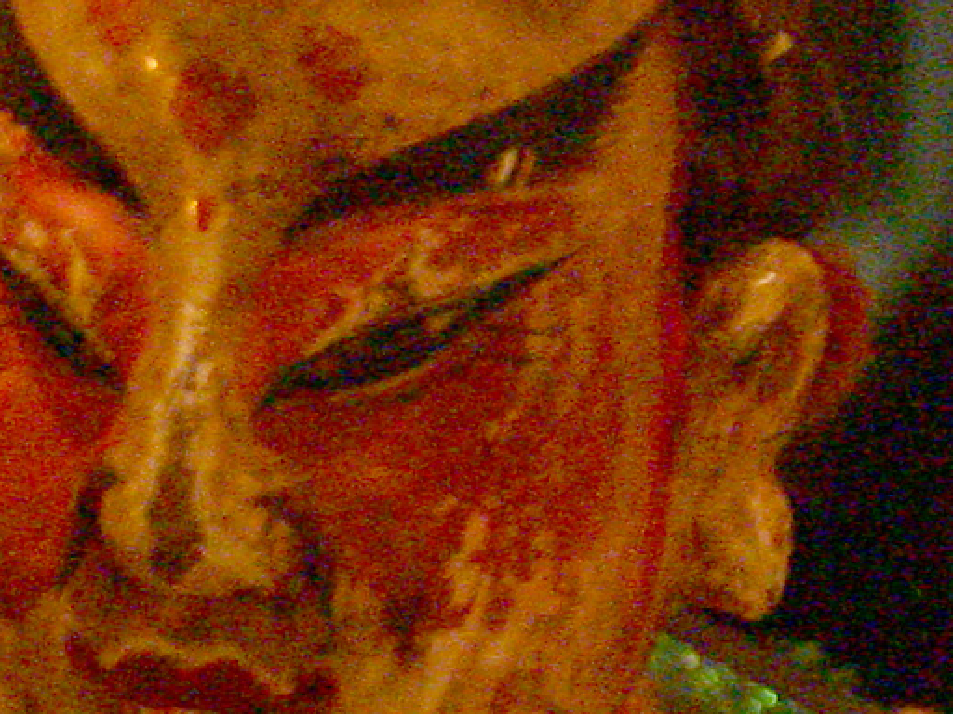
No-Flash

Slide 53

Result

Slide 54
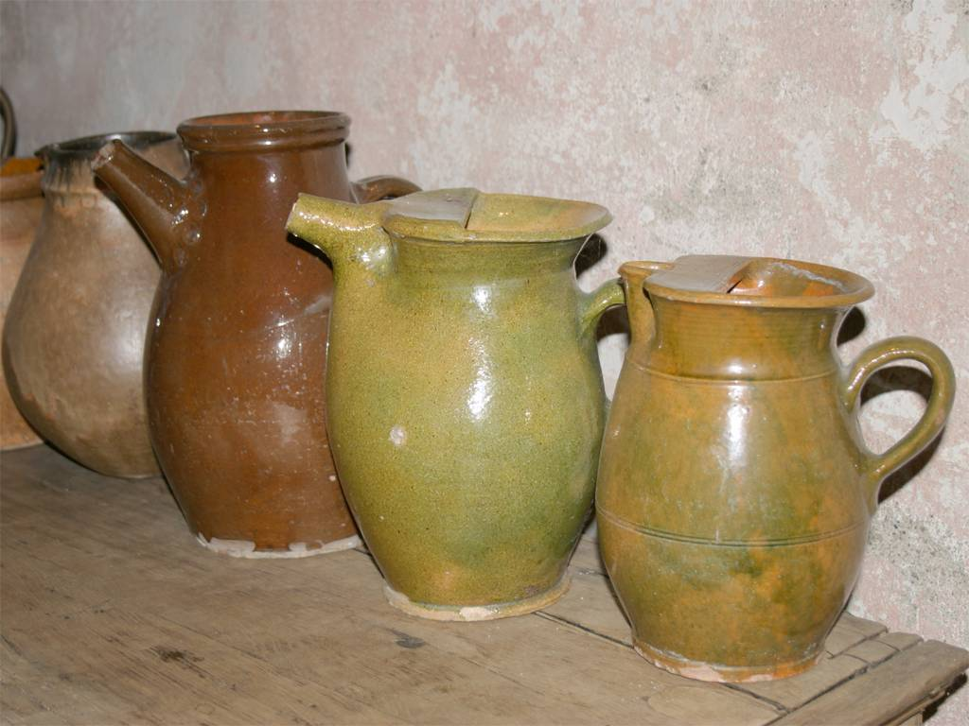
Flash
Notes:
Result - Pots
Here is a picture of pots with flash. [space] and with out [space] This is a detail crop of the flash image. Notice the brown pot is smooth and the green pot has a fine texture pattern caused by the fire glazing process. [point-to texture look-up] [space] In the no-flash image this texture is drowned in noise [point at texture] in fact it is hard to distinguish noise from texture [space] Our result restores these fine details and the brown pot appears smooth. [PAUSE] [space]

Slide 55
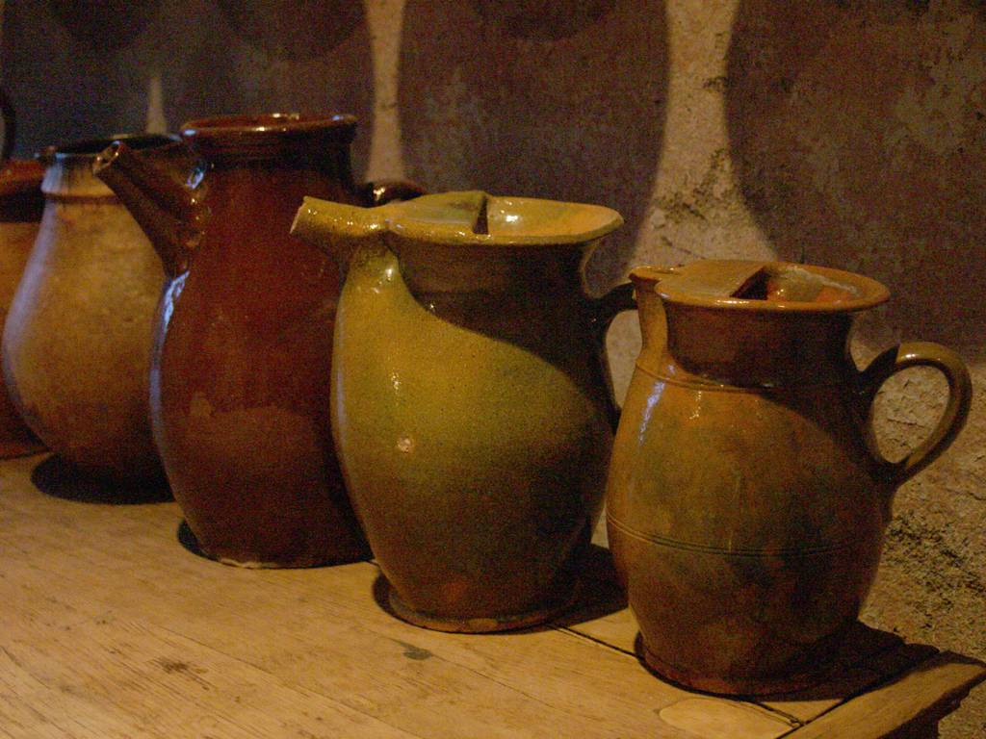
No-Flash

Slide 56
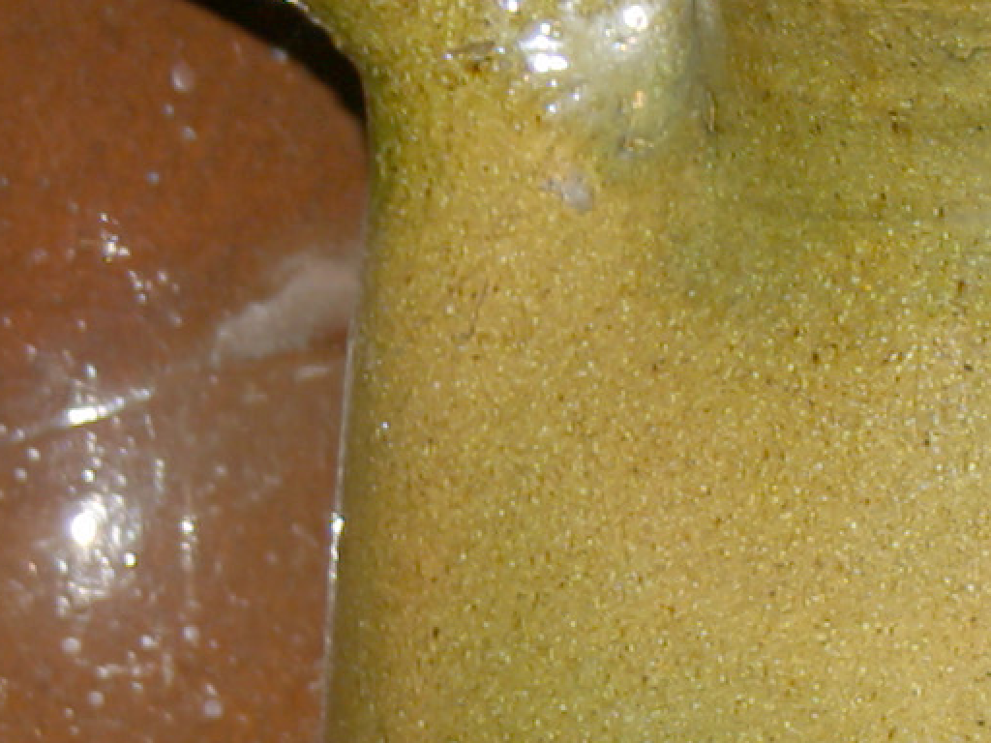
Flash

Slide 57
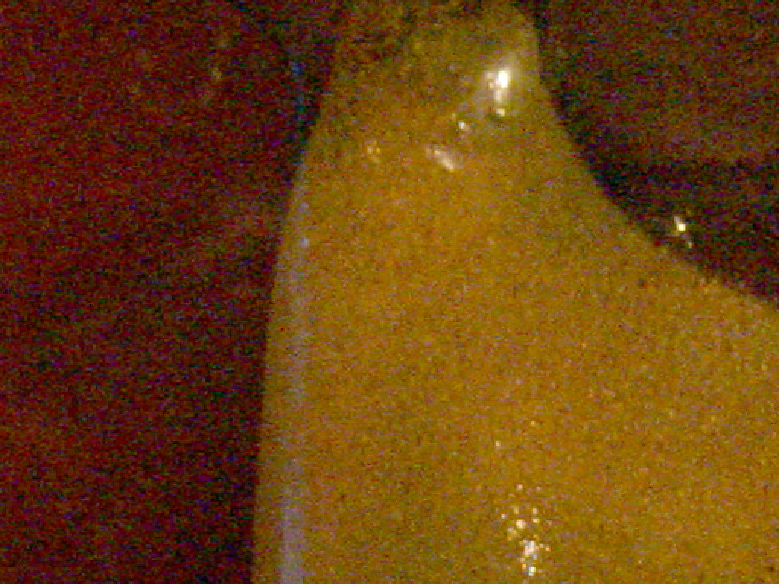
No-Flash

Slide 58

Result

Slide 59
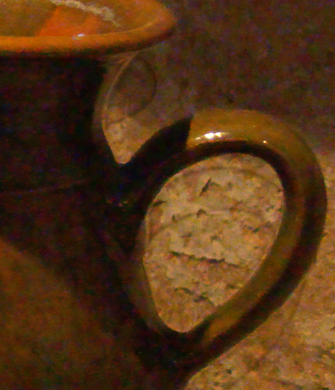
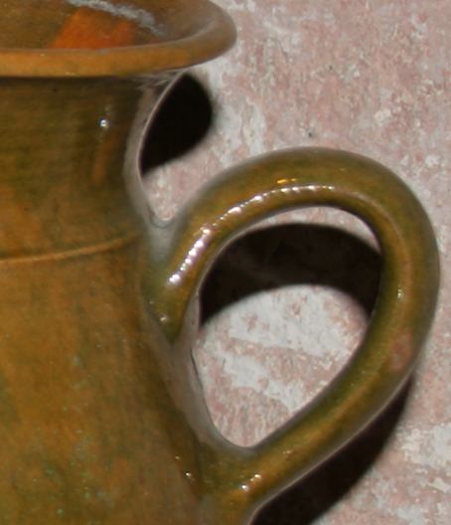
Flash Shadows and Specularities
Artifacts
Detail Transfer
No Mask
Flash
Notes:
Flash Shadows and Specularity
But there is one important thing I have ignored until now. Our technique assumes that the flash image is a good local estimator of the no-flash image. This assumption is violated in flash shadow and specular regions. Here flash shadow causes erroneous edges in our result. To properly combine the image pair we have to spare out these regions. [space]
We want to find flash shadows and specularities, so we need an image that is lit by flash only. [space] We get this image by subtracting the no-flash from the flash image. This subtraction is done in linear radiance space. In this example the flash is much brighter than the ambient illumination, so the difference image looks unchanged. [space]. Here are the images in linear space. Notice how the no-flash image is significantly darker than the flash image. [space]
Next we threshold the difference image. Near zero regions map to shadows. [point out correspondence in mask/difference] Very bright areas map to specularities. [point out correspondence in mask/difference].
In our case a user would interactively choose the shadow and specular thresholds.
In the next talk, Eisemann will discuss a different approach to shadow and specular detection.
Finally we dilate and blur the mask to accommodate for soft penumbras.
Here is a close-up of the mask. [space].
Within the mask we use standard bilateral filtering to produce our final result.
[back/forward]
Notice how the mask prevents the artifacts.
Before I move on, let me summarize. Our first application uses the flash image to denoise and transfer detail to the no-flash image. We then detect shadows and specularities and resort to standard bilateral filtering in these areas. space]

Slide 60
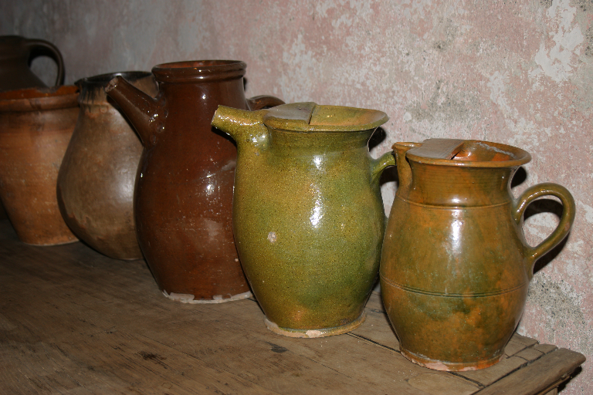
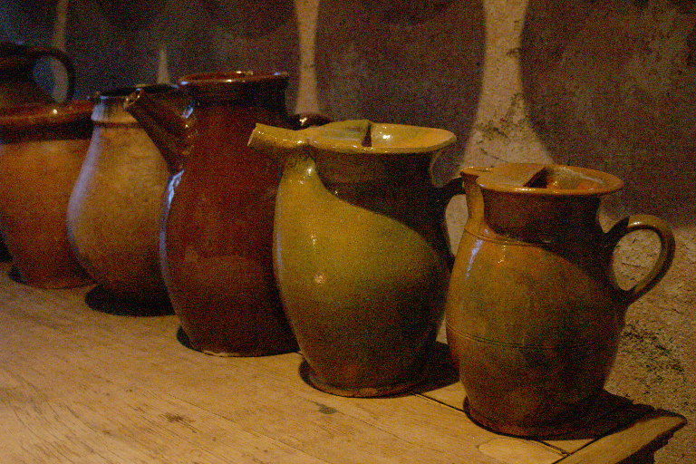
Flash
No-Flash

Slide 61
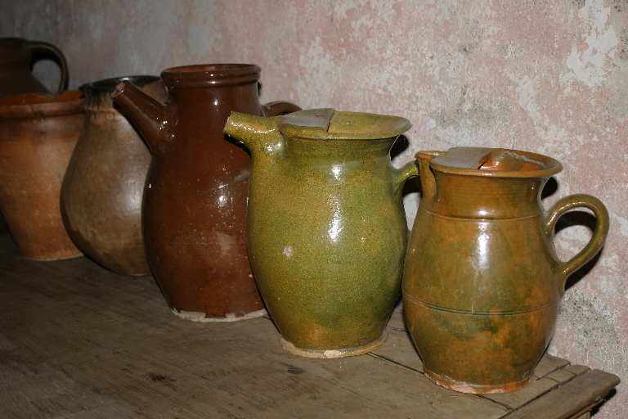
Flash
Difference
-
No-Flash

Slide 62
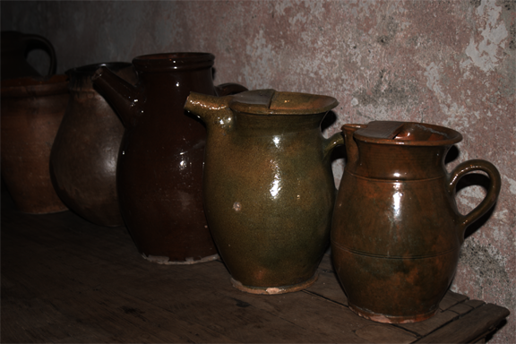
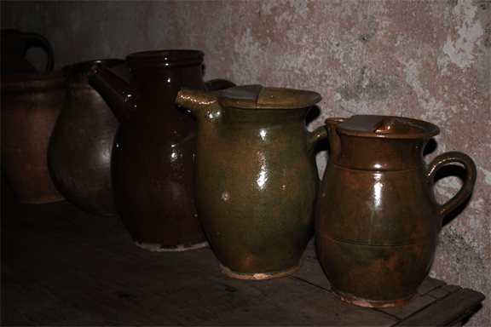
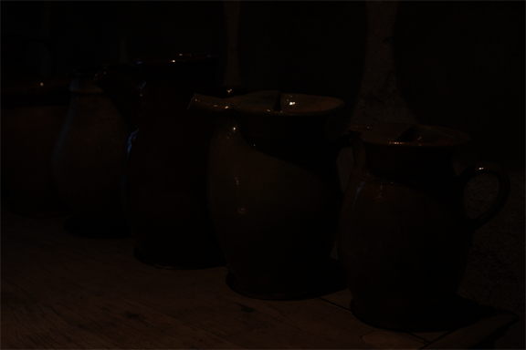
Flash
Difference
-
No-Flash

Slide 63
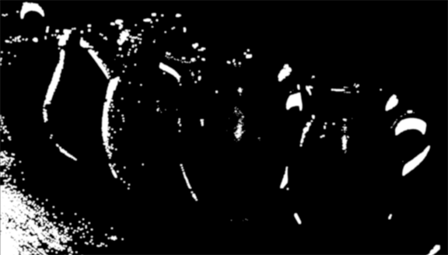
Flash
Difference
-
No-Flash
Threshold & Feather
Shadow & Specular Mask
[Eisemann04]

Slide 64

Flash Shadows and Specularities
Artifacts
Shadow and
Specular Mask
Detail Transfer
No Mask
Notes:
Add description of flash/specular detection. We use a simple algorithm to detect shadows and specular. Specular correspond to
For an alternative talk approach see the next paper.

Slide 65
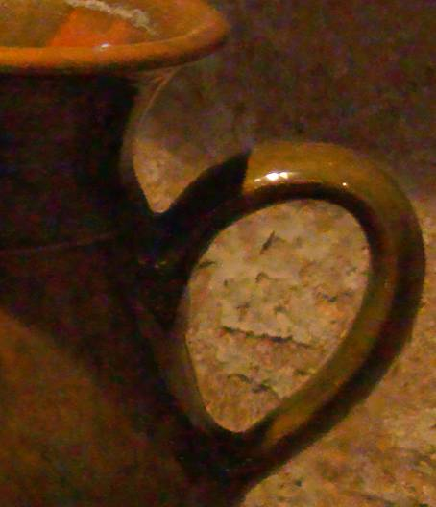
Flash Shadows and Specularities
Shadow and
Specular Mask
Detail Transfer
With Mask

Slide 66
Denoising and Detail Transfer
Denoise no-flash using flash image
  Joint bilateral filter
Transfer detail from flash to no-flash image
Detect shadows and specularities
  Resort to standard bilateral filter

Slide 67
1. Denoising and Detail Transfer
2. White Balancing
3. Red Eye Removal
4. Continuous Flash
Notes:
White Balancing
Our second application is white-balancing.
[space]
While the ambient illumination often captures the mood of a scene, it’s sometimes desirable to have the appearance of a neutral light. This process is called white balancing. Notice how the no-flash image has an orange cast compared to the flash image. [point to wood] This is very noticeable on the wood. Standard white balancing needs to guess the ambient illuminant from a single image. With the image pair, we are better off because the flash color is known and gives us a reference point.
White Balance Description
Our approach is heavily inspired by Jeffrey DiCarlos work, who was the first to suggest using an image pair for white balancing. Our goal is to infer a single ambient illuminant. Now we make two strong assumptions: 1. The camera is calibrated such that flash appears white. 2. All surfaces are Lambertian. As you can see not all surfaces are diffuse, but we will deal with that later.
[space]
Next, we go to radiance space [space] to compute the difference image. The result is an image illuminated by flash only. Since the flash is white, this image will corresponds to the surface albedo at unknown scale. To clarify, under the assumption of lambertian surfaces and white lighting, the difference image captures the albedo.
De-modulating the no-flash image and the difference image gives a per-pixel ambient illuminant estimate.
[space]
Since our goal is to infer a single ambient illuminant, we can use millions of pixel estimates for our inference. Hence we can lavishly discard outliers, such as dark shadows or bright specular pixels. We then take the mean and get our illuminant estimate. [space] [space]
The final step is to de-modulate the no-flash image and our illuminant estimate.[space]
[point to wood] This is the tone mapped result. Notice how the wood on the table appears ash-gray in our white-balanced result whereas it used to appear orange. Although the glazing on the pots violates the assumption of lambertian surfaces, we still on average get enough good pixel estimates to white-balance this image.

Slide 68
White Balancing
Flash
No-Flash
Flash is primary illuminant
Illuminant unknown

Slide 69
Flash
No
Flash
Assumptions
Single ambient illuminant
Flash is white
Lambertian reflectance
[DiCarlo01]

Slide 70
Flash
No
Flash
Assumptions
Single ambient illuminant
Flash is white
Lambertian reflectance

Slide 71
Flash
Difference
-
No
Flash
Assumptions
Single ambient illuminant
Flash is white
Lambertian reflectance

Slide 72

Flash
Difference
-
No
Flash
/
Assumptions
Single ambient illuminant
Flash is white
Lambertian reflectance

Slide 73
Flash
Difference
-
No
Flash
/
Assumptions
Single ambient illuminant
Flash is white
Lambertian reflectance
Illuminant
Estimate

Slide 74

Flash
Difference
-
No
Flash
/
Result
Illuminant
Estimate
/

Slide 75

No-Flash
Result
Illuminant
Estimate

Slide 76
1. Denoising and Detail Transfer
2. White Balancing
3. Red Eye Removal
4. Continuous Flash
Notes:
Red Eye Title
Our next application looks at a very common flash artifact – the dreaded red-eye.
Red Eye Removal
Many commercial red-eye removal systems follow a two step process: First, they detect red-eye and then they correct it. With a single image, these algorithms need to find red-eye via clever heuristics. Our approach, uses the image pair to find potential red-eye following a simple intuition. Red eyes only occurs in the flash image. In the no-flash image the eye is dark. So we we have to look for this difference in red-ness [space]
We use the red chromaticity channel, as it’s decoupled from brightness. Subtracting the two images gives us a mask of potential red-eye pixels. [space]
Here white suggests red-eye. We believe that this mask makes an excellent prior and can enhance most standard red-eye detection techniques. [space].
In our case we employ the technique of Andrew Patti to get our final result. [space]
Result 1
Here is a picture of myself with red-eye and without. And I added the blinking red-eye for additional drama.

Slide 77


Flash
No-Flash

Slide 78


Flash
Cr Channel
No-Flash
Cr Channel

Slide 79

Flash
Cr Channel
Cr Difference
-
No-Flash
Cr Channel

Slide 80

Flash
Cr Channel
Cr Difference
-
No-Flash
Cr Channel
Red Eye Detection
And Correction
Result
[Patti98]

Slide 81



Slide 82
1. Denoising and Detail Transfer
2. White Balancing
3. Red Eye Removal
4. Continuous Flash

Slide 83


Continous Flash
Linearly interpolate flash and no-flash image
No-Flash
Flash
Notes:
Continuous Flash
Our last application is continuous flash. [space] Sometimes the flash image looks pretty good, but the lighting may be bit a bit harsh and you want to tone it down a little. Continuous flash gives the user such control, by linearly interpolating between the image pair. [point] In this image the flash is too strong. [space] Here we reduce the effect of the flash [point – discuss result]
Note that we can extrapolate beyond the original image pair. [space] You can increase the intensity of the flash (call it the super flash) [space] or create the effect of negative flash [space]. While this technique is dead simple, we believe it provides useful control for over- or underexposed images.
This completes the four applications we present in our paper.

Slide 84



Flash
No-Flash

Slide 85




Flash
No-Flash

Slide 86


Future Work
Camera firmware implementation
Remove flash shadows and specularities
Correct motion blur
Flash/No-Flash
Notes:
Future Work
In the future we would like to implement our work in camera firm-ware.
Next we would like to improve the look of flash images by removing flash shadows and specularities. Notice how this portrait in the middle looks nice but has an awkward shadow silhouette around the nose.
Finally we would like to address motion blur as well.

Slide 87
Summary
Improving digital images with flash/no-flash
  Denoising and detail transfer
  White balancing
  Red eye removal
  Continuous flash
Simple algorithms with good results
Easy to acquire image pair
Notes:
Summary
In summary, we demonstrated four ways of combining flash and no-flash image pairs.
The main benefit of our approach` is that our algorithms are simple` and the image pair is easy` to acquire. This makes our technique attractive to implement` in current generation photo editing software` and next generation digital cameras.

Slide 88




Acknowledgements
My Parents
Marc Levoy
Stanford Graphics Lab
  Steve Marschner, Chris Bregler, Stan Birchfeld, Mike Braun
SIGGRAPH Reviewers
Microsoft Office
Microsoft Research
Notes:
Acknowledgements
To close, I wish to thank my parents for their support and for trying to make sense of my computer graphics explanations as well as my aunt for inspiring this work.
I particularly wish to thank Prof. Marc Levoy, my former advisor at Stanford and the Stanford computer graphics lab for abducting my camera and leaving such fun pictures behind.
And finally I wish thank all of you for being my audience this afternoon. Thank you.

Slide 89
See full-resolution images at
http://research.microsoft.com/projects/flashnoflash

Slide 90
No-Flash - 1/30s Exposure

Slide 91
Result

Slide 92

Reference – 3.2s Exposure
Notes:
This image was exposed 96 times longer than the noisy one.

Slide 93



Red Eye Removal - Results

