Slide 1
Fine Tone Control in Hardware Hatching
Matthew Webb
Emil Praun
Hugues Hoppe
Adam Finkelstein
Princeton University
Princeton University
Microsoft Research
Princeton University
Notes:
Hello. My name is Emil Praun.
I will present “Real-Time Hatching”, a project I worked on together with Hugues Hoppe from Microsoft and with Matthew Webb and my advisor from Princeton, Adam Finkelstein

Slide 2
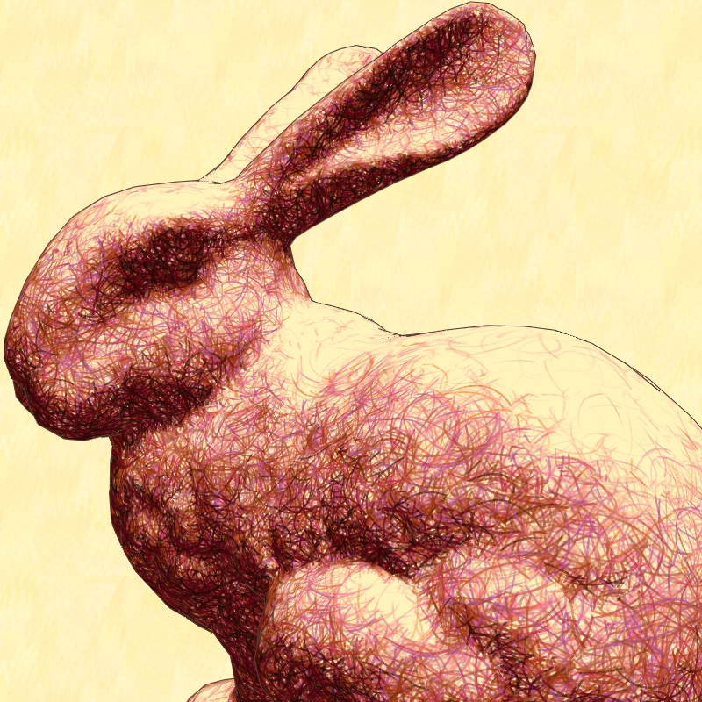
Goal
Describe two new real-time hatching schemes that provide enhanced control of tone
  Volume Scheme
    Color
  Threshold Scheme
    Per-pixel lighting operations
Demo
Notes:
Our goal in this paper is to explain a system that show

Slide 3


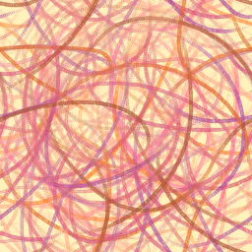
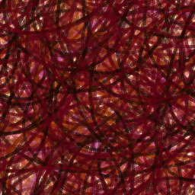
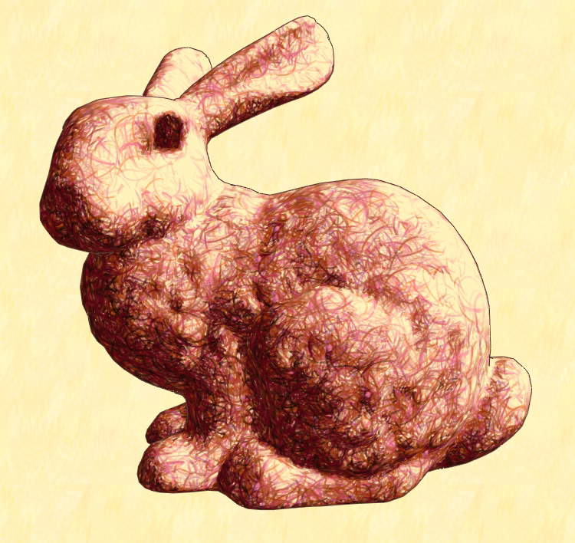
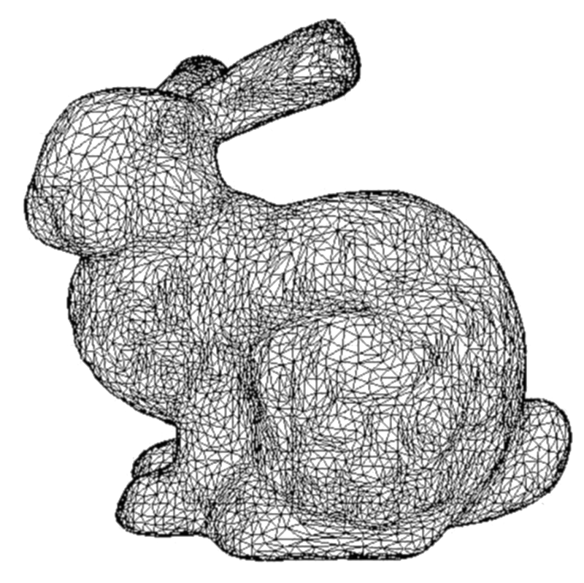
Approach
Set of textures
Result
Stroke Session
Mesh
Preprocess
Real-Time
Notes:
Here is an overview of our approach.
The main idea is to leverage the texturing power of recent graphics hardware, and to bundle strokes together in textures, rather than draw them as individual primitives.
We start with a bitmap of a stroke that an artist draws, or that we import from a drawing package. As a preprocess, we create a set of textures using several instances of our example stroke.
At runtime, we select and blend a subset of these texture images, applying them to the mesh surface.

Slide 4
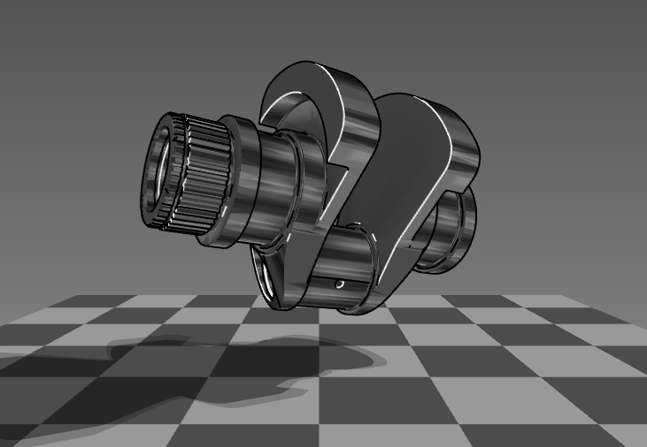
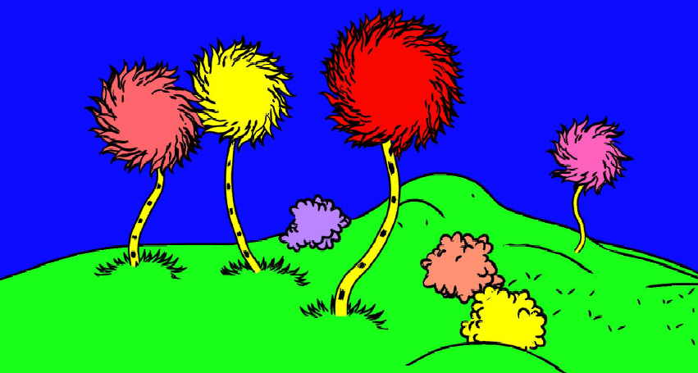
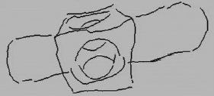
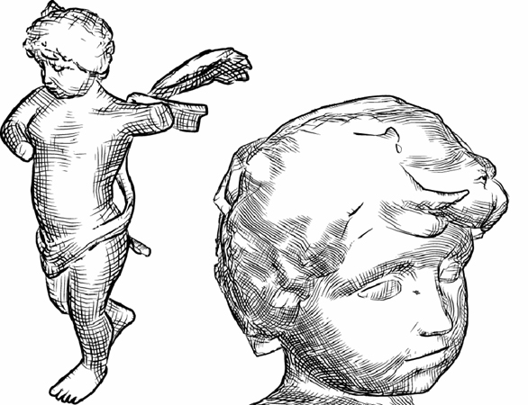
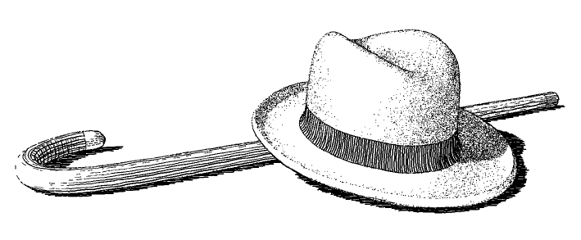
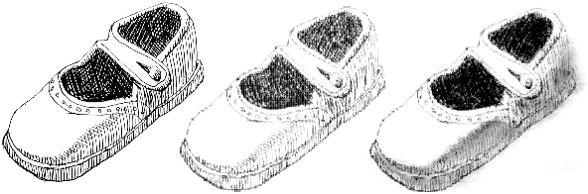
Previous Work
Real-Time NPR
[Gooch et al.’99]
  [Kowalski et al. ’99, …]
  [Markosian et al. ’97]
  [Hertzmann et al. 2000]
Offline Hatching
[Winkenbach et al. ’94, ’96]
[Hertzmann et al. 2000]
[Sousa et al. ’99]

Slide 5
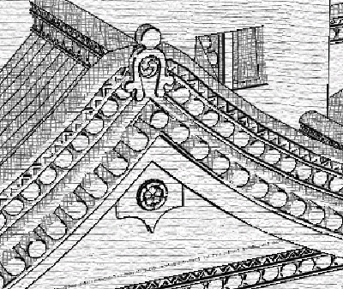
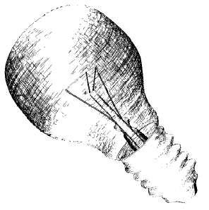
Previous Work
Real-Time Hatching
  Screen-space “filter”
  [Lake et al. 2000]
  Fixed density strokes
  [Elber ’99]
Notes:
Two notable systems have addressed real time hatching. The system presented by Lake et al. at NPAR 2000 renders scenes using strokes embedded in screen space. We are aiming for a different kind of artistic effect in our project, one in which strokes are associated with the object, helping reveal its shape both through the stroke direction and the optical flow created by motion.
Elber presented a system with object-space coherence, using strokes with fixed density on the object. In contrast, our system allows us to dynamically vary the stroke density in order to maintain constant spacing of strokes in the image.

Slide 6

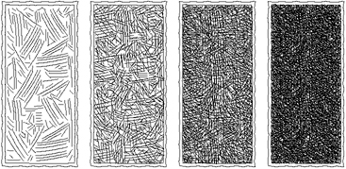
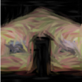
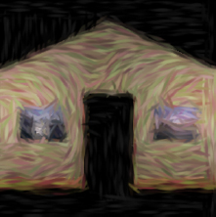

Previous Work – Stroke Collections
Prioritized Stroke Textures
[Salisbury et al. ’94]
[Winkenbach et al. ’94]
Art Maps
[Klein et al. 2000]
← scale →
← tone →
Notes:
In a moment, I will present a construction that uses two previous ideas involving stroke collections.
Prioritized stroke textures were introduced by Salisbury et al. and Winkenbach et al. at Siggraph in 94. They represent an ordered collection of strokes, where each stroke is annotated by the tone that would be produced by rendering it and all the previous strokes in the collection. You can see here several tones being rendered using prioritized stroke textures. At the bottom of the figure, you can see a continuous tone gradient.
Klein and co-workers presented a system for NPR-endering of virtual environments. The basic idea was to apply NPR filters to the textures in the scene. The goal was to keep the character and size of the strokes, regardless of resolution at which the surfaces were being rendered. They achieved this by constructing custom mipmap levels, each level being produced by running the NPR filter with the same size strokes. Since the different levels were produced independently, there was no coherence between strokes at different levels, so the strokes appeared to be swimming as one zoomed in and out from a surface.

Slide 7
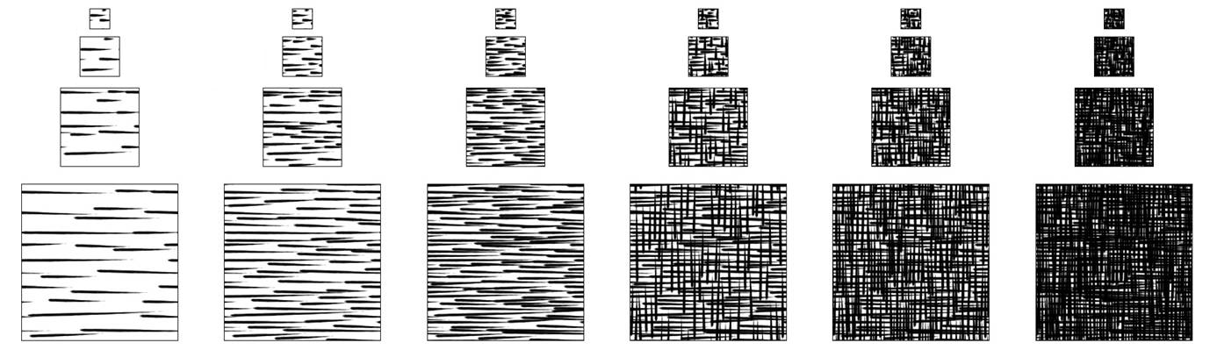
Previous Work – Tonal Art Maps
Real Time Hatching [Praun 2001]
  Blend specially designed texture maps
  High degree of coherence limits artifacts
← scale →
← tone →
Notes:
Combining the 2 approaches, we produce Tonal Art Maps, a collection of stroke textures parameterized by both tone and resolution. When rendering a 3D object we will blend some of these textures, so we need to design them with a very high degree of coherence, in order to avoid blending artifacts.
Specifically, we impose a stroke nesting property: all the strokes in one image appear in all the finer resolution images, and all the darker tone images. By transitive closure, they appear in ann the images to the right or down, in the Tonal Art Map array.
[Demo] You can see that as the square gets darker, all the strokes persist, and a few others are gradually blended in. The same thing happens as we zoom in.

Slide 8
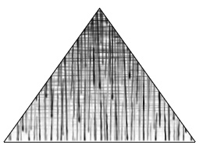
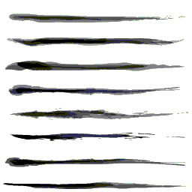
Previous Work – TAM Limitations
Coarse collections of Strokes
  Leads to blending in ‘waves’ of strokes
Limited artist control
  No color
  Small number of example strokes

Slide 9
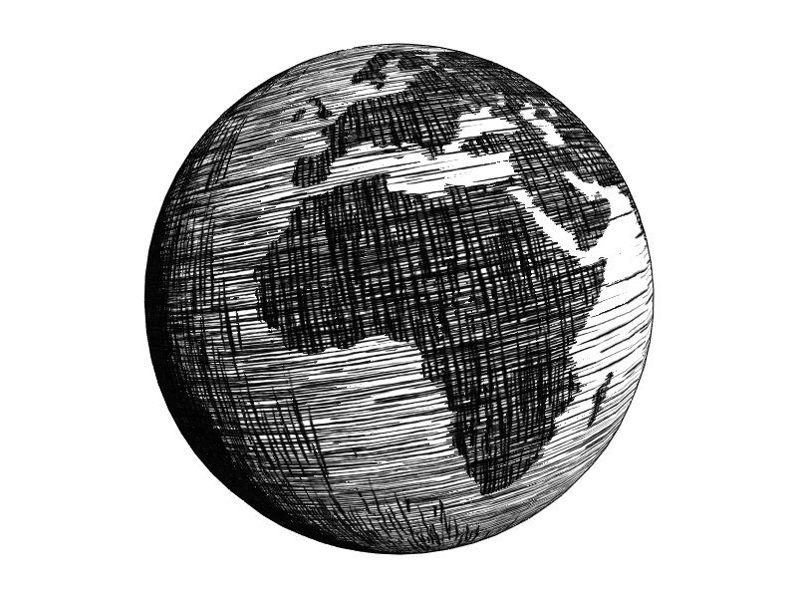
Method
Extend the concept of the TAM
  Volume TAM
    Fine Tone Control
    Color
  Threshold scheme:
    Fine Tone Control
    Per Pixel Lighting

Slide 10
Approach
Set of textures
Result
Stroke Session
Mesh
Preprocess
Real-Time
Notes:
Here is an overview of our approach.
The main idea is to leverage the texturing power of recent graphics hardware, and to bundle strokes together in textures, rather than draw them as individual primitives.
We start with a bitmap of a stroke that an artist draws, or that we import from a drawing package. As a preprocess, we create a set of textures using several instances of our example stroke.
At runtime, we select and blend a subset of these texture images, applying them to the mesh surface.

Slide 11
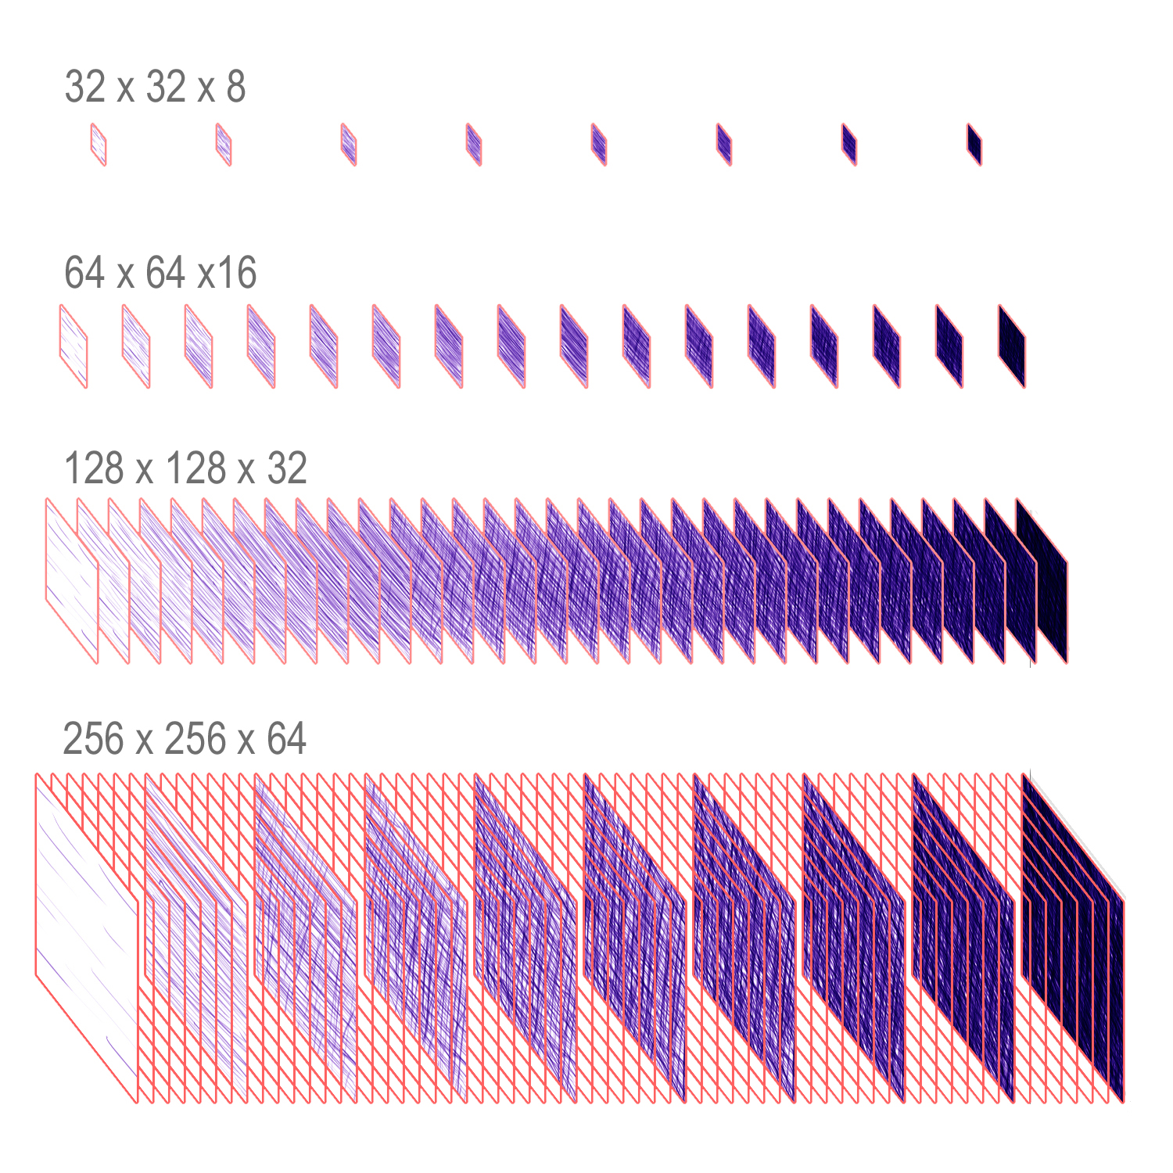
Volume TAM
Fine Tone Control
Color
Greater Artistic Control

Slide 12
Volume TAM creation
Volume TAM consists of 120 images
Artist works on most detailed level
Computer generates TAM images from subsets of artist’s strokes

Slide 13



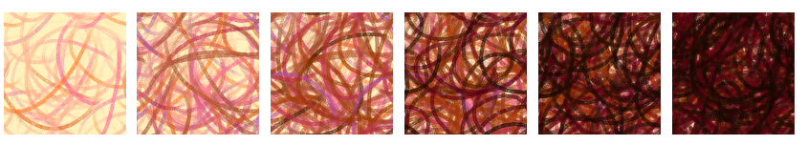
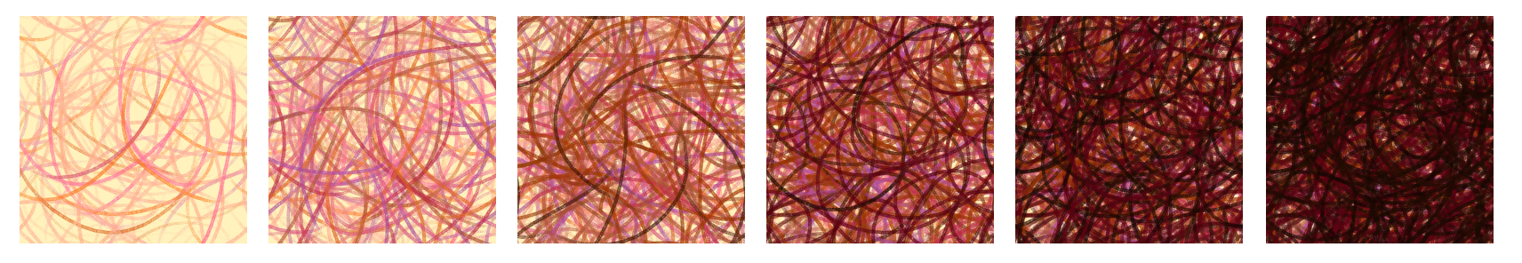
Volume TAM creation
8 images [32 x 32 px]
16 images [64 x 64 px]
Stroke Session
32 images [128 x 128 px ]
64 images [256 x 256 px]

Slide 14
Result

Slide 15
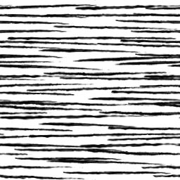
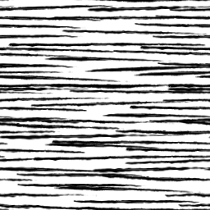
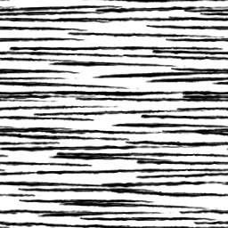
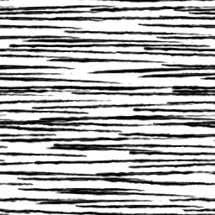

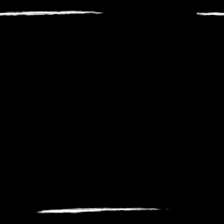

Volume TAM Observations
Few pixels change between adjacent images in the pyramid
Since approximating a single tone, a pixel tends not to change between successive images in the pyramid
17
18
19
20
diff 17, 18
diff 18, 19
diff 19, 20

Slide 16

Volume TAM Observations
Few pixels change between adjacent images in the pyramid
Since approximating a single tone, a pixel tends not to change between successive images in the pyramid
17
18
19
20
diff 17, 18
diff 18, 19
diff 19, 20
diff 17, 20

Slide 17
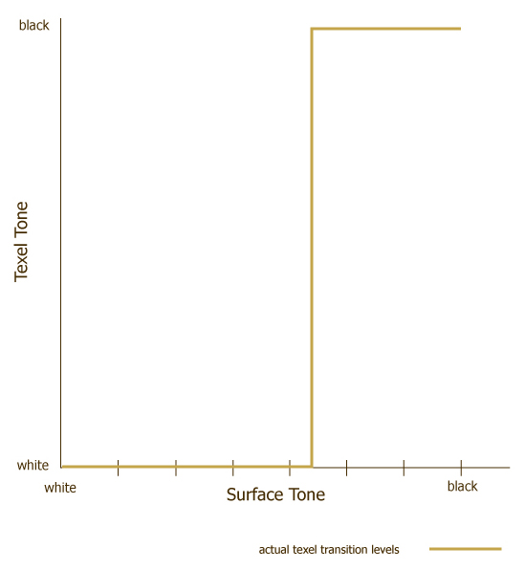
Pixel Transition
Threshold TAM Creation
Notes:
The observation that you could encode Frendenburg 01
He encoded one transition
We do it with 7 bins

Slide 18
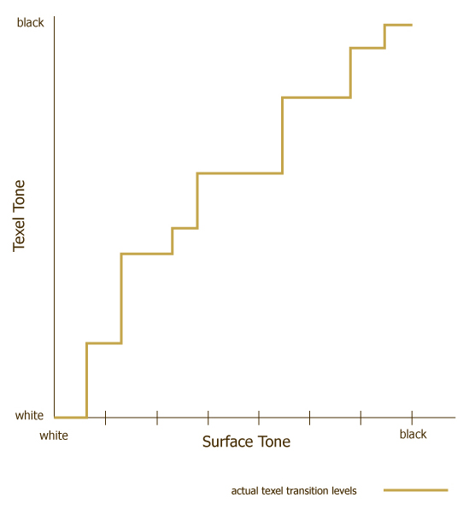
Pixel Transition
Threshold TAM Creation
Notes:
The observation that you could encode Frendenburg 01
He encoded one transition
We do it with 7 bins

Slide 19
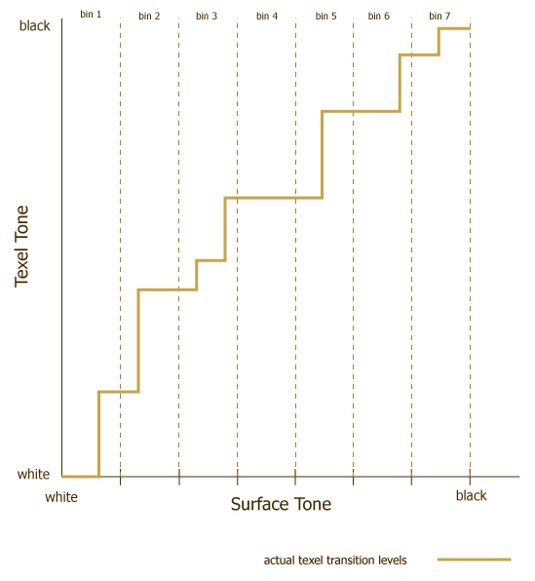
Divide range into
7 bins
Threshold TAM Creation
Notes:
The observation that you could encode Frendenburg 01
He encoded one transition
We do it with 7 bins

Slide 20
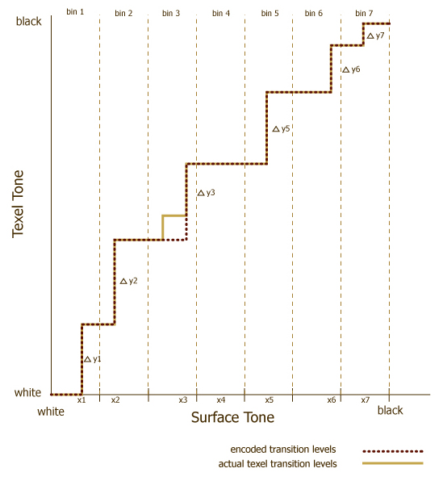
Why 7 bins?
-16 channels (rgba x 4)
- 2 channels used for other
processing
- for each bin need to
encode x_{i} andΔy_{i}
- use 7 x 2 = 14 remaining
channels
Threshold TAM Creation
Notes:
The observation that you could encode Frendenburg 01
He encoded one transition
We do it with 7 bins

Slide 21
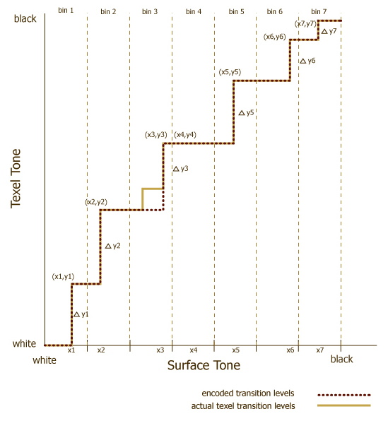
Why 7 bins?
-16 channels (rgba x 4)
- 2 channels used for other
processing
- for each bin need to
encode x_{i} andΔy_{i}
- use 7 x 2 = 14 remaining
channels
Threshold TAM Creation
Notes:
The observation that you could encode Frendenburg 01
He encoded one transition
We do it with 7 bins

Slide 22







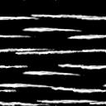
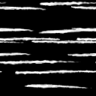
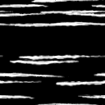
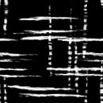
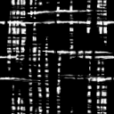
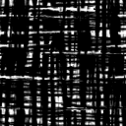
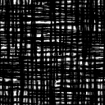
Threshold Scheme
Encode transition ‘bin’ as an image
x1 x2 x3 x4 x5 x6 x7
Δy1 Δy2 Δy3 Δy4 Δy5 Δy6 Δy7
Notes:
Use adam’s thoughts:
Threshold scheme condenses volume tam by encoding into a smaller set of images
Allows the information to be moved closer to the hardware
Can then be decoded using a simple pixel shader – this allows for per pixel effects – specifically texture modulation

Slide 23

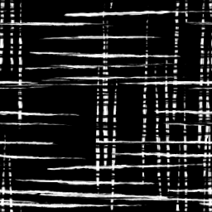
Threshold Scheme
Each pixel of each frame is calculated
Pixel value =
x4
Δy4
Notes:
Simple to decode

Slide 24
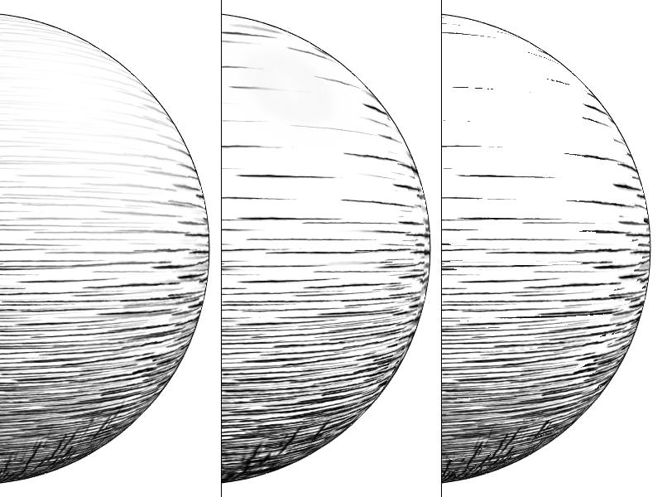
Finer Control
Praun 2001
Volume TAM
7 Thresholds

Slide 25
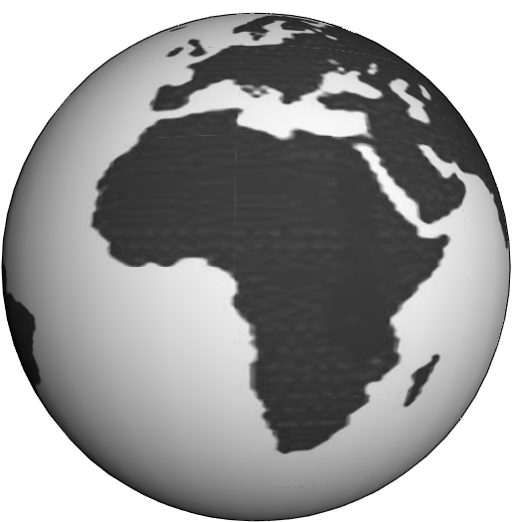
Per Pixel Effects

Slide 26
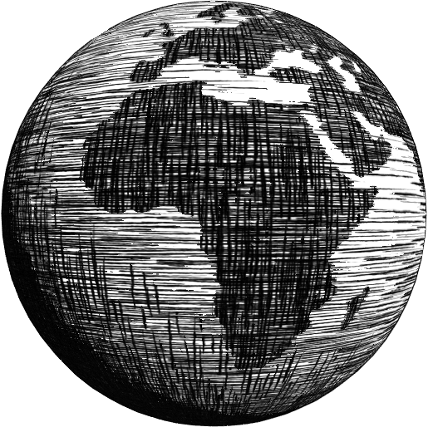
Per Pixel Effects

Slide 27
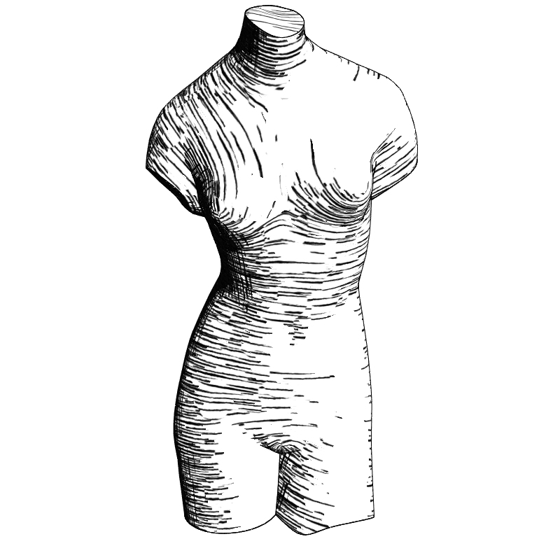
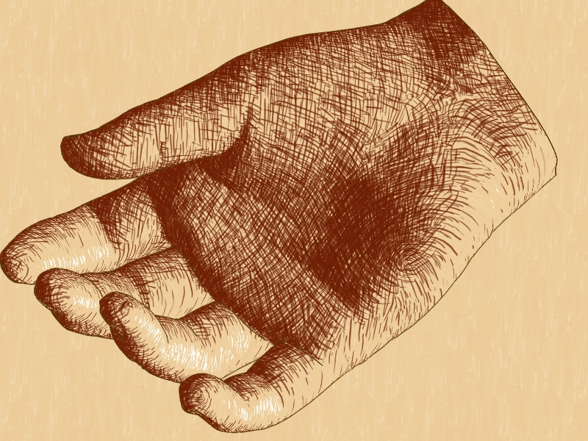
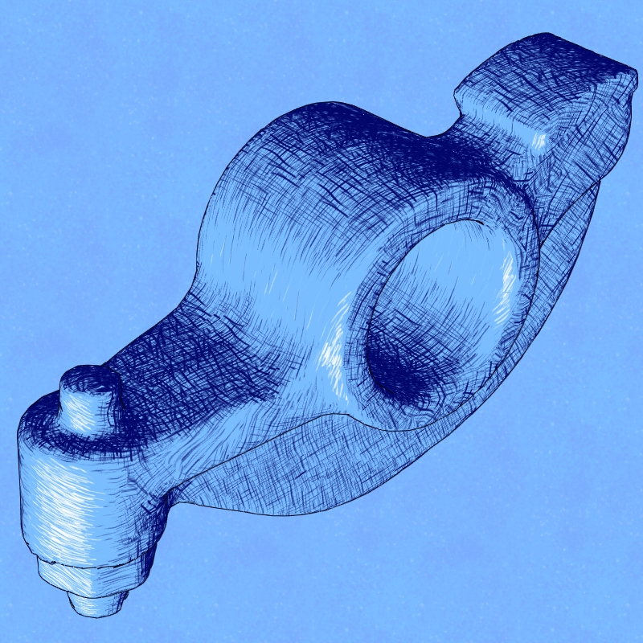
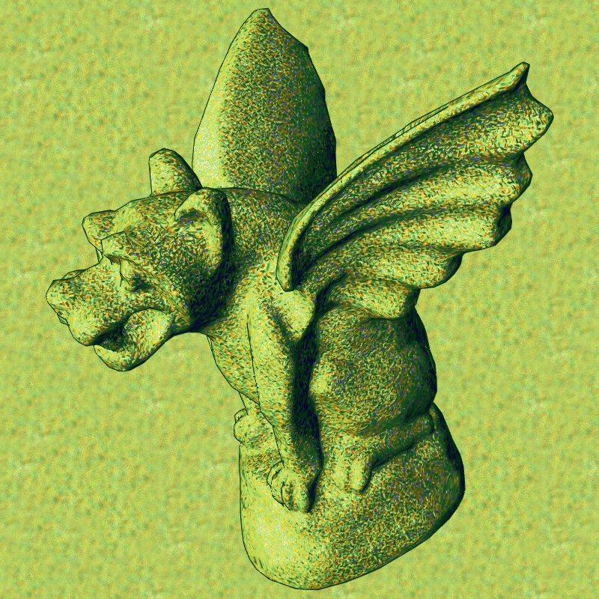
Results
demo

Slide 28
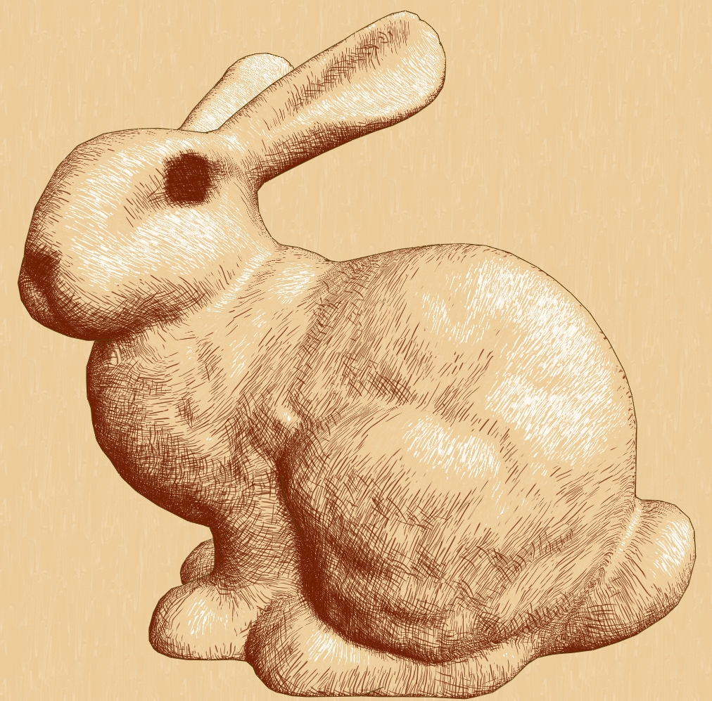
Future Work
Silhouettes
Texture Compression
Bounded Hue, Intensity Error
Scenes
  Shadowing
  Haloing

