Slide 1
SUPPLEMENTAL MATERIAL:
Compression Experiments
Factoring Repeated Content Within and Among Images
(SIGGRAPH 2008 submission 0064)

Slide 2
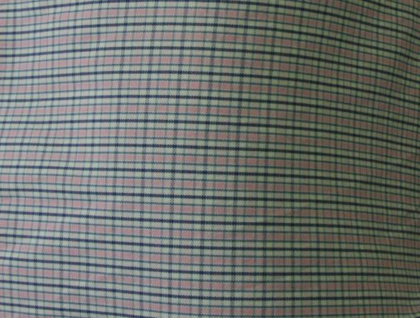
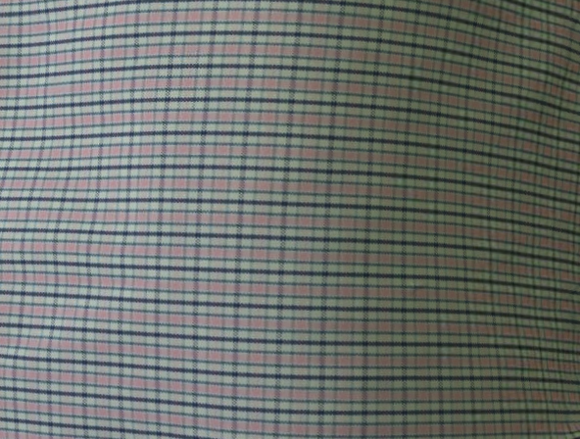
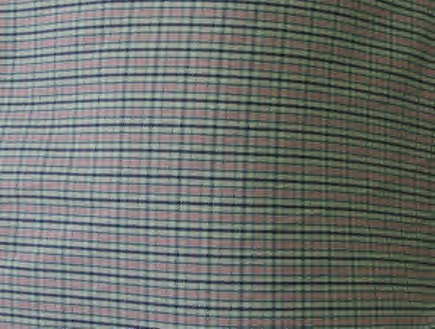
Comparison with JPEG 2000
Original image
592 x 448 pixels
Our factored representation
- epitome compressed to 5KB
using JPEG 2000
- transform map compressed to 5KB
JPEG 2000 compression
of original image
- compressed to 10KB
(same storage size)
(Requires 796KB for rendering)
(Requires 42KB for rendering)
(Requires 796KB for rendering)
- Our factoring is orthogonal to JPEG 2000, and at high compression rates it offers higher quality than JPEG 2000 alone.
- As discussed further in the rebuttal, our motivation is to reduce memory usage of texture images for real-time rendering. Because JPEG 2000 requires decompression prior to rendering, we feel that this comparison is interesting but not completely appropriate.

Slide 3
Close-ups
Original image

Slide 4
Close-ups
Our factored representation, in 10KB

Slide 5
Close-ups
JPEG 2000 alone, in 10KB

Slide 6
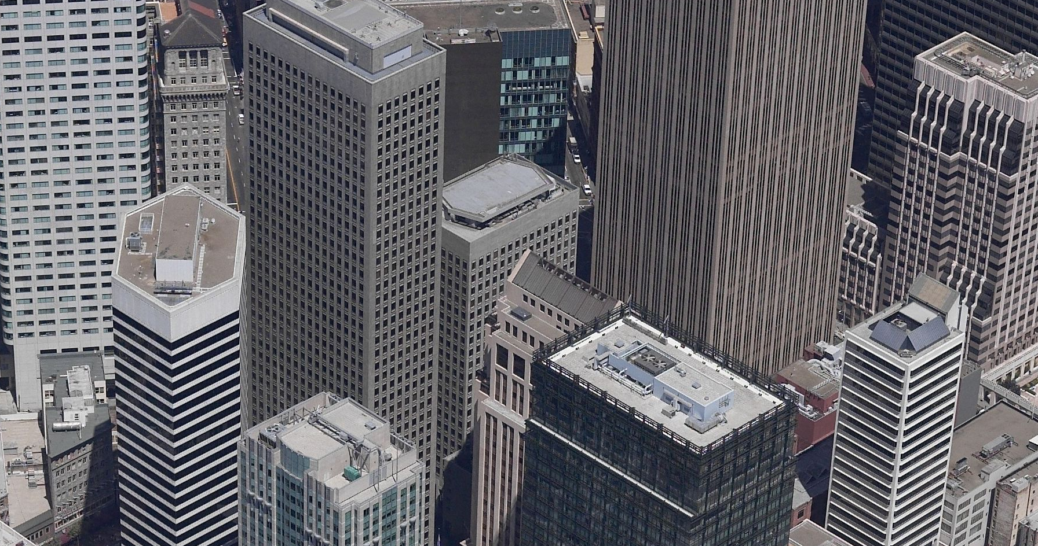
Original image
1792 x 944 pixels

Slide 7

Our factored image representation
- Epitome compressed using JPEG 2000 to 35KB
- Transform map compressed to 35KB
(for a total of 70 KB)
(Requires 1.3MB for rendering)

Slide 8

JPEG 2000 on original image
Original image compressed using JPEG 2000 to 70 KB
(Requires 5.1MB for rendering)

