Slide 1
Factoring Repeated Content Within and Among Images
Huamin Wang Georgia Tech
Yonatan Wexler Microsoft Corporation
Eyal Ofek Microsoft Corporation
Hugues Hoppe Microsoft Research
ACM SIGGRAPH 2008
August 12, 2008

Slide 2
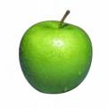
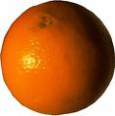
Factoring Repeated Content Within and Among Images
What is image factorization?
Epitome E
A
O
O
A
A
O
A
Map Φ
（A: Apple, O: Orange)
Image I

Slide 3
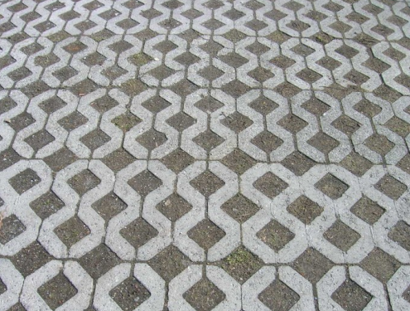
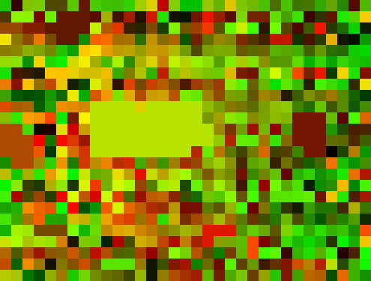
Our Representation
Epitome E (m× n)
Block B(s×s)
Map Φ(M/s× N/s)
Affine Transform
Illumination Transform
Image I （M × N)
| I | > | E | + | Φ|
(M×N) (m×n) (M/s×N/s)

Slide 4
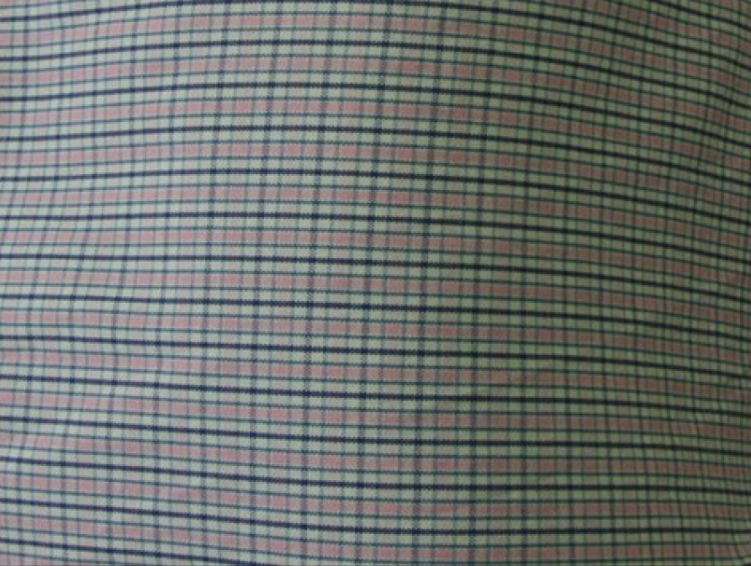
What is the advantage? (1)
Quality under very-high compression rate
Our Compression
Original
JPEG 2K
Ours
(592×448)
(777KB)
INPUT
Image I
Epitome
Map
JPEG
PNG
(5KB)
(5KB)
OUPUT
Compressed
Data
(10KB)

Slide 5
What is the advantage? (2)
Disk | GPU Memory
Pixel
Shader
JPEG (10KB)
Texture (777KB)
Pixel
Shader
Epitome + Map (10KB)
Epitome + Map (180KB)

Slide 6
Rendering Overview
Pixel Shader (for pixel p)
GPU Memory
(DXT)
Get p’s transformation
Render Buffer
Transform p into its
location in E
Reconstructed Image
Epitome E
Sample the pixel value
from E
Map Φ
Adjust illumination
>800Mpixels/sec

Slide 7
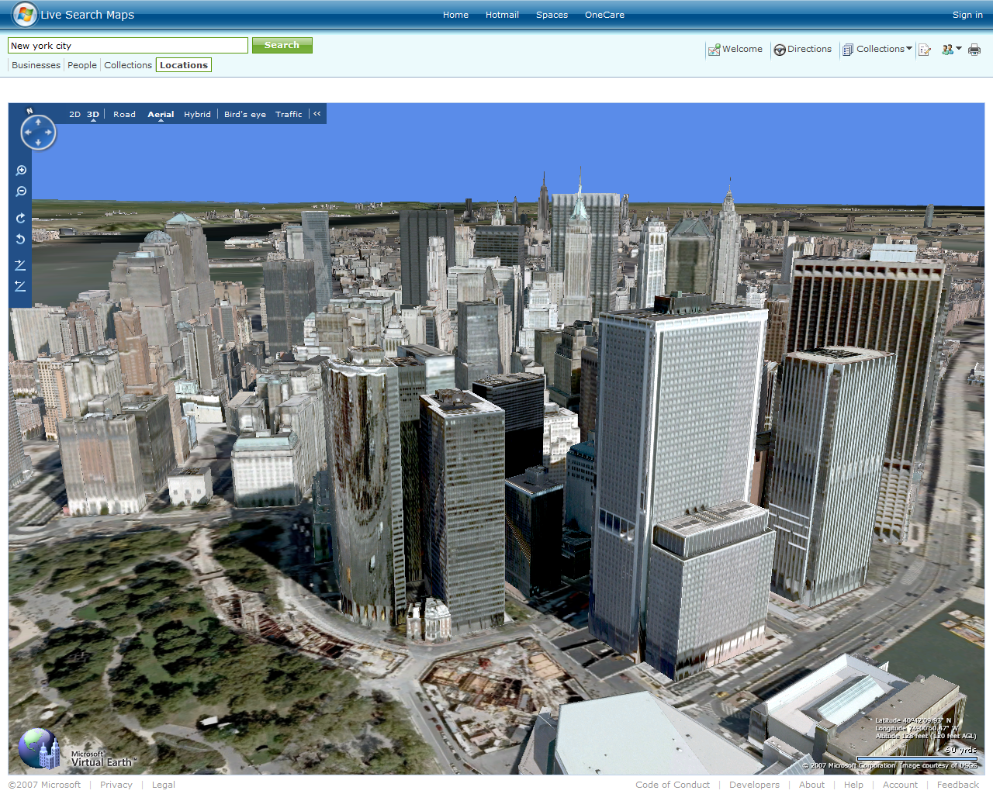

Slide 8
Some Previous Work
Vision
(2003) Epitomic Analysis of Appearance and Shape
N.Jojic, B.Frey, and A.Kannan, ICCV 2003.
(2006) Clustering appearance and shape by learning jigsaws
A. Kannan, J. Winn and C. Rother, NIPS 2006
Graphics
(2004) Near-Regular Texture Analysis and Manipulation
Y. Liu, Y. W.C. Lin and J. Hays, in proceedings of ACM SIGGRAPH 2004.
(2006) Discovering Texture Regularity as a Higher-Order Correspondence Problem J. Hays, M. Leordeanu, A. Efros, and Y. Liu, ECCV 2006
(2008) Inverse Texture Synthesis
J. Han, L. Wei, K. Zhou, B. Guo, H. Shum, in proceedings of ACM SIGGRAPH 2008.

Slide 9
Factoring Repeated Content Within and Among Images
The system pipeline
Input Image I
Finding Self-Similarities Over I
Selecting a texture chart for repeated content
Assembling charts into an epitome
Output E and Φ

Slide 10
Step 1: Finding Self-Similarities
What is a self-similarity (or a match)?
Block B_{i}
Match 1
For each p∈B_{i}:
I[p] ≈ I[M(p)]
Match 2
Match 3
Match n
Match 4
……
Match(B_{i})={M₁, M₂, M₃, …, M_{n}}

Slide 11
Step 1: Finding Self-Similarities
Measure a match? (Based on SSD)
M
γ: illumination scaling factor
σ: Block variance
α: normalization factor (0, 2)
β: small number

Slide 12
Step 1: Finding Self-Similarities
Solution: Kanade-Lucas-Tomasi Feature Tracker
p ∈ Block B_{i}
M
Start from an initialization M₀:
Initial Locations
Initial Rotations
Initial Scalings
M(p)

Slide 13
Step 1: Finding Self-Similarities
Seed searching locations:
Pruning if:
Color histograms of B_{i} and S_{j} are too different…

Slide 14
Step 1: Finding Self-Similarities
Seed searching orientations:
θ_{guess}=min_{θ’} Σ_{θ} ( |H_{orient}(θ, B_{i}) - H_{orient}(θ+θ’, S_{j})|² )
Magnitude
Magnitude
0°
0°
60°
60°
120°
120°
180°
180°
240°
240°
300°
A
300°
A
Block
Seed
Direction
Direction
Pruning if:
Gradient histograms of B_{i} and S_{j} after rotation are still too different…

Slide 15
Step 1: Finding Self-Similarities
Seed searching scaling levels:

Slide 16
Step 1: Finding Self-Similarities
Match results:
Block

Slide 17
Step 1: Finding Self-Similarities
The illumination

Slide 18
Step 1: Finding Self-Similarities
Without illumination scaling…

Slide 19
Factoring Repeated Content Within and Among Images
The system pipeline
Input Image I
Finding Self-Similarities Over I
Selecting a texture chart for repeated content
Output E and Φ

Slide 20
Step 2: Selecting charts
What is a chart?
A representative region on image I
How to select/grow a chart in a greedy way?
Minimize the chart size
Maximize # of blocks can be represented

Slide 21
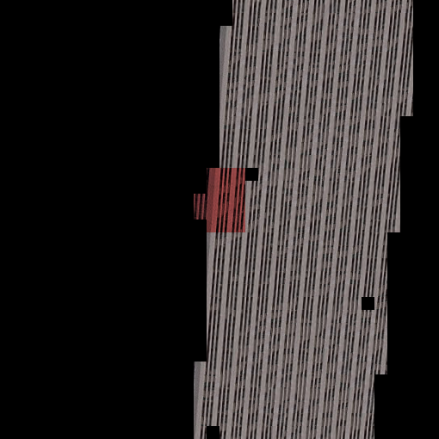
Step 2: Selecting charts
An example (1/4)
C₁

Slide 22
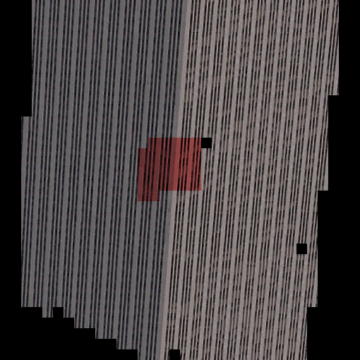
Step 2: Selecting charts
An example (2/4)
x
x
C₁
x
x
x
x

Slide 23
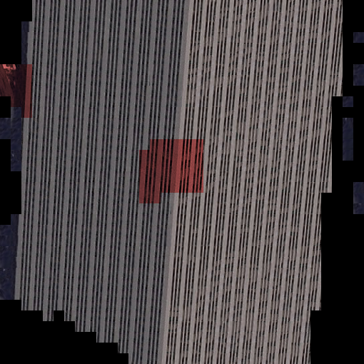
Step 2: Selecting charts
An example (3/4)
C₂
x
C₁

Slide 24
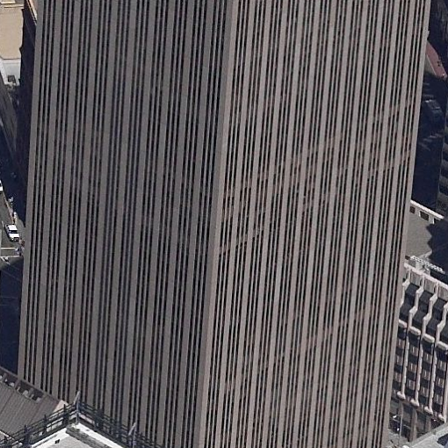
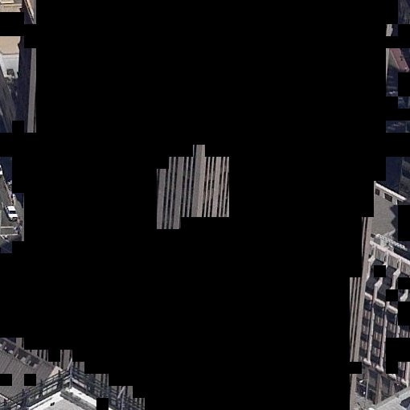
Step 2: Selecting charts
An example (4/4)

Slide 25
Factoring Repeated Content Within and Among Images
The system pipeline
Input Image I
Finding Self-Similarities Over I
Selecting a texture chart for repeated content
Assembling charts into an epitome
Output E and Φ

Slide 26
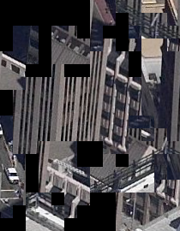
Step 3: Assembling charts
The goal
Charts on Epitome E
Charts on image I

Slide 27
Step 3: Assembling charts
Greedy polyomino packing
Pick a chart with the largest bounding area
Place it where the epitome is minimized

Slide 28
Results
16.2%
Original Image
Reconstructed Image

Slide 29
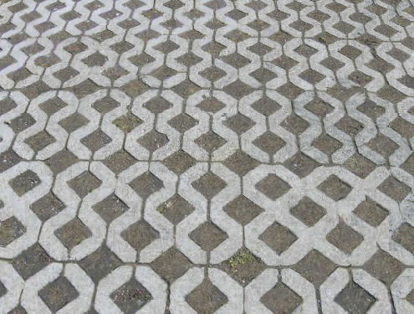
Results
16.3%
Original Image
Reconstructed Image

Slide 30
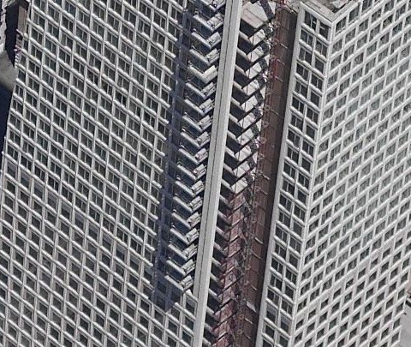
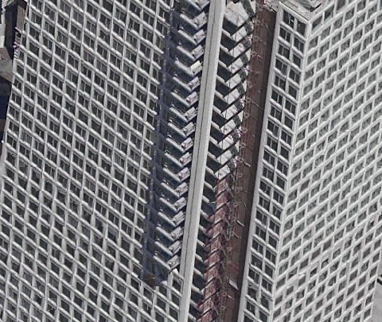
Results
15.7%
Original Image
Reconstructed Image

Slide 31
Results
18.5%
Original Image
Reconstructed Image

Slide 32
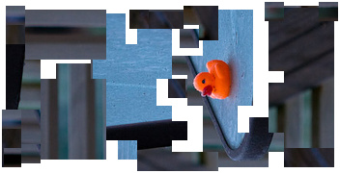
Results
Original Image
Reconstructed image

Slide 33
Results
10.7%
Original Image
Reconstructed Image
Reconstructed Image

Slide 34
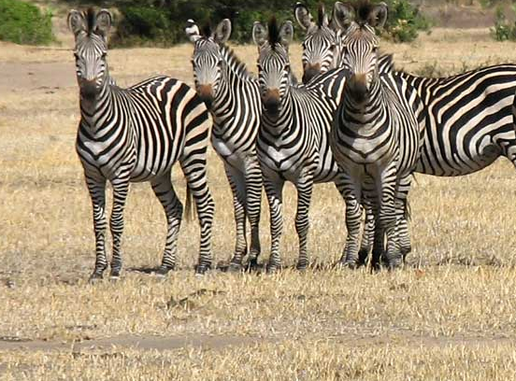
Results
A difficult case…

Slide 35
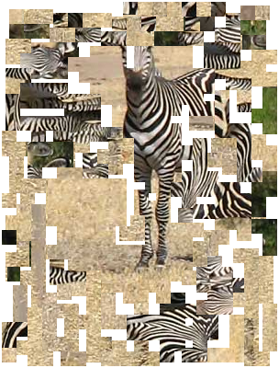
Results
A difficult case…

Slide 36
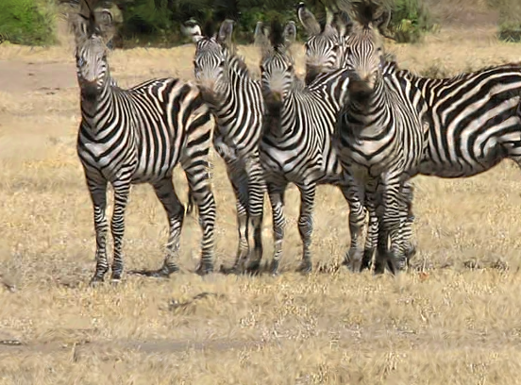
Results
A difficult case…
Reconstructed Image

Slide 37
Results
A difficult case…
Original Image

Slide 38
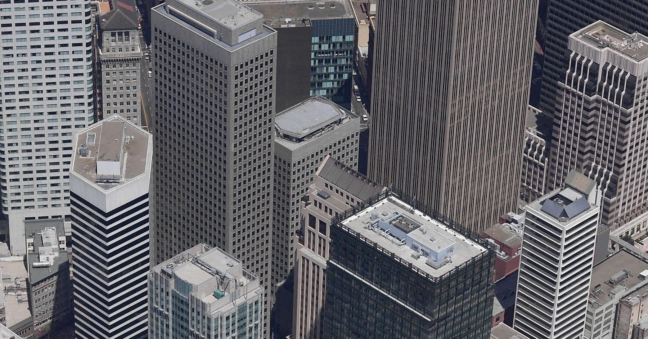
Results
Original Image (1800 X 945)

Slide 39
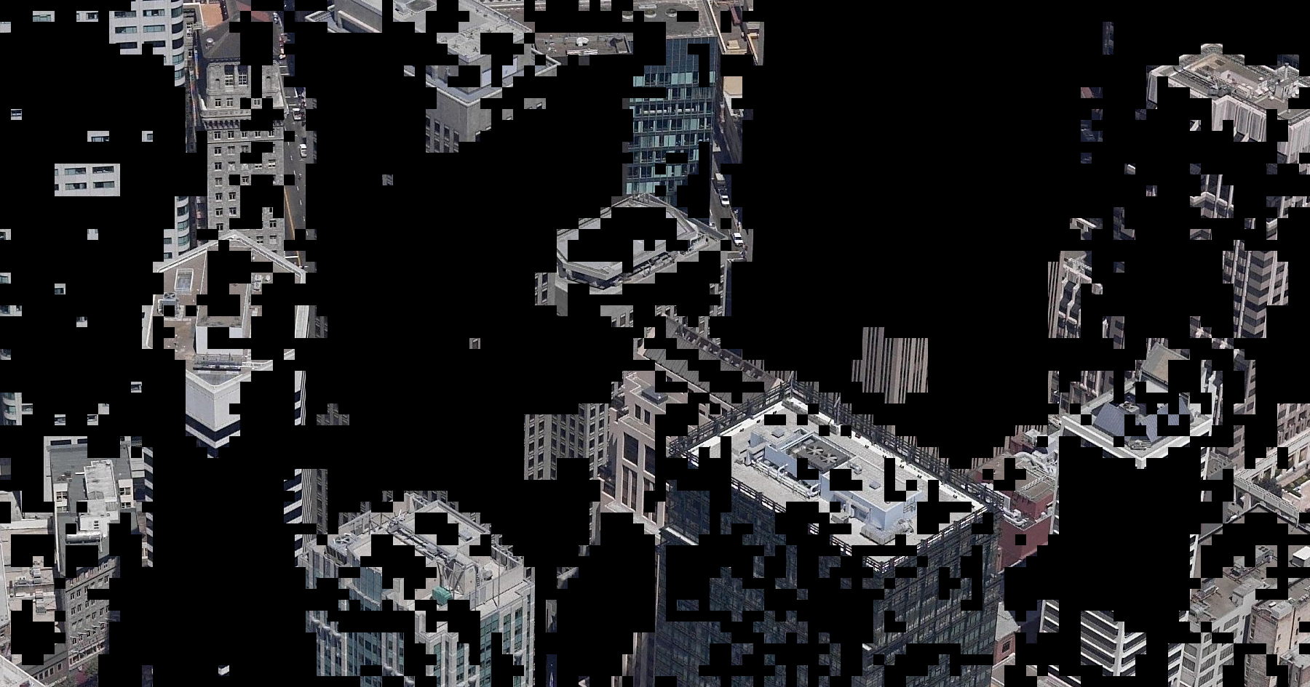
Results
25%

Slide 40
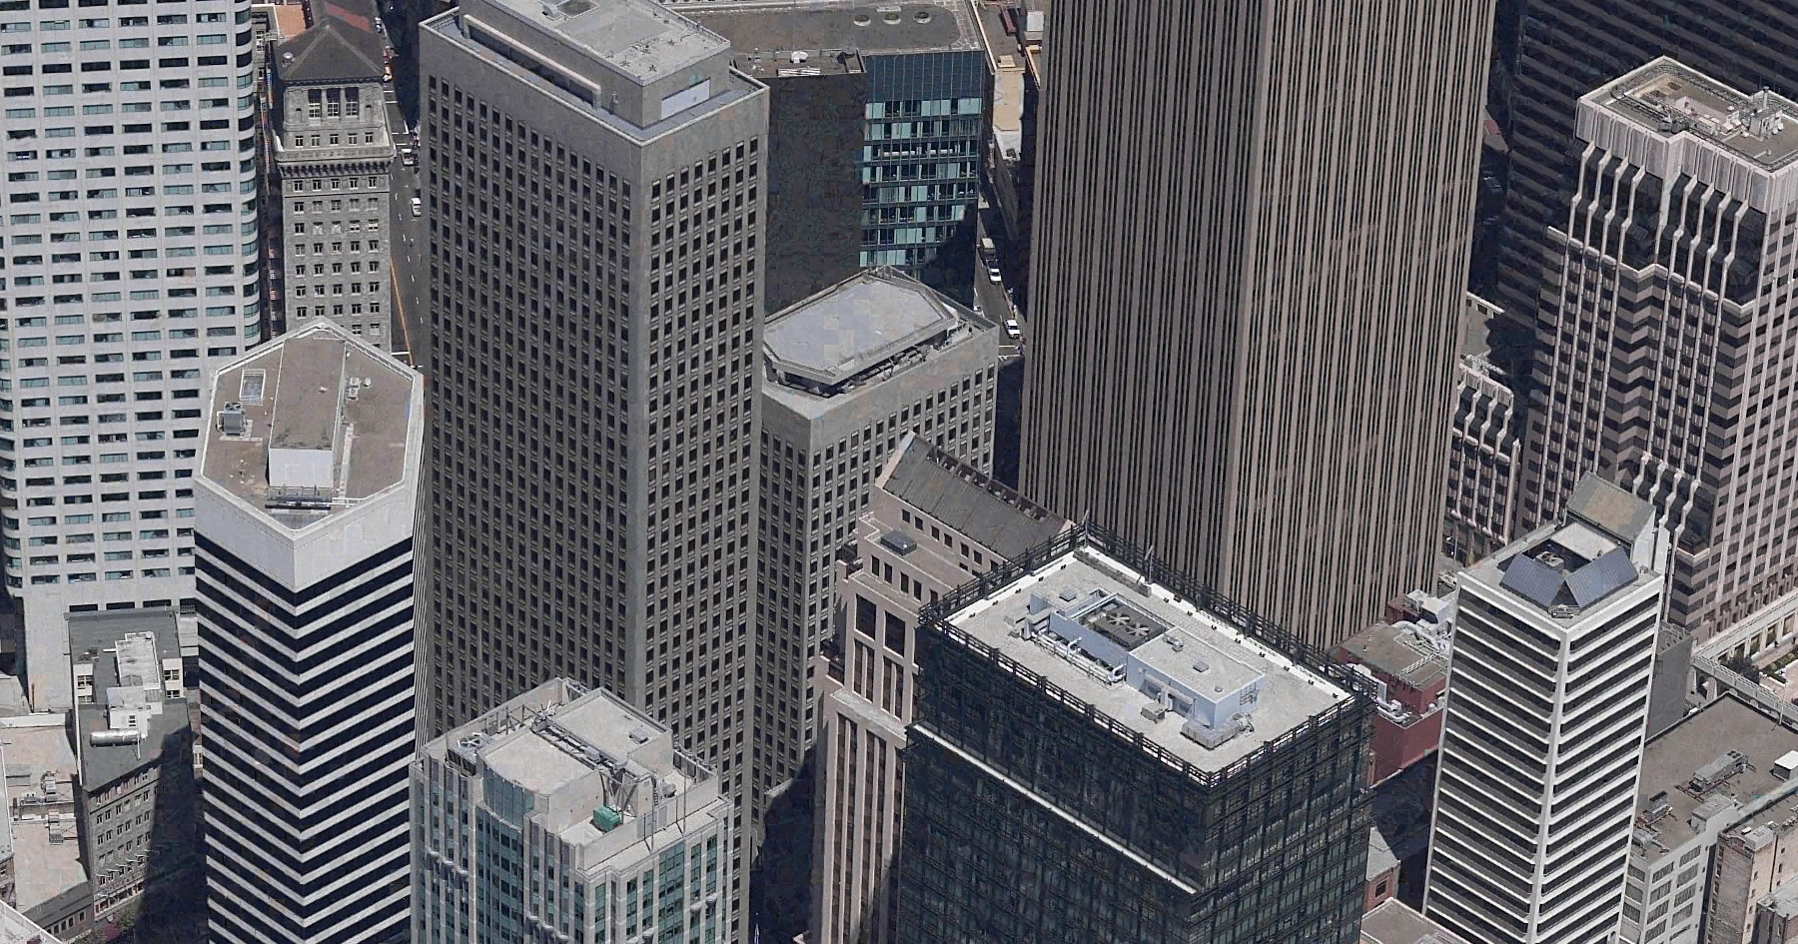
Results
Original Image (1800 X 945)
Reconstructed Image (1800 X 945)

Slide 41
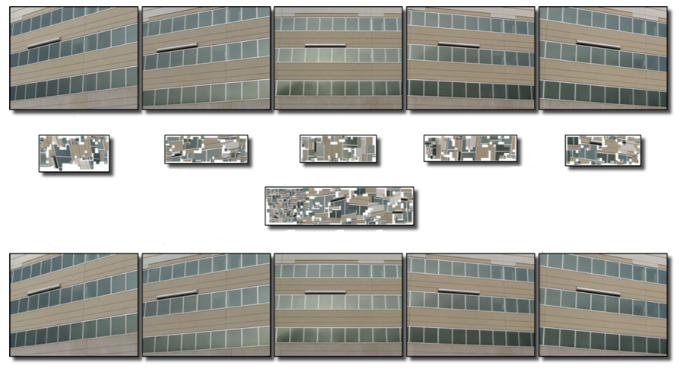
Results
Factoring among images
Epitome

Slide 42
Factoring among images

Slide 43
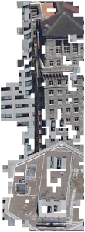
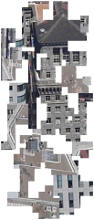
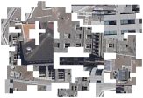
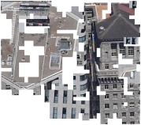
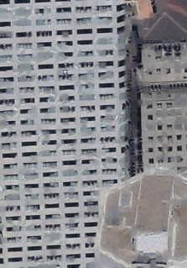
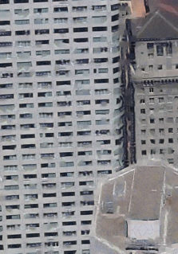
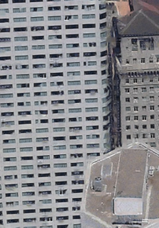
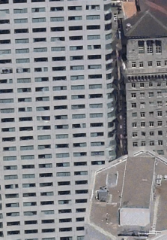
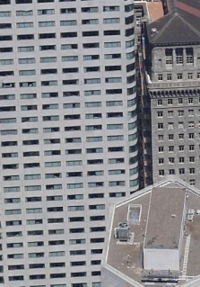
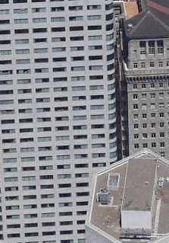
Progressive Transmission
0.0050
0.0045
0.0040
0.0035
0.0030
0.0025
0.0020
0.0015
0.0010
Approximation error tolerance ε

Slide 44
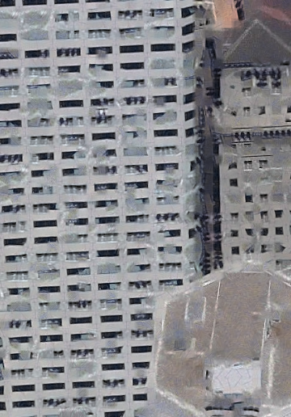
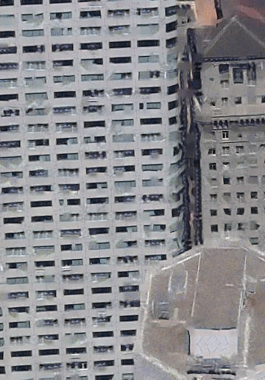
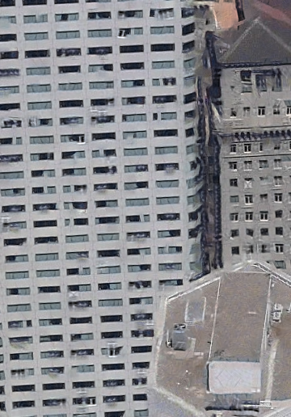
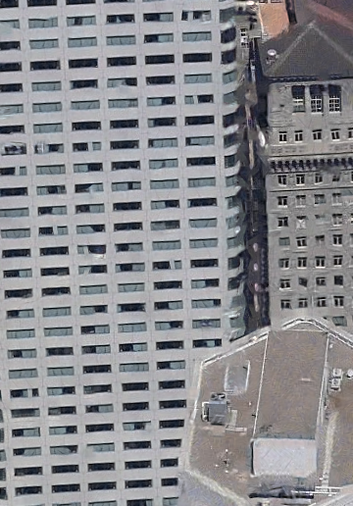
Progressive Transmission

Slide 45
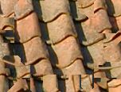
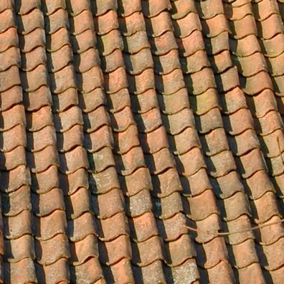
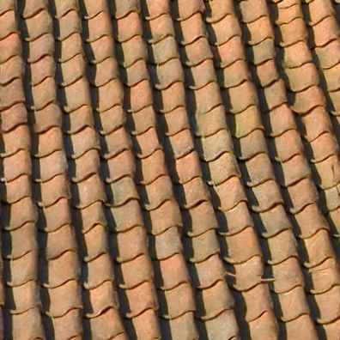
“Image Generification”
Original Image
Reconstructed Image

Slide 46
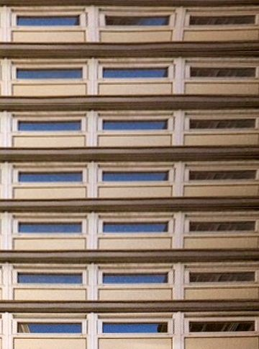
Detail Transfer

Slide 47
Conclusions
Pros
Orthogonal to existing compression methods
High quality under high compression rate
Allows random access
Reduces GPU resources
Real-time decoding process
Enables: texture analysis, progressive images, texture transfer, image generalization…
Cons
Less effective for images with little repeated content
Relatively slow compression

Slide 48
Acknowledgements
Special Thanks to:
Reviewers
Howard Zhou, Craig Kaplan
Microsoft Research Asia

Slide 49
Factoring Repeated Content Within and Among Images
Thank you!
Huamin Wang Georgia Tech
Yonatan Wexler Microsoft Corporation
Eyal Ofek Microsoft Corporation
Hugues Hoppe Microsoft Research
ACM SIGGRAPH 2008
August 12, 2008

Slide 50
Example | Input | Block size | Epitome | Memory savings | RMS error | Time (mins)
Figure 1a | 504×504 | 12 | 328×232 | 3.1 | 2.7% | 71
Figure 1b | 5×600×396 | 12 | 472×252 | 8.0 | 2.5% | 1100
Figure 3 | 432×372 | 12 | 152×132 | 6.7 | 3.1% | 65
Figure 4 | 492×372 | 12 | 192×132 | 6.1 | 3.0% | 77
Figure 11 | 432×432 | 12 | 132×136 | 8.2 | 3.3% | 70
Figure 18 | 360×516 | 12 | 348×148 | 3.3 | 2.6% | 43
Figure 19 | 5×600×480 | 12 | 548×196 | 10.0 | 2.9% | 1420
Figure 20a | 624×480 | 12 | 260×184 | 5.4 | 1.6% | 262
Figure 20b | 396×396 | 12 | 180×72 | 9.3 | 1.4% | 21
Figure 20c | 800×800 | 16 | 396×340 | 4.5 | 2.3% | 146
Figure 20d | 552×408 | 12 | 304×400 | 1.8 | 5.4% | 89
Figure 24 | 396×396 | 12 | 152×116 | 7.3 | 4.5% | 28
Figure 25 | 592×448 | 16 | 140×72 | 19.1 | 2.5% | 112
Figure 28 | 1792×944 | 16 | 372×1144 | 3.8 | 3.9% | 1950

Slide 51
What is the optimal block size?

