Slide 1
Efficient Traversal of Mesh Edges
using Adjacency Primitives
Pedro V. Sander
Diego Nehab
Eden Chlamtac
Hugues Hoppe
Hong Kong UST
Microsoft Research
Princeton University
Microsoft Research

Slide 2
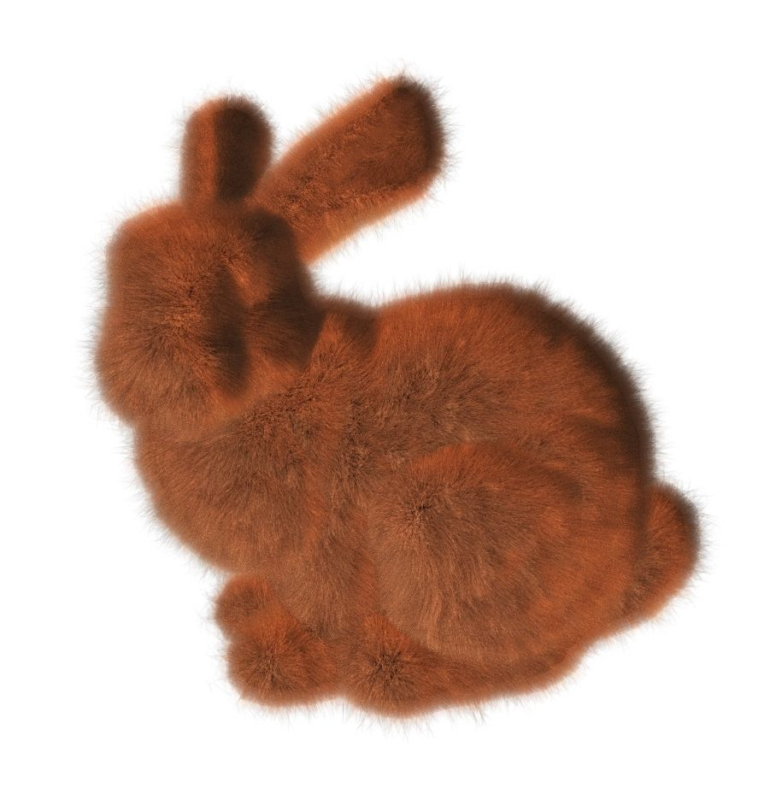
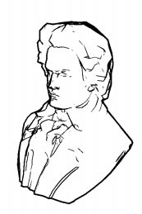
Motivation
Many rendering techniques process mesh edges
Silhouettes
Line illustration
Shadows
Motion blur
Fur shells and fins
Many others...
Our goal: Maximize efficiency on the GPU
Lengyel et al. [1999]
Hertzmann [1999]
Notes:
Processing mesh edges lies at the core of many real-time rendering applications.
Examples include rendering silhouettes and lines,
Computing shadows and motion blur,
Generating shells and fins for fur rendering,
As well as many others.
So, our goal in this paper is to maximize the efficiency of processing mesh edges on the GPU, in order to speed up these edge-processing applications.

Slide 3
Related work
Vast majority employs CPU-based processing
Much less explored on GPU
Common CPU-GPU hybrid technique:
Use degenerate quadrilaterals on mesh edges
Expand when appropriate
Used for
Shadow volumes [Brennan 2002]
Silhouettes and fins [Card and Mitchell 2002, McGuire and Hughes 2004]
Notes:
The vast majority of existing edge processing techniques are designed for the host CPU.
Direct edge processing is much less explored on the GPU.
Recently, hybrid techniques have been proposed that use degenerate quadrilaterals to represent edges.
Depending on a vertex shader test, these quadrilaterals are then expanded on the GPU.
This has been used to produce shadow volumes as well as silhouettes and fins.

Slide 4
Related work
GPU-only techniques introduced recently
Fur shells and fins [Tariq 2007]
Shadow volume [Microsoft 2007]
DX SDK sample
Baseline for our experiments
Use new Geometry Shader (GS) functionality
Notes:
More recently, with the advent of the geometry shader, new techniques have been developed for
Rendering fur and shadow volumes by generating the new geometry entirely on the GPU.
A GPU-only shadow volume implementation is provided by the Microsoft DirectX SDK and is used as the baseline for our experiments.
These techniques use the newly added geometry shader functionality from recent APIs.
So, lets quickly recap this added feature.

Slide 5
Graphics Rendering Pipeline
Application
Vertex Shader
Rasterizer
Pixel Shader
Display
Notes:
Prior to advent of the geometry shader, the rendering pipeline that we all know and love looked like this.

Slide 6
Graphics Rendering Pipeline
Application
Vertex Shader
Geometry Shader
Rasterizer
Pixel Shader
Display
Notes:
Then, a new step in the pipeline was introduced.
This completely programmable geometry shader is executed on each triangle immediately after the vertex shader, and right before triangle rasterization.

Slide 7
The Geometry Shader
Vertex Shader
Geometry Shader
Rasterizer
Executed once per triangle
Parallel SIMD processing
Can access adjacent triangles (6 vertices)
Zero or more triangles, lines, or points
Primitives then get rasterized
Pixel Shader
Display
Notes:
Like with vertex and pixel shaders,
different instances of the geometry shader can be executed in parallel SIMD fashion by the GPU.
A common usage is for each instance to process a triangle given information of six vertices:
The three vertices that define the triangle
as well as the three additional vertices that are adjacent to the neighboring faces, as shown in the diagram.
The geometry shader is not restricted to output a single triangle. It can output zero, one or more primitives for rasterization.
[3:05]

Slide 8
How to process edges on GS?
Can process edges on the geometry shader
Three edges w/ adjacency info
Many applications: Silhouettes, shadow volumes...
Notes:
So, how do we take advantage of this new functionality to process edges on the GPU?
Basically, this geometry shader has direct access to three edges with adjacency information, that is, with information about both faces adjacent to the edge.
This is useful for many real-time rendering applications, such as rendering silhouettes and shadow volumes.

Slide 9
How to process edges on GS?
Process one triangle with adjacency primitive per input mesh triangle
Arbitrary rule to process edge only once in GS
E.g., when vertex IDs increase clockwise
Optionally, process the center face
ID increases → process
43
31
ID increases → process
23
ID decreases → neighbor will process
Notes:
The traditional way of processing these edges is to render one triangle with adjacency for each input triangle of the mesh and provide an arbitrary rule so that the edge is not processed by both of its adjacent triangle faces.
One commonly used rule is to simply process the edge if the ID increases when traversing the vertices in counter-clockwise order.
If the ID decreases, then the edge will be processed by the neighbor face since the ID will necessarily increase during the neighbor’s traversal.

Slide 10
How to process edges on GS?
Drawbacks:
High number of adjacency primitives processed
Low SIMD efficiency
Low vertex cache utilization
Notes:
There are a few drawbacks with this and other common techniques that process all triangles.
First, it generates an adjacency primitive for each triangle of the mesh. That is excessive.
Second, different instances of the geometry shader will often process different number of edges, and this can lead to low SIMD efficiency.
Finally, there is no existing reordering algorithm for ordering these triangles with adjacency to take advantage of the vertex cache.

Slide 11
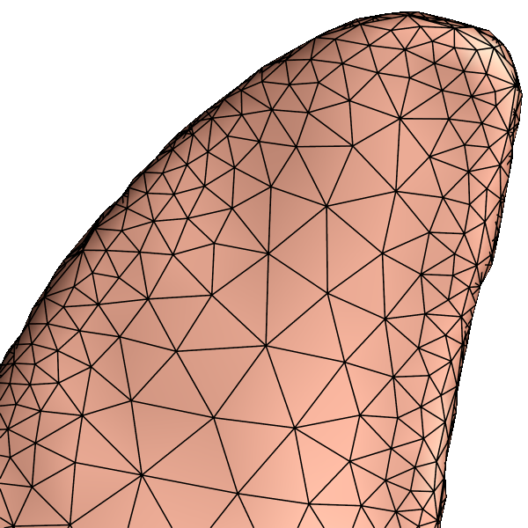
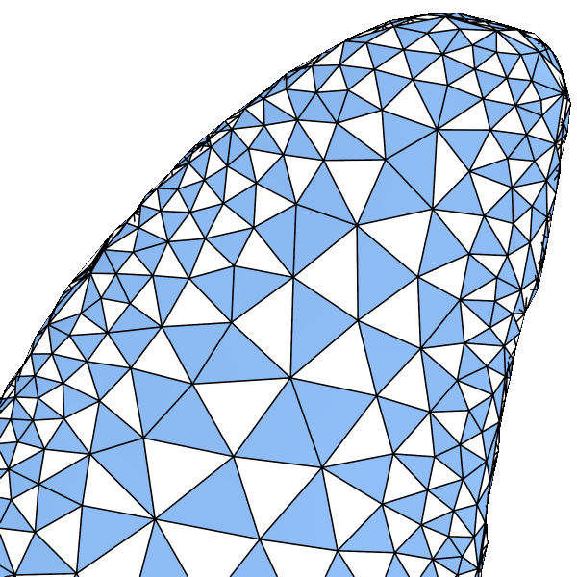
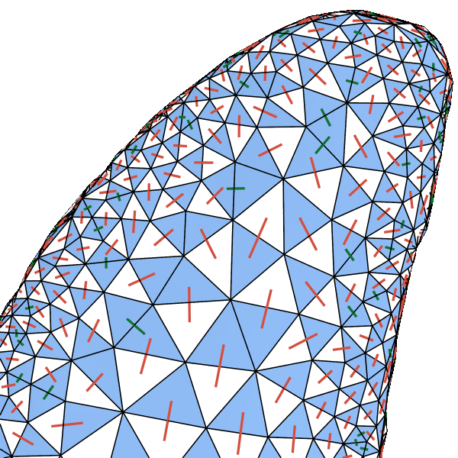
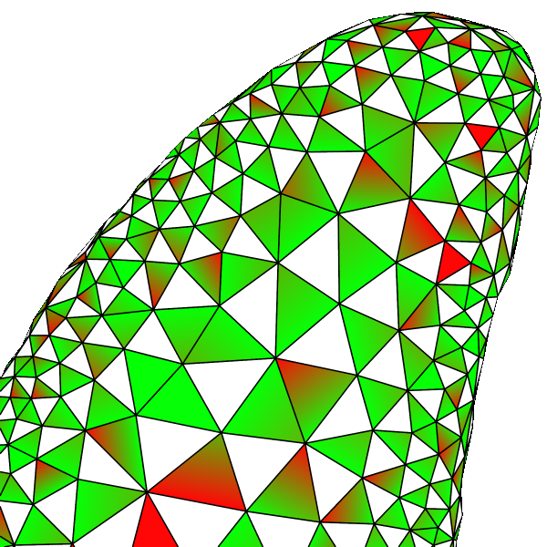
Our method
We address each of:
High number of adjacency primitives processed
Low SIMD efficiency
Low vertex cache utilization
Notes:
Our approach seeks to address the three inefficiencies in three steps.
<click>
We first reduce the number of adjacency primitives processed.
<click>
Then we show how we perform triangle assignments in order to improve SIMD efficiency.
<click>
Finally, we describe how to reorder the triangles with adjacency in order to improve vertex cache utilization.
<click>
<wait 1 second and click>

Slide 12
Our optimization targets
Geometry Shader
Reduce number of primitives processed and improve SIMD efficiency
Reduce number of vertices processed
Take advantage of vertex cache
Vertex Shader
Notes:
These optimizations target at reducing computation at both the geometry shader and the vertex shader stages of the pipeline. We will introduce new algorithms to accomplish these objectives.

Slide 13
1. Reducing the number of primitives
Subset of triangles that cover all edges
Notes:
So, the first step is to reduce the number of primitives while still being able to process, or cover, all of the edges.
We want to find the smallest possible number of triangle faces such that each edge is adjacent to at least one of these faces.

Slide 14
Vertex cover on the dual graph
Problem reduces to vertex cover on dual graph
min # of dual vertices min # of tris to to cover cross-edges cover edges
Notes:
And this problem is equivalent to the well known vertex cover problem on the dual graph of our mesh.
So, consider the dual edges, which are overlaid in red.
We basically want to determine the smallest set of vertices in this dual graph such that all red edges are covered.
The dual vertices of the minimum vertex cover represent the smallest number of mesh faces that are sufficient to cover all edges.

Slide 15
Vertex cover on the dual graph
Need to process boundary edges?
Include boundary triangles (blue)
Disconnect adjacent edges already covered (dotted)
Notes:
If the application requires processing mesh boundary edges, we can simply add the triangles adjacent to the mesh boundary to our cover.
Note that the edges connecting these boundary triangles, shown here in dotted lines, do not need to be considered when computing the vertex cover, since they will already be adjacent to these included boundary faces.

Slide 16
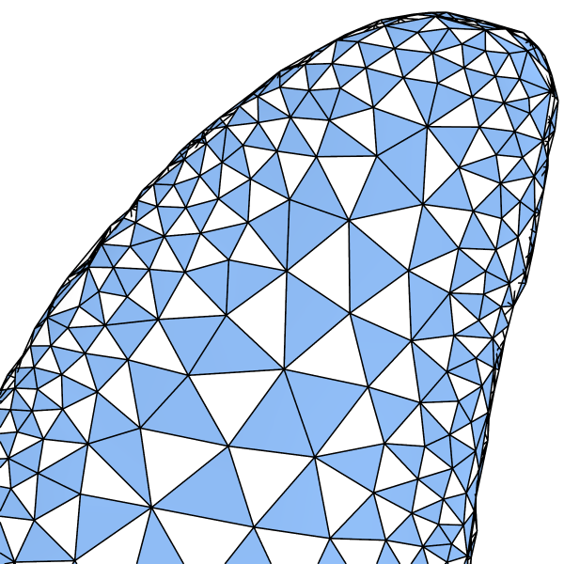
Vertex cover on the dual graph
Vertex cover is NP-complete
Many approximate heuristics exist
We use the recent method of [Grosso et al. 2007]
Notes:
Vertex cover is a well known NP-complete problem. So we cannot guarantee that we will find the absolute minimum number of triangles needed.
However, many good approximations exist.
For our purpose, we adopted a recent stochastic method by Grosso et al., which is efficient and provides very good results for triangle mesh data sets.
[6:22]

Slide 17
Vertex cover on the dual graph
How good is our cover result?
A little more than half of the mesh triangles
Minutes of preprocessing for very large meshes
New lower bound to the number of triangles (see Appendix of paper)
Compared lower bound with cover result: 2-3%
Notes:
So, how good are these results?
<CLICK>
Well, as you can see the cover has only a little bit more than half, or 50%, of the edges in the mesh.
Note that it must have at least half, since every edge is adjacent to two faces, and at least one such face must be in the cover.
However, it turns out that for arbitrary meshes, it is possible to produce a tighter lower bound <CLICK> for the least number of needed triangles.
We devised such a bound, which is described in the appendix of the paper.
<CLICK>
Note here that the algorithm manages to be within just 2-3% of our conservative lower-bound, and as a result it is certainly no farther than that from the optimal solution.
<CLICK>
In addition, the algorithm only takes seconds or a few minutes to process depending on mesh complexity.

Slide 18
2. Assigning “uncovered triangles”
Notes:
Ok. Now that we have our set of carefully chosen cover triangles, lets move on to the assignment step.

Slide 19
Assignment
All cover triangles (blue) can be processed
Handled when primitive associated to it is processed by GS
Useful for some applications
How to process remaining uncovered triangles (white)?
Notes:
Let me start by giving some motivation.
Basically, when a primitive is processed, not only its edges, but also the triangles can be processed.
This is handy for applications that also need to process triangles, such as for rendering the caps of shadow volumes.
We can always easily process the covered, or blue triangle, when its primitive is processed,
But how do we also process the white triangles that were not in the cover?

Slide 20
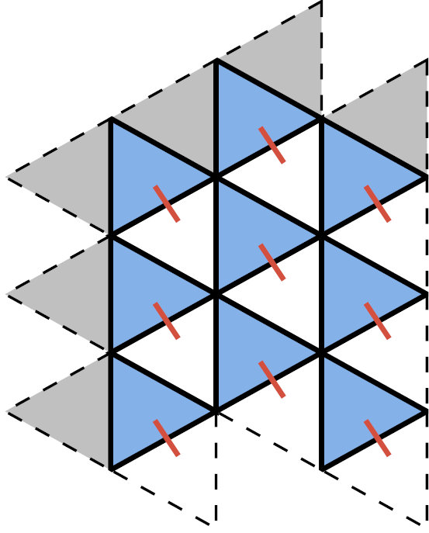
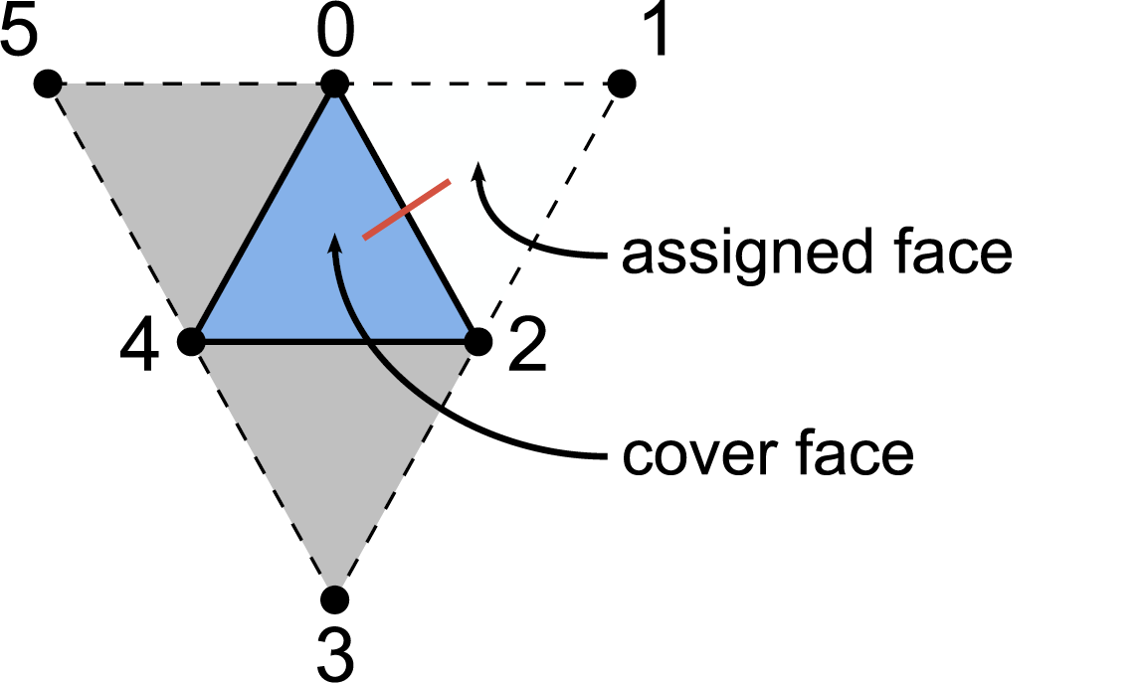
Assignment
Assign at most one uncovered triangle to a neighbor cover triangle
Achieves good SIMD load balancing
Regular mesh: Easy
Notes:
The basic idea is to assign these uncovered white triangles to adjacent covered blue triangles.
They can then be processed when the adjacent covered triangles are traversed.
We seek to assign at most one triangle per primitive to achieve good SIMD load balancing.
As a result, since blue triangles represent little over half of the total number of triangles,
nearly all primitives will then process two triangles and three edges.
This can be easily accomplished for regular mesh regions as clearly shown on the right, where the red edge represents the assignment.

Slide 21
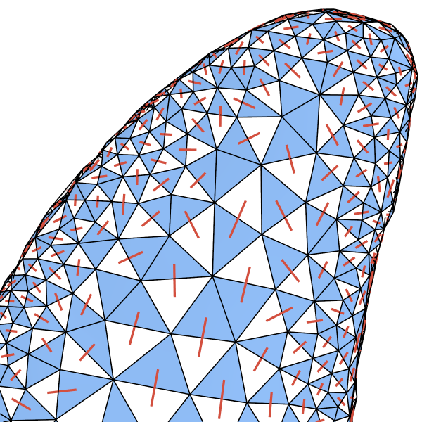
Assignment
Assign at most one uncovered triangle to a neighbor cover triangle
Achieves good SIMD load balancing
Irregular mesh: Trickier but possible
Notes:
Now, for arbitrary meshes, which include irregular regions, it is trickier, but we’ll show that it is still possible.

Slide 22
Primitive configurations
For good SIMD processing:
Assigned face is always {0, 1, 2} when available
Edge processed if and only if opposite triangle is not degenerate
Notes:
Before we begin describing how we do that, let me quickly describe the possible primitive configurations.
As mentioned before, each primitive has six vertices associated with it, as shown on the top left diagram.
For good SIMD processing, we require that the assigned face will always be the first neighbor.
That is, if an adjacent uncovered face is assigned to the current primitive, it will have indices 0, 1, and 2.
Notice that for the two configurations on the right side, there is no assigned face, and therefore index 1 is set equal to index 2, making that face degenerate. The geometry shader will check for this degeneracy and avoid processing an additional face in that case.
The second requirement is that all edges adjacent to the central blue triangle will be processed unless the opposite triangle is degenerate. So if the edge is already being processed by a neighbor face, then the degeneracy can be forced by setting two indices to the same vertex ID.
The diagrams above represent all such possible configurations of degenerate faces and processed edges.

Slide 23
Restricted matching
Consider no assigned face
If {0, 1, 2} not present:
Edge {0, 2} cannot be processed
Must be processed by neighbor
At least 1 assignment per connected component!
Notes:
Consider the case of a primitive with no assigned faces, which can occur in the two configurations shown on the top right.
Whenever this occurs, than at least one edge adjacent to that primitive cannot be processed.
That will be the edge that is represented by indices 0 and 2, <click> and is shown in green on the bottom.
It must therefore be processed by the neighbor. For that to happen the neighbor must also be a cover face, as shown here.<click>
Now, if the neighbor doesn’t have an assigned face, it will also have another edge with indices 0 and 2 that is not processed. And therefore itself must also be adjacent to yet another cover face.<click>
Now, we finally get to a cover face that has an assigned face, and therefore that assigned face can use indices 0, 1, 2 without degeneracies and process all of its three edges.<click>
So, as you can see, each connected component of cover faces must have at least one assignment. This ensures that all edges adjacent to this connected component can be processed.
[11:15]

Slide 24
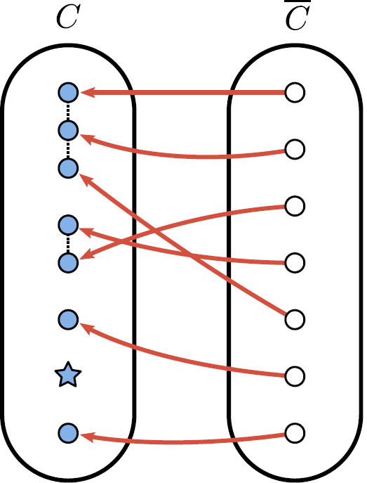
Matching all uncovered vertices
Without restrictions, matching is easier
Given the dual graph with:
Set of cover vertices C
Set of uncovered vertices C
Consider the bipartite graph resulting from removing edges not incident in C
Maximum bipartite matching
Matches all v ∊ C to C
Guaranteed [Hall 1935] (see paper)
Notes:
If we ignore this connected component restriction for a bit, assigning uncovered faces is easier.
Lets again, consider the dual graph of the mesh.
Here C is be the set of cover vertices, which are the dual of the blue cover faces.
C BAR is the set on uncovered vertices, which are the dual of the white uncovered faces.
If we remove all edges that connect two cover vertices in C, then we are left with a bipartite graph.
Using Hall’s Theorem, it can be shown that the maximum bipartite matching will match all vertices in C BAR to unique vertices in C, as shown in the bottom right.
Please refer to the paper for details.
Note however, that we are still not happy with this matching, since some of the connected components in C, more specifically the vertex denoted by a star, was not matched.

Slide 25
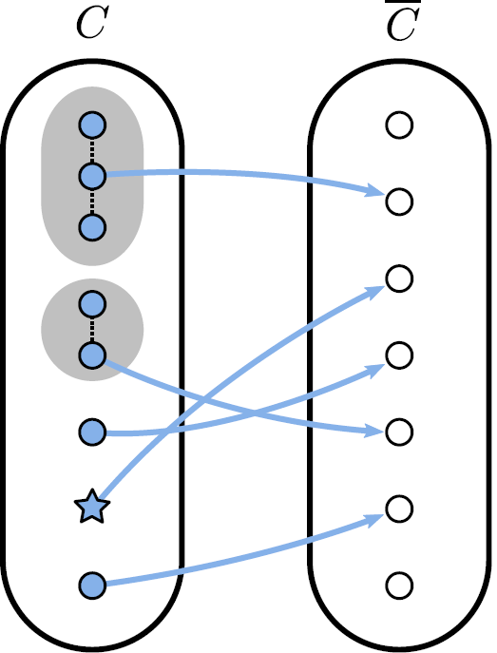
Matching all connected components
Merge vertices of each connected component C_{i} into a single gray vertex
We can also easily match all C_{i} to C
Also guaranteed by Hall [1935] (see paper)
However, not all v in C are matched!
Notes:
Now lets merge the vertices of C into mega vertices shown in gray representing each of the connected components.
In this case, also directly due to Hall’s Theorem, the maximum matching will match all connected components Ci in C, including the blue star. Again, the paper contains further details on this.
Note, however, that in this second matching, not all vertices in C BAR were matched.

Slide 26
Achieving both goals
We want a matching that satisfies both:
All v in C are matched (as in left matching)
All C_{i} are matched (as in right matching)
Notes:
So, what we need is a matching that satisfies both of the properties in our earlier matchings.
We want all vertices in C BAR to be matched as in the left, and all components Ci to be matched as in the right.

Slide 27
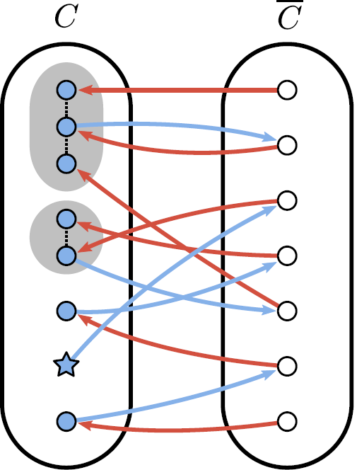
Proof
Consider the union of edges in two matchings
It contains disjoint cycles and paths
Since d(v) ≤ 2 for all v
∪
=
Notes:
Consider the union of edges in the two matchings.
This will have disjoint cycles and paths, since no vertices can have degree higher than 2.

Slide 28
Proof
Note blue star vertex represents C_{i} that was not matched in unrestricted matching
∪
=
Notes:
Now, note the blue star vertex that represents the Ci that was not matched in the left matching.
We seek to modify the left matching so that all such “star” vertices are matched.

Slide 29
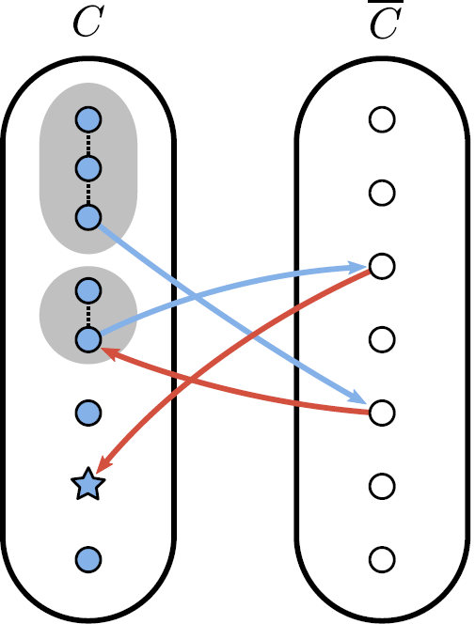
Proof
Consider alternating paths
Includes blue star vertex
End at some v that is only in the left matching
Notes:
Now consider alternating paths that start (or end) in such a blue star vertex, shown on the right.
In all such paths, the other end will be some vertex that is only in the left matching.

Slide 30
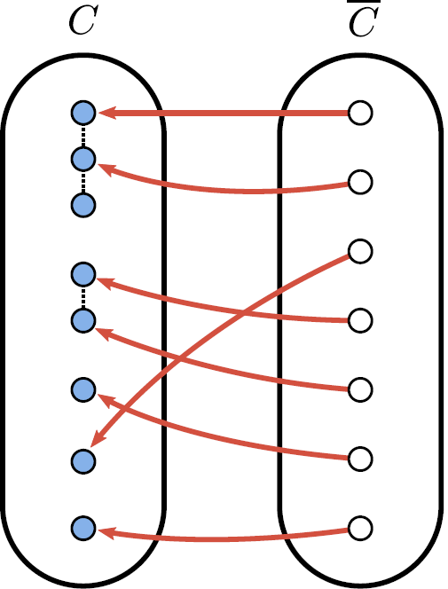
Proof
Lets flip the membership of all edges from such paths in the original unrestricted matching:
Guarantees all unmatched C_{i} are now matched
Does not affect membership of all v in C
Matching now satisfies restrictions
Original
Flipped edges
Final matching
Notes:
So, if we flip the membership of all edges from these paths, we basically modified our matching so that now the previously unmatched Ci are matched to C BAR. Note that all v in C BAR are still matched, since all v in C BAR that were in the alternating path were in both matchings. So the flip did not affect their presence in the final matching.
So our final matching will match all v in C BAR, and all Ci in C to at least one vertex in C BAR, and therefore it satisfies all of our required properties.
Please refer to the paper for additional details and special cases, such as mesh boundaries.

Slide 31
Algorithm
Algorithm follows from proof
Works for any cover C
Building block: Bipartite matching
O(n^{1.5}) algorithm by Hopcroft and Karp [1973]
Preprocessing algorithm timings:
Notes:
The actual algorithm strictly follows the steps of the proof.
An important building block is an algorithm for bipartite matching, since we have to initially build the two unrestricted matchings.
For that, we used the algorithm by Hopcroft and Karp, which has worst case complexity of n to the 1.5.
As you can see, in practice, it is pretty fast for most meshes of reasonable sizes, except for that last one which caused the computer to thrash to disk.
[14:50]

Slide 32
3. Reducing vertex cache misses
Notes:
Now that we have our covered and matched triangles, we are done with optimizing the primitives for geometry shader processing.
The final step is to reorder these primitives so that they take advantage of the vertex cache to reduce vertex processing.

Slide 33
Vertex cache optimization
Many existing techniques for triangle lists/strips
Hoppe [1999], Lin and Yu [2006] Chhugani and Kumar [2007], Sander et al. [2007], many others...
We will render
Using triangle with adjacency primitive
~50% triangles of the original mesh
No existing techniques for this configuration
Notes:
There are many excellent existing techniques for vertex cache optimization.
However they focus mainly on triangle lists and triangle strips.
We are instead using triangle with adjacency primitives.
Additionally, we only process about 50% of the triangles of the mesh.
There are no existing techniques for this particular primitive configuration.

Slide 34
Vertex cache optimization
We extend two methods
Fast scheme
Based on Sander et al. [2007]
Faster preprocessing; load-time or run-time
Careful scheme
Based on Lin and Yu [2006]
Slower preprocessing, but better ordering
Both schemes
Pick a central vertex greedily
Emit triangles around central vertex
Thus, easier to extend to arbitrary primitives
Refer to paper for details on both schemes
Notes:
So, to order our triangles, we extended two methods that were originally designed for regular triangle lists.
One is a very fast preprocessing scheme based on our 2007 algorithm that is suitable for load-time optimization when the cache size is known. It can also be suitable for interactive ordering in case the geometry changes.
The other is a careful scheme based on Lin and Yu. This scheme has slower preprocessing, but provides a more efficient ordering.
We chose to extend these two schemes because they are both based on a heuristic that successively picks a central vertex greedily, and then processes all triangles around this vertex.
This was easier to extend to arbitrary primitives.
In the interest of time, please refer to the paper for additional details.

Slide 35
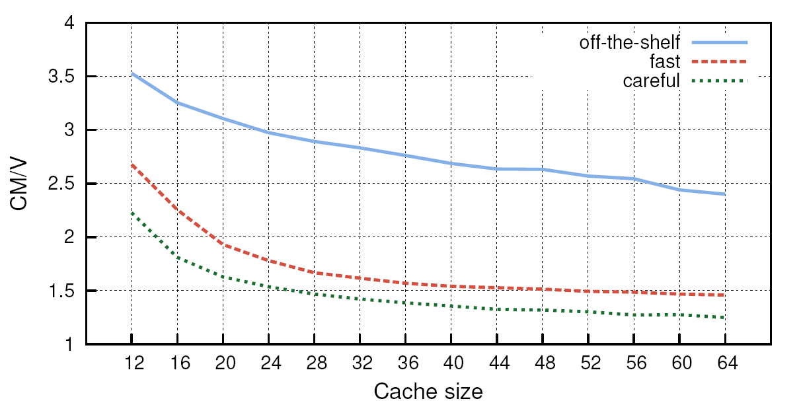
Vertex cache misses (bunny mesh)
Notes:
As you can see if we use one of the existing representative vertex reordering algorithms, labeled “off-the-shelf” here, the number of cache misses per vertex is very high, regardless of the cache size.
These results were similar for all the algorithms tested, and it makes sense, since these algorithms are not designed for triangles with adjacency.
Our two extensions perform significantly better, with the careful one clearly providing a better result than the fast preprocessing one.

Slide 36
Vertex cache misses
off the shelf fast careful
Notes:
Here we have visualizations, where dark regions represent cache misses.
As you can see, existing techniques meant for regular triangles only do not perform well.
Fast performs well,
And careful performs the best.

Slide 37
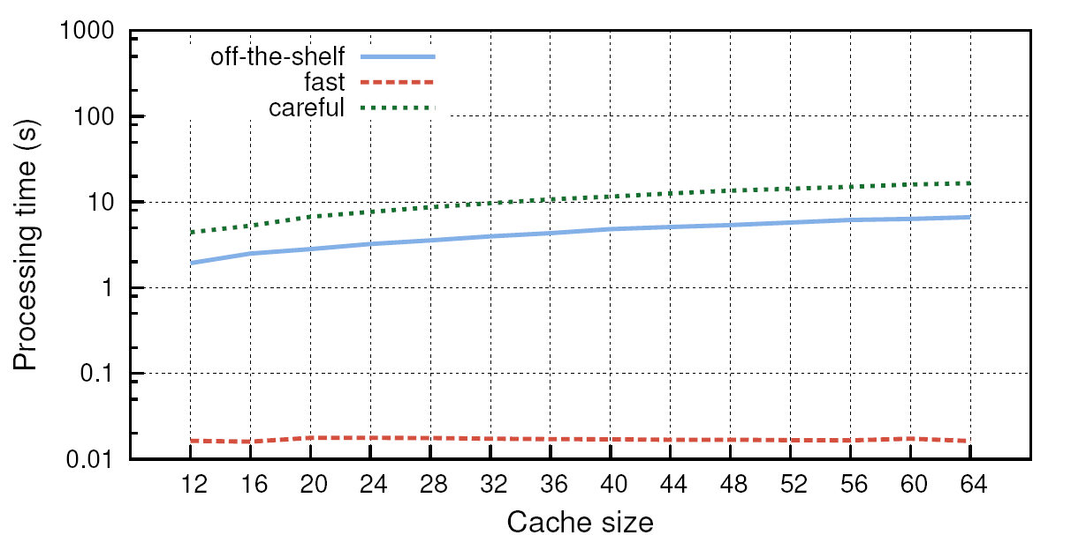
Preprocessing times (bunny mesh)
Notes:
While careful yields a better ordering, it comes at the price of longer preprocessing.
Note that careful is a bit slower than the off-the-shelf method in preprocessing.
However, the fast extension takes only a few milliseconds to preprocess the mesh.

Slide 38
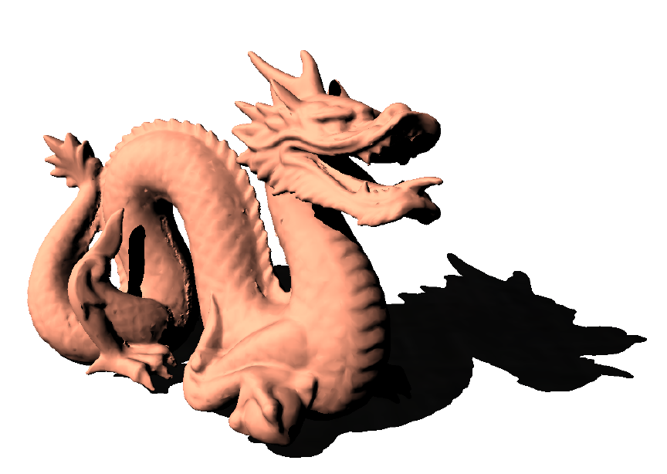
Applications – Shadow volumes
1.58-1.82x speedup
Notes:
Alright. This concludes our preprocessing pipeline. Now I will show some of our simple prototype application results.
Again, the method is suitable for any technique that needs to process edges with adjacency.
Optionally, due to the assignment step, it can easily be used to process the triangles as well.
Here we show shadow mapping. Basically it achieves about a 1.58 to 1.82 speedup over the previous GPU-based Geometry Shader technique. This range includes tests for all of our meshes in the paper in both AMD and NVIDIA hardware.

Slide 39
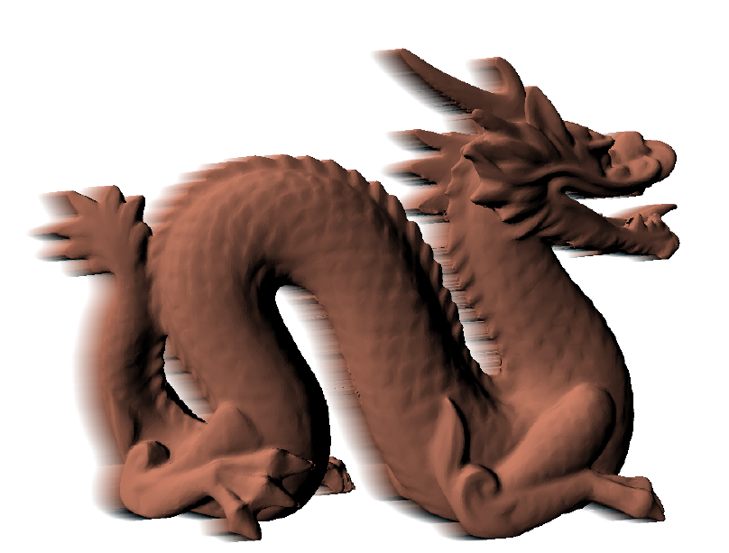
Applications – Motion blur
1.48-1.62x speedup
Notes:
Here is a simple motion blur application that extrudes silhouette edges. We achieve speedups of 1.48 to 1.62 times for this technique.

Slide 40
Applications – Line illustration
1.70-1.96x speedup
Notes:
Finally, a simple line illustration technique that renders silhouettes and sharp features. The speedup is 1.8 to 1.96 here.

Slide 41
Summary
GPU processing of edges (and faces)
Three algorithm steps
Cover – nearly 2X reduction in # of primitives
Assignment – allows face processing; SIMD efficient
Ordering – around 2X reduction in vertex processing
Efficient preprocessing times
Fast vertex cache scheme feasible for runtime
Significant gains for real-time applications
Notes:
In summary, we presented a set of preprocessing algorithms that when applied to a mesh,
speeds up GPU processing of its edges. Faces can also be optionally processed by these techniques.
The method consists of three algorithm steps. [AS SHOWN THERE, AND SKIP]
A cover step that reduces the number of primitives by nearly a factor of 2.
An assignment step that allows face processing in a SIMD efficient way.
And an ordering step that reduces the amount of vertex processing.
These algorithms have efficient preprocessing times. For vertex caching, since the cache size may only be known at runtime, we also introduce an additional faster preprocessing scheme.
Overall, these techniques allow for a significant improvement in rendering speed.

Slide 42
Future work
Future hardware
New processing stages
Even larger primitives/patches
Define efficient traversals for processing vertices, triangles, and edges
Notes:
For future work,
It would be interesting to investigate how to define traversals for processing newly introduced primitives more efficiently as well.
Thank you very much for your attention.

