Slide 1
Real-Time Classification of
Dance Gestures from Skeleton
Animation
Michalis Raptis, UCLA CSD
Darko Kirovski, Hugues Hoppe,
Wei-ge Chen, Microsoft Research
Joel Pritchett, Tom Fuller, Chuck Noble, XBOX Microsoft Game Studios

Slide 2
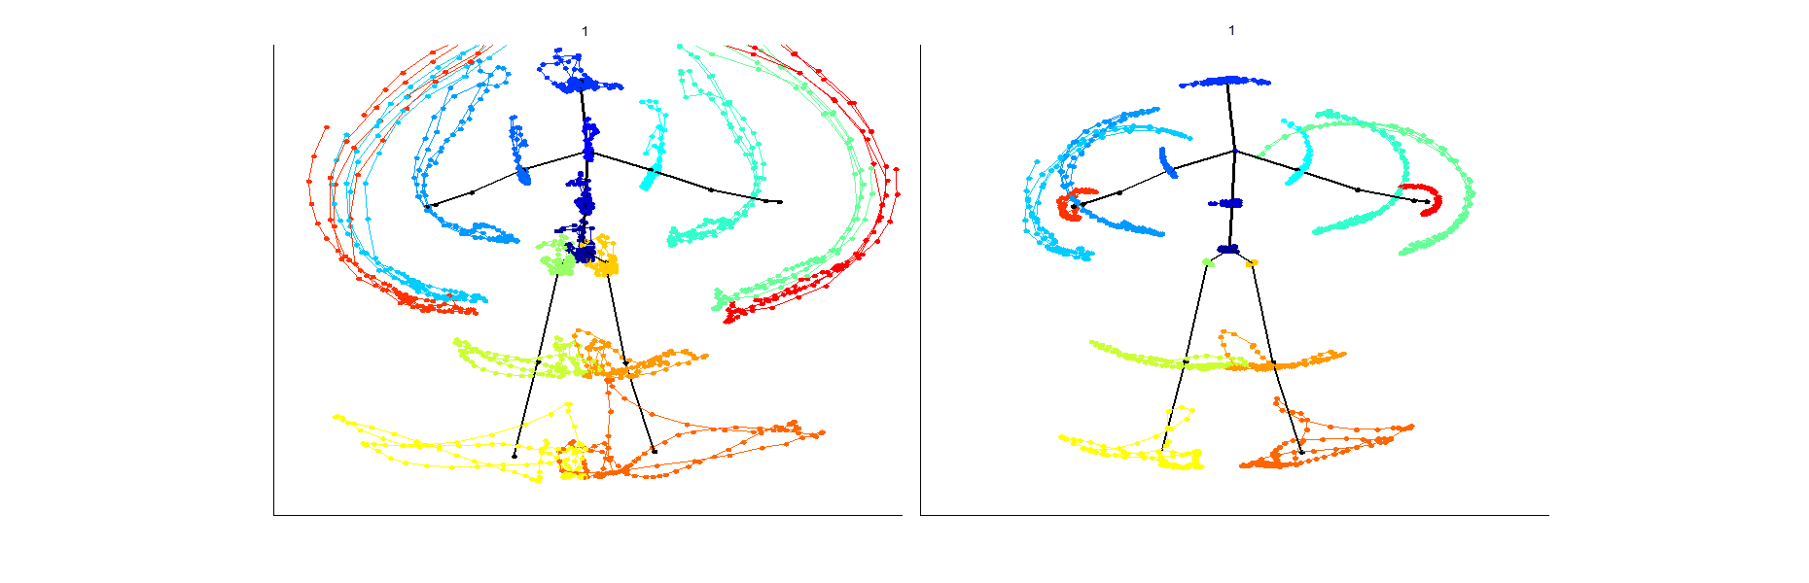
Absolute motion
Relative motion

Slide 3
Oracle vs. Random Dancer
Oracles

Slide 8
Oracle vs. Player Mean
Torso
angles
Oracle
Player mean
Elbows
Wrists
Knees
Feet
Left
Right

Slide 10
Towards MLE
Torso
angles
True negative
True positive
Elbows
Wrists
Knees
Feet

Slide 14
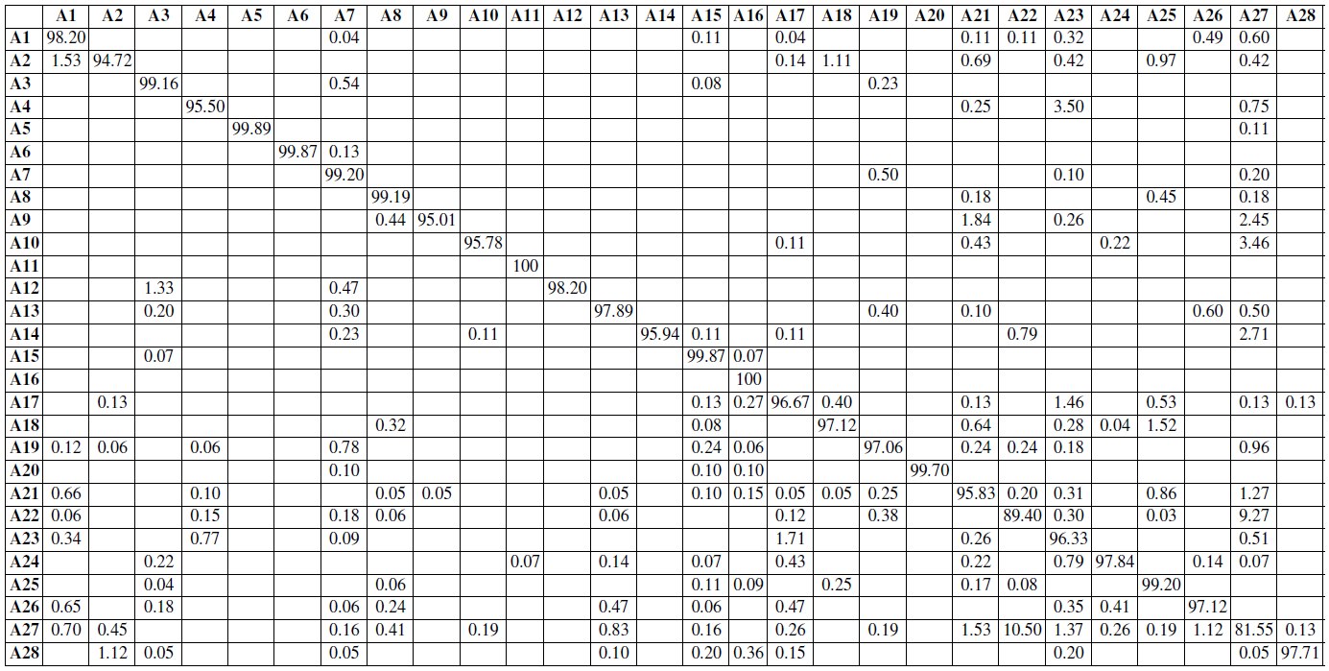
Confusion Matrix
HMM-based, others 50-60%

Slide 15
Summary
Features – generic, nearly lossless
Dance aligned to beat – no major time-warp
Detection
  Normalized circular cross correlation via FFT
  Maximum Likelihood estimator
  Logistic regression to resolve class similarity
Fast, scalable, extraordinary ROC

