Slide 1
Consistent Spherical Parameterization
Arul Asirvatham, Emil Praun (University of Utah)
Hugues Hoppe (Microsoft Research)

Slide 2
Consistent Spherical Parameterizations

Slide 3
Parameterization
Mapping from a domain (plane, sphere, simplicial complex) to surface
Motivation: Texture mapping, surface reconstruction, remeshing …
Notes:
Mention 1-1, low distortion

Slide 4
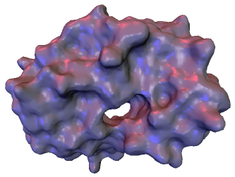
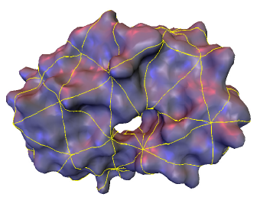
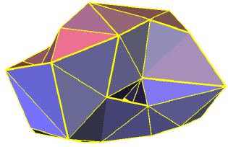
Simplicial Parameterizations
Planar parameterization techniques cut surface into disk like charts
Use domain of same topology
Work for arbitrary genus
Discontinuity along base domain edges
[Eck et al 95, Lee et al 00, Guskov et al 00, Praun et al 01, Khodakovsky et al 03]

Slide 5
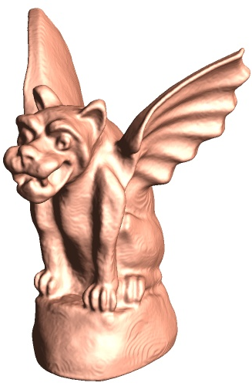
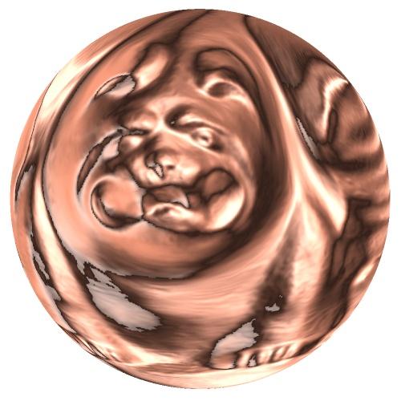
Spherical Parameterization
[Shapiro et al 98]
[Alexa et al 00]
[Sheffer et al 00]
[Haker et al 00]
[Gu et al 03]
[Gotsman et al 03]
[Praun et al 03]
No cuts ➔ less distortion
Restricted to genus zero meshes

Slide 6
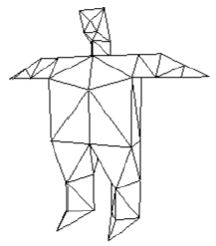
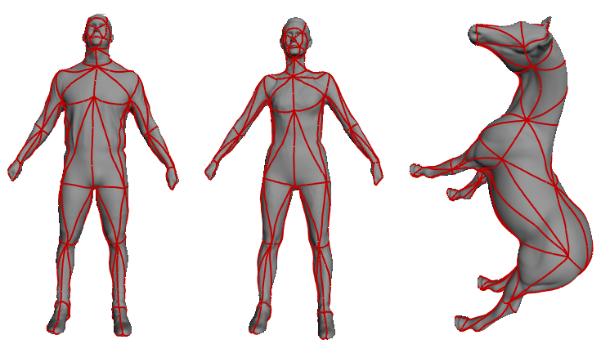
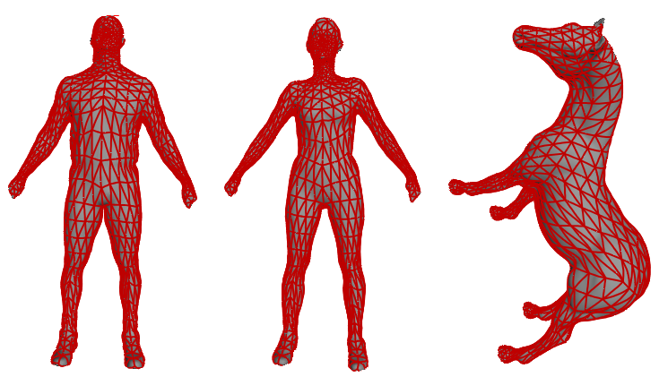
Consistent Parameterizations
Base Domain
Motivation
Digital geometry processing
Morphing
Attribute transfer
Principal component analysis
[Alexa 00, Levy et al 99, Praun et al 01]
Input Meshes with Features
Semi-Regular Meshes
DGP Applications

Slide 7
Consistent Spherical Parameterizations

Slide 8
Approach
Find “good” spherical locations
Use spherical parameterization of one model
Assymetric
Obtain spherical locations using all models
Constrained spherical parameterization
Create base mesh containing only feature vertices
Refine coarse-to-fine
Fix spherical locations of features

Slide 9
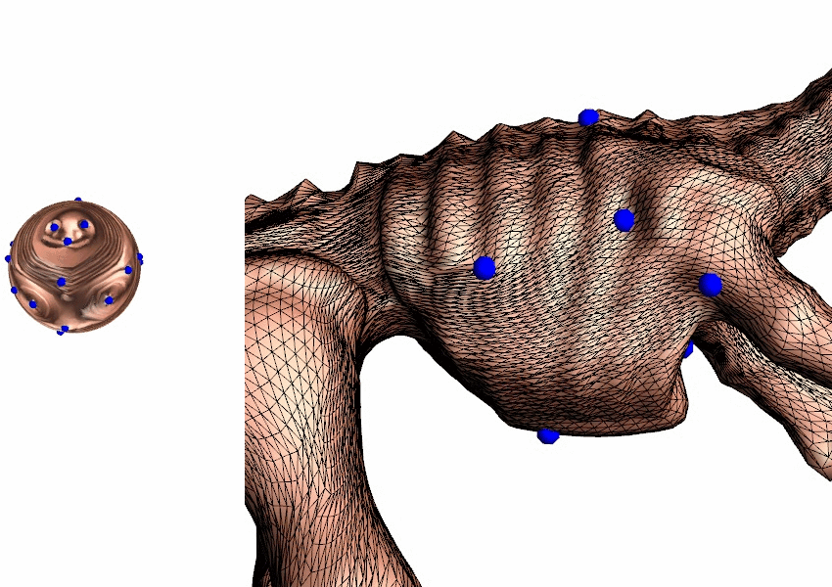
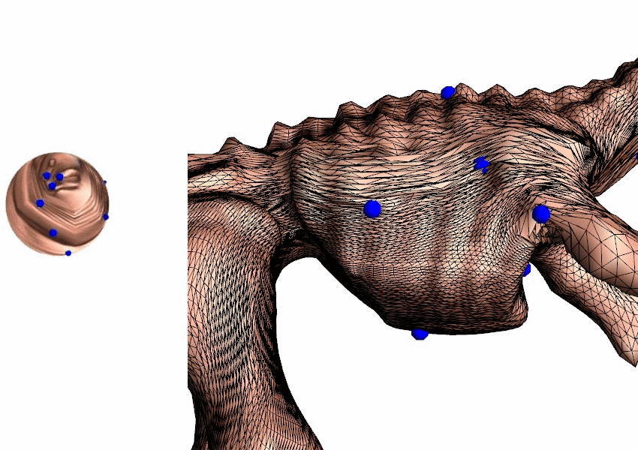
Finding spherical locations

Slide 10
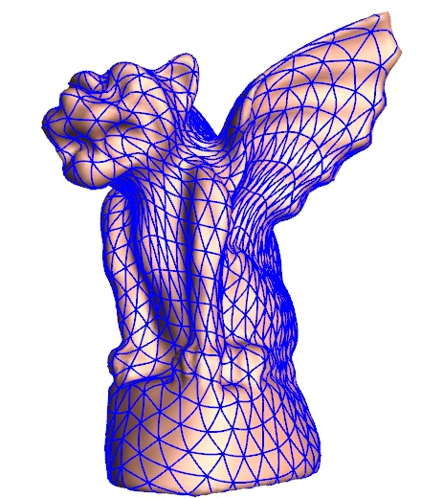
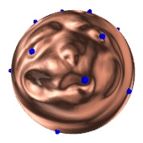
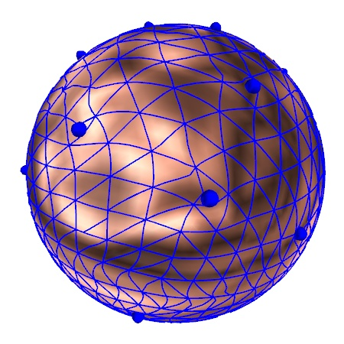
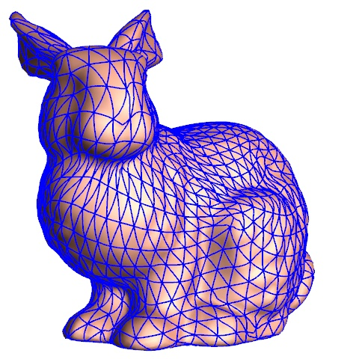
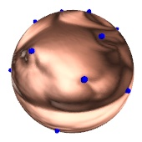
Algorithm
UCSP
step 1
+
CSP
step 4
UCSP
CSP
step 5
step 2
step 3
step 6
Find initial spherical locations using 1 model
Parameterize all models using those locations
Use spherical parameterizations to obtain remeshes
Concatenate to single mesh
Find good feature locations using all models
Compute final parameterizations using these locations

Slide 11
Unconstrained Spherical Parameterization [Praun & Hoppe 03]
Use multiresolution
Convert model to progressive mesh format
Map base tetrahedron to sphere
Add vertices one by one, maintaining valid embedding and minimizing stretch
Minimize stretch

Slide 12
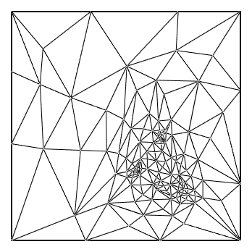
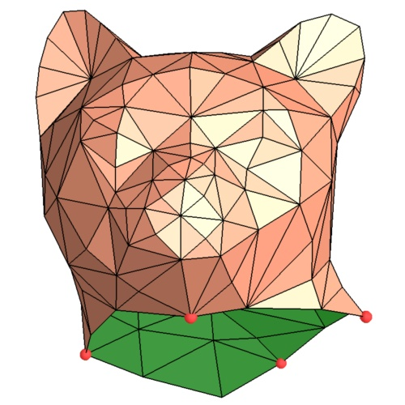
Stretch Metric [Sander et al. 2001]
linear map
2D texture domain
surface in 3D
singular values: γ , Γ
γ
Γ
Notes:
Lets first review some basic parametrization concepts that are useful for understanding the metric.
In a parametrization, <C>each triangle in the texture domain is linearly mapped to its respective triangle on the mesh surface.
<C>If we draw a unit circle on the triangle on the texture domain, it will map to an ellipse on the surface.
The lengths of the principal axes of this ellipse are the singular values of the linear map, little gamma, and big gamma.
<C>These singular values measure how much distances in texture space get stretched onto the surface.
We wish to avoid large singular values, as the resulting stretch leads to signal undersampling.

Slide 13
Conformal vs Stretch
Conformal metric: can lead to undersampling
Conformal
Stretch
Stretch metric encourages feature correspondence
Conformal

Slide 14
Constrained Spherical Parameterization

Slide 15
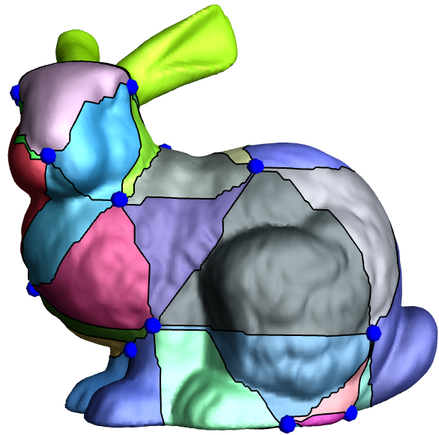
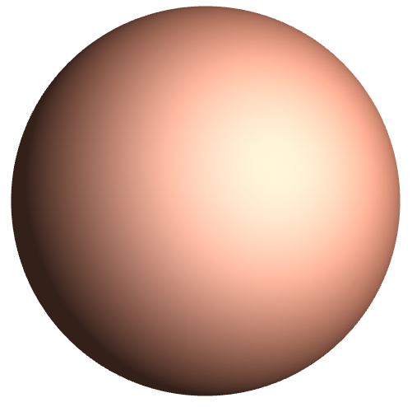
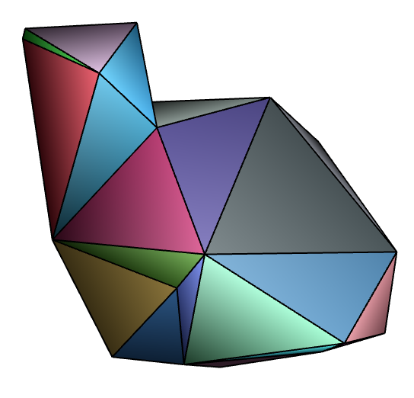
Approach

Slide 16
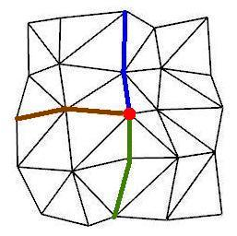
Consistent Partitioning
Compute shortest paths (possibly introducing Steiner vertices)
Add paths not violating legality conditions
Paths (and arcs) don’t intersect
Consistent neighbor ordering
Cycles don’t enclose unconnected vertices
First build spanning tree

Slide 17
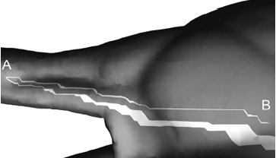
Swirls
Unnecessarily long paths

Slide 18
Heuristics to avoid swirls
Insert paths in increasing order of length
Link extreme vertices first
Disallow spherical triangles with any angle < 10º
Sidedness test
Unswirl operator
Edge flips

Slide 19
Sidedness test
E
C
E
B
D
D
B
A
C
A

Slide 20
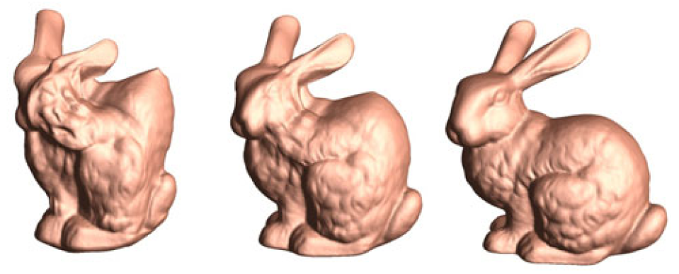
Morphing [Praun et al 03]

Slide 21
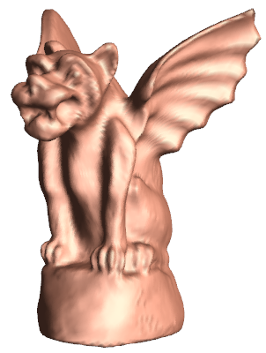
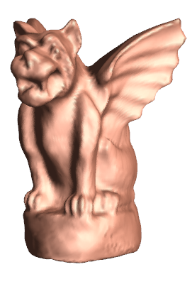
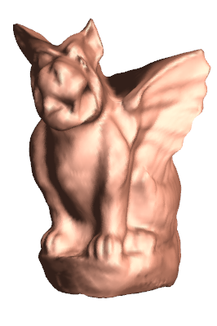
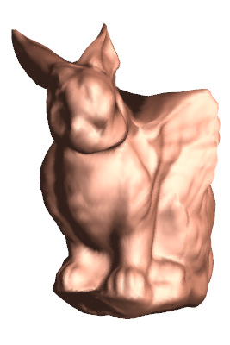
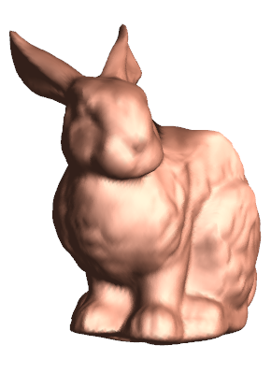
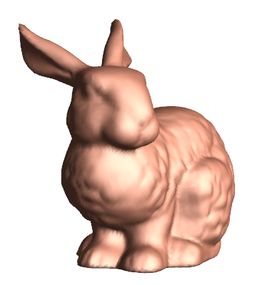
Morphing

Slide 22
Morphing

Slide 23
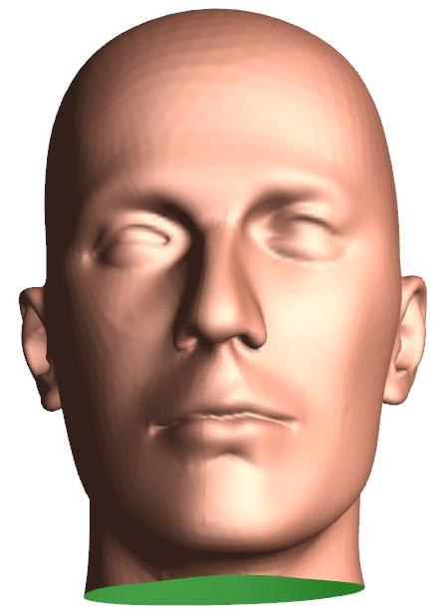
Attribute Transfer
+
Color Geometry

Slide 24
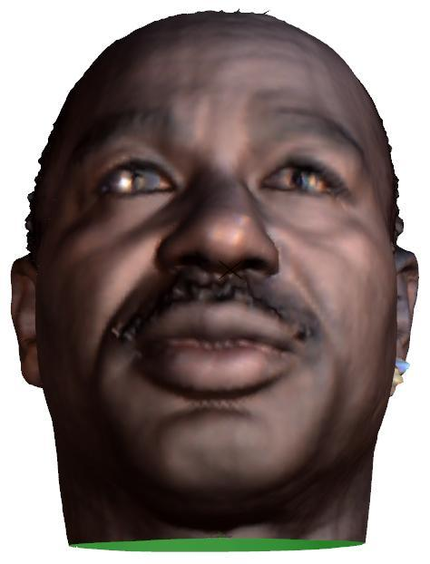
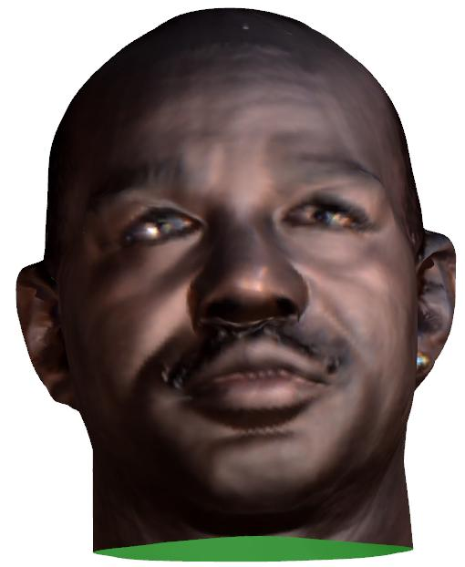
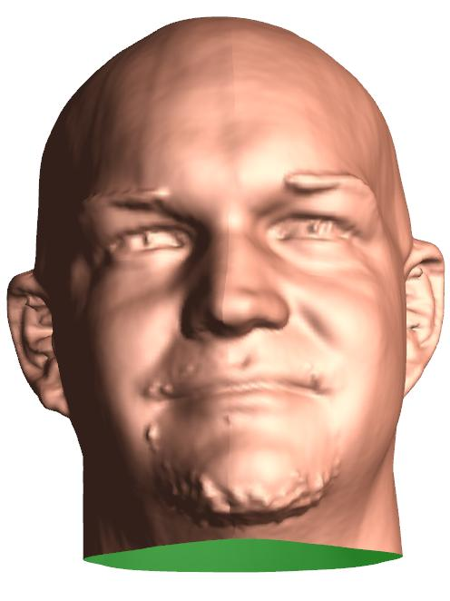
Attribute Transfer
+
Color Geometry

Slide 25
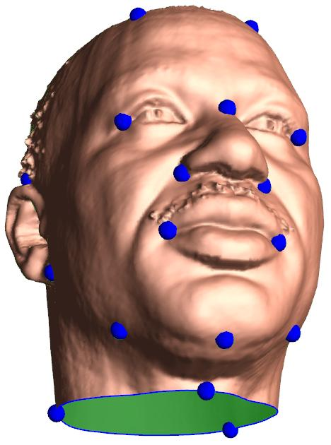
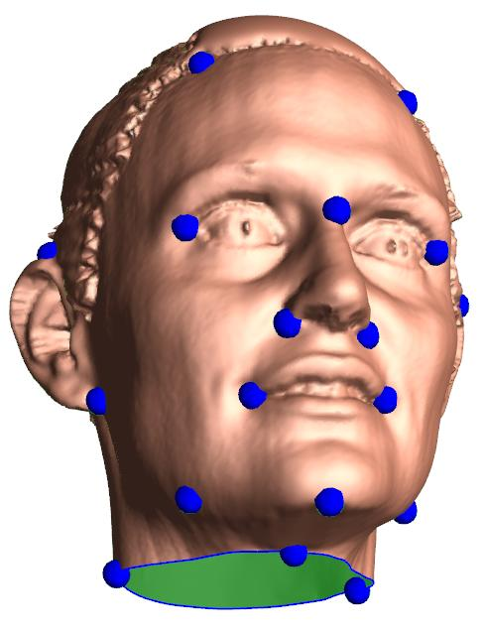
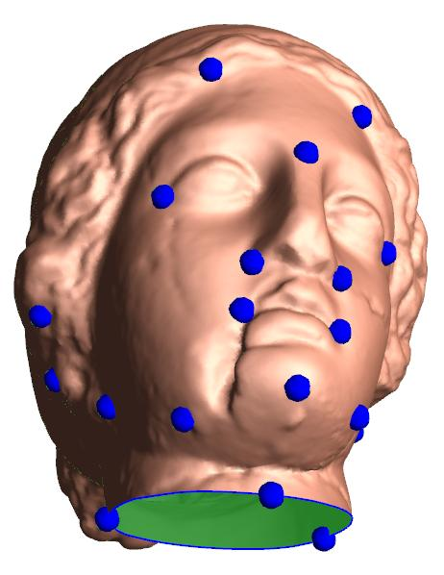
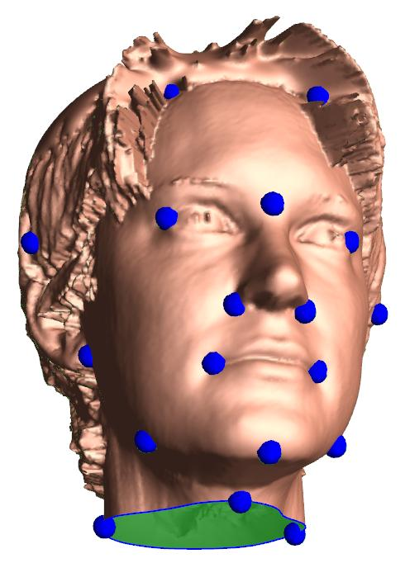
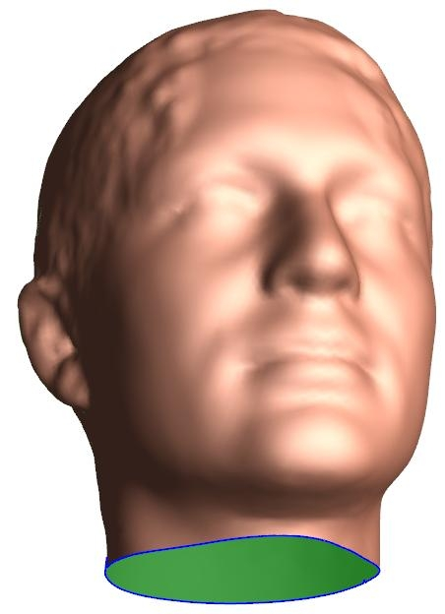
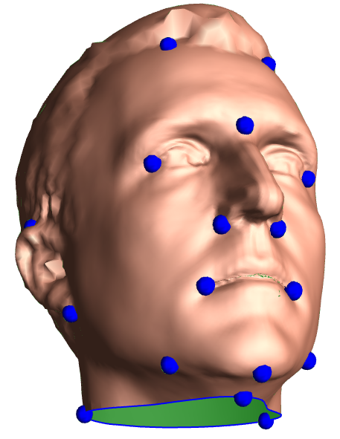
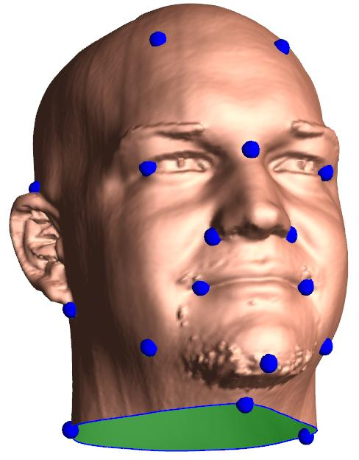
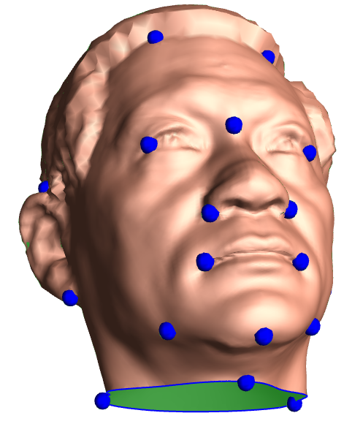
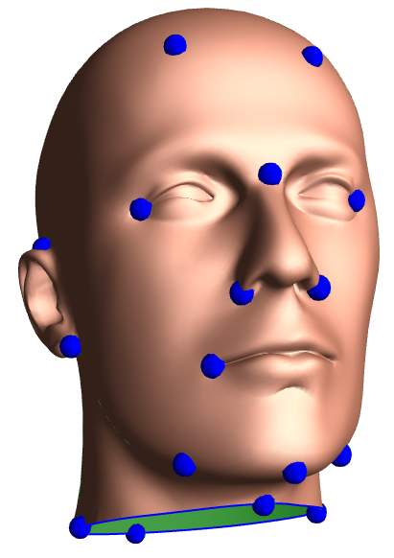
Face Database
avg
=

Slide 26
Timing
# models | #tris | 1 | 2 | 5 | 6 | Total (mins)
2 | 71k-200k | 10 | 5 | 5 | 17 | 37
4 | 24k-200k | 2 | 23 | 7 | 24 | 56
8 | 12k-363k | 19 | 81 | 8 | 95 | 203
2.4 GHz Pentinum 4 PC, 512 MB RAM

Slide 27
Contributions
Consistent Spherical Parameterizations for several genus-zero surfaces
Robust method for Constrained Spherical Parameterization
Methods to avoid swirls and to correct them when they arise

Slide 28
Thank You

Slide 29
Stretch Metric [Sander et al. 2001]
linear map
2D texture domain
surface in 3D
singular values: γ , Γ
γ
Γ
Notes:
Lets first review some basic parametrization concepts that are useful for understanding the metric.
In a parametrization, <C>each triangle in the texture domain is linearly mapped to its respective triangle on the mesh surface.
<C>If we draw a unit circle on the triangle on the texture domain, it will map to an ellipse on the surface.
The lengths of the principal axes of this ellipse are the singular values of the linear map, little gamma, and big gamma.
<C>These singular values measure how much distances in texture space get stretched onto the surface.
We wish to avoid large singular values, as the resulting stretch leads to signal undersampling.

