Slide 1
Cliplets: Juxtaposing Still and Dynamic Imagery
Neel Joshi, Sisil Mehta, Eric Stollnitz, Steven Drucker, Hugues Hoppe,
Matt Uyttendaele, and Michael Cohen
Microsoft Research
ACM UIST 2012
October 9 2012

Slide 2
Photos vs. Video
Photograph
Video
Cliplet
Sparks the imagination
What occurred before/after?
What lies outside the frame?
Carries viewer along
Tells a story.
Depicts an action.

Slide 3
Previous Work
Ken Burn’s “The Civil War”
1990
Video Textures
SIGGRAPH 2000
Animating Picture with Stochastic
Motion Textures
SIGGRAPH 2005
Cinemagram, Flixel, Kinotopic, Echograph, After Effects, Photoshop
Cinemagraphs
Beck and Burg 2011
Selectively De-Animating Video
SIGGRAPH 2012

Slide 4
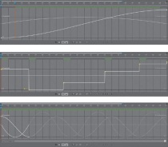
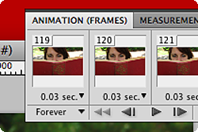
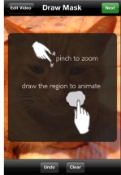
Ease-of-Use vs. Expressiveness
Cliplets
Expressiveness
Ease-of-Use

Slide 5
Cliplets Revisited
Juxtapose still and dynamic
Spatially
Temporally
More expressive than casual apps
Less complicated than professional tools

Slide 6
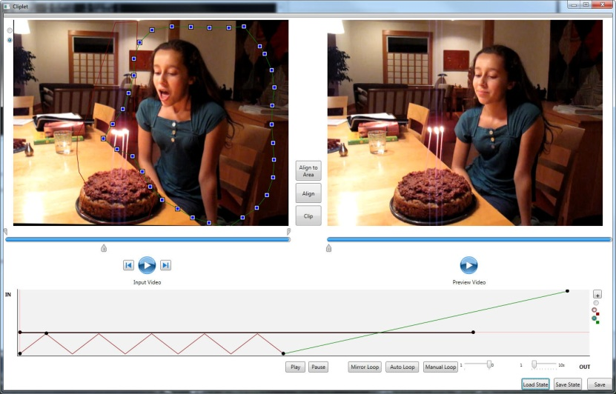
Exploration of Cliplet Creation

Slide 7
Time Mapping Idioms
still
tin
loop
mirror loop
still play still
tout

Slide 8
Demo

Slide 9
Refinements
Stabilization: hand held video
Alignment: local geometric, photometric, loop feathering, mask refinement

Slide 10
Results

Slide 11
User Generated (posted on YouTube)

Slide 12
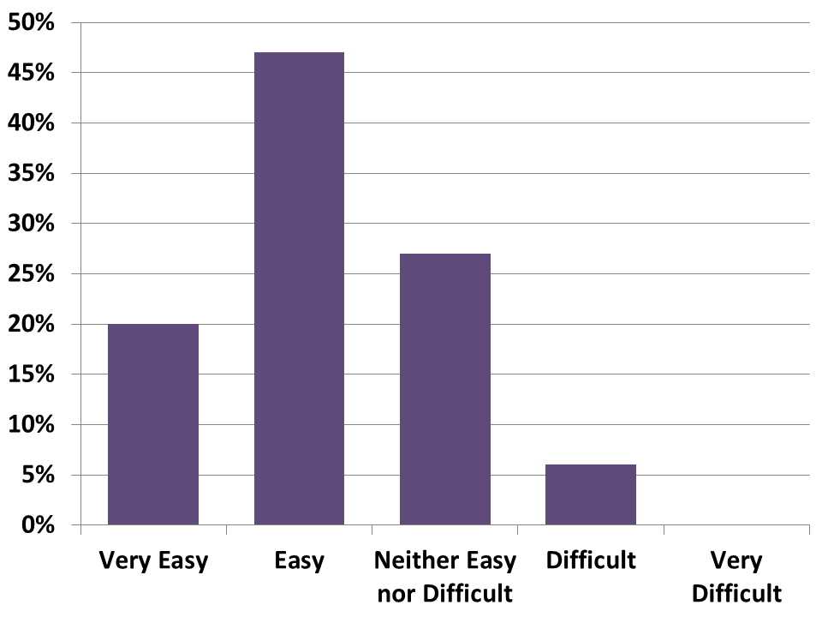
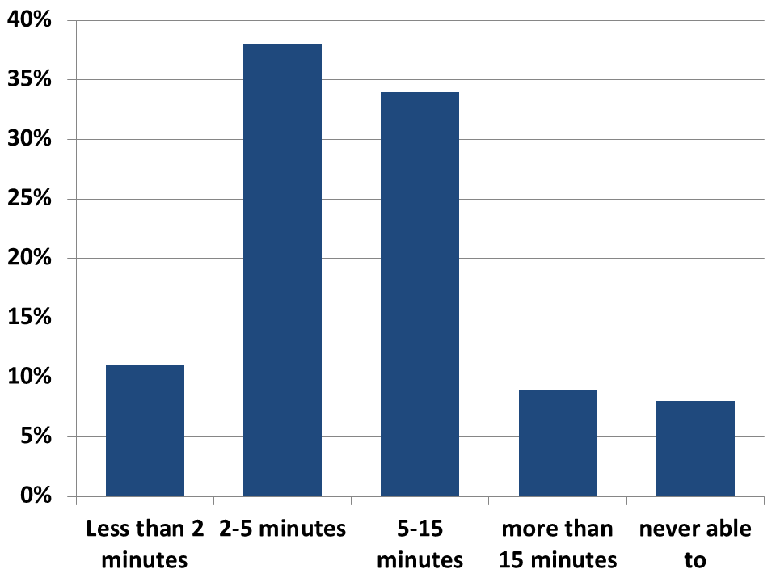
User Survey
Voluntary Survey, initiated after app used 2 times
> 400 responses
Easy of Use
Completion Time

Slide 13
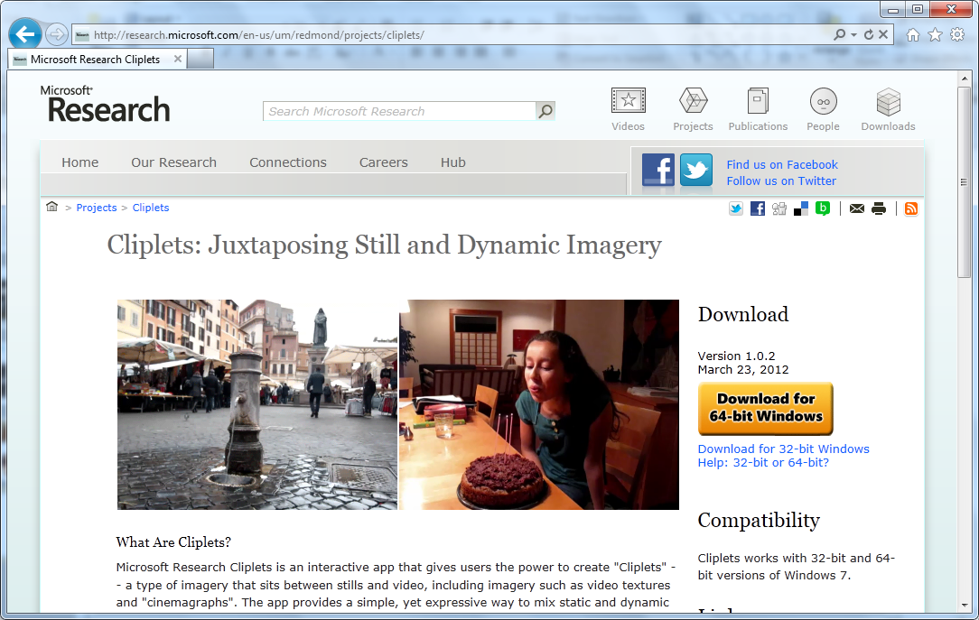
http://research.microsoft.com/cliplets

