Slide 1

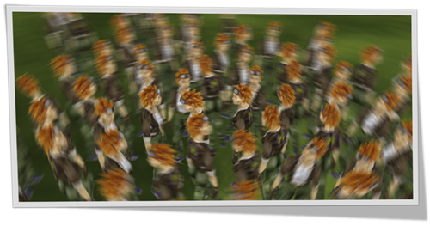




Image-Based Bidirectional
Scene Reprojection
Lei Yang¹, Yu-Chiu Tse¹,
Pedro Sander¹, Jason Lawrence², Diego Nehab^{3,4}, Hugues Hoppe³,
Clara Wilkins⁵
1
2
3
4
5
Notes:
Our new technique aims to improve the performance of real-time rendering applications.

Slide 2
Outline
Reprojection and data reuse
  Taxonomy
Bidirectional reprojection
  Scene-assisted reprojection
  Image-based reprojection
  Interoperability
Partitioned rendering and lag
  User study
Results
Notes:
The highlighted items are the major contributions of this paper.

Slide 3
Goal
Optimize performance for real-time rendering
  For complex shading tasks
  For low-end platform adaptation
A general-purpose acceleration method
  Generate in-between frames with low cost
  In real-time (interactive)
  Trade quality for performance
Notes:
This paper focuses on the goal of optimizing shading performance for real-time rendering.
Pack more complex shading effects into the pipeline, or
Adapt the engine to lower-end platforms.
A general way: generate some cheap in-between frames on the fly during rendering.
We have to lose some quality to trade for performance.

Slide 4
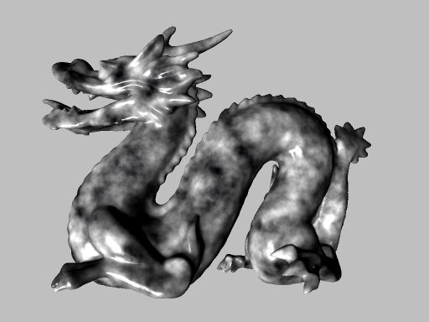
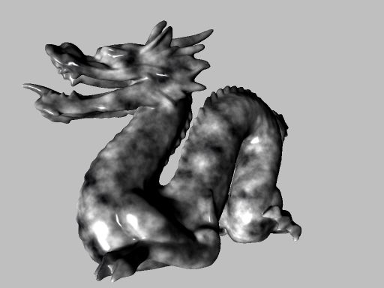
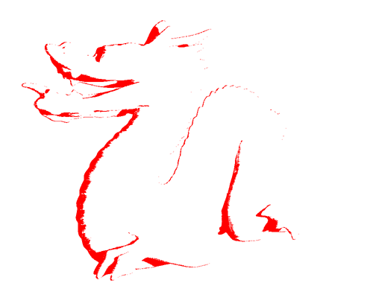
Reprojection for data reuse
Generate in-between frames with low cost ^{[Scherzer’11]}:
Reproject and reuse pixel data from similar frames
Avoid redundant computation
Newly disoccluded regions can be missing
Frame t
Frame t +α
Notes:
Avoid shading cost when generating in-between frames: reproject and reuse pixel data from adjacent, similar frames.
In a smooth animation, the shading usually changes very little at a small time increment.
By reusing shading results in neighboring frames, we avoid redundant computation.
An exception is the newly disoccluded regions, shown here in red, which may not find correspondence in the previous frame. These regions must be reshaded.

Slide 5
Reprojection for data reuse
Taxonomy for reprojection methods
  Temporal direction
  Data access
  Correspondence domain
Notes:
Three different aspects of reprojection methods

Slide 6


Reprojection: Temporal direction
Forward vs. Backward
We exploit both – bidirectional reprojection
  Few disocclusions → no reshading
  Smooth shading interpolation
Corresponding
surface point
in I-frames:
Visible
Occluded
…
…
Frame t
Frame t +α
Frame t +1
Notes:
Generate a new frame t+alpha between two normally shaded frames t and t+1:
Reproject and reuse data from frame t, in the forward temporal direction;
Reproject and reuse data from frame t+1, in the backward temporal direction.
In this paper, we explore both temporal directions, in a way we call bidirectional reprojection, or Bireproj.
Advantage:
The red regions, which has no correspondence in both t and t+1, become extremely rare. Therefore we can usually neglect them and completely drop the reshading pass.
For regions that are visible in both frame T and t+1, we can interpolate shading and provide smoother visual appearance. Results later.

Slide 7
Reprojection: Data access
Scatter vs. Gather
Scatter
●●●
●●●
●●●
…
●●●
●●●
●●●
…
Frame t
Frame t +α
Frame t +1
Notes:
How do we reproject data?
One way is to follow a scatter type approach, in which we start from each pixel in the source frame and reproject it to the target frame.
This can be done for both frame t and t+1.

Slide 8
Reprojection: Data access
Scatter vs. Gather
We choose “gather”
  Simpler, faster, higher quality filtering
Gather
●●●
●●●
●●●
…
●●●
●●●
●●●
…
●●●
●●●
●●●
●●●
●●●
●●●
Frame t
Frame t +α
Frame t +1
Notes:
An opposite direction is to start from each pixel in the target frame t+alpha, reproject it to the source frame t and t+1, and fetch the data back.
We choose to use this gather type of operation, because it is simpler, faster, and easy to provide higher quality filtering.

Slide 9
Reprojection: Correspondence domain
  -- Domain where the motion flows are stored
Source (w/ scatter) vs. target (w/ gather)
We propose “source” (gather-based)
…
…
Frame t
Frame t +α
Frame t +1
Motion flow
vectors
(source)
(target)
(source)
Notes:
The third aspect is the correspondence domain, or where the motion flow vectors are stored.
The vectors can be stored in the source frame, directing each pixel to its position in the target frame. This is usually used with scatter-based approaches.
The vectors can also be stored in the target frame, directing each pixel to the source frames, and this facilitates gather-based methods.
In our method: we want to avoid rasterizing the in-between frames. So we can only have this data in the source domain, containing correspondences between the two source frames.
However, we manage to perform gather-based reprojection with this data, which is a unique aspect of our method.

Slide 10





Overview of our approach
Render I-frames, insert interpolated B-frames
Use bidirectional reprojection (“Bireproj”)
Two approaches:
  Scene-assisted: extension of [Nehab’07]
  Image-based: main contribution
I-frame t
B-frame t +¼
B-frame t +½
B-frame t +¾
I-frame t +1
Notes:
Overview:
We have a pair of source frames t and t+1, which we call I-frames, rendered at runtime.
After I_t and I_t+1 are available we immediately generate and display the in-between B-frames, using bidirectional reprojection.
Two approaches for Bireproj:
Scene assisted method, which is an extension of the reverse reprojection cache by Nehab 2007;
Image-based method, which is our major contribution.

Slide 11
Scene-assisted Bireproj
Rasterize each B-frame
  Perform reprojection^{[Nehab’07]} onto both I-frames
  Occlusion test: reprojected depth = stored depth?
  Blend visible results based on α
…
…
I-frame t
B-frame t +α
I-frame t +1
(depth)
(depth)
Notes:
Scene-assisted method:
1. We rasterize each in-between B-frame. When doing that, we perform reverse reprojection onto both I-frames, and then fetch the color for each pixel.
(Reprojection is computed on a per-vertex basis and is very efficient. )
2. To test whether the occlusion changes in the I-frames, we test if the reprojected depth equals the stored depth.
3. After that we blend the visible results based on alpha.

Slide 12



Image-based Bireproj
Reprojection by searching in flow fields
  Generate motion flow fields for each pair of I-frames
  For each pixel in B-frame t +α
    Search in forward flow field $V_{t}^{f}$ to reproject to I-frame t
    Search in backward flow field $V_{t+1}^{b}$ to reproject to I-frame t +1
    Load and blend colors from frame t and t +1
…
…
I-frame t
B-frame t +α
I-frame t +1
(forward flow $V_{t}^{f}$)
(backward flow $V_{t+1}^{b}$)
Notes:
Image-based scheme does not need to rasterize the in-between frames.
Instead, it performs reprojection by searching in flow fields:
We generate two motion flow fields V_t^f and V_t+1^b for storing reciprocal correspondence between the two I-frames.
For each pixel in the target B-frame, we search in the forward flow field V_t^f to reproject to I-frame t, and in the backward flow field V_t+1^b to reproject to I-frame t+1.
After that we can load and blend colors, similar to the scene-assisted method.

Slide 13







The iterative search algorithm
Assumptions:
  The motion between t and t +1 is linear
  The motion flow field is continuous and smooth
Given $p_{t+α}$, find $p_{t}$ in field $V_{t}^{f}$such that
$p_{t}+αV_{t}^{f}[p_{t}]=p_{t+α}$
  Same for $p_{t}$₊₁ (in reverse)
An inverse-mapping problem
Motion flow
Image-space
$p_{t}$₊₁
$$p_{t+α}$$
$$p_{t+α}$$
α : 1-α
$$V_{t}^{f}[p_{t}]$$
$$p_{t}$$
Notes:
We perform this search using an iterative algorithm.
The assumptions are (1) the motion between frame t and t+1 are linear, and (2) the motion flow field is continuous and smooth.
For each point P_t+alpha in the in-between frame t+alpha, we want to search for PT in the motion flow field VTF, such that P_t reprojects to P_t+alpha in the alpha fraction of time.
And we also perform a similar search in the backward flow field V_t+1^b for P_t+1.
This is basically an inverse mapping problem.

Slide 14






The iterative search algorithm
Iterative search
  Initialize vector $v$ with the motion flow $αV_{t}^{f}{[p}_{t+α}]$
  Attempt to find $pt$ using $v$
  Update $v$with the motion flow at current $pt$ estimate
  Repeat 2-3 (3 iterations suffice in our experiments)
Motion flow
Iterative reprojection
$$v$$
$$v$$
$$p_{t+α}$$
$$v$$
$$p_{t}$$
Notes:
The iterative search process:
We first initialize the reprojection vector V using the alpha portion of the forward motion flow at point PT+alpha.
Then we attempt to find p_t using this vector V by tracing back from PT+alpha.
We update V using the flow vector at the current PT estimate, and we repeat the last two steps until it converges.
In our experiments, 3 iterations suffice to produce an accurate result.

Slide 15
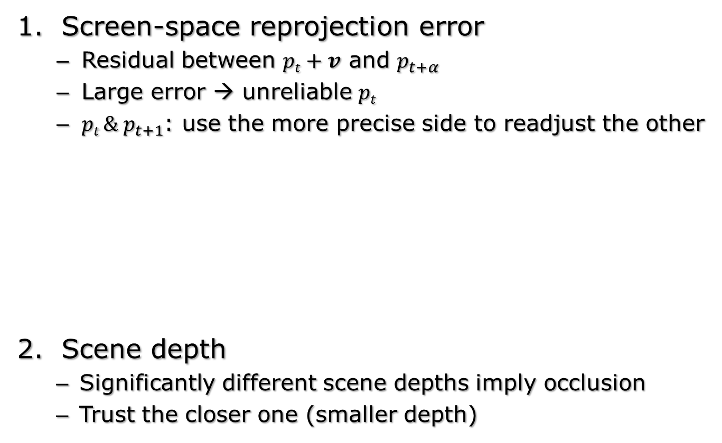


Visibility test criteria
Screen-space reprojection error
  Residual between $pt+v$ and $p_{t+α}$
  Large error → unreliable $pt$
  $pt {\& p}_{t+1}$: use the more precise side to readjust the other
Scene depth
  Significantly different scene depths imply occlusion
  Trust the closer one (smaller depth)
$$p_{t+α}$$
Reprojection
error
$$v$$
p_{t}
Notes:
For visibility test (image-based algorithm):
Check the reprojection error, or the residual between P_t + v and P_{t+alpha}.
(Large error indicates unreliable reprojection from Pt. In that case we can use the more precise side of Pt or Pt+1 to readjust the other, since they have correspondence. )
Check whether the scene depth between frame t and t+1 is significantly different, which implies occlusion changes. In that case we always trust the one with a smaller depth.

Slide 16
Additional search initialization
The motion field is often only piecewise smooth
  Imprecise initial vector across object boundaries
  Search steps can fall off the object
For a) :
  Additional 4 candidates within a small neighborhood
  Initialize using the result from a closer B-frame
For b):
  Initialize using the vector from the opposite I-frame
fast
●●
●●
slow
I-frame t
B-frame t +α
I-frame t +1
Notes:
Assumption of image-based approach: the motion field is continuous and smooth.
In reality this only holds in a piecewise manner.
Two related problems:
the initial vector V can be totally wrong across object boundaries;
the search steps can fall off the object and fail to converge.
We perform additional search initialization to overcome these problems.
we try 4 more candidates around the current pixel position, and we also attempt to initialize using the result from a closer B-frame other than the I-frame.
we attempt to initialize using the vector from the opposite I-frame, to avoid large steps.

Slide 17
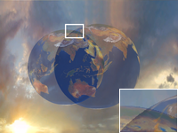
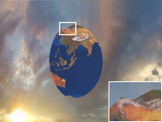
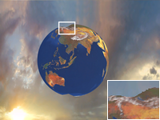
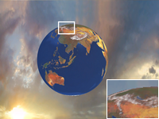
Additional search initialization
Comparison
I-frame t
B-frame t +¼
B-frame t +½
B-frame t +¾
I-frame t +1
Image-based
(No additional init.)
Image-based
(with “b”)
Image-based
(with “a+b”)
Linear blending
Notes:
Results comparing these approaches: (all are variants of the middle B-frame in the first row)
With linear blending we see how the globe in the two I-frames overlap.
With no additional initialization, only the overlapping regions are properly initialized.
With initialization from the opposite frame, we see a more complete globe.
By adding proper initialization across object boundaries, all the regions are correctly reprojected.

Slide 18
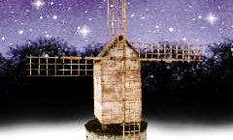
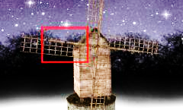
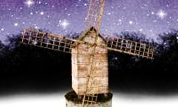
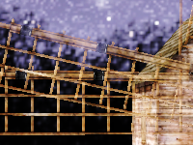
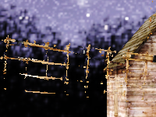
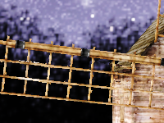

Interoperability
Problem with fast moving thin objects
Solution: mix multiple approaches (buffers shared)
I-frame t
B-frame t +0.5
I-frame t +1
…
…
Linear blending
Ours image-based
Ours image-based
+ scene-assisted pass on thin objects
Ours image-based
+ separate rendering of thin objects
Faster More precise
Notes:
The additional search initialization may still fail on fast moving thin objects, like the windmill blade shown here.
An advantage of our method is that our scene-assisted method and image-based method, and even the original rendering technique can share the same set of input and output buffers, which means they can inter-operate at the lowest cost.
Bottom row:
“2”: our image-based algorithm struggles in this extreme case.
“3”: we perform an additional scene-assisted pass on only the thin objects, and the result improves significantly at a low cost.
“4”: To further improve this, we can even separate the thin object rendering from our pipeline. This provides better handling of double occlusions.

Slide 19
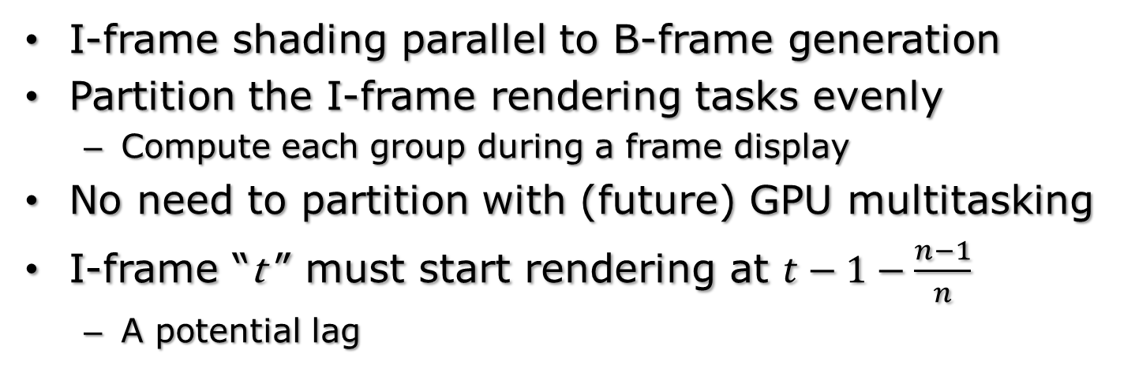
Partitioned rendering
I-frame shading parallel to B-frame generation
Partition the I-frame rendering tasks evenly
  Compute each group during a frame display
No need to partition with (future) GPU multitasking
I-frame “t ” must start rendering at $t−1−\frac{n−1}{n}$
  A potential lag
Animation input for I_{t}
display
I_{t} computation
& display
use
B computation
& display
t-2
t-1
t
Notes:
I-frame rendering is much slower than B-frame rendering:
during the time when I-frames are rendered, we have to generate and display B-frames at the same time to maintain a stable framerate.
We partition the I-frame rendering tasks evenly (red boxes), and interleave this task with B-frame computation and display (green boxes).
I-frame t should start rendering more than one frame before it’s displayed.
This introduces an additional lag to interactive rendering.

Slide 20
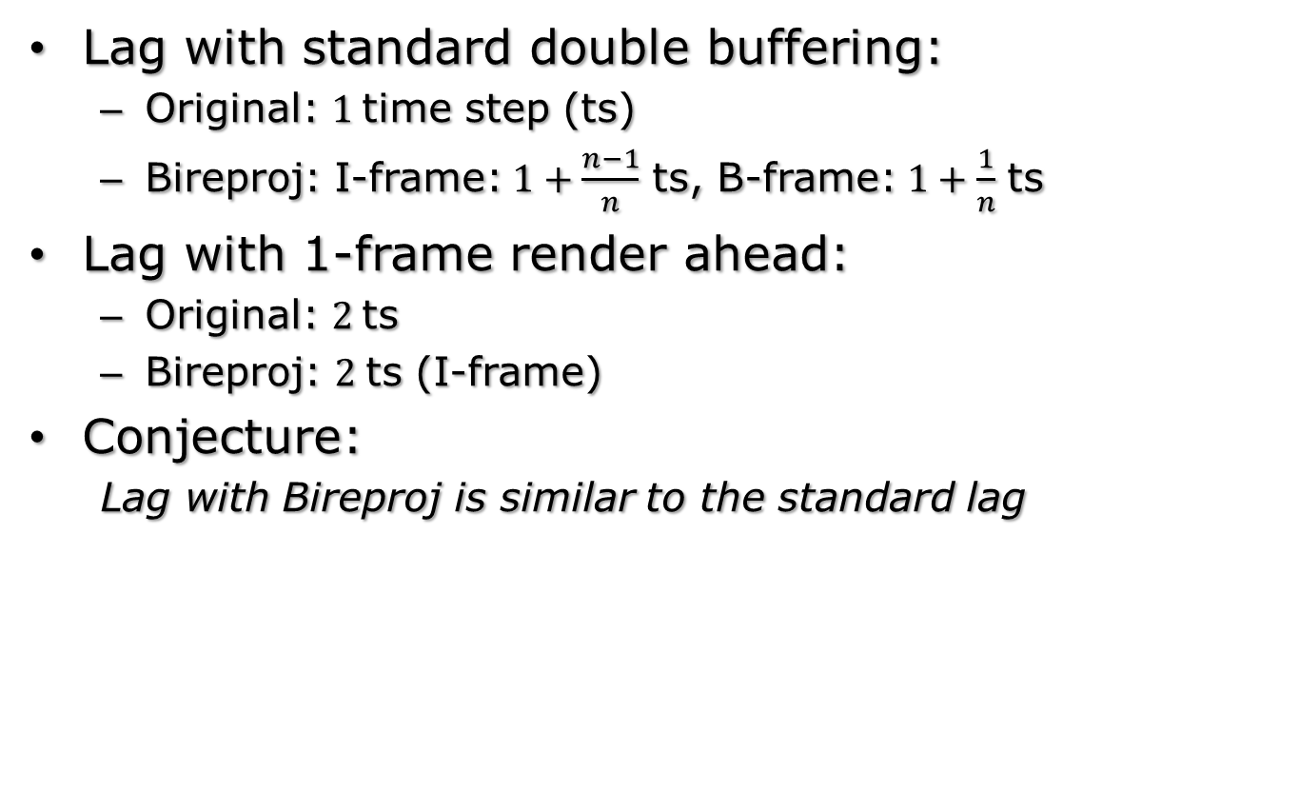
Lag
Lag with standard double buffering:
  Original: 1 time step (ts)
  Bireproj: I-frame:$1+\frac{n−1}{n}$ ts, B-frame:$1+\frac{1}{n}$ ts
Lag with 1-frame render ahead:
  Original: 2 ts
  Bireproj: 2 ts (I-frame)
Conjecture:
  Lag with Bireproj is similar to the standard lag
Notes:
Analyze the lag under two common scenarios:
Double buffering:
After an animation input is given, standard rendering takes one time step to display the result.
With Bireproj, although it takes a little bit less than 2 time steps to show it in I-frame, the input can already be seen in the first related B-frame, which takes slightly more than one time step to show.
Render ahead queue (commonly implemented in game engines and drivers)
Both the original and Bireproj rendering take 2 time steps to see an input.
The Bireproj lag is similar to the standard one?
We verify this with a user study.

Slide 21
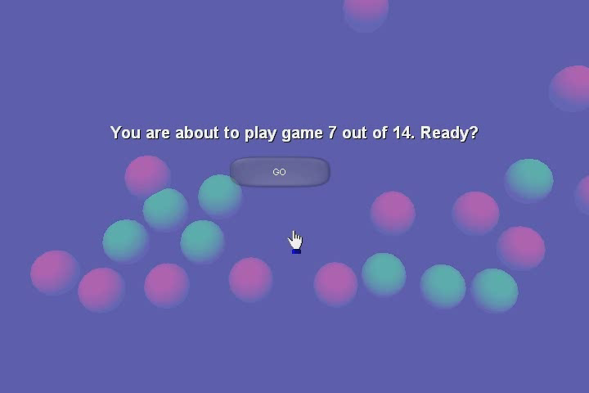
User study
The ball shooting game
  Goal: click green balls, avoid red ones and null clicks
  Subjects play in different modes and record results
Notes:
We use this simple ball shooting game in the user study.
The goal of this game is to click as many green balls as possible, while avoiding red ones and null clicks.
Each subject plays this game in different modes, and we record a set of objective and subjective measurements to compare these modes.

Slide 22
User study
Modes:
  Standard rendering 15fps (Baseline)
  Simulated 30fps / 60fps
  Artificially lagged 50/100/200ms (on 60fps)
  to be compared against:
  Bireproj (15 → 60fps)
Notes:
We assume that the standard rendering runs at 15fps, which is the baseline method.
We use bireproj to up-convert it 60 fps, and compare the results.
We also compare Bireproj against simulated 30fps and 60 fps modes (not achievable in reality).
To estimate the perceived lag, we also compare Bireproj with three artificially lagged modes, with 50 to 200 milliseconds of additional lag.
The subjects play all these modes randomly.

Slide 23
User study
Conclusions:
  Our method did better than 15fps, but worse than 30fps
  Perceived lag: 50ms < Bireproj << 100ms
  (The lag of standard 15fps is 66.7ms)
Mode | 60fps* | 30fps* | 15fps | Lag 50ms | Lag 100ms | Lag 200ms
Green Hits | ● | ● | ● | ● | ● | ●
Red Hits | ● | ● | ● | ● | ● | ●
Misses | ● | ● | ● | ● | ● | ●
Enjoyment | ● | ● | ● | ● | ● | ●
Difficulty | ● | ● | ● | ● | ● | ●
Responsiveness | ● | ● | ● | ● | ● | ●
Smoothness | ● | ● | ● | ● | ● | ●
objective
subjective
● Better than Bireproj ● Worse than Bireproj ● No significant difference
* infeasible in real scenarios
Notes:
The scoreboard:
Columns: the different modes that we compare to;
Rows: the objective and subjective measurements.
Blue dots means Bireproj wins, red dots means Bireproj loses, and gray means a tie.
Bireproj gives better results than 15fps, but is not as good as the simulated 30fps or 60 fps. (The lag diminishes in these simulated modes. )
Lagged mode (additional lag to simulated 60 fps): Bireproj has a perceived lag slightly larger than 50ms, but much smaller than a hundred. This is similar to the baseline lag 66.7ms in standard 15fps.
Therefore we can conclude that there is no perceivable additional lag and the results are better than the baseline.

Slide 24
Results
Suitable scenarios:
  Vertex-bound
  Fill-bound scenes
  Multi-pass rendering
  Motion blur rendering
Three B-frames per I-frame time step
Image-based Bireproj:
  2-3ms for a B-frame
  Pixel reprojection success rate: ≥99.6%
Notes:
Results:
We tested our method on several suitable scenarios.
For all the results, we always generate 3 B-frames per I-frame timestep.
Image-based bireproj: generating a B-frame requires 2-3 milliseconds on 1024x768 on a Geforce 8800.
The percentage of pixels that are correctly reprojected is larger than 99.6%.

Slide 25
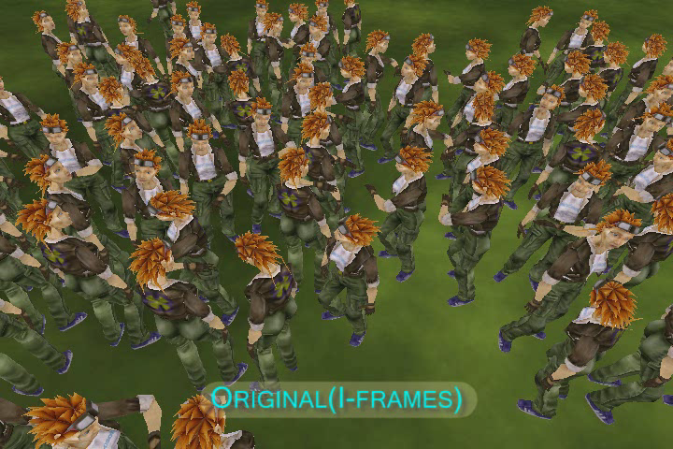
Results – the walking scene
Fill-bound with an expensive noise shader
Speed vs. reference: 2.9x (scene), 2.6x (image)
Notes:
Fill-bound scene:an expensive pixel shader applied on a crowd of walking characters.
With both methods (image-based and scene assisted) the framerate is boosted by nearly 3 times.

Slide 26
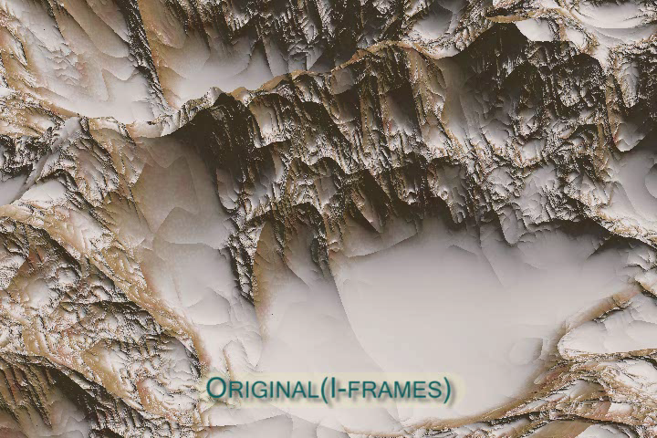
Results – the terrain scene
Geometry bound (1M triangles)
Speed vs. reference: 1x (scene), 2.8x (image)
Notes:
Geometry-bound (or vertex-bound) terrain scene.
With scene-assisted method, there is no speed gain because we have to rasterize the complex geometry for each B-frame.
With image-based method, the framerate is boosted by nearly 3 times.

Slide 27
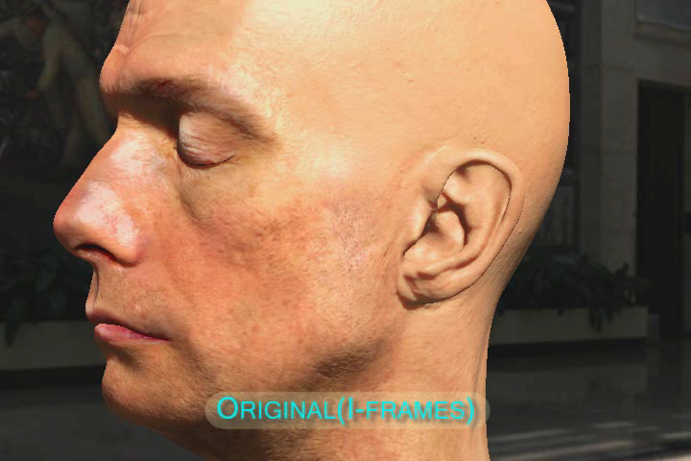
Results – the head scene
Multi-pass skin rendering ^{[d’Eon and Luebke 2007]}
Speed vs. reference: 3.4x (scene), 2.9x (image)
Notes:
Multi-pass rendering effects.
This deferred shading style demo is difficult for uni-directional reprojection techniques, primarily because of the difficulty to reshade disocclusions.
With bireproj, no reshade is needed. The speed-up factor is around 3X.

Slide 28
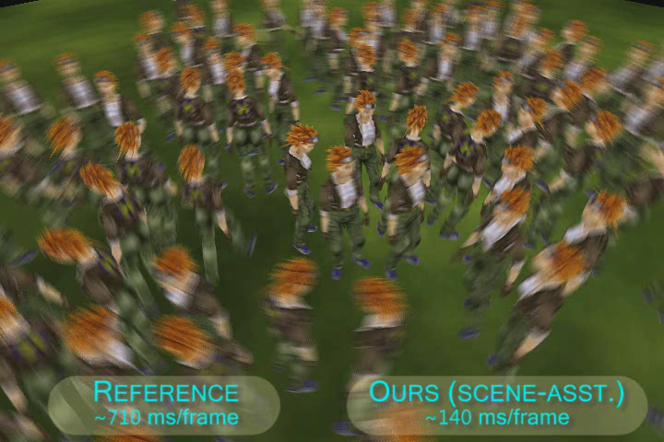
Results – motion blur
Accumulate 10 B-frames per I-frame
Speed vs. reference: 5.4x (scene), 6.2x (image)
Notes:
Motion blur effects.
In this walking scene example we accumulate 10 B-frames per I-frame.
The speed-up over brute-force rendering is 5-6x.

Slide 29
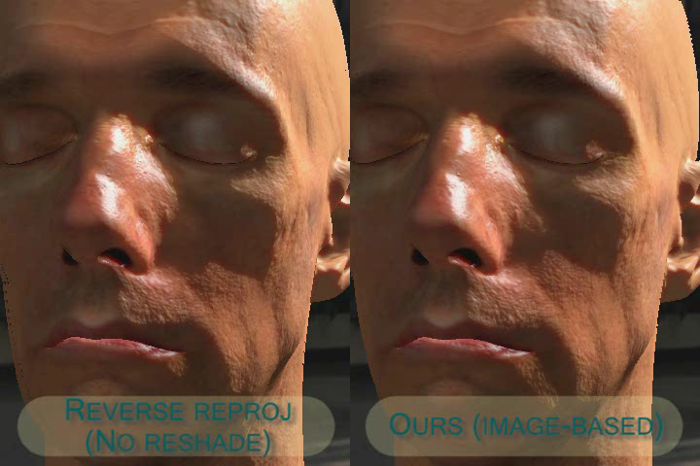
Improved shading interpolation
Compared to uni-directional reprojection: Reduced popping artifacts with dynamic lighting and shadows
Notes:
Bireproj improves the smoothness of dynamic lighting and shadows.
We compare uni-directional reprojection on the left with bireproj on the right.
The popping artifacts of the moving shadow and specular highlights is significantly reduced in our result.
We then compare bireproj with groundtruth. They are quite similar.

Slide 30
Conclusion
General purpose rendering acceleration
Real-time temporal upsampling
  Bidirectional reprojection
  Image-based iterative reprojection
Advantages:
  No need to reshade for disocclusion
  Compatible with multi-pass and deferred rendering
  Better dynamic shading interpolation
  Effect of lag is small or negligible
Notes:
To conclude, we present a general purpose rendering acceleration method by performing real-time temporal upsampling.
We introduce bidirectional reprojection and an iterative solution to image-based reprojection.
With bireproj there’s no need to reshade for disocclusion, which significantly simplifies the pipeline and makes it compatible with multi-pass and deferred rendering.
Bireproj also achieves better dynamic shading interpolation.
For the effect of lag, we’ve demonstrated that it is small and can be negligible.

Slide 31
Thanks!
Acknowledgement
  Piotr Didyk (for models and data)
  NVIDIA and XYZRGB (for the human head assets)
  NSF CAREER Award CCF-0747220
  HK RGC GRF grants #619008 and #619509
  INST grant from FAPERJ

