Slide 1
Appearance-Space Texture Synthesis
Sylvain Lefebvre Hugues Hoppe
Microsoft Research
Notes:
Hi,
I am going to present the work we’ve done with Hugues Hoppe on Appearance space texture synthesis.

Slide 2
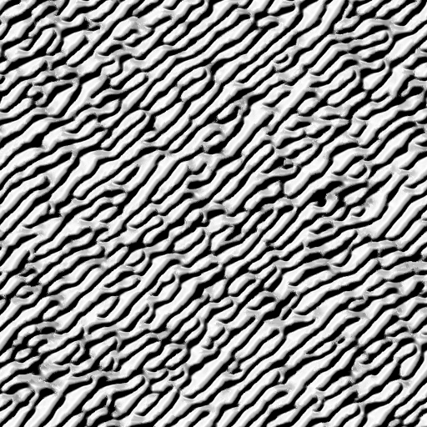
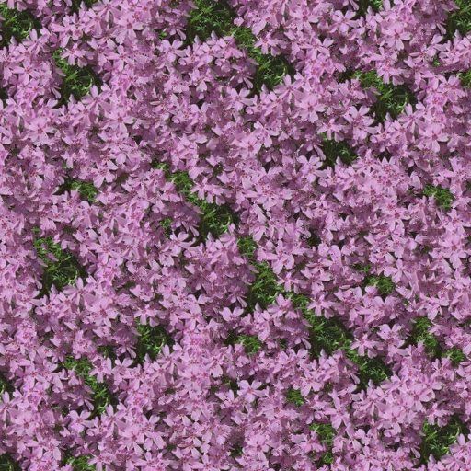
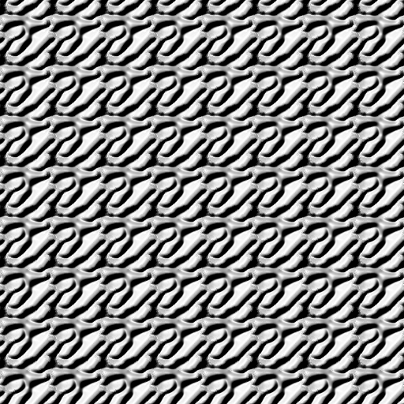
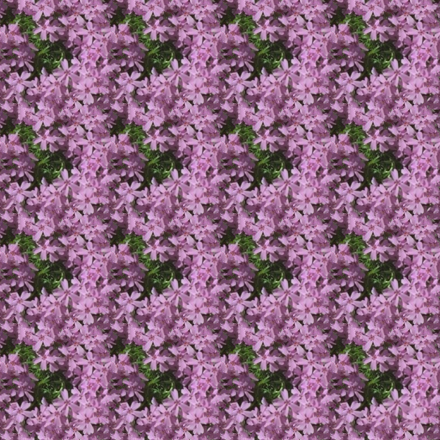
Texture synthesis from example
Exemplar
Exemplar
Synthesized
Synthesized
Tiled
Tiled
Notes:
Texture synthesis from example is a great tool to create large image reassembling a small input exemplar, # while avoiding the obvious repetitions of simple tilings.

Slide 3
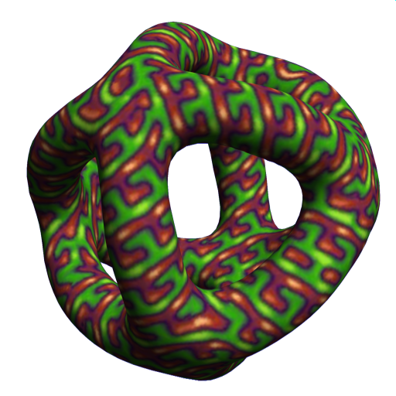

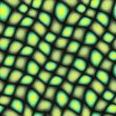
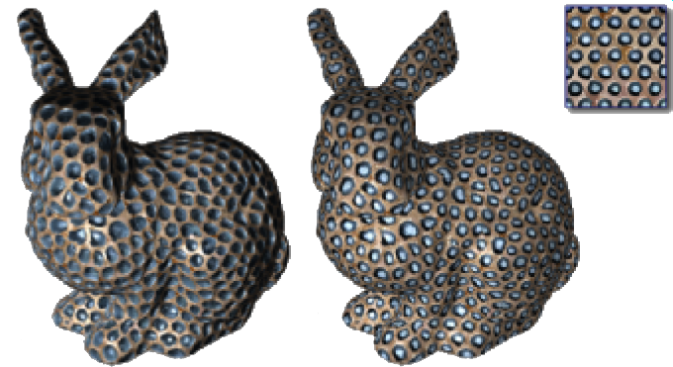
Recent extensions
[Turk 2001, …]
[Kwatra 2005]
Surface texture synthesis
Flowing textures
Millions of vertices
Slow → not interactive
Not unified
[Tong 2002, …]
High-dimensional texture data (BTF)
Notes:
But texture synthesis also has other motivations. # It has been used to generate directly on mesh surface textures that would be hard to paint by hand. # This has been extended to synthesis of high dimensional signals such as view dependent textures. # Finally, recent work has used synthesis techniques to animate a texture along a velocity field.
However, challenges remain.
# First, most surface texture synthesis techniques require finely tessellated meshes with millions of vertices,
# Second, most of these approaches are slow and offer little control over the result. In particular, the lack of interactive feedback makes it difficult to adjust the parameters.
# Third, these techniques have never been unified in a same scheme.

Slide 4
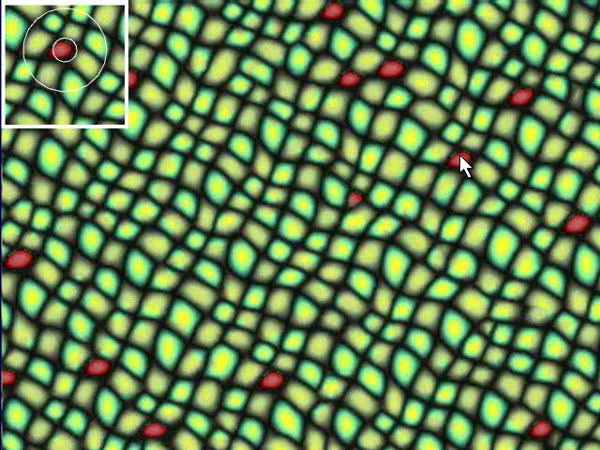
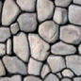
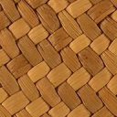
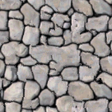
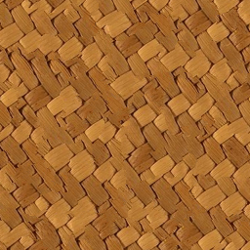
Fast, controllable synthesis
[Lefebvre and Hoppe 2005]
Only “flat” (isometric)
Quality limitations
Notes:
Last year, we introduced a fast controllable texture synthesis algorithm.
# However, this scheme performs only ‘flat’ isometric synthesis. We cannot synthesize on surfaces, we cannot handle high dimensional texture data, and we cannot synthesize advecting textures.
# Moreover, some textures are not properly synthesized. For instance these two textures generate poor results.
The problem here is that the neighborhoods used for synthesis are too small to capture the structures.
(The problem is that the limited extent of neighborhood comparisons does not accurately reproduce large structures.)
(The problem here is that the neighborhoods used for synthesis cannot capture the structures of these textures.)

Slide 5
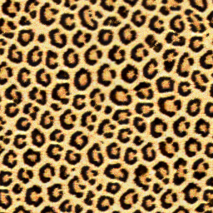
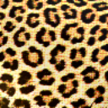
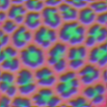
Overview
Appearance-space transform
  Improved efficiency
Color
Appearance space
Transformed exemplar
Exemplar
Synthesized
Notes:
In this work, we have two contribution areas.
We first introduce the appearance space transformation which transforms the exemplar prior to synthesis in an information rich space. This improves synthesis efficiency;
enables the use of non local information to further improve quality,
and lets us efficiently synthesize high-dimensional signals such as radiance transfer textures.
We build on this improved efficiency to propose novel real-time synthesis functionalities:
coherent anisometric synthesis, with interactive painting of the deformation field,
surface texture synthesis, directly in the parametric domain.
and real-time texture advection, with interactive painting of the advection field.
Finally we combine all this features in a unified synthesis framework implemented entirely on the GPU.

Slide 6
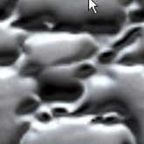
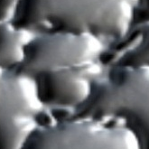
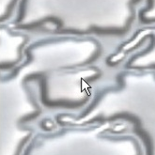
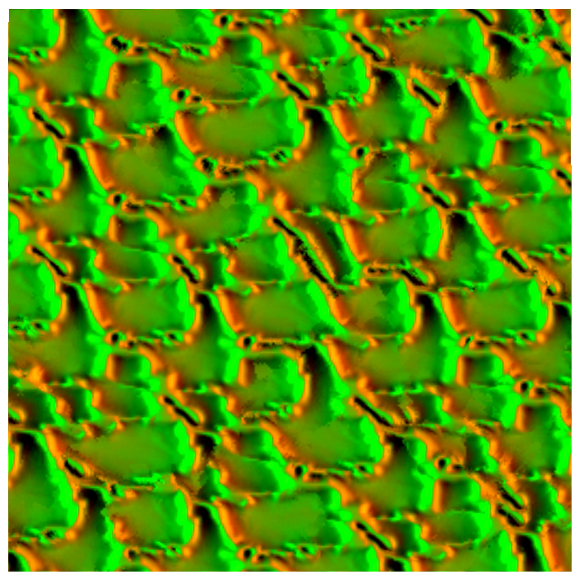
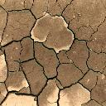
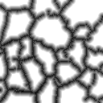
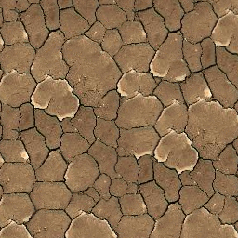
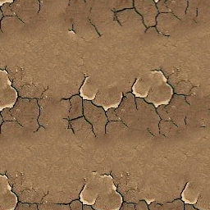
Overview
Appearance-space transform
  Improved efficiency
  Nonlocal features
  Radiance transfer
Novel techniques
With
Without
Notes:
DESCRIBE IMAGES

Slide 7
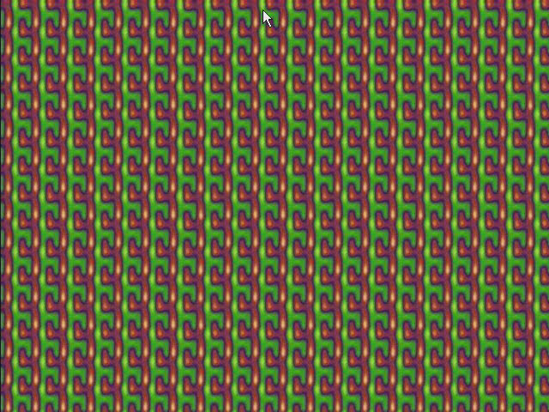
Overview
Appearance-space transform
  Improved efficiency
  Nonlocal features
  Radiance transfer
Novel techniques
  Anisometric synthesis

Slide 8
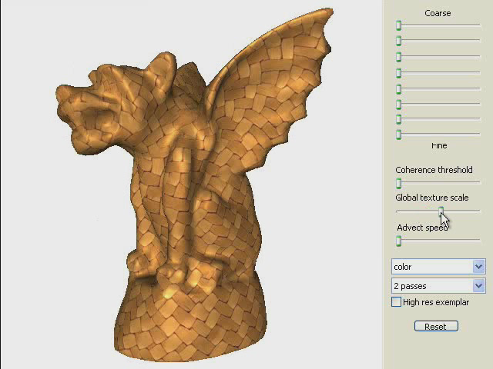
Overview
Appearance-space transform
  Improved efficiency
  Nonlocal features
  Radiance transfer
Novel techniques
  Anisometric synthesis
  Surface texture synthesis
Without
With

Slide 9
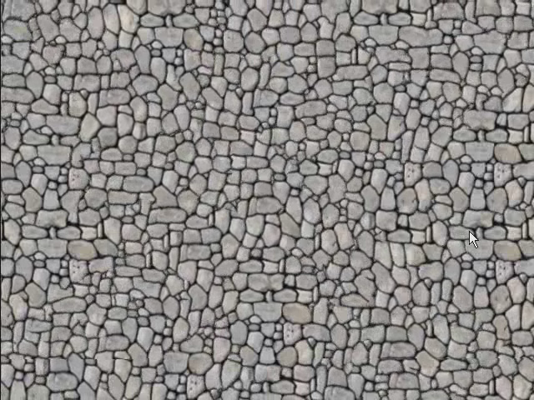
Overview
Appearance-space transform
  Improved efficiency
  Nonlocal features
  Radiance transfer
Novel techniques
  Anisometric synthesis
  Surface texture synthesis
  Texture advection
Without
With

Slide 10
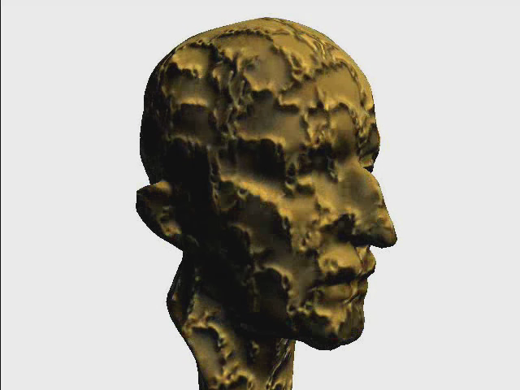
Overview
Appearance-space transform
  Improved efficiency
  Nonlocal features
  Radiance transfer
Novel techniques
  Anisometric synthesis
  Surface texture synthesis
  Texture advection
Unified framework, implemented on the GPU

Slide 11
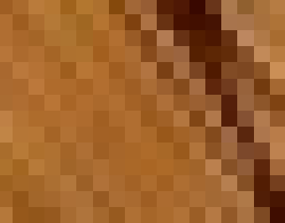
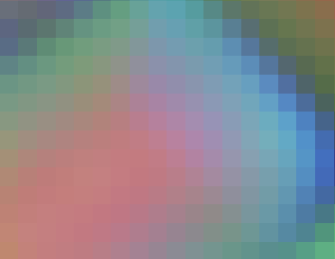
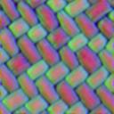
Neighborhood matching
Exemplar
Transformed Exemplar
Appearance space
Texture being synthesized
Notes:
Let me start by introducing the appearance space transform.
At the very heart of most per-pixel synthesis algorithms lies a very simple procedure, which is neighborhood matching.
The idea is to determine the color of a pixel from its surrounding. # The neighborhood of the pixel is extracted # and the exemplar is searched for the most similar neighborhood.
# Once found, the color of the pixel is updated. Note here that we can keep track of the coordinates of the pixels within the exemplar.
(Notice that we can easily keep track of the coordinate from where the pixel has been copied.)
Intuitively if we apply this process to all pixels of the image the result will look like the exemplar.
# With the appearance space transform we seek to improve this neighborhood matching process.
We start by replacing colors # by small appearance vectors better describing pixels and their surrounding. This makes the process better at distinguishing neighborhoods, and let us reduce the computational cost by using a smaller neighborhood. # In fact we use the smallest symmetric neighborhood, which is only four samples.

Slide 12
Building the transformed exemplar
(Nonlinear dim. reduction also possible)
5×5 pixel neighborhood
PCA
4D/8D
RGB exemplar
Appearance-space
exemplar
Transformed
exemplar
Appearance
vector
75D
(5x5xRGB)
Notes:
I will now describe how we build the transformed exemplar.
We start from an RGB image.
# We first compute an appearance space exemplar.
# The idea is to store in each pixel not only its color but a larger appearance vector describing its surrounding.
We form this appearance vector by concatenating the 5x5 neighborhood of the pixel. In this example the app vector thus has 75D: 5x5xRGB.
# Fortunately these large appearance vectors lie on a lower dimensional space, so we perform dimensionality reduction to obtain the transformed exemplar used for synthesis.
We chose the number of dimensions depending on the data - typically either 4D or 8D.
# We usually apply Principal Component Analysis, but it is important to note that non linear dimensionality reductions can also be used here.
In the paper we report some tests with LLE and ISOMAP – so please refer to the paper for more details.
(ANIMATION single pixel => appearance vector => concatenation => transform => animate)

Slide 13
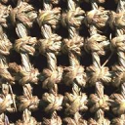

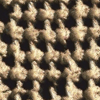
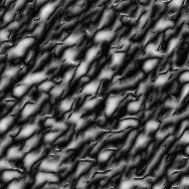
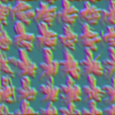

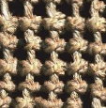
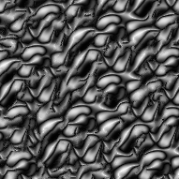
RGB versus 3D appearance space
RGB
3D appearance
space
PCA
3D
Appearance
Vector
Notes:
To verify the quality improvement of the appearance transform, we compare synthesis quality using just RGB colors, and using a 3D appearance space: We perform dimensionality reduction of the appearance vectors to 3D only.
The computational cost of the top and bottom rows are thus exactly the same: the algorithm inputs an image with 3d pixels in both cases.
However, as you can see at the bottom, appearance space does a much better job at capturing the texture appearance – The result is more faithful to the example even though the same synthesis algorithm was used in both cases.
The transform exemplar *does* contain more information than the original RGB image.

Slide 14
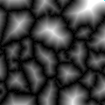
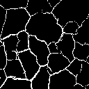
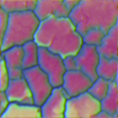
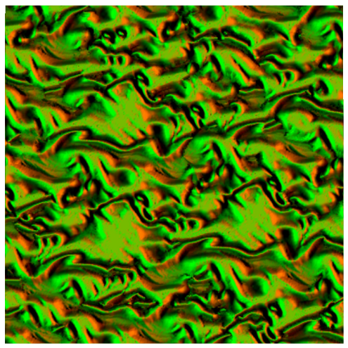
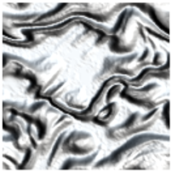
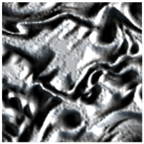
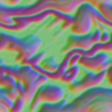
Nonlocal information
PCA
Appearance
Vector
Feature distance 5x5x4D (➔ 100D)
Radiance transfer 5x5x36D (➔ 900D)
Feature distance
Feature mask
4D
8D
Notes:
A very important aspect of the app space transform is that we can use more than just colors in the appearance vectors. In fact, we can introduce non local information to overcome the limitations of small neighborhood comparisons.
# We ask the user to provide a feature mask, # from which we compute a distance field that we add to the exemplar. The exemplar is now 4D: RGB and distance information.
The appearance vectors are thus 100D,
# and we here reduce them to 4D to compute the transformed exemplar
# that we use for synthesis.
Note how features are well preserved in the synthesized texture. I’ll show some more results later.
Instead of synthesizing colors,
# we also applied our approach to radiance transfer textures.
In this setting, each pixel is a vector of 36 SH coefficients representing its response to a lighting environment. Each appearance vector is then 900D.
# We reduce them to 8D as the data is more complex. We then use this transformed exemplar for synthesis.
Note that RTT synthesis results can be lit with a different environment after synthesis.

Slide 15
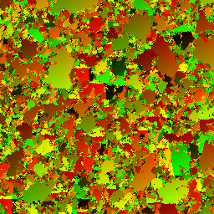
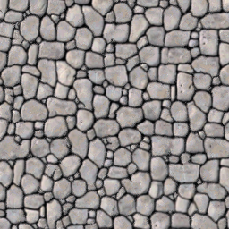
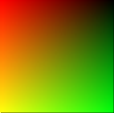
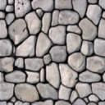
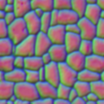
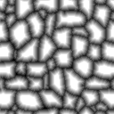
Synthesis pipeline
Exemplar E
Transformed exemplar E’
Per-pixel
synthesis
algorithm
color
appearance space
Synthesized coordinates S
Synthesized texture E[S]
Or color + feature:
Or radiance transfer:
Notes:
We can now look at the whole synthesis pipeline.
We start from a color exemplar.
# or color plus feature distance,
# or a radiance transfer texture,
# we transform the exemplar in appearance space as just described. This is done has a preprocess and can take several minutes.
# we use the transformed exemplar as the input to a neighborhood matching synthesis algorithm.
# we however assume that it outputs a coordinate map (which is the case of many algorithms). Each pixel of the result is thus the coordinate from where to read the color in the exemplar.
# we can therefore easily obtain the color version of the result, with a simple lookup into the original exemplar.
Let me give a few details on our per pixel synthesis algorithm

Slide 16
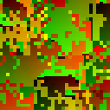







Texture synthesis algorithm
Parallel controllable texture synthesis [Lefebvre and Hoppe 2005]
  Multiresolution scheme.
  At each level:
Simplified correction neighborhood:
l
l-1
Upsampling
Jitter
Correction
Notes:
It is based on our parallel texture synthesis algorithm, implemented on GPU, that we introduced last year.
# It is a multi resolution algorithm that works on exemplar pixel coordinates.
I wont however go into details, please refer to the paper.
The important point is that thanks to appearance space synthesis efficiency, we can actually simplify the neighborhood matching algorithm, and use a 4 sample neighborhood instead of a 5x5 neighborhood.
All the results shown in this talk are obtained with this scheme.

Slide 17

Synthesis pipeline
Exemplar E
Transformed exemplar E’
Per-pixel
synthesis
algorithm
color
appearance space
Synthesized coordinates S
Synthesized texture E[S]
Notes:
# We now have seen all the key elements of the pipeline, so let’s have a look at some results

Slide 18





Results: Feature preservation
Add feature distance to appearance vector
(100D ➔ 4D)
[Zhang et al 2003,
Wu and Yu 2004]
Without
Notes:
Here are some results using feature distance.
On the left, you can see both the exemplar and the distance field that was used.
As you can see by comparing with the right column, synthesis quality is greatly improved.
For instance the shape of the leopard ‘spots’ (rosette) is better preserved.
Also note that the left and right column have the same synthesis cost: both are using a 4D transformed exemplar.
# It is worth noting that we get results similar to previous schemes but without any explicit feature matching during the synthesis process. In fact the synthesis algorithm is completely unchanged.

Slide 19


Results: RTT synthesis
Synthesize radiance transfer SH coefficients
(900D ➔ 8D)
Notes:
NOTICE HOW SHADOWING REMAINS CONSISTENT AFTER SYNTHESIS
Here are some first results of RTT synthesis.
You can see here the exemplar, under varying lighting conditions.
And now the result, also under varying lighting conditions. Note how the shadowing information is well captured.
RTT synthesis remains extremely efficient as we perform synthesis with an 8D transformed exemplar, instead of 4D in the color case.

Slide 20
Novel synthesis techniques
Coherent anisometric synthesis
Surface texture synthesis in parametric domain
Real-time advection
Notes:
Thanks to the improved efficiency of appearance space synthesis we explore novel real-time synthesis techniques.
The first of these techniques is coherent anisometric synthesis.

Slide 21


Coherent anisometric synthesis
Overview:
Exemplar
Target Jacobian field J
Notes:
In this setting, the user provides not only the exemplar, but also a Jacobian field covering the output. At each location, this field defines a local desired orientation for the texture.
#
Our algorithm is able to quickly synthesize a new texture following the orientation field.

Slide 22
Anisometric synthesis
A first approach: [Ying et al. 2001]
  Exemplar: Undistorted
  Synthesized: Distorted
☹ Sampling issues
☹ Loss of texture coherence
J⁻¹
Exemplar
Synthesized
Notes:
To perform anisometric synthesis we need to distort the neighborhoods before comparison.
A first approach is to fetch undistorted neighborhoods in the exemplar, and to compare them with a distorted neighborhood in the synthesized texture.
#
This works, however, there are sampling difficulties in the synthesized texture, as sample locations are no longer aligned with synthesized pixels. This is worsen by the fact that our algorithm store coordinates rather than colors, making re-sampling difficult.
But most importantly, performing correction using non local neighbors leads to a loss of texture coherence # as the content in between the pixel and the samples is ignored.
TODO (little squares with ?)

Slide 23
Coherent anisometric synthesis
Our approach:
  Exemplar: Undistorted
  Synthesized:
    Access immediate neighbors only
    Estimate distorted neighborhood
Exemplar
Synthesized
Notes:
We thus propose a new approach. We estimate the distorted neighborhood by only accessing immediate neighbors in the synthesized texture, shown here in red.
This reduces sampling issues and enable coherent synthesis.

Slide 24
Isometric
N(p)
p
Exemplar
Texture being synthesized
Notes:
First, let me introduce a few concepts in the isometric case – so there is no distortion.
Consider a pixel p and its already synthesized immediate neighbors.
Each immediate neighbor has a coordinate in the exemplar (recall we are synthesizing coords).
Now, each of these pixels, in the exemplar, has a neighbor that corresponds to p.
We call these pixels “proxy pixels”.
Our key idea is to use the proxy pixels to estimate the neighborhood around p.
A first insight to understand this is to now consider the proxy pixels only. Each of them can be used to retrieve one of the neighbor of p in the texture being synthesized.
So we can rebuild the neighborhood around p from the proxy pixels in the exemplar.

Slide 25
Anisometric
∗2
÷2
N(p)
p
Exemplar
Texture being synthesized
Notes:
Let’s now consider the anisometric case with a simple scaling as distortion.
# This is the distorted neighborhood we want to estimate.
First, we obtain the proxy pixels from the immediate neighbors as I explained before, but through the anisometric distortion – which is here the Jacobian.
Now, as in the isometric case, we use each proxy pixel to find one exemplar-space neighbor.
# The final result is the distorted neighborhood representing the surrounding of p.
Thanks to appearance space synthesis we only have to perform this computations on four neighbors, making this approach practical for real time synthesis. Using a 5x5 neighborhood would be much more expensive.

Slide 26



Results
Notes:
Here is a first result of anisometric synthesis. Here we use feature distance to preserve the keys.

Slide 27



Results
Notes:
Another result on a challenging texture.

Slide 28



Results
Notes:
Yet another result

Slide 29

Results
[Captured in Real-Time]
Notes:
As our synthesis algorithm is very fast, and implemented on GPU, the user can interactively paint the orientation field, adjusting either direction or scaling.

Slide 30
Novel synthesis techniques
Coherent anisometric synthesis
Surface texture synthesis in parametric domain
Real-time advection
Notes:
Next, we extend anisometric synthesis to synthesize surface texture directly in the surface parametric domain.

Slide 31



Surface texture synthesis
Overview:
Exemplar
Notes:
In this setting, we want to synthesize a texture directly in a multichart atlas,
#
So that once mapped onto the corresponding surface it looks like the texture has been synthesized on the mesh.

Slide 32

Surface texture synthesis
Similar to anisometric synthesis
  Jacobian field:
    Cancel mapping distortion
    Orient along user-defined tangential field
  Seamless charts:
    Use indirection maps
    Possible because:
    synthesis accesses only
    immediate neighbors.
Notes:
The problem is actually similar to anisometric synthesis.
We compute the Jacobian field to cancel mapping distortion – the flattening of the mesh - and to let the user orient the texture along the surface. All details about this computation are in the paper. The important point here is that we just compute a Jacobian field as an input to the anisometric synthesis scheme.
#
The only other difficulty concerns the charts. In particular if we fetch a neighborhood next to a chart boundary, we need to fill in the samples falling outside with information from the neighboring chart. To do so, we simply rely on precomputed indirection maps. We follow the pointers to retrieve coordinates of the samples from the neighboring chart.
Note that we can do this because our coherent anisometric scheme accesses immediate neighbors only, which bounds the neighborhood extent. If the neighborhood was going arbitrarily far outside the chart we could not use simple indirections.

Slide 33

Surface synthesis results
Interactive control
Notes:
Our scheme is fast enough to let the user interactively change randomness parameters, thus obtaining different textures.
Or change interactively the texture orientation.
Or adjust the scale of the synthesized texture.

Slide 34

Surface synthesis results
Interactive control
Notes:
Our scheme is fast enough to let the user interactively change randomness parameters, thus obtaining different textures.
Or change interactively the texture orientation.
Or adjust the scale of the synthesized texture.

Slide 35

Surface synthesis results
Interactive control
Notes:
Our scheme is fast enough to let the user interactively change randomness parameters, thus obtaining different textures.
Or change interactively the texture orientation.
Or adjust the scale of the synthesized texture.

Slide 36

Surface synthesis results
RTT synthesis on surface
Notes:
Here are examples of RTT synthesis. The resulting RTT textures can be dynamically re-lighted. Rendering is done in real-time.

Slide 37
Novel synthesis techniques
Coherent anisometric synthesis
Surface texture synthesis in parametric domain
Real-time advection
Notes:
The last technique we propose is real-time advection of texture content.

Slide 38


Real-time advection
Overview:
Velocity field
Notes:
In this setting, the user specifies an exemplar and a velocity field, possible time-varying. The chalenge is to synthesize a texture which is advecting along the velocity field, but keeps its appearance as it moves.

Slide 39

Real-time advection
l
l-1
Upsampling
Jitter
Correction
Notes:
Our advection scheme fits very nicely in our unified synthesis framework. In fact, it only involves a very simple modification of the upsampling step.
The idea is to advect the texture until there is too much distortion, in which case we locally re-synthesize the content.
I don’t want to give too much details now, please refer to the paper, but rather show you the results we obtain.

Slide 40

Advection results
Notes:
Here are results of real time advection, first on an easy texture,
Then on a more challenging texture.
We can also combine advection and surface synthesis to advect the texture along a mesh, interactively control the advection direction,
and even dynamically deform the surface as the Jacobian field computation itself is performed as a GPU rasterization pass.

Slide 41





Summary
Appearance-space synthesis
  Transformation as preprocess
  Nonlocal information
  Improved efficiency
Novel synthesis techniques
  Anisometric synthesis
  Surface texture synthesis
With
Without
Notes:
In summary,
we proposed appearance space texture synthesis,
which transforms the exemplar in an information rich space prior to synthesis,
enables the use of non local information to better preserve features,
and improves synthesis efficiency thus allowing to reduce runtime cost
It enables novel synthesis techniques all available in a unified framework:
coherent anisometric synthesis ,
surface synthesis directly in the parametric domain,
and real time advection of texture content.

Slide 42


Summary
Appearance-space synthesis
  Transformation as preprocess
  Nonlocal information
  Improved efficiency
Novel synthesis techniques
  Anisometric synthesis
  Surface texture synthesis
  Coherent advection
With
Without
Notes:
In summary,
we proposed appearance space texture synthesis,
which transforms the exemplar in an information rich space prior to synthesis,
enables the use of non local information to better preserve features,
and improves synthesis efficiency thus allowing to reduce runtime cost
It enables novel synthesis techniques all available in a unified framework:
coherent anisometric synthesis ,
surface synthesis directly in the parametric domain,
and real time advection of texture content.

Slide 43
Summary
Appearance-space synthesis
  Transformation as preprocess
  Nonlocal information
  Improved efficiency
Novel synthesis techniques
  Anisometric synthesis
  Surface texture synthesis
  Coherent advection
  All together in real-time
With
Without
Notes:
In summary,
we proposed appearance space texture synthesis,
which transforms the exemplar in an information rich space prior to synthesis,
enables the use of non local information to better preserve features,
and improves synthesis efficiency thus allowing to reduce runtime cost
It enables novel synthesis techniques all available in a unified framework:
coherent anisometric synthesis ,
surface synthesis directly in the parametric domain,
and real time advection of texture content.

Slide 44

Future work
Multi-layer textures
Notes:
Of course, there are some limitations.
# Some textures are very challenging as they contain different layers. We would like to recognize such textures and adapt our synthesis scheme. IMPROVE
# Finally, you may already have noticed it, but some of our advection results exhibit popping, which are due to local re-synthesis. This is an area for future improvement.
# Nonlinear – LLE ISOMAP
# Video textures

Slide 45
Future work
Multi-layer textures
Advection popping
Notes:
Of course, there are some limitations.
# Some textures are very challenging as they contain different layers. We would like to recognize such textures and adapt our synthesis scheme. IMPROVE
# Finally, you may already have noticed it, but some of our advection results exhibit popping, which are due to local re-synthesis. This is an area for future improvement.
# Nonlinear – LLE ISOMAP
# Video textures

Slide 46

Future work
Multi-layer textures
Advection popping
Nonlinear dimensionality reduction
Video textures
PCA
Isomap
LLE
Notes:
Of course, there are some limitations.
# Some textures are very challenging as they contain different layers. We would like to recognize such textures and adapt our synthesis scheme. IMPROVE
# Finally, you may already have noticed it, but some of our advection results exhibit popping, which are due to local re-synthesis. This is an area for future improvement.
# Nonlinear – LLE ISOMAP
# Video textures

Slide 47
Acknowledgements
Ben Luna, Peter Pike Sloan, John Snyder

Slide 48
The end
Thank you !!
Questions ?

Slide 50
Anisometric synthesis
∆
p
S[p+ ]
N(p)
Exemplar space
p
J⁻¹∆
- J
➔ Practical thanks to appearance space synthesis
∆
Synthesis space
(coordinates)
Exemplar
Notes:
Now, I will explain how we use coherent candidates for anisometric synthesis.
Our goal is to build an undistorted exemplar space neighborhood that captures the appearance around p in the texture being synthesized. This neighborhood will be compared against other undistorted exemplar neighborhoods.
We will build it one sample after the other. Recall that our neighborhoods have only 4 samples.
* * * *
So let’s start with the top left sample. The blue delta vector is the relative position of the sample within the exemplar space neighborhood.
Now, we can transform delta by the inverse jacobian, to obtain delta in synthesis space. This would be the location where to fetch the color. However, in order to avoid sampling issues, we compute a new vector, the red delta, which only keeps the direction of the transformed delta. It is computed to access a immediate neighbor of p in the synthesized texture. This is the green pixel here.
Now, we just use the coherent candidate approach, to find out what should be p according to its green neighbor.
Once we have the coherent candidate, we simply fetch the “color” of the pixel having the position given by delta in the neighborhood. This is the color that should be in the neighborhood according to the green neighbor of p. As this neighbor is in the correct direction, it will give us a good estimate of the neighborhood.
We then go to the next sample, and proceed in the same way until the neighborhood is complete.
Synthesis can then proceed as before.

Slide 51
Textons vs. Appearance Space
Textons
Appearance Space
Discrete
Continuous
Explicit distance matrix
Simple euclidean norm

Slide 52
Appearance space synthesis
Synthesize in information-rich space
    Exemplar-adapted
    Continuous low-dimensional space
    Euclidean metric
Transform exemplar prior to synthesis
    Run-time is not modified
Steerable filters
[Heeger and Bergen 1995, De Bonnet 1997, Portilla and Simoncelli 2000]
    Generic filters
    Applied at runtime
Textons
[Malik et al. 1999, Tong et al. 2002, Magda and Kriegman 2003]
    Discretization
    Distance metric ➔ large inner-product matrix
Notes:
So, let me start by introducing appearance space synthesis.
The key idea is to perform synthesis in an information rich space. Each RGB pixel of the exemplar will be replaced by a small appearance vector. Our appearance space is adapted to each exemplar, is continuous, low dimensional, and has an Euclidian metric.
This approach let us transform the exemplar *prior* to synthesis, so that the runtime algorithm does not have to be modified.
How does this relate to previous work?
- Several texture synthesis approaches use steerable filters to compute appearance vectors. These vectors encode the response of each exemplar location to the filters. However, generic filters are used, whereas in our scheme the appearance space is adapted to each exemplar. Moreover, the filters must be applied during the synthesis process, whereas we transform the exemplar prior to synthesis.
Textons approaches are probably the most related to our scheme. Exemplar locations are clustered with respect to their response to sets of gaussian fitlers. Synthesis is then performed in texton space.
Textons, however, have 2 drawbacks. First, the texton space is discrete which may introduce artifacts, whereas our apperance space is continuous. Second, the texton distance is encoded as a large inner product matrix. Random accesses into this matrix during synthesis reduces performance. In our scheme, however, a simple euclidian distance is used and the runtime synthesis algorithm need not be modified.

Slide 53
Real-time advection
l-2
ξ < threshold
l-1
advect ‘in-place’
ξ > threshold
upsample parent
?
l
Local distortion ξ
t-1
t
Notes:
Lets assume that we have the synthesis result of the previous time frame. It is the yellow pyramid on the left.
Lets also assume that we already synthesized a few levels of the current time frame pyramid. These are the blue levels on the right.
Now, we are interested in upsampling the next level l. Lets consider a single pixel.
#
We start by computing the distortion at the same pixel of the previous time frame. We can compute this distortion using finite differencing on the synthesizing coordinates.
#
If this distortion is below a given threshold, then we perform what we call ‘in-place advection’. We simply add the velocity to the previous time frame coordinates. This will create the motion.
#
If this distortion is above the threshold, we instead upsample friom the parent level, as usual. The effect is to locally refresh the advected texture with new synthesized content.

Slide 54







Anisometric synthesis magnification
Problems:
  Limited resolution
  Visible sampling patterns
Approach: [Lefebvre and Hoppe 2005]
  Synthesized coordinates ➔ parameterization
Notes:
One issue with performing synthesis in the parametric domain is that is produces visible sampling patterns.
Here at the bottom left you can see the synthesized texture, and on the right a closeup on a multichart boundary of the surface.
A naïve solution would be to increase synthesis resolution, but this would also greatly increase synthesis cost.
# Instead we use an idea similar to synthesis magnification we introduce last year. Recall that we do synthesis pixel coordinates. We simply bi-linearly interpolate these coordinates, with special handling of patch discontinuities, and access the exemplar using bilinear interpolation.
This produces a much smoother result, and the difference in sampling patterns of the charts are now invisible.
# Here you can see the huge improvement in rendering quality achieved by this method.

