Slide 1





Antialiasing Recovery
Lei Yang, Pedro V. Sander
The Hong Kong University of Science and Technology
Jason Lawrence
University of Virginia
Hugues Hoppe
Microsoft Research

Slide 2
Overview
Introduction
  Nonlinear filtering and edge artifacts
  Prior work
Antialiasing recovery
  A 1D illustration
  Finding the edge color model in 2D
  Correcting the filtered image
  A real-time GPU implementation
Results and discussion

Slide 3
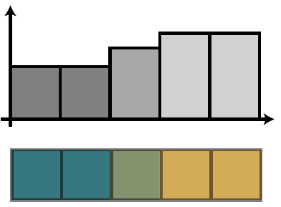
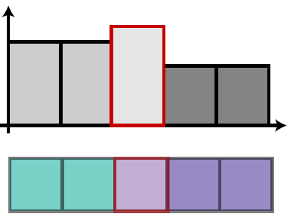
Smooth edge and nonlinear filters
Antialiased edges in images
  Smooth transition pixels along object boundaries
  Blending of the two meeting colors
Nonlinear filters
  Can map edge pixels to abrupt colors
  Very common in image processing
Luminance
Nonlinear Filter
Image scanline

Slide 4
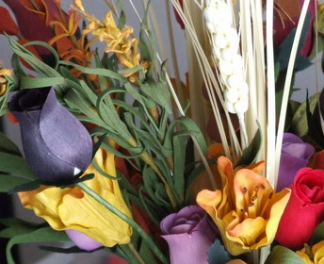
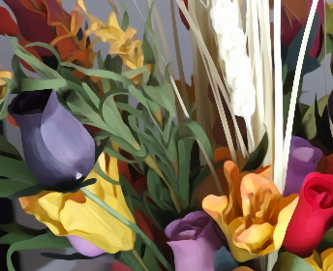
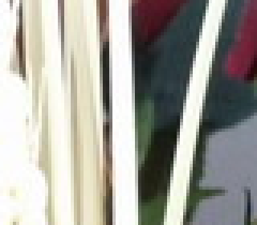
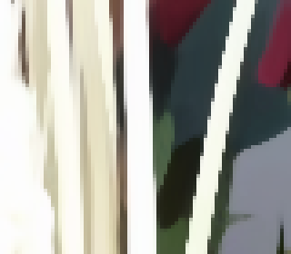
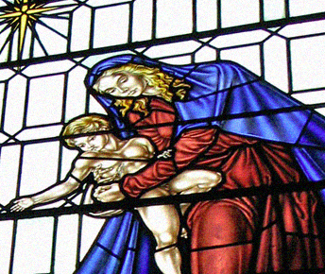
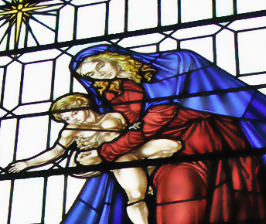
Image
Abstraction
Bilateral
Filtering

Slide 5
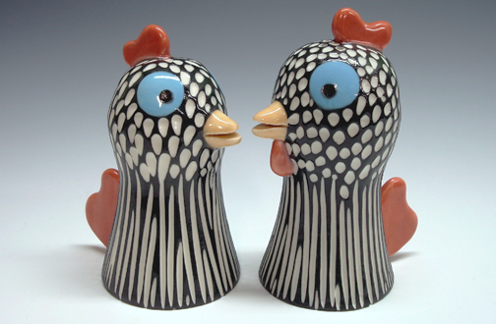
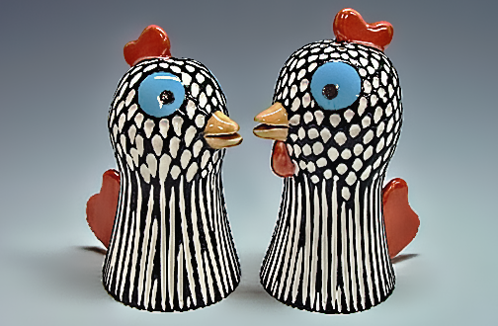
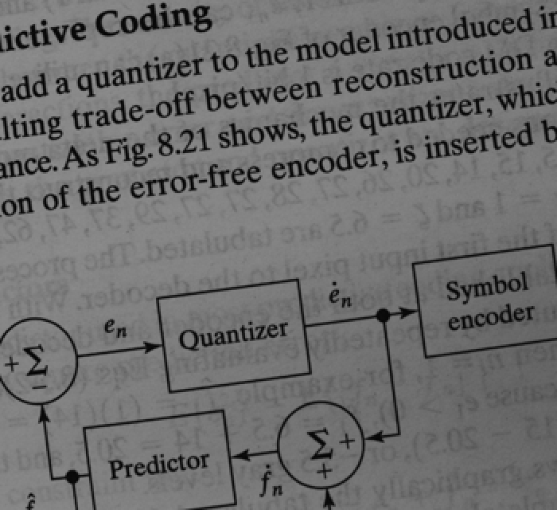
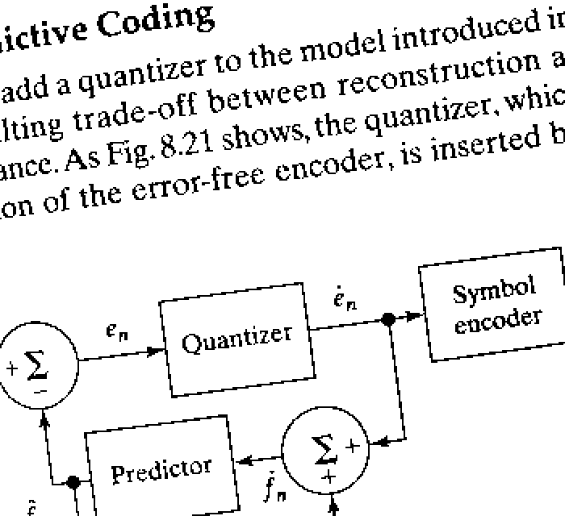
Detail
Enhancement
Intensity
Thresholding

Slide 6

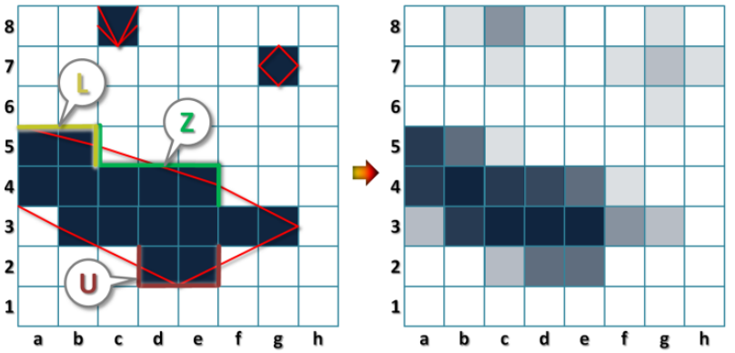




Repairing abrupt edges
Morphological antialiasing (MLAA) [Reshetov 2009]

Slide 7
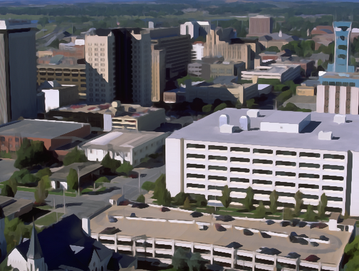

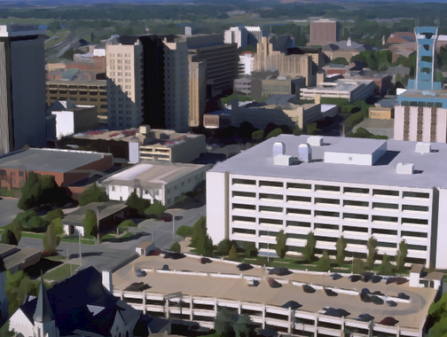
Repairing abrupt edges
Morphological antialiasing (MLAA) [Reshetov 2009]
  Designed to repair point sampling artifacts
  Not suitable for fixing partially antialiased edges
Filtered
MLAA
Desired

Slide 8
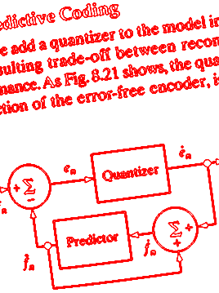
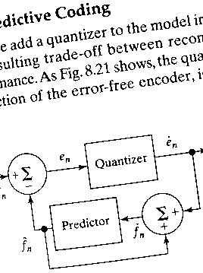
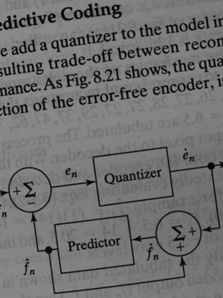

Antialiasing recovery
Original
Filtered
Extract the edge blending info from the original image
Apply it to the filtered image
Preserve filtered colors except at edges

Slide 9



Antialiasing recovery
A postprocess to existing nonlinear filters
Original (O)
Filtered (F)
Result (R)
Nonlinear
filter
Antialiasing recovery
Notes:
Our method is used as a postprocess to existing nonlinear filters.
It takes both the original input image (O) and the filter output (F). The result image (R) retains most of the changes in F except along edges.
Our method also assumes that O and F must have exact 1-1 pixel correspondence. So the nonlinear filter cannot apply any geometric distortion to the image.

Slide 10
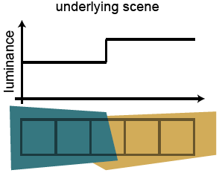
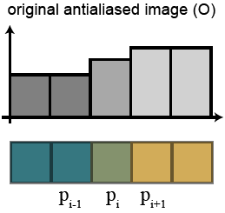
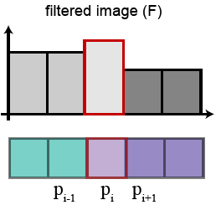
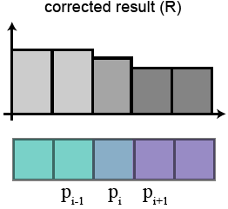
A 1D illustration
For each edge pixel:
  Resolve the contribution of the smooth regions in “O”
  Apply the same contribution factors in “F” to obtain “R”
Filtered:
Incorrect
Re-blended
Smooth regions
Edge
60%
40%
60%
40%
Contributions of smooth regions
Notes:
A simple example in 1D.
In the underlying scene, there are two smooth regions of different colors meeting at an edge. The luminance plot also shows this sharp transition.
After rasterizing this scene with proper filtering, we can see a blended color at the edge pixel. The edge pixel is contributed by 60% of the left color and 40% of the right color.
After non-linear filtering, the edge pixel may become incorrect and show an abrupt color.
We can recover this pixel with a blended color using the percentages.

Slide 11
Generalizing to 2D images
Difficulty: each pixel has 8 neighbors
Identify the two contributing colors
  Select two pixels p_{a} and p_{b}
  Most representative of the two
  smooth regions
  (Closest to their colors)
p_{a}
p
p_{b}
Notes:
Here we assume that only two colors contribute to the edge pixel p, which applies for the majority of edges.
Select two pixels p_a and p_b from the 8 neighboring pixels.

Slide 12
The color line model
Blendings of two colors are collinear in RGB color space
The two generating colors c_{a} and c_{b} are endpoints (extrema)
p_{a}
p
p_{b}
G
c_{b}
c
B
R
c_{a}

Slide 13
Identifying extrema colors
The local 3×3 patch may contain noise and other colors
Find the direction of maximum variance “x” in color space
  Compute the first principal component using EM [Roweis 97]
  Very efficient (2-3 iterations)
 | p
G
x
c
R

Slide 14
Identifying extrema colors
Form a datum line l = c + xt passing through the center color c along the principal direction x
Project each pixel color c_{i} onto l
  Distance: d_{i}, parametric coord.: t_{i}
Discard all pixels with d_{i} > 3σ_{d}
  σ_{d}: a user specified tolerance
 | p
G
x
6σ_{d}
l
d_{i}
t_{i}
c
R

Slide 15
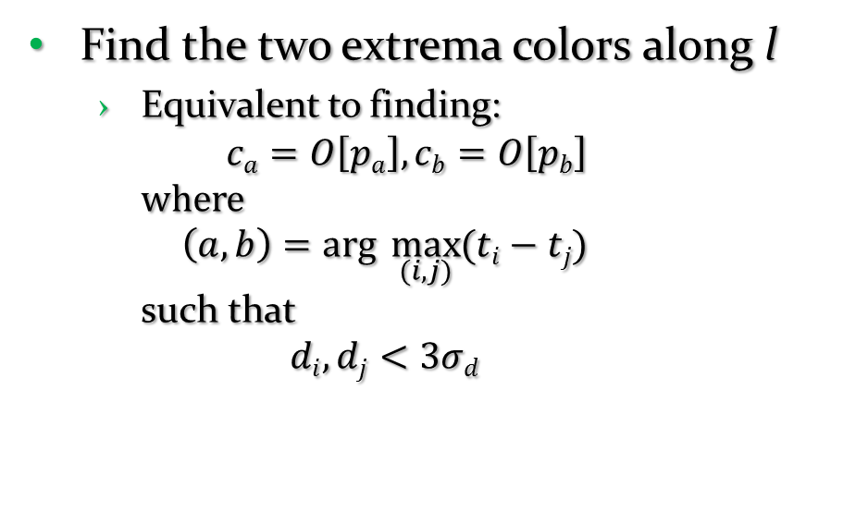
Identifying extrema colors
Find the two extrema colors along l
  Equivalent to finding:
  $ca=O\left[pa\right], cb=O\left[pb\right]$
  where
  $\left(a, b\right)=arg \max_{(i, j)}{(ti−tj)}$
  such that
  $di, dj<3σd$
 | p
p_{a}
p_{b}
c_{b}
G
t_{j}
l
t_{i}
c_{a}
c
R

Slide 16
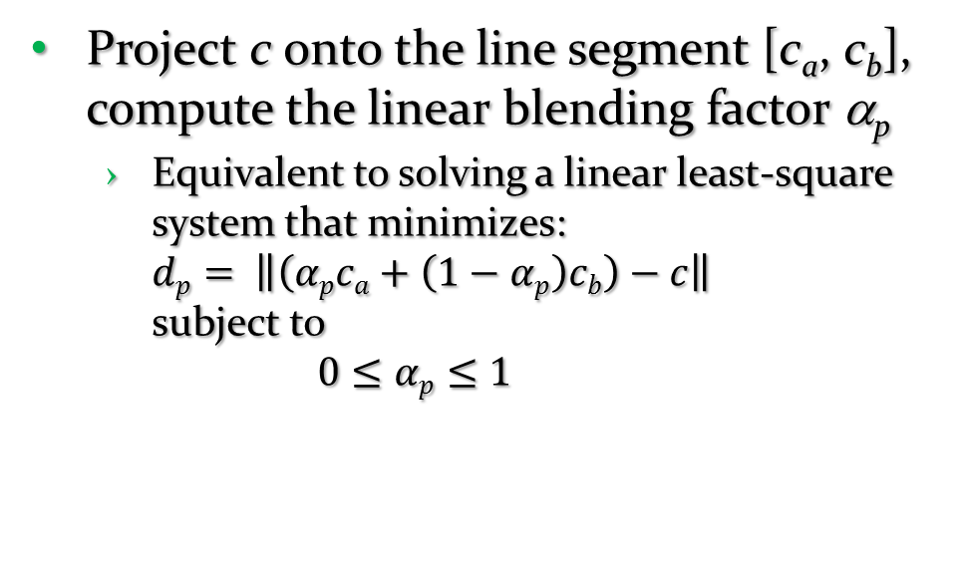
Determine pixel coverage values
Project c onto the line segment [c_{a}, c_{b}], compute the linear blending factor α_{p}
  Equivalent to solving a linear least-square system that minimizes:
  $dp= \left\|\left(αpca+\left(1−αp\right)cb\right)−c\right\|$
  subject to
  $0≤αp≤1$
 | p
p_{a}
p_{b}
c_{b}
G
1-α_{p} : α_{p}
d_{p}
c_{a}
c
R
Notes:
This is equivalent to computing a linear least-square system that minimizes the distance d_p, which is measured from the newly blended color to the center color C.
This distance d_p represents the interpolation error which will later be used to evaluate the confidence of interpolation.

Slide 17



Correcting the filtered image
Correct pixels only at edges
Determining edge strength e_{p}
  Compute and combine Sobel edge strength in O and F
×
=
Edges in O
Edges in F
Edge strength e_{p}

Slide 18
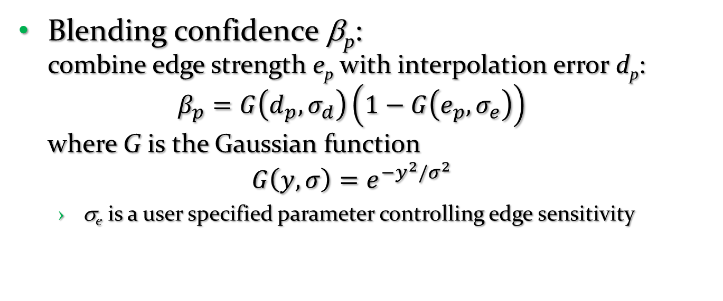
Correcting the filtered image
Blending confidence β_{p}:
combine edge strength e_{p} with interpolation error d_{p}:
$β_{p}=G\left(d_{p}, σ_{d}\right)\left(1−G\left(e_{p}, σ_{e}\right)\right)$
where G is the Gaussian function
$G\left(y, σ\right)=e^{−y^{2}/σ^{2}}$
  σ_{e} is a user specified parameter controlling edge sensitivity
Notes:
Larger edge strength together with smaller interpolation error generally indicates higher confidence for blending.
We combine two Gaussian functions here to control the sensitivity of these two factors, and so there are two associated parameters.
The resulting confidence beta_p ranges from zero to one.

Slide 19
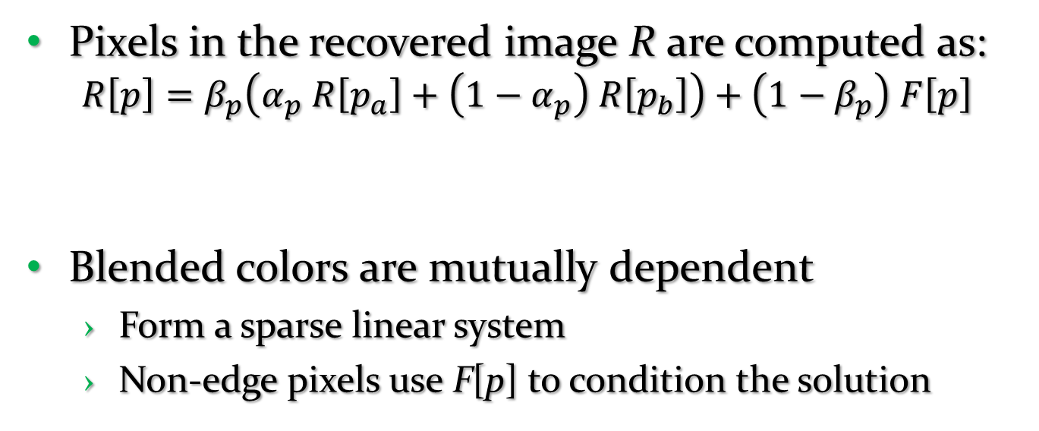
Correcting the filtered image
Pixels in the recovered image R are computed as:
$R\left[p\right]=β_{p}\left(α_{p} R\left[p_{a}\right]+\left(1−α_{p}\right) R\left[p_{b}\right]\right)+\left(1−β_{p}\right) F\left[p\right]$
Blended colors are mutually dependent
  Form a sparse linear system
  Non-edge pixels use F[p] to condition the solution
When the blending
confidence is high
When confidence
is low
Blended color
Unchanged
Notes:
Finally: compute all pixels in the recovered image R.
The pixel color R[p] is composed of a blended color using its two neighbors, and the unchanged color from the filtered image F.
At pixels where the blending confidence is high, the blended color plays a larger role, otherwise the initial filtered color dominates the result.

Slide 20
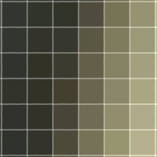
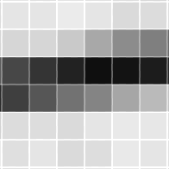
Examples of dependency chains
  Thick edges Thin features
Notes:
Two common examples where this mutual dependency of pixels is useful.
Thick edges: the edge pixels form dependency chains along the gradient direction. Our formulation allows these pixels to interact with each other when obtaining the solution.
Thin features: The pixels can only find extrema colors within the thin feature. Another type of dependency chain.

Slide 21
Real-time GPU Implementation
Embarrassingly parallel algorithm
Implemented using pixel shaders on the GPU
Apply Jacobi iterations to solve the linear system
  Use R = F as the initial solution
  Converges quickly (fixed 3 iterations suffices)
Extremely fast
  Over 500MP/s (= 270 1080p images/s) on AMD HD5870

Slide 22
Parameters
  σ_{e} for controlling edge sensitivity
  σ_{d} for controlling noise sensitivity
  We use a fixed σ_{d} = 0.1 and σ_{e} = 0.01 for results
    Insensitive to changing parameters in a range
  Can be interactively adjusted for special cases

Slide 23
Results
Application to a number of image processing tasks
  Image abstraction
  Bilateral filter
  Intensity thresholding
  Detail enhancement
  Gradient mapping
  Color to gray
  Color replacement

Slide 24

Results
Image abstraction
Original (O)
Filtered (F)
Recovered(R)
Images courtesy from J. E. Kyprianidis et al. [2009]
Notes:
Will not alter the structure in smooth regions of the filtered image, because there’s no edge response at those places.

Slide 25
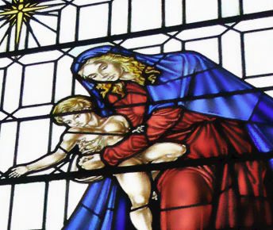
Results
Bilateral filter
Original (O)
Filtered (F)
Recovered(R)
Image courtesy of paullew@Flickr
Notes:
Staircase artifacts at strong edges because the transition colors are biased in its nonlinear filtering.

Slide 26
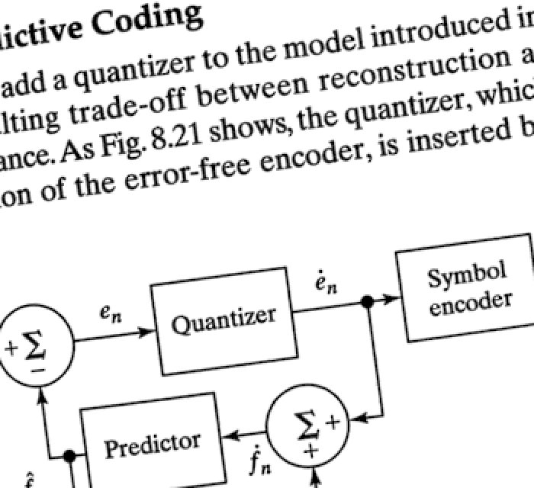
Results
Intensity thresholding
Original (O)
Filtered (F)
Recovered(R)

Slide 27
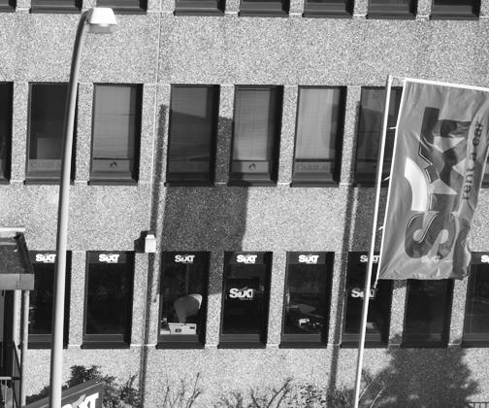
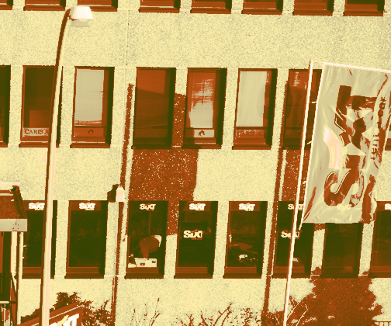
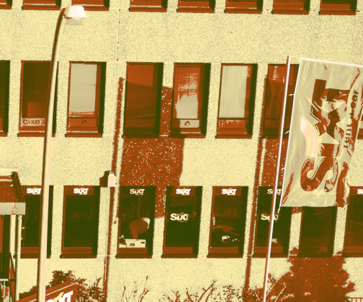
Results
Gradient mapping
Original (O)
Filtered (F)
Recovered(R)
Notes:
When the mapped gradient is nonlinear, the resulting image may show aliasing artifacts along edges.

Slide 28
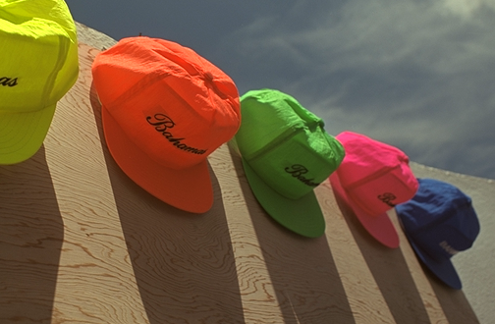
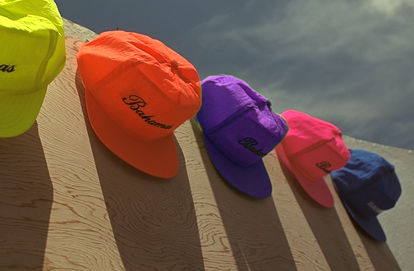

Results
Color replacement
Original (O)
Filtered (F)
Recovered(R)
Notes:
Replacing colors in an image usually does not properly treat the transition colors at object boundaries.
The result is not perfect, since the band is too wide which is caused by lens diffraction. But it is much more improved over the filtered result.

Slide 29
Limitations
Our method is not suitable for
  Filters with geometric distortions
  (E.g. image warping)
  Filters that intentionally change the edge fidelity
  (E.g. Gaussian blur)
  Filters that have artifacts in the interior regions
  (E.g. Unsharp masking)

Slide 30



Limitations
When the color line assumption is violated
  Pixels that receive more than two scene elements
  May lead to artifacts in extreme cases
Original (O)
Filtered (F)
Recovered(R)
Images courtesy of M. Čadík and Y. Kim
Notes:
Many of the corners have three or more colors meeting.
At some corners where two neighboring colors are very similar, our method may struggle with undesired blending.
Fortunately we have not observed this in natural images.

Slide 31
Conclusion
An algorithm to repair antialiased edges damaged by certain types of nonlinear filters
  Simple to implement
  Very fast (500 MP/sec)
  Useful for a number of filters
  Code will be available within a month
Future work
  Consider filters with geometric distortions
  Relax the color line model

Slide 32
Thanks
Acknowledgement:
  Diego Nehab and Tian Fang for fruitful discussions
  HK RGC GRF grant #619509
  Image credits:
    Yongjin Kim, Martin Čadík, Johannes Kopf, Jan Eric Kyprianidis, Giuseppe Papari, Phillip Greenspun, paullew@Flickr, shoshonasnow@Flickr and thaneeya@Flickr

